Slide 1
Twitter Project
Made and Presented By : Harshit Bhatt

Slide 2

What are we Achieving ?
Collecting tweets, retweets of Indian Celebrities.
Movie Stars
Cricketers
Politicians
Collecting “hashtags” and “user mentions” entities of tweet data.

Slide 3
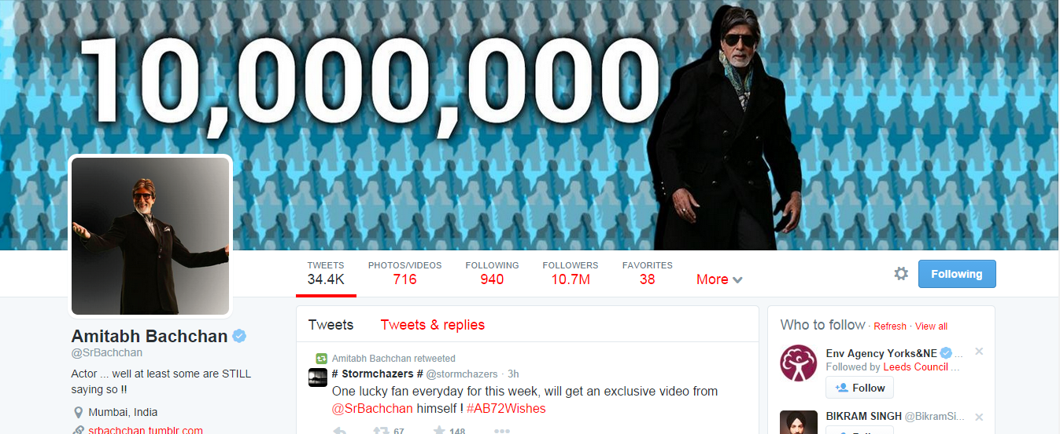
Chose one of the famous Indian Celebrity @SrBachchan
Collected his ‘friends’ and ‘friends of friends’ in DB of whom I collected the tweets. (1103 distinct celebrities)

Slide 4

Only collected the verified accounts users for sake of data limitation.

Slide 5
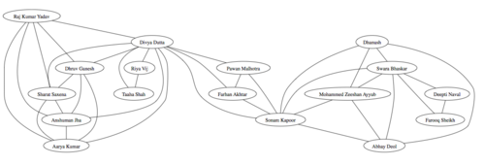
A prototype collection of what I wish to achieve.
Link strength by mapping a celebrity user to a certain hashtag and node size in accordance to the celebrity mention in retweets or reply.

Slide 6
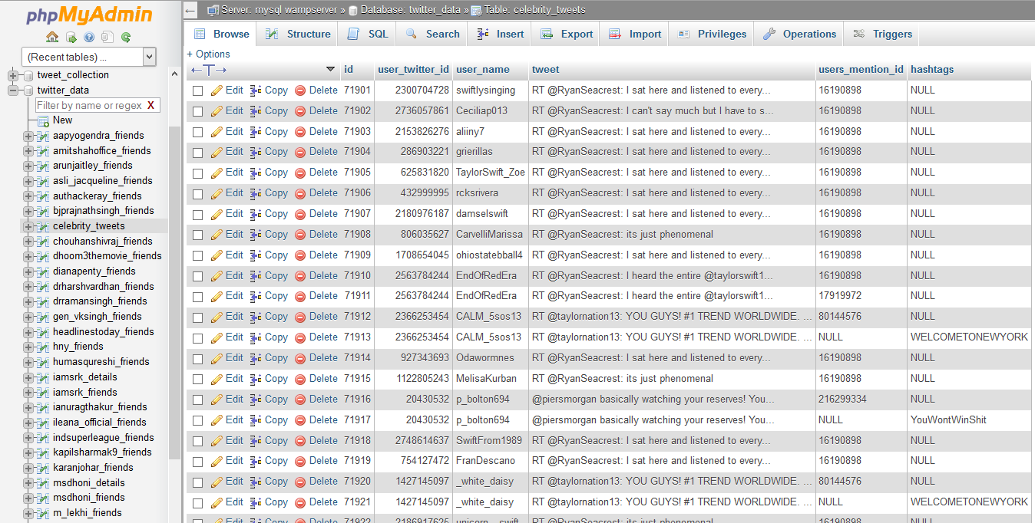
Snapshot of tweets collected

Slide 7
Technologies Used
MySQL Database
Twitter API
Gephi
Python Language

