Slide 1
DSPP - IRL
Brian Holland et al.

Slide 2
Agenda
Welcome
Environments (async)
Code-along
Dr. Ventura

Slide 3


Join at slido.com
#3198927
ⓘ Start presenting to display the joining instructions on this slide.

Slide 4

Rank these pizza toppings
ⓘ Start presenting to display the poll results on this slide.

Slide 5
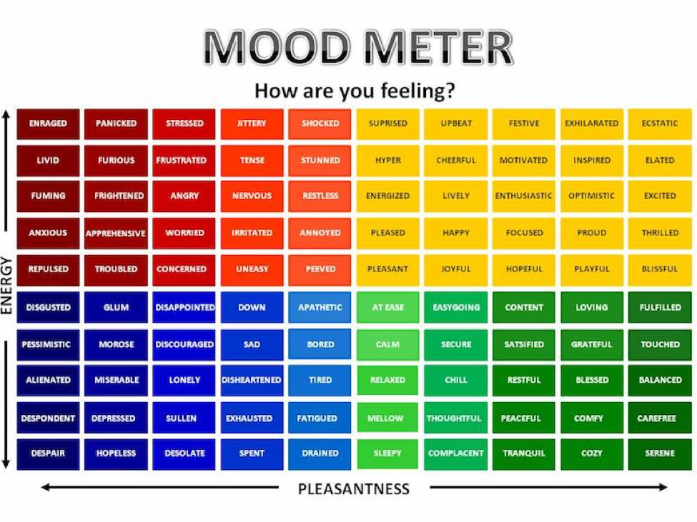

Slide 6

Mood Meter (wrong answers only)
ⓘ Start presenting to display the poll results on this slide.

Slide 7
People learn best through _______
ⓘ Start presenting to display the poll results on this slide.

Slide 8
“TA”s for this summer/session
Brian Holland
brh60
Keya Sengupta
sks166
Brad Wayne
bjw85
Sanha Tahir (traveling)
st1104

Slide 9

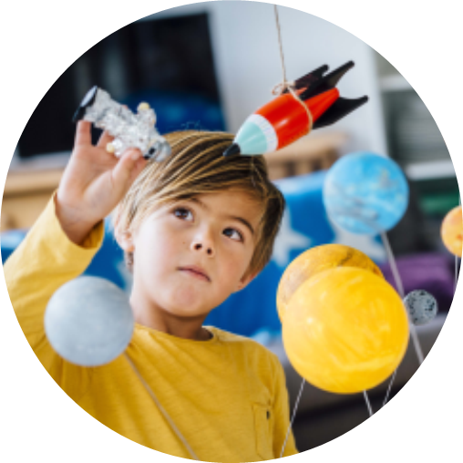
Expectations
We’re all tired. It’s the end of Foundations. But relax, you’re among friends. And we are also all tired.
But this is who will help you through the first year of this program. So make friends, build bridges, and share openly.

Slide 10
TODO (in any order)(possibly all done)
Create a GitHub account
Join our Canvas course
“DSPP Bootcamp”
Download the data and the notebook:
bit.ly/dspp-code-along
bit.ly/dspp-data-along
Install your local
Python IDE
(JupyterLabs, Conda, RStudio, VSCode, etc…)
Install R and RStudio
(yes, they are two separate things)
Fill out the survey
(we’ll use the data now)
bit.ly/dspp-toy-data

Slide 11
Begin with the end in mind
Your skills are not as marketable as your experiences and projects.
Build a resume
Build a portfolio

Slide 12
Thank you
DSPP Cohort 6
Website

