Slide 1
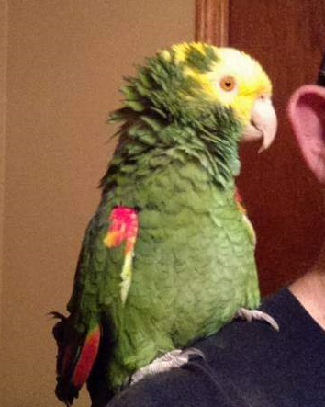

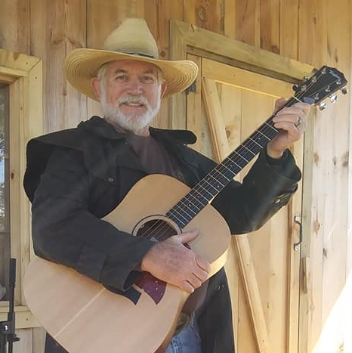
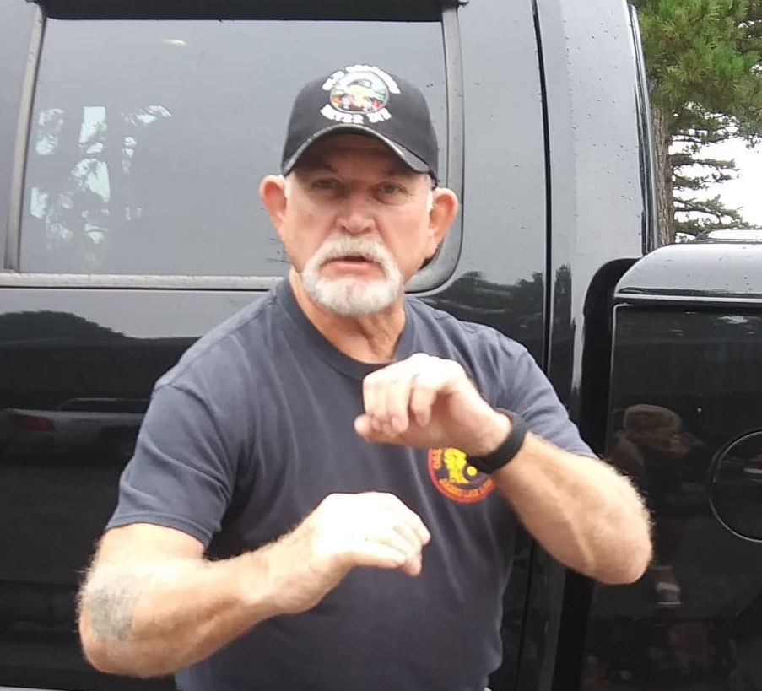
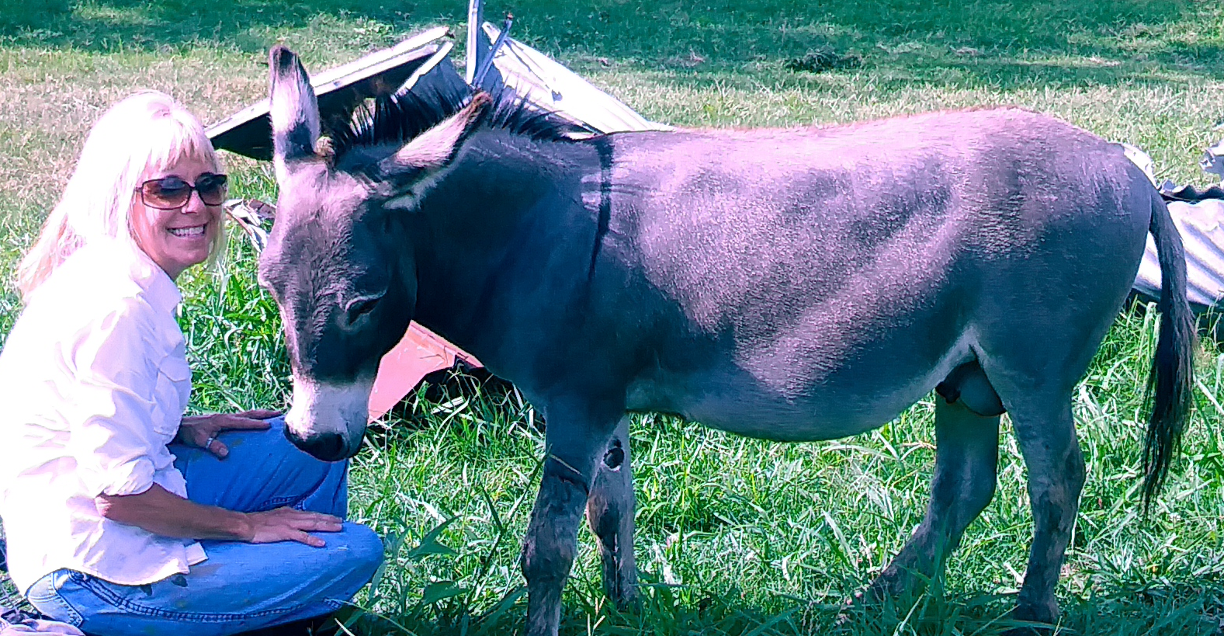
.NET Workflows
Bill Holman

Slide 2
Concept – What is a workflow
Dictionary definition - The flow or progress of work done by a company, industry, department, or person.
For the purpose of this discussion, a workflow is any sequence of steps or activities which can be adequately illustrated by a flow chart.

Slide 3
Example – New Developer Hired
Flow Chart
Document acceptance of position
IT Team provides network setup
Facility Walkthrough
Order Hardware – Phone, PC, etc.
HR Orientation
New Developer starts working

Slide 4
Database Modeling for New Hire Application
New DB
Candidates Table
HR Checklist Table
Background and Drug Test Results Table
Additional Table
Another Table

Slide 5
Process Model
Our New Application
Old Corp App
HR Software
Update Corporate Website
Accounting Software
Purchasing for Equipment

Slide 6
Applications Resources
Developer
Data Modeler
Architect
IT Security and infrastructure
Project Manager
Scrum Master
Project Owner

Slide 7
Is there a better way? Yes!
We can create a .net workflows application generic enough to adapt to the specific requirements if:
The process can be documented as a flow chart
The process is consistent over time
And…
The workflows application can handle communications between parties
The workflows application can contain a state machine to indicate workflow progress
Easily adaptable for reporting and data mining

Slide 8
The REALLY Good News!
There are workflow libraries available to minimize development time.
Introducing Elsa Workflows
Available with source code, or as Nuget packages
Limited or robust features – your choice
Can be used without user interation, or as a Web app, or a Web API app
Open-source and an MIT license!

Slide 9
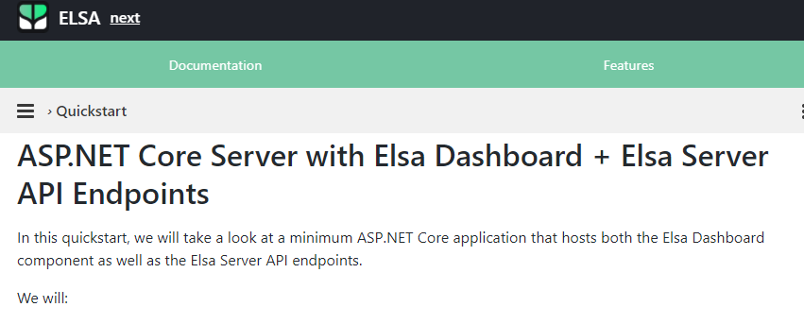
Elsa Workflows Example
https://elsa-workflows.github.io/elsa-core/docs/next/quickstarts/quickstarts-aspnetcore-server-dashboard-and-api-endpoints

Slide 10
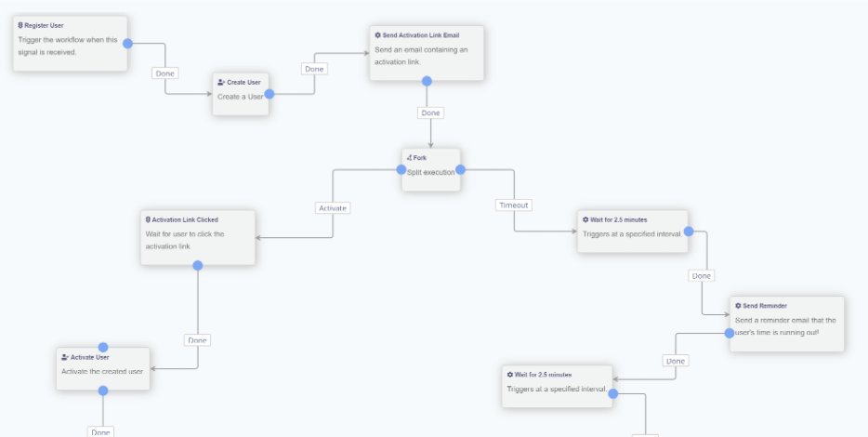
Can be sophisticated -

Slide 11
A Word about the Elsa Workflows Creator
Sipke Schoorstra
Sipke Schoorstra is a freelance software engineer with a true passion for software development. He specializes in .NET & cloud-based solutions with over 20 years of experience in the field.
His love for software development started even before he created first programs with Klik&Play, Macromedia Director and DirectX back in the late 90’s when he could think of little else but role playing & adventure games.
Sipke went on to study multimedia in Amsterdam to learn everything about scripting, designing, 3D-modeling and game development.
But as is the case with many young men who dream of becoming a game developer someday, Sipke was ultimately hijacked from school by his first employer where he would start a new adventure as a web developer.
Early 2004, Sipke decided to go on a new little adventure of his own and became a freelance software developer where he would specialize in web-based solutions, including CMS-driven sites.
Having built & maintained many CMS implementations, Sipke first entered the world of open source around 2011 as an Orchard Project consumer, and shortly thereafter, contributor.
Orchard is a modular open-source application framework created by the ASP.NET team at Microsoft around 2009, which was soon contributed to the open-source community and is now a .NET Foundation project.
Having worked with Orchard for many years, it wasn’t until 2018 when Sipke decided that the Workflows module was simply too cool to remain hidden within Orchard.
And so, Elsa was born as the result of a lift- and shift operation of the Orchard Workflows module into an independent, reusable set of .NET packages allowing any .NET application to host & execute workflows with ease.
Today, Sipke works full-time on his passion project. With Elsa 2 being stable, he is currently prototyping a brand-new engine which is to be released as Elsa 3.
Besides software development, Sipke enjoys hiking, mountain biking, reading and is a fervent blockchain enthusiast.

Slide 12
Discussion, Q & A
Questions?
Suggestions?

Slide 13
Thank you for Attending!
Additional Resources
KCDC.NET_Workflows
Building-Workflows
https://gitter.im/elsa-workflows/community?at=5e0622a289701b511d1d8e82
Inspired by Fire
Bill holman
(Click on image)

Slide 14
Acknowledgements
Sean Whitesell – For prodding me into doing this!
Sipke Schoorstra – For giving Elsa to the world and supporting it … for free!
NGL Energy Products - For allowing me the time off and resources to attend this conference and the opportunity to design a workflows application

