Slide 1

Engineering Economics| ME 2001 | 3 Credits | 3 0 0 3
Engineering Economics
Course Outcomes
Understand various economic decision-making concepts applicable to engineering.
Estimate the present, annual and future worth, rate of return for various types of cash flows.
Evaluate uncertainty and risk analysis in future events.
Analyses for replacement analysis and break-even analysis.
Calculate depreciation and expenses.
Course Instructor
Dr S S Sharma
Assistant Professor
Department of Mechanical Engineering
Ph: +91-9887765320
Faculty Block 1, 1AB

Slide 2
Syllabus
Thesis Outline
Introduction to Engineering Economics, Concept and Value Analysis, Economic Decision Making, Types of Estimates, Accounting and Control, Elements of Cost, Prime Cost, Overheads, Types of Cost, Process Cost & Cost of Production, Break Even Analysis, Inventory Control & Management, EOQ, Financial Analysis, Simple payback, Return on Investment, NPV (Net Present Value), IRR (Internal rate of Return), Life Cycle Cost Method, Sensitivity Analysis, Project Financing Options.
Budget and Budgetary Control, Concept of Budgeting, Type of Budgets. Risk - Risk vs Return, System Concept and Value Analysis, System Analysis & System Engineering, Value Analysis. Replacement Analysis, Depreciation, Network Analysis, Network Techniques, PERT (Programme evaluation and review technique), CPM (Critical Path Method).

Slide 3
Study Material Resources
Thesis Outline
Text Books
T1. R. Panneerselvam, Engineering Economics, Prentice Hall of India.
T2. J.L. Riggs, D.D. Bedworth and S.U. Randhawa, Engineering Economics, McGraw Hill Education.
T3. P.L. Mehta, Managerial Economics, Sultan Chand & Sons.
Reference Books
R1. E.L. Grant, W.G. Ireson and R.S. Leavenworth, Principles of Engineering Economic Analysis, John Wiley.
R2. G,J. Tuesen, W.J. Fabrycky and H.G. Tuesen, Engineering Economy, Prentice Hall of India.
R3. L. Blank and A. Tarquin, Engineering Economy, McGraw Hill Education.

Slide 4
Assessment Rubrics
Thesis Outline
Criteria | Description | Maximum Marks
Internal Assessment (Summative) | Mid Term Examination | 30
 | Quizzes and Assignments, Activity (CWS) | 30
End Term Exam (Summative) | End Term Examination | 40
Total |  | 100
Attendance (Formative) | A student must have maintained a 75% attendance rate in order to eligible for the End Term Examination. The 25 % allowance covers all leaves, not just medical ones.

Slide 5
Case Study
Case 1: Renewable Energy Project : A company plans to invest in a solar energy farm capable of generating 100 MW of electricity to supply power to nearby communities.
Economics Perspective:
Analysing the project from an economics standpoint would involve evaluating the overall impact on society, considering both direct and indirect effects.
The economic analysis would assess the project's potential to create jobs, reduce carbon emissions, and contribute to sustainable development.
It would also include an examination of market demand, the effects on electricity prices, and potential externalities.
Engineering Economics Perspective:
In engineering economics, the primary focus would be on the financial feasibility of the project.
Calculations would involve determining the initial investment cost, operating expenses, and expected revenue from electricity sales.
Various financial metrics, such as Net Present Value (NPV), Internal Rate of Return (IRR), and Payback Period, would be used to evaluate the project's financial viability.
Conclusion : The economics perspective provides a broader view of the project's social implications, while engineering economics emphasizes the financial feasibility and profitability of the investment. Integrating both approaches can lead to well-informed decisions that consider not only economic viability but also social and environmental impacts.

Slide 6
Case 2: Transportation Infrastructure Development : A government is considering constructing a high-speed rail network connecting major cities in the country.
Economics Perspective:
An economic analysis would assess the potential benefits of reduced travel time, increased connectivity, and improved regional economic development.
It would consider the project's impact on income distribution, employment opportunities, and economic growth across regions.
Furthermore, it would analyse potential negative consequences, such as environmental impacts and displacement of communities.
Engineering Economics Perspective:
The engineering economics analysis would focus on estimating the construction and maintenance costs, as well as projecting the revenue from ticket sales.
The financial assessment would include determining the project's economic life and calculating various financial metrics to determine its profitability.
Conclusion : In this scenario, the economics perspective would emphasize the project's socio-economic impact on a national scale, while engineering economics would provide a detailed financial assessment. Both perspectives are essential for evaluating the project's potential success and ensuring it aligns with broader economic and societal objectives.

Slide 7
Lecture 1
Introduction to Engineering Economics
Nature, scope, basic problems of an economy
Microeconomics and macroeconomics.

Slide 8
UNLIMITED WANTS
(for goods and services)
SCARE RESOURCES
(limited possibilities of producing for goods and services)
CHOICE
(allocation of resources among goods and services to achieve maximum satisfaction
Economics - Definitions
Lecture 1
Human needs.
Wants
Vs
When wants exceed the resources available to satisfy them, there is scarcity.
Fig. 1: The economic problem
Scarcity
Economics is the study of choices people make to cope with scarcity
Economics deals with the allocation of scarce resources among alternative uses to satisfy human wants.
Scarcity : Extensive Economic Problem
Faced with scarcity, people must make choices.

Slide 9
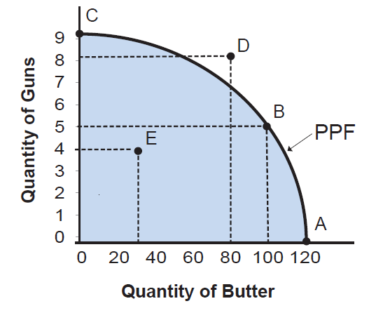
Basic Economics Problems
Lecture 1
By what methods are these commodities produced?
(How to produce ?)
What commodities are being produced and in what quantities ?
(What to produce ?)
How is society’s output of goods and services divided among its members?
(For whom to produce ?)
Resource
Allocation
Labour Intensive; Capital Intensive
No of Roads Build
Distribution
of Income
Production Possibilities Curve of a Country

Slide 10
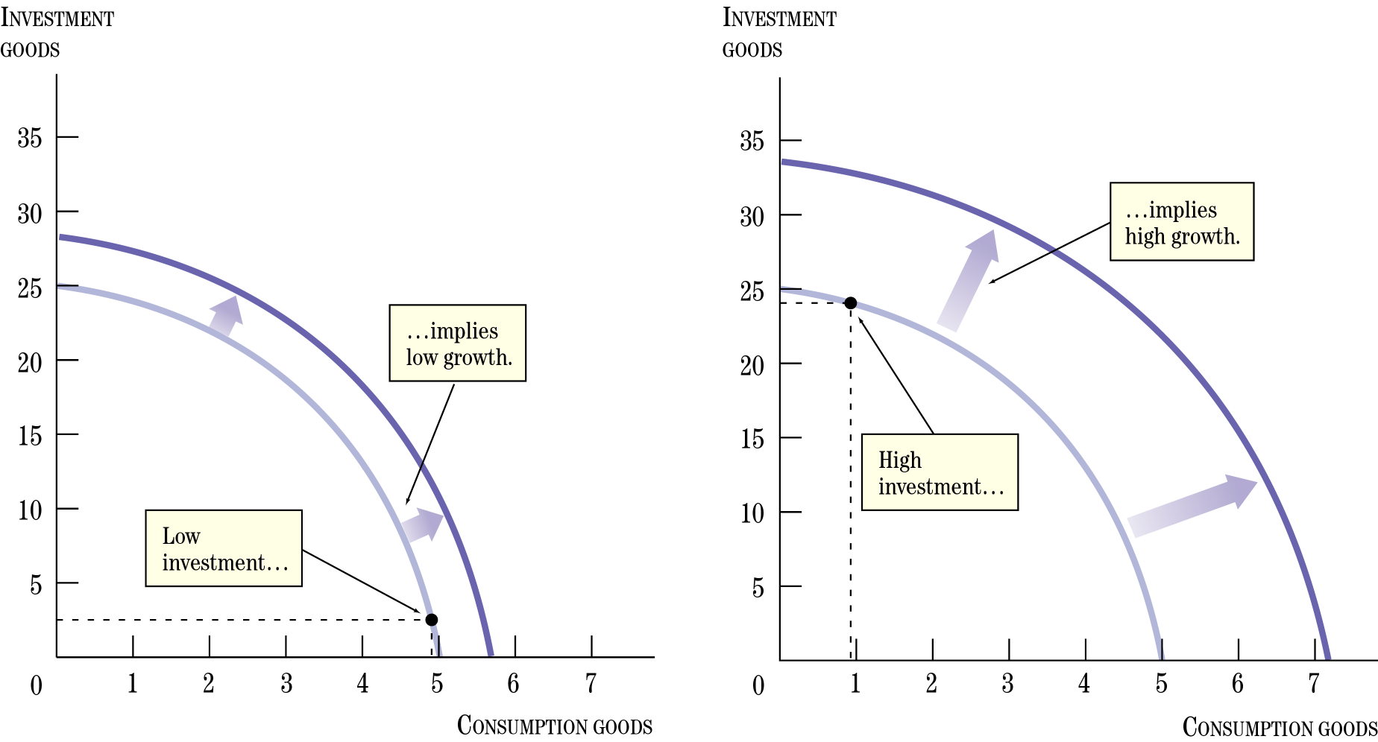
Basic Economics Problems
Lecture 1
Change in resources
Change in Technology
Increase in
available resources
Decrease in
available resources
Improvement in
Technology
Degradation in
Technology
Implies low
growth
Low Investment
Production Possibilities Curve of a Country

Slide 11
Basic Economic Goals, Micro/Macro-economics
Lecture 1
Economics is the science that deals with the production and consumption of goods and services and the distribution of these for human welfare.
Microeconomics
Branch of economics that deals with the behavior of individual economic units—consumers, firms, workers, and investors—as well as the markets that these units comprise.
High level of employment
Price stability
Equitable distribution of income
Growth
Some of the above goals are interdependent, not always complementary and may be conflicting.
Eg. Any move to have a significant reduction in unemployment will lead to an increase in inflation.
Economic Goals
Macroeconomics
Branch of economics that deals with aggregate economic variables, such as the level and growth rate of national output, interest rates, unemployment, and inflation.

Slide 12
Engineering Economics
Lecture 1
Engineering is an application of science.
It is an art composed of the skill and simplicity in adopting knowledge to the uses of the humanity.
Engineering is primarily a producer activity. Essentially a physical process with the objective being the maximization of physical efficiency.
Engineering
Physical Environment
Production or Construction
Economic Environment
  Engineering proposals
  Wants satisfaction
Engineering Economics
Engineering Economics - deals with decisions to be taken based on need/want recognition to its satisfaction, through series of steps involving developing alternatives, evaluating them & decision-making and its efficient execution.

Slide 13
Economic System: Working
Lecture 1
An economic system is an entire set of arrangements and institutions meant for meeting the two-fold objectives of a society:
– increasing the availability of resources
– ensuring the economic use
Types of economic systems are based following:
per capita income,
prioritization of individuals to spend their resources, and
scarcity of both income and resources
Types of economy system
Capitalist Economy:
Socialist Economy
Mixed Economy

Slide 14
Capitalist Economy
Lecture 1
Capitalist Economy: characterized by free markets and the absence of government intervention in the economy.
Merits:
Self regulatory.
Process of economic growth is faster
Decides ‘what to produce’ and ‘how to produce’ in agreement with with the forces of demand and supply.
Ensure a high degree of operative efficiency in the system.
Provides flexibility to adapt to the changed circumstances.
Demerits:
Capitalism generates inequalities of income and wealth.
Wide differences in economic opportunities.
Distortion in the production pattern.
Capitalism wastes its productive resources.
Production of merit goods is not profitable.
Business units produce only those goods and services which are profitable.
Loss of human values and welfare.
Increases the wastage of resources as a result of competition.

Slide 15
Socialist and Mixed Economy
Lecture 1
Socialist economy discards the use of market mechanism and replaces it with some form of regulatory authority, such as the planning commission.
It also abolishes the institutions of private property and inheritance.
Merits:
social security
elimination of fluctuations of economy
coordinated development
elimination of social disputes.
Demerits:
cyclical fluctuations of national income and prices
not able to provide economic incentives
continues to suffer from slow growth rate, poor productivity of labour and low per capita income.
Mixed economy:
– avoid the ill-effects of both capitalism and socialism
– secure the benefits of both
The selection of detailed features of a mixed economy is made with reference to the working of market mechanism, and its expected effects (both beneficial and harmful) on the society as a whole.

Slide 16
Thank you

