Slide 1
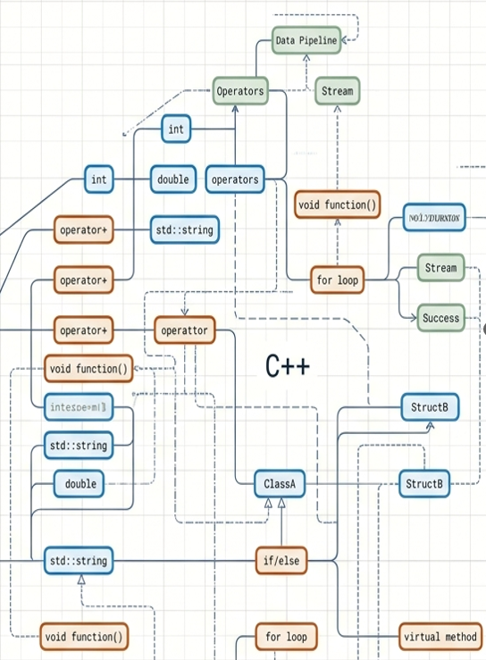
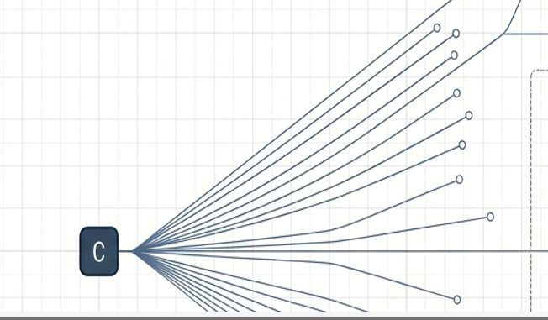
An overview of C++
Course Name – Data Structure and Algorithms
Course Code: ECE/VDT 2104

Slide 2
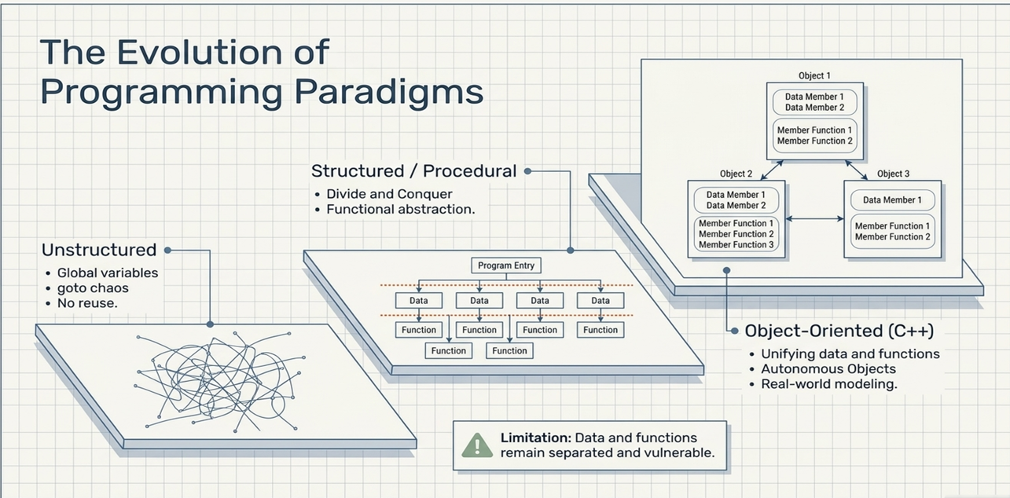

Slide 3
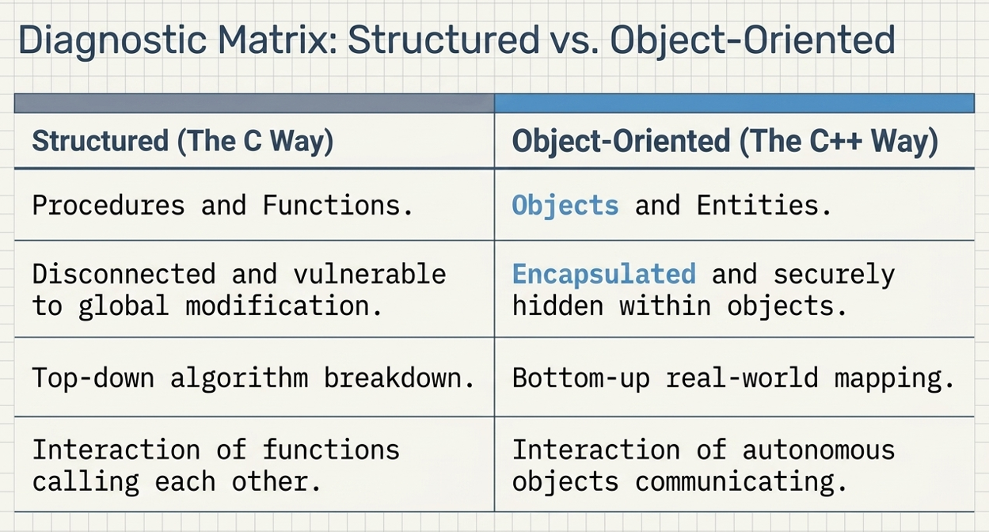

Slide 4
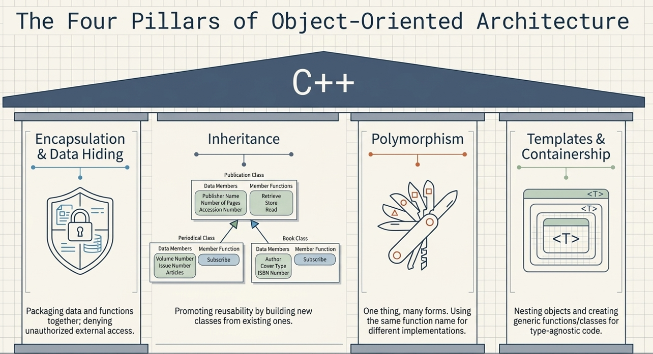

Slide 5
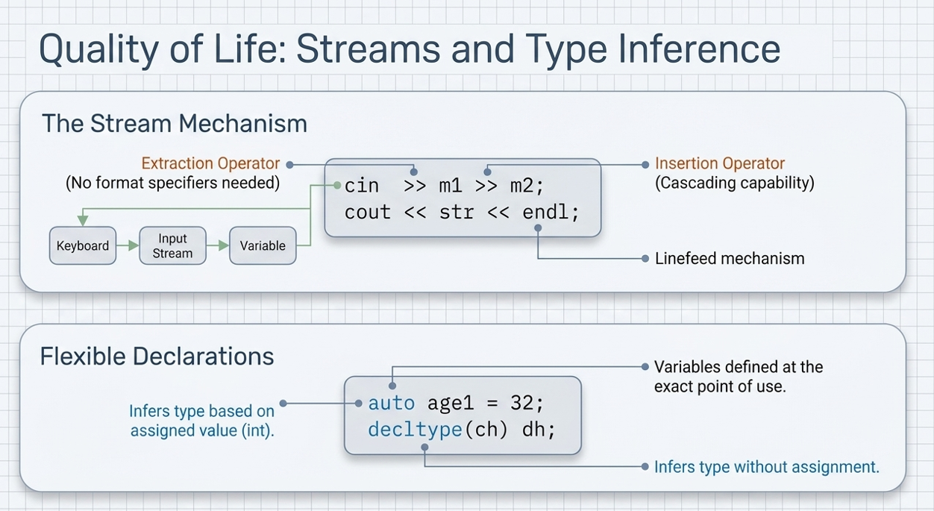

Slide 6
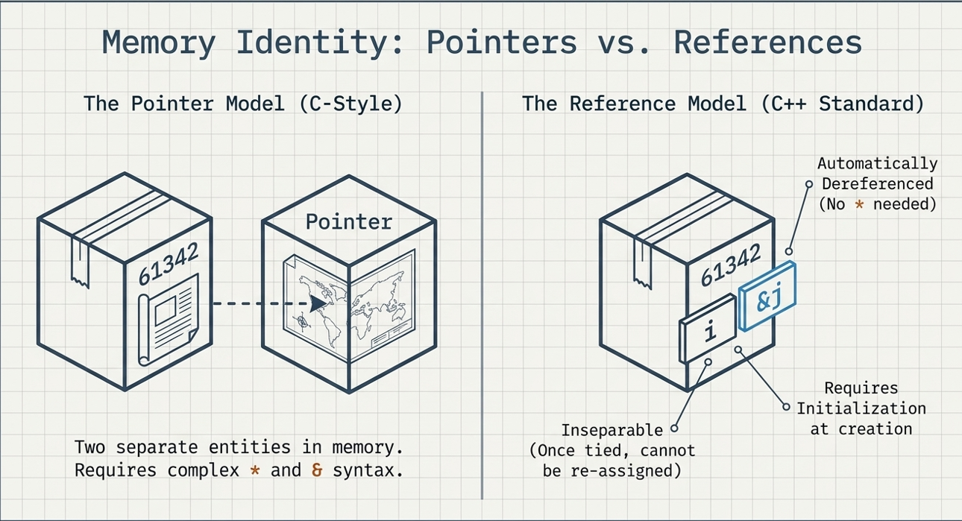

Slide 7
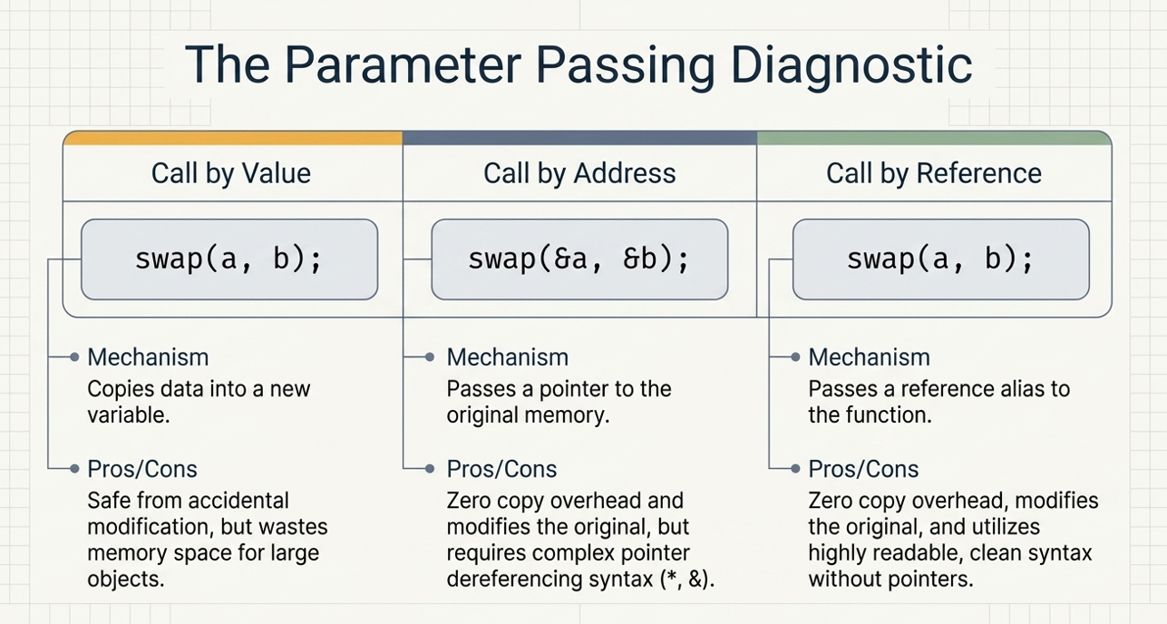

Slide 8
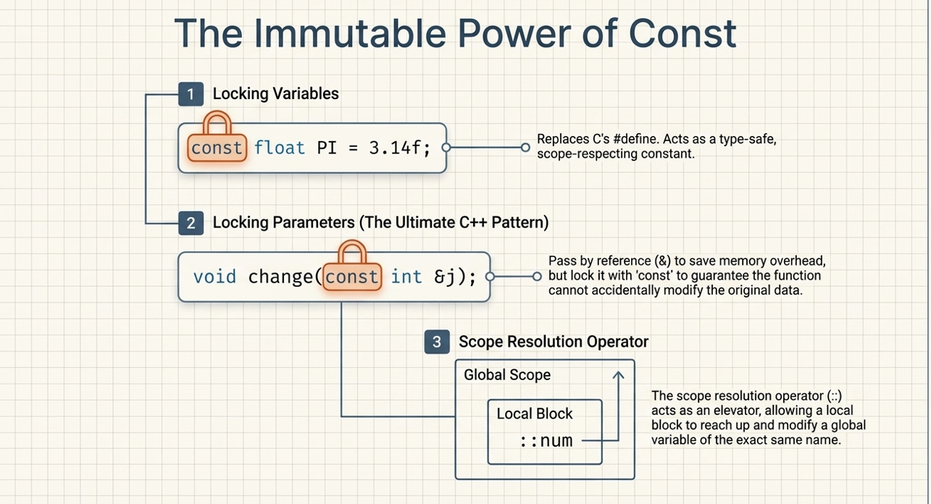

Slide 9
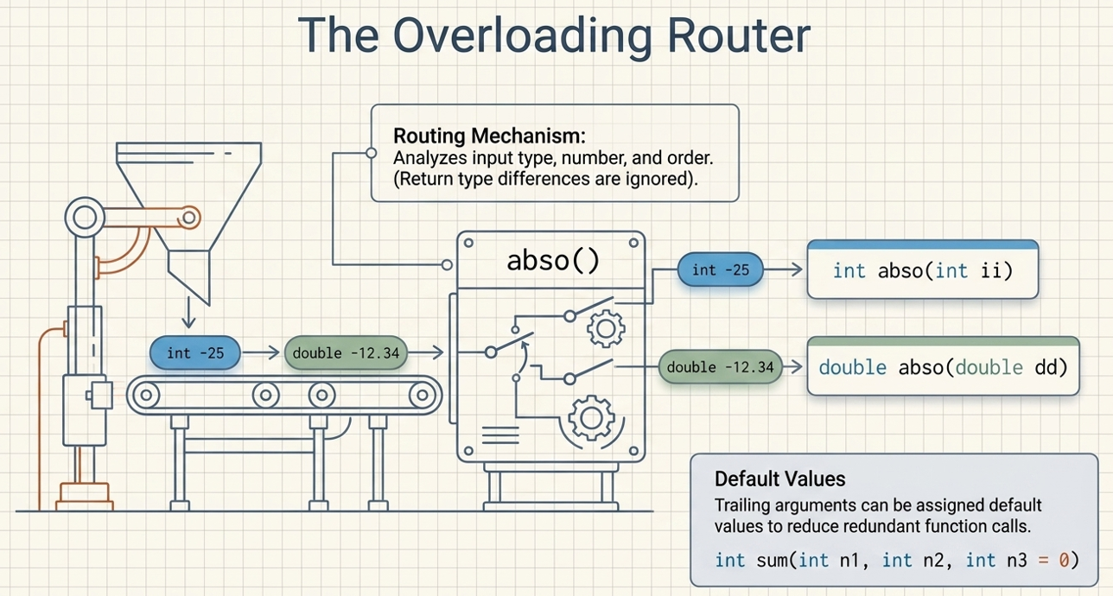

Slide 10
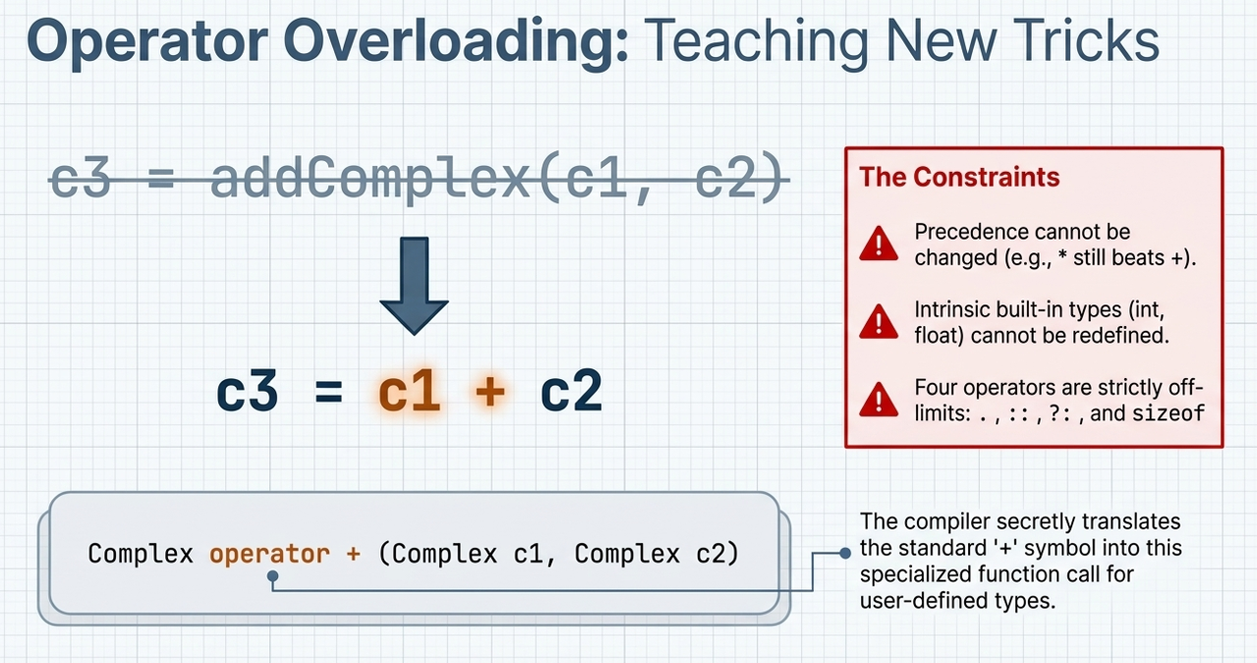

Slide 11
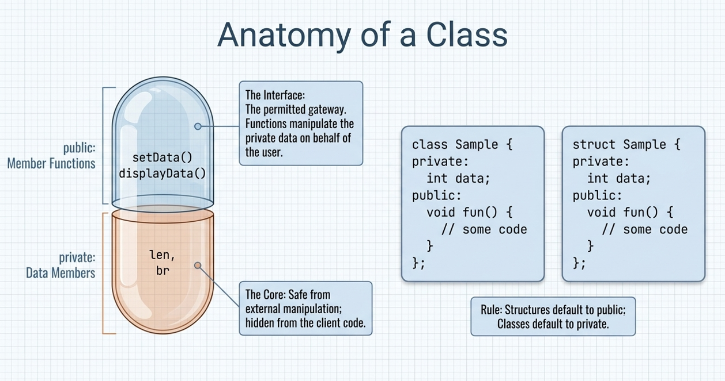

Slide 12
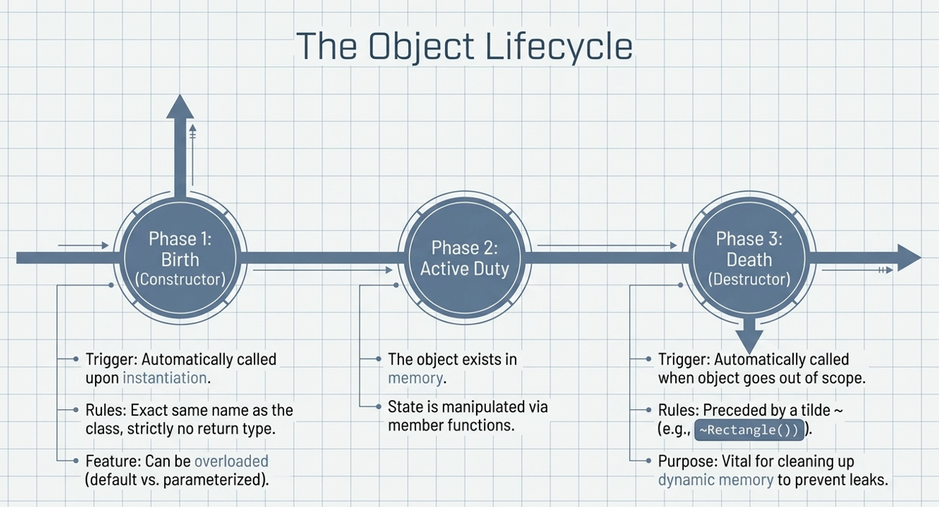

Slide 13
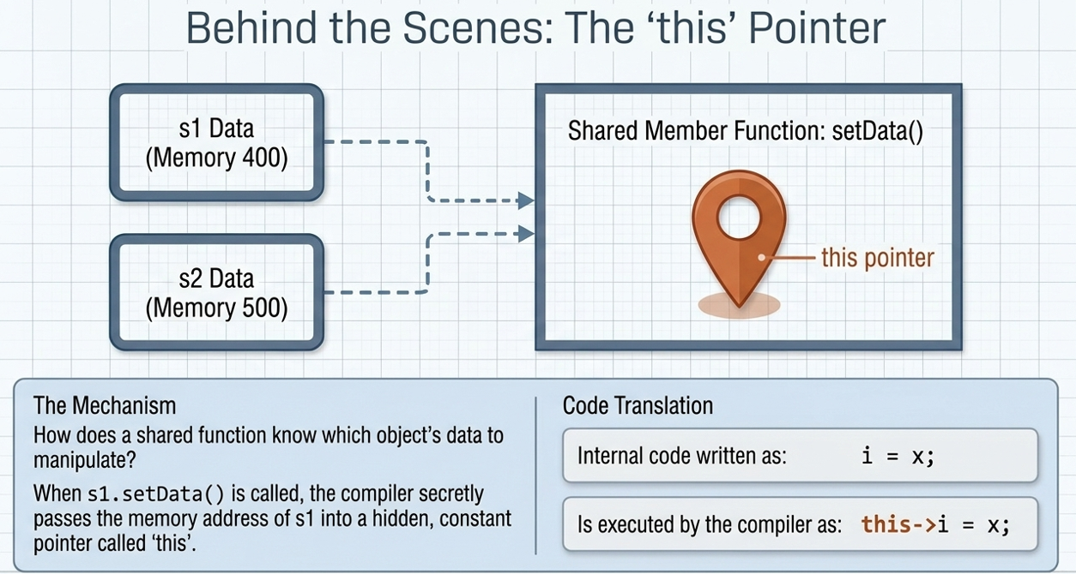

Slide 14
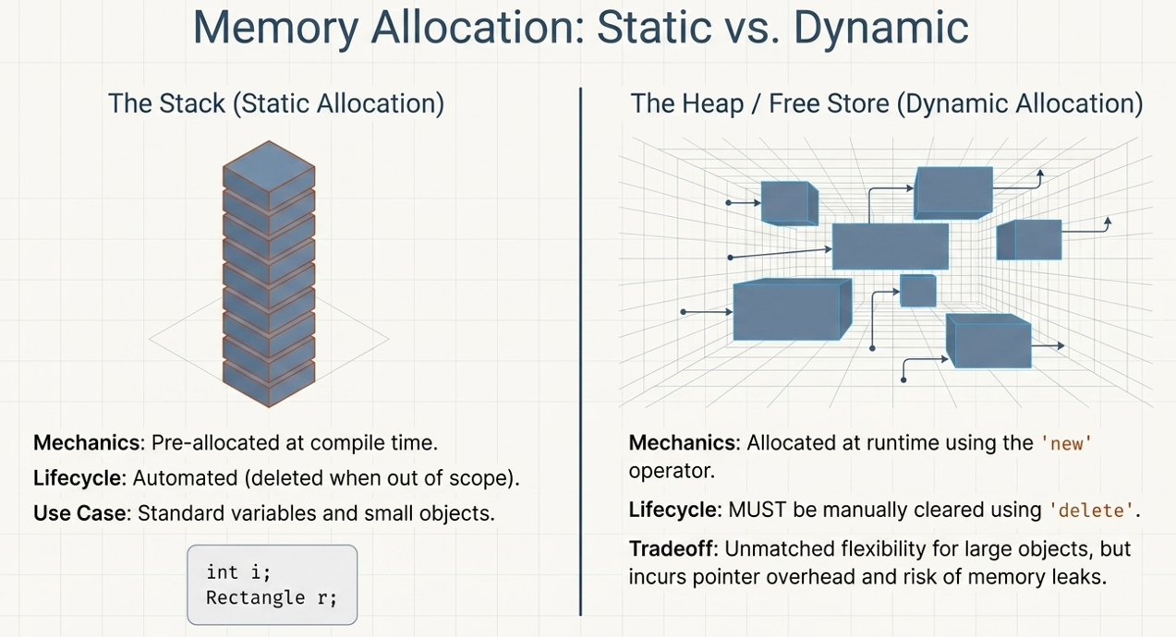

Slide 15
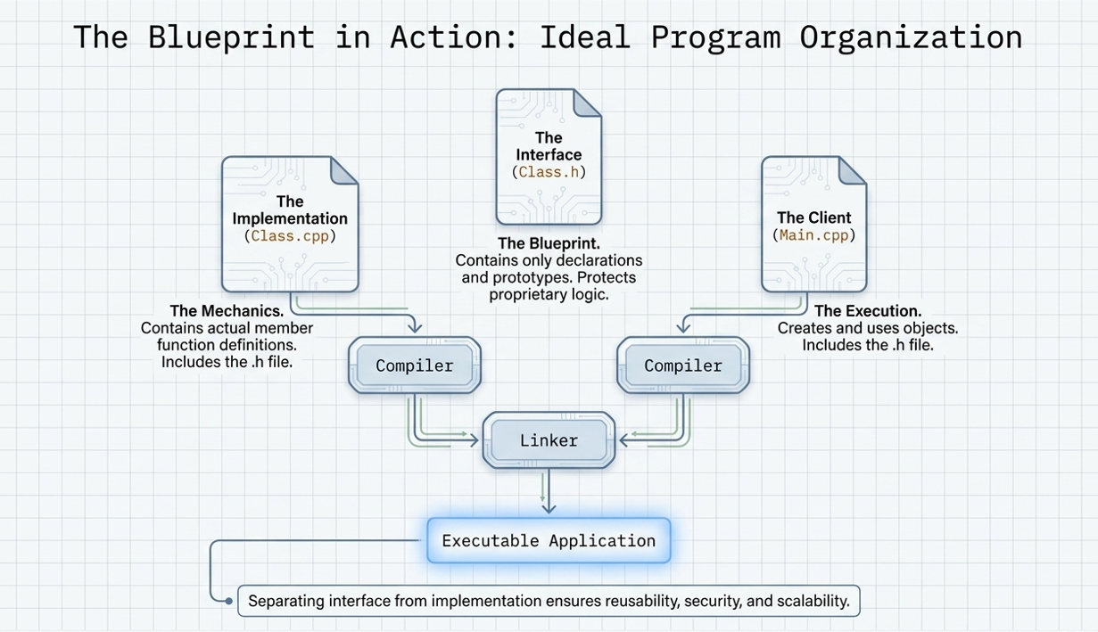

Slide 16
ACTIVITY OUTSIDE THE CLASS ROOMS (2 Hrs)
Revise Concept of C++ Programming
Write a Cpp program to print “Introduction to C++”
Write a CPP Program to print a table of 5
Write a CPP program using conditional statements

Slide 17
References
Yashavant Kanetkar, Data Structures Through C++, BPB Publications, 2023.
AI Tool for making slides attractive

