Slide 1
Programming language, basic terms and operations.
Course Name: Data Structure and Algorithms
Course Code: ECE2104

Slide 2
The C++ Paradigm: Object-Oriented & High Performance
Why C++ for Core Systems?
High Performance: C++ provides thin abstractions over hardware, delivering raw execution speed crucial for high-end database backends, game engines, and scientific computing.
Resource Control: Allows direct access to system memory via pointers, placing full power over resource lifespan directly in the developer's hands.
Structured Paradigm: Supports robust modular structures and code reuse via classes, inheritance, and generic templates.
C++ Abstractions Over Standard C
Safe Memory Allocators: Replaces complex C-style memory allocations with native, type-safe constructors via the 'new' and 'delete' keyword system.
Standard I/O Streams: Incorporates 'iostream' for highly structured terminal operations (cin/cout) instead of standard formatted prints (scanf/printf).
Variable References: Introduces local aliases or reference variables (&) which act as secure, non-null pointer replacements in function arguments.

Slide 3
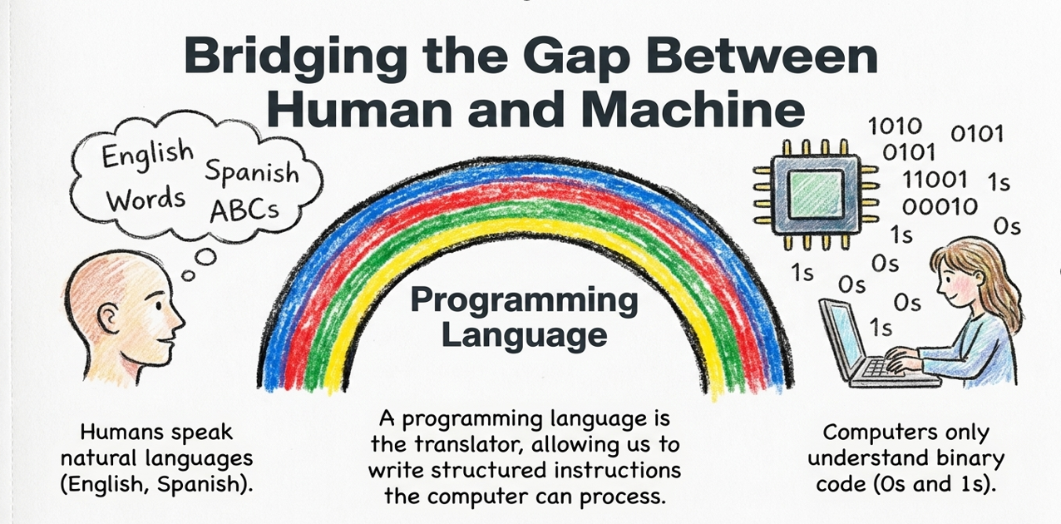

Slide 4
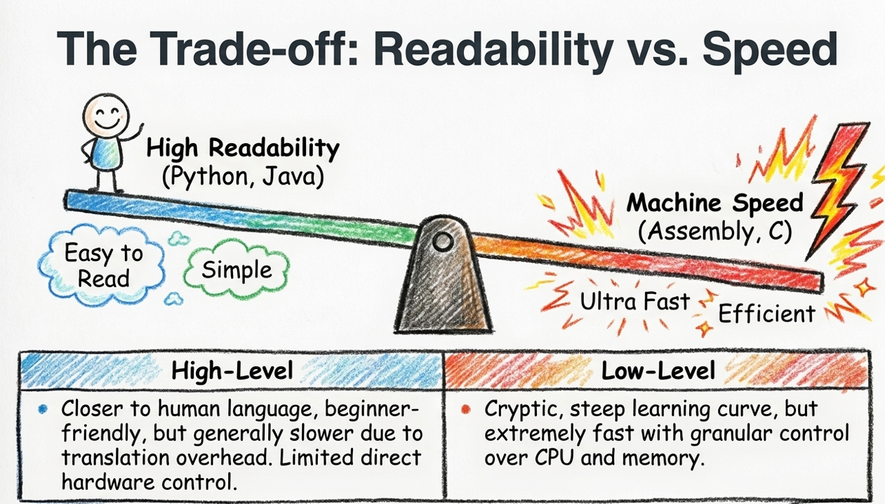

Slide 5
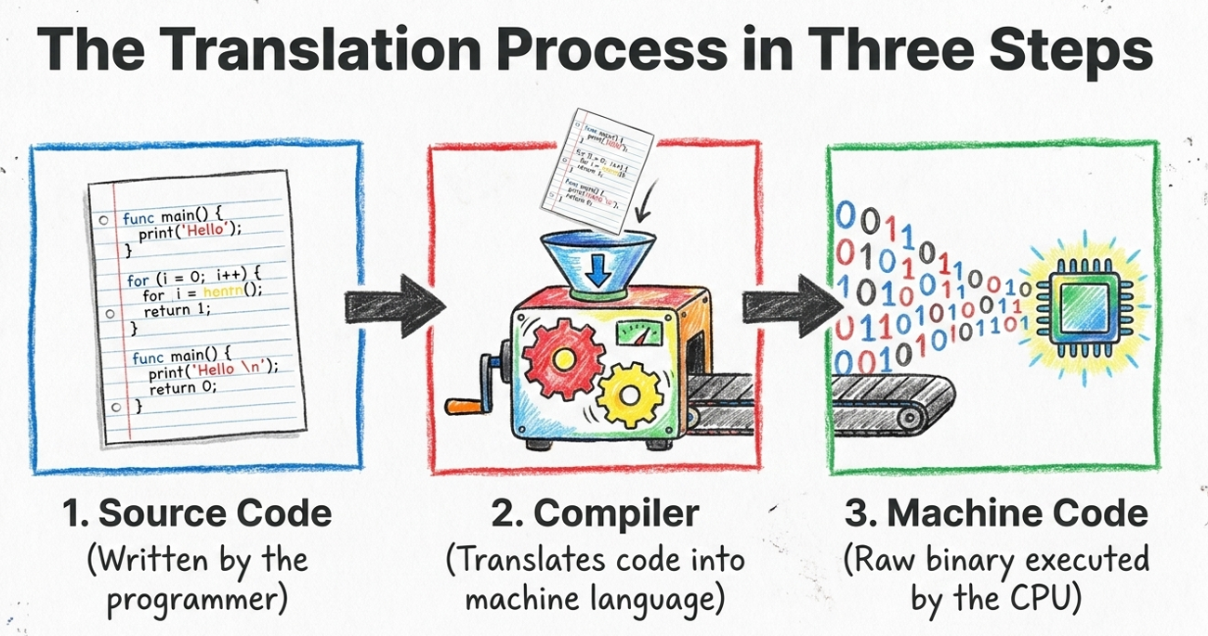

Slide 6
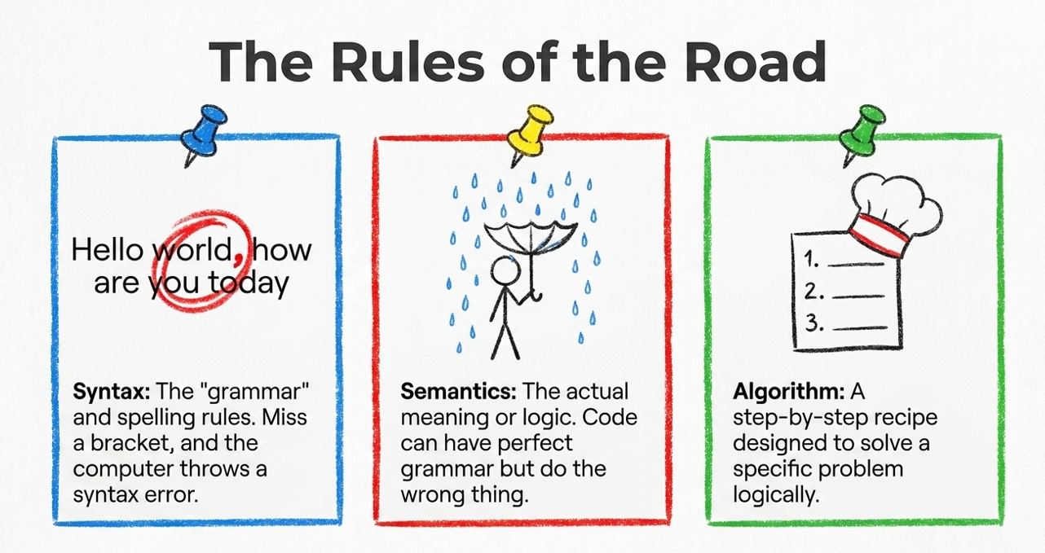

Slide 7
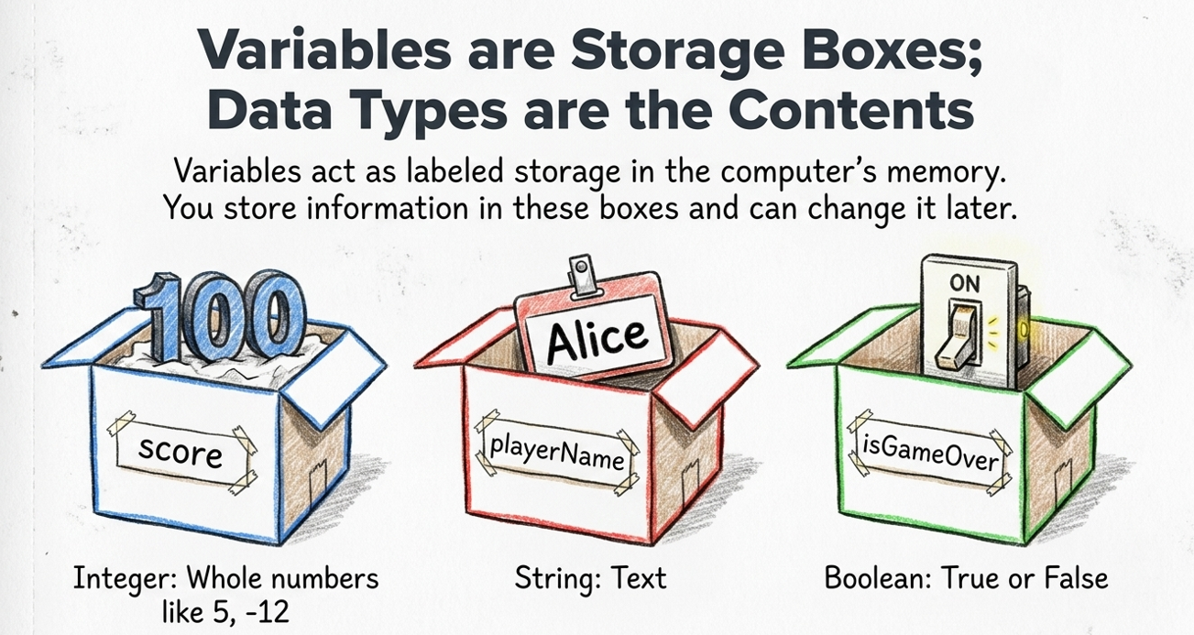

Slide 8
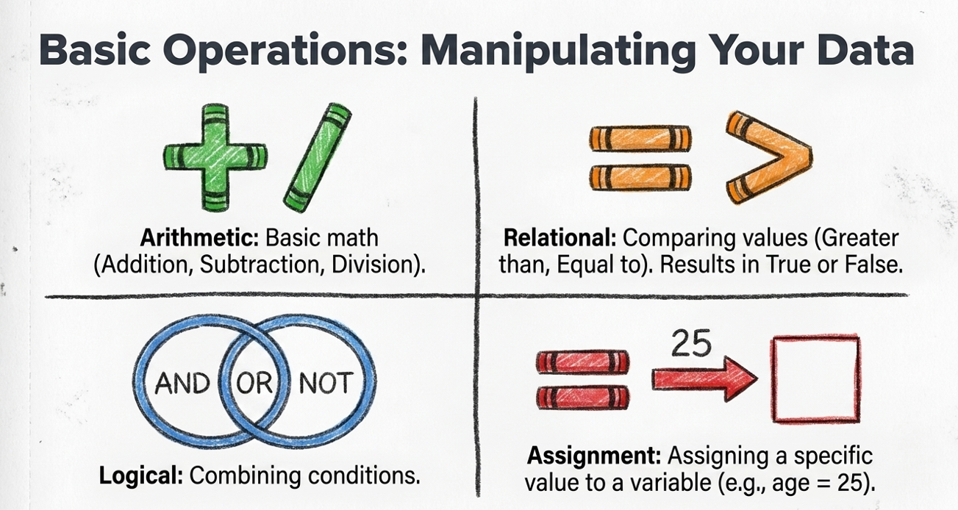

Slide 9
References
Yashavant Kanetkar, Data Structures Through C++, BPB Publications, 2023.
AI Tool for making slides attractive

