Slide 1
Conditional Statement (IF, ELSE), LOOPS (FOR, WHILE, DO WHILE), Function
Course Name: Data Structure and Algorithms
Course Code: ECE2104

Slide 2
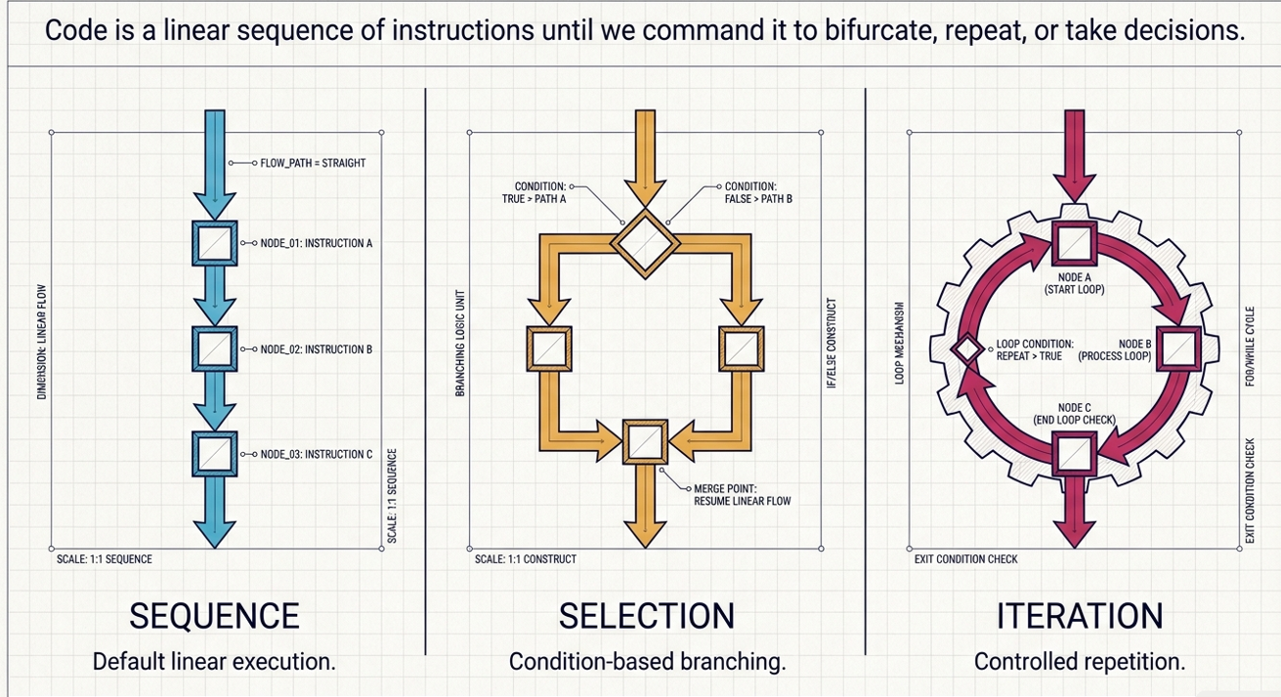

Slide 3
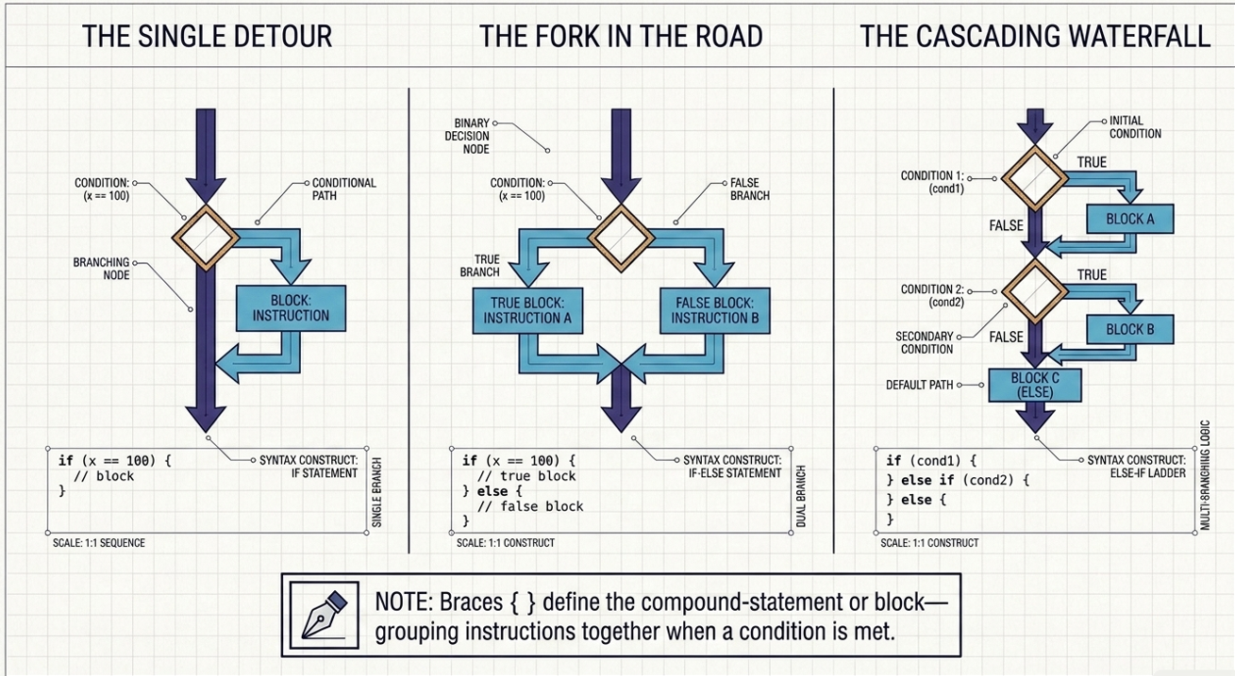

Slide 4
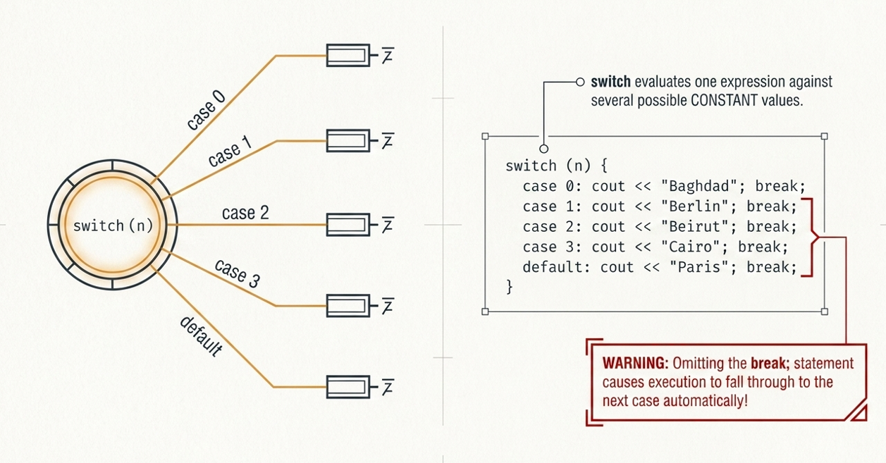

Slide 5
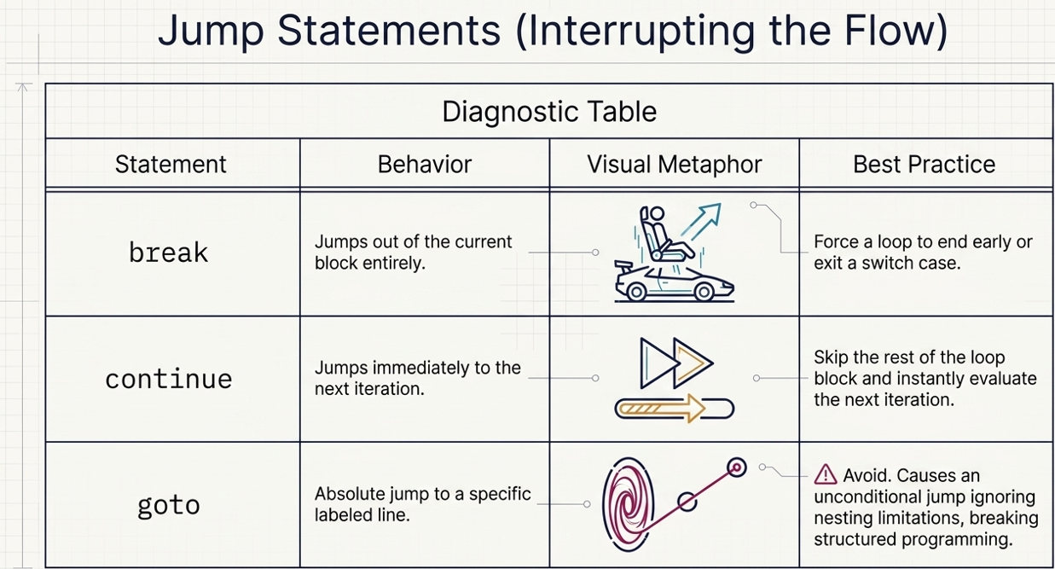

Slide 6
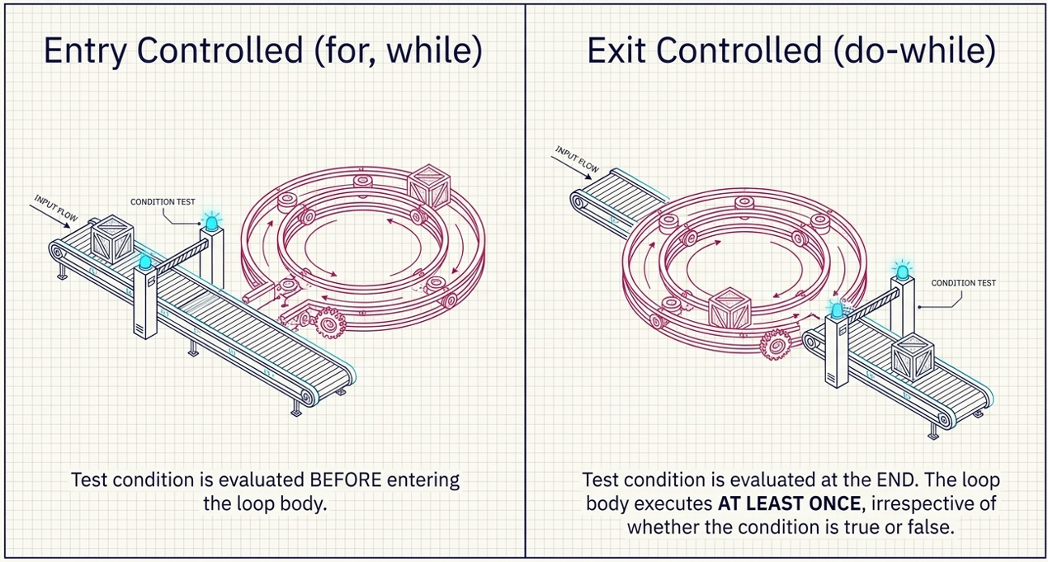

Slide 7
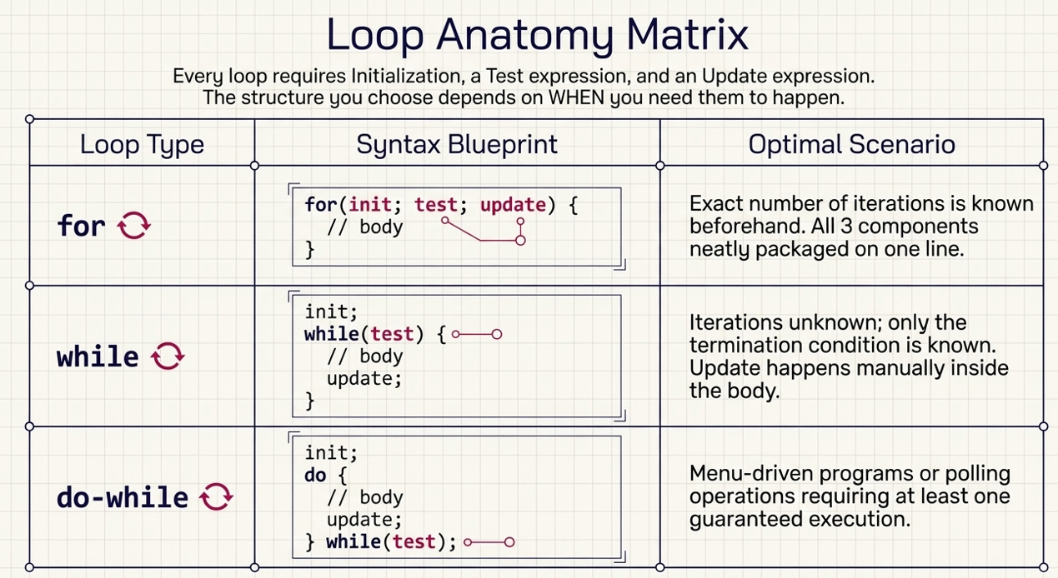

Slide 8
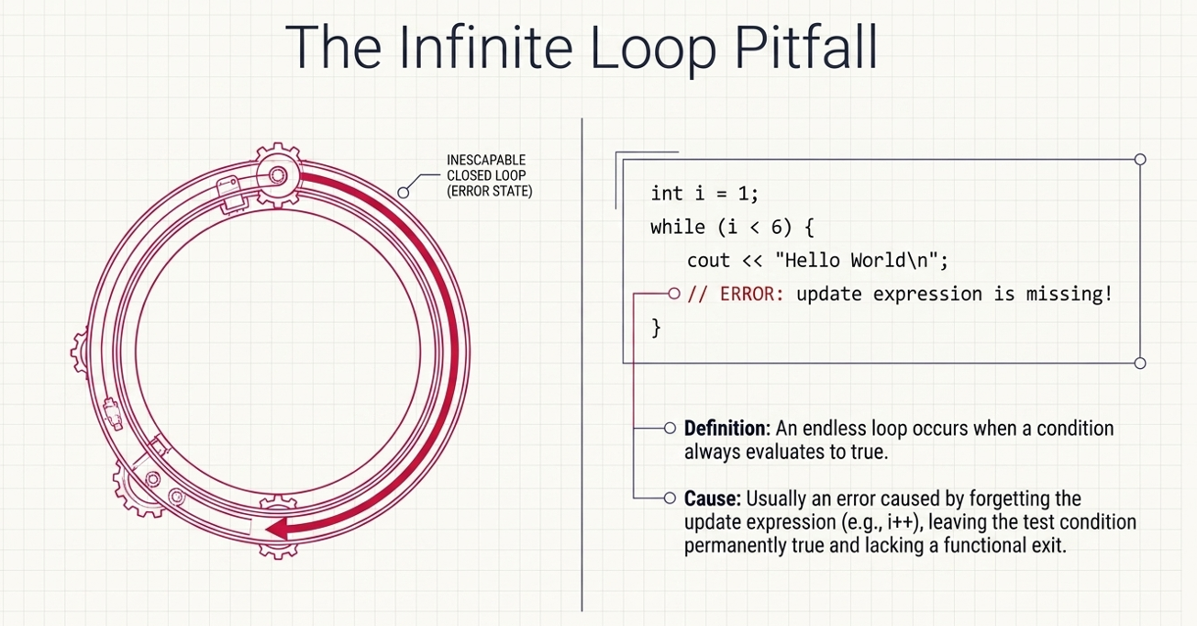

Slide 9
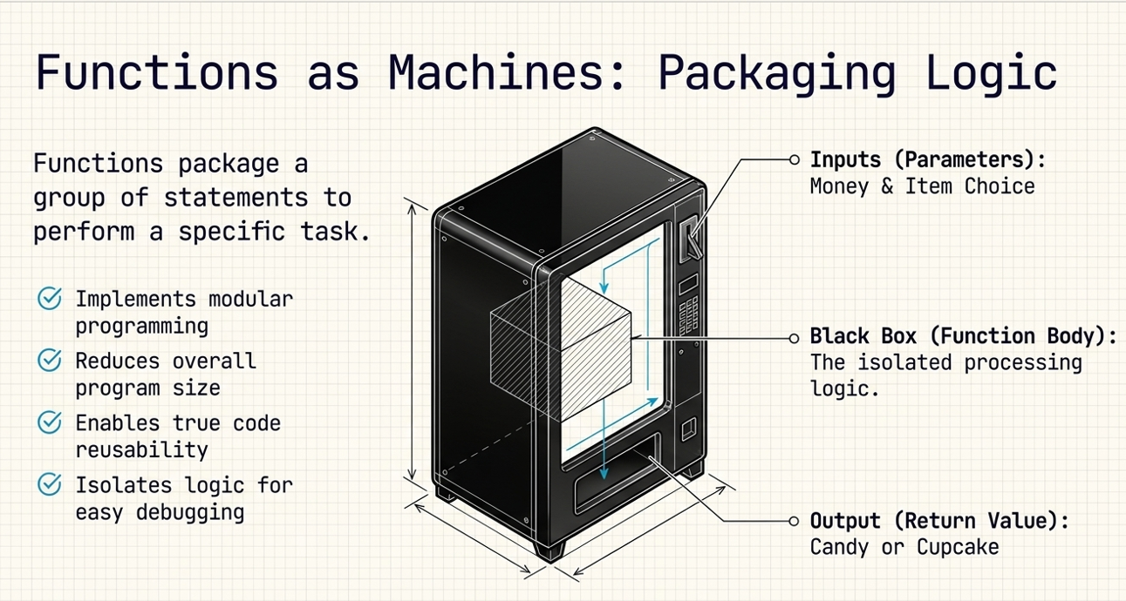

Slide 10
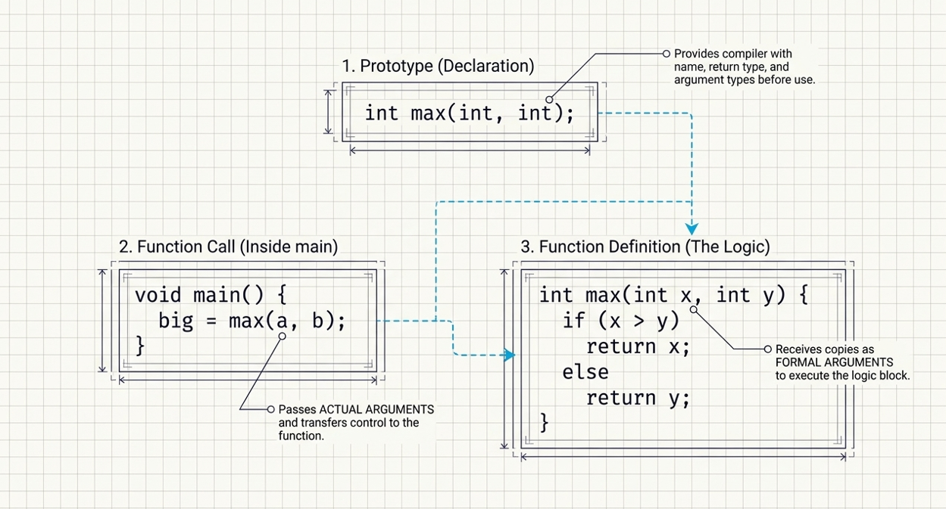

Slide 11
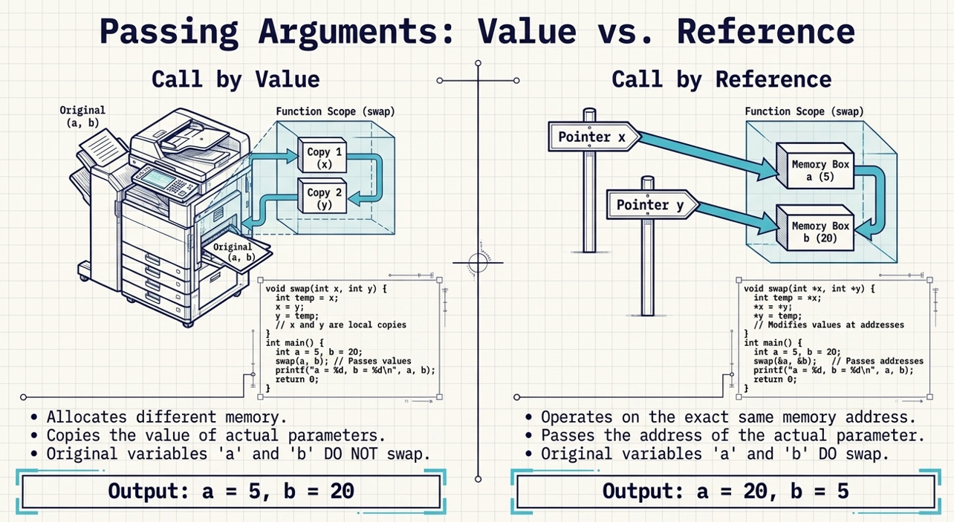

Slide 12
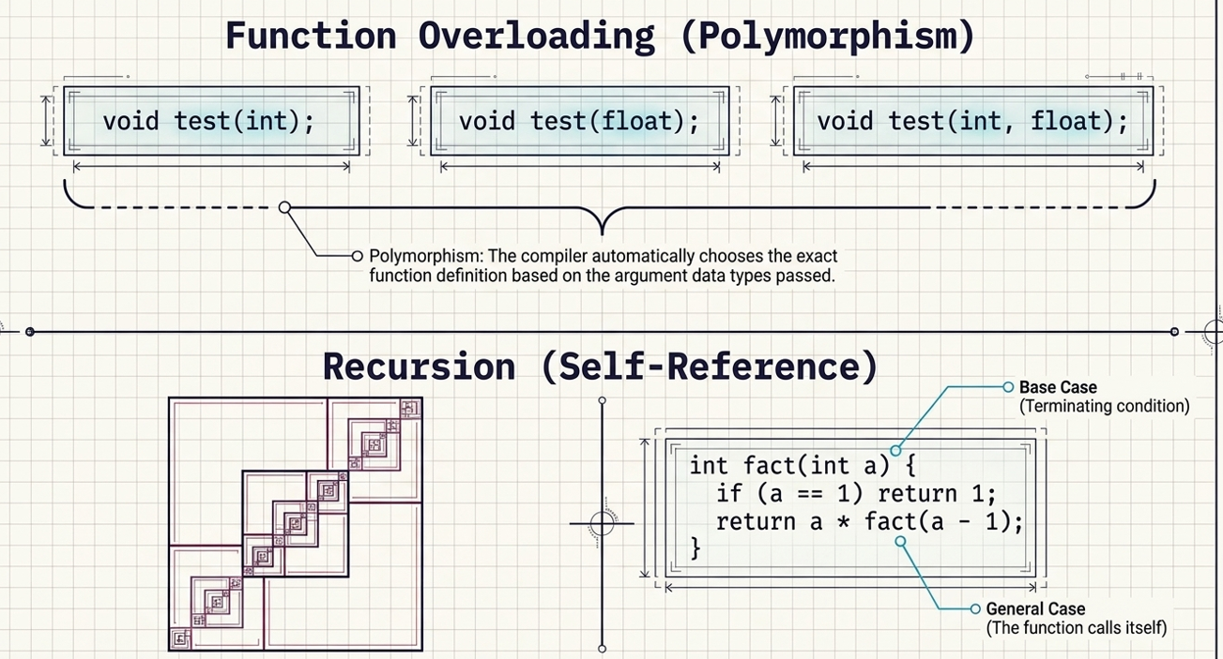

Slide 13
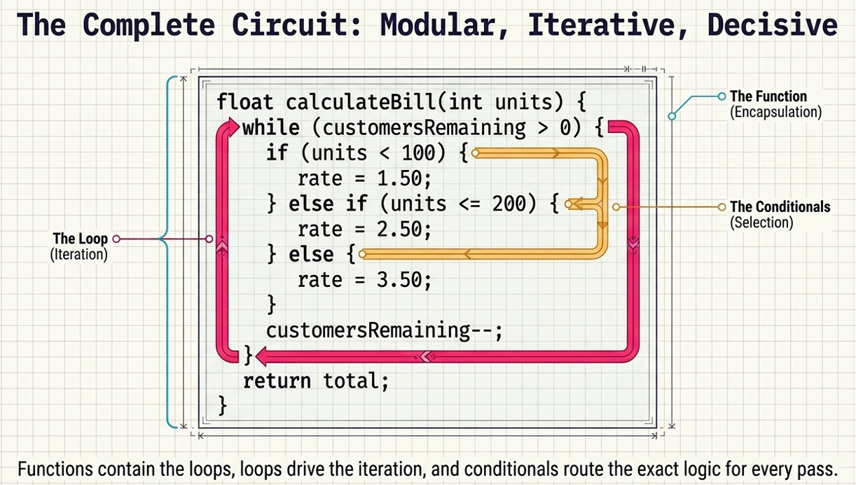

Slide 14
ACTIVITITY BEYOND CLASS ROOM (3 Hrs)
Write a C++ program to swap two numbers using call by value. Display the values before and after calling the function. Explain why the original values do not change.
Write a C++ program to find the square and cube of a number using a function with call by value.
Write a C++ program to find the maximum of two numbers using a function that accepts arguments by reference.
Write a C++ program to overload a function named area() to calculate:Area of a squareArea of a rectangleArea of a circle.
Write a C++ program to check whether a given number is prime using a loop.

Slide 15
ACTIVITITY BEYOND CLASS ROOM
Write a C++ program to input marks of five subjects, calculate the percentage, and display the grade using the following criteria:
Percentage | Grade
≥ 90 | A+
80–89 | A
70–79 | B
60–69 | C
50–59 | D
< 50 | Fail

Slide 16
References
Yashavant Kanetkar, Data Structures Through C++, BPB Publications, 2023.
AI Tool for making slides attractive

