Slide 1
Class, Objects, Constructor, deconstructor
Course Name: Data Structure and Algorithms
Course Code: ECE2104

Slide 2
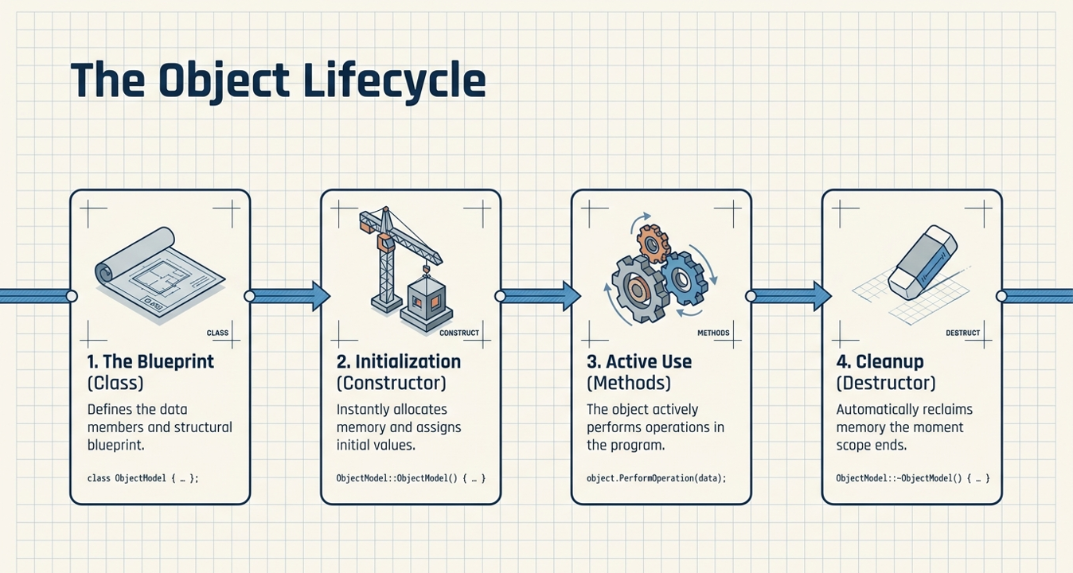

Slide 3
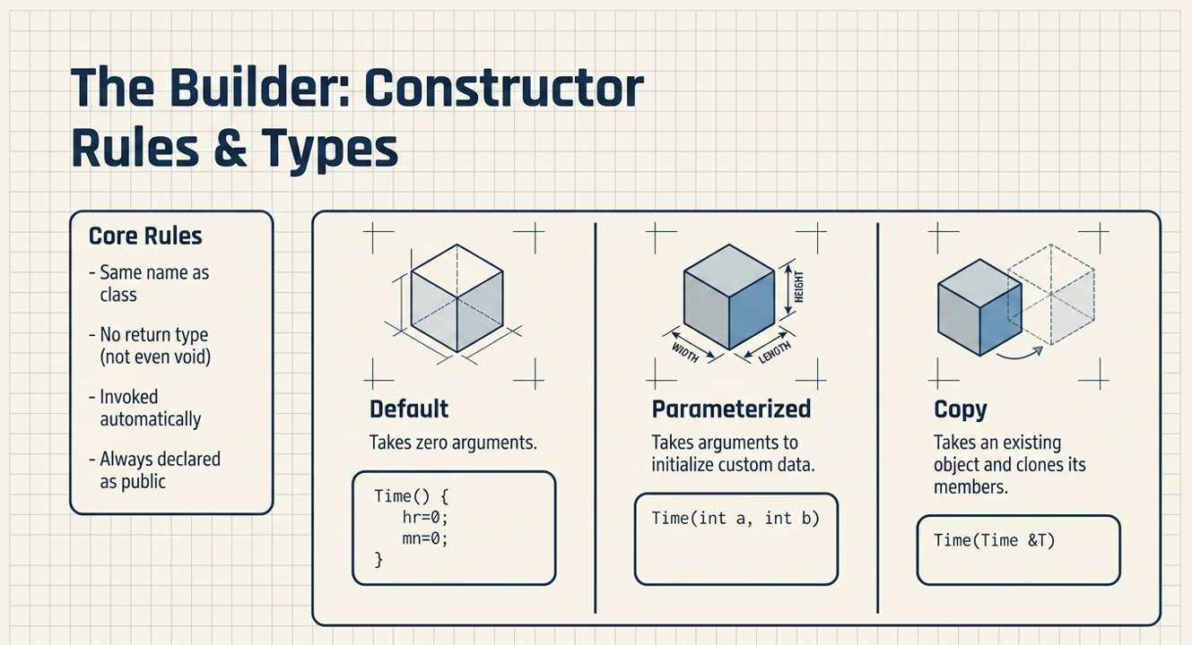

Slide 4
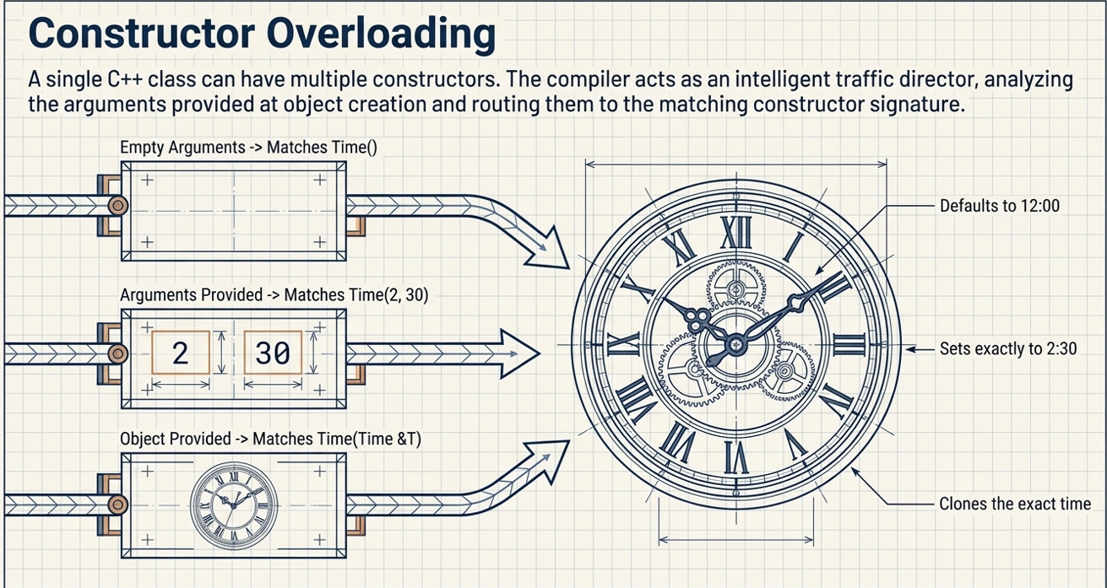

Slide 5
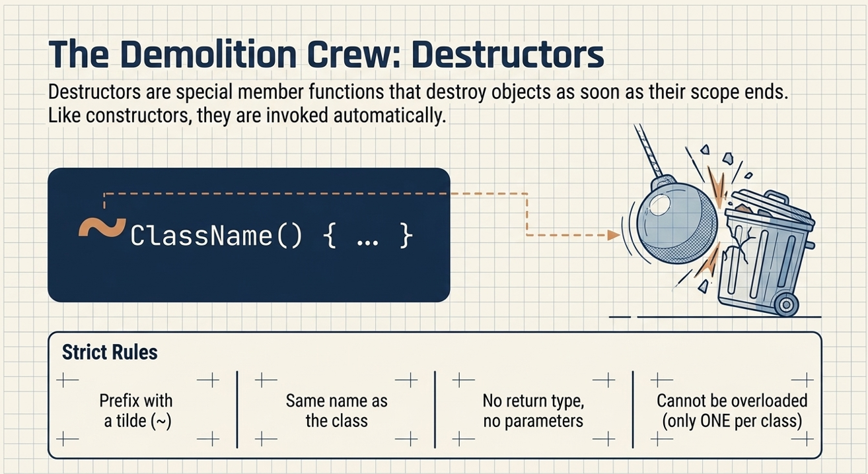

Slide 6
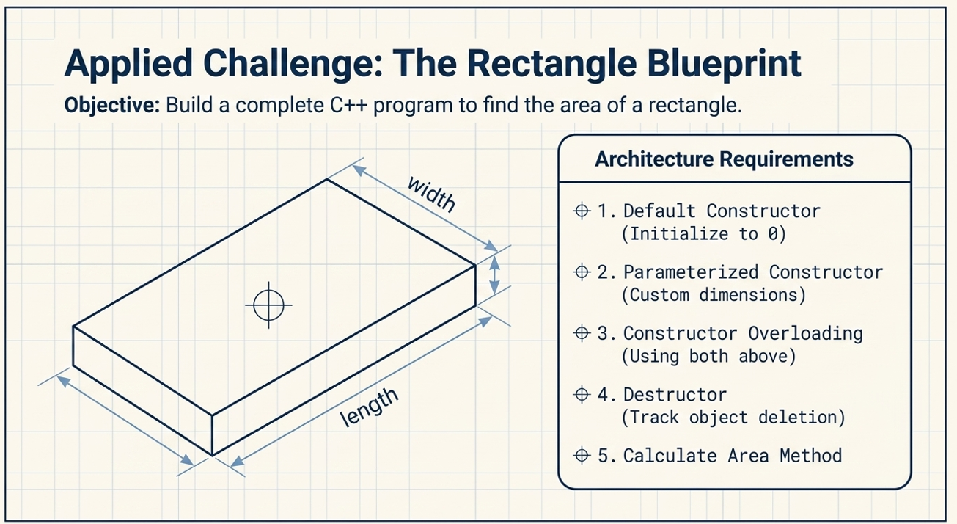

Slide 7
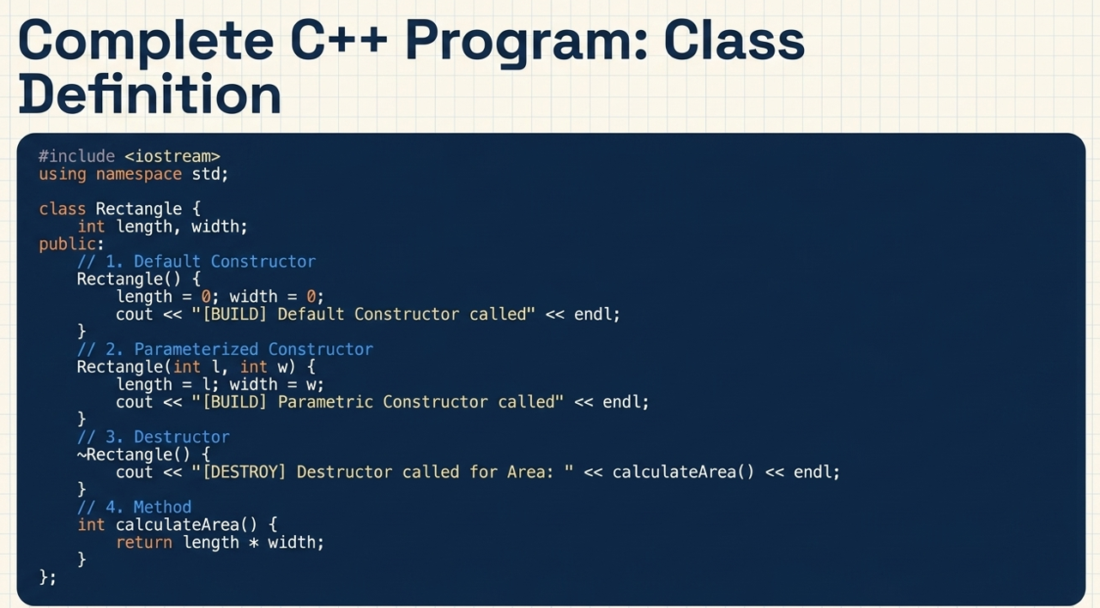

Slide 8
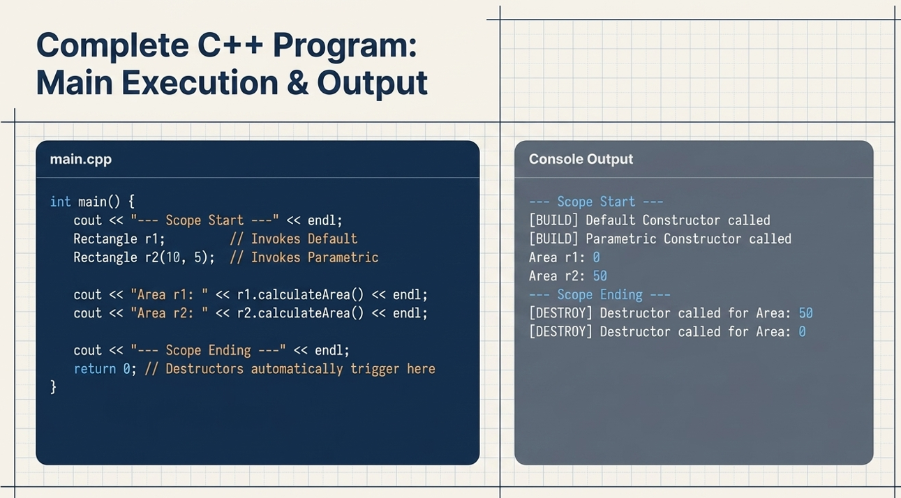

Slide 9
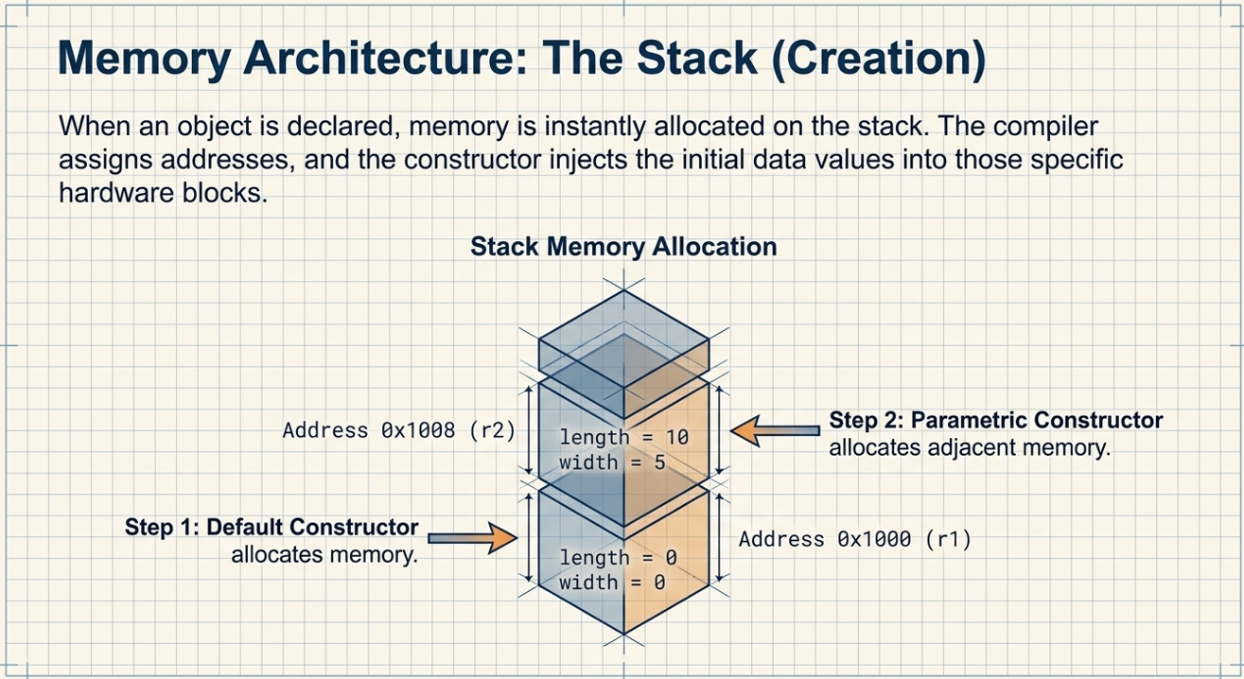

Slide 10
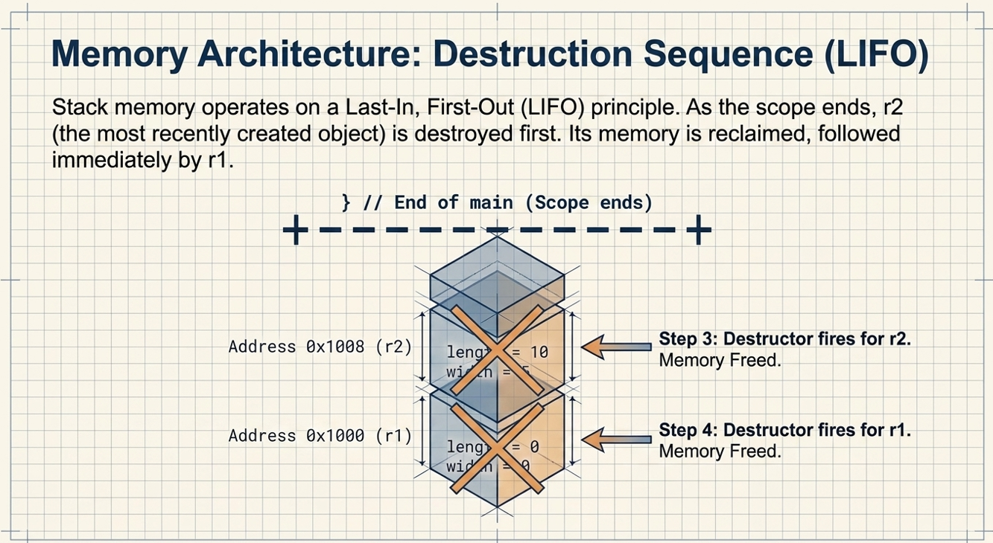

Slide 11
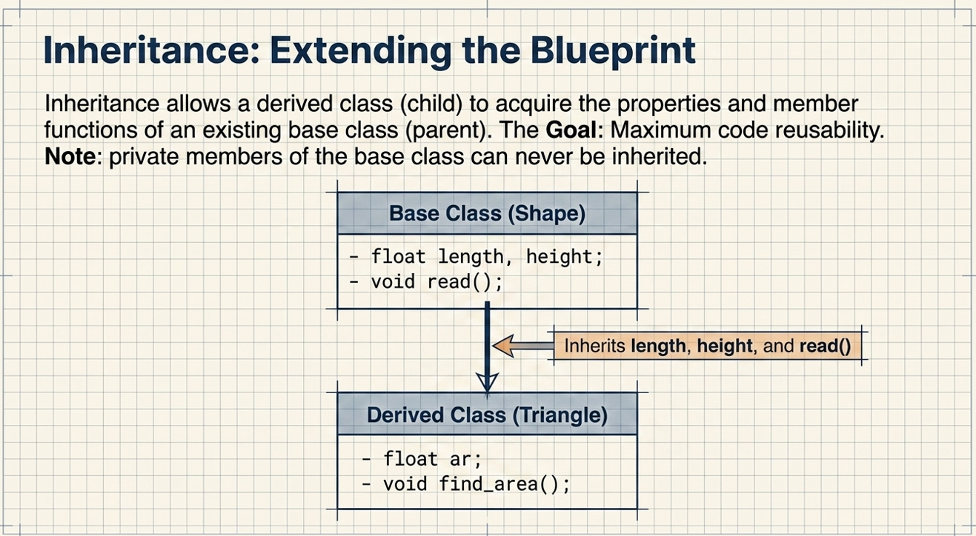

Slide 12
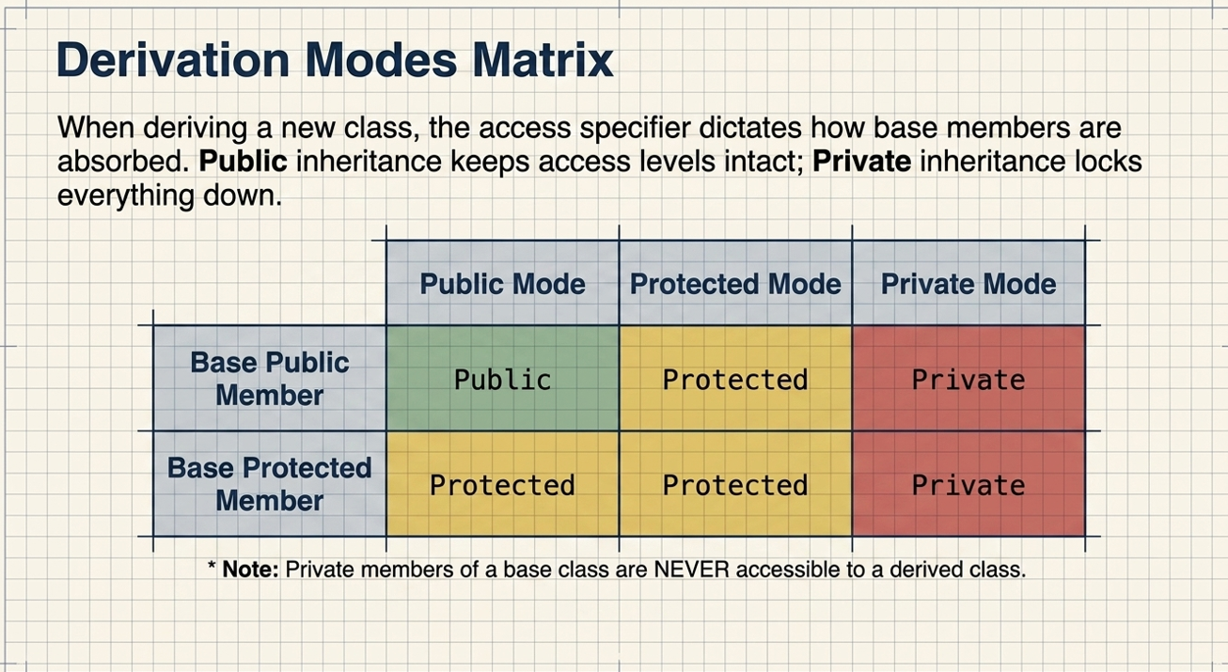

Slide 13
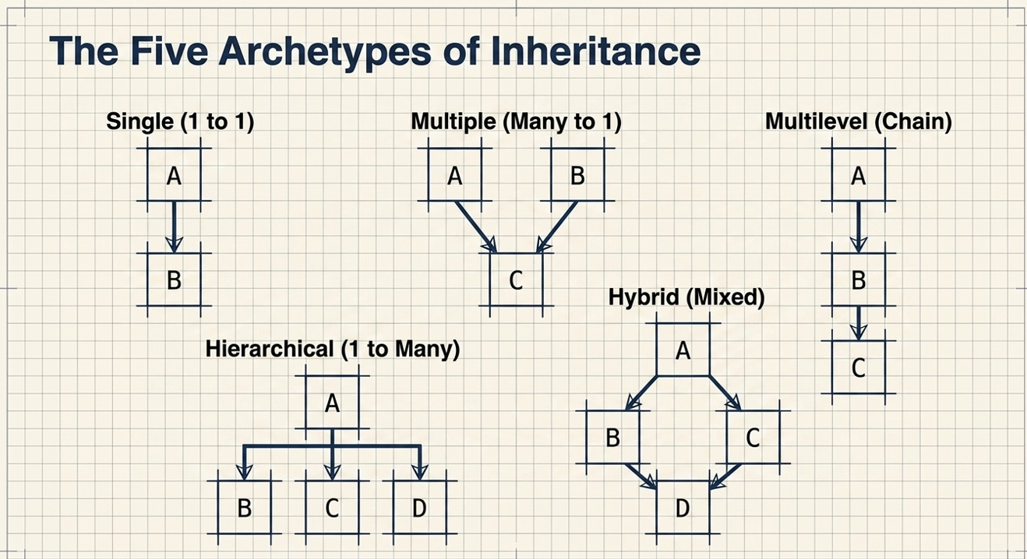

Slide 14
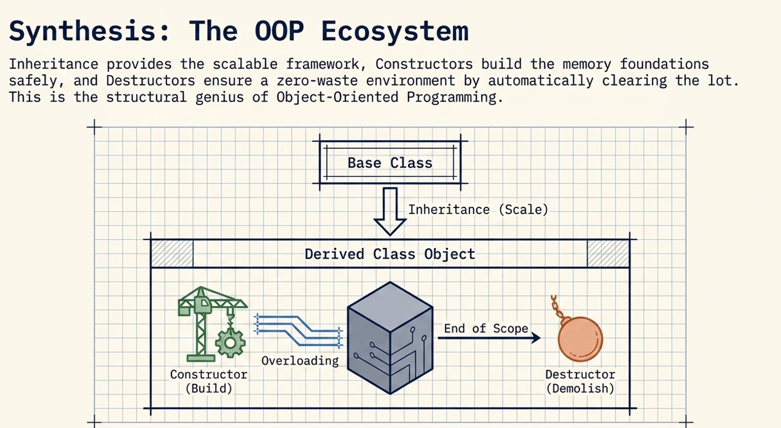

Slide 15
ACTIVITITY BEYOND CLASS ROOM (3 Hrs)
What is a class in C++?
What is an object?
How is it different from a class?
Why are access specifiers used in C++?
What is the default access specifier of a class?
Can private data members be accessed directly from main()? Why?
What is the difference between public, private, and protected access specifiers?
Why are member functions generally declared as public?
Can a class have multiple objects? Explain with an example.
What is data hiding? Which access specifier provides it?
What is encapsulation, and how is it implemented using classes and access specifiers?

Slide 16
References
Yashavant Kanetkar, Data Structures Through C++, BPB Publications, 2023.
AI Tool for making slides attractive

