Slide 1
Arrays
Memory Representation and Basic Operations
Course Name: Data Structure and Algorithms
Course Code: ECE2104

Slide 2
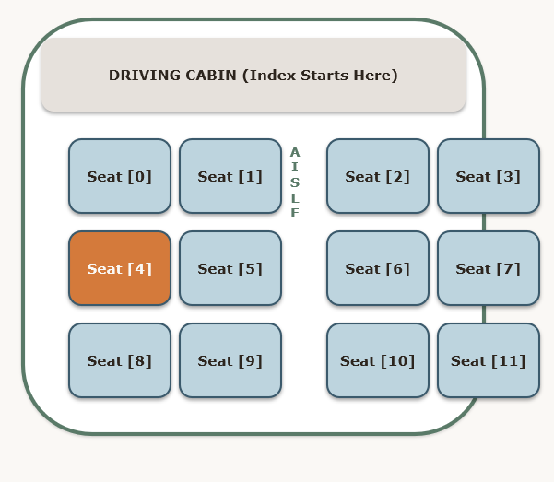
What is a Linear Array?
Homogeneous Elements: Every item in the list must share the exact same data type (e.g., all integers or all characters).
Fixed Size: The number of seats (capacity) is allocated at the start and cannot dynamically grow during the ride.
Direct Indexing: Each slot is numbered sequentially starting from 0 (index 0 to size-1), making lookups instant.
Bus Seat Analogy: If you book 'Seat 4' in a bus with contiguous seats, the conductor knows exactly where you sit relative to Seat 0, without walking past Seats 1, 2, and 3.

Slide 3
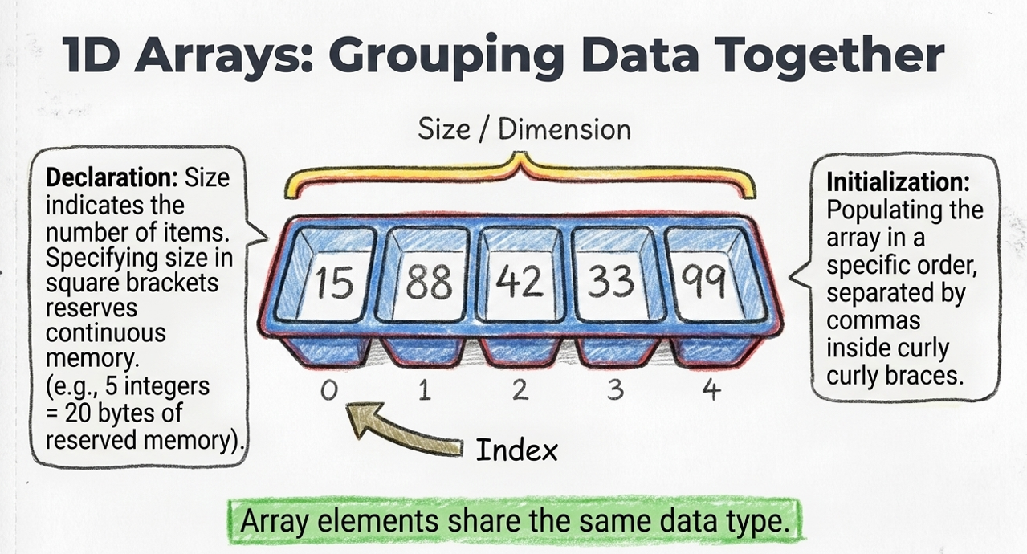

Slide 4
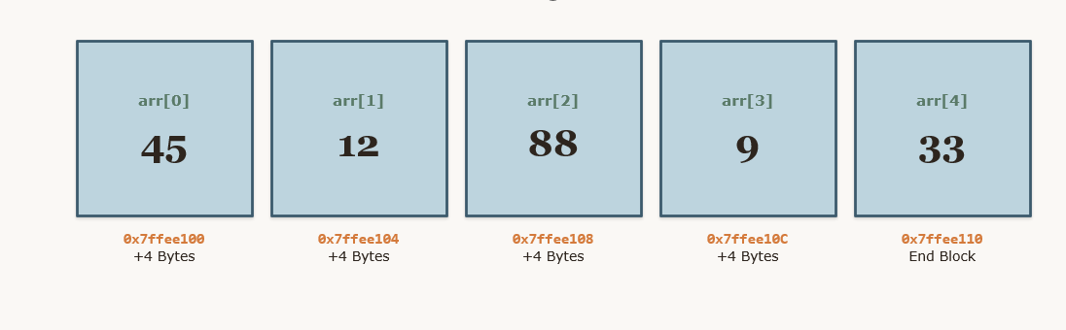
What happens in hardware when you declare an array in C++?
The compiler requests a single, unbroken block of bytes from RAM.
If you declare `int arr[5];`, and an `int` occupies 4 bytes of storage,
C++ reserves exactly 20 bytes of consecutive physical memory cells.
No other application can borrow memory from inside this block, guaranteeing absolute locality of reference

Slide 5
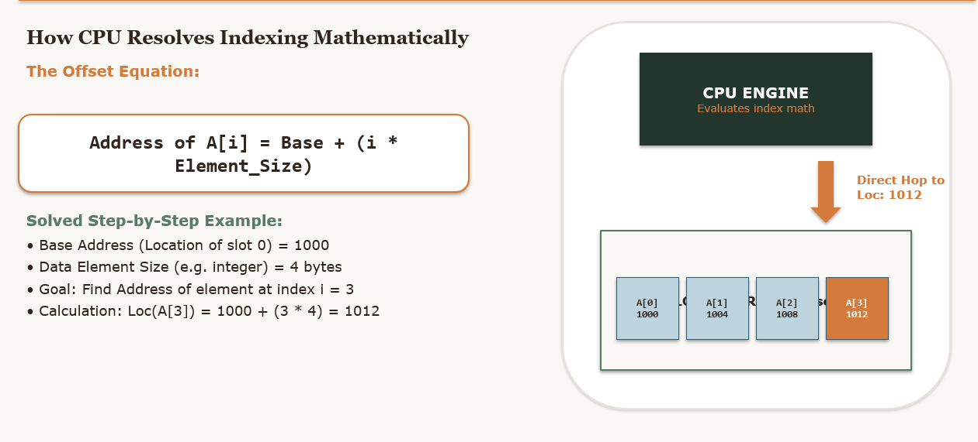

Slide 6
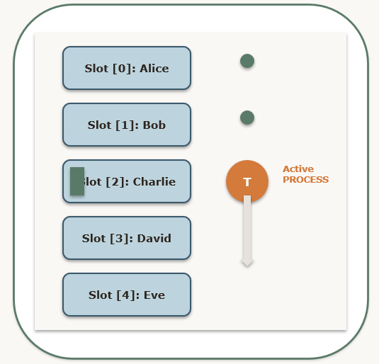
What is Array Traversal?
Systematic Processing: Visiting every element of the array exactly once, starting from index 0 up to index size-1.
Classroom Attendance Metaphor: A school teacher boards a bus and walks down the row sequentially, checking each student's name from Seat 0 to Seat N. The teacher does not skip anyone or double-check anyone.
No Jumping or Skipping: If a teacher needs to scan the bus, they must traverse the space linearly from front to back.
Performance Boundary: Requires visiting exactly N elements, which represents an O(N) linear time complexity.

Slide 7
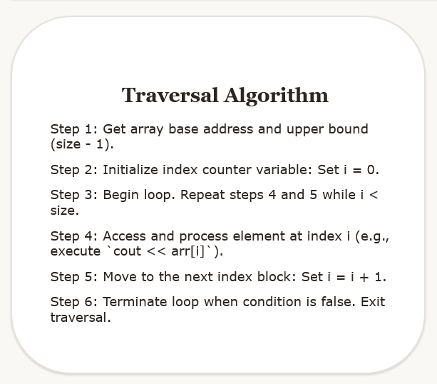
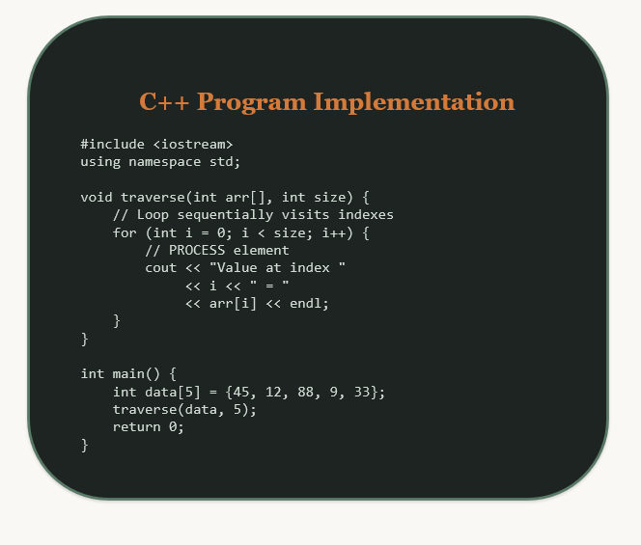

Slide 8
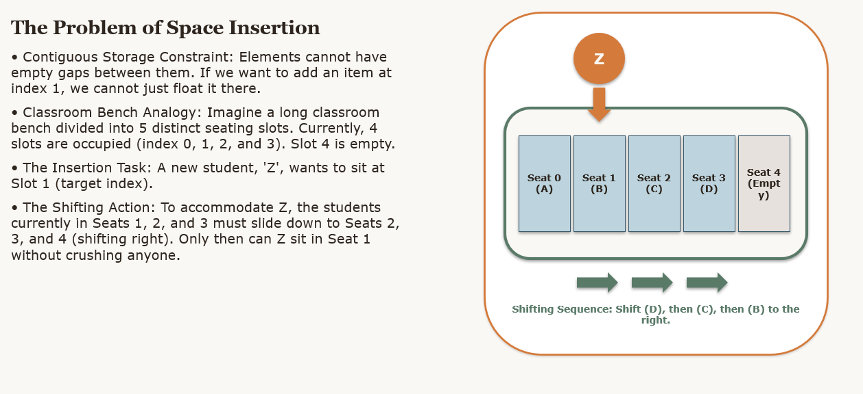

Slide 9
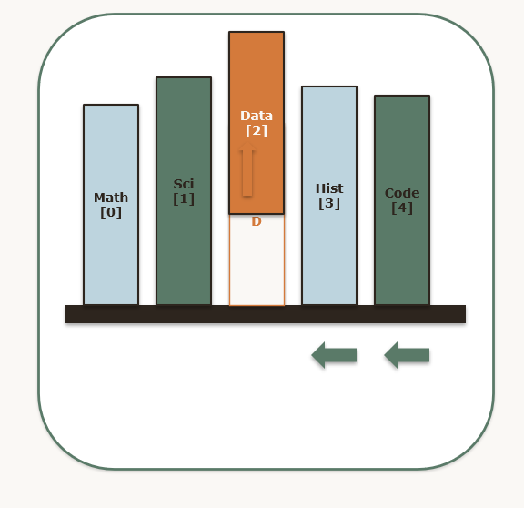
Solving the Vacated Space Problem
A linear array cannot host 'empty pockets' in the middle. Storage must be perfectly sequential and contiguous.
Think of a tightly packed row of vertical books on a shelf.
If you pull out a book at index 2 (e.g., removing a yellow book), it leaves an unsightly void or gap in the collection.
To restore structural integrity, you must slide all subsequent books (to the right of the gap) leftwards to fill the void. This preserves continuous alignment.

Slide 10
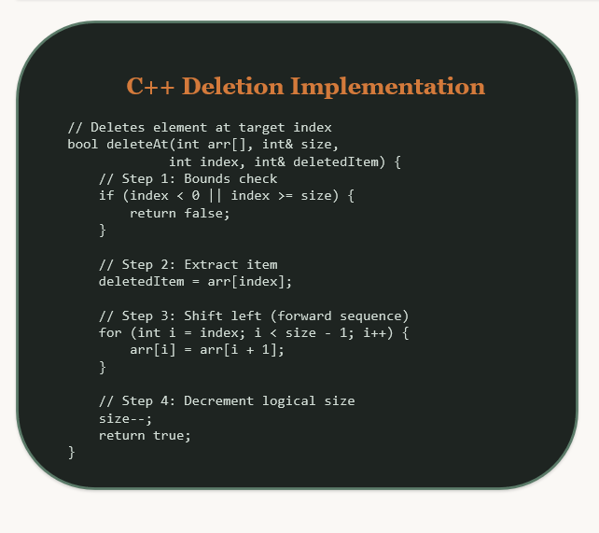
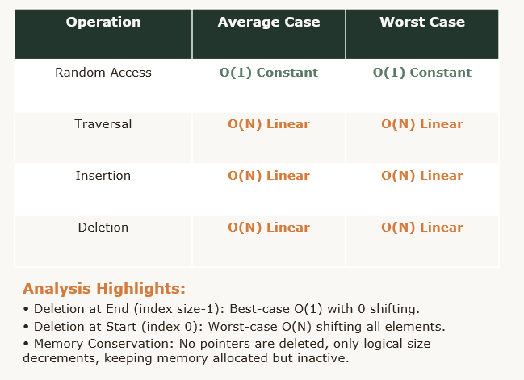

Slide 11
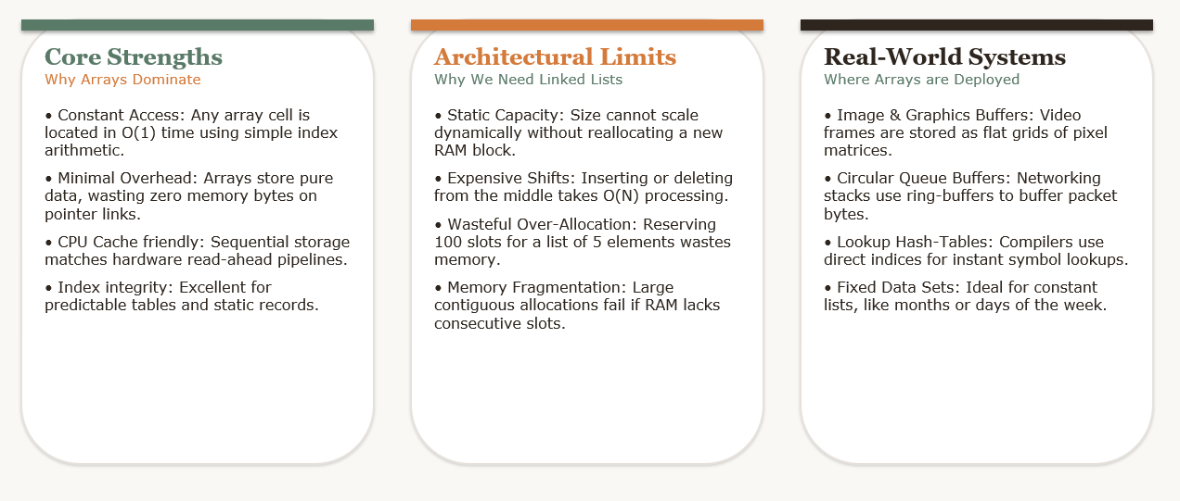

Slide 12
ACTIVITITY BEYOND CLASS ROOM (3 Hrs)
Write a C++ program to find the sum and average of the elements of an array.
Write a C++ program to find the largest and smallest element in an array.
Write a C++ program to sort the elements of an array in ascending order.
Write a C++ program to sort the elements of an array in descending order.
Write a C++ program to rotate the elements of an array one position to the left.
Write an algorithm for inserting an element at a given position in an array.
Write an algorithm to reverse the elements of an array.
Write the formula used to calculate the address of an array element.
What is the time complexity of accessing an element in an array? Why?
What is contiguous memory allocation? Why are arrays stored in contiguous memory?

Slide 13
References
Yashavant Kanetkar, Data Structures Through C++, BPB Publications, 2023.
AI Tool for making slides attractive

