Slide 1
Stack
Memory Representation and Basic Operations
Course Name: Data Structure and Algorithms
Course Code: ECE2104

Slide 2
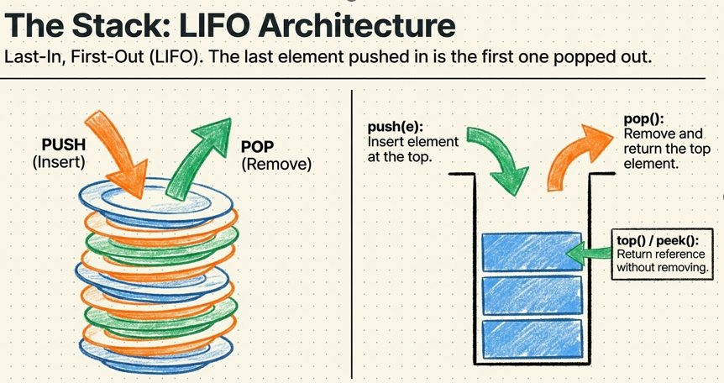
What is a Stack?
A stack is an Abstract Data Type (ADT), commonly used in most programming languages. It is named stack as it behaves like a real-world stack, for example – a deck of cards or a pile of plates, etc

Slide 3
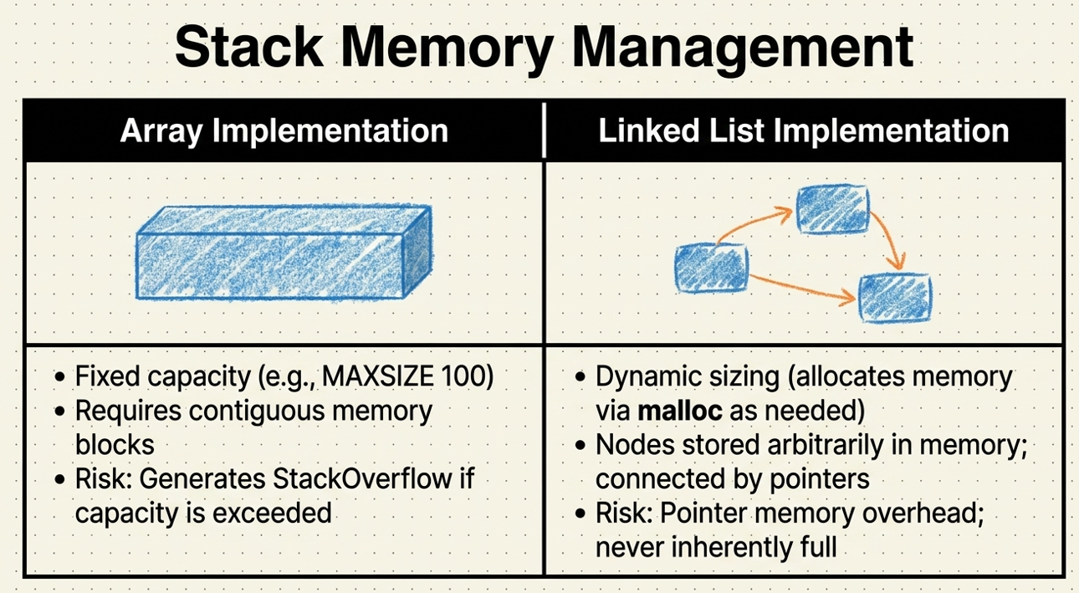

Slide 4
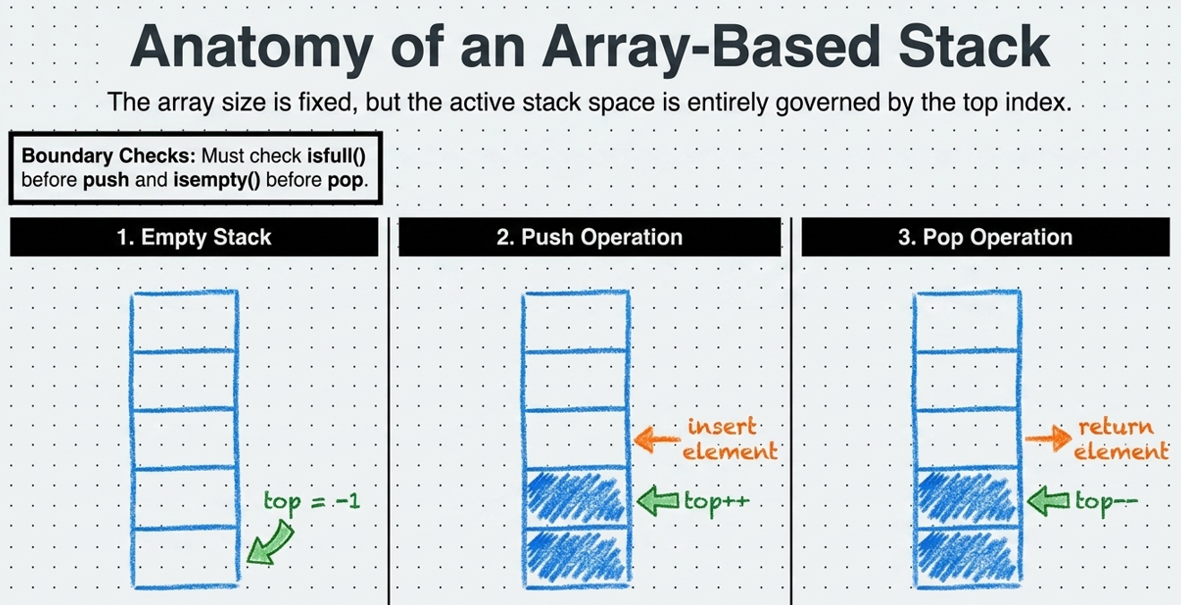

Slide 5
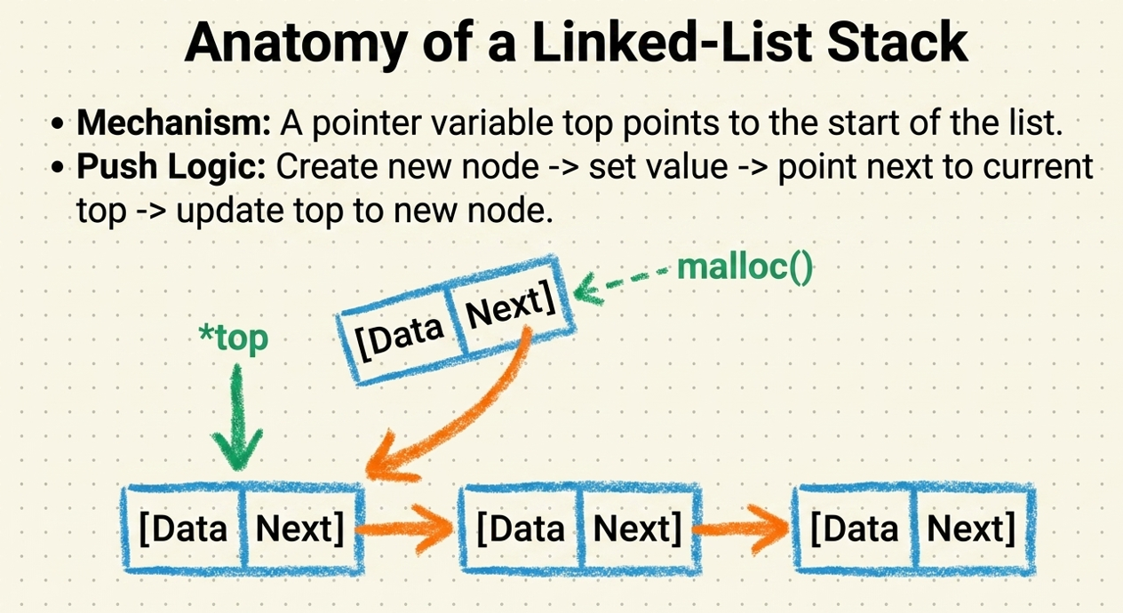

Slide 6
STACK: Last-In-First-Out (LIFO)
void push (stack *s, int element);
/* Insert an element in the stack */
int pop (stack *s);
/* Remove and return the top element */
void create (stack *s);
/* Create a new stack */
int isempty (stack *s);
/* Check if stack is empty */
int isfull (stack *s);
/* Check if stack is full */

Slide 7
Algorithm
POP(STACK, TOP)
START
1. Check whether the stack is empty.
IF (TOP == -1)
Print "Stack Underflow"
STOP
2. Store the top element.
ITEM = STACK[TOP]
3. Decrement TOP by 1.
TOP = TOP - 1
4. Print the deleted element (ITEM).
5. STOP
PUSH
top
top

Slide 8
Algorithm
PUSH(STACK, TOP, MAX, ITEM)
START
1. Check whether the stack is full.
IF (TOP == MAX - 1)
Print "Stack Overflow"
STOP
2. Increment TOP by 1.
TOP = TOP + 1
3. Insert the new element.
STACK[TOP] = ITEM
4. Print "Element inserted successfully."
5. STOP
POP
top
top

Slide 9
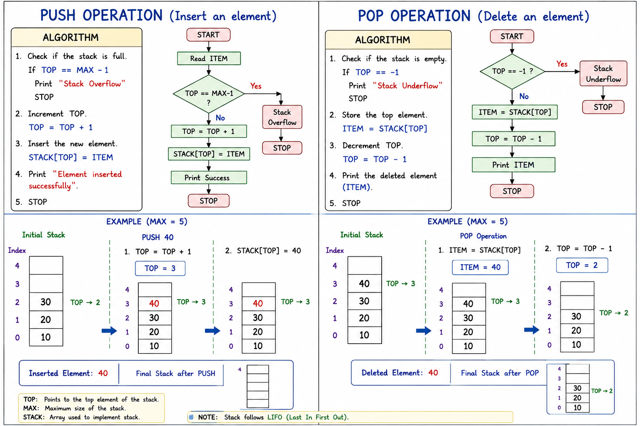

Slide 10
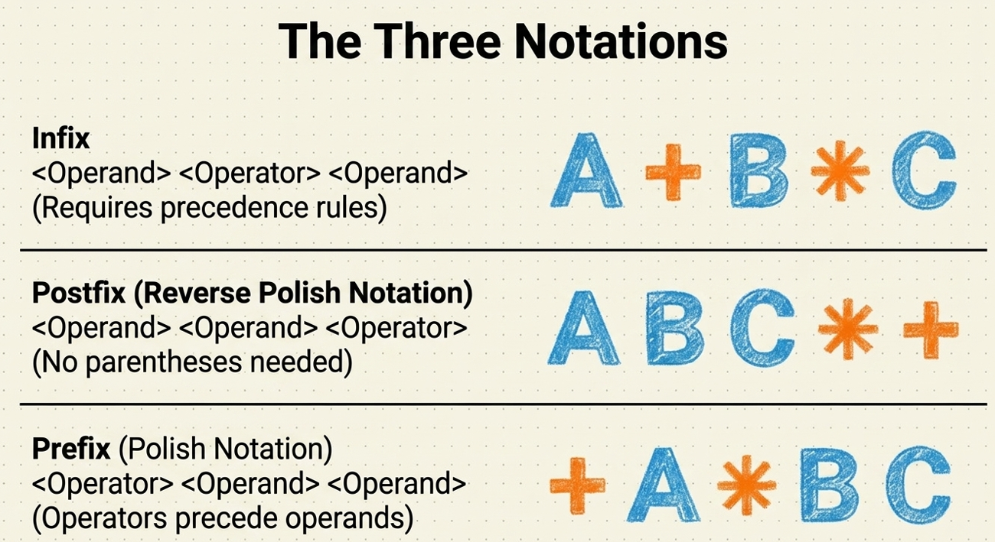
Expression Notations
Infix : Operator appears between operands.
A + B × C
Prefix: Operator appears before operands.
+AB
Postfix Expressions: Operator appears after operands.
AB+
Highest: exponential
Next Highest: Multiplication and Division
Lowest: Addition and Subtraction

Slide 11
Prefix Notation( Polish Notation)
Prefix Notation, also known as Polish Notation (PN), is a method of writing arithmetic expressions in which the operator is placed before its operands. In this notation, parentheses are not required because the order of operations is determined by the position of the operators and operands.
Characteristics
Operator is written before the operands.
Parentheses are not required.
Eliminates ambiguity in expressions.
Easy for computers and compilers to process.
Commonly used in expression conversion and compiler design.
Post fix Notation( Reverse Polish Notation)
Postfix notation, also known as Reverse Polish Notation (RPN), is a method of writing an expression in which the operator is placed after its operands. Postfix expressions are commonly evaluated using a stack, making them suitable for computer-based expression processing.
Characteristics
Operator is placed after the operands.
Example: AB+
Parentheses are not required to specify the order of operations.
No ambiguity occurs because the position of operators determines the evaluation order.
Stack is used to efficiently evaluate postfix expressions.
Suitable for computer and compiler processing because expressions can be evaluated systematically using stack operations.

Slide 12
Algorithm INFIX_TO_POSTFIX(Expression)
START
1. Create an empty stack S.
2. Scan the infix expression from left to right.
3. For each symbol in the expression:
a) If the symbol is an operand, append it to the postfix expression.
b) If the symbol is '(',push it onto the stack.
c) If the symbol is ')’, pop operators from the stack and append themto the postfix expression until '(‘ is found. Remove '(' from the stack.
d) If the symbol is an operator, while the stack is not empty and the operator at the top of the stack has higher or equal precedence than the current operator: Pop the operator from the stack Append it to the postfix expression Push the current operator onto the stack.
4. Repeat Step 3 until the entire expression is scanned.
5. Pop all the remaining operators from the stack and append them to the postfix expression.
6. Display the postfix expression.
STOP

Slide 13
Algorithm: POSTFIX_EVALUATION(P)
Step 1: Add a sentinel '#' at the end of the postfix expression P.
Step 2: Scan the postfix expression P from left to right, reading one character at a time.
Step 3: Read the next character from P.
Step 4: If the character is an operand, Push it onto the stack.
Else if next character is an operator
(a) Pop the top element from the stack. Let it be VAR1.
b) Again pop the top element (originally next-to-top) from the stack. Let it be VAR2.
(c) Compute ANSWER = VAR2 (Operator) VAR1
(d) Push ANSWER onto the stack.
End If
Step 5: Repeat Steps 3 and 4 until the sentinel '#' is encountered.
Step 6: Pop the top element from the stack. Let it be VAR3.
Step 7: Set ANSWER = VAR3
Step 8: Display ANSWER.
STOP

Slide 14
Example. Convert the following mathematical infix expression into its postfix expression. Then, evaluate the postfix expression: ((8 + (6 - 2)) × 5) ÷ 4
Sr. No | Scan Expression | Postfix Expression | Stack
1. | ( | - | (
2. | ( | - | ((
3. | 8 | 8 | ((
4. | + | 8 | ((+
5. | ( | 8 | ((+(
6. | 6 | 86 | ((+(
7. | - | 86 | ((+(-
8. | 2 | 862 | ((+(-
9. | ) | 862- | ((+
10. | ) | 862-+ | (

Slide 15
11. | * | 862-+ | (*
12. | 5 | 862-+5 | (*
13. | ) | 862-+5* | -
14 | / | 862-+5* | /
15. | 4 | 862-+5*4 | /
16. | End | 862-+5*4/ | -
Final Post Fix Expression: 862-+5*4/

Slide 16
Evaluate the Postfix Expression
Symbol | Stack After Operation | Operation | Sr.No.
8 | 8 | Push 8 | 1.
6 | 8 6 | Push 6 | 2.
2 | 8 6 2 | Push 2 | 3.
- | 8 4 | 6-2 | 4.
+ | 12 | 8+4 | 5.
5 | 12 5 | Push 5 | 6.
* | 60 | 12*5 | 7.
4 | 60 4 | Push 4 | 8.
/ | 15 | 60/4 | 9.
Expression | Result
Infix Expression | ((8+(6-2))*5)/4
Postfix Expression | 862-+5*4/
Evaluated Result | 15

Slide 17
ACTIVITITY BEYOND CLASS ROOM (3 Hrs)
Evaluate the post fix expression 5 24 3 2 2 ^ * / -
convert the following infix expression into postfix expression ((A+(B-C))/D).
Convert the following infix expression into postfix notation: (A+B)*(C-D)
Convert the following infix expression into prefix notation: (A-B/C)*(D+E)
Evaluate the following postfix expression using a stack. Show the stack contents after each operation: 52+83-*
Write a C++ program to implement a stack using an array and perform PUSH, POP, and DISPLAY operations. Also handle Stack Overflow and Stack Underflow.
Write a C++ program to convert an infix expression into its equivalent postfix expression using a stack.
Write a C++ program to evaluate the following postfix expression using a stack: 52+83-*

Slide 18
References
Yashavant Kanetkar, Data Structures Through C++, BPB Publications, 2023.
Rajesh K. Shukla, Data Structures using C & C++ , Wiley publication
AI Tool for making slides attractive

