Slide 1
SARCASM DETECTION IN NEWS HEADLINES
Presented by:
BHOMIK PATHAK (676349569)
JIVISHA (663685107)
LIPSA MISHRA (668886120)
SHALINI SINGH (663877768)

Slide 2

Technical talk after lunch !!
This is exactly what a speaker wants.

Slide 3
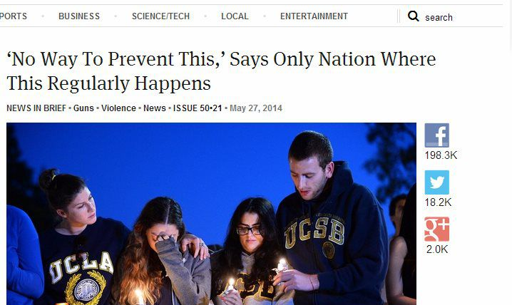
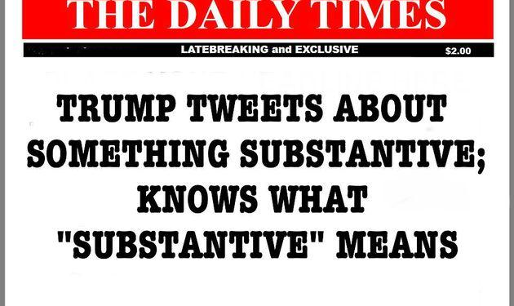
Sarcastic news headlines

Slide 4
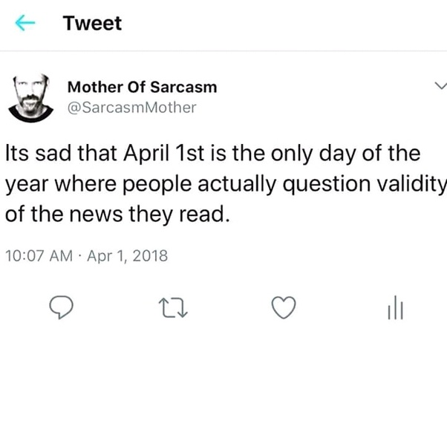
What is Sarcasm?
● Greek: sarkázein (speak bitterly, use of irony to mock)French: sarcasme
● Nuanced form of language where often the speaker explicitly states the opposite of what she implies.

Slide 5
Key Characteristics
● Sarcasm: “a sharp, bitter, or cutting expression or remark; a bitter gibe or taunt”.
● Sarcasm is negative sentiment.
○ You are never sarcastically positive

Slide 6
What makes Sarcasm detection difficult?
● It is deliberate - people employ play of language.
● It is subtle: it is just a word, phrases or a punctuation that is here and there.
● Even humans can find it hard to understand.
● Sarcasm is often used on social media platforms like twitter.

Slide 7
Dataset
Collection created from two real news websites, the Onion, and the HuffPost.
The Onion’s sole purpose is of publishing sarcastic news.
this helps us gain high-quality labels with very low noise compared to the twitter dataset
The News Headlines for both the websites are written by professionals in a formal manner.
No spelling mistakes and informal usage of words.
Such language helps in reducing the sparsity and increases the chances of finding pre-trained embeddings.

Slide 8
Dataset Properties
Total records: 28619
Sarcastic: 13634
Non-sarcastic: 14985
Attributes:
Article_link: link to the original news article
Headline: the headline of the news article
is_sarcastic: 1=sarcastic; 0=non-sarcastic

Slide 9
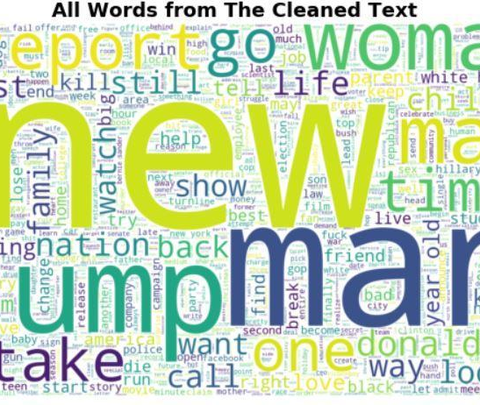
Data Cleaning
Removing non-ASCII characters
Lemmatization for tags
Counting and Removal of Punctuation
Removing Stop Words

Slide 10
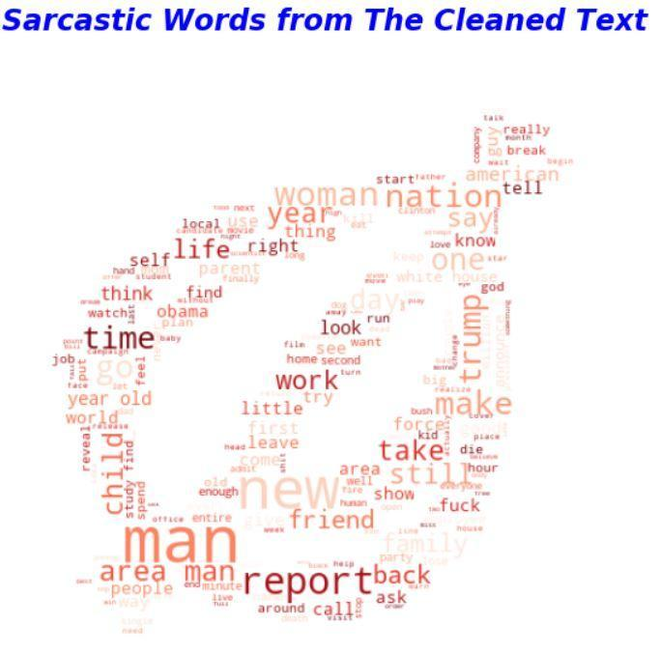
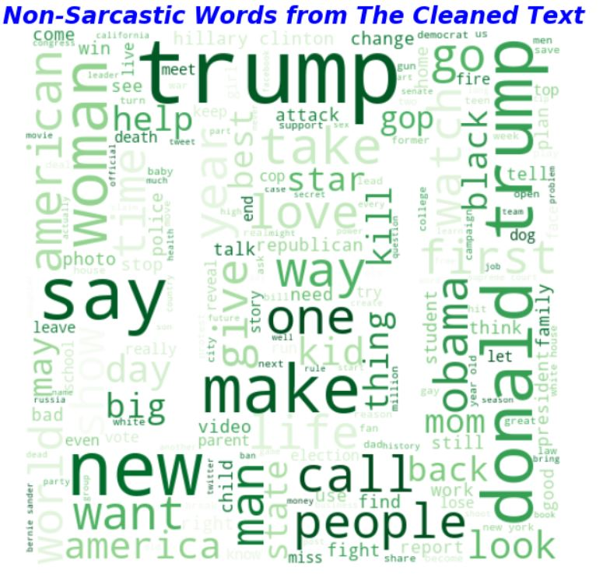
WORD CLOUDS created for the sarcastic and non-sarcastic word frequency

Slide 11
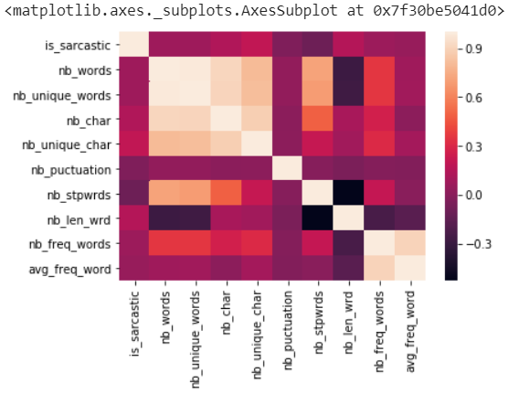
Feature Extraction
Feature extraction is carried out on the cleaned headline
Enable us to carry out diverse model creations

Slide 12
