Slide 1


AI-Powered Personal Mental Health Monitoring System
Bhoomi Narula
2410994780
Chitkara University
April 2025

Slide 2
Introduction
Mental health affects one in eight people globally. Traditional diagnostic methods are subjective and episodic. This project proposes an AI-driven solution using wearables and smartphones to monitor mental well-being continuously.

Slide 3
Problem Statement
Current mental health care is limited by accessibility, real-time monitoring, and personalization. There is a need for a scalable system that bridges clinical gaps with intelligent, continuous support.

Slide 4
System Overview
The system consists of wearable sensors, a smartphone interface, cloud storage, machine learning analytics, and a real-time dashboard for feedback.

Slide 5
Data Flow
- Wearables collect physiological data
- Smartphone logs behavioral data
- Data sent to cloud via MQTT
- ML processes
- Dashboard visualizes

Slide 6
Machine Learning Models
- Random Forest: Feature importance
- SVM: Mental state classification
- RNN: Trend prediction

Slide 7
Dashboard Features
- Health metrics graphs
- Mood score indicator
- Real-time alerts
- Personalized suggestions

Slide 8
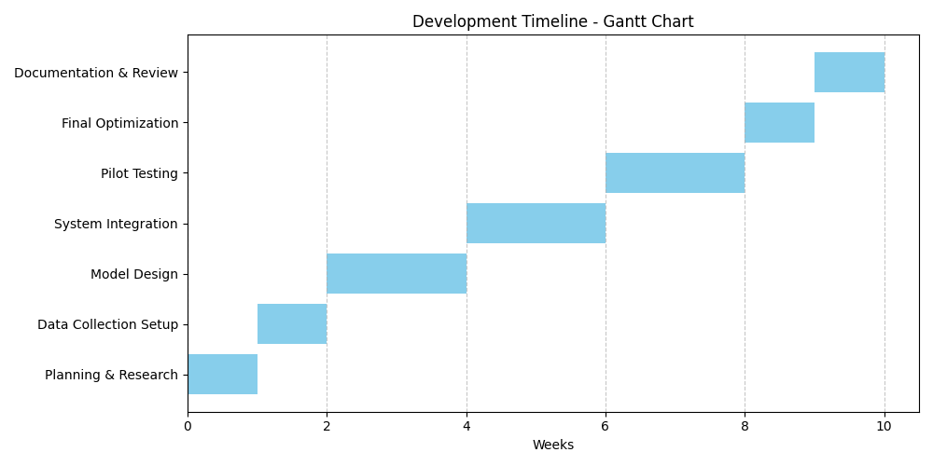
Timeline & Gantt Chart
10-week development including planning, sensor setup, ML training, system integration, testing, and review.
Gantt chart illustrates project flow.

Slide 9
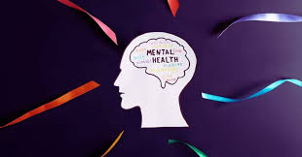

Conclusion
This system provides proactive, personalized mental health support using AI and IoT. Future work includes user trials, clinical integration, and refining model performance.

