Slide 1
Market Basket Analysis
Which products sell together, and where the cross-sell opportunities are
Data Analytics Internship — Codec Technologies

Slide 2
Approach
Groceries dataset — 14,963 shopping transactions, 167 unique products
01
02
03
Transactions
Apriori
Insights
Grouped raw purchase records into baskets (customer + date = one trip)
Mined frequent itemsets, then generated association rules (support, confidence, lift)
Ranked product pairs by lift to find genuine cross-sell opportunities

Slide 3
Most frequently purchased items
Support = % of all transactions containing the item

Slide 4
Beyond popularity — finding real associations
Support
Confidence
Lift
How often an item (or pair) appears across all transactions
Given item A was bought, the % chance item B was also bought
Whether A and B are genuinely linked, or just both popular on their own. Lift > 1 = real association
Whole milk pairs with almost everything simply because it's bought so often — high support alone doesn't mean a meaningful relationship. Lift filters that noise out.

Slide 5
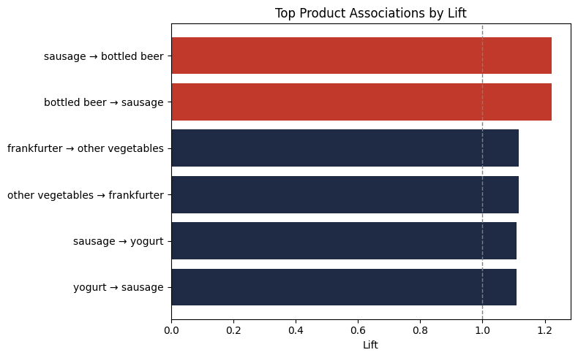
Top product associations by lift
Rules with lift closest to (and above) 1.0 are the strongest genuine pairings found

Slide 6
Recommendations
1
Bundle sausage with bottled beer
Strongest pairing found (lift 1.22) — place together or offer a combo discount to lift basket size.
2
Cross-merchandise frankfurter and vegetables
Lift 1.12 suggests a natural pairing for meal-kit style promotions or shelf placement.
3
Use whole milk as an anchor, not a target
It's in nearly every basket already — promotional spend is better used on the pairs above, not on milk itself.

