Slide 1

INSTITUTE
GOVERNMENT
POLYTECHNIC COLLEGE
SATNA (M.P.)

Slide 2
Project Name:
STUDENT INFORMATION SYSTEM
Notes:
The title you give to the presentation can be anything that describes what the presentation is all about. If it’s got a catchy title, the better.

Slide 3
Group Members Name
Name Roll No.
Bhoomika pandey 15047c04010
Mo.Asif Munsuree 15047c04025
Nitesh Kushwaha 15047c04029
Uttam Prajapati 15047c04055
________________________________
Notes:
Congress enacted FERPA for the three main purposes shown in this slide. In this presentation, the first two purposes are covered. The third has not become a major factor in our study of FERPA. Although important to the overall understanding of the intent of Congress in protecting the privacy of education records and providing for corrections to erroneous information found in education records, the hearing process has not emerged as an important part of this legislation since there have not been that many hearings that have resulted from a FERPA complaint within an institution.
Throughout the presentation, certain terms will be highlighted in a different color. These terms/words appear in BOLDFACE in this black and white publication. For example, the term “EDUCATION RECORDS” in this slide is in red in the powerpoint presentation that was used to prepare this section of this presentation. The reader/participant should understand what these key terms/phrases/concepts are. THEY ARE IMPORTANT TO UNDERSTANDING FERPA.

Slide 4
Problem Statement-
Introduction :
In many instituion it is very difficuilt to maintain student records. Due to this reason it is alsovery difficult to check information about any student.
Solutions:-
Due to that cause, we created a system which can handle the student information . So that these difficulties can be decrease, so we can called this system as Student Information System(SIS).
Notes:
The Family Policy Compliance Office is the office within the Department of Education that administers FERPA and is responsible for providing technical assistance to educational institutions on FERPA.
FERPA is applicable to both K-12 and higher education. The Family Policy Compliance Office is responsible for both levels of education.
The main difference in FERPA between these two levels of education is that the rights that are ascribed to the “student” at the higher education level are the parents at the K-12 level. As will be made clear in subsequent slides in this presentation, FERPA rights are granted to parents until their son/daughter reaches the age of 18 or begins attending an institution of higher education regardless of age.
The term “eligible student” found in the law (but not used in this presentation) refers to a student who has gained FERPA rights.

Slide 5
TASKS:
Student information system performs the following tasks:-
Record Entry Section:
In this section, the data of the student will be entered and saved.
Searching record section:
In this section, we can search any student’s data through various fields. Like-
By name.
By roll number.
By branch, semester & year of studying.
Notes:
And, if all else fails, this is the information you need to obtain assistance with your FERPA queries.

Slide 6
Display Section:
In this section, we can display student’s data by searching his/her roll number.

Slide 7
Update section
In this section modify the data of any student.
Delete section
In this section we can delete the whole profile of any student .
Notes:
The two statements found in this slide capture the essence of what FERPA is almost all about. Note the terms “education records,” “school official,” and “personally identifiable” are in red in this slide in the powerpoint presentation and boldface in these handouts.

Slide 8
Process model:
Problem statement:
User/customer has no clear idea what they want or about their product.
Process model:
We can choose prototyping model for student information system because user has no clear idea about their product so we use prototyping.

Slide 9
Software requirements specification (SRS)
Background:
A student information system (SIS) is a software application for education establishments to manage student data. The aim of the project is to implement a student information system suitable for a world class university, providing flexibility to adapt to new and changing requirements.

Slide 10
Scope:
The student information system performs the
following:-
To add the student data in database.
To search the student data from the database.
To modify the student in database.
To delete the student data from database.
Use term definition:
My sql microsoft stuctured query language
Notes:
These are the important concepts that anyone needs to know if they are to master FERPA.
This and the next slide are shown twice in this presentation. The first time is here to introduce the participants to those concepts and terms that will be emphasized in this presentation. The second time this slide is displayed is toward the end of the presentation when a summing up is done and you need a slide to emphasize those key concepts and terms that one needs to know to understand FERPA.

Slide 11
Requirements:
Hardware recuirements:
Hard disk (of any space)
Operating system.
Window XP , window vista,
Windows 7 or any other

Slide 12
DATABASE DESIGN-
A database is a collection of information that is organized so that it can be easily accessed, managed and updated.
Data is organized into rows, columns and tables, and it is indexed to make it easier to find relevant information. Data gets updated, expanded and deleted as new information is added.

Slide 13
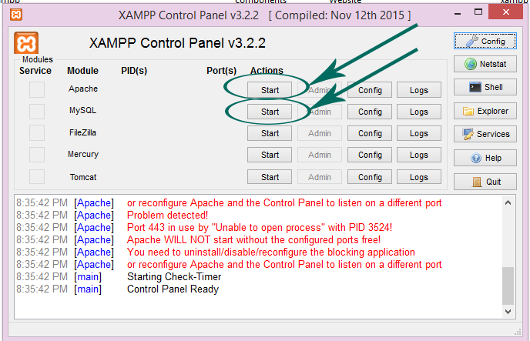
HOW TO CREATE A DATABASE
1. Open XAMPP Control Panel:-

Slide 14
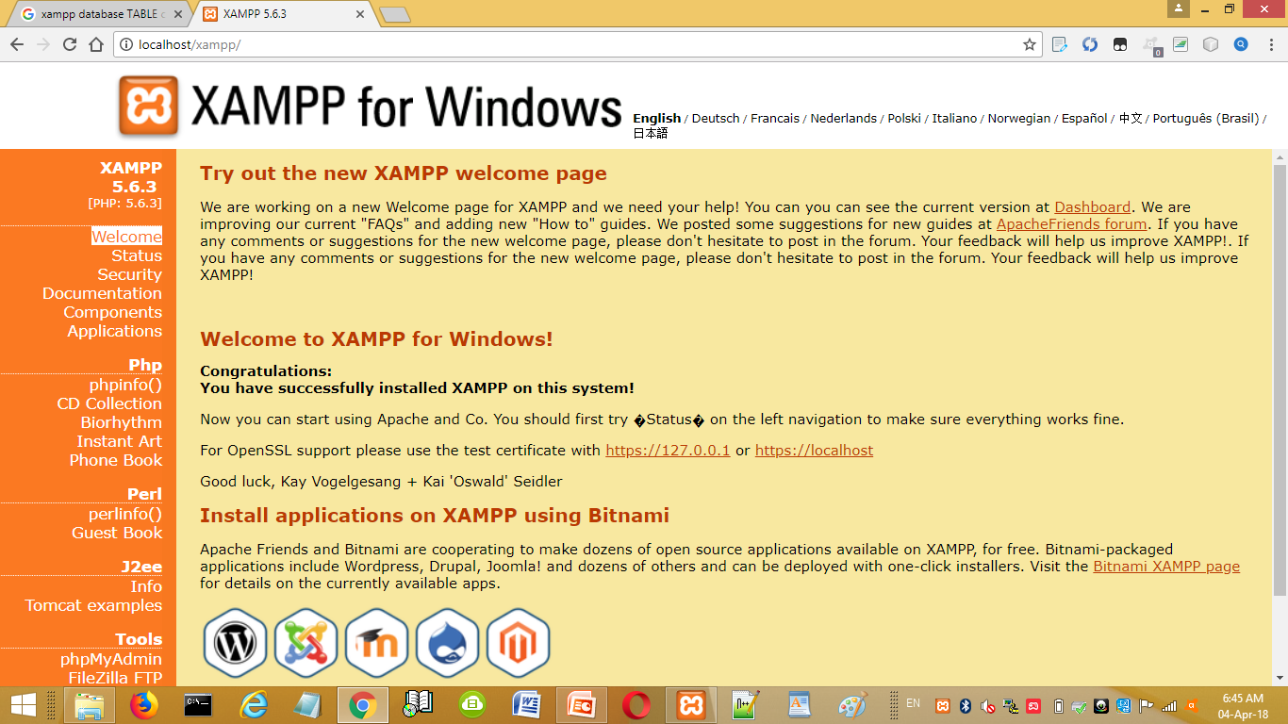
2. Go to phpmyadmin tool on XAMPP:-

Slide 15
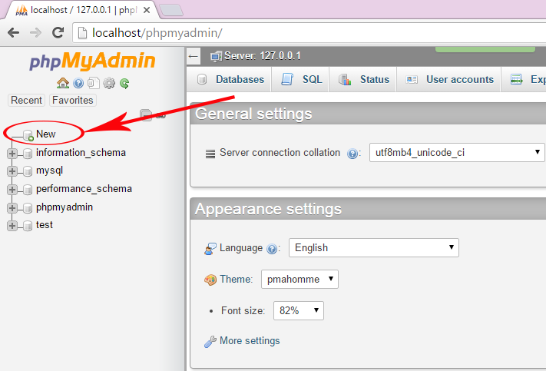
3. Click on New for new database:-

Slide 16
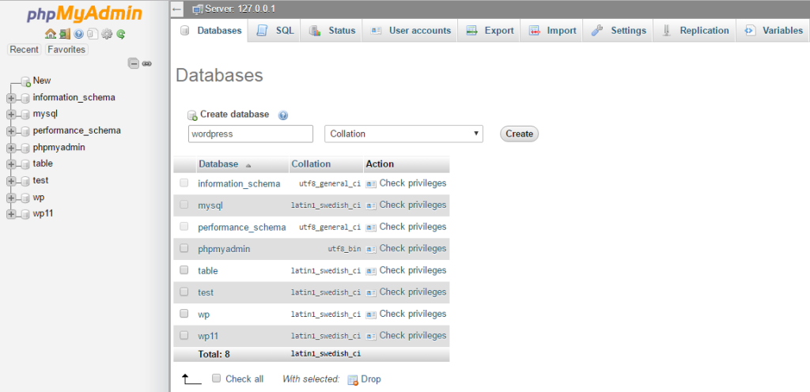
4. Insert the name of new database:-

Slide 17
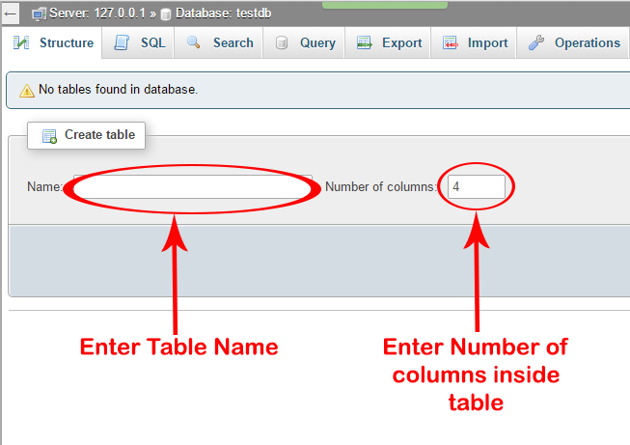
5. Create a table:-

Slide 18
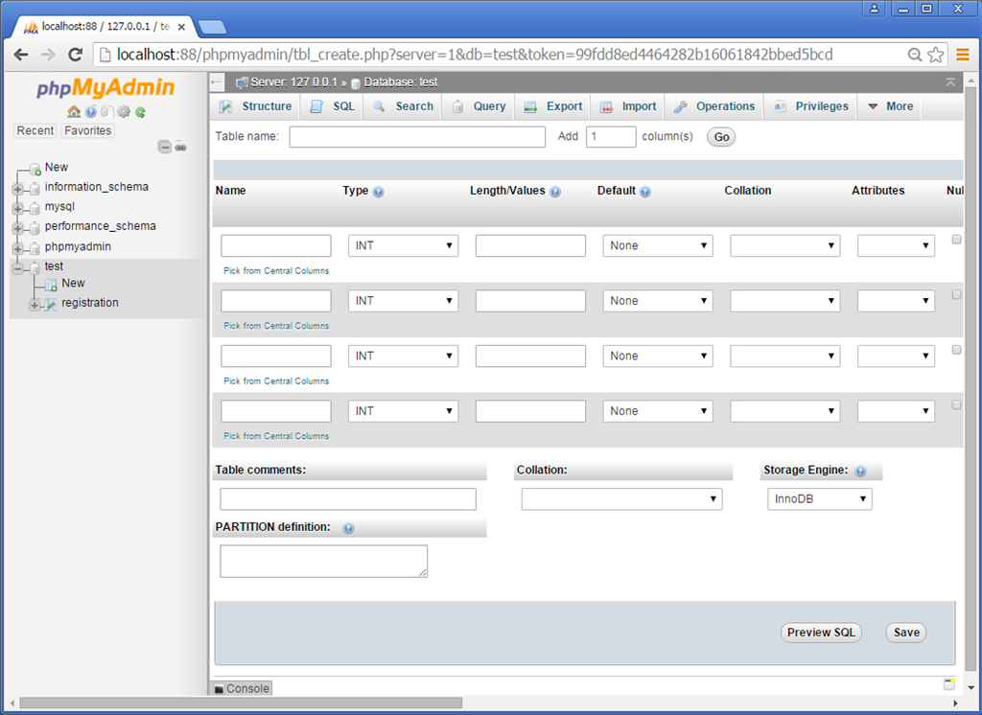
5. Insert the required fields:-

Slide 19
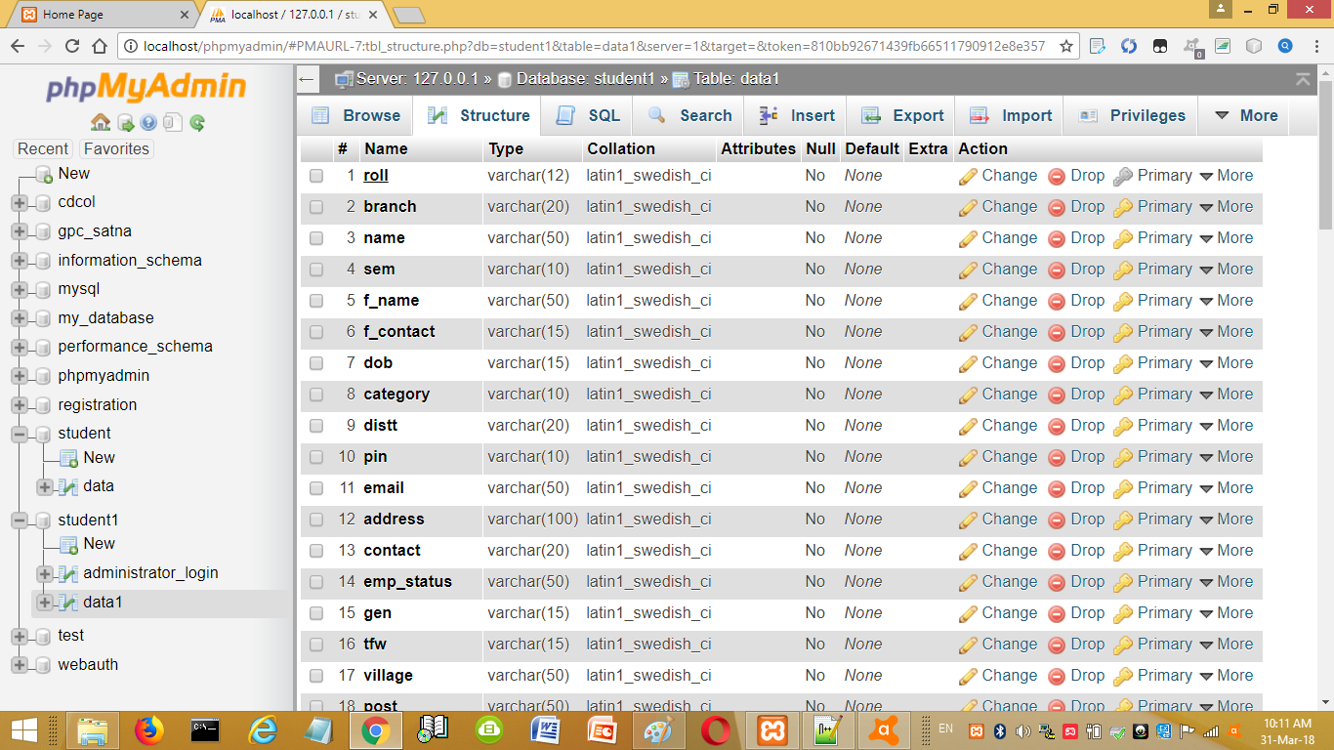
6. After inserting fields:-

Slide 20
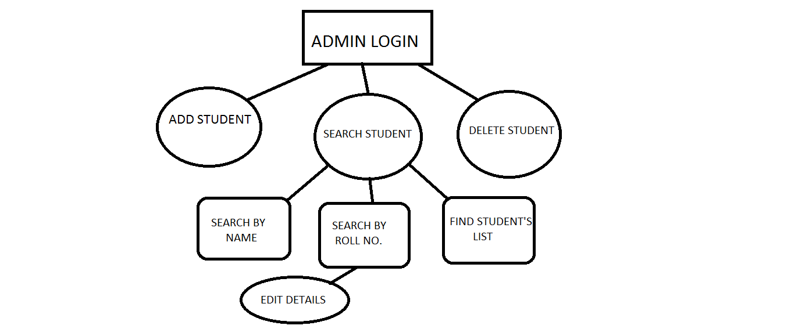
Hierarchy Structure

Slide 21
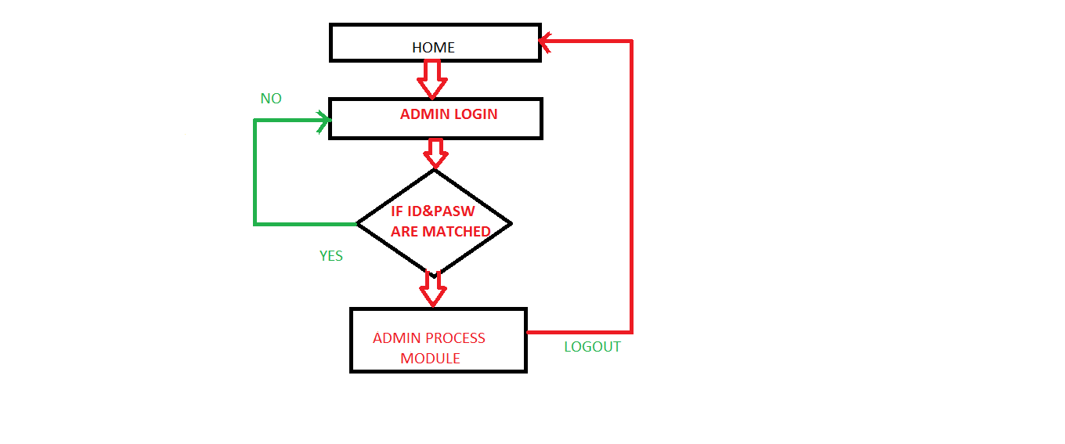
DATA FLOW DIAGRAM

Slide 22
DEVELOPING PHASE:-
We developed our project by using PHP.
The PHP Hypertext Preprocessor (PHP)
is a programming language that allows
web developers to create dynamic content that interacts with databases.

Slide 23
Features of PHP:-
It is open source.
Server-side scripting language.
Also used as general purpose
programming language.
Embedded with features offered
through paid scripting language.

Slide 24
Advantages of using PHP:-
1. Free, no need to pay any fees
2. Capable of creating any website
3. Quite easy to handle
4. Can run on any platform
5. Highly flexible
6. Uses its own memory space
7. PHP is secure
8. PHP community is huge
9. Easy availability of resources
10. Easy to learn scripting language

Slide 25
Functions of PHP:-
Create dynamic websites.
Create, open, make changes, close, read,
write and delete files.
Can collect form data.
PHP can encrypt data.
Can also be used to control user-access.

Slide 26
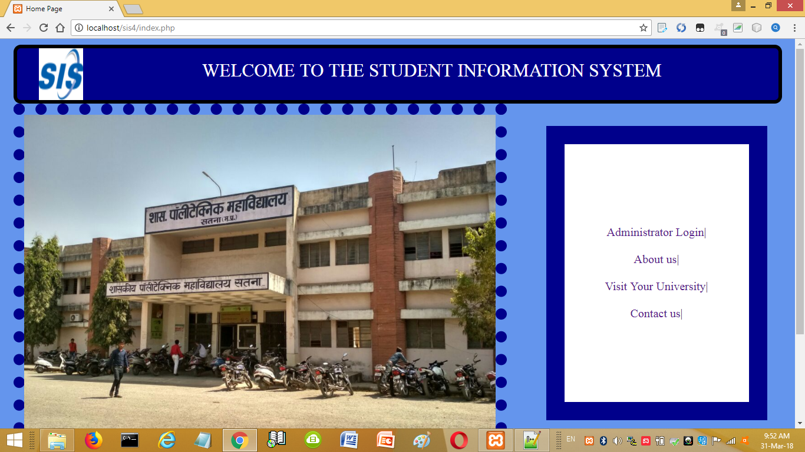
SCREENSHOTS

Slide 27
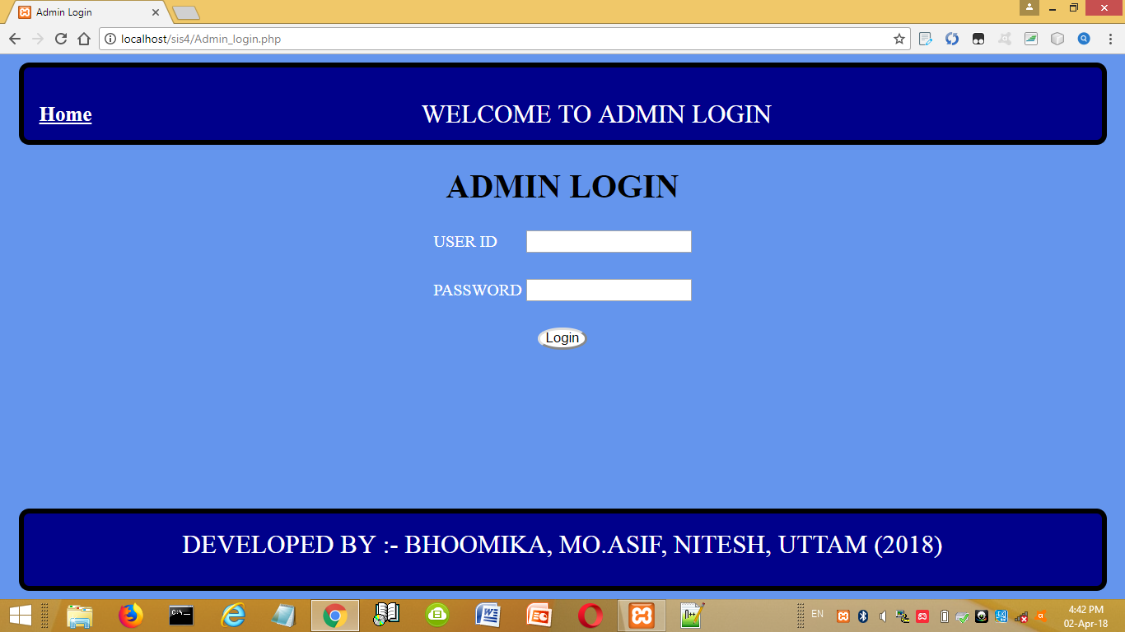

Slide 28
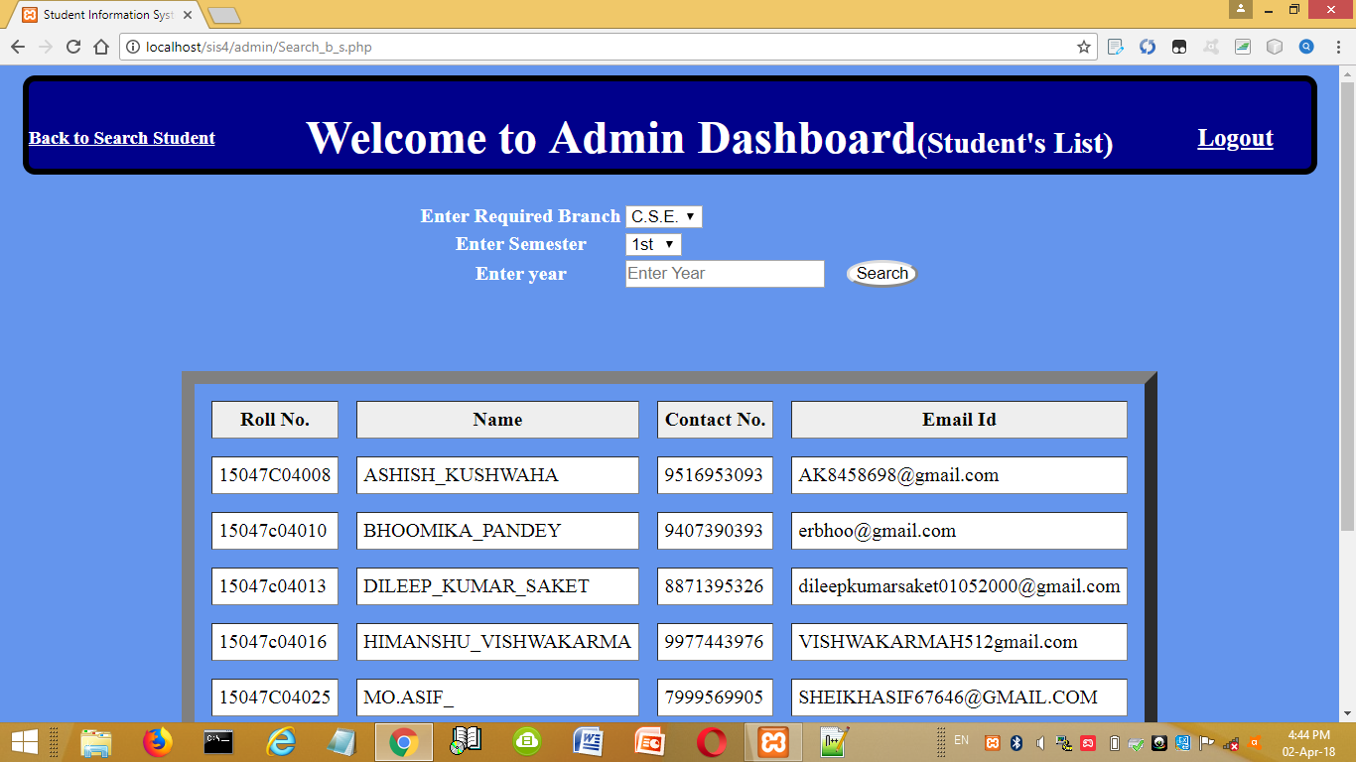

Slide 29
THANKS FOR WATCHING

