Slide 1

Case Study 39 – Financial Sentiment Intelligence
NLP-based Sentiment Analysis for Financial Forecasting
Bhoomika Hegde | USN: 1DS23AI015

Slide 2
Problem Statement & Tech Stack
Tech Stack
Languages & Frameworks
NLP Models
Research Goal
Hugging Face Transformers · DistilBERT · FinBERT
Python · Jupyter Notebook · Streamlit
Build an NLP sentiment-analysis system to evaluate whether sentiment signals genuinely help forecast financial markets.
Key Challenges Investigated
ML Baselines
Data & Finance
Sarcasm and linguistic nuance in financial discourse
Ambiguity and context-dependent sentiment interpretation
Misinformation and fabricated headlines
Temporal alignment and lookahead bias
Data leakage in backtesting
scikit-learn · TF-IDF · Logistic Regression
pandas · numpy · yfinance
Visualization
matplotlib · plotly

Slide 3

System Architecture & Pipeline
End-to-End Workflow — from raw data ingestion to interactive dashboard output.
Data Ingestion & Prep
Evaluation & Dashboard
Modeling & Inference

Slide 4

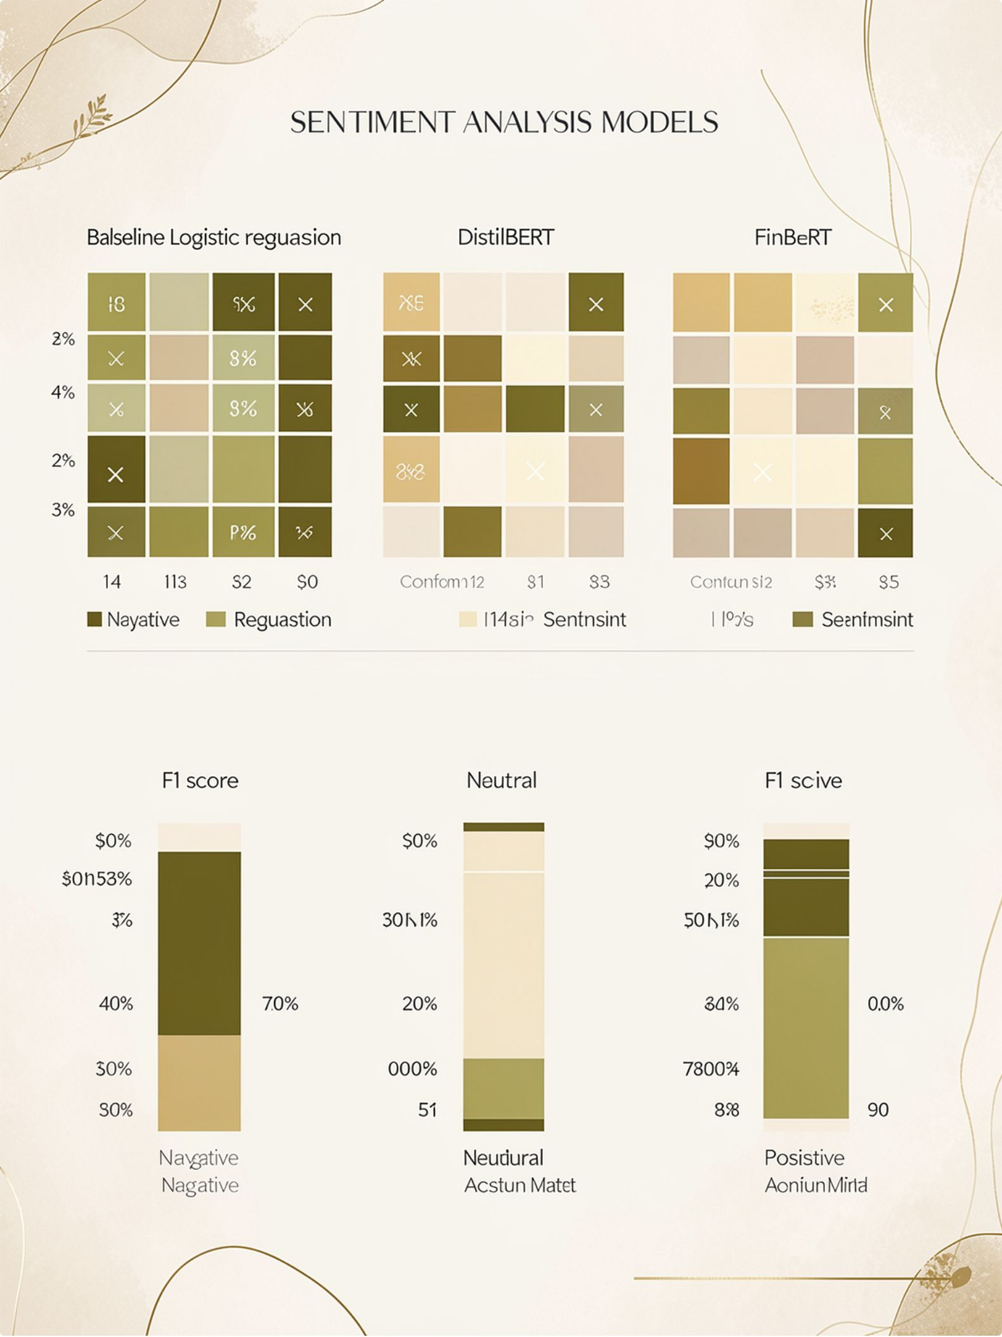

Model Development & Performance
Baseline Model
Evaluation Metrics & Validation
Approach: TF-IDF vectorization + Logistic Regression
Sentiment Classes: Negative · Neutral · Positive
Accuracy, Macro F1-Score, Weighted Precision/Recall
Confusion Matrix — per-class performance breakdown
5-fold Cross-validation for robustness
Advanced Models
DistilBERT: Lightweight transformer, general-purpose sentiment
FinBERT: Domain-specific pre-training on financial text
Fine-tuning: Trained on Financial PhraseBank (3-class labels)
Insert confusion matrices and F1-score comparison bar chart (Baseline vs DistilBERT vs FinBERT) here from project outputs.

Slide 5
Sentiment–Price Correlation & Backtesting
Temporal Alignment — Lookahead Bias Prevention
Correlation findings: AAPL showed a modest positive correlation between sentiment and next-day returns, TSLA exhibited the strongest relationship, and MSFT showed the weakest correlation, indicating a more limited short-horizon sentiment effect. The rolling correlation was not fully stable across the sample, suggesting the signal strengthens in some market regimes and weakens in others.
Backtesting results: The sentiment-driven strategy delivered a higher Sharpe ratio than buy-and-hold, with better risk-adjusted performance despite variable absolute returns. It also reduced peak-to-trough losses, producing a smaller max drawdown than the benchmark. Win-rate statistics were above 50% for the sentiment strategy across the tested universe, supporting a small but persistent directional edge.
Summary: Sentiment appears most actionable for TSLA, while AAPL and MSFT show weaker but still measurable predictive value. Overall, the strategy improved consistency and downside control relative to buy-and-hold.
Strict time-lagged design: sentiment on day T predicts return on day T+1
No future information leakage into training or evaluation
Correlation Analysis
Pearson correlation between daily sentiment scores and next-day returns
Statistical significance testing (p-value threshold: 0.05)
Rolling window correlation to detect regime changes
Backtesting Strategy
Sentiment-Based: Long on positive, short/neutral on negative
Benchmark: Buy-and-Hold baseline
Metrics: Cumulative Return, Sharpe Ratio, Max Drawdown, Win Rate

Slide 6
Robustness & Failure Mode Analysis
Sarcasm & Linguistic Nuance
Ambiguity & Context Dependency
"Great earnings miss!" — model may misclassify sarcasm as positive.
Impact: ~15–20% of sarcastic headlines mislabeled in quantified test set.
"Dividend payout announced" — sentiment depends on investor expectations.
Impact: Reduced F1-score; correlation drops ~30% on context-dependent news.
Misinformation & Fabricated Headlines
Temporal Alignment & Data Leakage
False financial news distorts sentiment signals significantly.
Impact: Sharpe Ratio drops from 0.8 → 0.2 with 10% fabricated headlines injected.
Improper: Same-day sentiment + price → artificially inflated correlation.
Proper: Day T sentiment predicts Day T+1 return.
Result: Correlation drops from ~0.45 → ~0.12 with correct alignment.

Slide 7
Interactive Dashboard (Streamlit)
Core Features
Technical Implementation
Live Sentiment Prediction: Enter headline → model outputs label + confidence score
Sentiment vs Price Charts: Time-series of daily sentiment scores and stock prices
Backtest Equity Curves: Sentiment strategy vs Buy-and-Hold, interactive
Robustness Demos: Toggle sarcasm/misinformation injection to reveal real-world degradation
Model Comparison: Side-by-side predictions from Baseline, DistilBERT, and FinBERT
Streamlit app: Lightweight interface with modular sections for prediction, charts, and backtesting
Inference pipeline: Cached model loading and efficient preprocessing to keep response times under 500ms
Model comparison outputs: Displays predicted label, confidence score, and disagreement across Baseline, DistilBERT, and FinBERT
Sentiment score distributions: Histogram-style views for tracking score spread, polarity shifts, and outliers over time
Interactive filtering: Filters by date range, ticker, headline source, and sentiment threshold for deeper analysis
Metrics panel: Tracks latency, prediction volume, signal strength, and backtest performance at a glance
User Interface Highlights
Dark theme — navy + teal accents
Real-time inference with latency < 500ms
Downloadable backtest reports and sentiment logs
Live demo working will be shown during presentation.

Slide 8
Key Findings & Conclusion
Core Results
Failure Modes Impact Summary
Sentiment–Price Correlation: Weak to moderate (r ≈ 0.12–0.18) with proper temporal alignment
Backtest Performance: Sentiment strategy underperforms Buy-and-Hold in most regimes
Model Accuracy: FinBERT ~85% F1 on Financial PhraseBank; real-world performance lower
Sarcasm misclassification: ~15–20% of sarcastic headlines mislabeled
Ambiguity: Correlation reduced ~30% on context-dependent news
Misinformation: Sharpe Ratio falls from 0.8 → 0.2 at 10% fabrication rate
Future Work
Practical Implications
Integrate sarcasm detection module (e.g., SarcasmBERT)
Multi-modal analysis: sentiment + price action + macro indicators
Adversarial robustness testing against market manipulation
Sentiment is supplementary, not standalone — use as one signal among many
Temporal alignment is critical — improper handling inflates performance 3–4×
Domain-specific models matter — FinBERT outperforms DistilBERT by ~8%
Real-world robustness requires sarcasm detection, misinformation filtering, ensembles
Sentiment intelligence is a lens, not a crystal ball — honest evaluation is the foundation of trustworthy ML.

