Slide 1
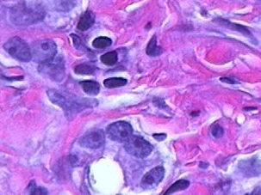
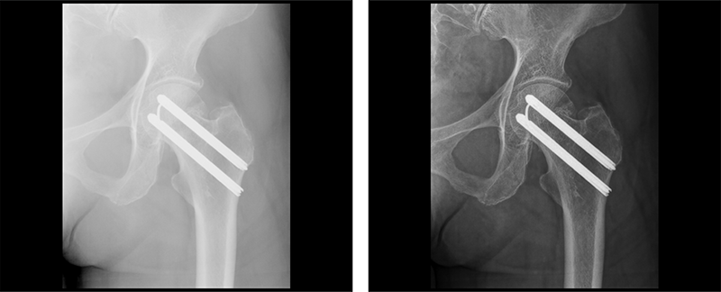
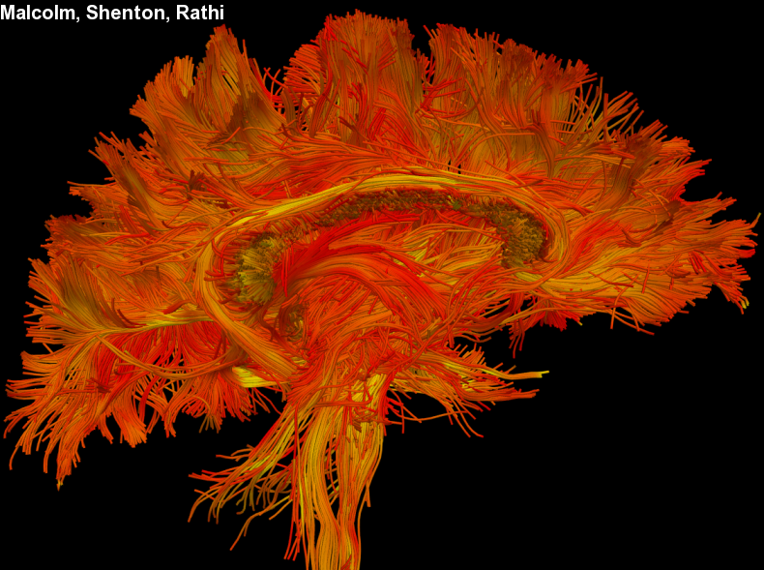
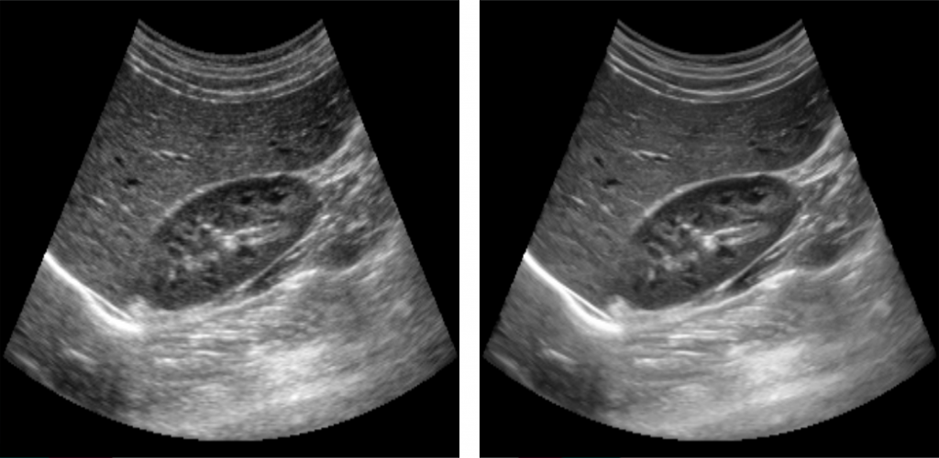
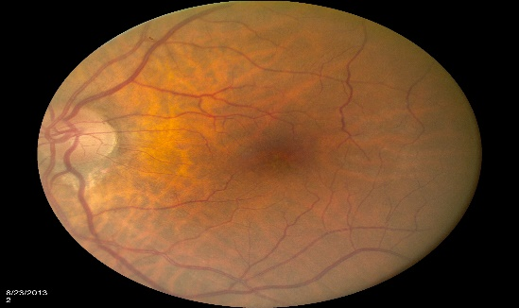
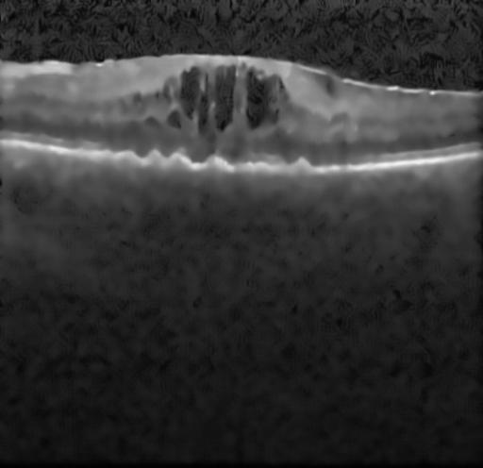
Medical Image Analysis
Medical Image Segmentation

Slide 2
Image Segmentation
Segmentation is the partitioning of an image into meaningful regions, most frequently to distinguish objects or regions of interest (“foreground”) from everything else (“background”).
In the simplest cases, there would be only these two classes (foreground and background) and the segmented image would be a binary image.
Segmentation is used, for example: for the detection of organs, such as the brain, heart, lungs or liver in CT or MR images; to distinguish pathological tissue, such as a tumor, from normal tissue; and in treatment planning.
The most basic attribute used in defining the regions is image gray level or brightness, but other properties such as color or texture can be used.
Segmentation is often the first stage in pattern recognition systems; once the objects of interest are isolated from the rest of the image, certain characterizing measurements could be made (feature extraction), and this could be used to classify the objects into particular groups or classes.

Slide 3
Segmentation techniques can be classified as either contextual or non-contextual.
Non-contextual techniques ignore the relationships that exist between features in an image; pixels are simply grouped together on the basis of some global attribute, such as gray level. Intensity-based thresholding, where each pixel is assigned to a particular region based on its gray value, is a non-contextual technique.
Contextual techniques additionally exploit the relationships between image features. Thus, a contextual technique might group together pixels that have similar gray levels and are close to one another or have similar gradient values.
Contextual techniques include: region-based techniques, such as region growing, where connected regions are found based on some similarity of the pixels within them; boundary-based techniques, where edge-based methods are used to delineate the boundaries between regions; and other methods, such as active contours and watershed segmentation

Slide 4
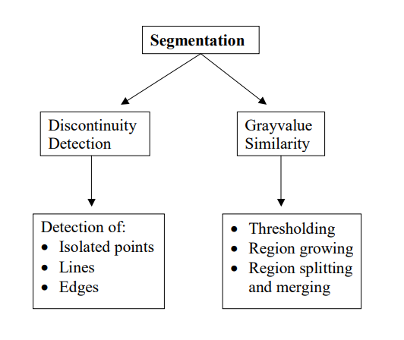

Slide 5
Thresholding
Thresholding according to intensity/brightness is a simple technique for images which contain solid objects on a background of different, but uniform, brightness.
Each pixel is compared to the threshold: if its value is higher than the threshold, the pixel is considered to be “foreground” and is set to white, and if it is less than or equal to the threshold it is considered “background” and set to black.
The success of thresholding depends critically on the selection of an appropriate threshold.

Slide 6

Intensity values grouped into two distinct modes
Select a threshold T that separates these modes
The segmented image g(x, y) is given by
where the points labeled 1 are called object points and other points are called background points
If T is constant in the above expression, the thresholding is called global thresholding
When the value of T changes over an image, the thresholding is called variable thresholding
Local or regional thresholding
  Variable thresholding in which the value of T at any point depends on its neighborhood
  If T depends on the location itself, the thresholding is called dynamic or adaptive thresholding

Slide 8
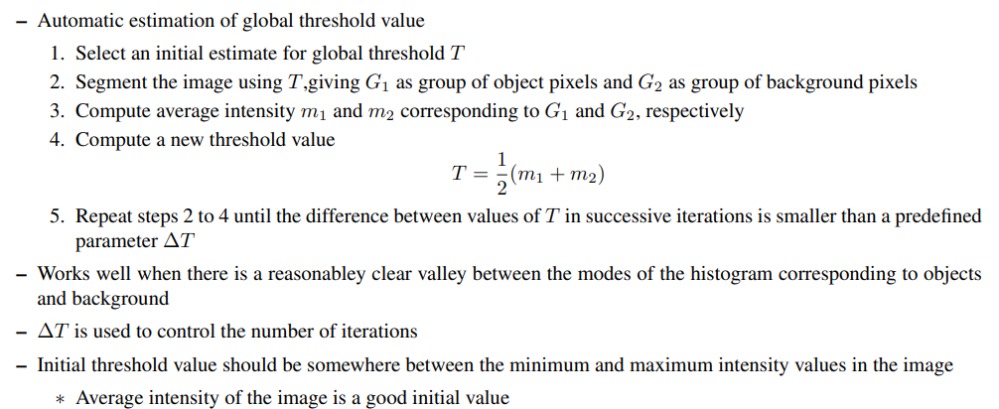
Basic global thresholding

Slide 9
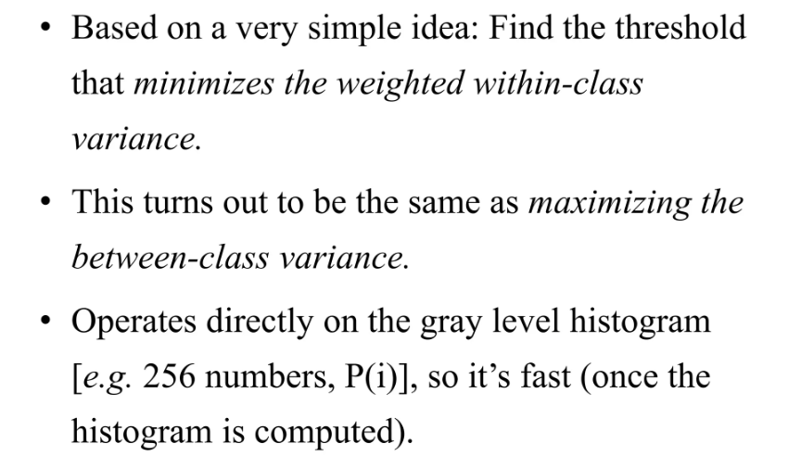
Otsu’s Thresholding Method

Slide 10
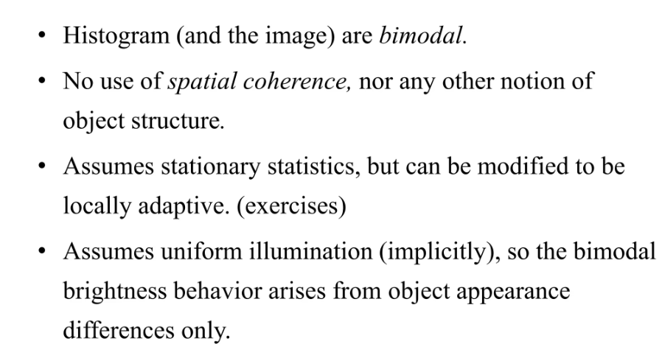

Slide 11
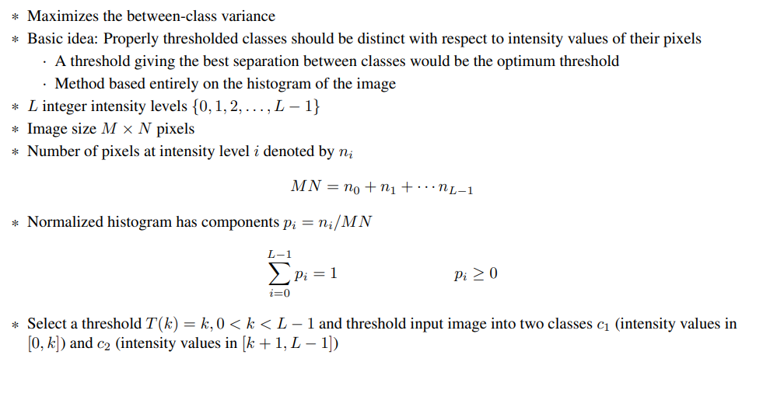
Otsu’s method

Slide 12
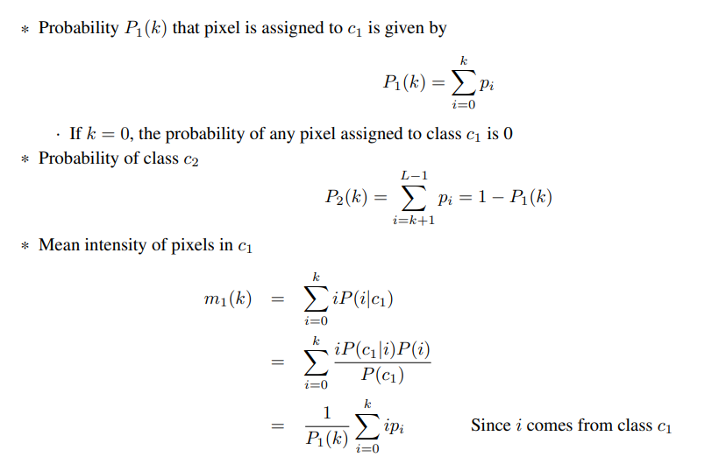
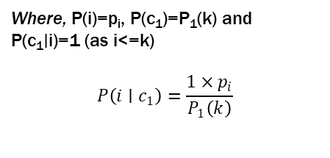
Where, P(i)=p_{i}​, P(c₁​)=P₁​(k) and P(c₁∣i)=1 (as i<=k)
$$P\left(i∣c_{1}\right)=\frac{1×p_{i}}{P_{1}\left(k\right)}$$

Slide 13
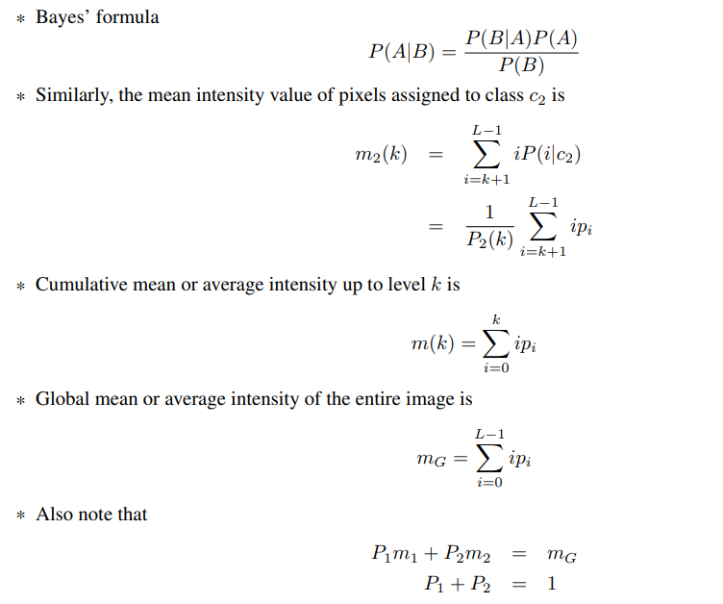

Slide 14
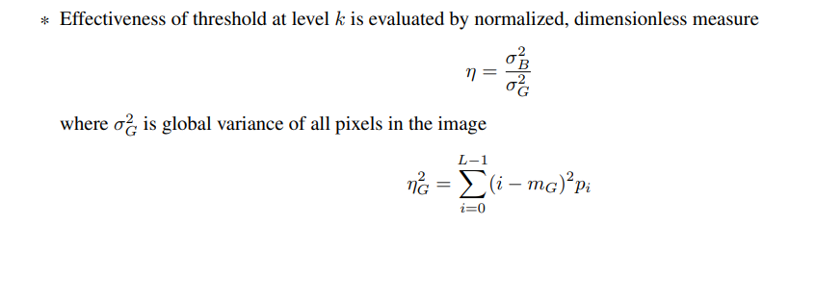

Slide 15





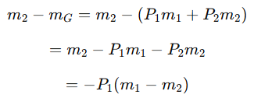





Slide 16
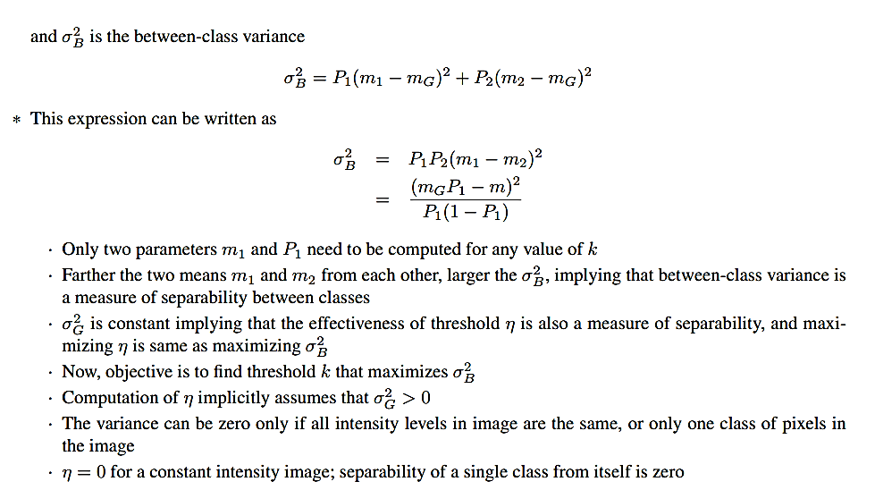

Slide 17
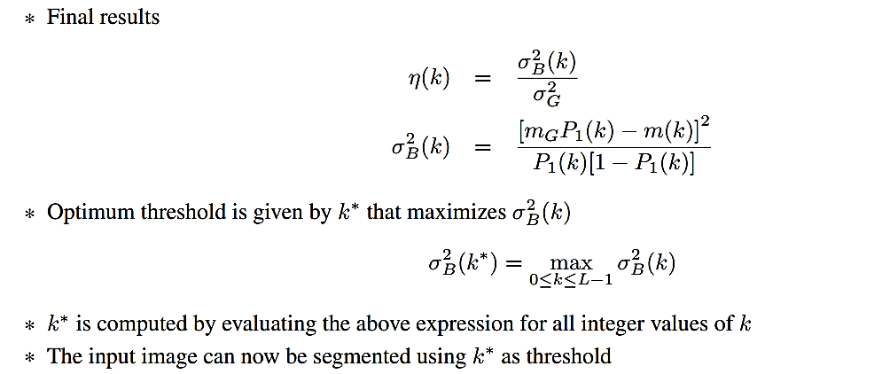


Slide 18
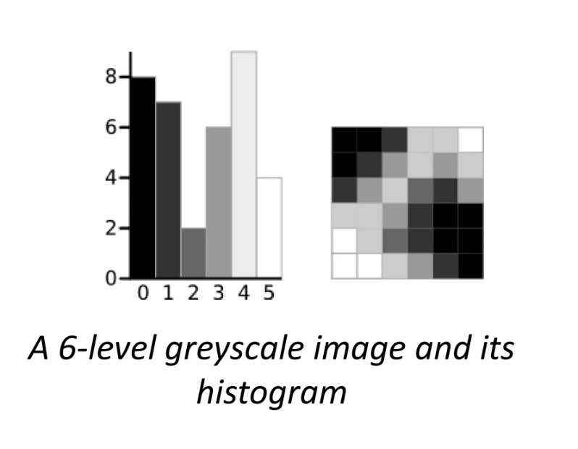
Example

Slide 19
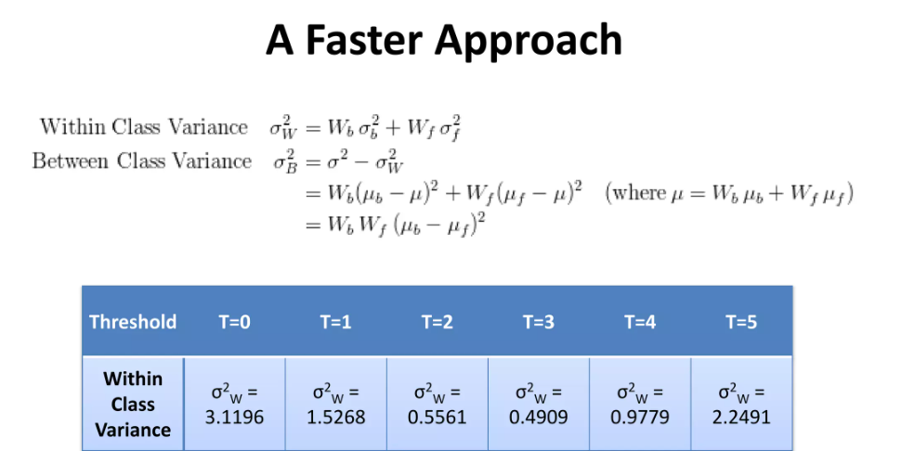

Slide 20
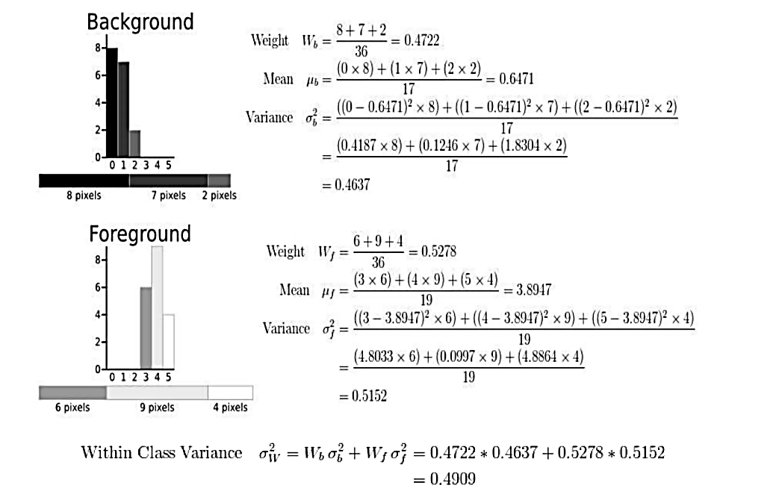

Slide 21
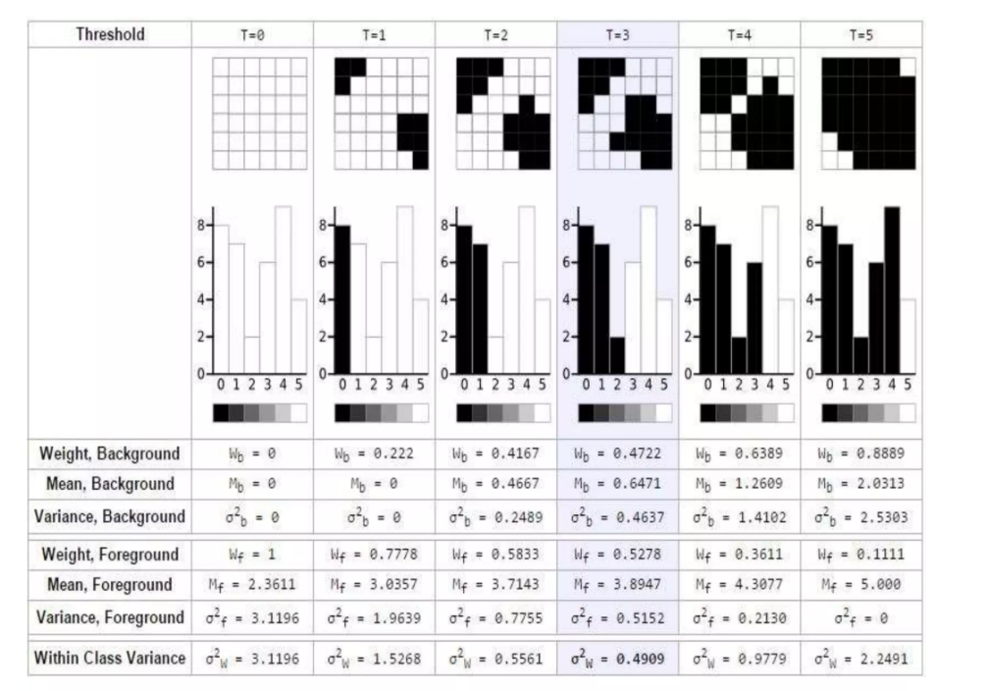

Slide 22
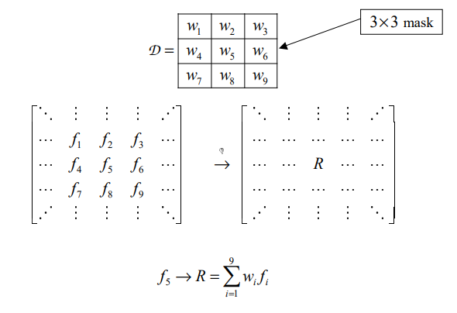
Detection of Discontinuities
This is usually accomplished by applying a suitable mask to the image.
The mask output or response at each pixel is computed by centering the mask on the pixel location.
When the mask is centered at a point on the image boundary, the mask response or output is computed using suitable boundary condition

Slide 23
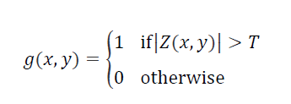
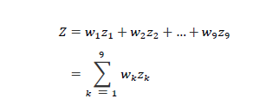
Point Detection
A point has been detected at a location (x, y) on which the kernel is centered if the absolute value of the response of the filter at that point exceeds a specified threshold.
Such points are labeled 1 and all others are labeled 0 in the output image, thus producing a binary image. In other words, we use the expression:
where g(x, y) is the output image, T is a nonnegative threshold, and Z,

Slide 24
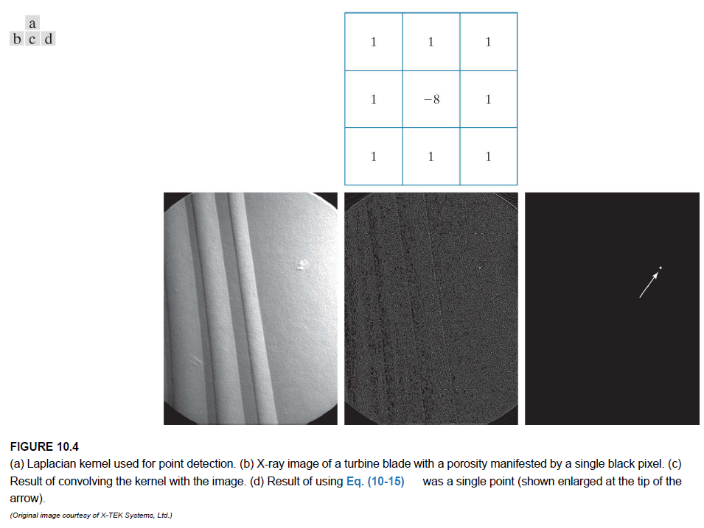

Slide 25
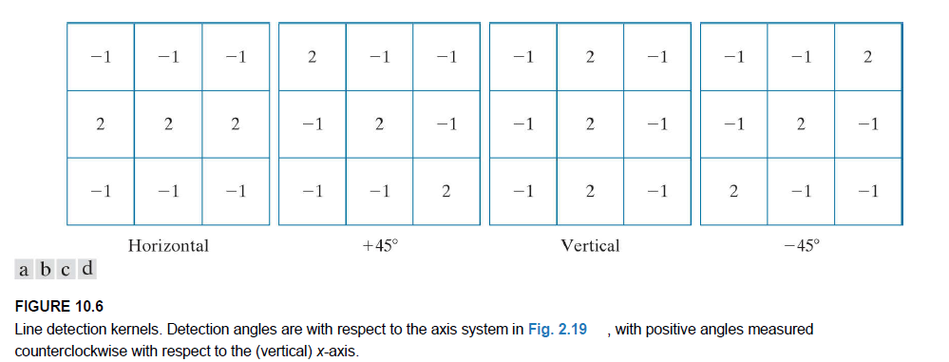
Line Detection
We know that for line detection we can expect second derivatives to result in a stronger filter response, and to produce thinner lines than first derivatives.

Slide 26
Region-based methods: Region Growing
Region growing is a procedure that groups pixels or sub-regions into larger regions based on predefined criteria for growth.
The basic approach is to start with a set of “seed” points, and from these grow regions by appending to each seed those neighboring pixels that have predefined properties similar to the seed (such as ranges of intensity or color).
Connectivity (4- or 8- ) is used to define which are neighboring pixels.
We can specify a variance for the property; region growing stops when a pixel is encountered that is not within this variance.
Region growing techniques are generally better in noisy images where edges are extremely difficult to detect.
They are particularly useful with images which have multi-modal histograms.

Slide 27
Region Splitting and Merging
It subdivides an image initially into a set of disjoint regions and then merge and/or split the regions in an attempt to satisfy the conditions of segmentation.
Let R represent the entire image region and select a predicate Q. One approach for segmenting R is to subdivide it successively into smaller and smaller quadrant regions so that, for any region Ri, Q(Ri)=TRUE.
We start with the entire region, R. If we Q(R)=FALSE, divide the image into quadrants. If Q is FALSE for any quadrant, we subdivide that quadrant into sub-quadrants, and so on.
This splitting technique has a convenient representation in the form of so-called quadtrees; that is, trees in which each node has exactly four descendants.
If only splitting is used, the final partition normally contains adjacent regions with identical properties.

Slide 28
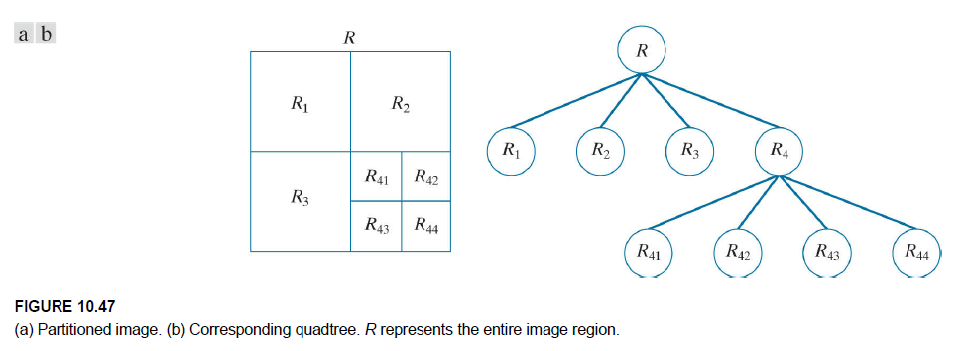

Slide 29
Mathematical morphology
The field of mathematical morphology contributes a wide range of operators to image processing, all based around a few simple mathematical concepts from set theory and, in the case of binary images, (Boolean) logic operations such as “AND,” “OR,” “XOR” (exclusive OR) and “NOT.”
The “union” operation, AUB, for example, is equivalent to the “OR” operation for binary images; and the “intersection” operator, A∩B, is equivalent to the “AND” operation for binary images.
In 4-connectivity, each pixel (P) has four connected neighbors (N) – top, bottom, right and left: the diagonally touching pixels are not considered to be connected.
In 8-connectivity, each pixel (P) has eight connected neighbors (N) – including the diagonally touching pixels.

Slide 30
Morphological operators: Dilation
In binary images dilation is an operation that increases the size of foreground objects, generally taken as white pixels.
The connectivity needs to be established prior to operation, or a structuring element defined.
The algorithm is as follows: superimpose the structuring element on top of each pixel of the input image so that the center of the structuring element coincides with the input pixel position.
If at least one pixel in the structuring element coincides with a foreground pixel in the image underneath, including the pixel being tested, then set the output pixel in a new image to the foreground value.
Thus, some of the background pixels in the input image become foreground pixels in the output image; those that were foreground pixels in the input image remain foreground pixels in the output image.

Slide 31
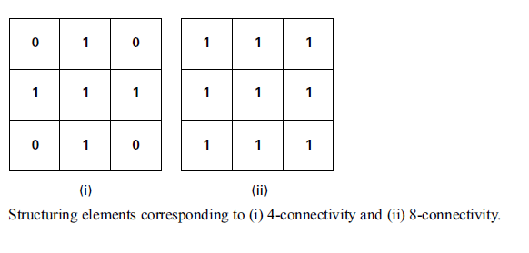
In the case of 8-connectivity, if a background pixel has at least one foreground (white) neighbor then it becomes white: otherwise, it remains unchanged.
The pixels which change from background to foreground are pixels which lie at the edges of foreground regions in the input image, so the consequence is that foreground regions grow in size, and foreground features tend to connect or merge.

Slide 32
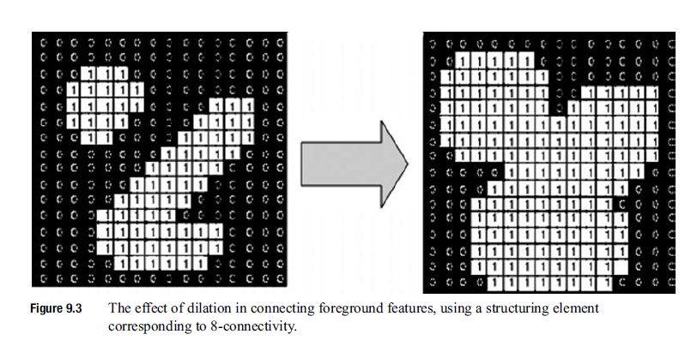

Slide 33
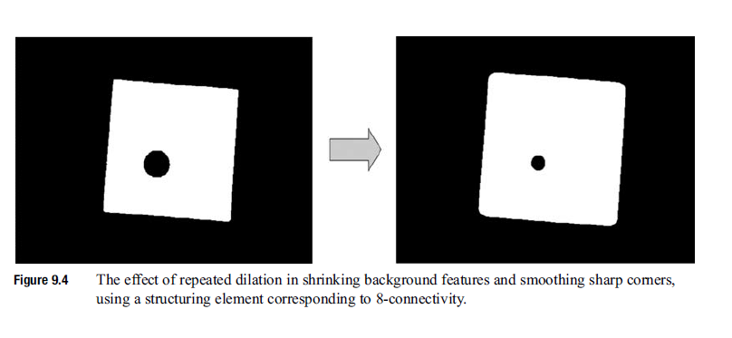

Slide 34
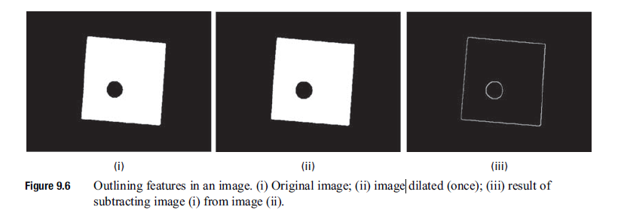

Slide 35
Morphological operators: Erosion
Erosion is an operation that increases the size of background objects (and shrinks the foreground objects) in binary images.
In this case the structuring element is superimposed on each pixel of the input image, and if at least one pixel in the structuring element coincides with a background pixel in the image underneath, then the output pixel is set to the background value.
Thus, some of the foreground pixels in the input image become background pixels in the output image; those that were background pixels in the input image remain background pixels in the output image.
The pixels which change from foreground to background are pixels at the edges of background regions in the input image, so the consequence is that background regions grow in size, and foreground features tend to disconnect or further separate.

Slide 36
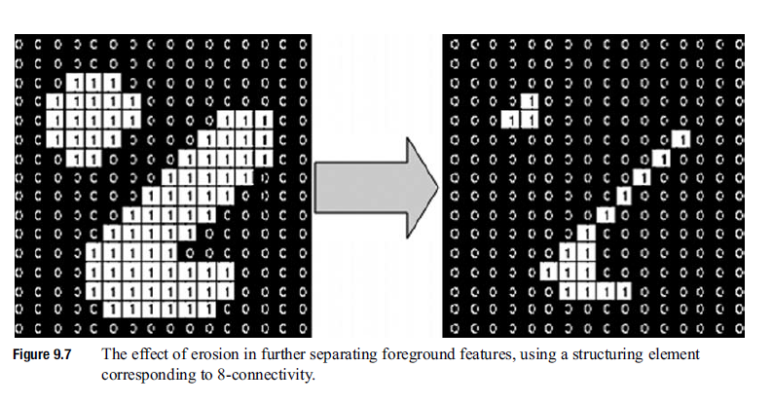

Slide 37
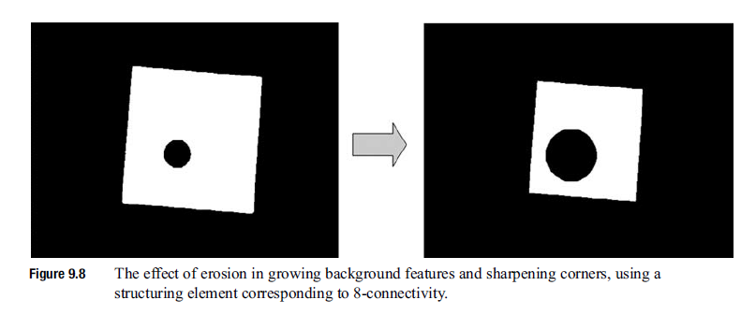

Slide 38
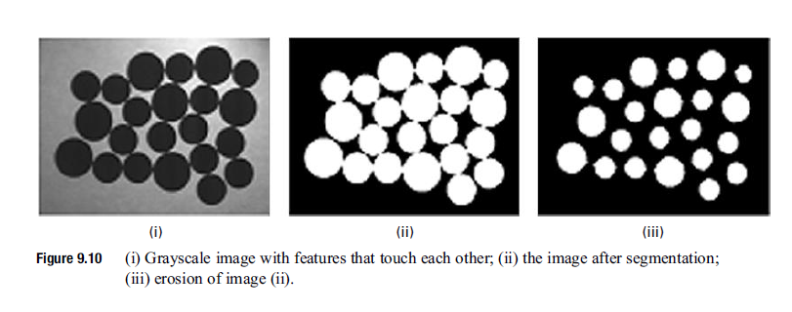

Slide 39
Morphological operators: Opening
Opening is defined as erosion followed by dilation using the same structuring element for both operations.
The erosion part of it removes some foreground (bright) pixels from the edges of regions of foreground pixels, while the dilation part adds foreground pixels.
The foreground features remain about the same size, but their contours are smoother. As with erosion itself, narrow isthmuses are broken and thin protrusions eliminated.
The effect of opening on a binary image depends on the shape of the structuring element: opening preserves foreground regions that have a similar shape to the structuring element, or that can completely contain the structuring element, while it tends to eliminate foreground regions of dissimilar shape.

Slide 40
Morphological operators: Closing
Closing is defined as dilation followed by erosion using the same structuring element for both operations.
Closing smoothes the contours of foreground objects but, contradistinction to opening, it merges narrow breaks or gaps and eliminates small holes.
Opening and closing are frequently used to clean up artifacts in a segmented image prior to further analysis

