Slide 1
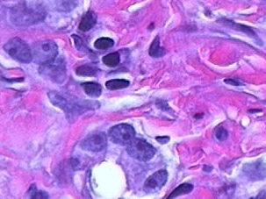
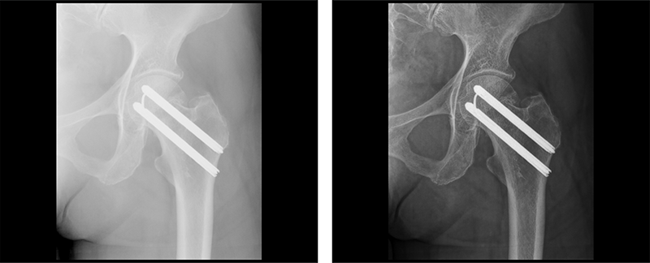
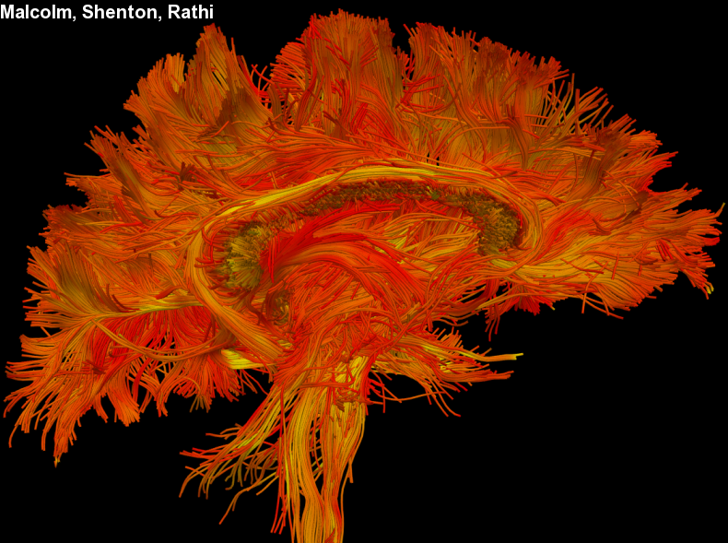
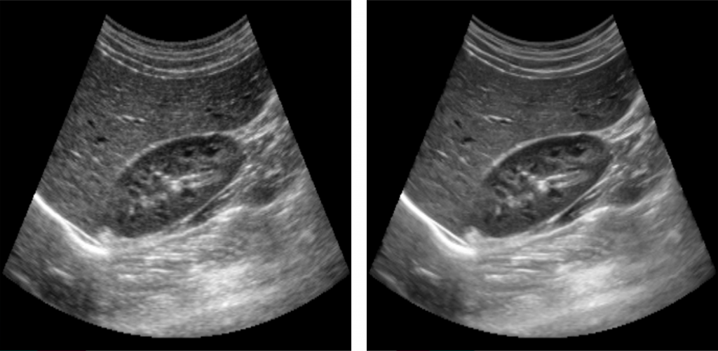
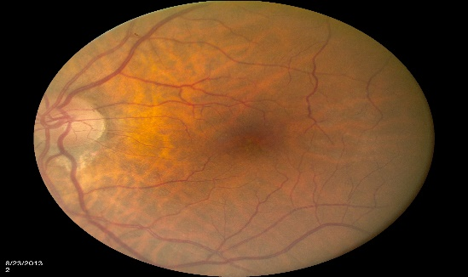
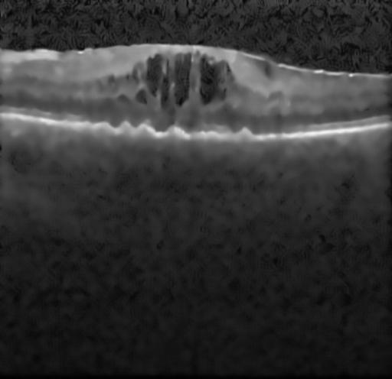
Medical Image Analysis
Basic Image Processing techniques

Slide 2
What is an image?
Image: A visual representation in form of a function $f\left(x,y\right)$ where $f$ is related to brightness (or color) at spatial coordinate point $\left(x,y\right).$
The amplitude of $f$ is called the intensity or gray level.

Slide 3
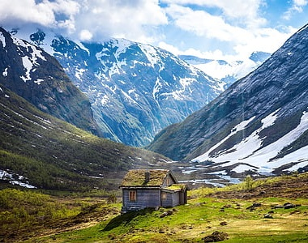
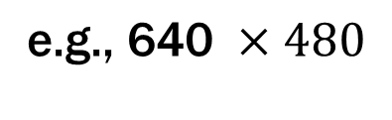




What is a digital image?
Digital Image: Discrete samples $f[x,y]$ representing continuous image $f\left(x,y\right).$
Each element of the 2-d array $f[x,y]$ is called a pixel.
column
pixel
$$x$$
row
$$Image size=\operatorname{maxx}{ ×}maxy$$
$$\text{e.g., 640} ×480$$
Pixel intensity $f\left[x,y\right]∈[0, 255]$
$$y$$

Slide 4
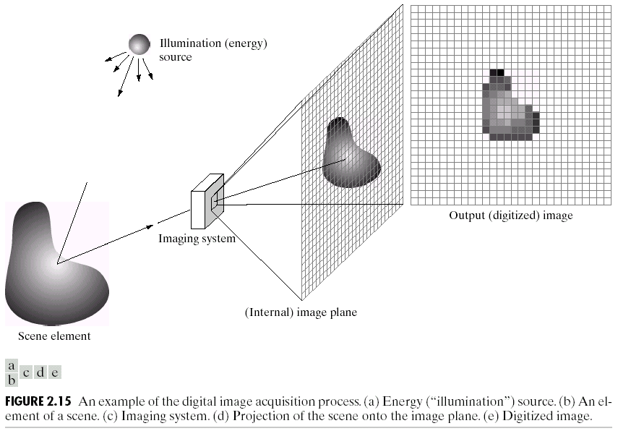
Digital Image Acquisition Process

Slide 5
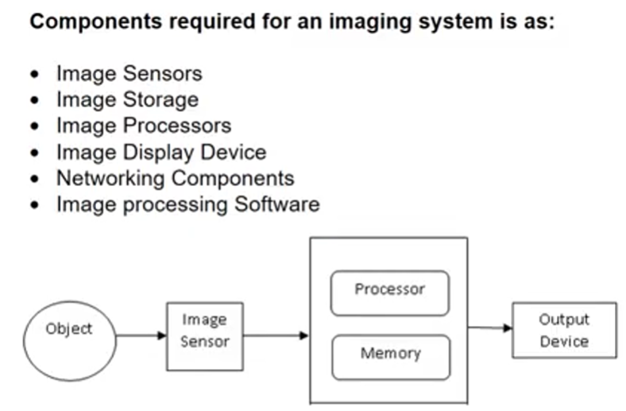

Slide 6
Key Steps in Digital Image Processing
Image Restoration
Morphological Processing
Image Enhancement
Segmentation
Image Acquisition
Representation
& Description
Problem Domain
Colour Image Processing
Image Compression
Object Recognition

Slide 7
Key Steps in Digital Image Processing
Image Restoration
Morphological Processing
Image Enhancement
Segmentation
Image Acquisition
Representation
& Description
Problem Domain
Colour Image Processing
Image Compression
Object Recognition

Slide 8

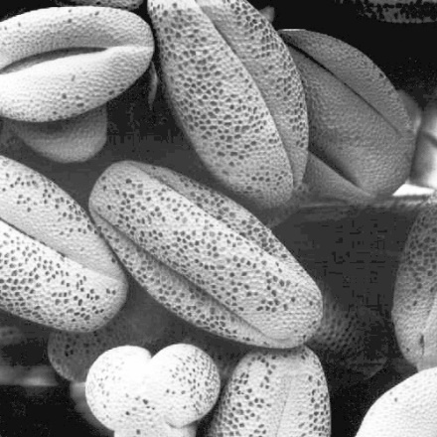
Key Steps in Digital Image Processing
Image Restoration
Morphological Processing
Image Enhancement
Segmentation
Image Acquisition
Representation
& Description
Example: Contrast Stretching
Problem Domain
Colour Image Processing
Image Compression
Object Recognition

Slide 9
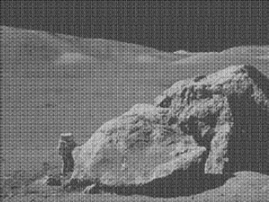
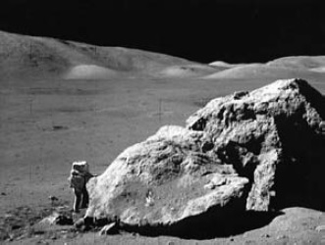
Key Steps in Digital Image Processing
Image Restoration
Morphological Processing
Image Enhancement
Segmentation
Image Acquisition
Representation
& Description
Example: Noise
Removal
Problem Domain
Colour Image Processing
Image Compression
Object Recognition

Slide 10
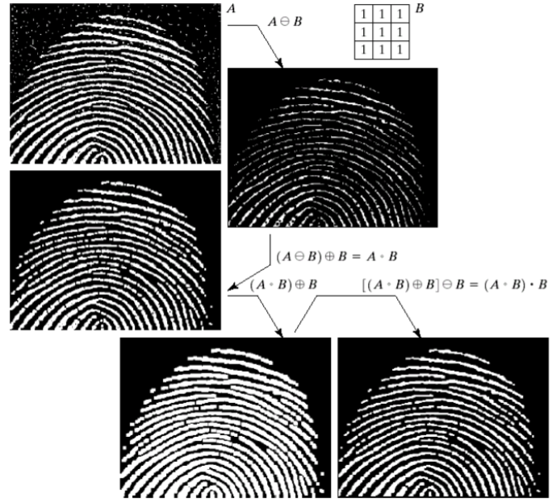
Key Steps in Digital Image Processing
Image Restoration
Morphological Processing
Image Enhancement
Extract attributes
Segmentation
Image Acquisition
Representation
& Description
Problem Domain
Colour Image Processing
Image Compression
Object Recognition

Slide 11
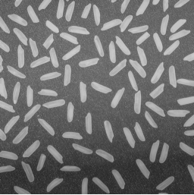

Key Steps in Digital Image Processing
Image Restoration
Morphological Processing
Image Enhancement
Segmentation
Image Acquisition
Representation
& Description
Divide image in constituent regions
Problem Domain
Colour Image Processing
Image Compression
Object Recognition

Slide 12
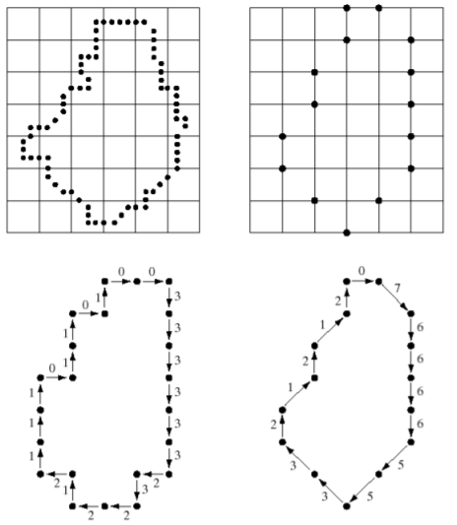
Key Steps in Digital Image Processing
Image Restoration
Morphological Processing
Image Enhancement
Segmentation
Image Acquisition
Representation
& Description
Image regions transformed
Problem Domain
Colour Image Processing
Image Compression
Object Recognition

Slide 13
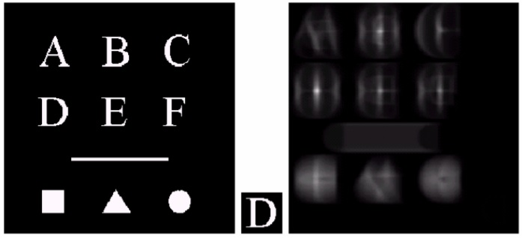
Key Steps in Digital Image Processing
Image Restoration
Morphological Processing
Image Enhancement
Segmentation
Image Acquisition
Representation
& Description
The third image is the correlation
coefficient of the first two images
Problem Domain
Colour Image Processing
Image Compression
Object Recognition

Slide 14
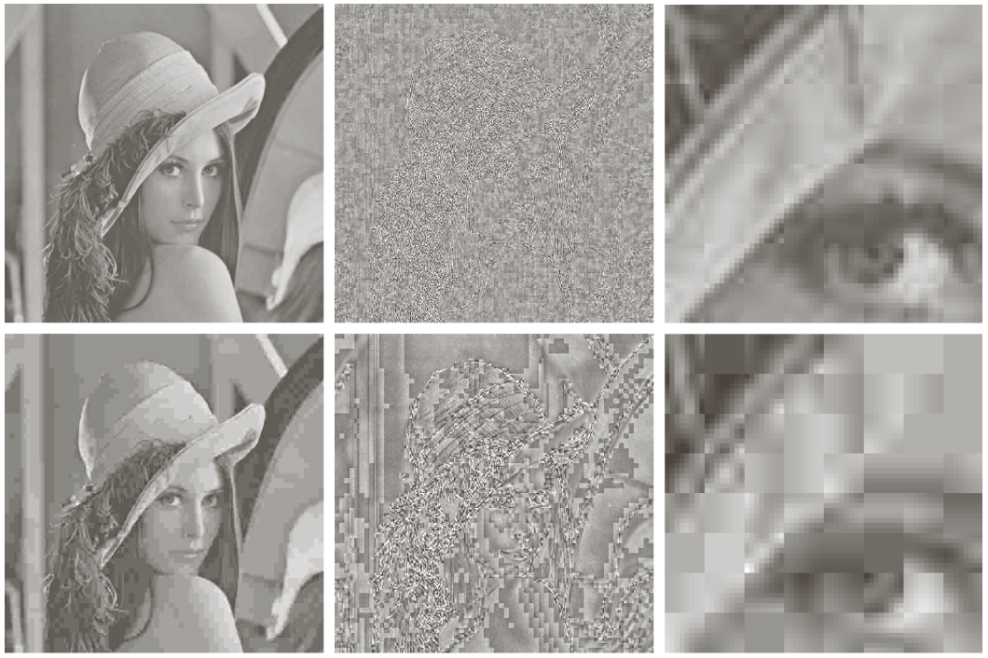
Key Steps in Digital Image Processing
Image Restoration
Morphological Processing
Image Enhancement
Segmentation
Image Acquisition
Representation
& Description
Two JPEG compression and reconstruction, difference with
original image, and a zoomed portion of the reconstructed image
Problem Domain
Colour Image Processing
Image Compression
Object Recognition

Slide 15
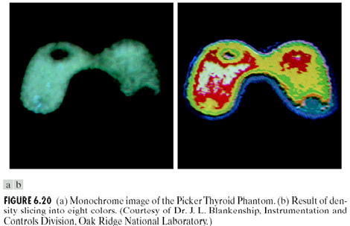
Key Steps in Digital Image Processing
Image Restoration
Morphological Processing
Image Enhancement
Segmentation
Image Acquisition
Representation
& Description
Problem Domain
Colour Image Processing
Image Compression
Object Recognition

Slide 16
Digitizing an image
Digitizing Image involves two steps:
  spatial quantization
  intensity quantization.
The term quantization means that a variable is not allowed to take any value, but can only take certain allowable (quantized) values;
  for example, only integer values but not the non-integer values between them.

Slide 17
Spatial quantization
Digitization is conveniently explained in terms of a single-sensor, flat-bed scanner.
Laser light is swept across the original analog image in a raster pattern, and the reflected light (if the image is a photographic print) or transmitted light (if it is a photographic negative or an x-ray film) is detected by the photodiode.
The photodiode records values at equally spaced positions along the raster, and these values are saved as a two-dimensional array.
The rate at which samples are taken is the sampling rate or sampling frequency, fs, and is expressed as the number of samples taken per unit distance, in units of samples per centimeter or dots (samples) per inch, (dpi).

Slide 19
Spatial quantization
Usually the sampling frequency is the same in both directions, and the small, square, area around each position, with sides equal to the distance between samples, d, make up a single pixel in the digitized image.
The sampling frequency determines the distance between samples, and this distance becomes the linear pixel size.
French mathematician Fourier recognized that any repetitive pattern can be made up from a number of sinusoidal patterns of differing spatial frequencies.
The high frequencies contain the information about the small details and sharp edges in an image, while the low frequencies contain the information on larger features within the image.
In order to capture adequately the fine detail information, the image needs to be sampled at a sampling frequency, fs, that is at least twice that of the highest frequency (fmax) contained in it; this is known as the Nyquist–Shannon sampling theorem.

Slide 20
Intensity quantization.
The discrete pixels formed around the sampled locations comprise the spatially quantized image, but the values within the pixels are still the sampled values measured from the original analog (i.e. continuous) image.
In order to form a digital image, these values need to be assigned to a finite set of discrete values. This is the second step in the process of digitizing an analog image, and is known as intensity (or brightness) quantization.
Many digital images are 8 bits deep, i.e. they allocate 8 bits to each pixel, resulting in 256 possible gray levels spanning black to white.
In general, allocating n bits per pixel gives 2^{n} shades of gray.

Slide 21
The result of digitization, i.e. spatial and brightness quantization, is an n-dimensional array of numbers (a matrix), representing a digital image.
Each number represents image brightness within a small discrete area (a pixel) in a two-dimensional (M×M pixels) grid representing a two-dimensional image/
Voxel in a three-dimensional (M×M×M voxels) grid representing a three-dimensional image.

Slide 22
Color images
The human visual pathway uses three types of cones, trichromacy, to discern and discriminate many thousands of different colors, whereas it can only distinguish about thirty different levels of brightness.
While photographs replicate the colors seen by our eye, diagnostic medical images do not record color, only brightness; the brightness indicating, for example, the attenuation of x-rays or the scattering of ultrasound.
Under some circumstances, it may be advantageous to add color to an image in order to better discern features in the image; the added color is false color, or pseudocolor, added to improve our visualization of the image.

Slide 23
The RGB (red, green, blue) model is widely used in acquiring, processing and displaying digital images, for example with color video cameras and color monitors, although it is not the only model.
Most colors can be created by mixing the three primary colors, taken to be red, green and blue by analogy with the response of the cones of the human retina.
The secondary colors cyan, magenta and yellow, each resulting from adding two primary colors.

Slide 24
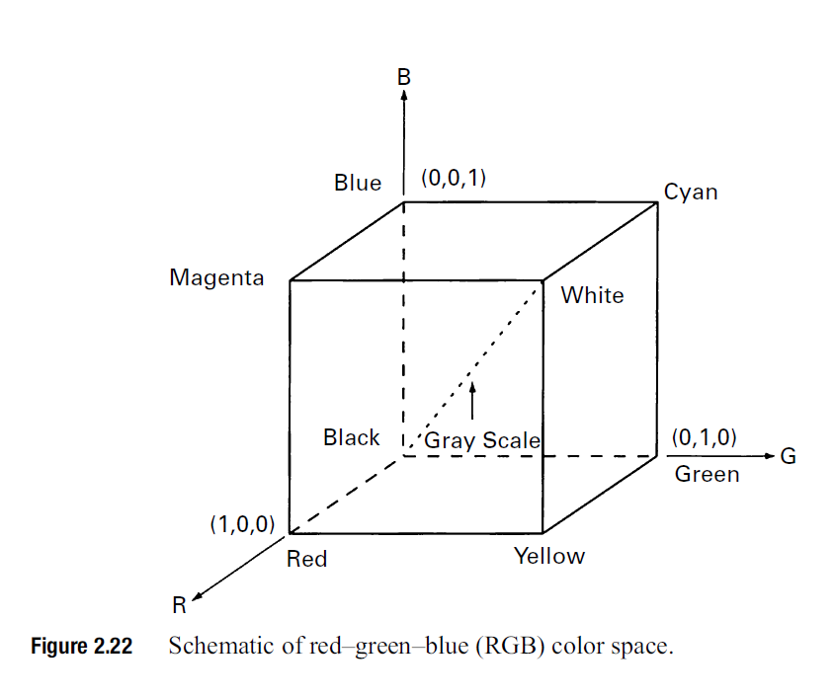

Slide 25
Relationship of Pixels
Basic Relationships Between Pixels
  Neighborhood
  Adjacency
  Paths
  Connectivity
  Regions
  Boundaries

Slide 26
Neighborhood
Neighbors of a pixel – N4(p)
Any pixel p(x, y) has two vertical and two horizontal neighbors, given by
(x+1, y),(x-1, y),(x, y+1),(x, y-1)
This set of pixels are called the 4-neighbors of P, and is denoted by N4(P).
Neighbors of a pixel – ND(p)
Any pixel p(x, y) has four diagonal neighbors, given by
(x+1, y+1), (x+1, y-1), (x-1, y+1), (x-1 ,y-1)
Neighbors of a pixel – N8(p)
ND(p) and N4(p) are together known as 8-Neighbors and are denoted by N8(p)
ND(p) U N4(p) = N8(p)
(x+1, y),(x-1, y),(x, y+1),(x, y-1),(x+1, y+1), (x+1, y-1), (x-1, y+1),
(x-1 ,y-1)
 | P(x,y+1)
P(x-1,y) | P(x,y) | P(x+1,y)
 | P(x,y-1)
Fig: N4 (p)
P(x-1,y-1) |  | P(x+1,y-1)
 | P(x,y)
P(x-1,y+1) |  | P(x+1,y+1)
Fig: ND (p)
P(x-1,y-1) | P(x,y+1) | P(x+1,y-1)
P(x-1,y) | P(x,y) | P(x+1,y)
P(x-1,y+1) | P(x,y-1) | P(x+1,y+1)
Fig: N8 (p)

Slide 27
Adjacency
Let V be the set of intensity values used to define adjacency
For binary images à V = {1} A particular grayscale image à V = {1,3,5,…,251,253,255}
4-adjacency: Two pixels p and q with values from V are 4-adjacent if q is in the set N4(p).
8-adjacency: Two pixels p and q with values from V are 8-adjacent if q is in the set N8(p).
m-adjacency: Two pixels p and q with values from V are m-adjacent if,
q is in N4(p)
OR
2) q is in ND(p) AND N4(p)∩N4(q) has no pixels whose values are from V

Slide 28
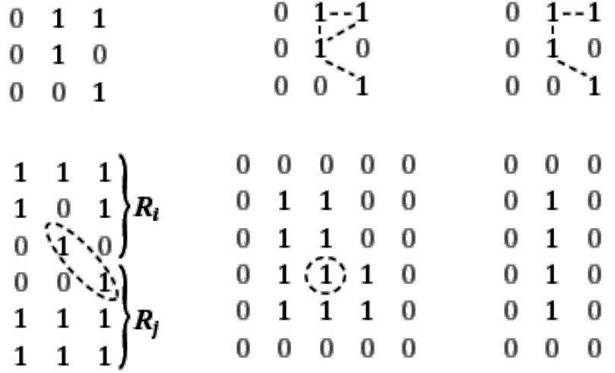
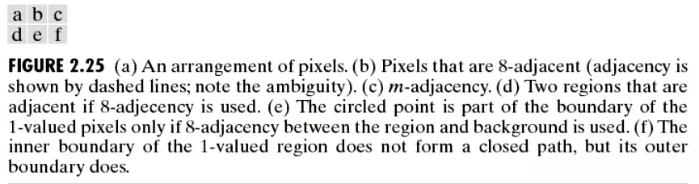

Slide 29
Path
Path: A digital path (or curve) from pixel p with coordinates to pixel q with coordinates is a sequence of distinct pixels with coordinates.
4-adjacency : 4-path
8-adjacency : 8-path
m-adjacency : m-path
path length : Number of pixels involved from source to destination pixel

Slide 30
Connectivity
Connectivity
Let S subset of pixels in an image
Two pixels p and q are said to be connected in S if there exist a path between them consisting entirely of pixels in S.
For any pixel p in S the set of pixels that are connected to it in S is called connected component of S.
  If S has only one connected component, then it is called connected set.

Slide 31
Region
Region
A connected set is also called a Region.
Two regions (let Ri and Rj) are said to be adjacent if their union forms a connected set. Adjacent Regions or joint regions
Regions that are not adjacent are said to be disjoint regions.
4- and 8-adjacency is considered when referring to regions.
Discussing a particular region, type of adjacency must be specified.
Fig2.25d the two regions are adjacent only if 8-adjacency is considered

Slide 32
Foreground and Background
Foreground and Background
Suppose an image contain K disjoint regions Rk , k=1,2,3,…K, none of which touches the image border
Let Ru denote the union of all the K regions.
Let (Ru)c denote its compliment.
We call all the points in Ru the foreground and all the points in (Ru)c the background

Slide 33
Boundary
Boundary
The boundary (border or contour) of a region R is the set of points that are adjacent to the points in the complement of R.
Set of pixels in the region that have at least one background neighbor.
The boundary of the region R is the set of pixels in the region that have one or more neighbors that are not in R.

Slide 34
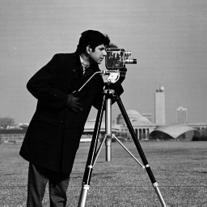
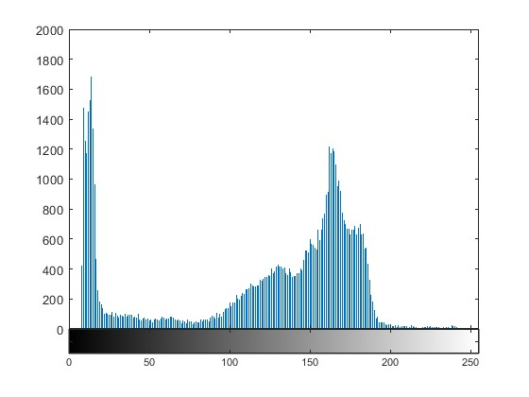
Histogram of the image
An image histogram is a type of histogram that acts as a graphical representation of the tonal (intensity) distribution in a digital image.
It plots the number of pixels for each intensity value.
By looking at the histogram for a specific image a viewer will be able to judge the entire intensity distribution at a glance.
The horizontal axis of the graph represents the tonal variations, while the vertical axis represents the total number of pixels in that particular tone.

Slide 35
Medical Image Registration
Imagine that two images have been taken of the same patient. The first image was taken before an operation and the second after the operation.
It could be interesting if the two images could be used to determine what impact the operation had.
However, the difference image will also be influenced by the fact that it is not physically possible to place a patient in exactly the same position during two scans. The way to deal with this problem is called image registration.
Using image registration, two images can be aligned so they fit together in the best possible way.
Formally, image registration is the process of determining a geometrical transformation that aligns an image to another reference image.

Slide 36
Geometric transformation
The term “geometric” transformation refers to the class of image transformation where the geometry of the image is changed but the actual pixel values remain unchanged.
An affine transformation is a type of geometric transformation which preserves collinearity (if a collection of points sits on a line before the transformation, they all sit on a line afterwards) and the ratios of distances between points on a line.
Types of affine transformations include translation (moving a figure), scaling (increasing or decreasing the size of a figure), and rotation (turning a figure about a point).

Slide 38
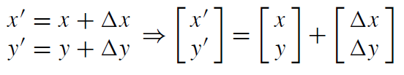
Translation
Translation is simply a matter of shifting the image horizontally and vertically with a given offset (measured in pixels) denoted ∆x and ∆y.
So if ∆x = 100 and ∆y = 100, then each pixel is shifted 100 pixels in both the x- and y-direction.

Slide 39
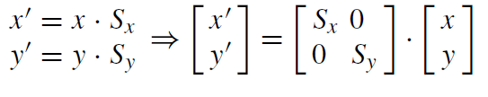
Scaling
When scaling an image, it is made smaller or bigger in the x- and/or y-direction.
Say we have an image of size 300 × 200 and we wish to transform it into a 600 × 100 image.
The x-direction is then scaled by: 600/300 = 2. We denote this the x-scale factor and write it as Sx = 2.
Similarly Sy = 100/200 = 1/2. Together this means that the pixel in the image f (x, y) at position (x, y) = (100, 100) is mapped to a new position in the image
g(x’, y’), namely, (x’, y’) = (100 · 2, 100 · 1/2) = (200, 50)

Slide 40
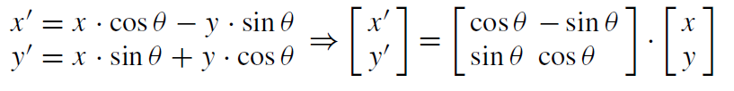
Rotation
When rotating an image, we need to define the amount of rotation in terms of an angle. We denote this angle θ meaning that each pixel in f (x, y) is rotated θ degrees.
Note that the rotation is done counterclockwise.
If we wish to do a clockwise rotation??

Slide 41

Shearing
To shear an image means to shift pixels either horizontally, Bx , or vertically, By .
The difference from translation is that the shifting is not done by the same amount, but depends on where in the image a pixel is.

Slide 42
In Fig. corresponding slices of the same brain imaged with a magnetic resonance (MR) scanner and a computed tomography (CT) scanner, respectively, are shown.
The two scanners have different spatial resolution, and the images have slightly different positions with respect to the anatomy due to different patient positioning in the scanners.
If we want to consider the information in the images simultaneously, we must provide a geometrical transformation between the two images.

Slide 43
Feature-Based Image Registration
An image feature can be a point or a line that is easy to recognize in all images. If we try to register two images of the human face, typical features would be the tip of the nose, the corners of the mouth, and the corners of the eyes.
In landmark-based image registration, a set of corresponding landmarks is manually or semi-automatically placed in both images.
Obviously, landmarks can only be placed on structures that are visible in both images.
A landmark is sometimes called a fiducial marker.

Slide 44
Anatomical landmark: a mark assigned by an expert that corresponds between objects in a biologically meaningful way.
Mathematical landmark: a mark that is located on a curve according to some mathematical or geometrical property (e.g., a point of maximum curvature).
Pseudo landmark: a mark that is constructed on a curve based on anatomical or mathematical landmarks. (e.g. sampled equidistantly along an outline).

Slide 45
We call the image that is fixed for the reference image R and the image that is to be changed for the template image T.
The set of N landmarks placed in the reference image is a_{i} ∈ R², i = 1, . . . , N and the set of N landmarks in the template image is b_{i} ∈ R², i = 1, . . . , N.
Note that a_{i} and b_{i} are points and not scalar values.

Slide 46
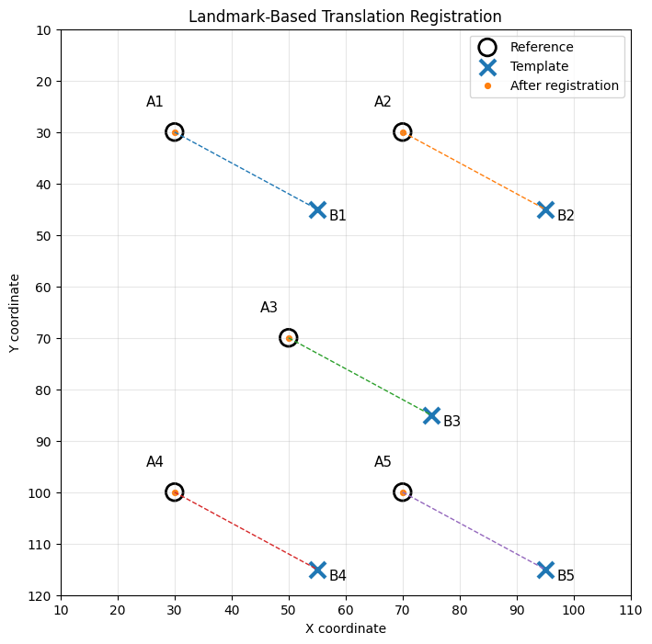

Slide 49
We can use transformations to align the reference image to template image.
Transformation is a function T that takes as input a point p(x, y) and computes the coordinates of the transformed point p(x’, y’):
P’=T(p)
where T can both be a simple transformation (translation or rotation) or a combined
transformation involving both scaling, translation, and rotation.
Our goal is to find the transformation that transforms the landmarks of the reference image so they fit as best as possible to the landmarks of the template image.
Basically, it means that the transformed landmarks a’_{i} should be close to b_{i} .

Slide 50
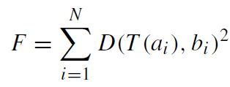

sum of squared distances
where D(x, y) is the Euclidean distance between two points, which is the length of the line connecting the two points.
The goal is therefore to compute the parameters of T that makes F as low as possible.
F is also called an objective function and finding the minimum of F is called an optimization problem.
If we put the parameters of T into a vector w, the optimization problem can be written formally like this

Slide 51
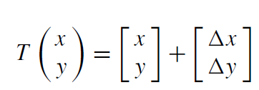
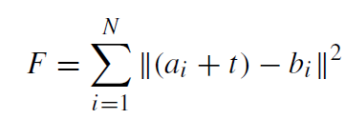
Translation
If the two images is just moved and not rotated or scaled compared to each other, we only need to care about the translation part of the transformation.
Geometrical transformation consisting of a pure translation t = (∆ x, ∆ y) is:
therefore w = (∆ x, ∆ y).
To find the optimal translation when corresponding landmarks are given, the translation that minimizes F should be computed.

Slide 52
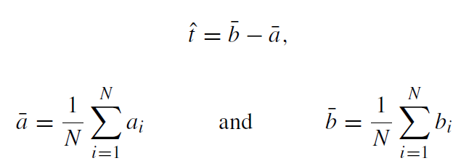
By differentiation with respect to t and setting equal to zero, it can be shown that the estimated optimal translation is

Slide 53
Translation + Rotation = Rigid Transformation
The rigid transformation is often used when we need to compensate for different patients positioning in the same scanner at different times of imaging.
That the transformation is rigid, means that there is no deformation of the image.
The rigid transformation consists of a translation t = (∆ x, ∆ y) and a rotation θ.
Therefore w = (∆ x, ∆ y, θ)

Slide 55
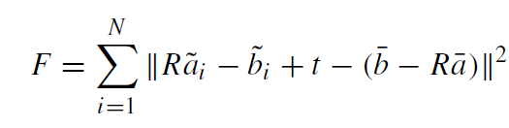
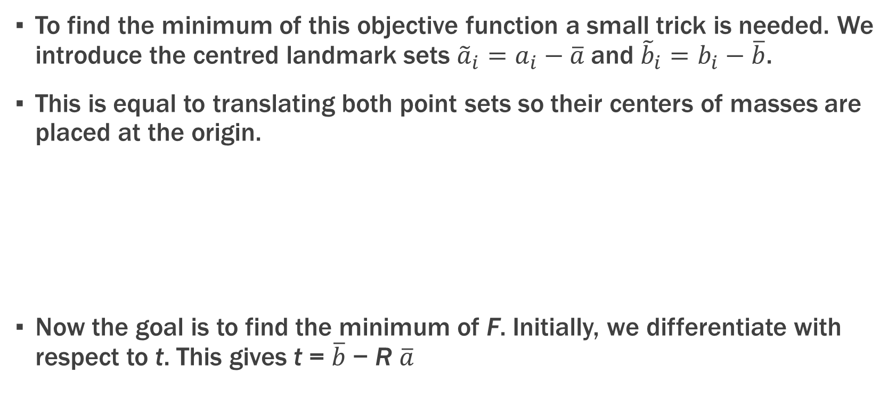
To find the minimum of this objective function a small trick is needed. We introduce the centred landmark sets ${\tilde{a}}_{i}=a_{i}−\overline{a}$and ${\tilde{b}}_{i}=b_{i}−\overline{b}$.
This is equal to translating both point sets so their centers of masses are placed at the origin.
Now the goal is to find the minimum of F. Initially, we differentiate with respect to t. This gives t = $\overline{b}$ − R $\overline{a}$

Slide 56
Intensity-Based Image Registration
The landmark-based method described in the previous section is limited by the fact that an experienced person is needed to place the landmarks on all images that should be aligned.
Since there is so much information in image, it is obvious to develop methods that can do the alignment automatically based on the information in the images.
In fact, image registration is similar to image template matching with the addition that in image registration the template image can be transformed in many different ways.
It gets even more complicated when the reference and the template image are not created by the same type of machine.

Slide 57
Intensity-Based Image Registration
When comparing a CT image with an MR image the correlation is low, since the different types of tissues are looking very different on the two types of machine (bone is white on CT and black on MR, for example).
One solution is to use a method called mutual information to compare the images.

Slide 58
The geometrical transformation: required to transform the template to the reference image. In some cases a rigid transformation, i.e., a translation and a rotation suffices, in other situations a non-linear geometrical transformation is necessary.
The similarity measure: that describes the goodness of the registration.
The optimization algorithm: that controls (determines the parameters of) the geometrical transformations to maximize similarity.
The regularization term: securing that only reasonable transformations are obtained.

Slide 59
Nonlinear transformations (as the spline-based methods) are described using many more parameters. The goal is to find the set of parameters wˆ , so T transforms the template image so it fits the reference image as best as possible. This can be formulated as
where the objective function F is formulated as
F = S (R, T (T)) ,
where S is a function that measures similarity between two images (cross-correlation, for example) and T (T) is the template image transformed using T .
Finding wˆ is normally not so simple as in the previous section, where equations could be found that gave the optimal solution directly.
One of the simplest approaches is called the steepest descent algorithm.

