Slide 1
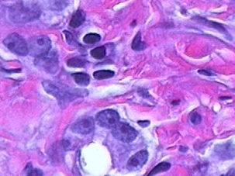
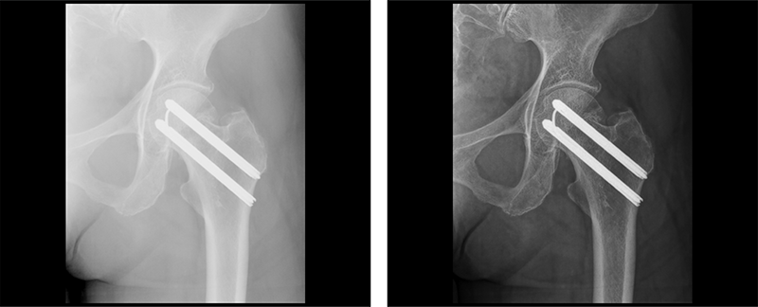
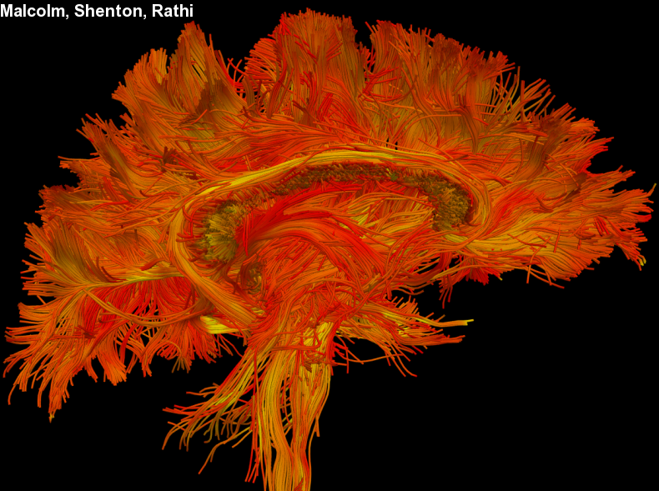
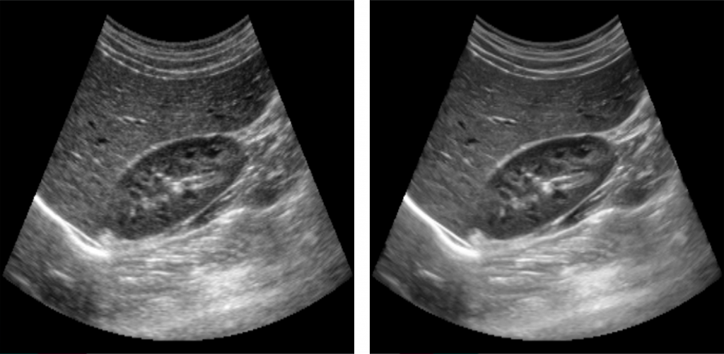
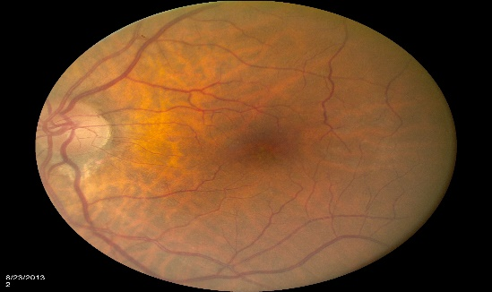
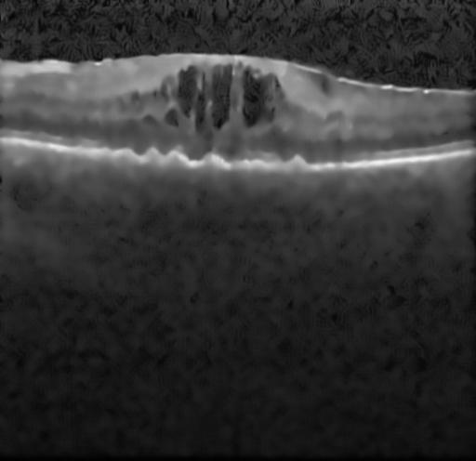
Medical Image Analysis
Medical Image Enhancement

Slide 2
Image enhancement
Enhancing an image provides better contrast and a more detailed image as compare to non enhanced image.
Image enhancement has very applications. It is used to enhance medical images, images captured in remote sensing, images from satellite e.t.c
The transformation function has been given below
s = T ( r )
where r is the pixels of the input image and s is the pixels of the output image. T is a transformation function that maps each value of r to each value of s.

Slide 3
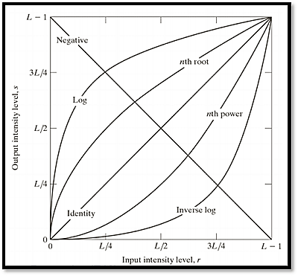
Gray level transforms
There are three basic gray level transformation.
Linear
Logarithmic
Power – law

Slide 4
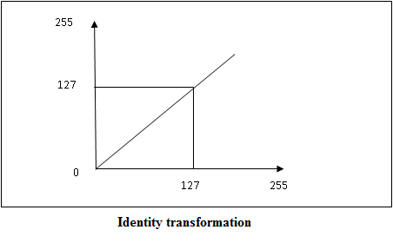
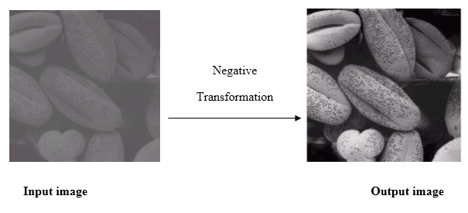
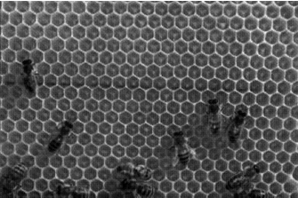
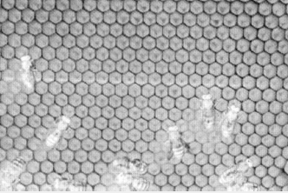
Linear Transformation
Linear Transformation
The linear transformation includes identity transformation and negative transformation.
In identity transformation, each value of the image is directly mapped to each other values of the output image.
Negative transformation is the opposite of identity transformation. Here, each value of the input image is subtracted from L-1 and then it is mapped onto the output image

Slide 5
Logarithmic transformations
The log transformations can be defined by this formula
s = c log(r + 1).
Where s and r are the pixel values of the output and the input image and c is a constant.
The value 1 is added to each of the pixel value of the input image because if there is a pixel intensity of 0 in the image, then log (0) is equal to infinity. So 1 is added, to make the minimum value at least 1.

Slide 6
Power-Law transformations
Power-Law transformations function can be defined as:
s=cr^p
This symbol p is called gamma, so this transformation is also known as gamma transformation.
The enhancement of the images depends on the variation of the p value.
Different types of display devices use this type of transformation to enhance image

Slide 7
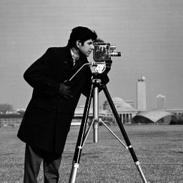
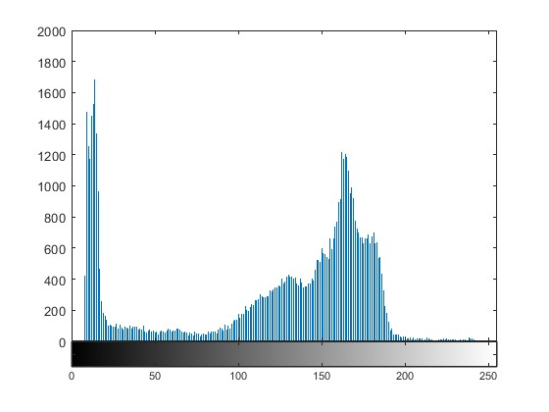
Histogram of the image
An image histogram is a type of histogram that acts as a graphical representation of the tonal (intensity) distribution in a digital image.
It plots the number of pixels for each intensity value.
By looking at the histogram for a specific image a viewer will be able to judge the entire intensity distribution at a glance.
The horizontal axis of the graph represents the tonal variations, while the vertical axis represents the total number of pixels in that particular tone.

Slide 8
Histogram
If the majority of the pixels in an image have low values we will see this as most high bins being to the left in the histogram and can thus conclude that the image is dark.
If most high bins are to the right in the histogram, the image will be bright.
If the bins are spread out equally, the image will have a good contrast and vice versa.

Slide 12



The histogram can be described as a function h(v), where h(v) is the count of pixels with value v.
If the total number of pixels in the image is Np, it can be seen that,
The histogram can be normalized by dividing each bin count with the total number of pixels:.
H(v) is equal to a probability density function and can be seen as the probability of a pixel having value v. As is the case with probability density functions:

Slide 13

Dynamic range and contrast
The range of pixel values, defined as the difference between the maximum (amax) and the minimum (amin) pixel values found in the image, ignoring any obvious outliers, is known as the dynamic range of the image.
It can be expressed either as the difference in pixel values or (in decibels (dB)) as,
Thus a 12-bit deep CT image, spanning the full range of pixel values (or CT numbers!) available to it (i.e. 4096, from −1000 to +3095), has a dynamic range of 72 dB

Slide 14
A closely related concept to dynamic range is contrast. When the dynamic range of an image covers the available range of the imaging system (2n for an n-bit system), the image exhibits high contrast.
Conversely, when the dynamic range is low, i.e. only a small range of closely spaced gray levels are present in the image, the image has low contrast and looks dull and washed out.

Slide 15
Define the contrast of the given images

Slide 16
Contrast and dynamic range are not synonymous. While the contrast does depend on the dynamic range, it is also related to the bin heights and to the average separation of pixel values in the image.
For example, an image with a bimodal histogram (Fig. 1), i.e. having two peaks, generally exhibits a higher contrast than an image with a unimodal histogram (Fig. 2), i.e. having a single peak.
1. Bi model Histogram
2. Unimodel Histogram

Slide 17
Histogram stretching
Histogram stretching :
This operation is denoted as g(x, y) = a ・ f (x, y) + b,
a = 255/f2 − f1
b = −a ・ f1,
where f1 is the left-most non-zero bin in the histogram and f2 is the right-most non-zero bin in the histogram of the input image.
It should also be noted that the distance between the different bins is increased; hence, the contrast is improved.

Slide 18
Histogram Stretching

Slide 19
Histogram equalization
The histogram of a digital image, with intensity levels between 0 and (L-1), is a function
h( r_{k} ) = n_{k} , where r_{k} is the k^{th} intensity level and n_{k} is the number of pixels in the image having that intensity level.
We can also normalize the histogram by dividing it by the total number of pixels in the image. For an N x N image, we have the following definition of a normalized histogram function:
p(r_{k} ) = n_{k}/N²
This p(r_{k} ) function is the probability of the occurrence of a pixel with the intensity level r_{k} . Clearly,
∑ p(r_{k} ) = 1
The histogram of an image, consists of the x-axis representing the intensity levels r_{k} and the y-axis denoting the h(r_{k} ) or the p(r_{k} ) functions.
Histogram equalization is the process of uniformly distributing the image histogram over the entire intensity axis by choosing a proper intensity transformation function.
Hence, histogram equalization is an intensity transformation process.

Slide 20
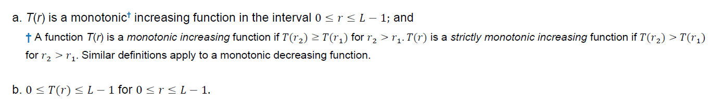
Mathematical Derivation of Transformation Function for Histogram Equalization:
Let us consider that the intensity levels of the image r is continuous, unlike the discrete case in digital images.
We limit the values that r can take between 0 and L-1, that is, 0 ≤ r ≤ L-1 . r = 0 represents black and r = L-1 represents white. Hence, transformation function is given as,
s=T(r)
where s denotes the intensity levels of the resultant image. We have certain constraints on T(r) :
We know that such functions are invertible. So we can get back r values from s. We can have a function such that r = T⁻¹( s ). in which case we change condition (a) to: (a′) T(r) is a strictly monotonic increasing function in the interval 0<=r<=L-1.

Slide 21
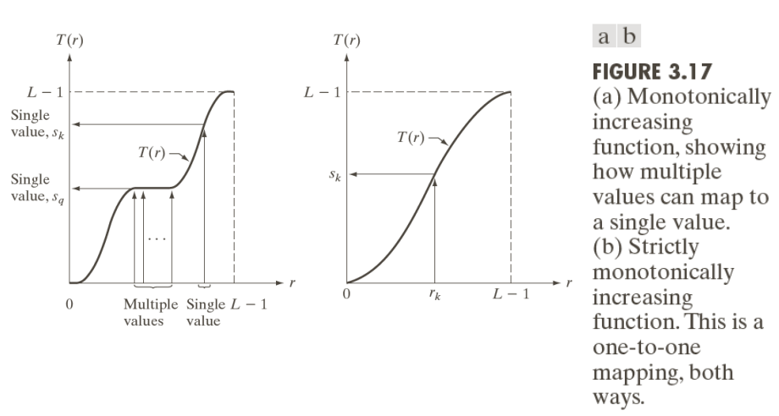

Slide 22
The condition in (a) that T(r). be monotonically increasing guarantees that output intensity values will never be less than corresponding input values, thus preventing artifacts created by reversals of intensity.
Condition (b) guarantees that the range of output intensities is the same as the input.
Finally, condition guarantees that the mappings from s back to r will be one-to-one, thus preventing ambiguities.

Slide 23
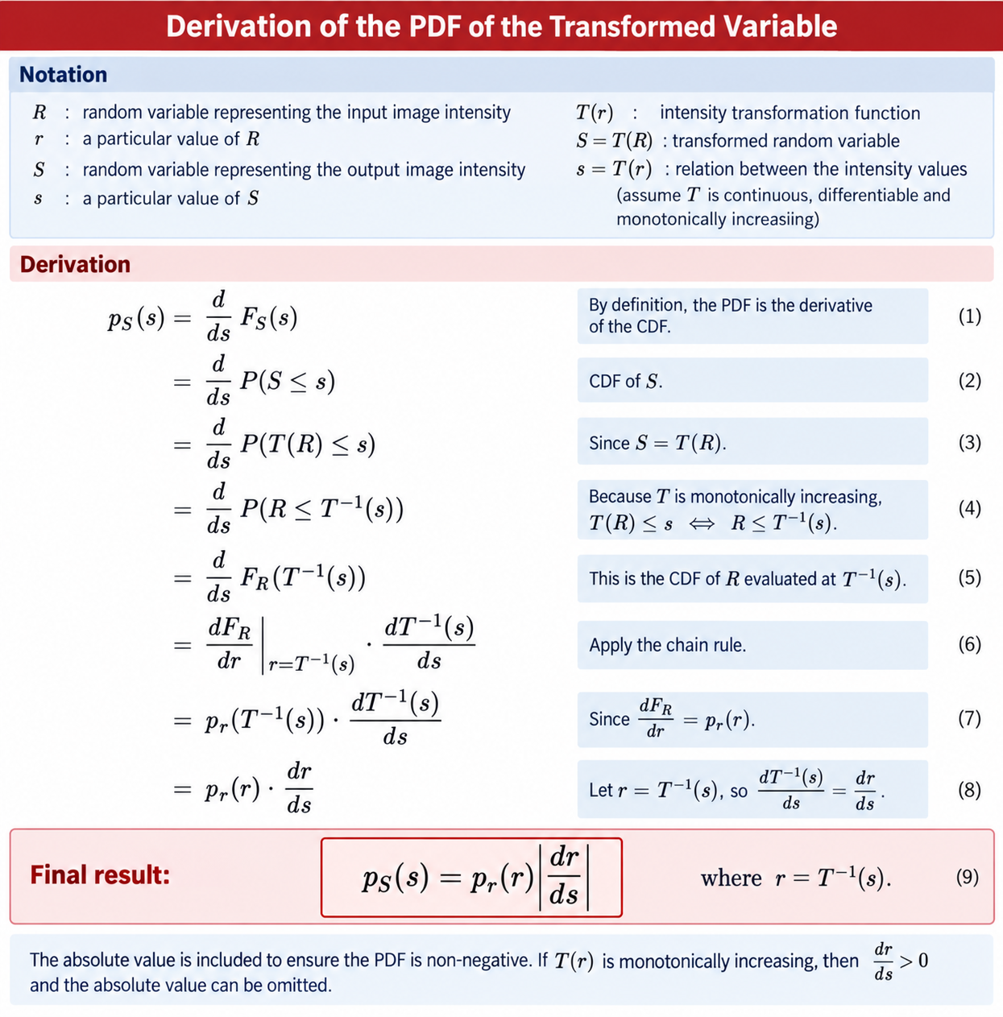

Slide 24

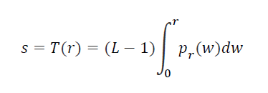
The intensity of an image may be viewed as a random variable in the interval [0,L-1].
Let p_{r} (r) and p_{s} (s) denote the PDFs of intensity values r and s in two different images.
A fundamental result from probability theory is that if p_{r} (r) and T(r) are known, and T(r) is continuous and differentiable over the range of values of interest, then the PDF of the transformed (mapped) variable s can be obtained as,
Thus, we see that the PDF of the output intensity variable, s, is determined by the PDF of the input intensities and the transformation function used [recall that r and s are related by T(r)].
A transformation function of particular importance in image processing is;
where w is a dummy variable of integration. The integral on the right side is the cumulative distribution function (CDF) of random variable r.
Eq. 1
Eq. 2

Slide 25
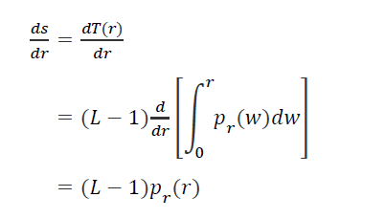
Because PDFs always are positive, and the integral of a function is the area under the function, follows that the transformation function of Eq.2 satisfies condition (a).
This is because the area under the function cannot decrease as r increases. When the upper limit in this equation is r = (L-1) the integral evaluates to 1, as it must for a PDF.
Thus, the maximum value of s is L-1, and condition (b) is satisfied also.
We use Eq 1 to find p_{s}(s) corresponding to the transformation just discussed.
We know from Leibniz’s rule in calculus that the derivative of a definite integral with respect to its upper limit is the integrand evaluated at the limit. That is,

Slide 26
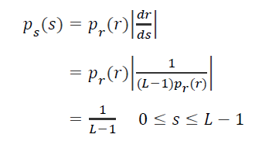
Substituting this result for dr/ds in Eq 1, and noting that all probability values are positive, gives the result:
We recognize the form of p_{s}(s) in the last line of this equation as a uniform probability density function. Thus, performing the intensity transformation in Eq 2 yields a random variable, s, characterized by a uniform PDF.
What is important is that p_{s}(s) in above derivation will be always uniform, independently of the form of p_{r}(r).

Slide 27
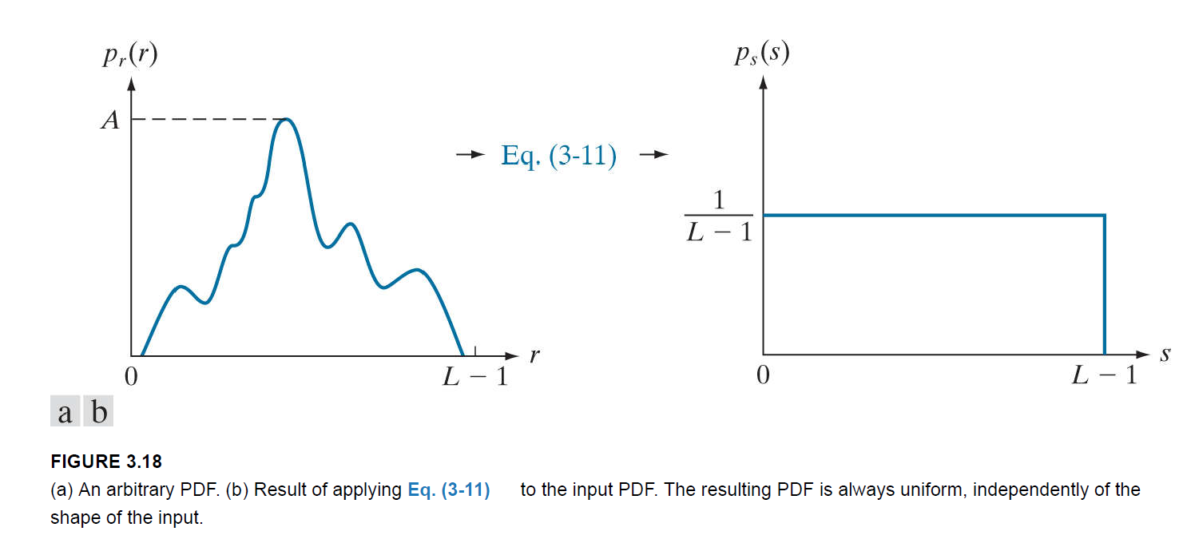

Slide 28
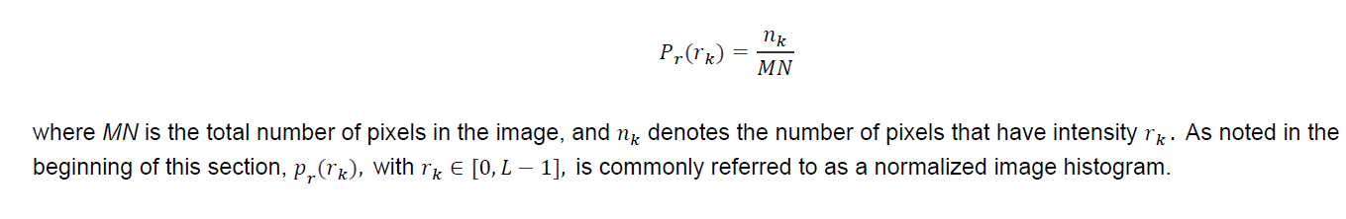
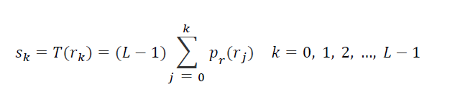
Histogram Equalisation: Discrete form
For discrete values, we work with probabilities and summations instead of probability density functions and integrals (but the requirement of monotonicity stated earlier still applies).
Recall that the probability of occurrence of intensity level r_{k} in a digital image is approximated by,
So the discrete form of Eq 1is,
Where, L is the number of possible intensity levels in the image.

Slide 29
Refer Chapter 3, Section 3 in Gonzalez R C, Woods R E, “Digital Image Processing Using MATLAB”, Third Edition, Prentice Hall, 2007. (Reference Book)

Slide 30
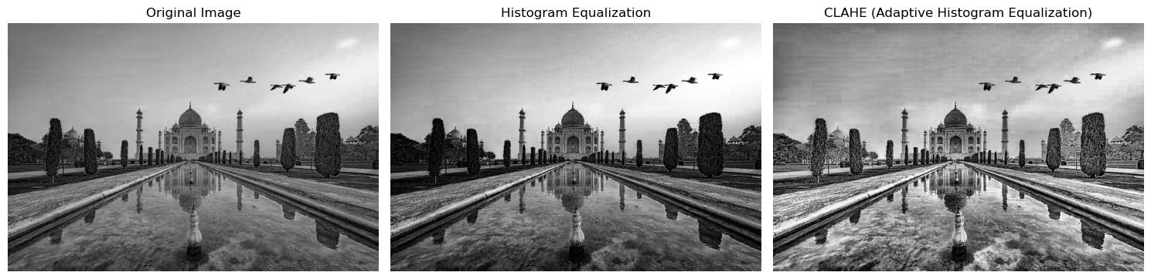
Problem with Global HE
Original image may contain:
  Bright regions
  Dark regions
  Non-uniform illumination
Global HE:
  Enhances overall contrast
  Fails to reveal local details
AHE:
  Processes small image regions independently
  Enhances local features and textures

Slide 31
Adaptive Histogram Equalisation
Divide image into small regions (tiles).
Compute histogram for each tile.
Apply histogram equalization locally.Interpolate neighboring tiles to avoid artifacts.

Slide 33
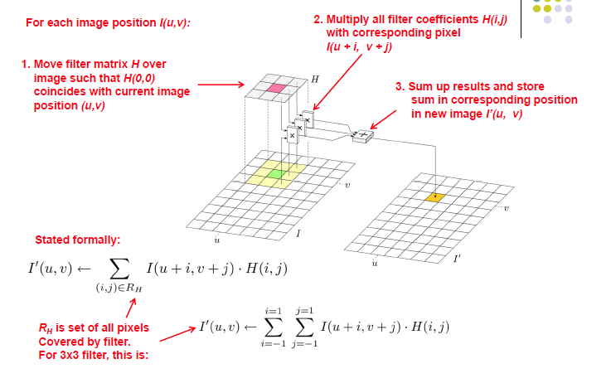
Convolution

Slide 34
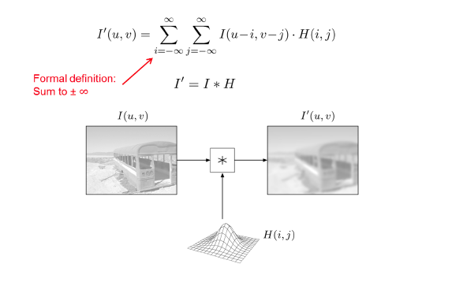

Slide 36
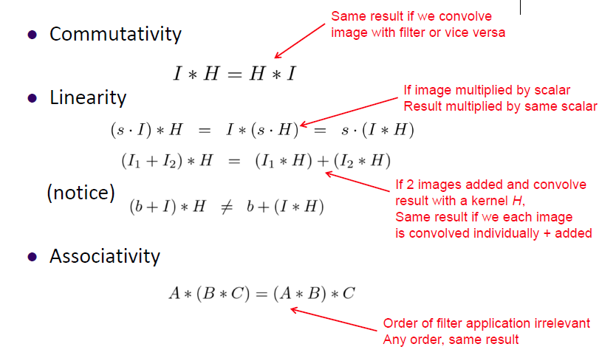

Slide 37
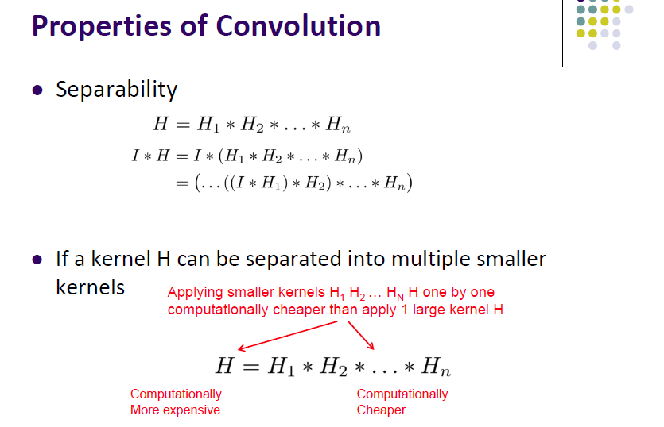

Slide 39
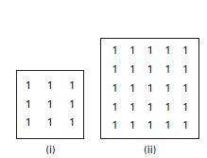
Smoothing masks
The simplest smoothing operation is that of neighborhood averaging, i.e. each pixel in the output image is formed from the average of the pixel values in a neighborhood surrounding the pixel in the input image at that position.
The mask that implements this is a k × k mask, with all coefficients equal to unity (Figs. (i) and (ii)) and a constant pre-multiplier of 1/k²; it is called an averaging or box mask.
The averaging process reduces the abrupt variations in local pixel values, smoothing the input image by reducing its noise.

Slide 40
Smoothing an image reduces its signal-to-noise ratio and changes its gray-level histogram.
One use of such a mask is to smooth out the false contours that occur in images acquired with an insufficient number of gray levels.
Another use is to blur out features smaller than the mask.

Slide 41
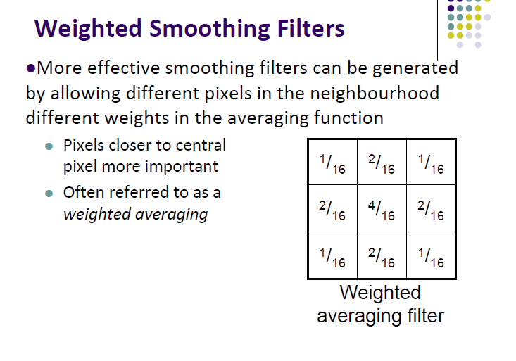

Slide 42
Each two-dimensional mask can be separated into two one-dimensional masks, which can be used successively on an image to produce the same effect but with less computation.
For example the two-dimensional mask in Figure (i) could be replaced by a one-dimensional horizontal mask, [ 1 1 1 ], and its transpose [1 1 1]^{T}, a one-dimensional vertical mask; since convolving these two masks gives the original two-dimensional mask.
Two-dimensional convolution can then be replaced by two one-dimensional convolution operations, the second operating on the result of the first.
The order is not important since convolution with linear shift-invariant operators is commutative. This reduces the number of multiplications from k² to 2k per pixel.
The convolution mask can be written as a matrix h and, if it is separable, h can be written as,
[h]=[h_{col}][h_{row}]^{T}

Slide 43
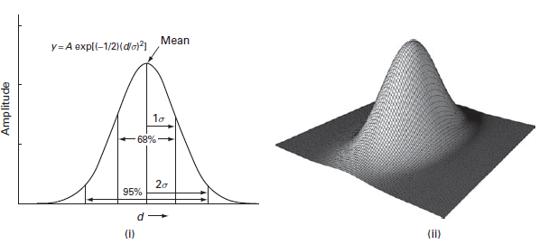
Gaussian masks have a bell-shaped profile, with a high value element in the center and symmetrical tapering to either side. They produce a response somewhat similar to the weighted average mask, but with even less ringing because of the gradual tapering of their profile.
^{The mask elements are given by}
where A is a scaling factor, d is the distance of a pixel from the center of the mask and σ determines the width of the mask.
The rule of thumb is to set σ = (2w + 1)/2, where w is the size of the feature to be blurred out. Gaussian masks are separable, so that they can be implemented by using a one-dimensional horizontal Gaussian, followed by a one-dimensional vertical Gaussian.

Slide 44
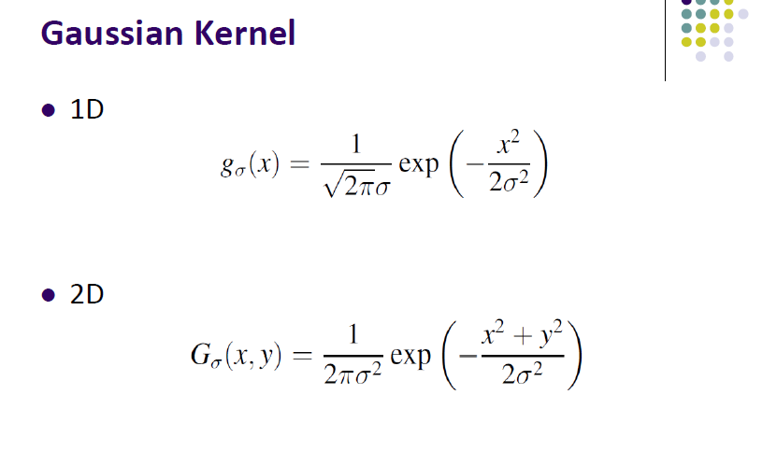

Slide 45
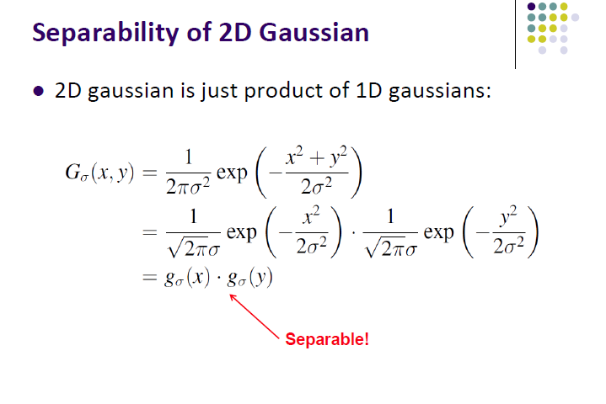

Slide 46
Order Statistic Filters
Suppose that X is a real-valued variable for a population and that are the observed values of a sample of size n corresponding to this variable.
In statistics, the k^{th} order statistic of a statistical sample is equal to its k^{th}-smallest value (usually denoted as ).
Thus

Slide 47
Sharpening and edge-detecting masks
Sharpening is used to produce a crisper image with sharper edges in order to highlight fine detail.
One way of sharpening an image is by unsharp masking. The original image is blurred, i.e. unsharpened, and a fraction of it is subtracted from the original.
The resulting image, g(x, y), is given by g(x,y)=f(x, y) - c (f(x,y)-f_{S}(x,y))
where f_{S}(x, y), the smoothed image, is obtained using an averaging mask and c is a constant.

Slide 48
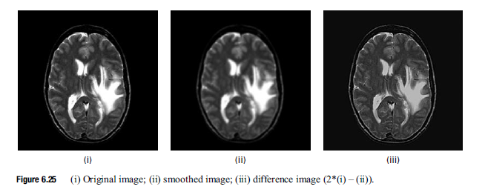
Sharpening is the reverse operation to smoothing. Since smoothing is achieved by averaging, which is essentially integration, intuition suggests that sharpening should be achieved by subtraction or differentiation.

Slide 49
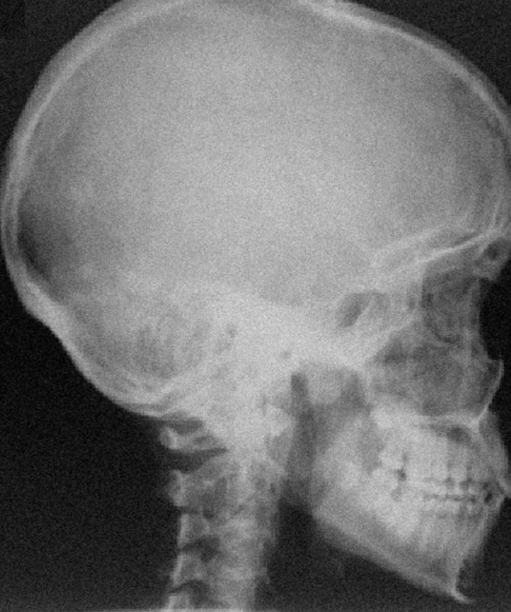
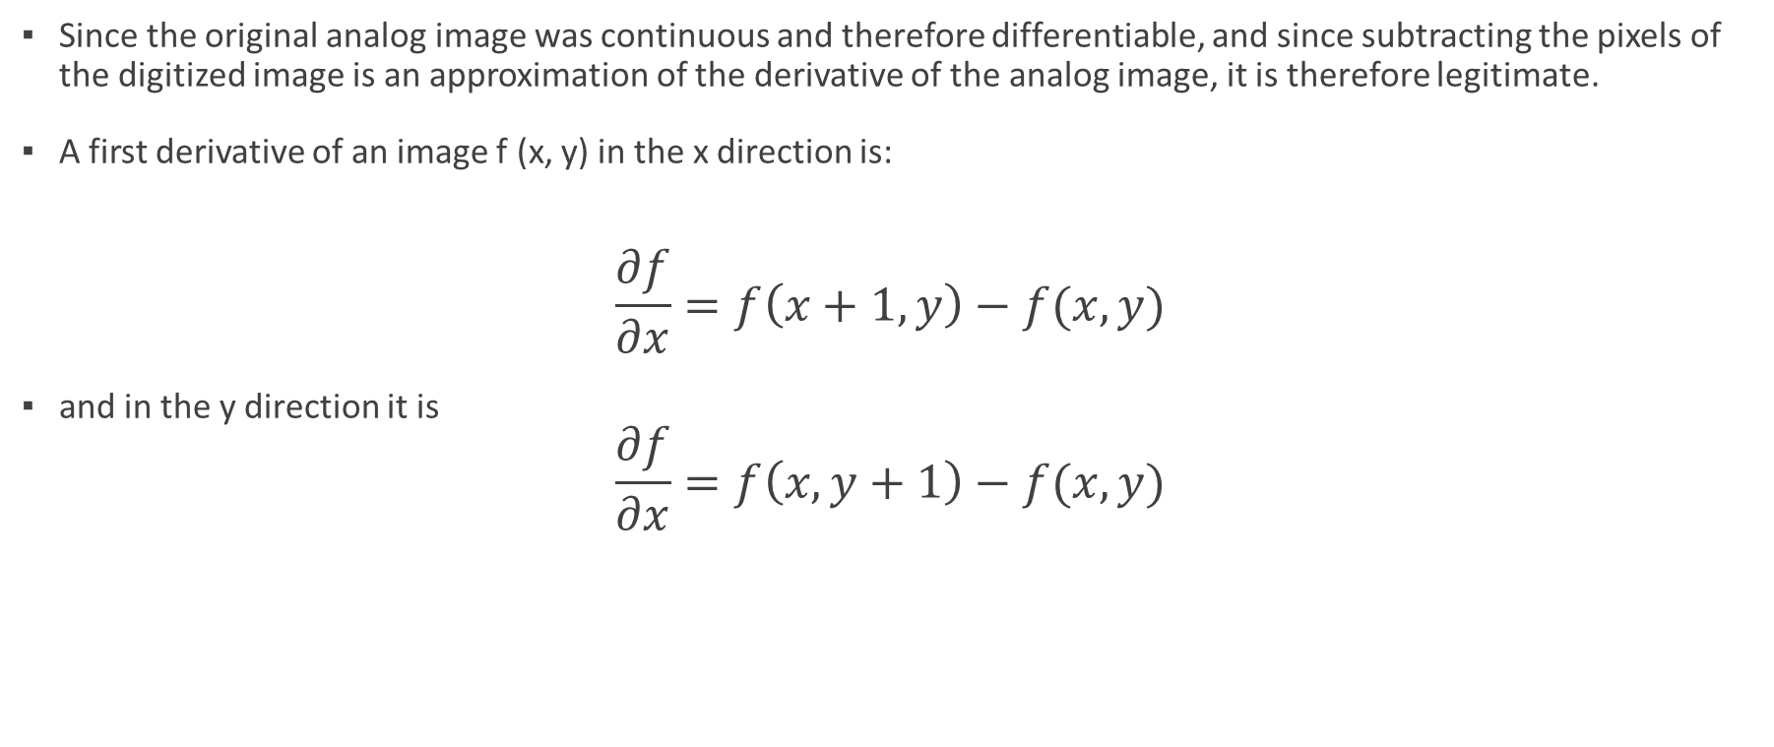
Gradients of Image
Since the original analog image was continuous and therefore differentiable, and since subtracting the pixels of the digitized image is an approximation of the derivative of the analog image, it is therefore legitimate.
A first derivative of an image f (x, y) in the x direction is:
$$\frac{∂f}{∂x}=f\left(x+1,y\right)−f(x,y)$$
and in the y direction it is
$$\frac{∂f}{∂x}=f\left(x,y+1\right)−f(x,y)$$

Slide 50
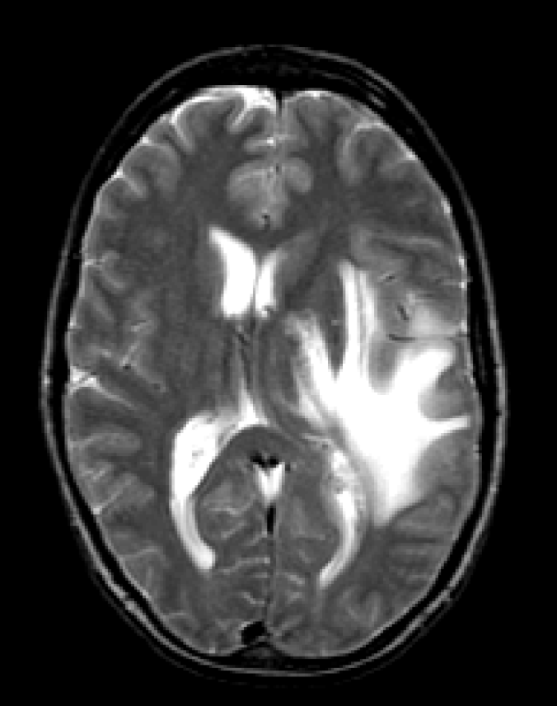

Slide 51
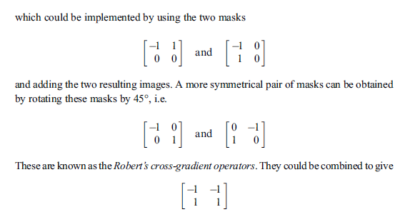
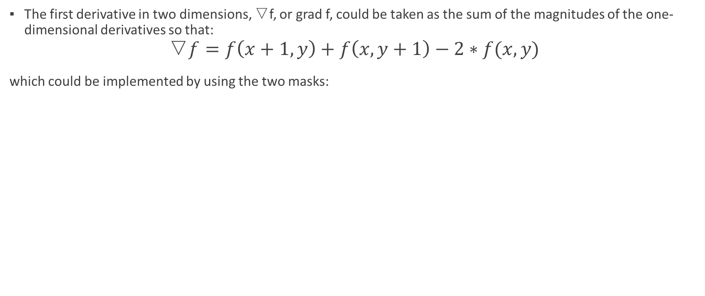
Gradients of Image
The first derivative in two dimensions, ▽f, or grad f, could be taken as the sum of the magnitudes of the one-dimensional derivatives so that:
$$\text{▽}f=f\left(x+1,y\right)+f\left(x,y+1\right)−2∗f(x,y)$$
which could be implemented by using the two masks:

Slide 52
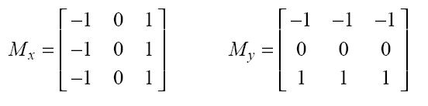
Prewitt Operator
Setting c = 1, we get the Prewitt operator:

Slide 53
Sobel Operator
Setting c = 2, we get the Sobel operator:

Slide 54
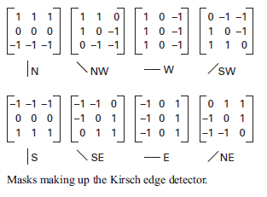

Slide 55
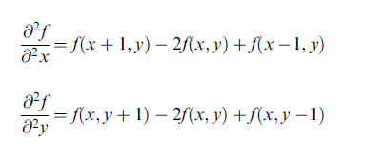
Second-derivative masks
The objective of edge-detecting algorithms is to locate regions where the grayscale intensity is changing rapidly. This corresponds to a gradient or first derivative, larger than some threshold value.
An alternative would be to look for a zero crossing of the second derivative, since this corresponds to a local maximum of the gradient (Fig. 6.31).
The second derivative is the difference between two first derivatives, taken at a small distance apart, so that the second derivatives in the x and y directions could be written as

Slide 56

Laplacian of Gaussian (LoG)
(Marr-Hildreth operator)
To reduce the noise effect, the image is first smoothed.
When the filter chosen is a Gaussian, we call it the LoG edge detector.
It can be shown that:
σ controls smoothing
(inverted
LoG)

Slide 57
Noise in Image
Noise is unwanted fluctuation in the pixel values of an image. It results in a degradation of the image quality.
Since it is a random or stochastic process it is not possible to predict its values precisely, but it is possible to determine its statistical properties.
Although it is not possible to write a mathematical expression to describe the complete profile, it is possible to quantify the noise in terms of various average properties such as its mean value, its mean square value and its probability density function.

Slide 58


Noise in Image
The simplest way of characterizing a random variable is in terms of its expected value and variance.
If a is a random variable the expected value (expectation or mean) of a is denoted as either μ_{a} or E{a}. It represents the (probability-weighted) average value for the random variable.
If a is taken to be the pixel value (or pixel amplitude) in an image, its mean value, a, can be obtained either by integrating the profile (i.e. finding the area under it) and dividing by the distance in that direction, L, where the distance L should be preferably infinitely long,
if the probability density function, p(a), of the noise (the probability of having a particular value a) is known, by using

Slide 59



In terms of an image with an additive noise component, the mean total power, the mean square amplitude (E{a²}), is given by the sum of the d.c. power in the signal, the square of the mean amplitude , and the mean power in the noise, the variance or σ².
The signal-to-noise ratio, SNR, of the image, is given by
Noise in imaging systems can be either independent of the signal (i.e. the image pixels), and can often be described as additive,
or it can be dependent noise, a function of the signal strength or pixel value, in which case it is simulated using a more complicated multiplicative model:
Quantum noise and film grain noise are actually multiplicative, whereas electronic noise is additive. For most image restoration processes the noise is considered to be additive.

Slide 60
Types of noise
White noise:
  This is noise with a constant power spectrum, i.e. its power spectral density, often referred to as its noise power spectrum (NPS), is constant with frequency.
  The terminology is derived froman analogy with white light, which contains nearly all the frequencies in the visible spectrum in equal proportions.
  White noise is totally uncorrelated, i.e. each pixel value is unrelated to neighboring pixel values.

Slide 61


Gaussian Noise (Additive White Gaussian Noise - AWGN)
  Caused by electronic circuit disturbances in image sensors.
  Mathematical Model:
  where N(x,y) follows a Gaussian distribution with mean μ and variance σ2.
  Gaussian noise has a probability density function, or normalized histogram, given by where a is the gray value,
  μ is the average gray value and σ is its standard deviation. Approximately 70% of its pixel values are in the range [(μ − σ), (μ + σ)].
  It is a particularly attractive model since it can be analytically integrated, which may explain its over-use. It also conveniently has the same spectral shape in the frequency domain.
  Gaussian noise comes from many natural sources, such as the thermal vibrations of atoms in antennas (referred to as thermal noise or Johnson noise) and black body radiation from warm objects.
  Gaussian white noise is a good approximation of many real-world situations and generates mathematically tractable models.

Slide 62
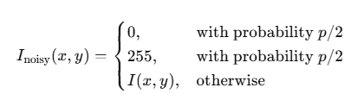
Salt-and-Pepper Noise (Impulse Noise)
  Another common form of noise is data drop-out noise, commonly referred to as impulse noise or salt-and-pepper noise. Here, the noise is caused by errors in data transmission.
  Corrupted pixels are either set to the maximum value or to zero, giving the image a “salt and pepper” like appearance.
  Unaffected pixels remain unchanged. The noise is usually quantified by the percentage of pixels which are corrupted. Randomly occurring black (0) and white (255) pixels due to transmission errors or sensor malfunctions.

Slide 63

Poisson Noise (Shot Noise or quantum noise )
  Photon noise results from the statistical nature of electromagnetic waves, which include visible light, x-rays and γ-rays: all are emitted as packets of energy, photons, with a probability distribution that is a Poisson distribution.
  Its average level is √N, where N is the signal average, so that it is not independent of the signal nor is it additive.
  Caused by the quantum nature of light, affecting low-light images.

Slide 64

Speckle Noise (Multiplicative Noise)
  Although Gaussian noise and speckle noise can appear superficially similar in an image, they are a result of different processes and require different approaches for their removal.
  Whereas Gaussian noise can be modeled by random values added to the pixel values of an image, speckle noise is modeled by random values which are multiplied by the pixel values.
  Speckle noise is a major problem in some radar applications.
  Occurs in coherent imaging systems like ultrasound, SAR (Synthetic Aperture Radar).

Slide 65
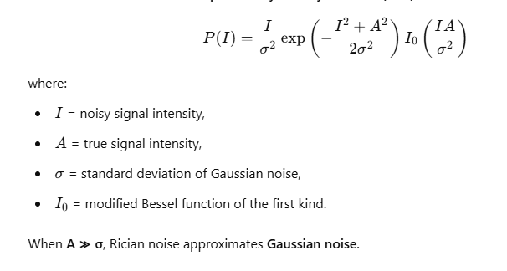
Rician Noise
  Rician noise is a type of noise commonly found in magnetic resonance imaging (MRI) and ultrasound imaging.
  It arises due to the magnitude reconstruction of complex Gaussian-distributed signals and follows a Rician distribution instead of a normal distribution.
  Non-Gaussian: Unlike Gaussian noise, Rician noise is signal-dependent (i.e., its variance depends on the signal intensity).
  Appears in MRI and Ultrasound: Occurs due to phase and magnitude reconstruction errors.
  Modeled in the Frequency Domain: Often analyzed using Fourier Transform.

Slide 66
Types of noise
Quantization noise:
  Quantization noise is inherent in the amplitude quantization process and occurs in the analog-to-digital converter, ADC, when sampled values are fitted to a finite number of levels. The noise is additive and independent of the signal when the number of bits n ≥ 4.
For a digitized signal that is bounded with a minimum and maximum pixel value, amin and amax, respectively, the signal-to-noise ratio, SNR, is given by
where σn is the standard deviation of the noise

Slide 67
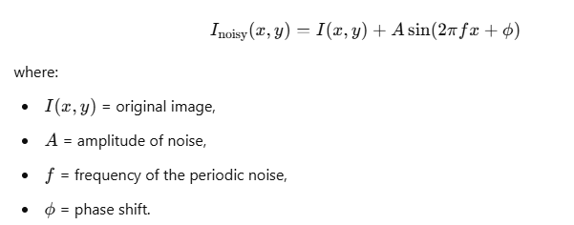
Periodic Noise:
  This arises typically from electrical interference, especially in the presence of a strong mains power signal during image acquisition.
  Periodic noise is a structured, repeating disturbance in an image, often caused by electromagnetic interference, mechanical vibrations, or faulty sensor components
  It is spatially dependent and generally sinusoidal at multiples of a specific frequency.
  Unlike random noise (e.g., Gaussian, salt-and-pepper), periodic noise appears as repeating patterns, such as sinusoidal waves or grids.

Slide 68
Denoising Using NLM
The Non-Local Means (NLM) algorithm is a noise reduction technique used in image processing. It was introduced by Antoni Buades, Bartomeu Coll, and Jean-Michel Morel in 2005.
Similar image patches (homogenous regions) tend to repeat throughout an image, and these repetitions can be used to denoise the image effectively
Instead of averaging only nearby pixels (as in traditional filters like Gaussian blur), NLM searches for similar patches throughout the entire image, even if they are far apart (hence "non-local").

Slide 69
Denoising Using NLM
Compute Weighted Avg for similar partches: More similar patches get higher weights, while less similar patches get lower weights.
The similarity between two patches is typically measured using the Euclidean distance or Gaussian-weighted Euclidean distance.
If two patches are highly similar, their corresponding pixels contribute more to the denoised result. (Pixels from similar patches are more likely to represent the true underlying signal rather than noise.)

Slide 70
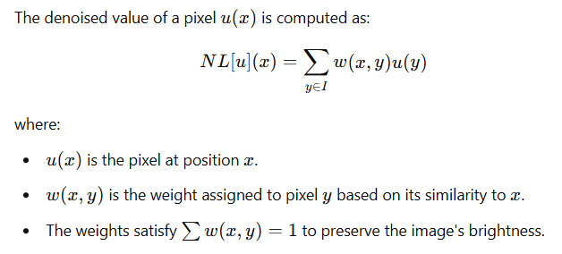
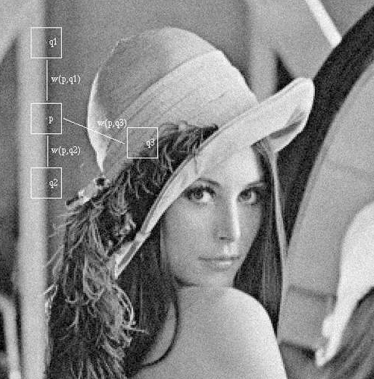
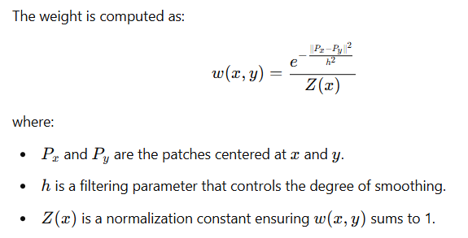
Denoising Using NLM
Source: 42184313-10-1-1-100-81.pdf

Slide 71
Noise Estimation from Images
Local Statistics Method
Compute local mean and standard deviation in small, non-textured regions.
Assumes that natural images are smooth, and high variations indicate noise.
Median Absolute Deviation (MAD)
Compute the median filter output and subtract it from the original image.
Estimate noise as the median absolute deviation from the median.

Slide 72
Colored noise:
Pink noise, 1/f noise or flicker noise has a power spectral density that is proportional to the reciprocal of the frequency. Over an octave, a doubling of frequency, it drops to half power, i.e. it drops off at 3 dB per octave.
Brown noise, Brownian noise or red noise has a power spectral density that is proportional to the reciprocal of the square of the frequency.
(Explore these)

