Slide 1

APEXPLANET SOFTWARE PVT. LTD.
TASK 5 | CAPSTONE INTEGRATION
Data Analytics Internship Portfolio
Capstone Integration & Portfolio Finalization
Prepared by Bhoomika N · B.Tech Computer Science & Engineering

Slide 2
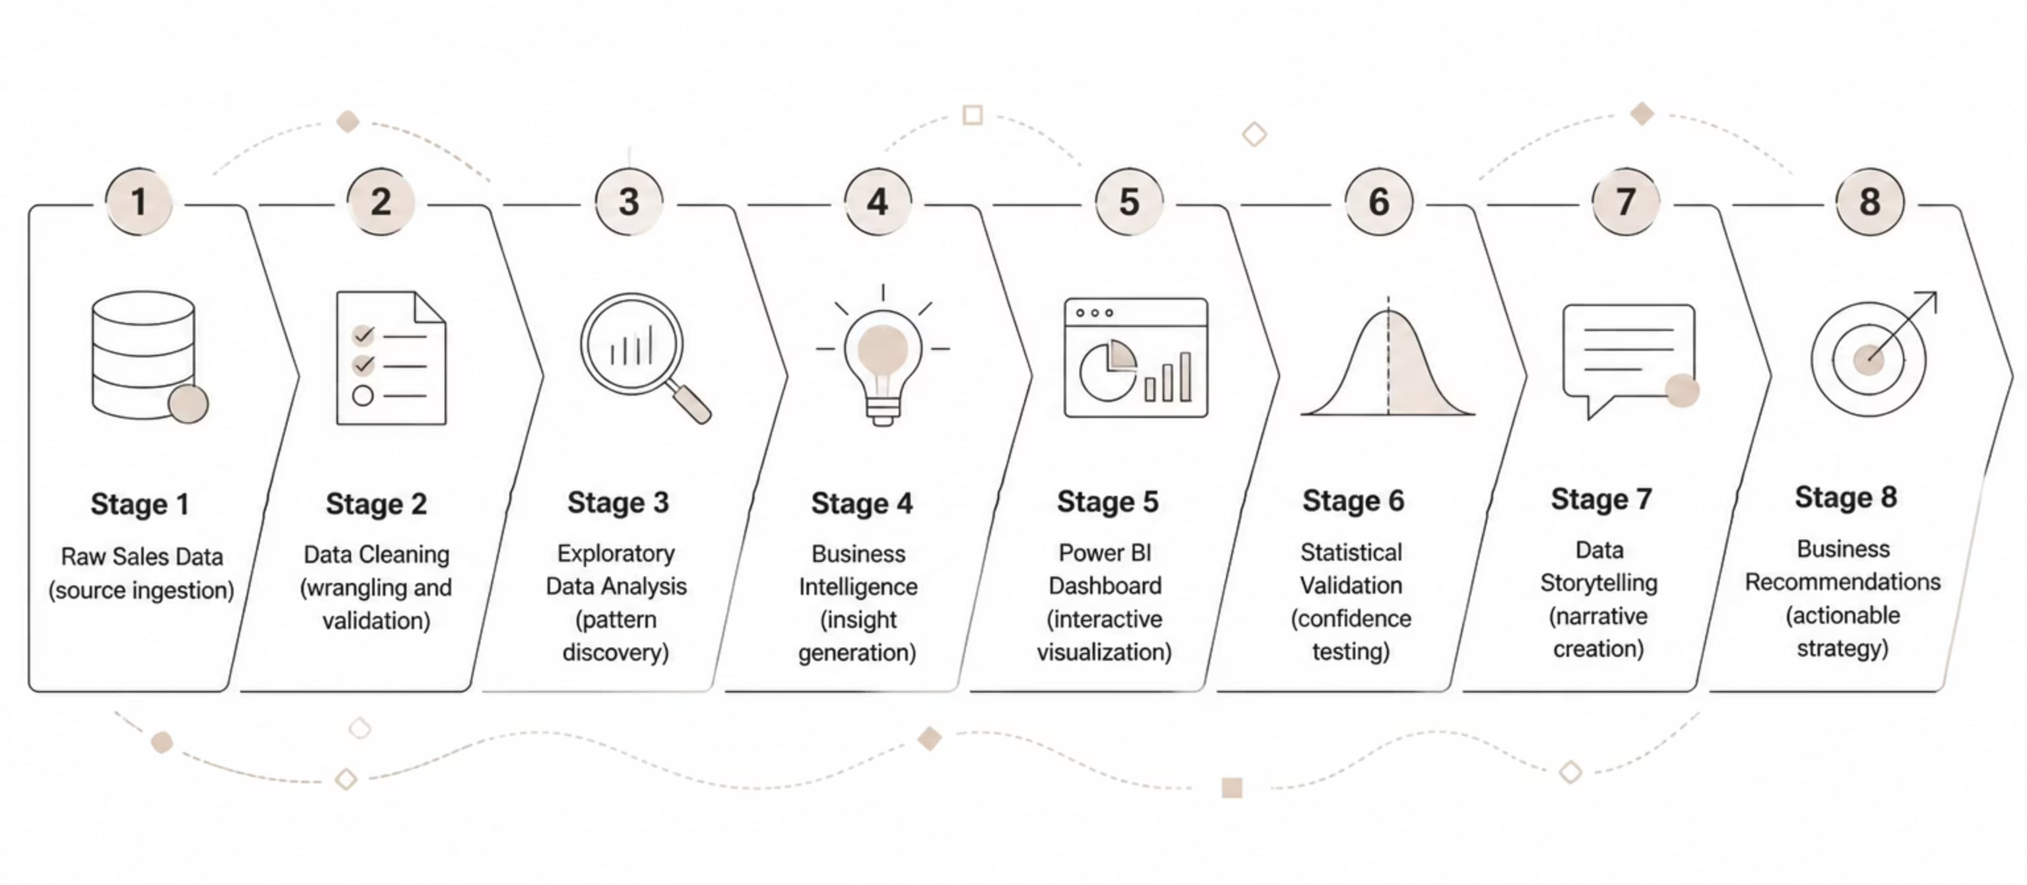
Internship & Project Overview
This internship provided hands-on experience across the complete data analytics lifecycle — from raw data ingestion to business-ready insights — using a real-world Sales Analytics project. Each phase built on the last, culminating in a validated, stakeholder-ready portfolio.

Slide 3
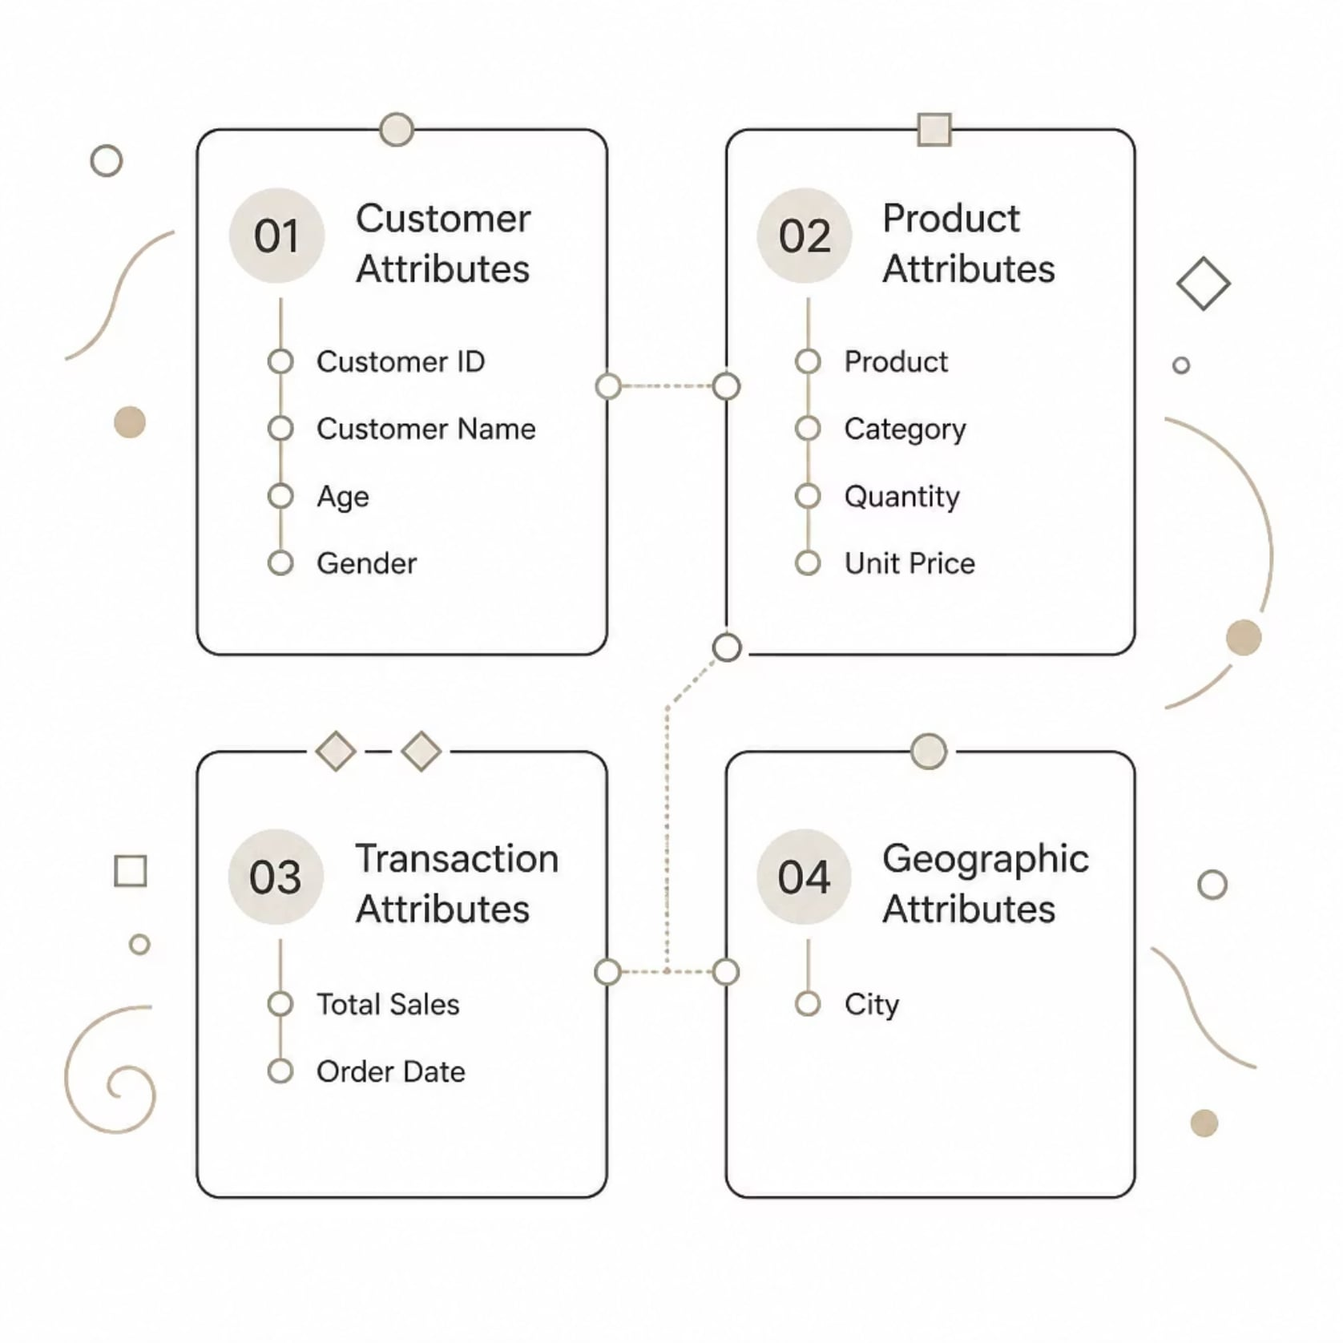
Dataset & Business Objectives
What We Set Out to Discover
Overall sales performance and revenue trends
High-performing products and categories
Customer purchasing behavior patterns
Geographic sales comparisons across cities
Time-based sales trends and seasonality
Actionable business recommendations

Slide 4

TASK 1
Data Immersion & Wrangling
The first task established a reliable, analysis-ready dataset through systematic data quality checks and transformation using Python, Pandas, NumPy, and Google Colab/Jupyter Notebook.
Inspect
Clean
Deliver
This structured approach ensured data integrity before any downstream analysis, reducing the risk of misleading results.

Slide 5
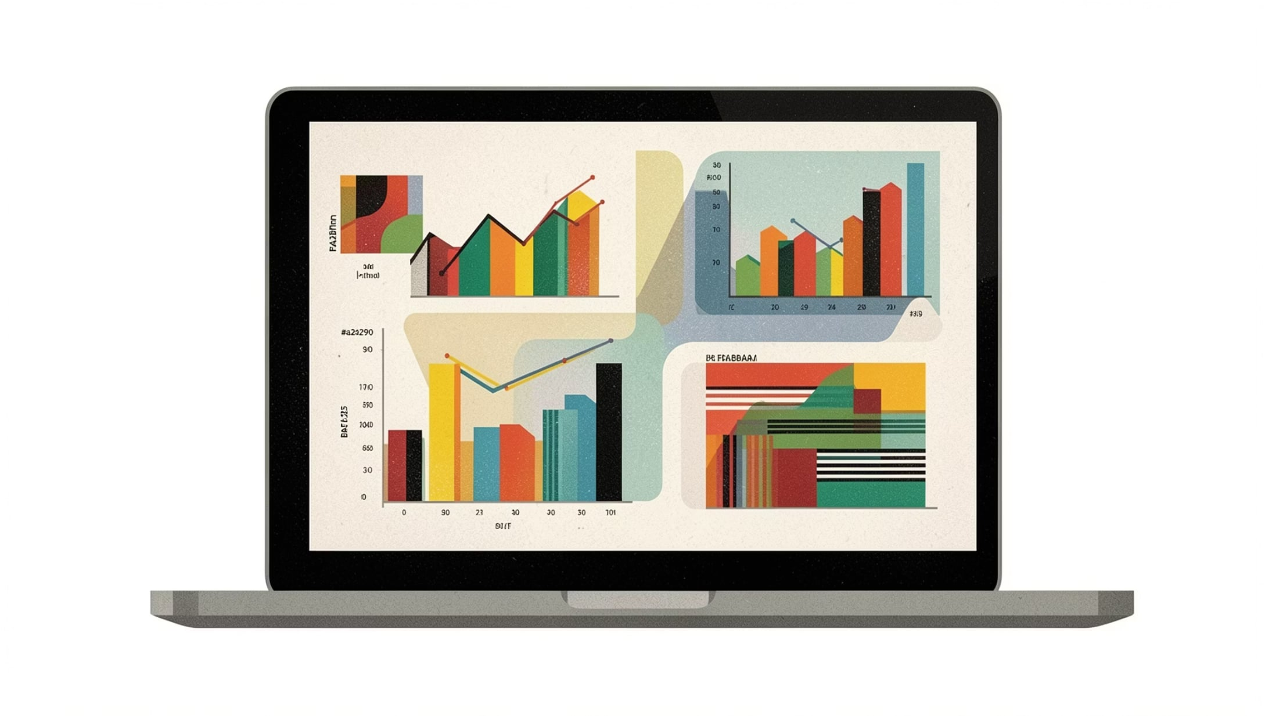
TASK 2
Exploratory Data Analysis & Business Intelligence
Analysis Dimensions
Revenue performance and sales trends over time
Product and category-level contribution
Customer behavior and segmentation
Gender-based purchasing analysis
City-wise geographic sales comparison
Tools
Python · Pandas · Matplotlib · Seaborn
Summary statistics and visualizations transformed cleaned data into meaningful analytical and business insights.

Slide 6
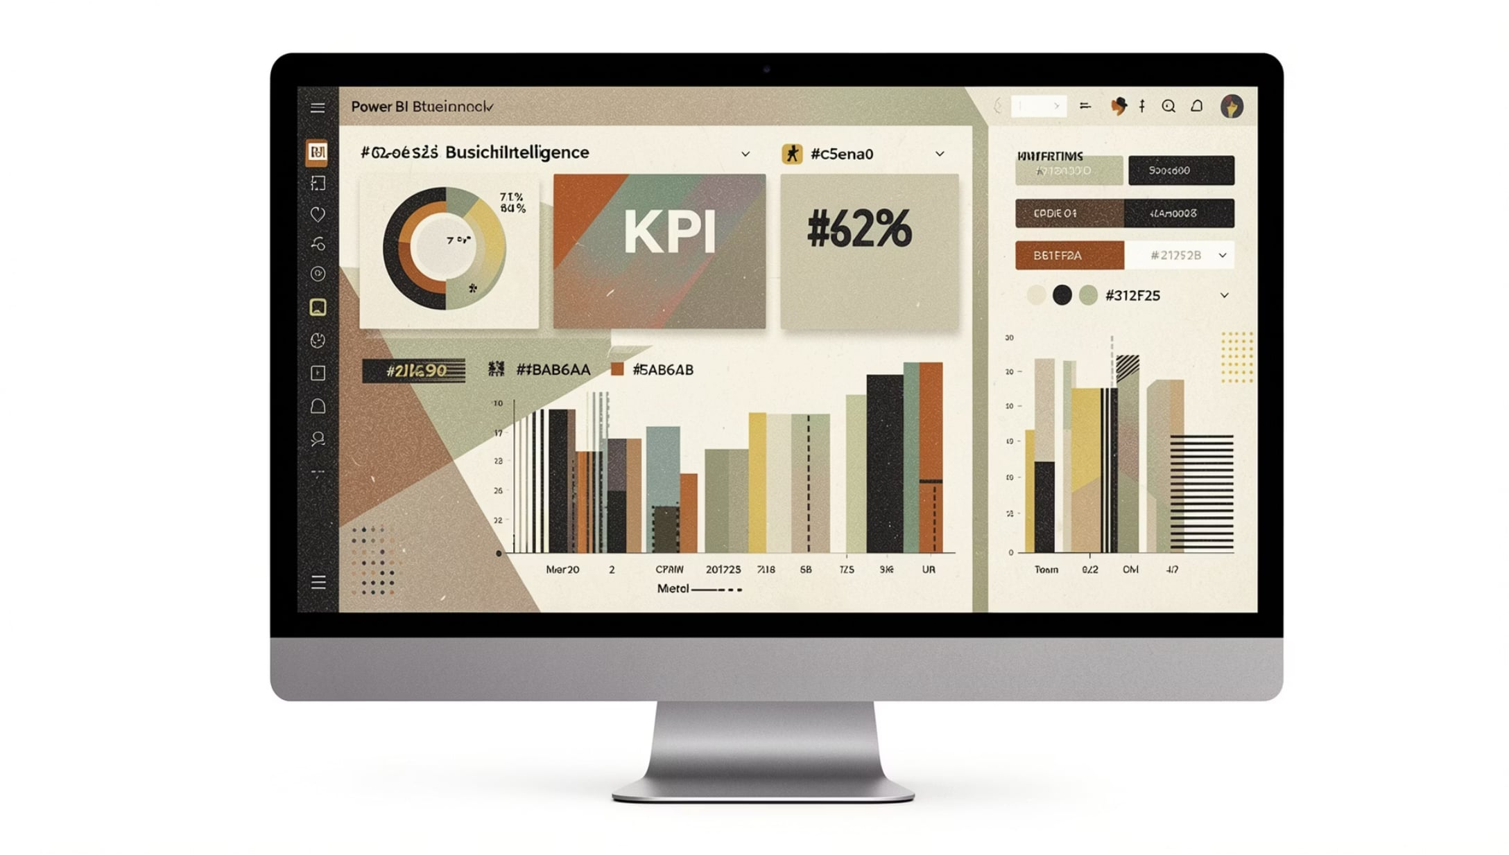
TASK 3
Deep-Dive Analysis & Interactive Dashboarding
Dashboard Components
Total Sales KPI — ~139.40M
Sales breakdown by Category & Product
City-wise and Gender-based performance
Customer-level and time-series analysis
Interactive filtering for visual exploration
Built in Microsoft Power BI, the dashboard enabled intuitive interpretation of sales performance and supported data-driven decision-making for stakeholders.

Slide 7
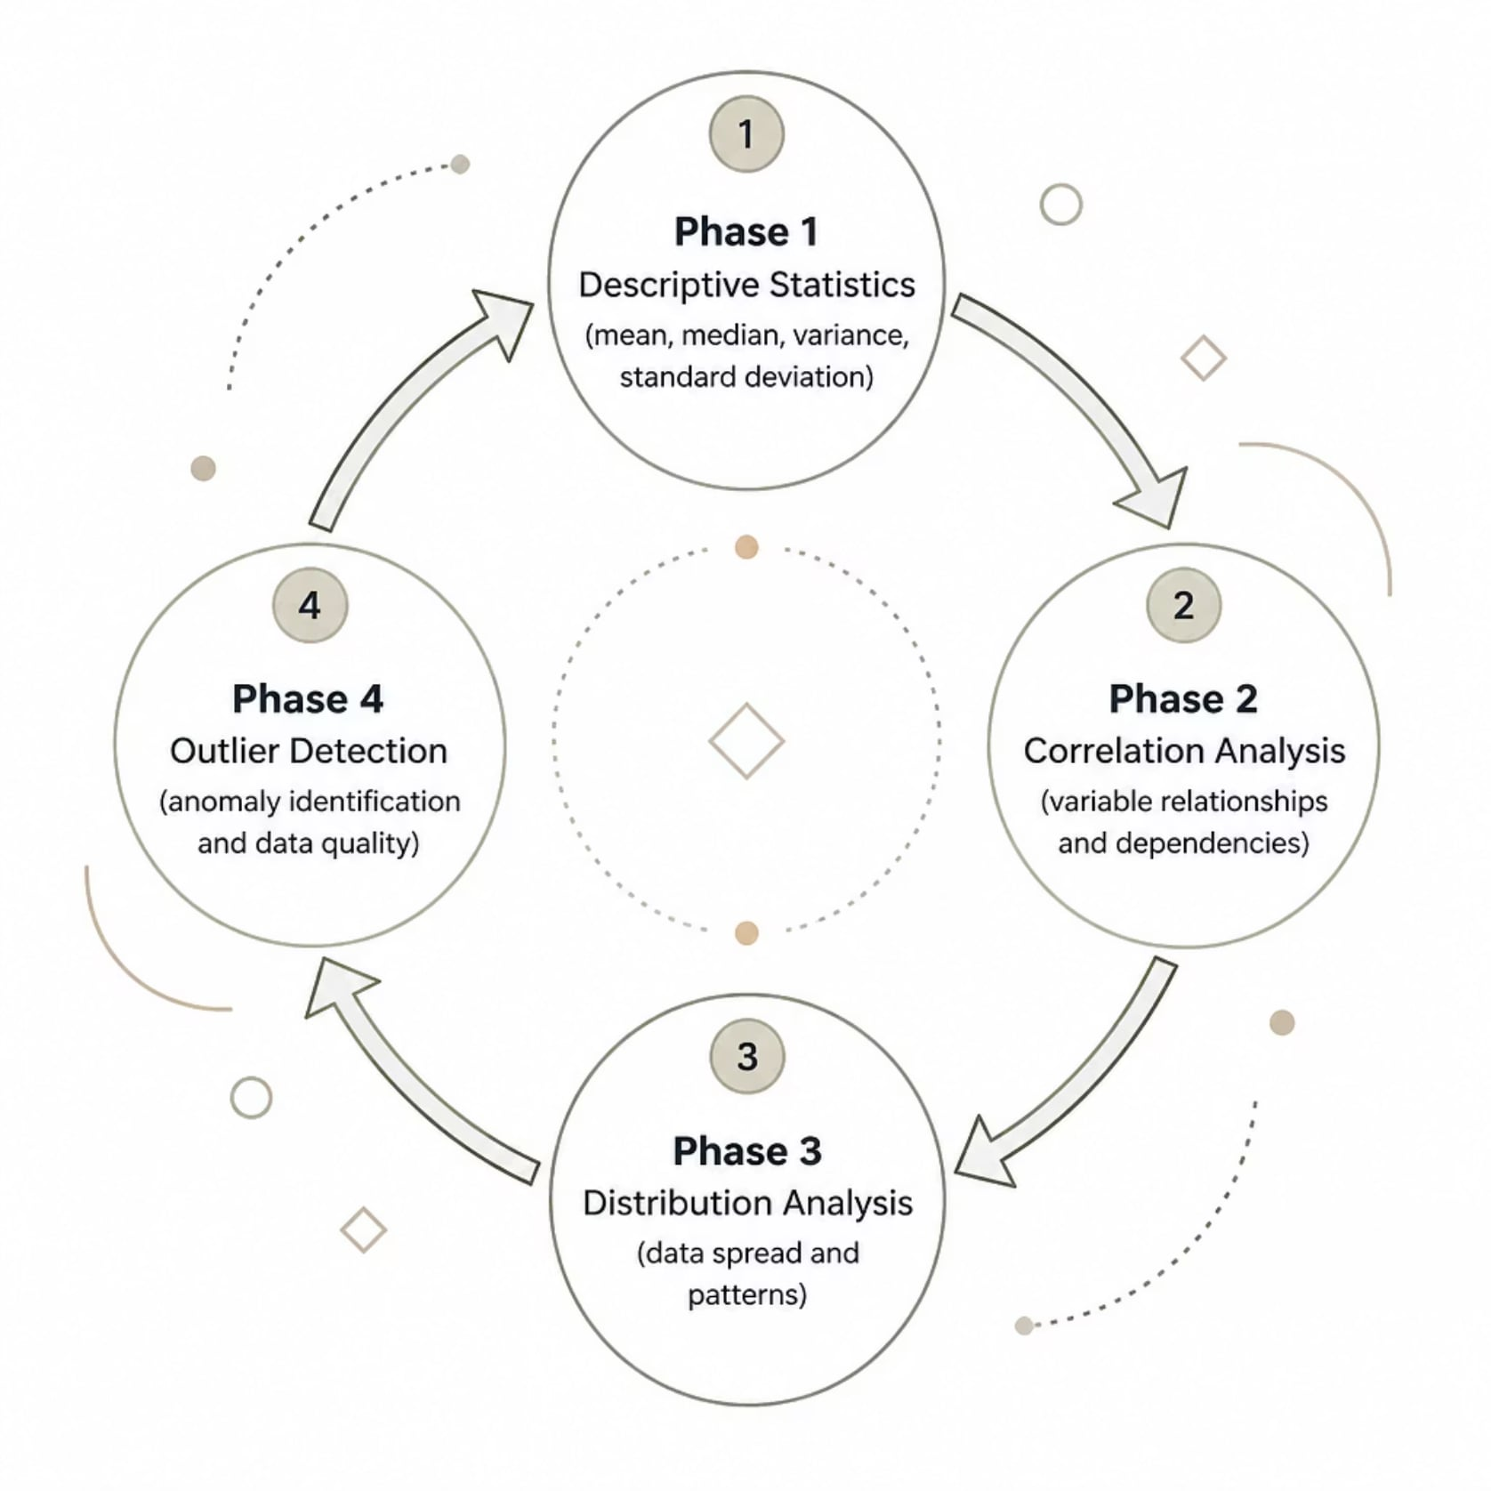
TASK 4
Data Storytelling & Statistical Validation
Statistical Techniques Applied
Descriptive statistics — mean, median, variance
Standard deviation and distribution analysis
Correlation analysis across key variables
Outlier detection and data quality checks
Statistical validation increased confidence in analytical findings, while data storytelling converted numerical results into clear, actionable business narratives.

Slide 8
Key Business Insights
Category Leadership
Product Contribution
Electronics emerged as the top revenue-generating category, driving the largest share of total sales.
Product-level analysis revealed significant variation in individual sales contribution across the catalog.
Geographic Performance
Customer Segmentation
City-wise analysis identified stronger and weaker performing markets for targeted strategy.
Gender and customer-level analysis uncovered meaningful purchasing behavior differences.

Slide 9
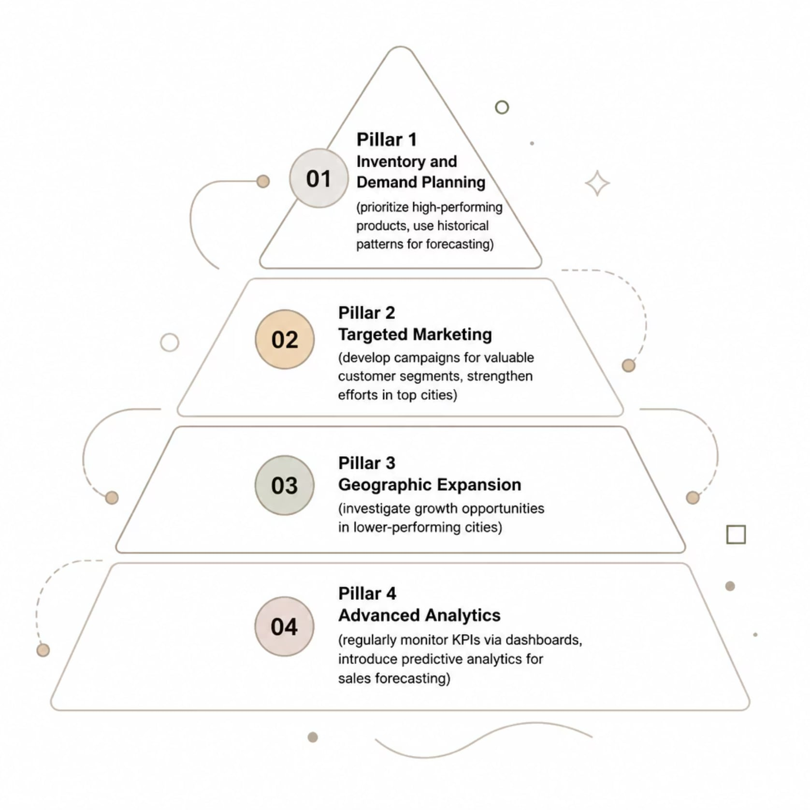
Business Recommendations
Actionable Next Steps
Prioritize inventory for high-performing products and categories
Develop targeted campaigns for valuable customer segments
Strengthen marketing in high-performing geographic markets
Investigate growth opportunities in lower-performing cities
Use historical patterns for inventory and demand planning
Monitor KPIs regularly via interactive dashboards
Introduce predictive analytics for future sales forecasting

Slide 10

TOOLS · SKILLS · OUTCOMES
Technical Skills & Learning Outcomes
Programming & Analysis
Python · Pandas · NumPy · Data Cleaning · EDA · Statistical Analysis
Visualization & BI
Matplotlib · Seaborn · Power BI · Dashboard Development · Data Storytelling
Platforms & Workflow
Google Colab · Jupyter Notebook · Git · GitHub · Business Intelligence
From Raw Data to Actionable Business Intelligence — This internship strengthened both technical and business-oriented analytical skills, producing a complete, portfolio-ready data analytics project.
Thank you — Bhoomika N · B.Tech Computer Science & Engineering · ApexPlanet Software Pvt. Ltd.

Slide 11
Thank you

