Slide 1
CSE7000 - INTERNSHIP A Presentation on Travio – AI-Powered Smart Travel Planner
Student Details
Name | Bhoomika N
Roll No | 20241CSE0670
Section | 5CSE09
Under the Supervision of,
Dr. Jayanthi Kamalasekaran
Associate Professor
Mr. Mithun H S
Assistant Professor
Presidency School of Computer Science and Engineering
Presidency University
Name of the Program: B. Tech (CSE)
Name of the HoD: Dr. Nagaraja S R
Name of the Program Internship Coordinator: Ms. Vidhya Rengasamy
Name of the School Internship Coordinators: Dr. Bhuvaneshwari Patil

Slide 2
Content
About Company or Organization
Working domain or the Technology
Objectives of the work
Methodology Used / Course Description
Results (Optional)
Conclusion

Slide 3
About Company or Organization
NVIDIA is a global leader in AI and GPU computing.
Founded in 1993 in California, USA.
Develops high-performance GPUs for AI and data centers.
Creator of the CUDA parallel computing platform.
Powers innovations in Generative AI, robotics, and autonomous vehicles.
NVIDIA technologies are widely used in research and industries.
Focuses on advancing AI through cutting-edge hardware and software.
Provides AI software tools and developer platforms worldwide.

Slide 4
About Company or Organization
Presidency School of AI and Advanced Studies, Presidency University
Summer Internship Program — 2026
Two-week intensive program in AI, Machine Learning and GPU accelerated computing
10 instructional days, 30 contact hours and 2 academic credits
Format: Lecture + Hands-on GPU Lab
Infrastructure: NVIDIA H200 Tensor Core GPU
Faculty, mentors and industry practitioners support the program

Slide 5
Working domain or the technology
Project Domain: AI-Powered Smart Travel Planner.
Frontend: React.js and Vite for a responsive web interface.
Backend: Node.js and Express.js for API development.
Database: Firebase Authentication and Cloud Firestore.
AI Integration: Atlas AI using the Gemini API for travel assistance.
Features: Search, itinerary, hotels, weather, maps, flights, and personalized recommendations.
Architecture: Modular, scalable, and responsive design.
Dynamic Routing: Destination pages generated dynamically.

Slide 6
Objectives of the work
Develop an AI-powered smart travel planning application.
Provide personalized travel recommendations using Atlas AI.
Integrate hotels, weather, maps, flights, and restaurants.
Enable secure user login with Firebase Authentication.
Create dynamic destination pages with intelligent search.
Design a responsive, user-friendly, and scalable platform.
Enhance trip planning through AI-generated itineraries and packing guides.
Improve travel decision-making through real-time information.
Reduce manual trip planning with intelligent automation.

Slide 7
Methodology Used / Course Description
Requirement Analysis: Identified project goals and user requirements.
Project Planning: Planned the workflow and system architecture.
Technology Selection: Chose React, Node.js, Express.js, and Firebase.
UI/UX Design: Created responsive layouts and page designs.
Database Design: Structured user and destination data.
Resource Preparation: Organized images and travel content.
Architecture: Followed a modular and scalable design.
Feature Planning: Defined core modules and functionalities.

Slide 8
Methodology Used / Course Description
Frontend Development: Built responsive pages using React and Vite.
Backend Development: Developed REST APIs with Express.js.
Authentication: Integrated Firebase Google Sign-In.
Database: Stored user data using Cloud Firestore.
AI Integration: Connected Atlas AI with the Gemini API.
API Integration: Added weather, maps, hotels, and flights.
Search System: Implemented dynamic destination search.
Personalization: Developed recommendations and itinerary features.

Slide 9
Methodology Used / Course Description
Functional Testing: Verified all application features.
Debugging: Fixed issues during development.
Performance: Optimized application speed and responsiveness.
Error Handling: Added fallback mechanisms for APIs.
Responsive Design: Tested across multiple devices.
Code Optimization: Improved reusability and maintainability.
Documentation: Prepared the report and presentation.
Final Validation: Reviewed the complete application before submission.

Slide 10
Results (Optional)
Project Completion: Successfully developed the Travio web application.
AI Features: Integrated Atlas AI for travel assistance.
Travel Services: Added hotels, weather, maps, and flights.
Authentication: Implemented secure Firebase login.
Dynamic System: Enabled search and destination management.
Performance: Achieved smooth and responsive navigation.
User Experience: Delivered a modern and interactive interface.

Slide 11
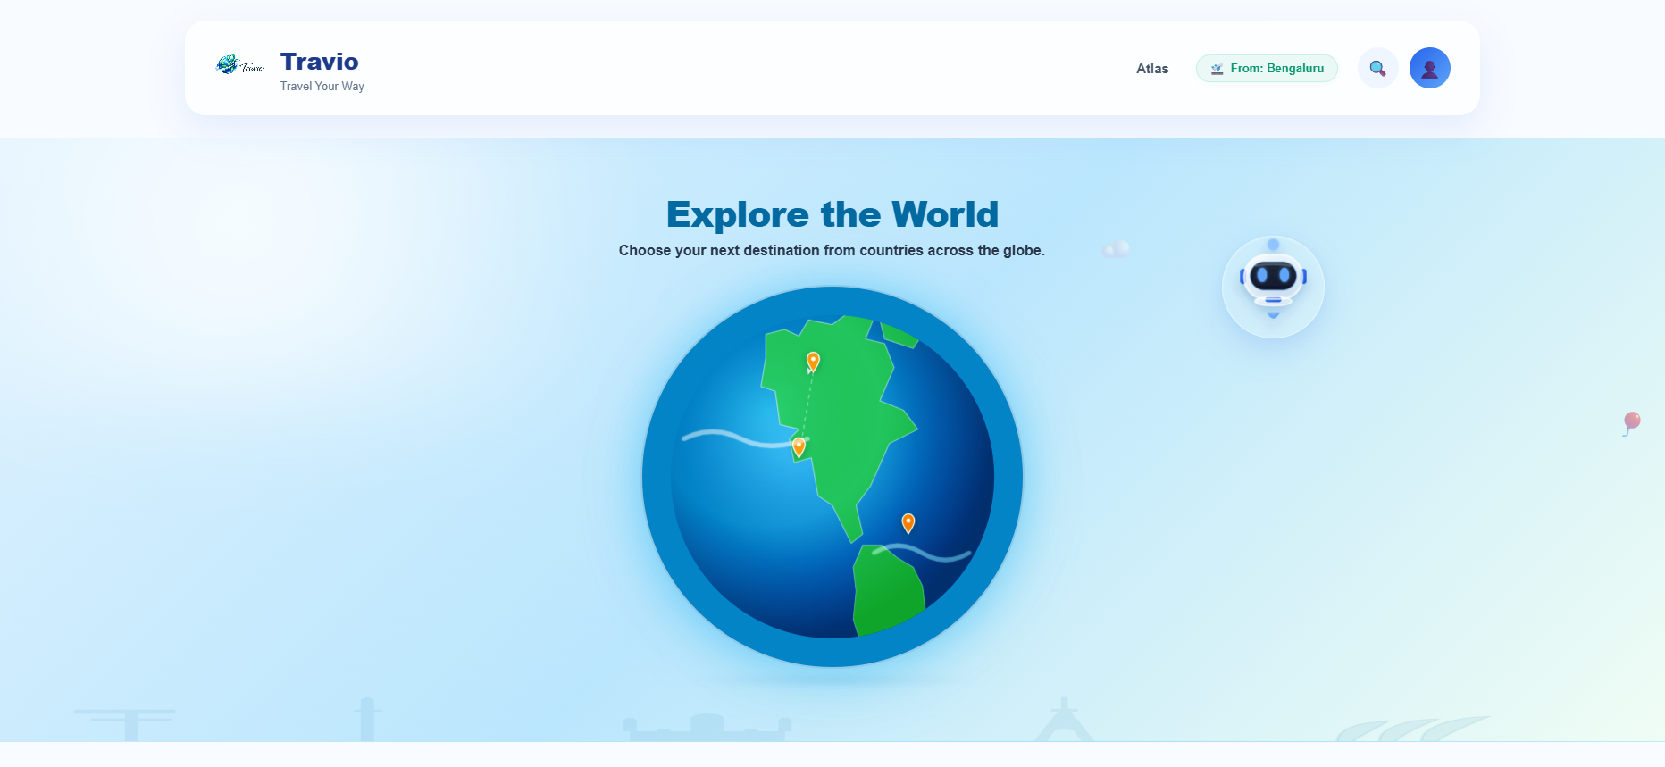
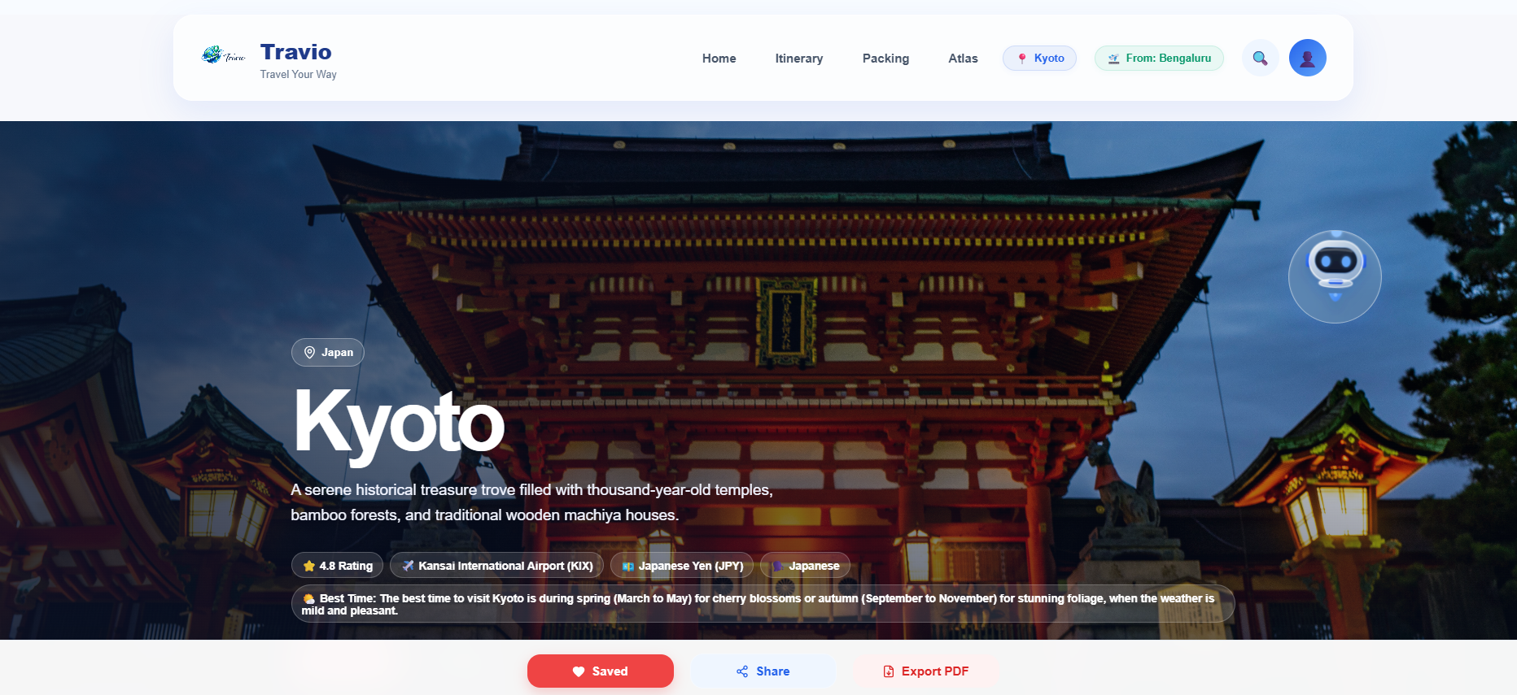
Results (Optional)

Slide 12
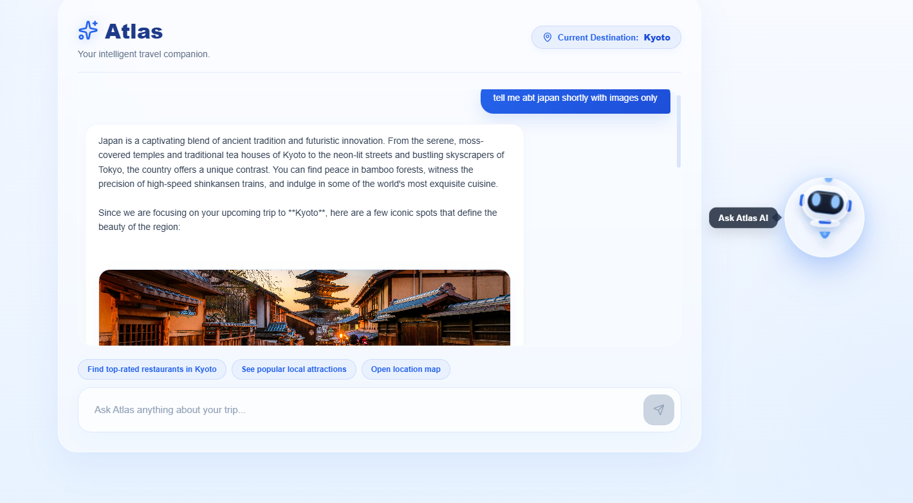
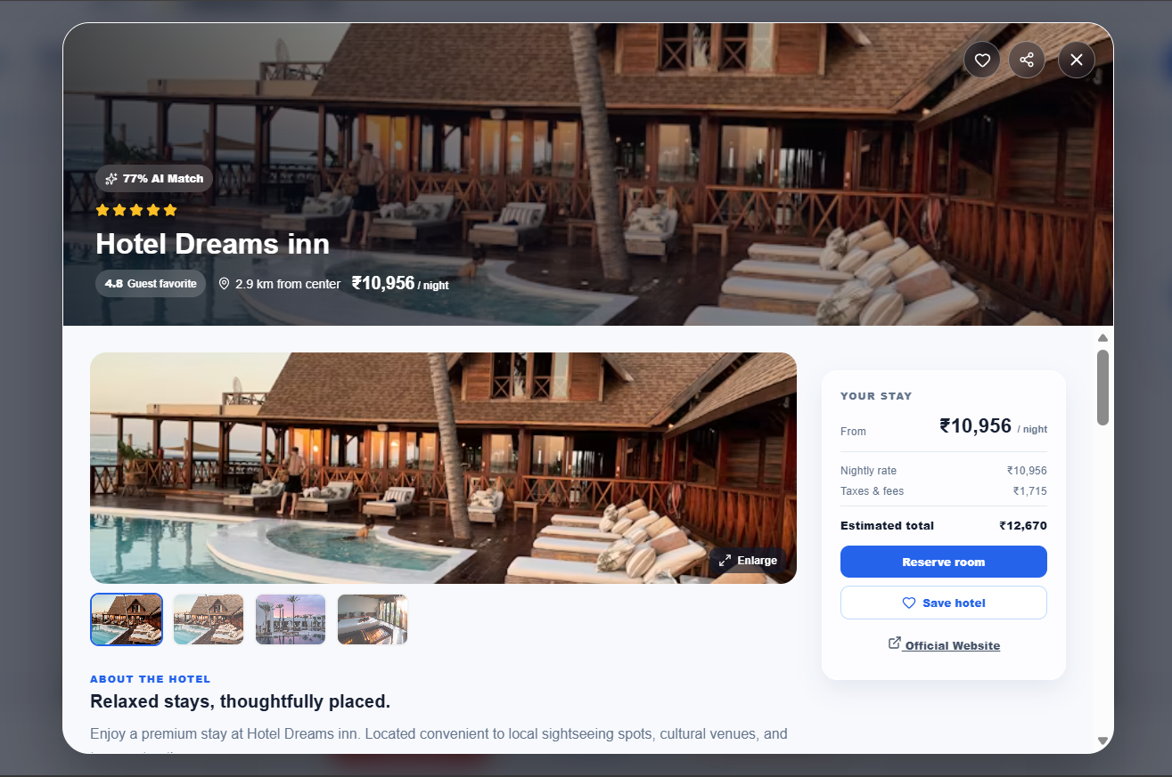
Results (Optional)

Slide 13
Conclusion
Developed an AI-powered smart travel planning application.
Integrated React, Node.js, Firebase, and Gemini AI.
Implemented dynamic search and personalized recommendations.
Combined travel services into a single platform.
Followed a modular and scalable architecture.
Gained practical experience in full-stack development and AI integration.
Improved problem-solving through debugging and continuous testing.
Designed a responsive interface for a consistent user experience across devices.

Slide 14
Q&A

Slide 15
Thank you !!

