Slide 1

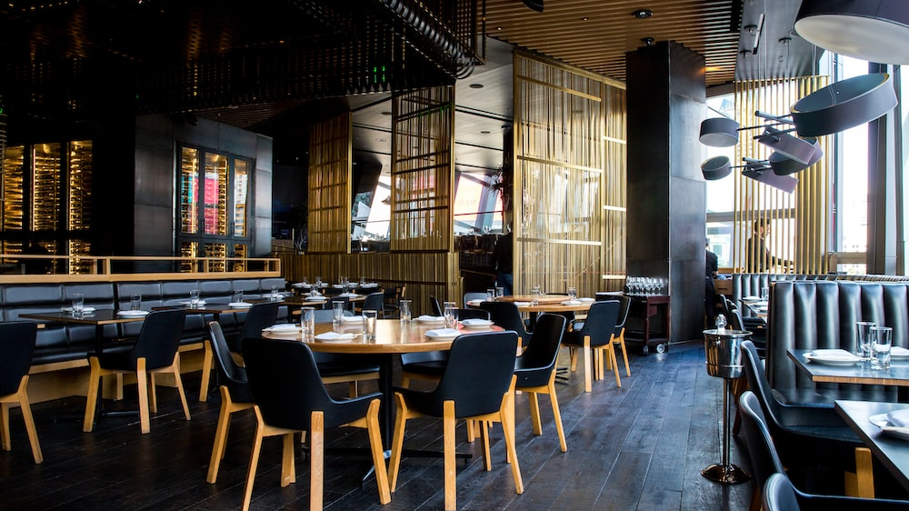

BOOK MY TABLE
z

Slide 2
Team members:
Parth Ashok Rajpara (200230111002)
Rutul Tusharbhai Gajera (200230111027)
Neel Babubhai Gujarati (200230111019)
Jignesh Bhimajibhai Ladumor (200230111058)

Slide 3
Contents:
Introduction: Briefly explain the purpose of the website and its key features.
Problem Statement: Common challenges in booking restaurant tables.
Solution: Introduce Book My Table as a solution to streamline table booking.
Features
Advantages
Disadvantages
Conclusion

Slide 4
Introduction: Briefly explain the purpose of the website and its key features.​

Slide 5

Welcome to Book My Table, the online table booking service that is revolutionizing the restaurant industry. Our platform allows users to easily search for and book tables at their favorite restaurants, all from the comfort of their own home.
At Book My Table, we understand the importance of a good meal shared with friends and loved ones. That's why we've made it our mission to make the dining experience as seamless and enjoyable as possible. With just a few clicks, users can reserve a table.
It's never been easier to dine out than with Book My Table.
z

Slide 6
z
Here are some key features for vendors on our website:
Increased Exposure: By listing their business on our platform, vendors gain access to a vast user base actively seeking dining options. This increased exposure helps vendors reach potential customers who may not have discovered their establishment otherwise.
Easy Management of Reservations: Our website provides a seamless reservation management system that simplifies the process for vendors. They can easily view, accept, and manage incoming table bookings, allowing for efficient planning and organization.

Slide 7
Problem Statement: Common challenges in booking restaurant tables.​

Slide 8
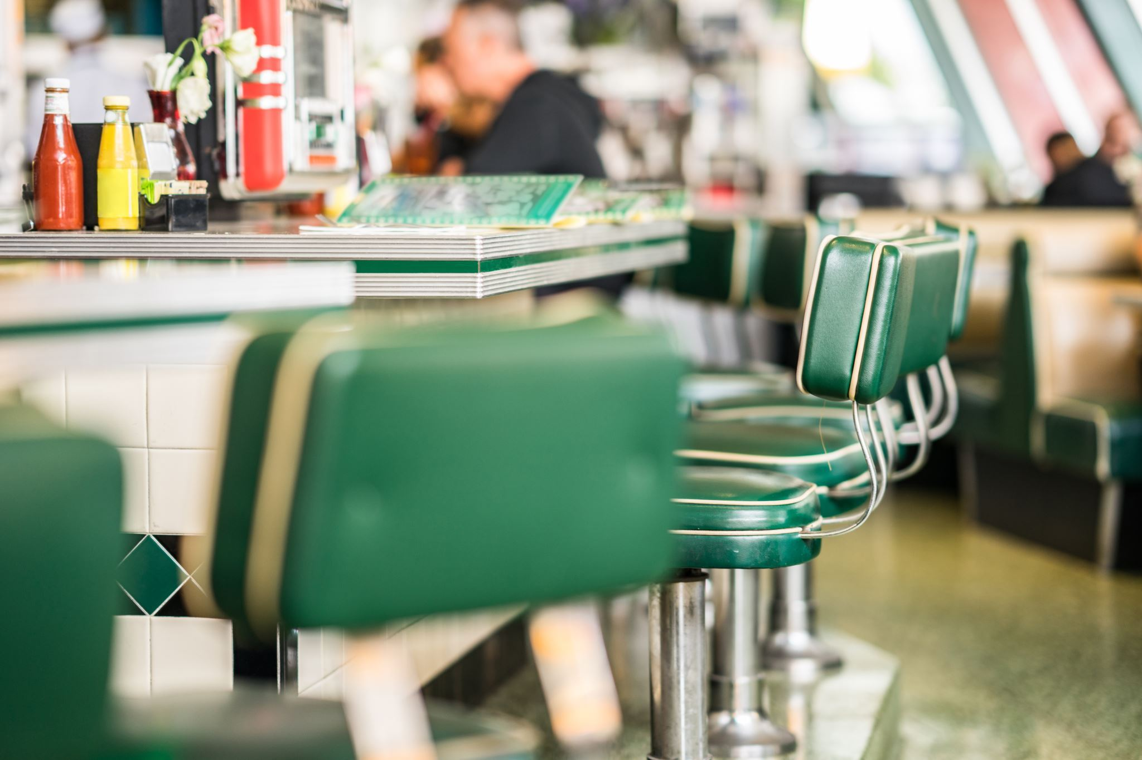
Waiting in Queues: When customers visit a restaurant in person to book a table, they may encounter long queues, especially during busy hours or peak dining times. Waiting in line can be time-consuming and frustrating, particularly if customers have limited availability or are looking for a last-minute reservation.
Limited Availability: Popular restaurants often have limited seating capacity, especially during peak hours or on special occasions. This can make it challenging to secure a table at the desired time, leading to disappointment or the need to settle for alternative options.
Time-consuming Process: Traditional methods of booking tables, such as making phone calls, can be time-consuming. Customers may have to wait on hold or navigate through multiple menus before speaking to a restaurant representative. This can be inconvenient, particularly for individuals with busy schedules or those who prefer a quick and efficient reservation process.
z

Slide 9
Solution: Introduce Book My Table as a solution to streamline table booking.

Slide 10
z
In today's fast-paced world, people are increasingly turning to the internet for their everyday needs. From shopping to entertainment, the internet has become an integral part of our lives. However, one area where the internet has yet to make a significant impact is in the restaurant industry. While many restaurants have websites, few offer the ability to book tables online. This is where Book My Table comes in.
According to recent studies, over 80% of consumers research restaurants online before making a reservation. However, only 10% of those reservations are actually made online. This means that there is a huge untapped market for online table booking services. By offering a convenient and easy-to-use platform for booking tables, Book My Table aims to fill this gap in the market and provide a valuable service to both restaurants and customers alike.
Book My Table offers a unique solution to the problem of restaurant booking. Our website allows customers to book tables online, saving them the hassle of calling restaurants and waiting on hold. But what sets us apart from our competitors is our intuitive interface and personalized recommendations. This not only makes the booking process more efficient but also enhances the overall dining experience.

Slide 11
Features

Slide 12
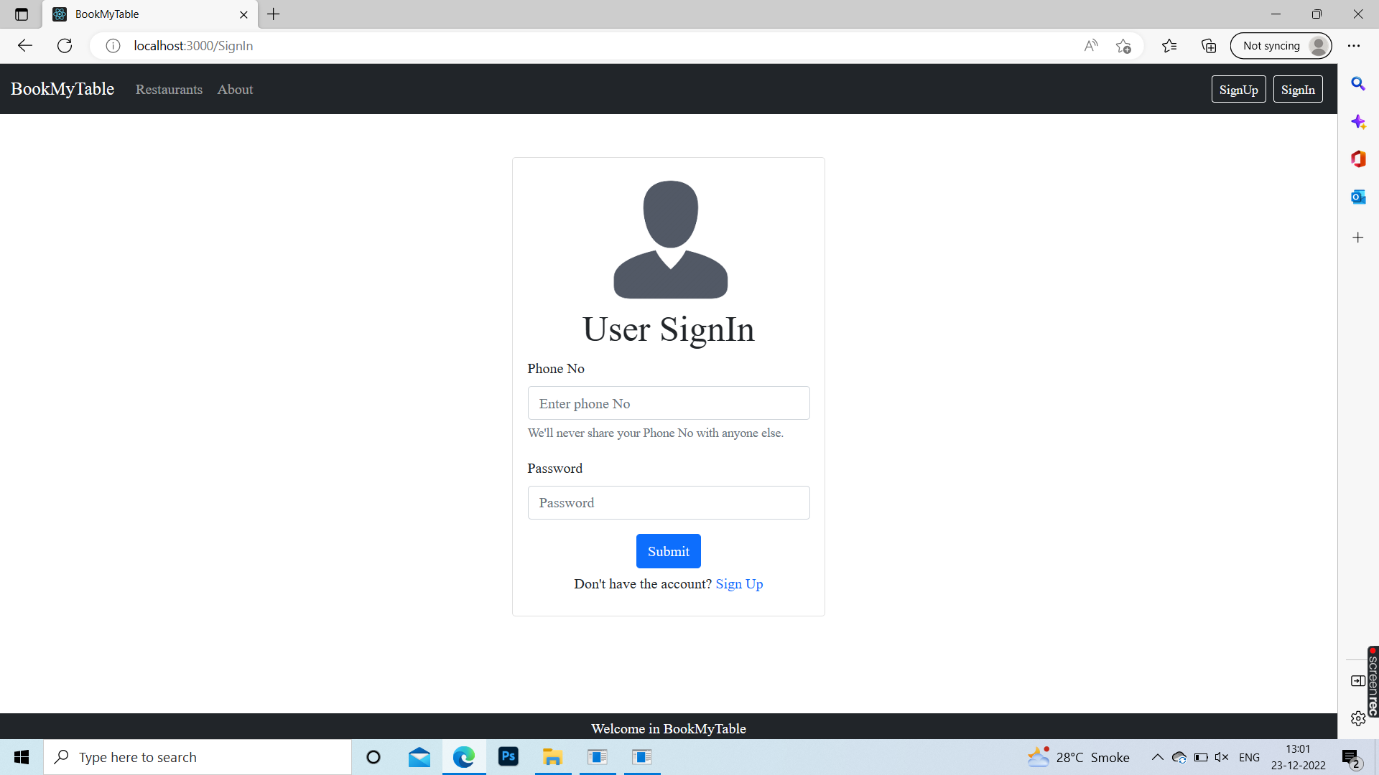

z
Here are some of the features:
User Registration: Users can create accounts on the web app, enabling them to save their preferences, manage their bookings, and receive personalized recommendations based on their dining preferences.
Vendor Dashboard: For vendors, the web app provides a dedicated dashboard where they can manage their restaurant profiles, update menus, view reservations, respond to customer reviews, and access analytics to track their performance.
Search and Filter: The app allows users to search for restaurants based on various criteria such as location, cuisine type, price range, availability, and user ratings. Users can also apply filters to narrow down their search results and find the perfect dining option.

Slide 13
Advantages

Slide 14
z
One of the main advantages of using an online booking platform such as Book My Table is that it allows customers to easily and quickly reserve a table at their desired restaurant without having to call and potentially wait on hold. This can save time and make the booking process more convenient for both the customer and the restaurant.
Another advantage is that it can increase the efficiency and organization of the restaurant's reservations system. With an online platform, the restaurant can easily manage and track bookings, reducing the risk of double-bookings and overbooking. This can help to improve the overall customer experience and ensure that the restaurant runs smoothly.
In addition, an online booking platform can also help to increase the visibility of the restaurant. By allowing customers to easily find and book a table through the platform, the restaurant can attract more customers and potentially increase its revenue.
Overall, using an online booking platform like Book My Table can provide a range of benefits for both restaurants and customers, including convenience, efficiency, and increased visibility.

Slide 15
Disadvantages

Slide 16
z
One of the main disadvantages of using an online booking platform such as Book My Table is that it may not be accessible to everyone. Some customers may not have access to the internet or may not be comfortable using technology to make a reservation. In these cases, they may prefer to call the restaurant directly to make a booking.
Another potential disadvantage is that an online booking system can sometimes be less personal than speaking with a member of the restaurant's staff directly. This may be particularly important for customers with specific needs or requests, such as allergies or dietary restrictions, who may prefer to discuss these with a staff member in person.
In addition, there is always the risk of technical issues or errors when using an online platform. For example, if the platform experiences downtime or is not functioning properly, customers may not be able to make a booking. This can be frustrating for both the customer and the restaurant.
Overall, while an online booking platform like Book My Table can offer many benefits, it is important to consider the potential disadvantages and ensure that it is the right solution for both the restaurant and its customers.

Slide 17
Conclusion

Slide 18
z
The Book My Table application when launched can change the life the people. The main goal of the web application is to provide table booking for the user. Vendor can add their restaurant with simple tricks.
The main goal of a web application is to provide to book a table in a very small amount of time
The user interface (UI) of the web application is so simple as the user and vendor can easily manage the system at their fingertips.

Slide 19
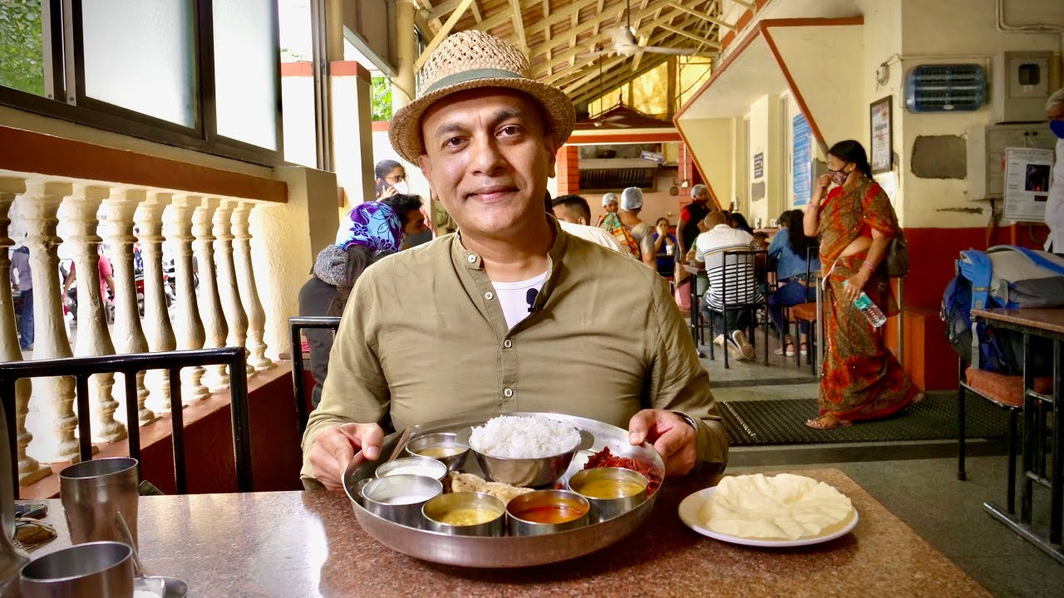
z
Thanks

