Slide 1

Chapter 1
The Sociological Imagination
SOC 2020
Sixth Edition

Slide 2
What’s to Come?
What Is Sociology?
Sociology’s Roots.
Five Big Questions.
Three Sociological Perspectives.
Sociology Is a Verb.

Slide 3
As You Read
What is sociology?
How do sociologists look at the world?
How might someone practice sociology?

Slide 4
What Is Sociology?
Sociology: the systematic study of the relationship between the individual and society and of the consequences of difference.

Slide 5
The Sociological Imagination
As proposed by C. Wright Mills, the sociological imagination is our exploration of the interdependent relationship between who we are as individuals and the social forces that shape our lives.
Private troubles: problems we face in our immediate relationships with particular individuals in our personal lives.
Public issues: problems we face as a consequence of the positions we occupy within the larger social structure.

Slide 6
The Significance of Place
Our place in society affects our access to resources and opportunities.
Influenced by our parents, teachers, friends, and other people we interact with.
Social class, gender, and race and ethnicity also have great significance and have been of special interest to sociologists.
CEOs earn 361 times as much as an average worker.
Men tend to earn more than women.
Whites consider President Obama less successful than minorities do.

Slide 7
A Hamburger Is a Miracle
Consider how difficult it would be to make a hamburger without relying on any knowledge, skills, tools, or resources from others.
Without an interdependent network of people performing myriad small tasks, we would be hard-pressed to provide for ourselves.
Interdependence means we do not have to rely on our own knowledge and skill alone for survival.

Slide 8
Defining Sociology 1
Systematic Study.
Empirical data is gathered through systematic research.
The Individual.
Individuals can reject behavioral guidelines because of agency, the freedom individuals have to think and act as they choose.
Society.
The study of society is at the heart of sociology.
Society consists of the structure of relationships within which culture is created and shared through regularized patterns of social interaction.

Slide 9
Defining Sociology 2
The Consequences of Difference.
Sociology looks at how economic, social, and cultural resources are distributed.
Sociology views the implications of these patterns in terms of the opportunities and obstacles they create for individuals and groups.
Social inequality: a condition in which members of society have differing amounts of wealth, prestige, or power.

Slide 10
5 Movies on the Sociological Imagination
12 Years a Slave.
An 1840s African American man is kidnapped and sold into slavery.
Children of Men.
A dystopian vision of society where humans can no longer reproduce.
Black Panther.
The African civilization of Wakanda might just save the world.
Philomena.
A mother’s search for the child she gave up for adoption.
Lady Bird.
On the path to adulthood, a young woman navigates the obstacles life puts in her way.

Slide 11
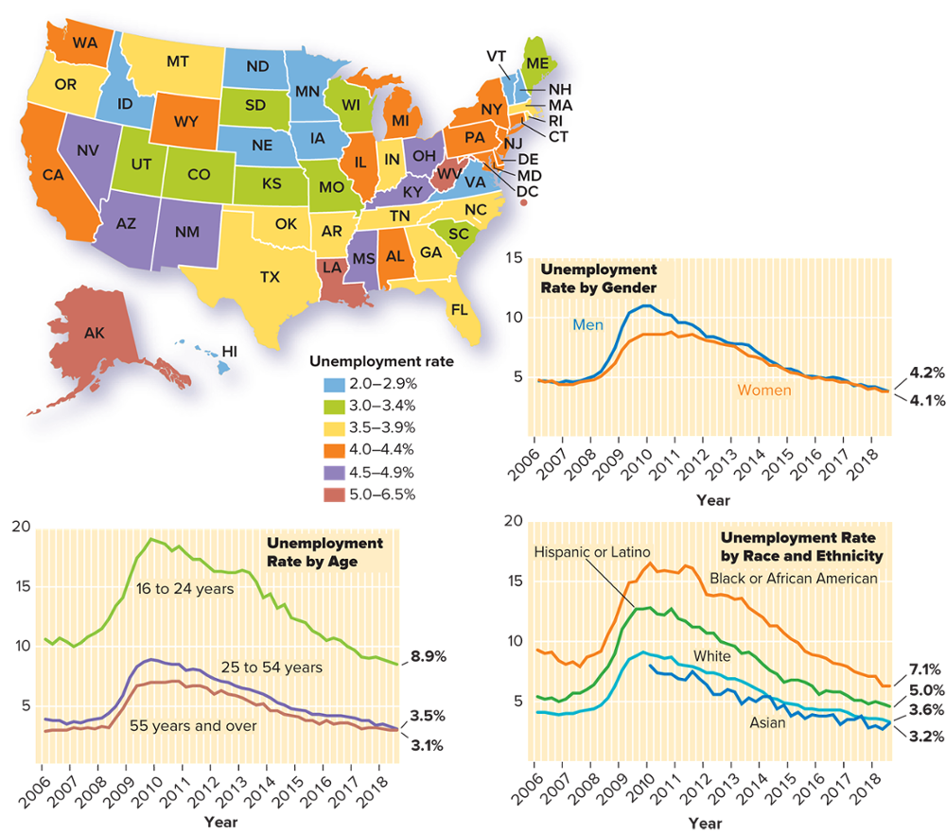
U.S. Employment Trends
Note: The unemployment rate includes people 16 years and older who are available for work but do not have a job and who have actively looked for work within the previous four weeks. Sources: Bureau of Labor Statistics 2016a and 2016b.
Access the text alternative for slide images.

Slide 12
Sociology’s Roots
The discipline of sociology arose in the midst of significant upheaval as a means to understand and control the social forces that shaped our lives.
Advent of the Industrial Revolution in the early 19th century.
Spread of democracy.
Shift from a primarily religious view of the world to a more scientific one.
Urbanization.

Slide 13
A Science of Society 1
Science provided the foundation upon which sociology was built.
Early scientists challenged conventional ideas about how the world worked.
The scientific method insists on empirical investigation that can be measured using our senses.
The explanatory power of laws of nature led others to explore the possibility of uncovering equally powerful laws of society.

Slide 14
A Science of Society 2
Auguste Comte (1798 to 1857) made three significant contributions to the founding of sociology.
Identified two important societal forces worthy of in-depth study: social stability and social change.
Coined the term sociology.
Argued sociologists should serve in a leadership role to advance policies that would enhance social stability and work toward positive social change.

Slide 15
A Science of Society 3
Harriet Martineau (1802 to 1876) also made three significant contributions.
Wrote the first book on sociological methods.
Introduced the significance of inequality and power into the discipline.
Maintained that intellectuals and scholars should act on their convictions to benefit society.

Slide 16
Theory and Research 1
Theory: in sociology a set of statements that seeks to explain problems, actions, or behavior.
Effective theories have explanatory and predictive power.
Formulating Sociological Theories.
Émile Durkheim (1858 to 1917) theorized that social forces shape individual action.
Social facts, as defined by Durkheim: manners of acting, thinking, and feeling external to the individual with coercive power to shape how we act, think, and feel.
Durkheim chose to study suicide, hypothesizing that suicide rates vary with the degree of social integration.

Slide 17
Theory and Research 2
Testing Sociological Theories.
Durkheim chose religious affiliation as an indicator of social integration and gathered data from different countries to see if suicide rates varied.
Applying Sociological Theories.
Built in to Durkheim’s theory is the presupposition that we find meaning in life through our relationships with others.
We cannot consider what it means to be an individual apart from our position in society.
Durkheim’s work on suicide provides a classic case of sociological theory at work.

Slide 18
Theory and Research 3
Suicide Rates.
Sociologists and others continue to explore the contextual elements that influence the likelihood of suicide.
Social science: an umbrella term for a number of disciplines engaged in the systematic study of human behavior, interaction, and change.
Natural science: the systematic study of the physical features of nature and the ways in which they interact and change.

Slide 19
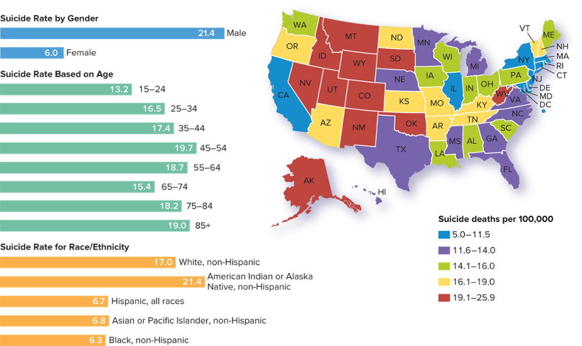
Suicide Rates
Note: Rates are per 100,000, not percentages. Source: Xu et al. 2018.
Access the text alternative for slide images.

Slide 20
Five Big Questions
How is social order maintained?
How do power and inequality shape outcomes?
How does interaction shape our worlds?
How does group membership (especially class, race, and gender) influence opportunity?
How should sociologists respond?

Slide 21
How Is Social Order Maintained?
Émile Durkheim in particular placed a premium on understanding how social order was achieved and maintained.
Introduced the concept of anomie—a weak sense of social solidarity due to a lack of agreed-upon rules to guide behavior.

Slide 22
How Do Power and Inequality Shape Outcomes?
Karl Marx (1818 to 1883) emphasized the role that power and control over resources played in how social order is established and maintained.
Alienation: loss of control over our creative human capacity to produce, separation from the products we make, and isolation from our fellow producers.
Max Weber (1864 to 1920) offered a more general theory of power.
Who has power is determined not only by social class and ownership of material resources but also by social status and organizational resources.

Slide 23
How Does Interaction Shape Our Worlds?
Macrosociology concentrates on large-scale phenomena or entire civilizations.
Microsociology stresses study of small groups and the analysis of our everyday experiences and interactions.
Thomas theorem: what we perceive as real is real in its consequences.
Erving Goffman (1922 to 1982) recommended studying everyday interactions as if we are all actors on a stage seeking to successfully put on a performance.

Slide 24
How Does Group Membership Influence Opportunity?
W. E. B. Du Bois (1868 to 1963) combined an emphasis on the analysis of everyday lived experience with a commitment to investigating power and inequality based on race.
Ida Wells-Barnett (1862 to 1931) argued societies can be judged on whether the principles they claim to believe in match their actions.
Used her analysis of society to resist oppression.

Slide 25
How Should Sociologists Respond?
Sociological theory and research should contribute to positive social change.
Jane Addams (1860 to 1935), an early member of the American Sociological Society, cofounded Hull House.
Working with Ida Wells-Barnett, Addams also prevented racial segregation in the Chicago public schools.
Durkheim, who considered an educated citizenry essential to democratic success, helped shape French educational policy and practice.
Du Bois cofounded the NAACP.

Slide 26
Three Sociological Perspectives 1
The rich array of sociological theories can be classified into three major theoretical perspectives or paradigms:
Functionalist.
Conflict.
Interactionist.

Slide 27
Three Sociological Perspectives 2
Functionalist perspective: a sociological paradigm that sees society as like a living organism in which its various parts work together for the good of the whole.
Society and its parts are structured to provide social order and maintain stability.
Emphasizes consensus and cooperation.

Slide 28
Three Sociological Perspectives 3
Conflict perspective: a sociological paradigm that focuses on power and the allocation of valued resources in society.
Social order cannot be fully understood apart from an analysis of how the status quo is established and maintained.
Interactionist perspective: a sociological paradigm that maintains that society is a product of our everyday encounters with others through which we establish shared meanings and thus construct order.

Slide 29
Three Sociological Perspectives 4
Topic area | Functionalist | Conflict | Interactionist
View of society | Stable, well integrated | Characterized by tension and struggle between groups | Active in influencing and affecting everyday social interaction
Level of analysis emphasized | Macro | Macro | Micro, as a way of understanding the larger macro phenomena
Key concepts | Social integration Institutions Anomie | Inequality Power Alienation | Symbols Self Generalized other
View of the individual | People create and share culture in order to establish a relationship to nature and with each other | People are shaped by power, coercion, and authority | People manipulate symbols and create their social worlds through interaction
View of the social order | Maintained through cooperation and consensus | Maintained through force and coercion | Maintained by shared understanding of everyday behavior
View of social change | Enhances social order over the long run | Challenges to existing system of inequality are resisted by those in power | Occurs as a consequence of people exercising their agency to choose new pathways
Example | Public punishments reinforce the social order | Laws enforce the positions of those in power | People respect laws or disobey them based on their own past experience
Proponents | Émile Durkheim Talcott Parsons Robert Merton | Karl Marx W. E. B. Du Bois Ida Wells-Barnett | George Herbert Mead Charles Horton Cooley Erving Goffman

Slide 30
Sociology Is a Verb
“What can I do with sociology?”
Personal sociology.
Academic sociology.
Applied sociology.
Clinical sociology.

Slide 31
Personal Sociology
Personal sociology: the practice of recognizing the impact the positions we occupy have on who we are and how we think and act.
We can all practice personal sociology.
The sociological imagination provides us with the tools necessary.
Social, cultural, political, and economic events around the world have a profound effect on how we think and what we do.
Globalization: the worldwide integration of government policies, cultures, social movements, and financial markets through trade and the exchange of ideas.

Slide 32
Academic Sociology
Those who study sociology in depth cultivate a variety of skills applicable in many other fields.
Using the sociological imagination.
Conducting data analysis.
Working in teams.
Writing reports.
Creating presentations.
Analyzing social problems.
Addressing diversity.
The most common occupational category is social services.

Slide 33
Applied and Clinical Sociology
Applied sociology: the use of the discipline of sociology with the specific intent of yielding practical applications for human behavior and organizations.
Clinical sociology: the use of the discipline of sociology with the specific intent of altering social relationships or restructuring social institutions.

Slide 34

Sociology Degrees Conferred in the United States, by Gender
Source: National Center for Education Statistics, Digest of Education Statistics—Most Current Digest Tables. Washington, DC: Institute of Education Services, U.S. Department of Education, September 6, 2016. www.nces.ed.gov. Photo: ©Maria Suleymenova/Shutterstock
Access the text alternative for slide images.

Slide 35
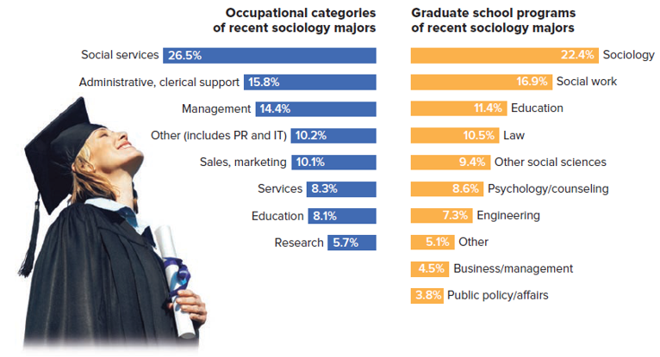
Where Are They Now?
Note: Percentage based on sociology majors attending graduate school 18 months after graduation. Source: Spalter-Roth, Roberta, and Nicole Van Vooren. 2009. “Idealists vs. Careerists: Graduate School Choices of Sociology Majors.” American Sociological Association Department of Research and Development. Washington, DC: American Sociological Association. www.asanet.org. Photo: ©Stockbyte/PunchStock
Access the text alternative for slide images.

Slide 36
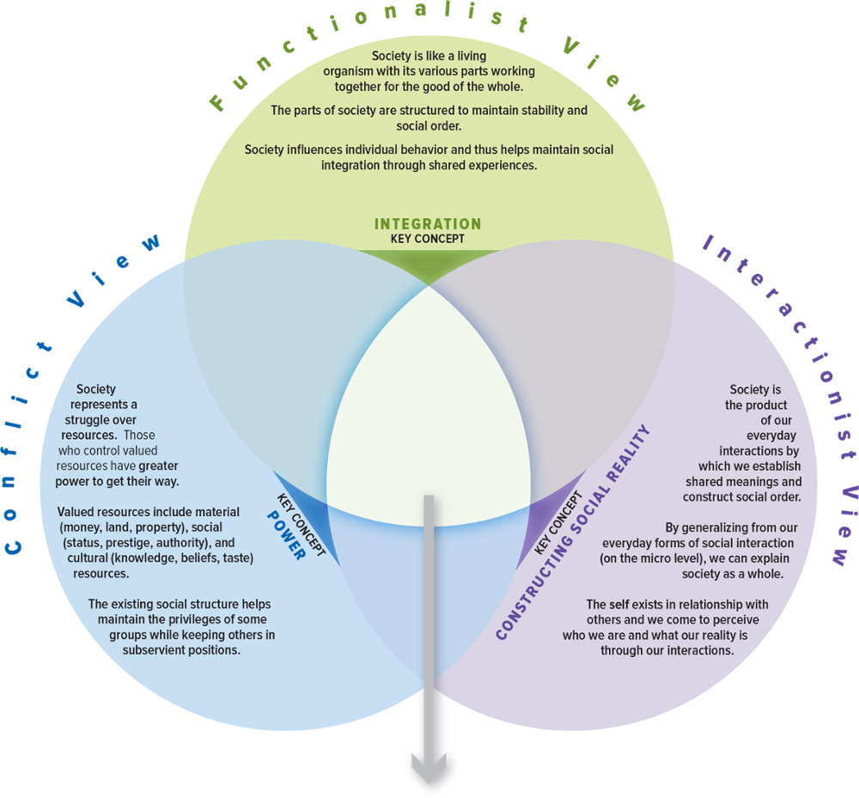
SOC VIEWS on the Sociological Imagination

Slide 37
Make the Connection
Why might having multiple theoretical perspectives help us when we practice the sociological imagination?
How might each perspective differ in how it looks at what it takes to produce something (such as a hamburger, a house, a book, and so on)?
How might each perspective approach the study of unemployment? Of suicide?
How does each perspective enable you to see the way you participate in sports, either as a fan or as an athlete, in a different light?

Slide 38
End of Main Content

Slide 39
Accessibility Content: Text Alternatives for Images

Slide 40
U.S. Employment Trends - Text Alternative
Return to parent-slide containing images.
The map infers the following data. The unemployment rate, 2.0 to 2.9 percent: Idaho, North Dakota, Minnesota, Iowa, Nebraska, Virginia, Vermont, New Hampshire, and Hawaii. The unemployment rate, 3.0 to 3.4 percent: Maine, South Carolina, Wisconsin, Missouri, Kansas, Utah, Colorado, Kansas, Missouri, and South Dakota. The unemployment rate, 3.5 to 3.9 percent: Massachusetts, Rhode Island, North Carolina, Tennessee, Georgia, Florida, Indiana, Arkansas, Oklahoma, Oregon, and Montana. The unemployment rate, 4.0 to 4.4 percent: Connecticut, New York, Pennsylvania, New Jersey, Delaware, Maryland, Michigan, Alabama, Illinois, Washington, Wyoming, and California. The unemployment rate, 4.5 to 4.9 percent: Ohio, Kentucky, Mississippi, Nevada, Arizona, and New Mexico. The unemployment rate, 5.0 to 6.5 percent: West Virginia, Louisiana, Washington D.C., and Alaska. The first graph is titled, unemployment rate by age. The horizontal axis representing year ranges from 2006 to 2018, in increments of 1. The vertical axis ranges from 0 to 20, in increments of 5. The graph shows three lines. The line representing 16 to 24 years begins at (2006, 10.5 percent) and ends at (2018, 8.9 percent) with peaks at (2010, 19 percent) and (2013, 16 percent). The line representing 25 to 54 years begins at (2006, 4.5 percent) and ends at (2018, 3.5 percent) with peak at (2010, 9 percent). The line representing 55 years and over begins at (2006, 3.5 percent) and ends at (2018, 3.1 percent) with peak at (2010, 7 percent). The second graph is titled, unemployment rate by gender. The horizontal axis representing year ranges from 2006 to 2018, in increments of 1. The vertical axis ranges from 0 to 15, in increments of 5. The graph shows two lines. The line representing men begins at (2006, 5 percent) and ends at (2018, 4.2 percent) with peak at (2010, 11 percent) and dip at (2017, 4.7 percent). The line representing women begins at (2006, 5 percent) and ends at (2018, 4.1 percent) with peak at (2010, 8.5 percent). The third graph is titled, unemployment rate by race and ethnicity. The horizontal axis representing year ranges from 2006 to 2018, in increments of 1. The vertical axis ranges from 0 to 20, in increments of 5. The graph shows four lines. The line representing Asian begins at (2010, 8 percent) and ends at (2018, 3.2 percent). It has predominant lows and highs. The line representing White begins at (2006, 4.5 percent) and ends at (2018, 3.6 percent) with peak at (2010, 9.5 percent). The line representing Black or African American begins at (2006, 9.5 percent) and ends at (2018, 7.1 percent) with peak at (2010, 16.5 percent). The line representing Hispanic or Latino begins at (2006, 5.5 percent) and ends at (2018, 5.0 percent) with peak at (2010, 13 percent). Note: all values are approximate.
Return to parent-slide containing images.

Slide 41
Suicide Rates - Text Alternative
Return to parent-slide containing images.
For example, states with the highest suicide rate are clustered in the West and include the neighboring states of New Mexico, Nevada, Utah, Colorado, Idaho, Wyoming, South Dakota, Montana, and Oklahoma. Similarly, a cluster of neighboring states including Kansas, Missouri, Arkansas, Tennessee, and Kentucky, all fall in the second highest suicide rate category.
Return to parent-slide containing images.

Slide 42
Sociology Degrees Conferred in the United States, by Gender - Text Alternative
Return to parent-slide containing images.
The left page of the planner reads the title. The right page of the planner shows a horizontal bar graph. The horizontal axis represents the degrees awarded (thousands) and the vertical axis represents the year. Each horizontal bar is divided into two: women and men. The three-fourth portion of each bar is occupied by women. The total values of the bar along with its year are as follows: 1990, 15.9; 1994, 22.4; 1998, 24.7; 2002, 25.3; 2006, 28.5; 2010, 28.7; 2014, 30.3; and 2016, 29.8.
Return to parent-slide containing images.

Slide 43
Where Are They Now? - Text Alternative
Return to parent-slide containing images.
The occupational categories of recent sociology majors infer the following data: social services, 26.5 percent; administrative, clerical support, 15.8 percent; management, 14.4 percent; other (includes PR and IT), 10.2 percent; sales, marketing, 10.1 percent; services, 8.3 percent; education, 8.1 percent; and research, 5.7 percent. The graduate school programs of recent sociology majors infer the following data: sociology, 22.4 percent; social work, 16.9 percent; education, 11.4 percent; law, 10.5 percent; other social sciences, 9.4 percent; psychology or counseling, 8.6 percent; engineering, 7.3 percent; other, 5.1 percent; business or management, 4.5 percent; and public policy or affairs, 3.8 percent.
Return to parent-slide containing images.

