Slide 1

Chapter 3
Culture
SOC 2020
Sixth Edition

Slide 2
What’s to Come?
The Social Construction of Reality.
Constructing Culture.
Three Elements of Culture.
Cultural Variation.

Slide 3
As You Read
Why do humans create culture?
What does culture consist of?
How does culture both enable and constrain?

Slide 4
The Social Construction of Reality
Social construction of reality: the ongoing interdependent relationship within which individuals create society through our actions and, at the same time, become products of the society we construct.
Peter Berger and Thomas Luckmann’s three-step model includes:
Constructing culture.
Constructing the self.
Constructing society.

Slide 5
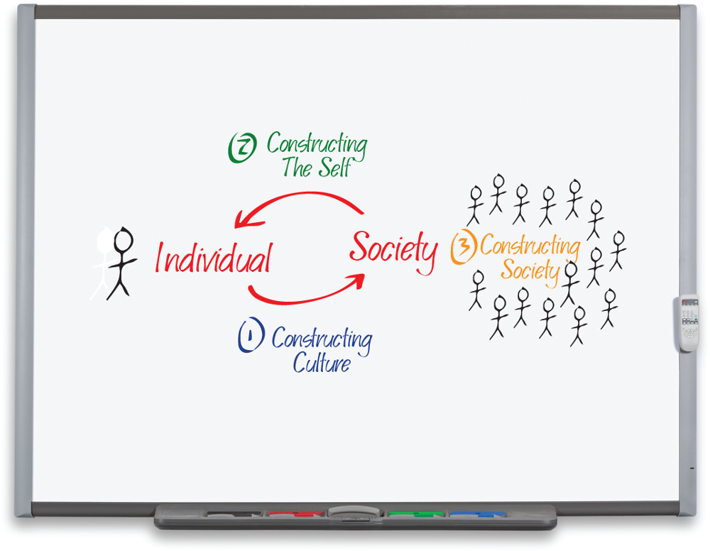
World Construction
Access the text alternative for slide images.
Source: McGraw-Hill Education. Photo: RTimages/Alamy Stock Photo

Slide 6
Constructing Culture
Culture: everything humans create in establishing our relationships to nature and with each other.
Culture mediates between individuals and the external world.
Culture facilitates social interaction.
Society: the structure of relationships within which culture is created and shared through regularized patterns of social interaction.
Societies construct culture in different ways, resulting in significant cross-cultural variation.

Slide 7
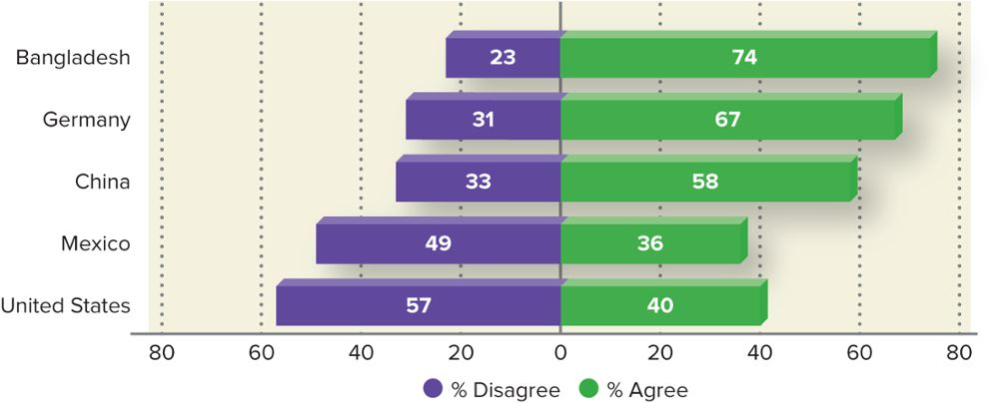
Is Success in Life Determined by Forces Outside Our Control?
Access the text alternative for slide images.
Source: Pew Research Center 2014a.

Slide 8
Cultural Universals 1
Cultural universal: a common belief or practice shared by all societies.
George Murdock found there are common denominators shared by all cultures—though how they go about addressing each varies significantly.
Sports.
Division of labor.
Funeral rites.
Incest taboos.
Marriage.
Sexual restrictions.
Etc.

Slide 9
Cultural Universals 2
Debate over the degree to which our behavior is determined is a nature versus nurture matter.
Sociobiology: the systematic study of how biology affects human social behavior.
Sociological research reveals significant cross-cultural and cross-time variation in how we think and act.
Leads sociologists to prioritize the significance of “nurture” over “nature.”
Researchers argue that an interdependent relationship exists between genes and environment.

Slide 10
Innovation
Innovation: the process of introducing new ideas or objects to a culture.
Discovery: the process of revealing a previously unknown aspect of reality.
Invention: the combination of existing materials to create something new.

Slide 11
Diffusion
For innovation to succeed, others must recognize and accept the new discovery or invention.
Diffusion: the process by which a cultural item spreads within and between societies.
Mass media, the Internet, immigration, and tourism accelerate the diffusion and transmission of culture.
In practice, globalization has led to the cultural domination of developing nations by more affluent nations.

Slide 12
Three Elements of Culture
The culture we create can be grouped into three general categories:
Material.
Cognitive.
Normative.
Each type enables us to interact more effectively with the world around us.

Slide 13
Material Culture
Material culture: our physical modification of the natural environment to suit our purposes.
Clothes, books, chairs, carpets, lights, buildings, cars, roads, and so on.
Technology: a form of culture in which humans convert natural resources into tools to accomplish practical ends.
Cultural lag: the general principle that technological innovation occurs more quickly than does our capacity to perceive, interpret, and respond to that change.

Slide 14
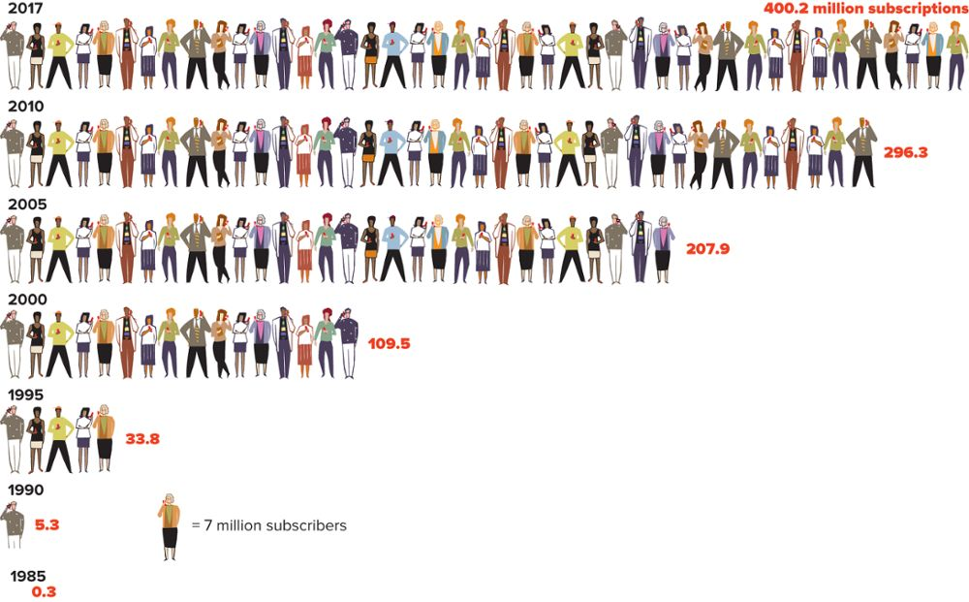
Material Culture: United States Wireless Subscriptions
Technology makes it possible for us to keep in touch with almost anyone anywhere, as these numbers showing the explosion in the number of wireless device subscriptions since 1985 demonstrate. Source: CTIA 2018.
Access the text alternative for slide images.

Slide 15
Cognitive Culture 1
Cognitive culture: our mental and symbolic representations of reality.
Language.
Language: a system of shared symbols.
Language is fundamentally social in nature.
Sapir-Whorf hypothesis: the structure and vocabulary of language shapes our perception of reality and therefore also our actions.
Nonverbal communication: the use of gestures, facial expressions, and other visual images to communicate.

Slide 16
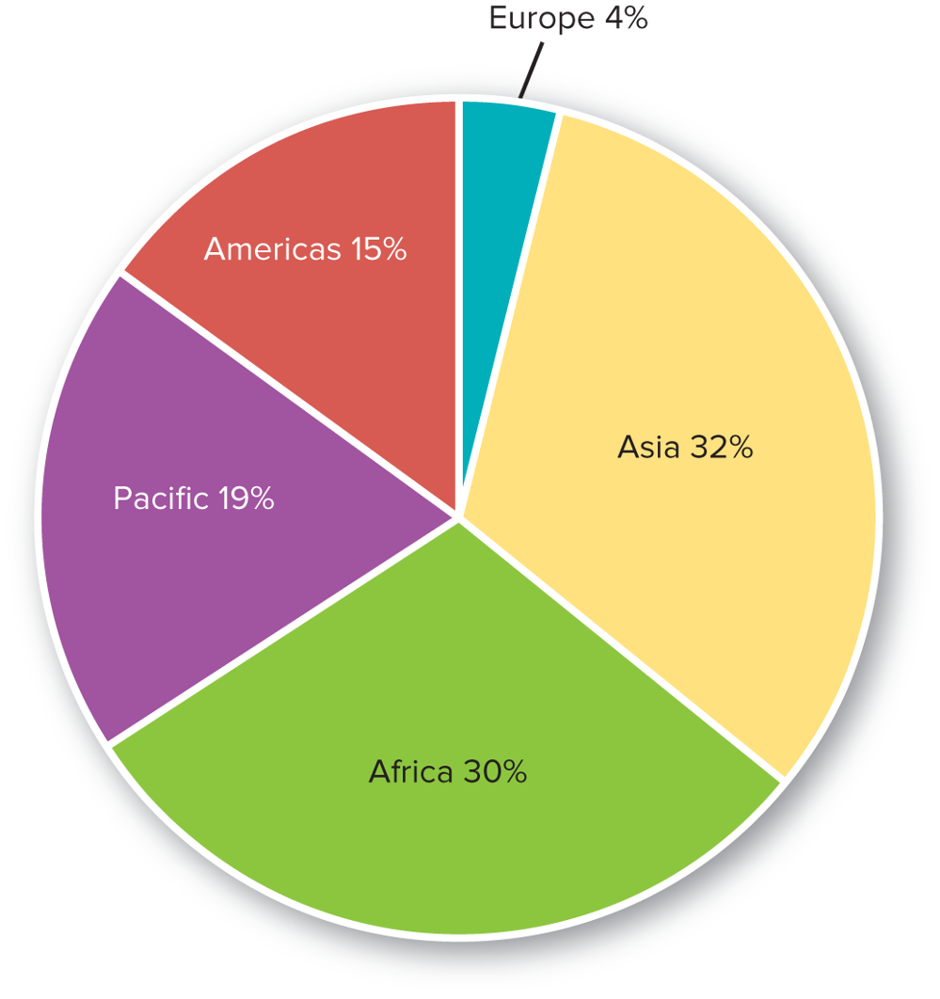
Distribution of the World’s Living Languages by Region of Origin
Note: A total of 7,097 languages are represented. Source: Simons and Fennig 2018.
Access the text alternative for slide images.

Slide 17
Cognitive Culture 2
Values.
Value: a collective conception of what is considered good, desirable, and proper—or bad, undesirable, and improper—in a culture.
Examples: family, love, opportunity, community, freedom.
Values of a culture may change, but most remain relatively stable during any one person’s lifetime.

Slide 18
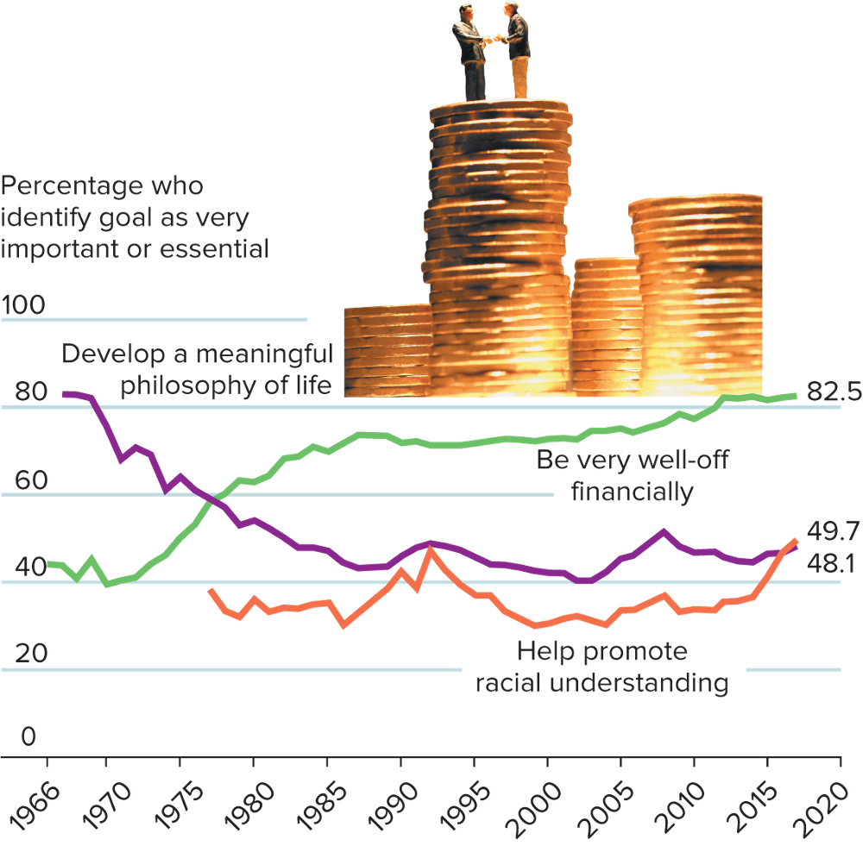
Cognitive Culture: Life Goals of First-Year College Students in the United States
Access the text alternative for slide images.
Source: Stolzenberg et al. 2019. Photo: ©Carson Ganci/Design Pics

Slide 19
Normative Culture 1
Normative culture: consists of the ways we establish, abide by, and enforce principles of conduct.
Norm: an established standard of behavior maintained by a society.
Sociologists classify norms into three primary categories, each representing a continuum:
Centrality.
Formality.
Adherence.

Slide 20
Normative Culture 2
Types of Norms.
Mores: norms deemed highly necessary to the welfare of a society; considered central to society.
Folkways: norms governing everyday behavior, whose violation raises comparatively little concern.
Formal norm: a norm that has been written down and that specifies strict punishments for violators.
Laws: formal norms enforced by the state.
Informal norm: a norm that is generally understood but not precisely recorded; low in formality.

Slide 21
Normative Culture 3
Types of Norms, continued.
Ideal norms: guidelines for behavior that people agree should be followed; there is a high expectation of adherence.
Real norms: rules of conduct generated from people’s actual behavior.
Breaking Norms.
We can choose not to abide by a norm.
Sometimes norms clash.
There are exceptions to any norm.
Violating norms can serve as a foundation for social change.

Slide 22
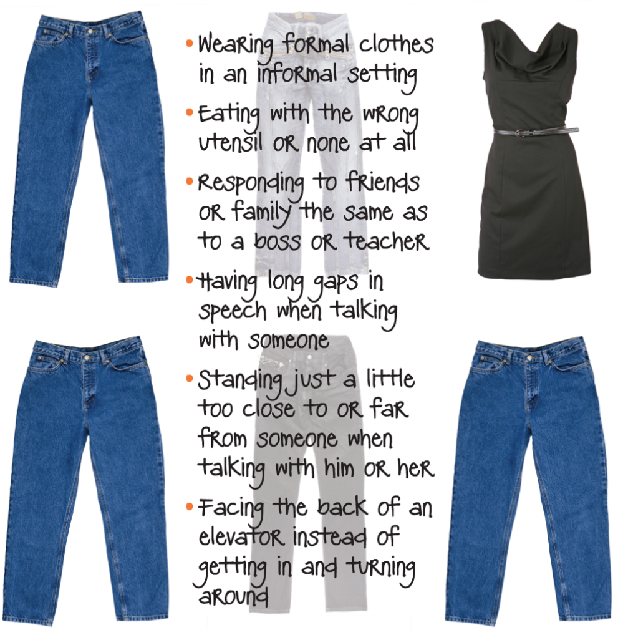
Normative Culture: Break-a-Norm Day
Norms provide us with rules that guide our everyday behavior. All we need to do is step outside the lines even a little bit to see the influence they have over our lives. These are some examples of how people violate norms.
Access the text alternative for slide images.
Photos: (dress): ©C Squared Studios/Photodisc/Getty Images; (jeans): ©Gordana Sermek/iStock/Getty Images

Slide 23
Normative Culture 4
Sanctions.
Sanction: a penalty or reward for conduct concerning a social norm.
Positive, such as pay raises, medals, words of gratitude.
Negative, such as fines, threats, imprisonment, stares of contempt.

Slide 24
5 Movies on United States Culture
Sorry to Bother You
An African American telemarketer adopts a White accent in pursuit of the American Dream.
En el Séptimo Día (On the Seventh Day)
There’s power in community.
If Beale Street Could Talk
A young couple’s love runs up against society’s injustice.
The Rider
A rodeo champion’s riding accident shatters his dreams.
Revolutionary Road
When living the American Dream becomes a nightmare.

Slide 25
5 Movies on Cultures Outside the United States
Shoplifters
Sometimes it’s better to choose your own family.
Embrace of the Serpent
Worlds collide when an Amazonian shaman, the last of his tribe, encounters two scientists.
Roma
A year in the life of a family living in Mexico City.
Persepolis
An animated coming-of-age film set during the Iranian Revolution.
Departures
An unemployed man violates Japanese norms by becoming an undertaker.

Slide 26
Cultural Variation
Together the elements of culture provide us with social coherence and order.
Culture also varies across time and place.
Some people have more power to impose their culture on others.

Slide 27
Aspects of Cultural Variation 1
Subcultures.
Subculture: a segment of society that shares a distinctive pattern of mores, folkways, and values that differs from the pattern of the larger society.
Argot: specialized language used by members of a group or subculture.
In recent years, the growing divide between political subcultures in the United States has raised concerns.

Slide 28
Aspects of Cultural Variation: Subculture Slang
Anime and Manga Fans
chibi eyes: the characteristic, big childlike eyes used in anime
majoko: a girl anime character with magical powers who must save the world
Con Artists & Scammers
grifter: a person who steals through deception
phishing: seeking personal information by sending out emails that appear to be from legitimate companies
Graffiti Writers
bite: to copy another graffiti writer’s work
burner: a stylistically impressive, brilliantly colored piece of graffiti, usually written in a complex pattern of interlocking letters and other visual elements
toy: an inexperienced or unskilled graffiti writer
kill: to saturate an area with one’s graffiti
Bikers (Motorcyclists)
brain bucket: a helmet
ink slinger: a tattoo
pucker factor: the degree of panic felt during a near-accident
yard shark: a dog that races out to attack passing motorcyclists
Skateboarders
deck: a skateboard platform
face plant: a face-first crash
sketchy: in reference to a trick, poorly done
Subcultures often produce their own unique jargon. The words may be appropriate in those subcultures, but they draw a line between insiders and the rest of us. Source: Reid 2006.

Slide 29
Aspects of Cultural Variation 2
Countercultures.
Counterculture: a subculture that conspicuously and deliberately opposes certain aspects of the larger culture.
Hippies.
Terrorist cells.
Culture Shock.
Culture shock: the feelings of disorientation, uncertainty, and even fear that people experience when they encounter unfamiliar cultural practices.

Slide 30
Dominant Ideology
Dominant ideology: a set of cultural beliefs and practices that legitimates existing powerful social, economic, and political interests.
Helps explain and justify who gets what and why in a way that supports and maintains the status quo.
Karl Marx argued that the dominant ideas in society maintain the interests of the ruling class.
Lukács and Gramsci: it is used as an instrument of power.
Feminists: the dominant ideology works to reinforce gender stereotypes and subordinate women.

Slide 31
Understanding Others
Ethnocentrism.
Ethnocentrism: the tendency to assume that one’s own culture and way of life represent what’s normal or is superior to all others.
Some degree of ethnocentrism is normal; the challenge is in the implicit denigration of other nations and cultures.
Cultural Relativism.
Cultural relativism: the viewing of other people’s behavior from the perspective of those other people’s culture.
Different social contexts give rise to different norms, values.

Slide 32
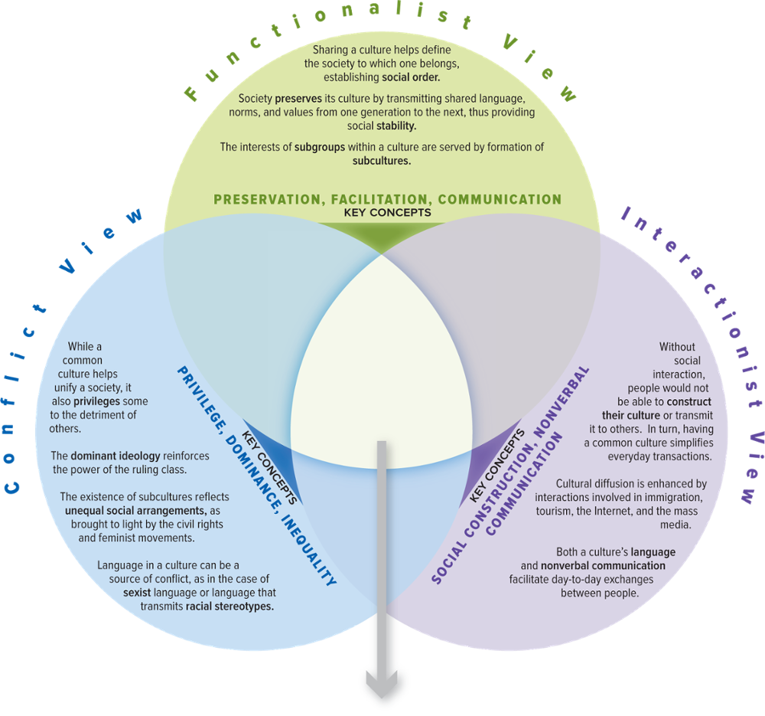
SOC VIEWS on Culture
Access the text alternative for slide images.

Slide 33
Make the Connection
How would each of the three perspectives describe the lessons learned from the No Pants Subway Ride?
How would each perspective explain the role material, cognitive, and normative culture plays in our lives?
How would each perspective approach the role that dominant ideology performs in a culture?
How would you use the perspectives to describe one of the subcultures at your school?

Slide 34
End of Main Content

Slide 35
Accessibility Content: Text Alternatives for Images

Slide 36
World Construction - Text Alternative
Return to parent-slide containing images.
Each individual contributes in constructing a society through their culture and the society in turn contributes in constructing an individual.
Return to parent-slide containing images.

Slide 37
Is Success in Life Determined by Forces Outside Our Control? - Text Alternative
Return to parent-slide containing images.
The graph infers the data in the following format: Country, percentage of people who disagreed, and percentage of people who agreed. Bangladesh, 23 percent, 74 percent; Germany, 31 percent, 67 percent; China, 33 percent, 58 percent; Mexico, 49 percent, 36 percent; and United States, 57 percent, 40 percent.
Return to parent-slide containing images.

Slide 38
Material Culture: United States Wireless Subscriptions - Text Alternative
Return to parent-slide containing images.
The increase is represented by increase in the number of people in a queue. Each person in the queue is equal to 7 million subscribers. The data follows: 1985, 0.3 million subscriptions; 1990, 5.3 million subscriptions; 1995, 33.8 million subscriptions; 2000, 109.5 million subscriptions; 2005, 207.9 million subscriptions; 2010, 296.3 million subscriptions; and 2017, 400.2 million subscriptions.
Return to parent-slide containing images.

Slide 39
Distribution of the World’s Living Languages by Region of Origin - Text Alternative
Return to parent-slide containing images.
The chart infers the following data: Europe, 4 percent; America, 15 percent; Pacific, 19 percent; Africa, 30 percent; and Asia, 32 percent.
Return to parent-slide containing images.

Slide 40
Cognitive Culture: Life Goals of First-Year College Students in the United States - Text Alternative
Return to parent-slide containing images.
The horizontal axis represents the years from 1966 to 2020, with a 5 months interval from the year 1970. The vertical axis represents percentage who identify goal as very important or essential and it ranges from 0 to 100, in increments of 20.
The graph shows three lines. The first line representing, help promote racial understanding, ranges between 30 to 40 percent from the year 1976 to 1986, it raises to 45 percent in 1992, falls to 30 percent in 2004, and raises again to 49.7 percent in 2016. The second line representing, be very well-off finically, starts at 43 percent in 1966, gradually raises to 73 percent in 1990, stays steady till 2002 and steadily increases to 82.5 percent in 2016. The third line representing, develop a meaningful philosophy of life, starts at 80 percent in year 1966, steadily decreases to 40 percent in 2002, and gradually increases to 48.1 in 2016. All the values are approximated.
Return to parent-slide containing images.

Slide 41
Normative Culture: Break-a-Norm Day - Text Alternative
Return to parent-slide containing images.
They follow: Wearing formal clothes in an informal setting; eating with the wrong utensil or none at all; responding to friends or family the same as to a boss or teacher; having long gaps in speech when talking with someone; standing just a little too close to or far from someone when talking with him or her; and facing the back of an elevator instead of getting in and turning around.
Return to parent-slide containing images.

Slide 42
SOC VIEWS on Culture - Text Alternative
Return to parent-slide containing images.
It consists of 3 views: Conflict view, functionalist view, and interactionist view. Conflict view: While a common culture helps unify a society, it also privileges some to the detriment of others. The dominant ideology reinforces the power of the ruling class. The existence of subcultures reflects unequal social arrangements, as brought to light by the civil rights and feminist movements. Language in a culture can be a source of conflict, as in the case of sexist language or language that transmits racial stereotypes. The key concepts of conflict view are privilege, dominance, and inequality.
Functionalist view: Sharing a culture helps define the society to which one belongs, establishing social order. Society preserves its culture by transmitting shared language, norms, and values from one generation to the next, thus providing social stability. The interests of subgroups within a culture are served by formation of subcultures. The key concepts of functionalist view are preservation, facilitation, and communication.
Interactionist view: Without social interaction, people would not be able to construct their culture or transmit it to others. In turn, having a common culture simplifies everyday transactions. Culture diffusion is enhanced by interactions involved in immigration, tourism, the internet, and the mass media. Both a culture’s language and nonverbal communication facilitate day-to-day exchanges between people. The key concepts of interactionist view are social construction and nonverbal communication.
Return to parent-slide containing images.

