Slide 1

Chapter 5
Social Structure and Interaction
SOC 2020
Sixth Edition

Slide 2
What’s to Come?
Social Interaction.
Elements of Social Structure.
Traditional, Modern, and Postmodern Social Structures.
Bureaucracy.

Slide 3
As You Read
What does society provide that we need?
How do sociologists describe traditional versus modern societies?
How does social structure shape individual action?

Slide 4
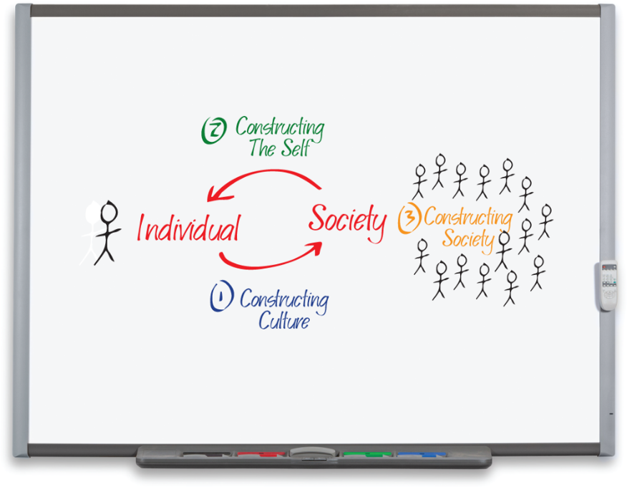
Social Interaction
The third stage of “World Construction” is the construction of society.
Social structure: the underlying framework of society, consisting of the positions people occupy and the relationships between them.
Access the text alternative for slide images.
Photo: RTimages/Alamy Stock Photo

Slide 5
Self and Society
Social interaction: a reciprocal exchange in which two or more people read, react, and respond to each other.
George Herbert Mead: “Selves can only exist in definite relationships to other selves. No hard-and-fast line can be drawn between our own selves and the selves of others.”

Slide 6
Positions and Power
According to the conflict perspectives, accepted patterns of relationships create a power differential.
Some people’s values and voices are privileged over others.
When members of less powerful groups challenge existing social norms, they can raise society’s collective awareness about the consequences of group membership or social position.
Example: Mohammad Ali.

Slide 7
Elements of Social Structure
Social structure provides the underlying framework of society by linking together the positions people occupy and defining the relationships between them.
Sociologists seek to identify and reveal society’s four elemental building blocks:
Statuses and roles.
Groups.
Social networks.
Social institutions.

Slide 8
Statuses and Roles 1
Achieved and Ascribed Status.
Status: the social positions we occupy relative to others.
Achieved status: a social position that is within our power to change.
Ascribed status: a social position assigned to a person by society without regard for the person’s unique talents or characteristics.
Master Status.
Master status: a status that dominates others and thereby determines a person’s general position in society.

Slide 9
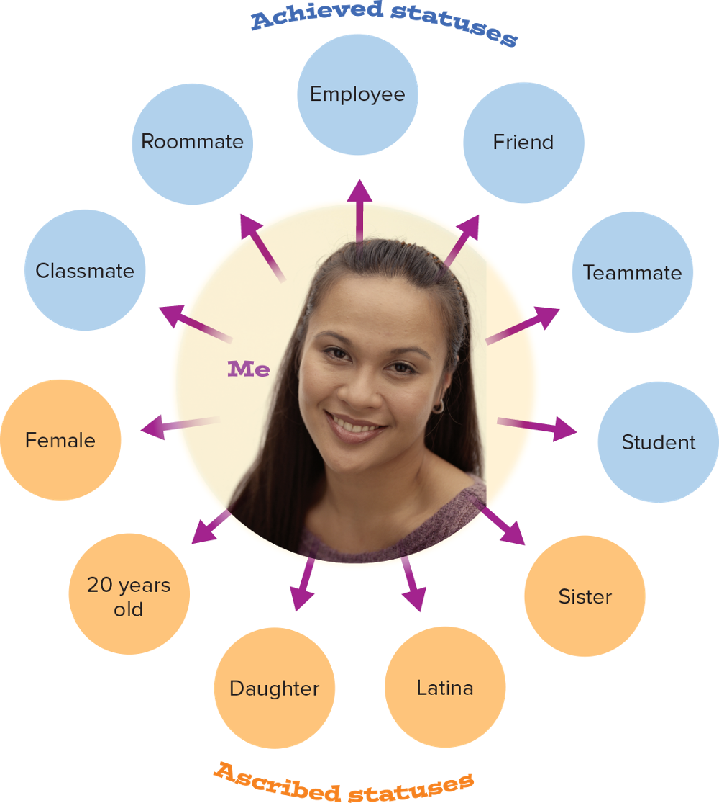
Statuses and Roles: Social Statuses
Access the text alternative for slide images.
Photo: Amos Morgan/Photodisc/Getty Images

Slide 10
Statuses and Roles 2
Roles.
Social role: a set of expectations for people who occupy a given social status.
In some roles, our performance feels perfectly natural; but we are always performing roles regardless of how we feel.
Changing our status changes how we act, think, and feel.
Role Strain and Role Conflict.
Role strain: the difficulty that arises when role expectations within the same social status clash.
Role conflict: the situation that occurs when incompatible expectations arise from two or more social statuses held by the same person.

Slide 11
Statuses and Roles 3
Role Exit.
Role exit: the process of disengagement from a role that is central to one’s self-identity in order to establish a new role and identity.
Helen Rose Fuchs Ebaugh’s four-stage model of role exit:
Doubt.
Search for alternatives.
Action stage: leaving.
Creation of a new identity.

Slide 12
Groups 1
Group: two or more people, united by a shared sense of identity or purpose, who interact with one another over time in ways that distinguish them from outsiders.
Different from an aggregate—a collection of people who happen to be in the same place at the same time but do not interact regularly or have a shared purpose or practices.
We spend much of our time in group settings.
Some groups demand our almost undivided attention and shape our core identity.

Slide 13
Groups 2
Primary and Secondary Groups.
Primary groups: small groups characterized by intimate, face-to-face association and cooperation.
Secondary groups: formal, impersonal groups created to accomplish specific, shared goals.
In-Groups and Out-Groups.
In-group: a category of people who share a common identity and sense of belonging.
Out-group: a category of people who do not belong or do not fit in.

Slide 14
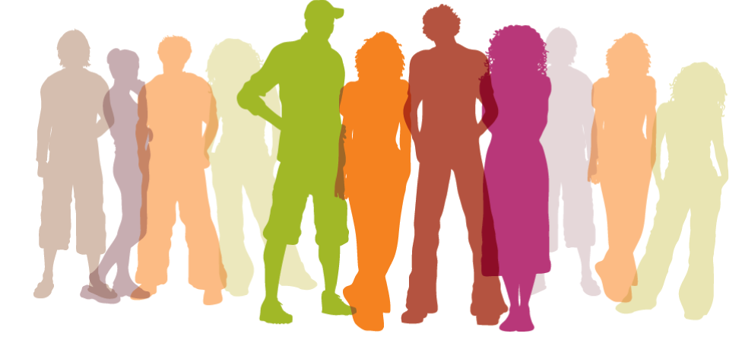
Comparison of Primary and Secondary Groups
Primary Group | Secondary Group
Generally small | Usually large
Relatively long period of interaction | Relatively short duration, often temporary
Intimate, face-to-face association | Little social intimacy or mutual understanding
Some emotional depth to relationships | Relationships generally superficial
Cooperative, friendly | More formal and impersonal

Slide 15
Groups 3
Reference Groups.
Reference group: any group that individuals use as a standard for evaluating themselves and their own behavior.
Reference groups have two basic purposes:
Serve a normative function by setting and enforcing standards of conduct and belief.
Perform a comparison function by serving as a standard against which people can measure themselves and others.
Coalitions.
Coalition: a temporary or permanent alliance geared toward a common goal.
Coalition building occurs frequently in political movements.

Slide 16
Social Networks 1
Social network: a web of relationships through which people interact both directly and indirectly to accomplish formal and informal goals.
Dyad: the most basic building block of a social network; it consists of two nodes and the relationship between them.
Triad: within a social network, it consists of three nodes and the direct and indirect relationships among them.
Centrality measures the degree to which any particular individual has more direct and indirect relationships than do others.
As networks become larger, centrality becomes an important additional dimension.

Slide 17
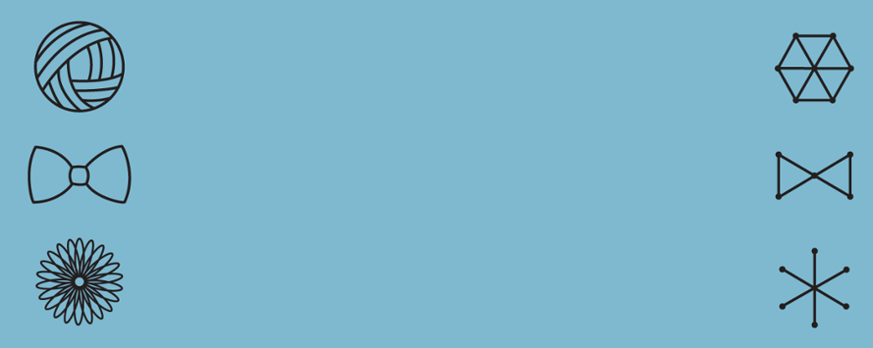
Social Networks: College Student Friendship Networks
Tight-knitters: One dense network in which nearly all friends are friends with each other.
Compartmentalizers: Two (or more) separate clusters in which friends on one side do not know or interact with friends on the other.
Samplers: A diverse array of individual friendships with people who, for the most part, don’t really know or connect with each other.
Although an almost infinite combination of direct and indirect network links is possible, recurring patterns do occur. Among college students, Janice McCabe identified three distinctive types of friendship networks.
Access the text alternative for slide images.

Slide 18
Social Networks 2
We can categorize our network relationships as more or less strong using measures such as:
Time spent together.
Emotional intensity.
Mutual confidences.
Shared sense of reciprocal obligation.
Strong ties are typically characterized by homophily—our tendency to establish close social networks with others who share our same knowledge, beliefs, practices, and characteristics.
This leads to the creation of dense clusters of similar people in social networks.

Slide 19
Social Networks 3
In an argument known as “the strength of weak ties,” sociologist Mark Granovetter maintained that weaker ties can be extremely important.
They can connect us with whole new networks of people with whom we have no direct relationships.
Mutual friends serve as matchmakers.
Social media theorist Clay Shirky maintains that the social networking potential of the Internet has radically transformed the possibilities for collective action.
Example: the Women’s March, January 2017.

Slide 20
Social Institutions 1
Social institution: an integrated and persistent social networks dedicated to ensuring that society’s core needs are met.
Sociologists have tended to focus on five major institutions that serve as key elements of the larger social structure.
Family.
Education.
Religion.
Economy.
Government.

Slide 21
Social Institutions 2
Focusing on institutions enables us to see the different ways in which societies fulfill certain needs.
Families carry out both biological reproduction and social reproduction, and provide care and protection for members.
Through education we teach the more formal and public culture necessary to be members of the larger society.
Religion acts as the glue that holds society together, answering basic questions about meaning and enforcing both individual and collective discipline.
Government helps maintain internal order and establish stable relationships with other societies.
The economy regulates the production, distribution, and consumption of goods and services.

Slide 22
Social Institutions 3
How societies choose to fulfill these functions can vary significantly, as can the degree to which these institutions overlap.
Sociologists using the conflict perspective suggest that we must also look at the ways our construction of these institutions reinforces inequality.
Major institutions, such as education, help perpetuate the privileges of the most powerful while contributing to the powerlessness of others.

Slide 23
Traditional, Modern, and Postmodern Social Structures
Early sociologists believed that constructing a clear picture of the social structure undergirding traditional societies would enable them to better understand the challenges faced with the rise of modern society.

Slide 24
Gemeinschaft and Gesellschaft
Ferdinand Tönnies (1855 to 1936) viewed the city as a dramatic change from the ideal of a close-knit community in his native Germany.
Gemeinschaft: a close-knit community, often found in rural areas, in which strong personal bonds unite members.
Gesellschaft: consists of a large, impersonal, task-oriented society, typically urban, in which individuals have a limited commitment to the group.

Slide 25
Mechanical and Organic Solidarity
Émile Durkheim was more interested in the transition to modern society—the birth of a new form of social order.
Mechanical solidarity: social cohesion based on shared experiences, knowledge, and skills in which things function more or less the way they always have, with minimal change.
Characteristic of societies with a minimal division of labor.
Organic solidarity: social cohesion based on mutual interdependence in the context of an extreme division of labor.

Slide 26
Technology and Society 1
Gerhard Lenski: society’s level of technology is critical to the way it is organized.
New social forms arise as technology changes.
Preindustrial Societies.
Hunting-and-gathering society: people rely on whatever foods and fibers are readily available in order to survive.
Horticultural society: people plant seeds and crops rather than merely subsist on available foods.
Agrarian society: members are engaged primarily in the production of food, but they increase their crop yields through technological innovations such as the plow.
Some people are freed up to focus on specialized tasks.

Slide 27
Technology and Society 2
Industrial Societies.
Industrial society: a society that depends on mechanization to produce its goods and services.
Industrialization significantly altered the way people lived and worked, and it undercut taken-for-granted norms and values.
Specialization of tasks and manufacturing of goods increasingly replaced the home workshop.
Individuals, villages, and regions became interdependent
Education emerged as a social institution distinct from the family due to the need for specialized knowledge.
Bureaucracies were established.

Slide 28
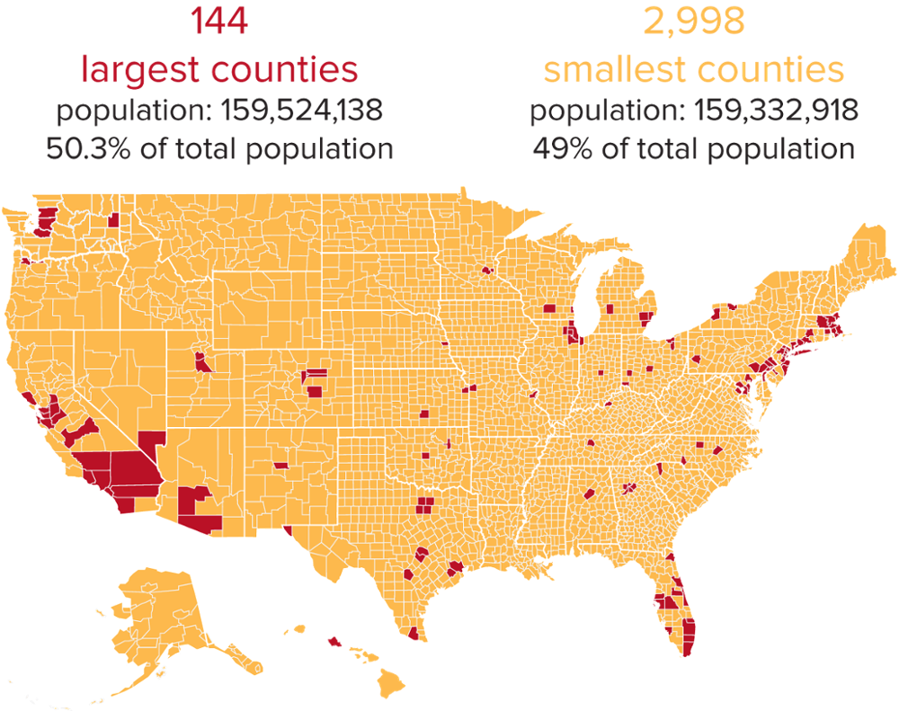
Effects of the Industrial Revolution
Access the text alternative for slide images.
Source: Adapted from http://dadaviz.com/s/population-extremes/#4568.

Slide 29
Technology and Society 3
Postindustrial Societies.
Postindustrial society: a society whose economic system is engaged primarily in the processing and control of information.
Main output is services rather than manufactured goods.
The resultant differential access to resources has hidden consequences.

Slide 30
Postmodern Life 1
Postmodern society: a technologically sophisticated, pluralistic, interconnected, globalized society.
Four elements provide a sense of the key characteristics of such societies today:
Stories.
Images.
Choices.
Networks.

Slide 31
Postmodern Life 2
Stories.
People in these societies hold different, often competing, sets of norms and values.
Images.
Postmodern society is also characterized by the explosion of the mass media.
Postmodern theorists argue that we no longer confront or interact with the material world directly; instead, our images or models of reality come first.

Slide 32
Postmodern Life 3
Choices.
In a postmodern world, reality is negotiated: we must pick and choose our reality from the images and experiences presented to us.
Choices include partners, schools, jobs, faiths, and identities.
Networks.
Members of postmodern societies live in a globally interconnected world.

Slide 33
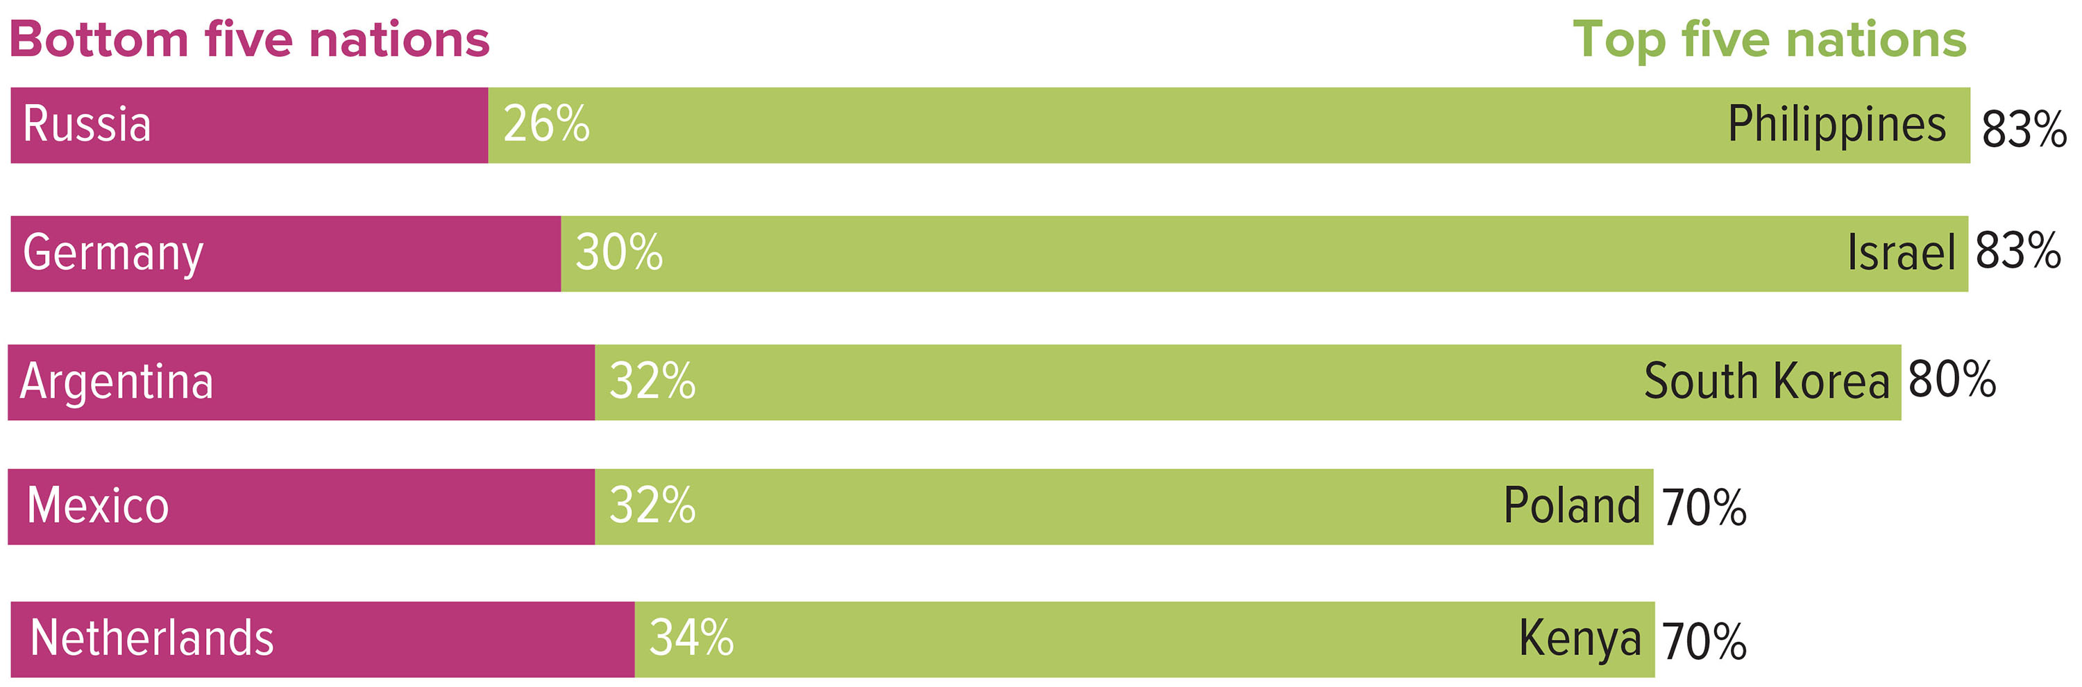
International Favorability Ratings for the United States
Note: The numbers represent the percentage of people in each country who responded with a favorable or unfavorable opinion of the United States. Source: Wike et al. 2018.
Access the text alternative for slide images.

Slide 34
Bureaucracy
Bureaucracy: a formal organization built upon the principle of maximum efficiency.
Max Weber saw bureaucracy as the most rational form of management ever devised.

Slide 35
Characteristics of a Bureaucracy 1
Weber identified five core characteristics of bureaucracies.
Division of labor.
Hierarchy of authority.
Written rules and regulations.
Impersonality.
Employment based on qualifications.
He did so by constructing what he called an ideal type: an abstract model of the essential characteristics of a phenomenon.

Slide 36
Characteristics of a Bureaucracy 2
Division of Labor.
Specialized experts perform specific tasks, increasing efficiency.
Workers can experience a sense of alienation—a loss of control over the creative human capacity to produce, separation from the product, and isolation from fellow workers.
Workers can be subjected to greater job insecurity.
Bureaucracy can produce “silos” within an organization that communicate poorly.

Slide 37
Characteristics of a Bureaucracy 3
Hierarchy of Authority.
Each position is under the supervision of a higher authority.
Written Rules and Regulations.
Bureaucracies generally offer employees clear statements of their rights and responsibilities.
Goal displacement: overzealous conformity to official regulations of a bureaucracy.
Impersonality.
Bureaucratic norms dictate that officials perform their duties without giving personal consideration to people as individuals.

Slide 38
Characteristics of a Bureaucracy 4
Employment Based on Technical Qualifications.
Performance is measured against specific standards.
Written policies dictate who gets promoted and often provide an avenue for appeal.
Such procedures protect workers against arbitrary dismissal.

Slide 39
Characteristics of a Bureaucracy 5
Characteristic | Positive consequences | Negative consequences for the individual | Negative consequences for the organization
Division of labor | Produces efficiency in a large-scale corporation | Limits knowledge | Creates communication barriers
Hierarchy of authority | Clarifies who is in command | Deprives employees of a voice in decision making | Permits concealment of mistakes
Written rules and regulations | Let workers know what is expected of them | Stifle initiative and imagination | Lead to goal displacement
Impersonality | Reduces bias | Contributes to feelings of alienation | Discourages loyalty to company
Employment based on technical qualifications | Discourages favoritism and reduces petty rivalries | Discourages ambition to improve oneself elsewhere | Inhibits innovative thinking

Slide 40
Bureaucratization as a Way of Life 1
Bureaucratization: the process by which a group, an organization, or a social movement increasingly relies on technical-rational decision making in the pursuit of efficiency.

Slide 41
Bureaucratization as a Way of Life 2
The Spread of Bureaucratization.
McDonaldization: the process by which the principles of efficiency, calculability, predictability, and control shape organization and decision making in the United States and around the world.
Weber predicted that even the most private sphere would become rationalized—we would turn to rational techniques to manage our self.
Something human gets lost in the process: those parts of the self deemed not necessary to the job would be dismissed as irrelevant.

Slide 42
Bureaucratization as a Way of Life 3
From Bureaucracy to Oligarchy.
Iron law of oligarchy: the principle that all organizations, even democratic ones, tend to develop into a bureaucracy ruled by an elite few.
Leaders have a vested interest to hold on to power.
Example: the specter of “Washington insiders” who look out for their self-interests rather than honoring the ideological commitments they made to get elected.

Slide 43
Bureaucracy and Organizational Culture
Scientific management approach: theory of management that measures all aspects of the work process to eliminate any inefficiencies.
Established by Frederick Winslow Taylor in the late 1800s.
Treats workers as objects to be managed, and ignores their cares and concerns.
Human relations approach: an approach to the study of formal organizations that emphasizes the role of people, communication, and participation in a bureaucracy and tends to focus on the informal structure of the organization.

Slide 44
5 Movies on Social Structure and Interaction
Office Space.
The insanity of life in a modern bureaucracy.
The Truman Show.
In this postmodern tale, a man unknowingly lives his life on television.
District 9.
The power to define who belongs and who does not.
The Greatest Showman.
This is me.
Green Book.
An African American pianist hires an Italian bouncer to tour the segregated South.

Slide 45
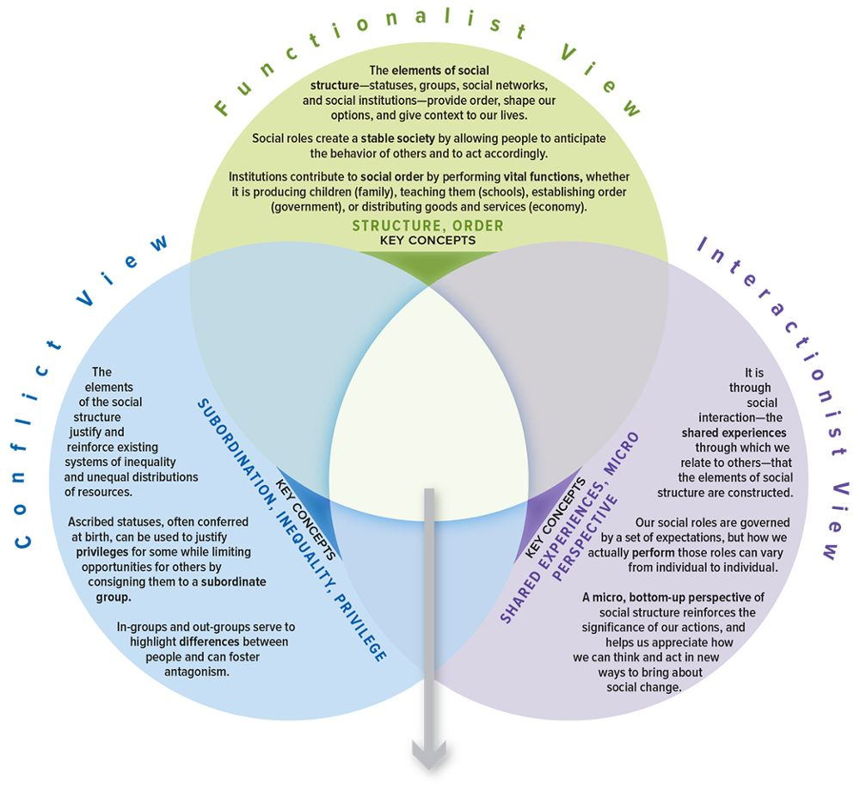
SOC VIEWS on Social Structure and Interaction
Access the text alternative for slide images.

Slide 46
Make the Connection
What insight might each perspective offer regarding the way the structure of games impacts how we play?
Briefly describe how a functionalist, a conflict theorist, and an interactionist would view ascribed versus achieved status.
In what ways does education as an institution function to provide for greater social order and stability?
Have you ever been part of an in- or out-group? If so, how might each perspective shed light on your experience?

Slide 47
End of Main Content

Slide 48
Accessibility Content: Text Alternatives for Images

Slide 49
Social Interaction - Text Alternative
Return to parent-slide containing images.
Each individual contributes in constructing a society through their culture and the society in turn contributes in constructing an individual.
Return to parent-slide containing images.

Slide 50
Statuses and Roles: Social Statuses - Text Alternative
Return to parent-slide containing images.
Achieved statuses are classmate, roommate, employee, friend, teammate, and student and the ascribed statuses are female, 20 years old, daughter, Latina, and sister.
Return to parent-slide containing images.

Slide 51
Social Networks: College Student Friendship Networks - Text Alternative
Return to parent-slide containing images.
The first is the Tight-knitters: One dense network in which nearly all friends are friends with each other. It resembles a ball of yarn. It is also represented by a dot at the center, surrounded by 6 dots. All the six dots are connected to the center dot and all the 6 dots are joined forming the shape of a hexagon. The second is the Compartmentalizers: Two (or more) separate clusters in which friends on one side do not know or interact with friends on the other. It resembles a bow tie. It is also represented by a dot at the center with 2 dots each on the either sides. All the dots are joined.
The third is the Samplers: A diverse array of individual friendships with people who, for the most part, don’t really know or connect with each other. It resembles a daisy. It is also represented by one dot at the center, surrounded by 6 dots. The dot at the center is connected to the 6 dots.
Return to parent-slide containing images.

Slide 52
Effects of the Industrial Revolution - Text Alternative
Return to parent-slide containing images.
The map infers the following data. There are 144 largest countries with a population of 159,524,138, which is 50.3 percent of the total population; and there are 2,998 smallest countries with a population of 159,332,918, which is 49 percent of the total population.
Return to parent-slide containing images.

Slide 53
International Favorability Ratings for the United States - Text Alternative
Return to parent-slide containing images.
The illustration infers the following data. Top five nations: Philippines, 83 percent; Israel, 83 percent; South Korea, 80 percent; Poland, 70 percent; and Kenya, 70 percent. Bottom five nations: Russia, 26 percent; Germany, 30 percent; Argentina, 32 percent; Mexico, 32 percent; and Netherlands.
Return to parent-slide containing images.

Slide 54
SOC VIEWS on Social Structure and Interaction - Text Alternative
Return to parent-slide containing images.
It consists of 3 views: Conflict view, functionalist view, and interactionist view. Conflict view: The elements of the social structure justify and reinforce existing systems of inequality and unequal distributions of resources. Ascribed statuses, often conferred at birth, can be used to justify privileges for some while limiting opportunities for other by consigning them to a subordinate group. In-group and out-groups serve to highlight differences between people and can foster antagonism. The key concepts of conflict view are subordination, inequality, and privilege.
Functionalist view: The elements of social structure—statuses, groups, social networks, and social institutions—provide order, shape our options, and give context to our lives. Social roles create a stable society by allowing people to anticipate the behavior of others and to act accordingly. Institutions contribute to social order by performing vital functions, whether it is producing children (family), teaching them (schools), establishing order (government), or distributing goods and services (economy). The key concepts of functionalist view are structure and order.
Interactionist view: It is through social interaction—the shared experiences through which we relate to other—that the elements of social structure are constructed. Our social roles are governed by a set expectations, but how we actually perform those roles can vary from individual to individual. A micro, bottom-up perspective of social structure reinforces the significance of our actions, and helps us appreciate how we can think and act in new ways to bring about social change. The key concepts of interactionist view are shared experiences and micro perspective.
Return to parent-slide containing images.

