Slide 2
Internship Mid-Term I Review

Slide 3
Industrial Training
Project Title
Member’s Name | Roll Number | Branch
Gurmanpreet kaur Dhanju | 1/20/FET/BCS/161 | CSE-DFCS
Gowthami Dasari | 1/20/FET/BCS/170 | CSE-DFCS
Under the guidance of
Dr. Umesh Dutta
Director,MRIIC

Slide 4
1.Introduction
2.Training Details
3.Introduction
4.Technical Skills Acquired
5.Project /Task Overview
6. Key Learning and Insights

Slide 5
Training Details
Institute Name- Manav Rachna Innovation and Incubation Center.
Mode of training- Offline
Duration- 6 months
Address- Faridabad , Haryana

Slide 6
Objectives of Internship
In this presentation, we delve into essential components of modern technology stacks: Django, React, and Tableau. Django, a Python-based web framework, enables rapid development and secure web frontends. React, a JavaScript library, streamlines UI development and application architectures with extensions like Flux and React Native. Meanwhile, Tableau, a leading data visualization and business intelligence tool, facilitates informed decision-making through intuitive data analysis and visualization. Understanding these tools is crucial for adapting to industry standards and harnessing their potential for success in today's dynamic digital landscape.

Slide 7



Technical skills Acquired
Django
Tableau
React js

Slide 8
Project Undertaken
Django
-Blog Website
-Blood Donation(Currently working)
JavaScript
-Tic Tac Toe
- To-do-list
Tableau
-Sales Dashboard

Slide 9
Project / Task Overview
Blood Donation
Objective:
Our goal is to make it easy for people who need blood to connect with those who want to donate. We focus on simple communication, detailed profiles, and an easy system for requests. We keep things private and also encourage everyone to learn and support each other in donating blood willingly.
Problem statement:
There is a lack of a user-friendly online platform that efficiently connects blood donors with patients in need, causing delays in critical situations. The current system lacks transparency and urgency, highlighting the need for a streamlined solution to facilitate quick and secure connections between donors and patients.

Slide 10
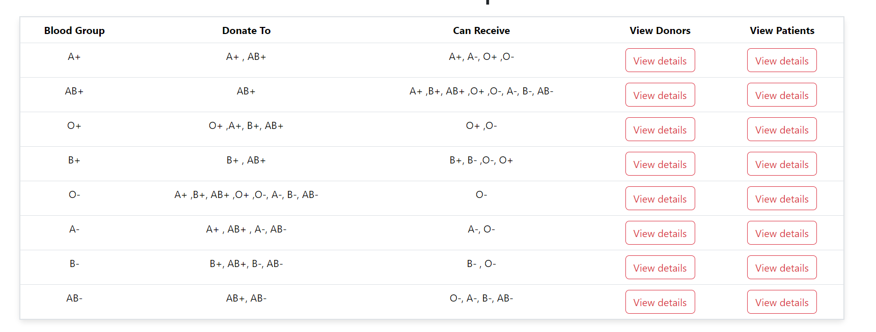
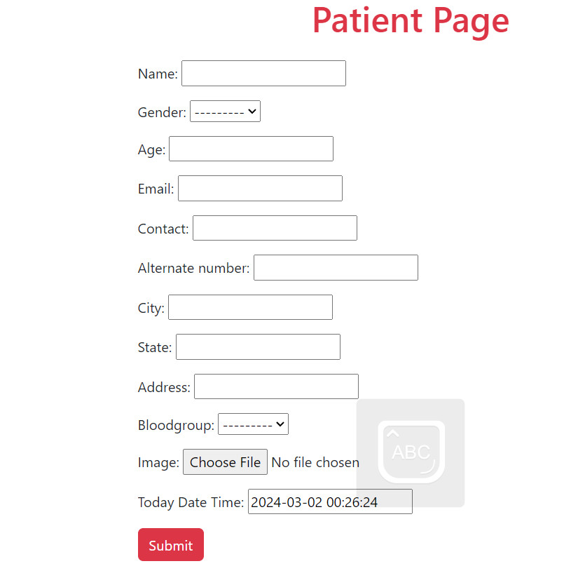
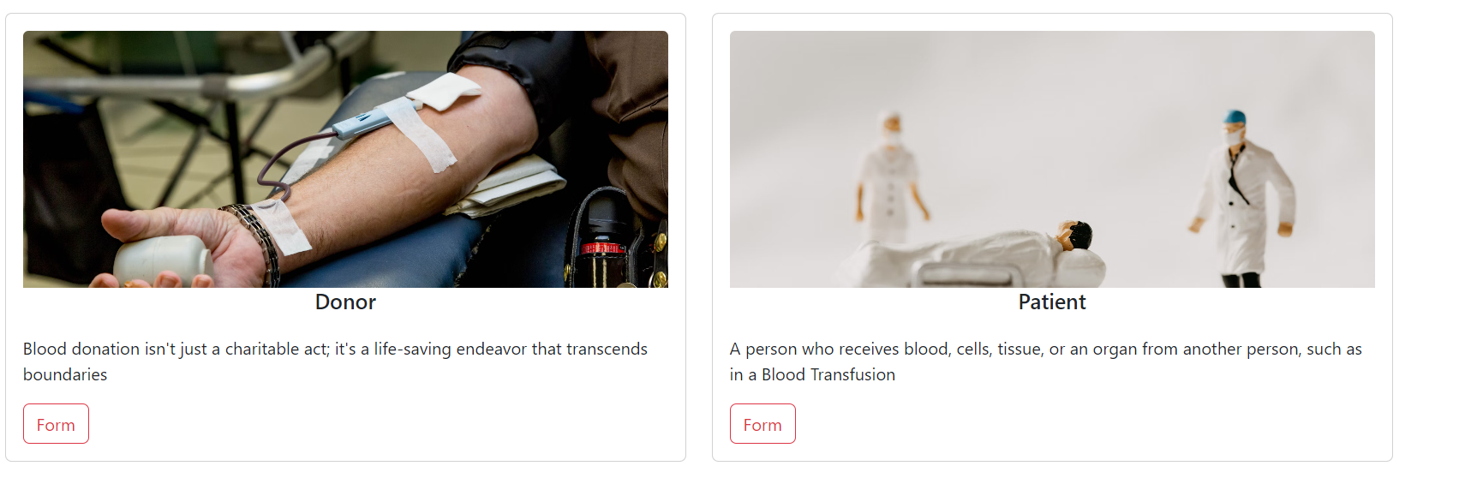
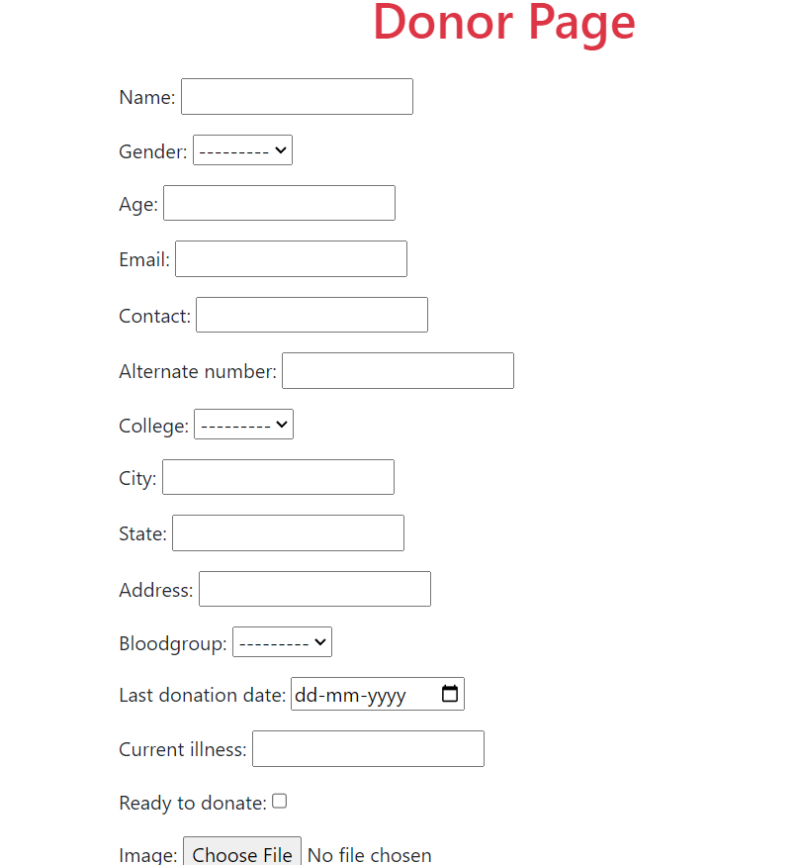
User-Interface

