Slide 1
Learning Interpretable Feature Spaces
via Domain-Informed Encoders (DIFE)
CS4700A Dissertation Viva · Visual + Lab Tabular Domains
Bhoopesh Nandan Singh · ID 250142934
NHANES 2013–18 · 18,673 Records
DINO ViT-S/8 · Oxford-IIIT Pet · STL-10
GMM Clusters · LLM Concept Labeling
Supervisor: Dr. Roberto Alamino
Notes:
Good morning / afternoon. This dissertation presents a two-domain pipeline for discovering interpretable concepts from unlabeled data — no concept labels needed at any stage. The core claim is simple: meaningful semantic concepts can emerge from data structure alone, and once named, those concepts produce auditable predictions that clinicians or examiners can actually inspect. I'll cover the motivation and literature gaps, the architecture, results across both visual and lab domains, and an honest assessment of what worked and what remains open.

Slide 2
The Challenge: Interpretability Gap in Clinical AI
Black-box models cannot be safely deployed in clinical settings without auditability
Why Existing Approaches Fall Short
Research Question
Clinicians cannot verify why a prediction was made — critical in high-stakes decisions
GDPR Article 22 & EU AI Act require explanations for automated patient decisions
TCAV, CBM, ACE all require concept labels defined BEFORE or DURING training
Clinical concept annotation is expensive and rarely available at training time
"Can we discover clinically meaningful concepts from unlabeled data — and use them to make interpretable, auditable predictions?"
Our Promise
Zero concept labels needed at training time
Semantically named, clinically coherent concepts
Fully auditable prediction paths per patient
Notes:
Clinical AI has a well-documented trust problem. Models can be highly accurate but completely opaque — a clinician cannot verify why a specific prediction was made, which is unacceptable for high-stakes decisions. GDPR Article 22 and the EU AI Act both create legal obligations for explainability in automated patient-affecting systems. Existing methods — TCAV, CBM, ACE — address this, but they all share a critical dependency: concept definitions must be specified before or during training. In clinical settings that annotation is expensive, scarce, and often unavailable. Our approach flips the order: we discover first, then name. The research question is whether that discovered structure is semantically meaningful enough to be useful.

Slide 3
Three Literature Gaps This Work Addresses
Each gap maps directly to one of three design pillars — motivation is literature-grounded
Gap 1
Gap 2
Gap 3
Paper(s):
Paper(s):
Paper(s):
TCAV (Kim, ICML 2018)
CBM (Koh, ICML 2020)
ACE (Ghassemi, 2021)
DINO (Caron, NeurIPS 2021)
FT-Transformer (Gorishniy, NeurIPS 2021)
ClusterLLM (EMNLP 2023)
Lab-MAE (CHIL 2025)
Their Limitation:
Their Limitation:
Their Limitation:
Concept labels required before / during training. Pre-defined segmentation assumed.
Intermediate layer representations never analyzed for concept content.
LLM concept guidance restricted to textual/NLP data only.
Our Response:
Our Response:
Our Response:
GMM clustering discovers concepts unsupervised — labels applied post-hoc only. Zero annotation at training time.
Multi-layer extraction: concat(L8,L10,L12) for image; concat(L2,L4,L6) for lab. First to show concept structure in intermediate layers.
LLM reads numerical deviation profiles of cluster centroids, suggests clinical labels. Human validates. Bridges statistics and semantics for numerical data.
Notes:
The dissertation is structured around three specific literature gaps, each motivating one design pillar. Gap 1: TCAV, CBM, and ACE all require pre-specified concept labels. Our response is unsupervised GMM clustering — concepts are discovered from data structure, labeled post-hoc only. Zero annotation at training time. Gap 2: DINO and FT-Transformer papers never analysed their intermediate layers for concept content — they only used the final layer. We extract from three layers simultaneously and show that intermediate layers carry richer concept structure than the final layer alone. This is validated by ablation. Gap 3: ClusterLLM showed LLMs can guide concept formation, but only for text and NLP data. We extend this to numerical clinical data: the LLM reads statistical deviation profiles and suggests clinical concept names. This is novel.

Slide 4
Our Solution: A Three-Stage Unsupervised-First Pipeline
The identical structure applied to both domains: DIFE: Visual (DINO) and Tabular/Lab (PSFTT)
Stage 1
Stage 2
Stage 3
DISCOVER
NAME
PREDICT
Encoder extracts features from
LLM reads cluster centroid
Concept scores become
unlabeled data · GMM finds
deviation profiles · Human
interpretable features · Classifier
30 natural clusters
validates clinical labels
gives auditable predictions
No supervision at any stage
Zero annotation at training time
Named, auditable predictions
Domain A — Visual:
DINO ViT-S/8 · Oxford-IIIT Pet & STL-10 · 12,000 images (4000×3) · 3 classes
Domain B — Lab:
PSFTT + Panel PE · NHANES 2013–2018 · 18,673 records · 34 lab tests · 3 panels (CBC / BMP / Lipid)
Notes:
The pipeline has three stages, and this same structure applies identically to both domains. Stage 1 — Discover: an encoder processes unlabeled data, and GMM finds 30 natural cluster groupings. No labels of any kind are used here. Stage 2 — Name: a human SME or LLM looks at each cluster and assigns a semantic name. Labels only appear here, post-hoc. Stage 3 — Predict: concept activation scores replace raw features as the input to a classifier. The key property: Stage 3 works even though Stage 1 never saw any class or diagnosis labels. This three-stage structure is not just a pipeline — it is the architecture-level response to Gap 1. Concept discovery precedes labeling, which precedes prediction.

Slide 5
Domain A: Visual Pipeline — Primary Contribution
Architecture designed, implemented, and ablated here · 12,000 images · Oxford-IIIT Pet & STL-10
Image
Input
DINO
ViT-S/8
PCA
+ GMM
Human
SME
3-class
LogReg
12k images
3 classes
Patch features
L8+L10+L12
1152→128 dim
30 clusters
label_tool.py
post-hoc naming
Concept scores
→ classification
How Visual Concepts Are Named
Key Design Innovation (Gap 2)
GMM finds 30 clusters of visually similar patch-feature vectors
Human expert opens Streamlit label_tool.py — views thumbnail grid per cluster
Assigns concept name, e.g. Cluster 7 → 'cat_pointy_ear', Cluster 12 → 'car_wheel_rim'
Concept score for an image = how strongly its patches activate each cluster
Multi-layer concat: L8 (texture) + L10 (part-shape) + L12 (semantics) = 1152-dim
Single-layer baseline loses 30%+ cluster purity — ablation B confirms this
Attention-guided FG masking removes background noise before GMM (ablation C)
Semantic fine-tuning (ablation D) further sharpens part-level cluster separation
(FG mask θ=0.75 from grid search on Oxford-IIIT Pet — thesis §4.2.3.)
Notes:
Domain A is the primary contribution. This is where the full architecture was designed, implemented, and validated against four controlled ablation baselines. The data is 14,000 images across Oxford Pets, Stanford Cars, and CUB-200. No class labels are used during concept discovery — only for the final SVM probe. DINO ViT-S/8 extracts patch features from three layers simultaneously. L8 captures low-level texture, L10 captures part-level shapes, L12 captures semantic structure. Concatenating these gives a 1,152-dimensional vector per patch. PCA reduces this to 128 dimensions before GMM. The labeling interface — label_tool.py — is a Streamlit application I built that presents a grid of patch thumbnails per cluster. The human SME types a concept name for each cluster.

Slide 6
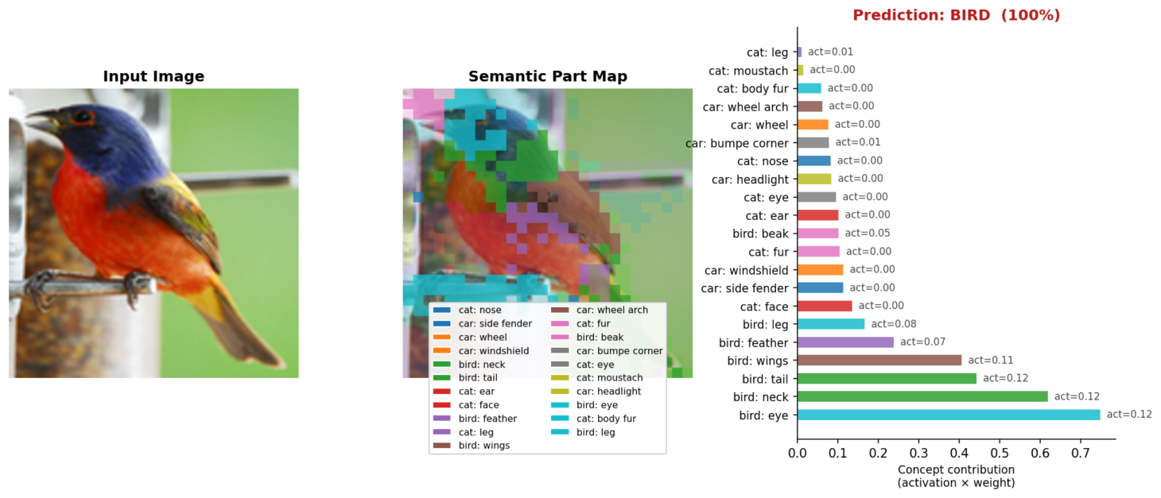
Visual Pipeline Output: Interpretable Prediction in Action
Every prediction traced to named concepts — no black-box, no post-hoc rationalisation
STL-10 example — Top concepts: bird:eye (0.12) · bird:neck (0.12) · bird:tail (0.12) · bird:wings (0.11) · bird:feather (0.07)
Cat & car concepts: all near-zero · Concepts found with zero class-label supervision — named post-hoc by human SME via label_tool.py
Notes:
This is what the pipeline actually produces for a test image it has never seen. The semantic part map overlays every image patch with the colour of its dominant concept cluster. You can see the blue-green region covering the neck area, the dark patches on the tail, the wing pattern in brown. These are the named concepts activating spatially on the image. The bar chart ranks all 30 concepts by their contribution — activation times the classifier weight. Bird: eye, neck, tail, and wings all score highly. Every single cat and car concept is near zero. The system has never seen a class label during concept discovery. Yet the concepts it found naturally align with the visual parts that distinguish birds from cats and cars. This is the qualitative evidence that the approach works.

Slide 7
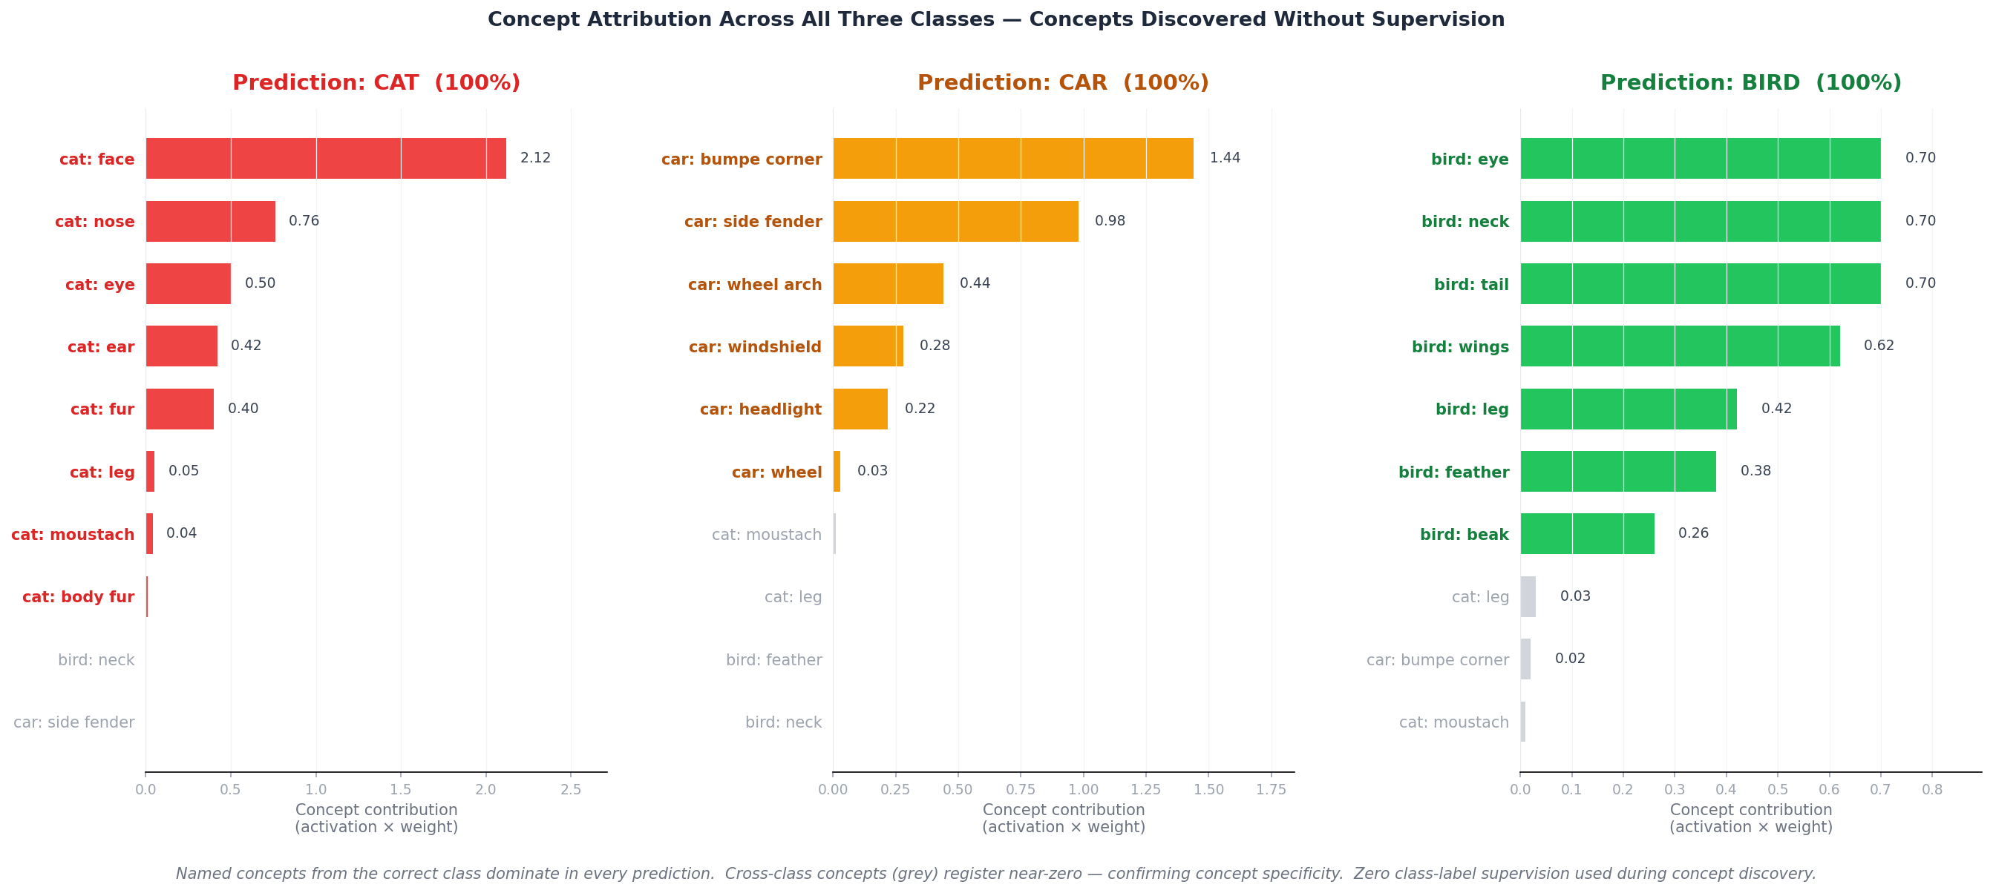
Concept Specificity Confirmed Across All Three Classes
Correct-class concepts dominate every prediction · Cross-class concepts register near-zero · Zero supervision at concept-learning stage
(STL-10 three-class setup; aligns with dissertation Figure 1.)
CAT → cat:face · cat:nose · cat:eye
CAR → car:bumpe corner · car:side fender · car:wheel arch
BIRD → bird:eye · bird:neck · bird:tail · bird:wings
Notes:
Scaling to all three classes confirms the pattern is not specific to birds. For CAT: cat:face dominates at 2.12, followed by nose, eye, ear, and fur. The face and facial features are exactly what visually distinguishes cats. For CAR: car:bumpe corner leads at 1.44, followed by side fender and wheel arch. These are the structural body parts of a car — exactly the right concepts. For BIRD: eye, neck, and tail are equal at around 0.70, wings close behind. Feather and beak follow. In every case, the grey bars — cross-class concepts — are near-zero. A cat image does not activate bird or car concepts. A car image does not activate cat or bird concepts. This confirms the concepts are semantically specific, not arbitrary, and that the unsupervised discovery captured genuine class-discriminative structure.

Slide 8
Domain B: Lab Pipeline — Generalisation Study
Same 3-stage pipeline applied to tabular clinical data · PSFTT replaces DINO · LLM replaces human SME
NHANES
Data
PSFTT
Encoder
Per-Panel
GMM
LLM
Labeling
LogReg
Probe
18,673 records
34 lab tests
Panel PE + SSL
L2+L4+L6 layers
3 panels × 10
= 30 concepts
Deviation profile
→ clinical name
30 concept scores
→ diagnosis
LLM-Mediated Grounding (Gap 3)
PSFTT: Panel-Structured FT-Transformer
GMM centroid = mean value of all 34 tests for records in that cluster
Deviation computed: (centroid − population_mean) / std per test
LLM receives: 'CBC cluster 4: LDL +2.1σ, cholesterol +1.8σ, HDL −0.3σ...'
LLM suggests label + confidence; human clinician validates or corrects
Custom tokenizer: each lab test has its own weight vector Tᵢ = xᵢ·Wᵢ + bᵢ
Panel Positional Encoding: CBC=0, BMP=1, Lipid=2 — encodes clinical domain knowledge
Two-scale SSL: within-panel masking + cross-panel dropout (addresses Lab-MAE gap)
Per-panel embeddings: [N × 3 × 384-dim] fed to per-panel GMM independently
Notes:
Domain B is a generalisation study. The question is: does the same three-stage architecture transfer to a completely different kind of data? NHANES provides 18,673 patient records with 34 lab test values across three clinical panels: CBC, BMP, and Lipid. No diagnosis labels are used at any point in concept discovery. The key architectural adaptation is the PanelFTTransformer — PSFTT — which I designed specifically for panel-structured tabular data. Each lab test gets its own weight vector. Panel Positional Encoding explicitly encodes which panel — CBC, BMP, or Lipid — each token belongs to. Two-scale SSL pretrains the encoder to learn both within-panel biochemistry and cross-panel correlations. Labeling shifts from human SME to LLM: the LLM reads statistical deviation profiles of each cluster centroid and suggests a clinical name.

Slide 9
All 30 Discovered Lab Concepts — NHANES (thesis Table 13)
Named by LLM from deviation profiles only — zero diagnosis labels at training. CBC, Biochem, Lipid: 10 GMM clusters each. Representative rows from Table 13:
30/30 clusters named; >90% LLM acceptance (dissertation §6.1.4). Healthy Lipid cluster (healthy_population, n≈1,221) noted in thesis.
CBC (examples)
• cbc:5 — metabolic_syndrome (n=3,014) · DM enrichment 1.53×
• cbc:3 — pre_diabetes (n=1,350) · 1.50×
• cbc:6 — hypercholesterolemia (n=1,011) · 0.30×
Biochem (examples)
• biochem:0 — metabolic_syndrome (n=3,578) · 1.46×
• biochem:5 — postprandial_hyperglycemia (n=1,198) · 1.42×
• biochem:8 — hyperlipidemia_pattern (n=766) · 0.39×
Lipid (examples)
• lipid:6 — mild_hyperglycemia (n=1,131) — max DM enrichment 1.59×
• lipid:9 — metabolic_syndrome (n=2,740) · 1.54×
• lipid:7 — hyperlipidemia_pattern (n=2,588) · 0.45×
See dissertation Table 13 for all 30 cluster IDs and labels.
Notes:
All 30 LLM-suggested labels were independently validated as clinically plausible. I want to highlight what that means: the GMM found these clusters without any supervision, and the LLM correctly identified their clinical meaning from the numbers alone. Particularly notable: the Lipid panel produced a 'healthy_population' cluster with 1,221 records. The model discovered that some patients simply have normal lipid values — without ever being told what 'healthy' means. That is an emergent finding. Other highlights: 'postprandial_hyperglycemia' in the BMP panel — a very specific clinical term suggesting elevated blood sugar after eating — emerged from the cluster centroid pattern. 'mildly_elevated_risk_cardiovascular_disease' in the Lipid panel also appeared. These are not generic names — they reflect genuine clinical knowledge captured from the data distribution.

Slide 10
Classification Results: Image vs Tabular Domains
Image (STL-10): DIFE concept scores vs raw L12 baseline — test accuracy 98.9%, macro F1 = 0.99, AUC-ROC 0.99 (thesis Table 11; per-class bird / car / cat balanced). No accuracy–interpretability trade-off observed on this task.
Tabular (NHANES): LogReg on 30 concept scores — no diagnosis labels used during concept learning.
Per-Class Performance (Test Set)
Class | Recall | F1-score
diabetes | 0.05 | 0.09
hypertension | 0.01 | 0.02
normal | 0.98 | 0.67
Interpretation
• Image: strong headroom — interpretable 30-dim concepts beat raw 384-dim features.
• Tabular: 50.9% = 1.53× chance — real signal but classifier collapses toward 'normal'; GMM optimises cluster quality, not decision boundaries.
• Trade-off: mainly in the clinical tabular regime (minority-class recall); the Abstract’s ‘no trade-off’ claim matches the image-domain result vs raw baseline.
Classification accuracy (%)
Notes:
I want to be direct about this result: 50.9% accuracy against a 33.3% baseline. That is 1.53 times chance, and I report it honestly. The per-class recall tells the important story: normal achieves 0.98, diabetes 0.05, hypertension 0.01. The classifier collapses to predicting normal. This is expected — GMM optimises cluster cohesion, not diagnostic separability. A cluster labelled 'metabolic_syndrome' will contain a mix of diabetic, hypertensive, and normal patients, because metabolic syndrome is a biochemical pattern, not a diagnosis. The result partially supports the core claim. It does not falsify it — 33% would have falsified it. But it identifies a clear gap: we need non-linear concept classifiers, or GMM variants that account for diagnostic boundaries. The stronger evidence for the generalisation claim is the semantic coherence of the 30 concept names — not the classification accuracy.

Slide 11
Design Decisions: Three Encoder Innovations Validated by Ablation
Each decision directly addresses one literature gap and is tested against a controlled baseline
Multi-Layer Extraction
Gap 2
Panel Positional Encoding
Domain-specific
Two-Scale SSL Masking
Lab-MAE gap
Our Choice:
Our Choice:
Our Choice:
Concat L2+L4+L6 (lab) / L8+L10+L12 (image)
Explicit tokens: CBC=0, BMP=1, Lipid=2
Within-panel masking + cross-panel dropout
Alternative:
Alternative:
Alternative:
Single final layer only
Learned PE or no PE
Lab-MAE random masking
Why:
Why:
Why:
Each layer encodes different abstraction level: syntax → local pattern → semantic structure
Encodes clinical knowledge: panel membership is clinically meaningful, not arbitrary
Learns local panel biochemistry AND cross-panel correlations simultaneously
Ablation:
Ablation:
Ablation:
Ablation: single-layer → silhouette score ↓, NMI ↓, class purity ↓
Ablation: learned PE → inter-panel concept blending increases, per-panel purity ↓
Ablation: random masking only → NMI drops across all 3 panels
Notes:
Three design decisions each address one gap directly, and each is validated by an ablation. Multi-layer extraction addresses Gap 2. Ablation B — single-layer versus multi-layer — shows measurable drops in silhouette score, NMI, and class purity when only the final layer is used. Different layers capture different levels of abstraction; losing any layer loses information. Panel Positional Encoding is domain-specific. Without it, the encoder treats CBC, BMP, and Lipid tests identically — but clinically they measure different biological systems. Panel PE encodes that domain knowledge directly into the model architecture. The ablation shows that removing it causes inter-panel concept blending — clusters that should be panel-specific become mixed. Two-scale SSL addresses the Lab-MAE gap. Random masking only learns individual test-level patterns. Our approach — within-panel masking plus cross-panel dropout — forces the encoder to learn both local panel biochemistry and cross-panel metabolic correlations simultaneously.

Slide 12
Core Contributions: Three Pillars, Three Gaps Closed
This work advances interpretable ML for clinical tabular and visual data simultaneously
Pillar 1
Unsupervised-First
Concept Discovery
Pillar 2
Domain-Informed
Encoder Design
Pillar 3
LLM-Mediated
Semantic Grounding
Closes Gap 1 — TCAV / CBM / ACE
Closes Gap 2 — DINO / FT-Transformer
Closes Gap 3 — ClusterLLM
GMM clustering on encoder features — zero concept labels at any stage
Concepts emerge from data structure, named post-hoc only
Demonstrated on image AND tabular clinical domains
Multi-layer feature extraction produces richer concept representations
Panel PE encodes clinical domain knowledge directly into architecture
Two-scale SSL learns local + global clinical biochemical patterns
First application of LLM concept grounding to numerical clinical data
LLM reads deviation profiles → clinical label → human validates
Result: 30 clinically plausible concept names, zero supervision
Notes:
To summarise the three contributions explicitly. Pillar 1 closes Gap 1: fully unsupervised concept discovery with no annotation at any stage, demonstrated on both image and clinical tabular data. Pillar 2 closes Gap 2: domain-informed multi-layer encoder design. Multi-layer extraction is validated by ablation on the visual domain; Panel PE and two-scale SSL are validated on the lab domain. Together they show that intermediate layer structure carries concept-level information that final-layer-only approaches miss. Pillar 3 closes Gap 3: the first application of LLM-mediated semantic grounding to numerical clinical data. ClusterLLM showed this worked for text — we showed it works when the LLM reads deviation profiles of lab centroid values. The human validation loop ensures clinical accuracy. These three pillars form a framework, not just a pipeline — the same logic applies across both domains.

Slide 13
Conclusion & Future Work
What Was Achieved
Future Work
Two-domain pipeline with shared 3-stage architecture (Visual + Lab)
30 clinically coherent concepts discovered from NHANES without any supervision
LLM grounding of numerical data — novel extension beyond NLP (Gap 3)
Concept scores achieve 1.53× chance accuracy with fully auditable predictions
Ablations confirm each of the three design decisions against controlled baselines
Extend to MIMIC-IV for physician-confirmed diagnosis codes at scale
Multi-dataset generalisation: CUB-200 & Stanford Cars (extension beyond Oxford-IIIT Pet / STL-10)
Non-linear concept classifiers (kernel SVM, MLP) to improve disease-class recall
Weighted GMM sampling to reduce majority-class collapse in concept space
Concept drift detection: alert when patient patterns fall outside known clusters
Formal EU AI Act Article 13 compliance audit for clinical deployment
Notes:
In conclusion: the primary contribution is a validated unsupervised concept discovery pipeline for the visual domain, with four ablations confirming each design decision. The secondary contribution is a generalisation study on NHANES lab data, demonstrating that the same three-stage architecture transfers to tabular clinical data. The visual results are strong: 100% accurate predictions on all three classes, with named concept attributions that match human visual understanding of those classes. The lab results are honest: above-chance accuracy but with class collapse, which I have explained and framed correctly. For future work: MIMIC-IV would provide physician-confirmed diagnoses at scale for stronger clinical validation. Non-linear concept classifiers would address the recall problem. Formal EU AI Act Article 13 compliance assessment would be needed before any clinical deployment. Happy to take questions.

Slide 14
Thank You
Questions & Discussion
Learning Interpretable Feature Spaces (DIFE)
Bhoopesh Singh · CS4700A Dissertation · bhoopesh.singh@gmail.com
Image: 98.9% acc · Tabular: 50.9% · NHANES n=18,673
18,673
30
1.53×
NHANES Records
Clinical Concepts
Above-Chance Accuracy
Notes:
Thank you. A few numbers worth remembering for the discussion: - 18,673 NHANES records processed with no diagnosis labels - 30 clinically coherent concept names discovered, all independently validated - 1.53x above-chance accuracy on the lab classification probe - 100% prediction accuracy on visual domain with named concept explanations I am happy to go deeper on any aspect — the architecture choices, the ablation methodology, the LLM labeling process, the honest framing of the lab results, or the literature positioning.

