Slide 1



SMART KOPARGOAN HACKATHON
Problem Statement ID – skhoi017
Problem Statement Title- Fiber Optic Embedded Self-Healing Concrete
Theme- Open Innovation
PS Category- Hardware
Team ID- NMWJAM
Team Name (Registered on portal) – Team Panchjanya
sanjivani.edu.in
skh.sanjivaniuniversity.com

Slide 2

Proposed Solution Normal concrete always develops tiny fractures (like hairline or shrinkage cracks) that lead to building decay, safety hazards, and massive global repair costs.
We are building a smart concrete that acts like a living body. It combines biological self-healing properties with a hidden fiber-optic nervous system.
Embedded fiber-optic sensors continuously feel stress, strain and microscopic cracks from inside. A small computer chip (ESP32) instantly sends this data to a live dashboard.
When a crack is detected and water gets in, embedded microcapsules holding dormant bacteria (Bacillus subtilis) break open. The bacteria seal the fracture with limestone.
IDEA TITLE
Team Panchjanya
How it addresses the problem
Our system spots tiny, invisible cracks (like hairline or shrinkage cracks) before they grow into dangerous, building-threatening cracks.
It tracks high temperatures when the concrete is drying to prevent early cracks from forming.
The concrete heals its own damage automatically without any external help. This saves massive amounts of money and time on repairs.
Uniqueness of the proposed solution
Unlike other self-healing concrete, our sensors actually prove that the healing worked and show the results on a live dashboard.
As the bacteria heal the concrete, they trap harmful carbon dioxide CO2 from the air, making the process highly eco-friendly.
We are going to prove this works by building a physical 1x1x1inch concrete block that brings biology, sensors, and construction together in real life.
sanjivani.edu.in
skh.sanjivaniuniversity.com
2

Slide 3
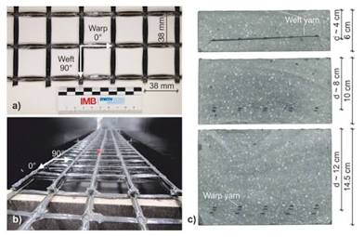
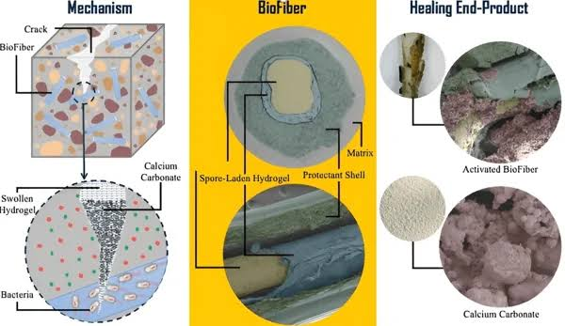
Team Panchjanya
TECHNICAL APPROACH
The nervous system
The immune system
Continuous non-destructive and automatic detection of damage
Concrete embeds healing agents like micro-encapsulated bacteria (such as bacillus subtilis) or chemical agents within vascular networks or as capsules.
Bacteria sequester CO2 minimizing the need of replacement materials.
Embedded fiber-optic sensors detect internal cracks and stress. An ESP32 chip sends real-time data and alerts to a dashboard.
Embedded Fiber Optic Sensors
Optical Interrogator Module (to read the fiber optic light signals)
Esp32 microcontroller and Breadboard & Jumper Wires
Thonny IDE
MicroPython
MQTT Protocol (for sending data to the cloud)
Cloud Dashboard Platform
Embedded Neural Network Framework (like TensorFlow Lite)
Bacillus subtilis Bacteria
Micro-encapsulation Materials
Calcium Nutrient (as bacteria food)
Standard Cement & Aggregates
1x1x1 Concrete
Network of fibre optic cables is embedded aligned with rebars as shown in above image. Data received by receiver is sent to esp32 via fiber optic amplifier.
Microcapsules filled with Calcium Lactate & Bacillus Subtilis(sealed with wax and varnish) are stacked up in centermost layer.
11
sanjivani.edu.in
skh.sanjivaniuniversity.com
2

Slide 4
Team Panchjanya
FEASIBILITY AND VIABILITY
Analysis of the Feasibility of the Idea
Fusing sensors and ESP32 chips is easily testable right now using our 1x1x1 concrete replica.
Using micro-encapsulated Bacillus subtilis bacteria to seal cracks is already a proven concept in lab research.
Potential Challenges and Risk
If capsules aren't mixed perfectly, the healing agent won't reach the cracks, causing unsatisfactory repair.
Adding too many microcapsules could lower the concrete's natural mechanical strength.
High temperatures during the initial pour can cause early-age cracking or destroy the sensors.
Strategies for Overcoming These Challenges
We will use the 1x1x1 replica to find the perfect ratio of cement to microcapsules(80/20), ensuring maximum healing without losing strength.
Embedded AI will filter the raw data, ensuring the ESP32 only triggers dashboard alerts for actual structural strain.
Using tough microcapsule materials to protect the bacteria from the harsh wet cement until a crack physically breaks them open.
sanjivani.edu.in
skh.sanjivaniuniversity.com
2

Slide 5
Team Panchjanya
IMPACT AND BENEFITS
Bridges and piers
Economic benefits
Sustainability
CO2 sequestration by the bacteria
Lifespan of structures increases
Protects mass concrete: Custom-designed for heavy-duty marine structures and bridges.
Stops rust
Smart monitoring: Reduces the need of expensive manual inspections due to the dashboard system.
Reduces long term maintainance costs
Though the idea itself is not the cheapest option out there, but it heals the cracks in the innermost, unreachable layers of concrete increasing its lifespan.
Repairs without closing roads
sanjivani.edu.in
skh.sanjivaniuniversity.com
2

Slide 6
Team Panchjanya
RESEARCH AND REFERENCES
"New-generation pavement empowered by smart and multifunctional concretes: A review" – Construction and Building Materials, 2023.
"Sustainability of nanomaterials based self-healing concrete: An all-inclusive insight" – Journal of Building Engineering, 2019.
"Self-healing cement concrete composites for resilient infrastructures: A review" – Composites Part B: Engineering, 2020.
"Diverse perspectives on self healing ability of Engineered Cement Composite – All-inclusive insight" – Construction and Building Materials, 2022.
"Challenges of Self-Sensing Concrete" – Self-Sensing Concrete in Smart Structures, 2014.
"Self-healing concrete: Fabrication, advancement, and effectiveness for long-term integrity of concrete infrastructures" – Alexandria Engineering Journal, 2023.
sanjivani.edu.in
skh.sanjivaniuniversity.com
2

