Slide 1

Prognostic-AI MultiDisease Prediction
Jaykumar Nayi_20104005
Nishank Jain_20104046
Anish Bhosale_20104033
Project Guide
Ms. Mansi Choche

Slide 2
Contents
Introduction
Objectives
Scope
Literature Survey
Proposed System
Project Outcomes
Block Diagram
Use Case/DFD
Technology Stack
Suggestions in Review-1
Result and Discussion
Conclusion and Future Scope
References

Slide 3
1. Introduction
Problem Identified :
Diabetes, heart disease, Parkinson's disease are for the most part driving reasons for illness in the present society.
High rates of obesity and high blood pressure among younger people are putting them at risk for heart disease earlier in life.
Parkinson’s is caused by the progressive degeneration of dopamine-producing neurons in the brain
Solution Proposed :
Our Prediction Model will help an individual to check weather he or she will have any of these disease in future.
On the Basis of generated results the user can maintain the health to avoid further risk of any disease

Slide 4
2. Objectives
To identify various diseases by observing the symptoms of patients.
To check whether the patient is likely to be diagnosed with any cardiovascular heart diseases ,diabetics, Parkinson’s.
To early detect and prevent of diseases can potentially reduce healthcare costs by avoiding expensive treatments for diseases that could have been prevented.
To develop a system that will enable end users to predict chronic diseases without having to visit a physician or doctor for diagnosis.

Slide 5
3. Scope
This project helps user whether he/she is suffering from diseases or not
To help user to take necessary precaution if they get suffered from disease
It provide prediction based on certain parameters.
To provide user-friendly GUI

Slide 6
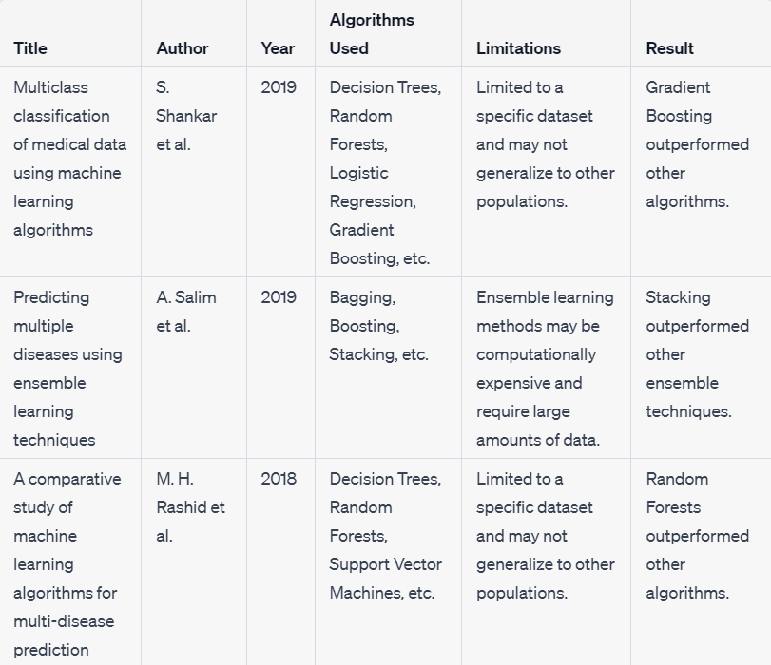
4. Literature Survey

Slide 7
5. Proposed System
Feature 1 :
    Most of the chronic diseases are predicted by our system. It accepts the structured type of data as input to the machine learning model
Feature 2 :
    Our proposed system bridges the gap between doctors and patients which will help both classes of users to achieve their goal. This system is used to predict diseases according to symptoms.
Feature 3 :
    In multiple disease prediction, it is possible to predict more than one disease at a time. So the user doesn’t need to traverse different sites in order to predict the diseases as we are taking multiple disease in our system.

Slide 8
6. Outcome of Project
Users will have ability to detect disease at an early stage where treatment is more likely to be effective
Reduce diagnostic errors that can occur due to human bias or errors in interpretation of medical data
The project could lead to the development of a user-friendly platform or application that can be integrated into existing healthcare systems and workflows
User will able to reduce health-care costs associated with the disease
help healthcare providers work more efficiently by reducing the time and effort required for diagnosis

Slide 9
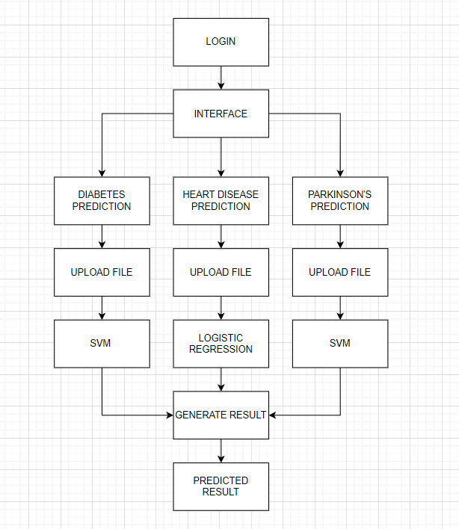
7. Flow Diagram

Slide 10
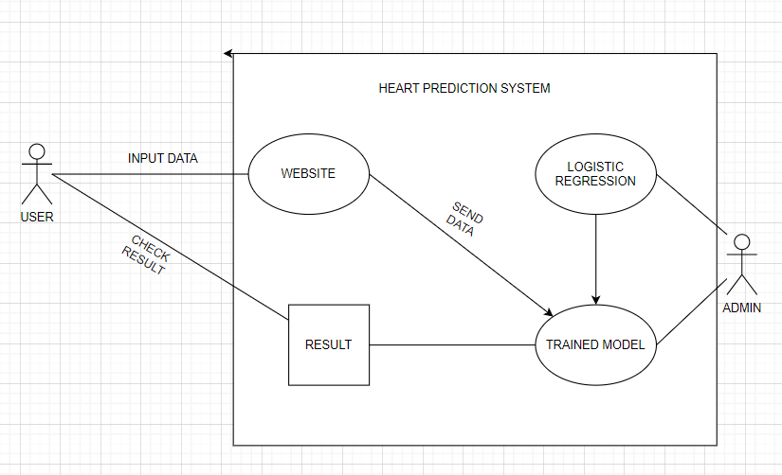
8. Use Case/Data Flow Diagram

Slide 11
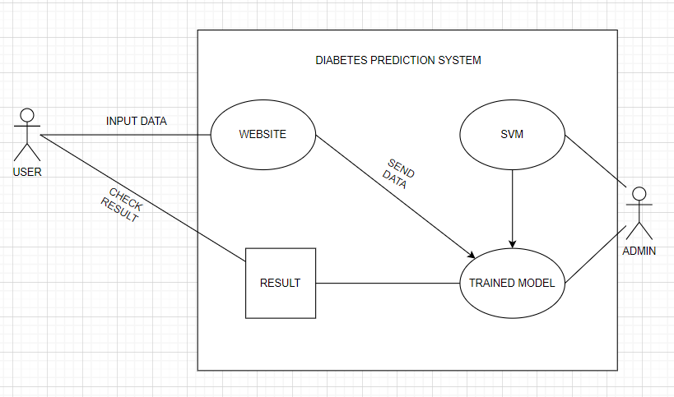
8. Use Case/Data Flow Diagram

Slide 12
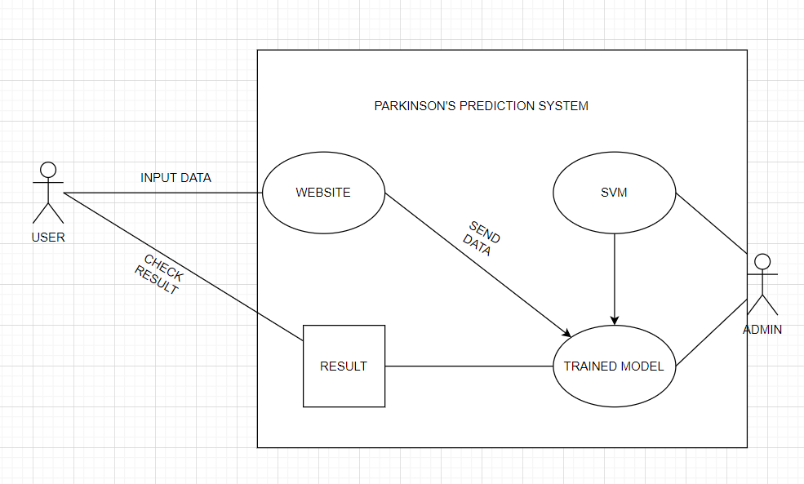
8. Use Case/Data Flow Diagram

Slide 13
9. Technology Stack
Frontend:
StreamLit
Backend:
Python Using ML Algorithms
Logistic Regression
SVM(Support Vector Machine)

Slide 14
10. Suggestions in Review-1
Add a File from where you can take all details from user no need to type it manually
Add one more Disease Prediction Feature
Literature Survey in Tabular Form

Slide 15
11. Result and Discussion
In this study, we developed a machine learning model to predict the presence of multiple diseases based on electronic health record (EHR) data. We used a dataset consisting of demographic information, medical history, and laboratory results of patients to train and evaluate our model. The dataset contained information on patients diagnosed with various diseases, including Parkinson’s, diabetes, and heart disease.
Our results show that machine learning algorithms can be used effectively to predict multiple diseases based on EHR data. This can be valuable in improving patient outcomes by enabling early detection and intervention. Our study also highlights the importance of selecting appropriate algorithms for the task at hand, as different algorithms can have varying performance on different datasets.

Slide 16
12.Future Scope/Conclusion
The system could provide personalized recommendations based on an individual's predicted risk factors for certain diseases, such as lifestyle modifications or preventive screenings.
The system could enable healthcare providers to collaborate and share information with other healthcare providers to provide more comprehensive and coordinated care.
The system could provide educational resources and awareness campaigns to help individuals better understand their risk factors and take proactive steps to prevent or manage diseases

Slide 17
References
[1]. Shankar, S., Ramesh, K., & Ganapathiraju, M. K. (2019). Multiclass classification of medical data using machine learning algorithms. Journal of medical systems, 43(5), 109.
[2]Salim, A., Hossain, M. S., Al Mamun, A., & Hasan, M. M. (2019). Predicting multiple diseases using ensemble learning techniques. Journal of biomedical informatics, 100, 103318.
[3]Rashid, M. H., Islam, M. M., & Al-Emadi, N. A. (2018). A comparative study of machine learning algorithms for multi-disease prediction. Journal of healthcare engineering, 2018.
https://iopscience.iop.org/article/10.1088/1742-6596/2089/1/012009

Slide 18
Thank You...!!

