Slide 1
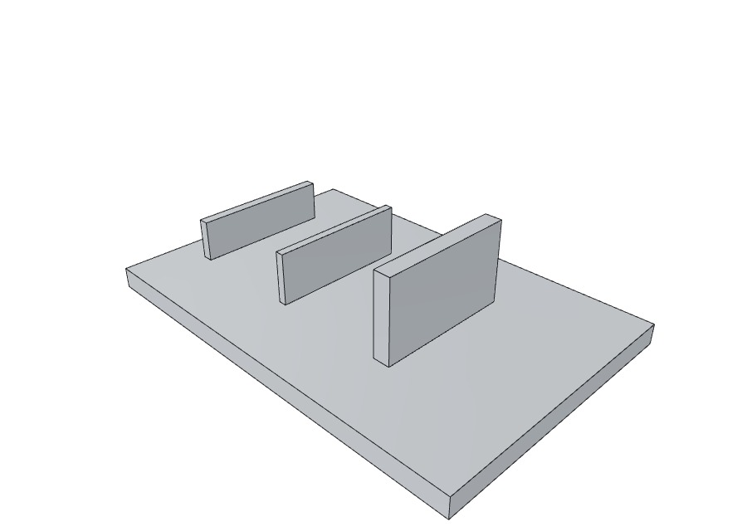
PART OF THE BRAINSPARK AI COST-ENGINEERING PLATFORM
DFM / DFA Studio
Manufacturability measured from the CAD model — not judged from a checklist
Upload a STEP file. Get every rule your chosen process breaks, marked on the part,
priced by the same engines that quote it, and written as decisions with owners.
Avinash Bhosale · Cost Engineering · August 2026
Notes:
Good morning, and thank you for the time. I am going to take about fifteen minutes on the DFM and DFA Studio, and then I have one thing to ask you. If there is a slide you have already seen, stop me and I will move on. Let me start with what it is in one sentence. You give it a CAD file and tell it how you plan to make the part. It measures the part, tells you every rule that part breaks for that process, shows you where on the part the problem is, and tells you what each problem costs. That is it. The thing that makes it different from a checklist is the word MEASURED. Nobody types a number in. The tool opens the CAD model and measures the wall thickness, the draft angle, the bend radius. So when it says a wall is two point one millimetres, something actually measured two point one. The picture on the right is a real part, rendered by the tool itself out of a CAD file. It is not a stock image.

Slide 2
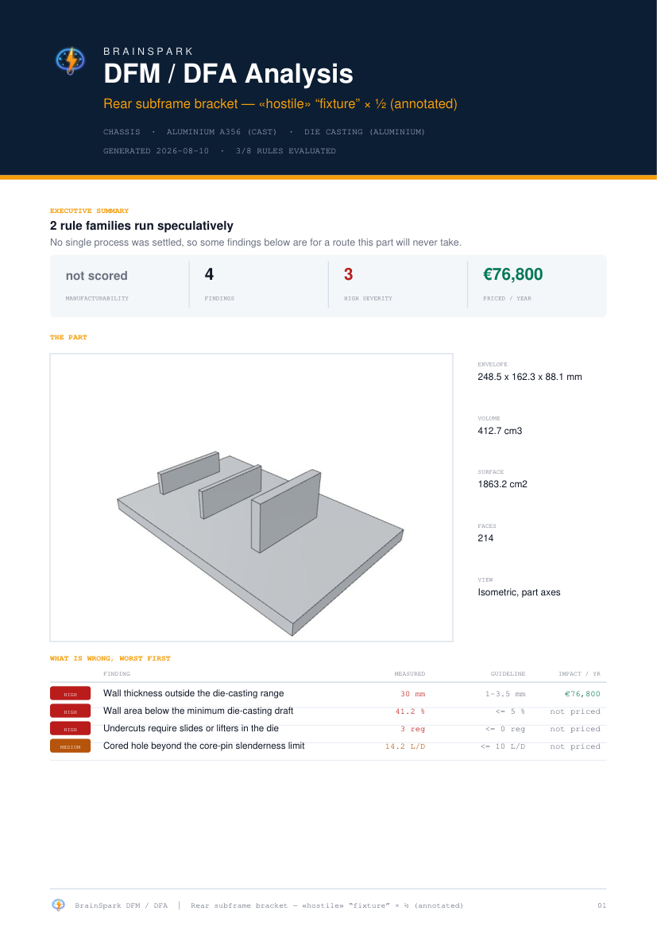
WHY THIS TOOL
The cheapest moment to change a part
A DFM review today depends on who is in the room.
A senior engineer catches an undercut in ten seconds. A busy one signs the drawing. The part reaches the toolmaker, the slide appears in the quote, and by then the tooling is committed and the change costs ten times what it would have.
Three things go wrong repeatedly:
1
The rule is generic
One draft figure for every casting process, one bend radius for every alloy — so the finding is either wrong or ignored.
2
The finding has no place
"34 undercut regions" sends a supplier hunting through CAD instead of acting.
3
The finding has no price
Nobody prioritises a list where a cosmetic radius and a €77k slide sit on the same line.
BrainSpark DFM / DFA Studio · Design-for-Manufacture & Assembly · 1/19
Notes:
Let me start with the problem, because I want to be honest about it. Today, a DFM review depends entirely on who is sitting in the room. A senior engineer who has done twenty die castings spots an undercut in ten seconds. Somebody who is busy that week signs the drawing. The part then goes to the toolmaker, the slide appears in the quotation, and by that point the tool is committed. Changing it then costs roughly ten times what it would have cost at design. Now look at the three points on the left, because these are the three specific things I set out to fix. NUMBER ONE, the rule is generic. Most tools carry one draft angle for all castings and one bend radius for all steels. But high-pressure die casting and sand casting need completely different draft. DP980 needs four times the bend radius of mild steel. When the rule is generic, the finding is either wrong or it gets ignored — and both are equally useless. NUMBER TWO, the finding has no place. A report that says thirty-four undercut regions sends the supplier hunting through the CAD model to find them. Most people just do not bother. NUMBER THREE, the finding has no price. If a cosmetic radius and a seventy-seven thousand euro slide sit on the same line of a list, nobody knows which one to fix first. Those three map exactly onto the next three things I am going to show you.

Slide 3
HOW IT WORKS
Four stages, each one auditable
READ
MEASURE
JUDGE
PRICE
B-rep from your STEP or IGES
Geometry, not guesswork
248 rules across 35 families
The same should-cost engines
OpenCascade kernel. Faces, edges, topology — no mesh approximation of the shape.
>
Wall thickness, draft, undercuts, bends, holes, tool reach — each with the method it used.
>
Only the rules for the process YOU chose, with thresholds resolved for YOUR alloy.
>
What the change is worth per part and per year, or an explicit reason it cannot be priced.
THE RULE THE WHOLE PLATFORM LIVES BY
Math for numbers. AI for judgment.
Every dimension is measured by the geometry kernel and every cost by a deterministic engine. There is no language model anywhere in this analysis — nothing on the report was written by one, and nothing was estimated by one.
BrainSpark DFM / DFA Studio · Design-for-Manufacture & Assembly · 2/19
Notes:
This is the whole shape of the tool in four steps. Read, measure, judge, price. It READS your STEP file — the real solid model, with faces and edges, not a picture of it. It MEASURES the part. Wall thickness, draft, undercuts, bends, holes, and whether a cutting tool can even reach each surface. It JUDGES what it measured against the rules for the process YOU chose, at the limits for YOUR alloy. And it PRICES what it found, using the same should-cost engines we use to quote parts. Now the dark box at the bottom is the one sentence I would ask you to remember from the whole presentation. Math for numbers, AI for judgment. Everywhere else in this platform we use AI — for generating ideas, for reading documents. In this tool there is no AI at all. Not a single number in the report was written or estimated by an AI. It is a geometry engine and a rule book, and both are things you can check line by line. I am making a point of that because the first question people ask about any AI tool is whether it made the numbers up. Here, it cannot.

Slide 4






UNDER THE BONNET
What happens when you press Analyse
1
>
2
>
3
>
4
>
5
>
6
You give it two things
It opens the real solid
It measures the shape
It applies YOUR rules
It prices what it found
It writes it up
The CAD file, and how you intend to make the part.
Not a picture of the part — the actual faces, edges and holes the designer built.
Walls, draft, undercuts, bends, holes, corners — each one an actual measurement.
Only the rules for your process, at the limits for your alloy — or your plant's own limit.
Re-costs the part as drawn, then again with the problem fixed. The gap is the finding's worth.
Marked on the part, sorted worst first, with an owner against every decision.
STEP or IGES · material + process
OpenCascade B-rep kernel
six measuring passes
248 rules · 35 families
the same should-cost engines
PDF · 14-sheet workbook
The six measuring passes, in order
Every rule ends in one of three states
Mesh the surface
Wall thickness
Draw direction
Features
Folded sheet?
Tool reach
PASS
FAIL
NOT EVALUATED
cleared
broken — priced
could not measure — says why
Each one reports the figure it measured — how many rays, how many triangles — or says it was skipped, and why.
An unmeasurable rule is never scored as a pass. That is the whole difference.
BrainSpark DFM / DFA Studio · Design-for-Manufacture & Assembly · 3/19
Notes:
You asked to see what the tool actually does inside, so this is that view. Six steps, and the whole thing takes about two seconds per part. STEP ONE. You give it two things: the CAD file, and how you intend to make the part. That second one matters far more than it sounds. Telling it die casting in A356 is what makes the answer specific instead of generic. STEP TWO. It opens the real solid. Not a picture, not a mesh — the actual faces and edges the designer built, through the same geometry kernel that professional CAD systems use. That is why it can tell the difference between a drilled hole and a cast one. STEP THREE is the heart of it, and it is the six boxes along the bottom left. Let me walk them. First it covers the surface in tiny triangles so it can work with curved shapes. Then it fires rays through the part to measure how thick the wall is at thousands of points. Then — and this one I like — it tries three different directions the tool could open in and picks the one with the fewest undercuts. It does not assume; it tests. Then it recognises features: the holes, the ribs, the pockets, the bends. Then it checks whether the part is actually folded sheet metal. And finally it sweeps a virtual cutter over the surface to see which faces a real tool could physically reach. Every one of those passes reports what it did — how many rays it fired, how many triangles — or it says it was skipped and why. Nothing happens silently. STEP FOUR applies the rules. Only the ones for your process, at the limit for your alloy. And if our plant has agreed its own number, ours wins over the textbook. Now the three boxes on the bottom right. This is the bit I would ask you to hold onto. Every rule ends in one of three states: passed, failed, or could not be measured. Most tools I have looked at collapse that third one into a green tick — which is how you end up with a clean-looking report on a part nobody actually checked. Ours says plainly that it could not check, and names the measurement it was missing. STEP FIVE prices it. It runs the costing engine twice — once on the part as drawn, once with the problem fixed. The difference is what that finding is worth, per part and per year. STEP SIX writes it up: marked on the part, worst first, with an owner against every decision. Two seconds, start to finish, and no AI anywhere in it.

Slide 5
THE OTHER HALF OF THE SPEC
The drawing carries the tolerances
A STEP file does not know its own tolerances. Most parts still declare them on a 2D drawing — so the Studio reads that too, and then makes the two argue.
1 · READ
2 · JUDGE
3 · CHECK
Vision extracts
The same rules run
The model disagrees
Dimensions with their tolerances, GD&T frames, surface finishes, and the general-tolerance note — as structured data, never free text.
The extracted tolerances feed the SAME commodity rules the geometry does. A drawing tolerance is judged against the process capability, not just recorded.
Every dimension the drawing declares is measured on the 3D model. Agreement is confirmed, disagreement is a CONFLICT, and neither is silently resolved.
ON A REAL AUTHORED DRAWING, WITH FAULTS PLANTED ON PURPOSE
3
1
1
CONFIRMED BY THE MODEL
CONFLICT, NAMED
NOT FOUND ON THE MODEL
The drawing said it; the geometry measured the same thing.
Drawing and model disagree. The report prints both numbers and refuses to pick.
Declared on the drawing, absent from the geometry — reported, not quietly dropped.
BrainSpark DFM / DFA Studio · Design-for-Manufacture & Assembly · 4/19
Notes:
One thing the last few slides skipped: everything I have shown you is measured from the 3D model. But a STEP file does not know its own tolerances. In most of our supply base the requirements still live on a 2D drawing. So the Studio reads the drawing as well. Three steps, left to right. It extracts — dimensions with tolerances, geometric frames, surface finishes, the general-tolerance note in the corner — as structured data, not as a paragraph of text. Then it JUDGES. And this is the part that matters: those tolerances go into the same commodity rules the geometry does. It is not filing your drawing away, it is asking whether a die caster can actually hold what you have written. Then it CHECKS the drawing against the model. Every dimension the drawing declares gets measured on the 3D geometry. The numbers along the bottom are from a real run on a drawing we authored with faults planted in it deliberately, because a test you cannot fail proves nothing. Three dimensions confirmed. One CONFLICT — the drawing and the model disagree, and the tool prints both numbers and refuses to decide which is right, because that is an engineering judgement and not its call. And one declared on the drawing that it could not find on the model at all — reported, not quietly dropped. If you take one thing from this slide: the tool does not merge the two sources into a comfortable single answer. It shows you where they disagree.

Slide 6
THE DISCIPLINE
Three outcomes, not two
PASS
FAIL
NOT EVALUATED
The rule ran and the geometry cleared it.
The rule ran and the geometry broke it. Measured value, limit, and what it costs.
The rule could not be judged — and the report says WHY, naming the missing measurement.
Why it matters commercially. A tool that scores an unmeasurable rule as a pass produces a clean sheet on a part it never actually checked. Ours reports the coverage figure beside the score, and the score is null — not 100 — when nothing could be evaluated. You always know how much of the catalogue actually ran on your part.
69.3 %
stated
null
MEAN RULE COVERAGE
EVERY ABSTENTION
SCORE WHEN BLIND
Measured across 93 shaped parts, 10 Aug 2026
Named with the measurement it lacked
Never 100. A clean sheet must be earned
BrainSpark DFM / DFA Studio · Design-for-Manufacture & Assembly · 5/19
Notes:
If you take one engineering idea away from today, I would like it to be this one. Three outcomes, not two. A rule can pass. A rule can fail. Or the tool can be unable to check it at all — because the measurement it needs is not there in the file. Here is why that third box matters commercially. Imagine a report comes back and everything is green. You would reasonably assume the part was checked and it was fine. But if the tool quietly counts everything it could not measure as a pass, that green report might mean nothing was checked at all. That is worse than no report, because it gives false confidence. So we do two things. We print the coverage percentage right next to the score — that is the sixty-nine per cent figure at the bottom left, measured across ninety-three parts. And when nothing at all could be evaluated, the score comes back as blank, not as a hundred. A clean sheet has to be earned. That is the whole difference.

Slide 7
WHAT IS INSIDE
The catalogue knows your process and your alloy
248
35
64
49
RULES
PROCESS FAMILIES
MATERIALS
PROCESSES
Each citing its source and grading it
Casting, forming, machining, moulding, PM, additive
Thresholds resolve to the alloy where it matters
11 casting routes alone — HPDC, LPDC, GDC, VHPDC, SSM
Selecting Steel DP980 + Stamping does not filter a generic list — it runs a different ruleset, with thresholds resolved for that steel.
High-pressure die casting
Wall range · draft · cored-hole draft · core-pin slenderness · undercuts
Sheet metal / stamping
Bend radius by alloy · springback · max bend radius · hole size by sheet strength · strip utilisation
Machining
Tool reach · setup count · internal corner radius · pocket slenderness · hole depth
Injection moulding
Wall uniformity · draft · rib proportions · boss height · undercuts
Deep drawing
Draw operations counted from the drawing-ratio table · wall uniformity · undercuts
Powder metallurgy, forging, extrusion
Press depth, flash, die slenderness, overhang angle
Picked by the name a plant uses — HPDC, LPDC, GDC, VHPDC, SSM, PHS, MIM — grouped by commodity, with 20 casting alloys including Silafont-36, Castasil-37, ADC10, AM60B and ZAMAK 2.
BrainSpark DFM / DFA Studio · Design-for-Manufacture & Assembly · 6/19
Notes:
This is what is actually in the box. Two hundred and forty-eight rules across thirty-five process families, and forty-nine processes to choose from. But the number of rules is not the interesting part. The interesting part is the line in bold underneath. Choosing your material and your process does not just filter a long generic list. It runs a completely different rule set, and it changes the numbers those rules compare against. Pick DP980 steel and stamping, and the bend radius rule wants four times the material thickness. Pick mild steel and it wants one. Same rule, different number, because the metal is different. Look at the table. Die casting is judged on wall range, draft, cored hole draft and core pin slenderness. Sheet metal is judged on bend radius by alloy, springback and strip utilisation. They have almost nothing in common — as it should be. And the line at the very bottom is worth a mention because it is new. The picker now names processes the way we name them in a plant — HPDC, LPDC, GDC, PHS — grouped by commodity, with twenty casting alloys including Silafont and Castasil. Previously HPDC was buried in a long list under the label Die Casting Aluminium, and if you were scanning for the letters H-P-D-C you would never find it. That is fixed.

Slide 8
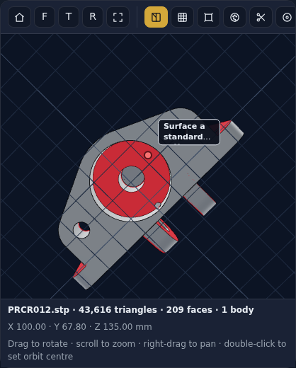
LOCATED EVIDENCE
The finding, marked on the part that caused it
Click a finding. It takes the model.
Its own faces are painted in its own severity colour, with the camera brought square to them — not a ring floating above the area, the surfaces the rule was measured on.
It runs both ways: click a painted face and the finding that painted it opens. Where two findings share a face the more severe wins the click, and the banner counts the other.
Three outcomes again, not two. A finding shows faces, or a callout when the engine measured a POINT rather than a surface, or it states in grey why it can be shown at all — "measured across the whole part, so there is no single face to mark".
And it never overstates what it painted. This part has 67 faces the cutter cannot reach; the kernel caps the list it sends at 40. The caption reads "40 of 67", not "40".
BrainSpark DFM / DFA Studio · Design-for-Manufacture & Assembly · 7/19
Notes:
This is the slide I would slow down on, because it is the one suppliers react to. What you are looking at is a real machined part in the tool, and every red surface is a face a standard cutter cannot reach. Not an arrow pointing at the area — the actual faces, tinted. You click a finding in the list and it takes over the model: its faces paint in its own severity colour, and the camera comes round square to them so you are not looking at the problem edge-on. Now, the version of this I showed you before drew numbered RINGS on the picture. That was honest but it was weak, and a supplier told us why: on a casting with nine ribs, a ring near a rib does not tell you WHICH rib. So we fixed it properly. The engine already knew which B-rep faces it measured — it was computing the face identifiers and then throwing them away in four separate places. Now it keeps them. It also runs backwards, which people like more than I expected. You see a red face, you click it, and the finding that painted it opens in the list. If two findings claim the same face, the more severe one wins the click and the banner tells you another one is there — because quietly hiding the second would be the same sin as never showing it. And the honesty rule survives into the picture. Some findings have faces. Some were measured at a POINT, not on a surface — those get a marker and the tool says so. And some genuinely cannot be pointed at: a wall-thickness distribution is a property of the whole part, and rather than pin it somewhere plausible the tool writes, in grey, why there is nothing to mark. One last detail, bottom right, and it is the one I would want you to hold me to. This part has sixty-seven unreachable faces. The geometry kernel caps the list it sends at forty. So the caption says forty OF sixty-seven. A tool that painted forty and said "forty" would be telling you it had shown you everything.

Slide 9
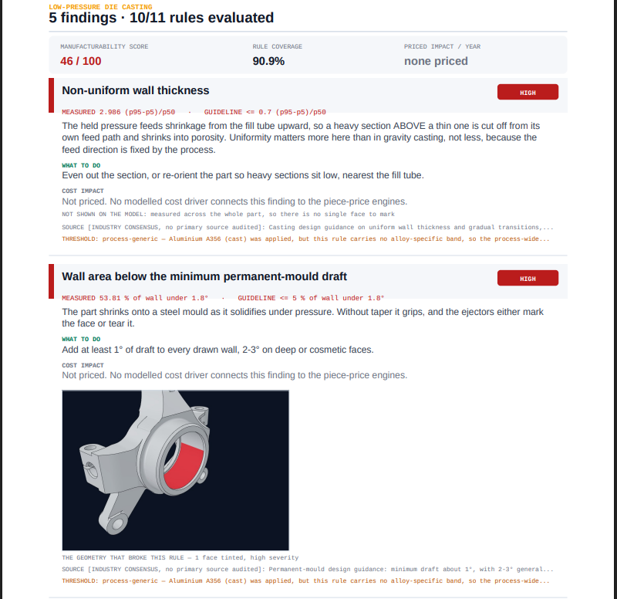
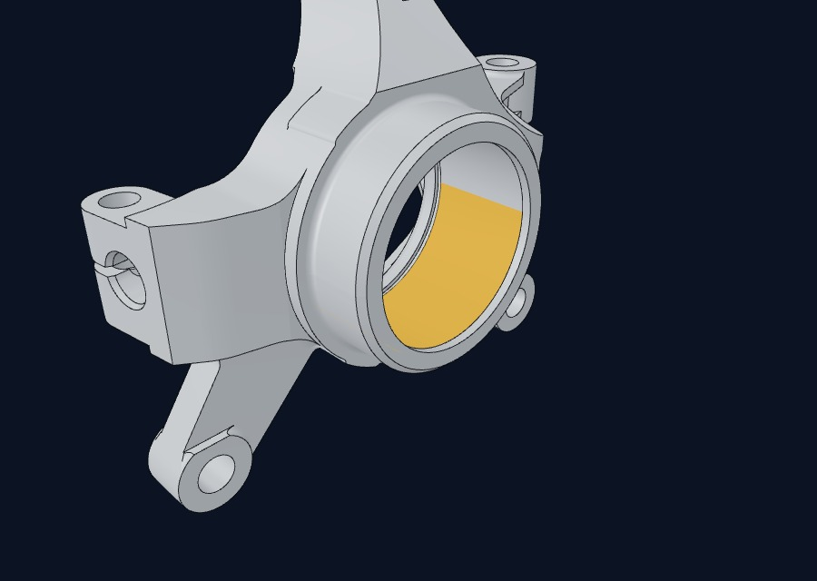
IT LEAVES THE SCREEN
The same evidence, inside the PDF and the workbook
A finding argues its case where it is written down.
Each finding's card in the PDF carries its own render — only that finding's faces, its own severity colour, camera square to them — captioned with the face count.
Look at the card above it: no picture, and a grey line saying why. "Measured across the whole part, so there is no single face to mark." A gap with no explanation reads as an oversight.
The workbook too.
A new Evidence sheet embeds the same renders beside each measurement, and the Findings sheet gained two columns: how many faces were highlighted, and — when none were — why.
BrainSpark DFM / DFA Studio · Design-for-Manufacture & Assembly · 8/19
Notes:
A fair challenge to the last slide is: that is lovely on your screen, but I forward a PDF to a supplier in Poland and a workbook to my buyer. So does the evidence travel? It does now. On the left is page seven of a real report on a steering knuckle. Look at the second finding — under-drafted wall — and it has its own picture, inside its own card, showing only ITS faces in red, with the camera square to them. Captioned with the face count. Now look at the finding ABOVE it. Non-uniform wall thickness. No picture — and a grey line explaining why: measured across the whole part, so there is no single face to mark. That is deliberate. A card with a gap where a picture should be reads as an oversight, and the supplier stops trusting the rest of the page. And the workbook, bottom right. It used to carry the numbers and send you back to the PDF to find out what a row meant. It now has an Evidence sheet with the same renders embedded next to each measurement, and the Findings sheet gained two columns — how many faces were highlighted, and when none were, the reason. The point worth stressing: those are the SAME images, captured once from the same viewer state. The screen, the PDF and the workbook cannot disagree with each other about what a finding looks like.

Slide 10
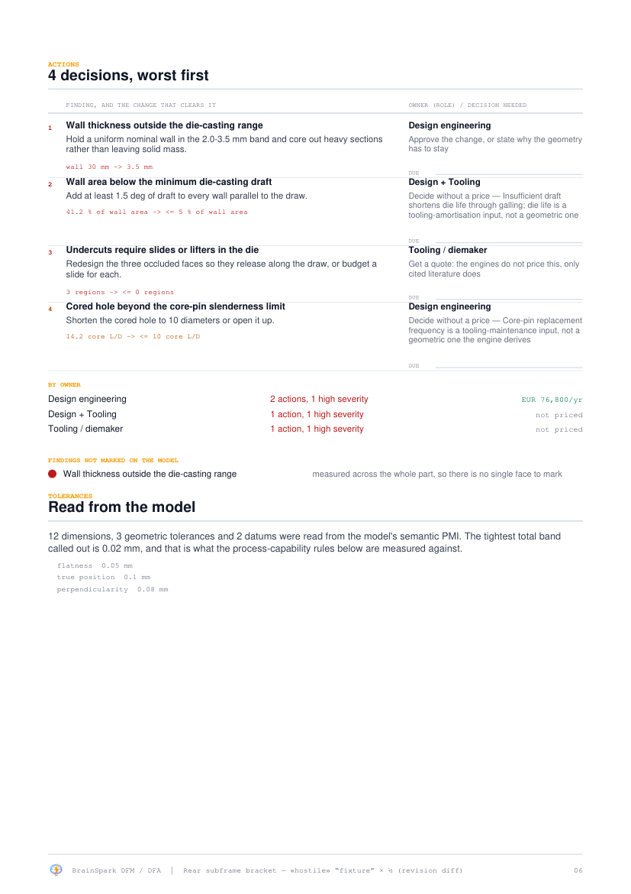
FROM FINDINGS TO DECISIONS
Nobody leaves a review with a percentage
They leave with an owner and a decision.
The report used to say what was wrong and what it cost, then stop. It now closes with an action list.
The action is the rule's own fix text
Nothing on that page was authored by the tool.
The owner is a ROLE, not a name
A slide is a toolmaker's problem; a wall thickness is a designer's. The tool does not know who works here.
The due date is blank on purpose
A date this tool invented would be its least credible column.
Rolled up by owner
So each role can be sent their own rows out of the workbook.
BrainSpark DFM / DFA Studio · Design-for-Manufacture & Assembly · 9/19
Notes:
This is what turns an analysis into something a programme can actually run on. The report used to tell you what was wrong and what it cost, and then stop. People would read it, agree it was interesting, and nothing would happen. Nobody walks out of a review holding a percentage. So the report now ends with an action list. Every finding becomes a decision, with an owner. Three deliberate choices in there, and each one is about staying credible. FIRST, the action text is the rule's own recommendation, word for word. The tool did not compose it. Nothing on that page is invented. SECOND, the owner is a ROLE, not a person's name — design, tooling, press shop. The tool genuinely does not know our organisation chart, so it does not pretend to. THIRD, and this is the one people notice: the due date column is deliberately empty. A date generated by software would be the first column anybody stopped believing, and once they stop believing one column they stop believing the page. And it rolls up by owner, so the tooling engineer can be sent just their rows straight out of the spreadsheet.

Slide 11
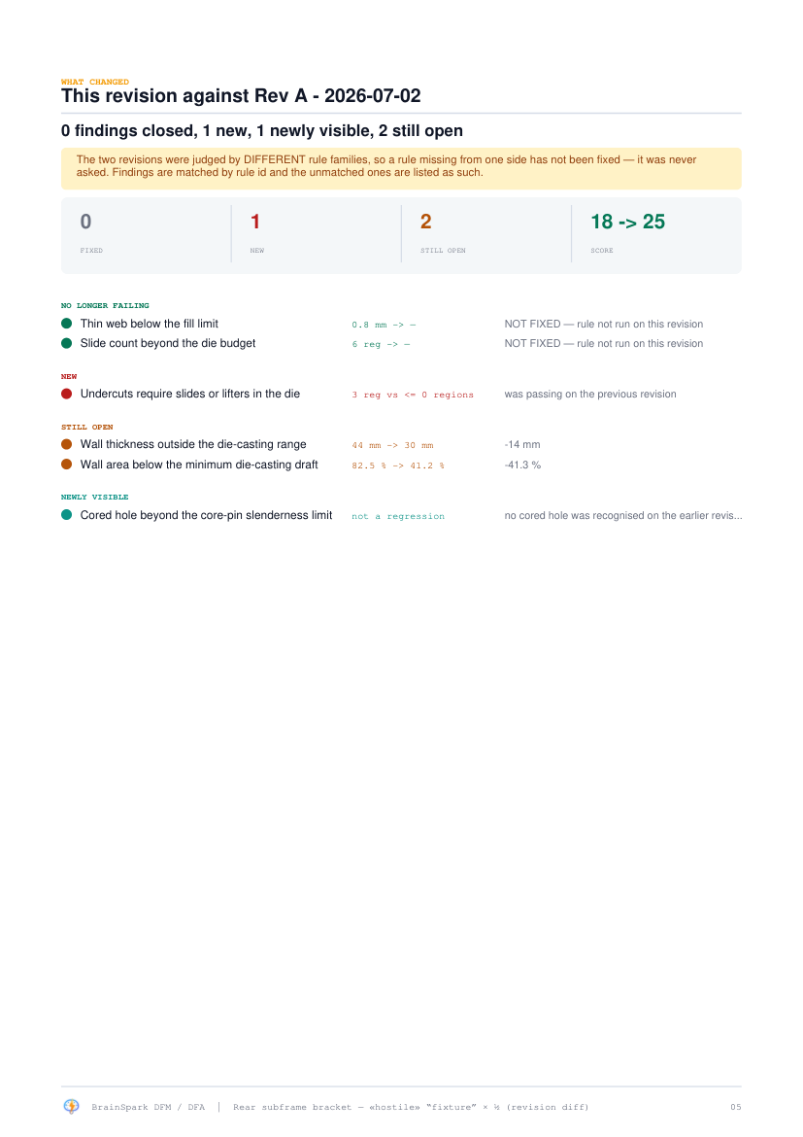
REVISION COMPARISON
Did the changes we agreed last month actually work?
Every report used to be a snapshot. Reviewers diffed two PDFs by eye — which is how a closed finding gets missed and a regression ships.
FIXED
The rule now passes. This is the only state that frees money.
NOT FIXED
It stopped failing because the measurement disappeared. Counting this as a win is the most dangerous thing the feature could do — so it never does.
NEWLY VISIBLE
Could not be judged before, fails now. Not a regression — it became measurable.
NEW
Was passing, fails now. The only genuine regression.
Comparing two different processes, or two different alloys, is warned about — not silently tabulated.
BrainSpark DFM / DFA Studio · Design-for-Manufacture & Assembly · 10/19
Notes:
The second question a programme always asks is: we agreed changes last month, did they work? Until recently we could not answer that. Every report was a snapshot, so people compared two PDFs side by side and looked for differences by eye. That is how a fixed problem gets missed, and how a new problem ships. Now you upload the new revision and it tells you what changed, in four categories. And the four categories are the point of this slide. FIXED, in green, means the rule now passes. That is the only category that actually frees up money. NOT FIXED is the important one. Sometimes a rule stops failing not because the part got better, but because the measurement disappeared — for example the new file was exported without its tolerance data. A naive comparison would report that as solved. Ours calls it NOT FIXED and credits zero money against it. If this feature ever told you a problem was solved when it was not, you would rightly stop trusting the whole tool. NEWLY VISIBLE means it could not be judged before and now fails. That is not a regression — the part became measurable. And NEW, in red, means it was passing and now fails. That is the only genuine regression. One last thing: if you try to compare two revisions made by different processes or different alloys, it warns you instead of quietly putting them in a table.

Slide 12
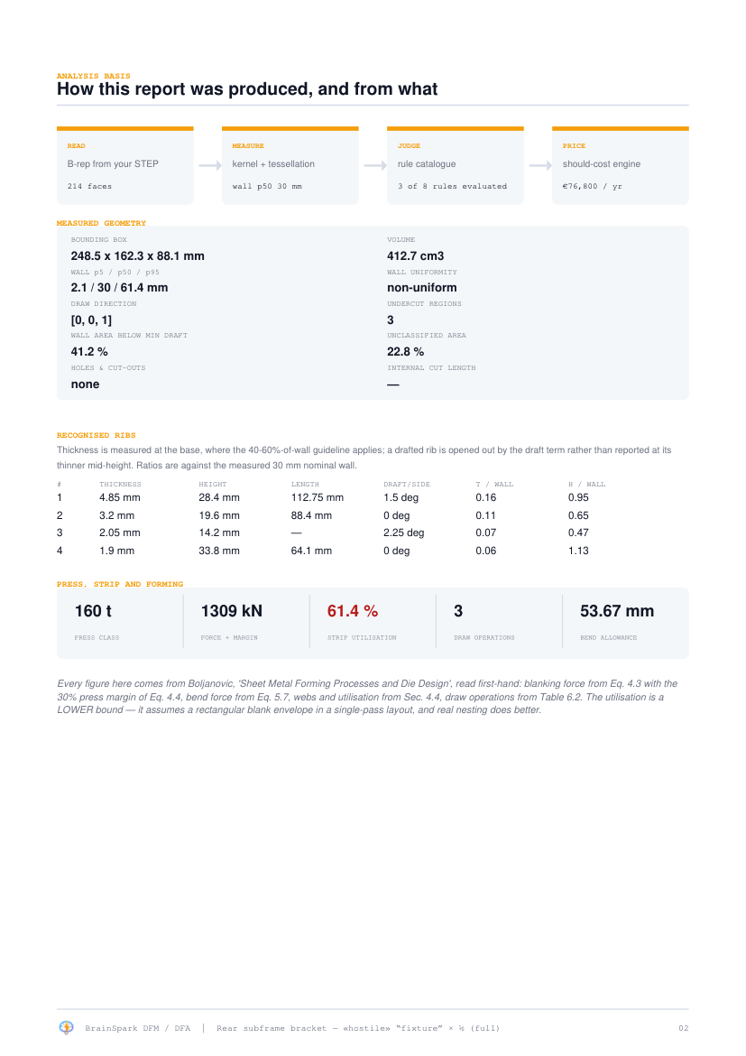
COST, NOT JUST CONFORMANCE
Findings are priced, and the process is costed
Every finding carries what it is worth.
The same should-cost engines that quote the part are re-run with the geometry as drawn and again with the rule satisfied. The difference is the finding's value, per part and per year. Where the engines cannot price something — a slide, a die-life effect — the report says so and cites the literature range instead of inventing one.
And the route table asks the harder question:
the same geometry run through every other process's own rules, priced, carbon-scored, with the reason each alternative is or is not viable.
NEW — WHAT THE STANDARD PROMISES
Capability bands, before any rule fires
For die castings and steel castings the report now opens with what NADCA #402 or SFSA 2000 promises at this part's own size — tolerance band, machining allowance, flatness — so a purchasing conversation starts from the standard, not from a finding.
BrainSpark DFM / DFA Studio · Design-for-Manufacture & Assembly · 11/19
Notes:
Two things on this slide. The first is that every finding carries a price. The tool runs the same should-cost engine we use to quote parts, once with the geometry as drawn and once with the problem fixed, and the gap between them is what the finding is worth — per part and per year. That matters because it means the designer and the buyer are finally looking at the same number, from the same engine. Not two spreadsheets that disagree. And where the engine genuinely cannot price something — a die slide, a die-life effect — it says so and quotes the published range instead of inventing a figure. I would rather it say I do not know than guess. The second thing is the route table. It asks the harder question: what if we made this part a completely different way? It takes the same measured geometry, runs it through every other process's own rules, prices it, and scores its carbon — and tells you why each alternative is or is not viable. And the panel in the dark box is the newest addition. For die castings and steel castings, the report now opens with a small band that says what the governing standard PROMISES for a part of this size — the tolerance band it can hold, the machining allowance it needs, the flatness it can keep — before any rule has fired. The reason is that a purchasing conversation goes very differently when it starts from what the industry standard says the process can do, rather than from a complaint about the drawing. Sheet metal parts get the same treatment with press tonnage and strip utilisation, from the die-design textbook equation by equation.

Slide 13
HOW WE KNOW IT IS RIGHT
Tested against arithmetic, not itself
200/200
758
93
0
GEOMETRY ACCURACY GATE
AUTOMATED TESTS
SHAPED PARTS SWEPT
AI-WRITTEN NUMBERS
Every fixture is a shape whose truth is arithmetic — a 3.000° cone, a 25 mm wall. CI fails on any regression.
Plus HTTP integration tests and an accessibility gate on every page. 12 Aug 2026.
Ten commodities, ten variants each, through the full production path.
No language model touches this analysis at any point.
What we deliberately do NOT claim
Of 248 thresholds, 33 now come from a reference we have read first-hand — up from 12 a week ago, after nine primary documents were read cover to cover (next slide). 2 are recorded as CONTESTED, where a primary source disagrees with the value we hold; the rest are unaudited industry consensus, and the register names each one.
That register ships with the product and there is a command that prints it. A number nobody has checked is worth knowing about before a supplier finds it.
BrainSpark DFM / DFA Studio · Design-for-Manufacture & Assembly · 12/19
Notes:
This is the slide that should decide whether you believe anything on the previous ten. Start top left. A hundred and ninety-nine out of a hundred and ninety-nine on the geometry accuracy gate. Those are test shapes where we know the right answer by arithmetic — we built a cone with exactly three degrees of draft, so the engine must say three degrees. If it says two point eight, the build fails and the code does not ship. That runs automatically on every change. Seven hundred and twenty-seven automated tests, ninety-three real-shaped parts swept through the full production path, and zero numbers written by AI. Now the bottom half. When I first showed this slide, this was the weakest part of the tool — out of the whole rule book, only five limits came from a document we had personally read. I said so at the time. That number is now thirty-three, and the reason is simple: over the last week we obtained and read nine primary documents cover to cover — the actual NADCA standards for die casting, the Steel Founders' Society handbooks for steel castings, the DuPont and Covestro design guides for plastics, the die-design textbook for sheet metal, ISO 8062-4 for casting tolerances, and now DIN 16742, the moulded-part tolerance standard the plastics industry quotes against. The next slide shows exactly what each one gave us. The rest of the thresholds are still industry consensus, and the register still names every one of them, with a command that prints it. Two are recorded as CONTESTED, where a source we trust disagrees with the number we hold. I keep this slide in deliberately. The alternative is a supplier finding an unaudited number first and then doubting everything else we say.

Slide 14
THE RULE BOOK'S SOURCES
Nine primary documents, read cover to cover
NADCA Product Design for Die Casting, 7th ed.
Draft computed from the book's own formula at each feature's depth · fillets · bosses · cored holes
12 → 33
NADCA #402 Product Specification Standards (2021)
Die-casting tolerance CAPABILITY, computed per dimension and grade — Standard vs Precision is now an input
PRIMARY-READ THRESHOLDS
SFSA Steel Castings Handbook, Supplement 1
In one week. Counted from the register, not remembered
Steel casting design: rib height coupled to rib thickness · junction fillets with the printed 13–25 mm clamp
SFSA Supplement 3 — Dimensional Capabilities
Steel casting tolerances (SFSA 2000 CT grades) · required machining allowance · production series input
DuPont Engineering Polymers, Module I
0
Moulding draft per resin and draw depth · fillet knee · boss and blind-core limits
Covestro Part and Mold Design
PC-family ribs, draft and fillets from the resin maker's own tables — read from page images
CONSTANTS TUNED TO FIXTURES
Boljanovic, Sheet Metal Forming Processes
Formulas verified against each book's own printed worked examples first
Press force, strip utilisation, bend allowance and draw operations, equation by equation
ISO 8062-4:2017 — General tolerances for castings
Non-ferrous casting tolerances per metal group · draft tables · the standard's own ‘-’ cells refuse
DIN 16742:2013 — Plastics moulded part tolerances
2
Moulding tolerance groups per resin and dimension · rotomoulding at TG9 · replaces DIN 16901
RULES CONFIRMED UNCHANGED
READING THE BOOK CHANGED THE VERDICT
DuPont printed our exact rib band — an audit hit, recorded as one
A 2 mm tolerance band on a first-article steel sand casting used to pass the old screen. SFSA's own statistics say no foundry can promise it — it now fails at 0.33× capability, with the table cited. And the same bracket passes draft as nylon and fails as ABS, because DuPont's table judges each resin at its own angle.
BrainSpark DFM / DFA Studio · Design-for-Manufacture & Assembly · 13/19
Notes:
This slide is the answer to the weakness I admitted on the previous slide, so let me walk you through what actually happened. Over the last week we obtained nine of the reference documents that the industry actually runs on, and read them cover to cover. Not summaries of them — the documents themselves. The two NADCA documents for die casting, including the 2021 specification standard that carries the tolerance tables. The two Steel Founders' Society handbooks for steel castings. The DuPont and Covestro design guides, which are what the plastics industry designs against. The die-design textbook for sheet metal. ISO 8062-4, the international tolerance standard for castings, which finally covers the non-ferrous alloys — and where it prints a dash, steel in a permanent mould for instance, the tool abstains rather than borrowing a neighbouring column. And now DIN 16742, the moulded-part tolerance standard, which replaced the DIN 16901 our old rule cited from memory: every plastic in our picker is assigned to one of the standard's own tolerance groups, and the band is priced at each dimension's own size. It also gave rotational moulding its first tolerance rule ever — the standard classifies the whole process into its loosest group, TG9, in one printed sentence. Each row on the left tells you what came out of each book. But three things on the right matter more than the list. FIRST, the count of thresholds we have personally verified against a primary document went from twelve to thirty-three in that week. That number is counted live from the register when this deck is generated — I did not type it. SECOND — and this is a discipline point — before any formula from a book was wired in, it was tested against the book's OWN printed worked examples. The NADCA tolerance standard prints an example: an aluminium dimension of five inches should come out at plus or minus point three five millimetres. Our code has to reproduce that exact number or the tests fail. That catches misread tables — and it caught two real mistakes before they shipped, including one where a rounding error would have charged an extra inch of tolerance. THIRD, honesty cuts both ways. When DuPont's figure for rib proportions turned out to print exactly the numbers we already used, we did not quietly claim we knew all along — the register records it as a CONFIRMATION. And where a book's number was LOOSER than the screen we already had, the stricter number stayed, with both claims named on the finding. Now the dark box, because this is the part with money in it. Reading these books did not just improve citations — it changed verdicts. A two-millimetre tolerance band on a first-article steel sand casting used to pass our old screening check. The Steel Founders' statistics — built from a hundred and forty thousand measured production features — say no foundry can promise that as-cast. It now fails, at a third of capability, and the finding cites the exact table. That is a scrap-rate conversation we can now have with a supplier BEFORE the quote, with their own industry's book on the table. And the drafting example at the end: the same bracket now passes draft as nylon and fails as ABS, because the DuPont table judges each resin at its own angle. One part, two materials, two different correct answers. That is what alloy-specific genuinely means.

Slide 15
TESTED ON REAL PARTS
Three real components, seven faults found
The benchmarks prove the maths. They cannot tell you whether the report SAYS the right thing. So we took three real components, read every finding by hand, and re-ran them through the live tool.
Steering knuckle
Casting bracket
Seat locking bracket
Hot forging · high-strength steel
HPDC · aluminium A356
Stamping · high-strength steel
It reported a EUR 151,200 a year saving
Now says NOT PRICED, with the reason
on a bend-radius finding — but the figure priced deleting all 23 bends, which is a different part
It recommended cold heading a die casting
6 gates now — it refuses both
a wire-fed fastener process, for a 320 cm3 bracket. Only 2 of 35 routes had a feasibility gate
One label, two different numbers
The angle is printed in the label
"wall below minimum draft" read 64% on page 1 and 56% on page 2 — measured at different angles
A rule told you to do the wrong thing
Titles and fixes read the alloy limit
"open the radius to 1x thickness" when the steel it had resolved needs 2x
26 holes, none of them round
Measured — 12 round, 14 shaped
it asked the CAD exporter what shape they were instead of measuring
All seven are fixed, and every one is now held down by a test that fails if it comes back. 758 tests run on every change.
BrainSpark DFM / DFA Studio · Design-for-Manufacture & Assembly · 14/19
Notes:
This slide exists because of a fair question: how do you know the tool is telling the truth? The benchmarks on the last slide prove the MATHS is right. They cannot prove the REPORT says the right thing. Those are two different problems, and a tool can pass the first while failing the second badly. So we took three real components — a forged steering knuckle, a die-cast bracket, and a stamped seat bracket. We read every single finding by hand, then re-ran the same files through the live tool and compared. We found seven things our own tool was getting wrong. They are on the slide. Let me take you through the two that matter most. THE FIRST ONE, top of the list. The report showed a saving of a hundred and fifty-one thousand euros a year. That was the biggest number in the whole document. When we traced it back, the calculation was pricing the removal of all twenty-three bends in the part — in other words, a completely flat piece of metal. But the finding it was attached to just asked you to open one bend radius slightly. Opening a radius removes no bends and saves nothing. So the number was real arithmetic attached to the wrong question. It now says NOT PRICED and explains why. THE SECOND ONE, and this is the one an experienced engineer spots in ten seconds. The tool was recommending Cold Heading as a cheaper way to make a die-cast bracket. Cold heading makes bolts out of wire. It cannot make a bracket. The reason was that only two of our thirty-five processes had any check on whether they could physically make the part at all. Everything else was allowed by default. We have added those checks, and it now refuses cold heading and MIM outright, with the reason. The other three on the list are the same character — right maths, wrong wording, or a check that trusted the CAD file instead of measuring. The point I want to land is this. We found all seven ourselves, on purpose, before a supplier did. And every one of them is now pinned by a test that fails automatically if the fault ever comes back. That is why the number at the bottom matters — seven hundred and one tests, run on every single change. If we had not done this exercise, the first person to spot the hundred and fifty-one thousand would have been someone reading the report in a supplier review.

Slide 16
WHAT IT CAN ACTUALLY SAY
Measured on 93 shaped parts · 10 Aug 2026
A rule that is correct and abstains on every real part is worth nothing. So we measure how much of the catalogue actually speaks, by commodity.
Commodity | Process family | Rule coverage | Findings / part
HPDC housing | High-pressure die casting | 83.3 % | 4.8
Gear blank | Powder metallurgy | 83.3 % | 0.0
Extruded profile | Extrusion | 83.3 % | 0.1
Moulded cover | Injection moulding | 77.8 % | 3.3
Machined block | Machining | 71.4 % | 1.3
Drawn cup | Deep drawing | 68.0 % | 0.3
Forged lever | Hot forging | 66.7 % | 3.7
Turned shaft | Turning | 60.0 % | 1.0
Sand-cast arm | Sand casting | 60.0 % | 1.5
Sheet bracket | Sheet metal | 37.5 % | 0.0
69.3 %
MEAN COVERAGE
Up from 64.1% when the sweep was first built
The sheet-metal row is the honest one
37.5% — the lowest on the board. Our test brackets are flat plates with holes, so no bend is recognised and seven bend rules never fire.
It is a fixture gap, not a rule gap, and it is on the slide because you would find it in five minutes.
BrainSpark DFM / DFA Studio · Design-for-Manufacture & Assembly · 15/19
Notes:
This is the measurement I am proudest of having, and least proud of some of the numbers in. The standard I set myself was this: a rule that is technically correct but stays silent on every real part is worth nothing. So we run ninety-three realistically-shaped parts — ten commodities, ten variants each — through the whole tool, and count how much of the rule book actually speaks. The average is sixty-nine per cent. Die casting, powder metallurgy and extrusion are all above eighty. Those are genuinely good. Now look at the bottom row, sheet metal, thirty-seven and a half per cent, in red. That is the worst number on the board and I have deliberately left it on the slide. The reason is not that the rules are wrong. It is that our synthetic test brackets are flat plates with holes in them. They have no bends. So seven bend-related rules never get a chance to run, and they score zero through no fault of their own. That is a test-data problem, not a rule problem. And it is exactly why my ask at the end of this presentation is what it is — I need one real bent bracket. I am showing you this because you would find it within five minutes of using the tool, and I would rather point at it myself.

Slide 17
AGAINST THE MARKET
Versus DFMPro, aPriori and Boothroyd
Capability | BrainSpark | Established tools | Position
Geometry read from B-rep | Yes | Yes | Parity
Process- and alloy-specific rules | Yes | Yes | Parity
Findings priced by a should-cost engine | Yes | aPriori yes | Parity with the leader
Alternative process routes, priced and carbon-scored | Yes | Partial | Ahead
"Not evaluated" as a first-class outcome | Yes | Rare | Ahead
Threshold provenance published with the finding | Yes | No | Ahead
Tolerance capability computed from the named standard | Yes | Table lookups | Ahead
Revision-to-revision comparison | Yes | Yes | Parity
Validated against measured production outcomes | Not yet | Yes | Behind
Native CATIA / NX / JT input | No | Yes | Behind
The two red rows are the honest gaps, and they are the two I would spend money on next. Everything above them we already do.
BrainSpark DFM / DFA Studio · Design-for-Manufacture & Assembly · 16/19
Notes:
A fair comparison against the established tools — DFMPro, aPriori, Boothroyd Dewhurst. The green rows are where we are genuinely ahead, and there are four now. We price alternative process routes and carbon-score them. We treat could-not-evaluate as a real outcome instead of a green tick. And we publish where every threshold came from and how much it is worth trusting. I have not found a commercial tool that will tell you one of its own numbers is unaudited. And since last week, tolerance capability is COMPUTED from the named standard at the part's own dimensions — NADCA 402 for die castings, SFSA 2000 for steel — where the established tools do static table lookups. The middle rows are parity — reading real geometry, process and alloy specific rules, pricing findings, comparing revisions. We match them. Now the two red rows, because those are the honest ones. They have decades of measured production outcomes behind their numbers. We have zero. Their limits have been checked against real scrap rates from real plants; ours have been checked against published guidance. And they read native CATIA, NX and JT files. We read STEP and IGES, which means a translation step, and we lose the tolerance data every time. Both of those are solvable. Neither is solved by me writing more code — the first one needs data from the business, and that is what I am about to ask for.

Slide 18
WHAT IS NEXT
Ordered by impact, not by effort
1
Validate against one real part
A production part, its quote, and the supplier's own DFM markup. This is what converts "internally consistent" into "accurate" — and it is the only item on this list I cannot do alone.
2
Native CAD input
CATIA, NX and JT. Today we read STEP and IGES, which means a translation step and a lost PMI tolerance every time.
3
Extend the standards library to machining
The moulding and casting tolerance story is CLOSED — nine documents in, DIN 16742 arrived last. The machined families still screen on ISO 2768 quoted from memory; buying ISO 2768/286-2 makes them computed too. A catalogue purchase.
4
Company standards, plant-wide
Already built and org-scoped; needs the plant's own values loaded to be worth anything.
BrainSpark DFM / DFA Studio · Design-for-Manufacture & Assembly · 17/19
Notes:
Four things next, in the order that changes the answer rather than the order of effort. NUMBER ONE, in gold, is to validate against one real part. That is the only item on this list that I cannot do by myself, and it is the only one that converts this tool from internally consistent to actually accurate. I will come back to it on the next slide. NUMBER TWO is reading native CAD — CATIA, NX, JT. Today every file goes through a translation to STEP and we lose the tolerance information on the way. That is why you saw tolerance rules abstaining on the coverage slide. NUMBER THREE is a small purchase rather than a project — and I can now say the original version of this ask is DONE. Every standard we named as a blocker has been bought, read and coded: ISO 8062 for the castings and DIN 16742 for the mouldings both arrived this week. Every moulding and casting family in the tool now judges tolerance from a document we hold. What remains is the machined families, which still screen on ISO 2768 quoted from memory — the same catalogue purchase, and the register names it as the exact blocker. NUMBER FOUR is loading our own plant standards. The mechanism is already built and it already overrides the textbook where we set a value. It just needs our actual numbers put into it, which is a conversation with manufacturing rather than a coding job. Everything from two down I can schedule myself.

Slide 19
THE ASK
One real part, with its quote
The tool is built, tested and honest about its limits. What it has never had is a production part with a known outcome.
Give me one part we already buy — the STEP file, the quote we pay, and the supplier's own DFM comments. I will run it, publish every disagreement, and we will know within a week whether this is a tool we can put in front of a supplier or a prototype that needs another quarter.
A sheet-metal bracket with real bends would be ideal — it would light up seven rules that have never yet run on anything but a fixture.
Avinash Bhosale · Cost Engineering · August 2026
Notes:
So here is the ask, and it is deliberately a small one. I am not asking for budget. I am not asking for headcount. I am asking for one part. Specifically: one component we already buy today. Three things with it — the STEP file, the quotation we actually pay, and whatever DFM comments the supplier gave us. I will run it through the tool and publish everything, including every place the tool disagrees with the supplier. Especially those. The reason is this. Right now the tool is internally consistent. It is tested, it is honest about its limits, and every number in it is reproducible. What it has never been is checked against reality — against a part where somebody already knows the right answer. Within a week of getting that part, we will know whether this is something we can put in front of a supplier, or a prototype that needs another quarter of work. And either answer is worth having. One preference, in the box at the bottom. If you can find me a sheet metal bracket with real bends in it, that would be ideal — it would exercise seven rules that have never yet run on anything except a test fixture. That is everything. Happy to take questions, and if you have five more minutes I can run a real part through it live right now.

