Slide 1


Institute for Advanced Computing & Software Development
Title
Portfolio Management using Machine Learning

Slide 2
Portfolio Management using Machine Learning
Project guide, By,
Akshay Tilekar Kalpana Vyavahare 223325
Siddhi Bhosale 223354

Slide 3
Objective
The objective of the project is portfolio management in order to help the investor to invest in different type of stock using machine learning.

Slide 4
Why we need portfolio
Make right investment choices
Reduce time spend in monitoring the portfolio
Helps keep the capital safe

Slide 5
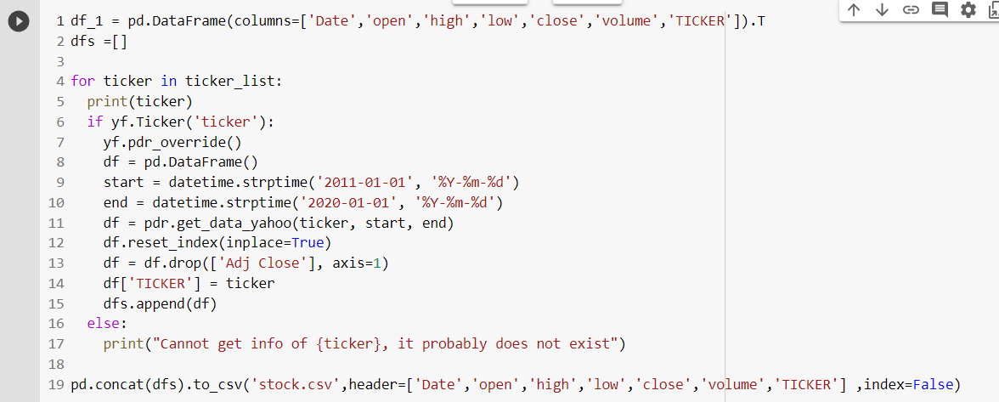
Dataset

Slide 6
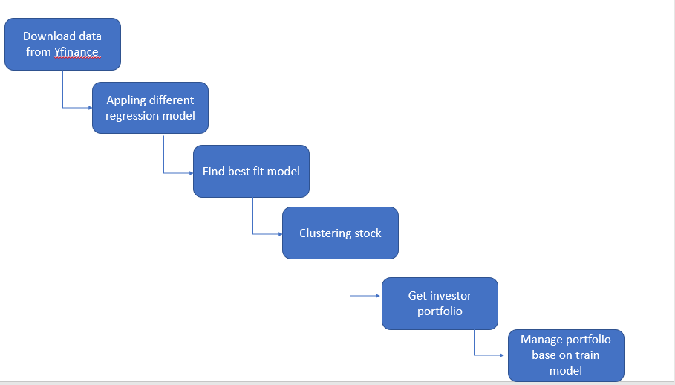
Propose system

Slide 7
Regression model we use
Linear regression
Decision tree
Random forest
XGboost

Slide 8
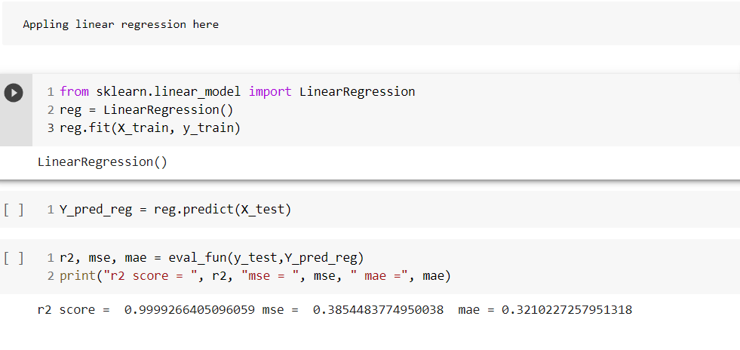
Linear regression

Slide 9
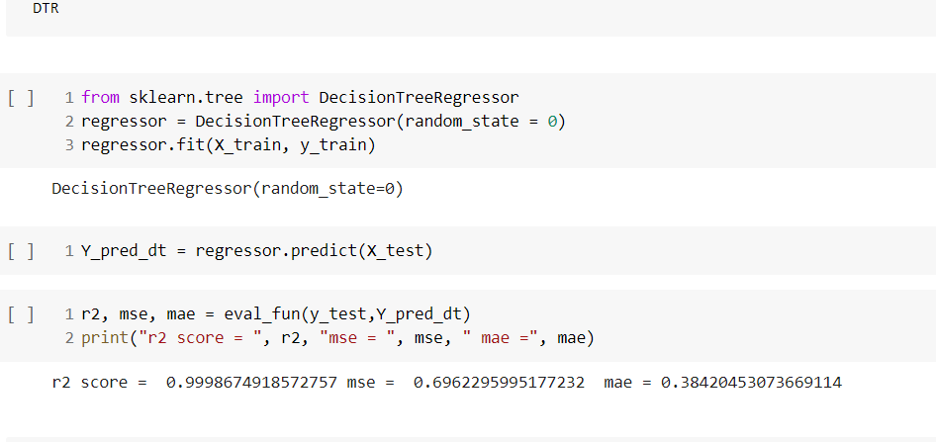
Decision Tree

Slide 10
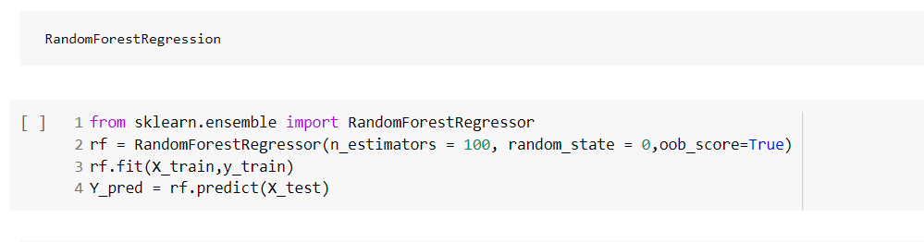
Random Forest

Slide 11
Why XGBoost?

Slide 12
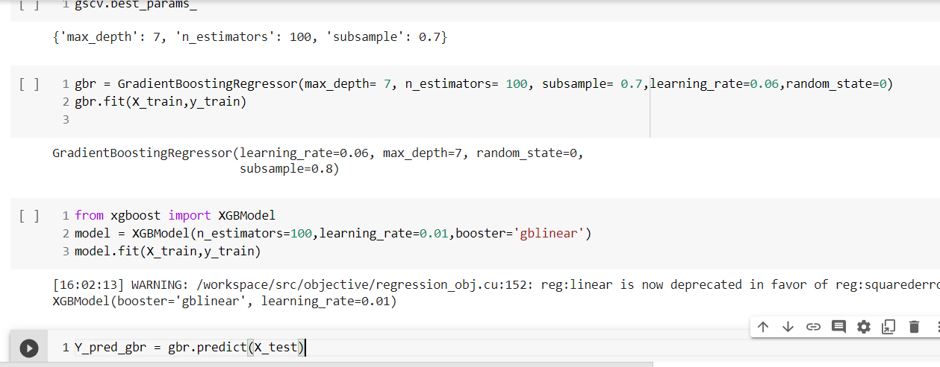
XGBoost?

Slide 13
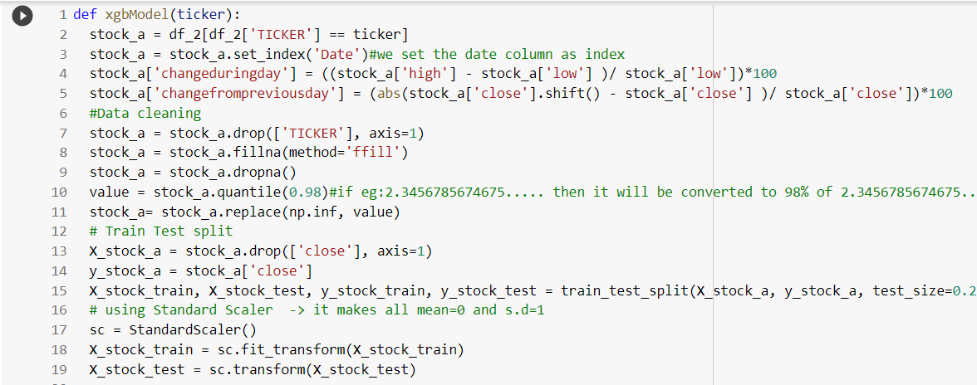
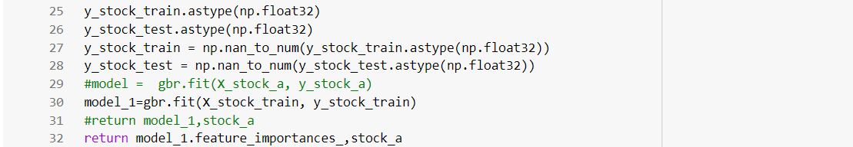
Why XGBOOST?

Slide 14
After Applying Our Model On 500 Stocks
A coeff1 file is generated which contains all the coefficients and target for 500 stocks.
The csv file has columns like ‘TICKER','CLASS','Coef for open','Coef for high','Coef for low','Coef for volume','Coef for change within day','Coef for change from prev day'.
Later applying standard scalar and doing train test split and dropping the target columns from x and adding it into y.

Slide 15
THE FIRST MODEL USED IS Kneighbors classifier
It’s a supervised learning machine learning method.
K refers to the number of nearest neighbors to include in the majority.
It is used to classify data point based on how its neighbors are classified.
Larger values of K will have smoother decision boundaries which means it will lower the variance but increase bias.
It's a lazy learner because it does not learn from the training data but memorizes the training data instead.

Slide 16
After applying knn and fitting the model to our data
Accuracy of KNN 0.7160
score of KNN 0.7160
The accuracy the model provided was only 71%.
As the accuracy was not satisfactory, we decided to apply another model .

Slide 17
As Number of neighbors increases, density decreases , Thus the outliers increase.
On the same note as number of neighbor decreases density increases thus the number of outliers decrease.
Suppose, we have an image of a creature that looks similar to cat and dog, but we want to know either it is a cat or dog. So for this identification, we can use the KNN algorithm, as it works on a similarity measure. Our KNN model will find the similar features of the new data set to the cats and dogs images and based on the most similar features it will put it in either cat or dog category.

Slide 18
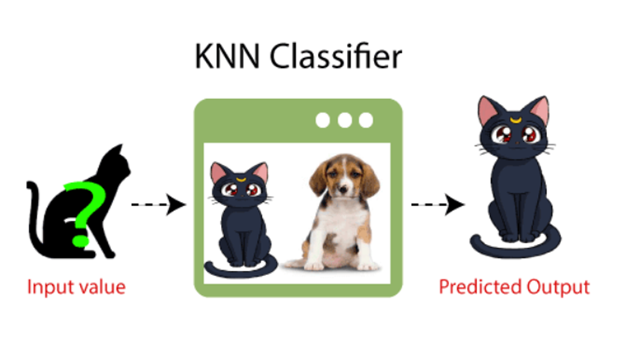

Slide 19
THE SECOND MODEL USED IS Kmeans
Kmeans is a technique for data clustering that is used under unsupervised machine learning.
It is capable of classifying unlabelled data into a predetermined number of cluster based on similarities(k).
Kmeans clustering algorithms computes centroids and repeated until the optimal centroid is found.

Slide 20
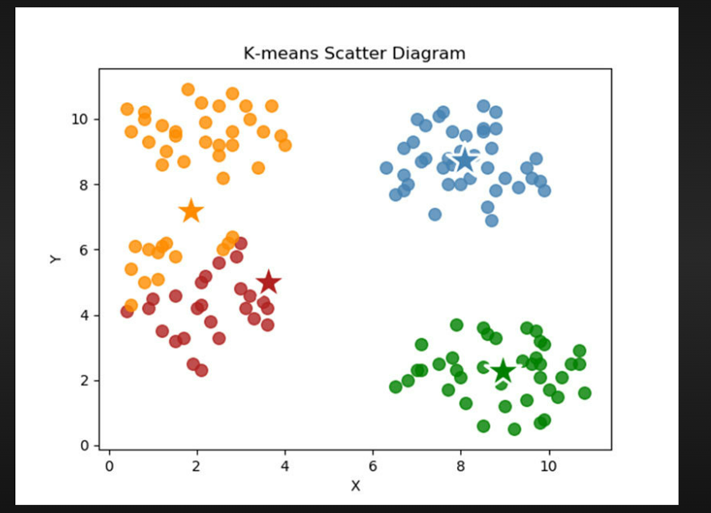
Here k denotes the number of clusters.
In this method data points are assigned to the clusters that the sum of the squared distances between the data points and the centroid is as small as possible
Here star represents the centroid

Slide 21
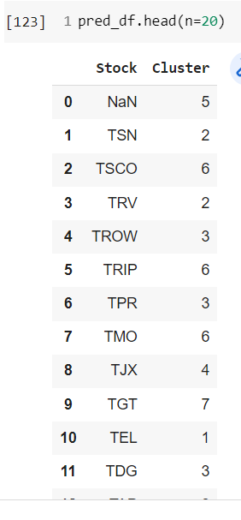
After fitting the k mean model on our data we saw the labelled cluster number assigned
Here we see how cluster numbers are assigned to different stocks.

Slide 22
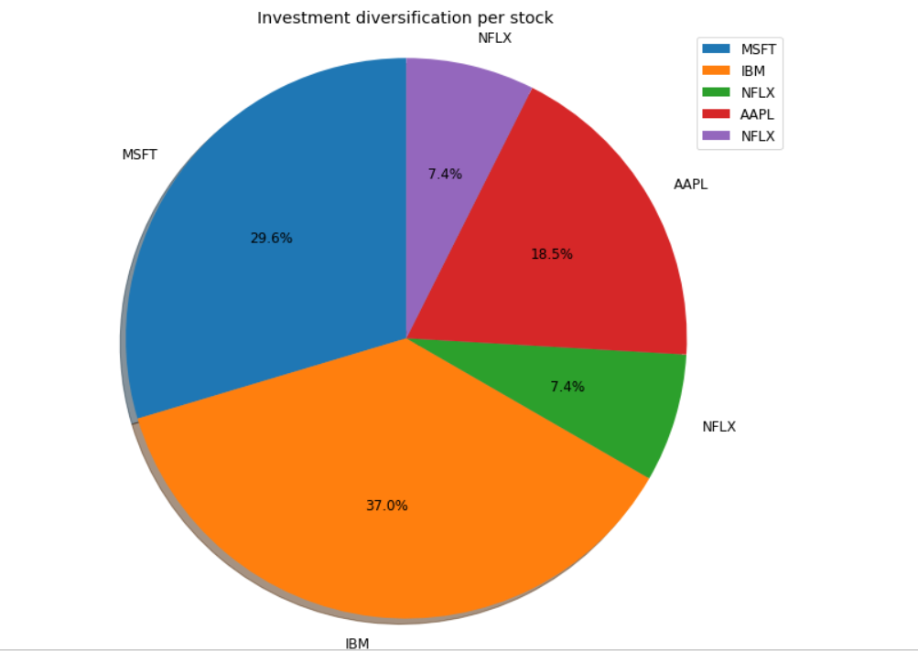
Now we take the csv file of our investors current portfolio .
Draw a pie chart for the stock investment distribution based on individual stocks

Slide 23
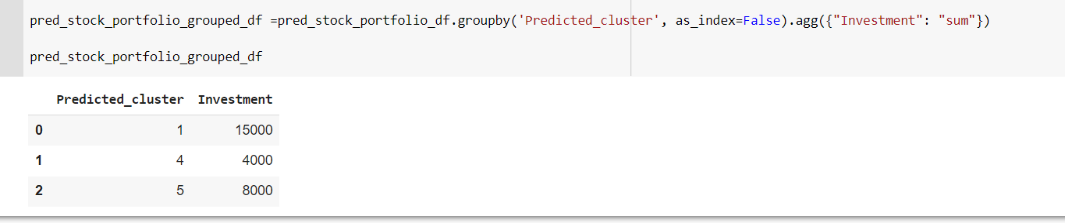
Now fitting the model to the data and grouping by cluster number and taking the aggregate investment amount.

Slide 24
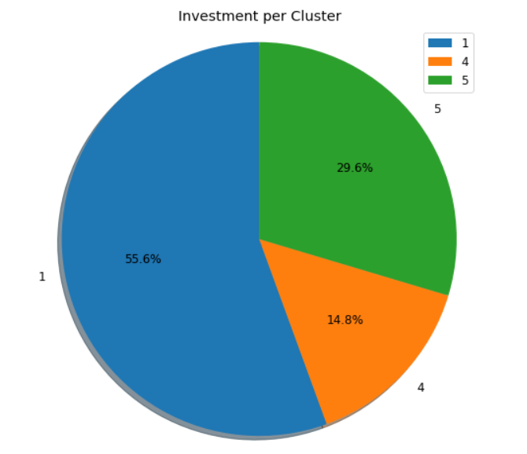
Next we take Pie chart, to show distribution of investment per cluster

Slide 25
Taking Investors input regarding the new investment she/he wants to make investment in that particular stock.
By using our model we predict the stock’s class(high) and the cluster number(1).

Slide 26
Challenges
Applying multiple algorithm and large data set time consuming
Manage data according to model

Slide 27
Future Scope
Use pyspark due to big data set
Use Deep learning technique for better result
We can do sentiment analysis.

Slide 28
Conclusion
We used many model and selected the model which gives the best outcome
In the end we asked the investor for his interest in a particular stock and predicted the class for the stock and its cluster number

Slide 29
Thank you!!!

