Slide 1
Data Types of MongoDB
Integer
Boolean
Double
String
Arrays
Null
Object ID
Binary data
Date

Slide 2
Data Types
String : This is most commonly used data type to store the data. String in mongodb must be UTF-8 valid.
Integer : This type is used to store a numerical value. Integer can be 32 bit or 64 bit depending upon your server.
Boolean : This type is used to store a boolean (true/ false) value.
Double : This type is used to store floating point values.
Min/ Max keys : This type is used to compare a value against the lowest and highest BSON elements.
Arrays : This type is used to store arrays or list or multiple values into one key.
Timestamp : ctimestamp. This can be handy for recording when a document has been modified or added.
Object : This datatype is used for embedded documents.

Slide 3
Data Types
Null : This type is used to store a Null value.
Symbol : This datatype is used identically to a string however, it's generally reserved for languages that use a specific symbol type.
Date : This datatype is used to store the current date or time in UNIX time format. You can specify your own date time by creating object of Date and passing day, month, year into it.
Object ID : This datatype is used to store the document’s ID.
Binary data : This datatype is used to store binay data.
Code : This datatype is used to store javascript code into document.
Regular expression : This datatype is used to store regular expression

Slide 4
Basic Database Operations
Database
collection

Slide 5
Basic Database Operations- Database
use <database name>
switched to database provided with command
db
To check currently selected database use the command db
show dbs
Displays the list of databases
db.dropDatabase()
To Drop the database

Slide 6
Basic Database Operations- Collection
db.createCollection (name)
Ex:- db.createCollection(Stud)
To create collection
>show collections
List out all names of collection in current database
db.databasename.insert
({Key : Value})
Ex:- db.Stud.insert({{Name:”Jiya”})
In mongodb you don't need to create collection. MongoDB creates collection automatically, when you insert some document.
db.collection.drop() Example:- db.Stud.drop()
MongoDB's db.collection.drop() is used to drop a collection from the database.

Slide 7
CRUD Operations
Insert
Find
Update
Delete

Slide 8
CRUD Operations - Insert
The insert() Method:- To insert data into MongoDB collection, you need to use MongoDB's insert() or save()method.
Syntax
>db.COLLECTION_NAME.insert(document)
Example
>db.stud.insert({name: “Jiya”, age:15})

Slide 9
CRUD Operations - Insert
_id Field
If the document does not specify an _id field, then MongoDB will add the _id field and assign a unique ObjectId for the document before inserting.
The _id value must be unique within the collection to avoid duplicate key error.

Slide 10
_Id field
_id is 12 Byte field
4 Bytes – Current time stamp
3 Bytes- Machine Id
2 Bytes- Process id of MongoDB Server
3 Bytes- Incremental Value.

Slide 11
CRUD Operations - Insert
Insert a Document without Specifying an _id Field
db.stud.insert( { Name : “Reena", Rno: 15 } )
db.stud.find() { "_id" : "5063114bd386d8fadbd6b004”, “Name” : “Reena", “Rno”: 15 }
Insert a Document Specifying an _id Field
db.stud.insert({ _id: 10, Name : “Reena", Rno: 15 } )
db.stud.find() { "_id" : 10, “Name” : “Reena", “Rno”: 15 }

Slide 12
CRUD Operations - Insert
Insert Single Documents
db.stud.insert
( {Name: “Ankit”, Rno:1, Address: “Pune”} )

Slide 13
CRUD Operations - Insert
Insert Multiple Documents
db.stud.insert
( [
{ Name: “Ankit”, Rno:1, Address: “Pune”} ,
{ Name: “Sagar”, Rno:2},
{ Name: “Neha”, Rno:3}
] )

Slide 14
CRUD Operations - Insert
Insert Multicolumn attribute
db.stud.insert(
{
Name: “Ritu",
Address: { City: “Pune",
State: “MH” },
Rno: 6
}
)

Slide 15
CRUD Operations - Insert
Insert Multivalued attribute
db.stud.insert(
{
Name : “Sneha",
Hobbies: [“Singing”, “Dancing” , “Cricket”] ,
Rno:8
}
)

Slide 16
CRUD Operations - Insert
Insert Multivalued with Multicolumn attribute
db.stud.insert(
{
Name : “Sneha",
Awards: [ { Award : “Dancing”, Rank: “1st”, Year: 2008 },
{Award : “Drawing”, Rank: “3rd”, Year: 2010 } ,
{Award : “Singing”, Rank: “1st”, Year: 2015 } ],
Rno: 9
}
)

Slide 17
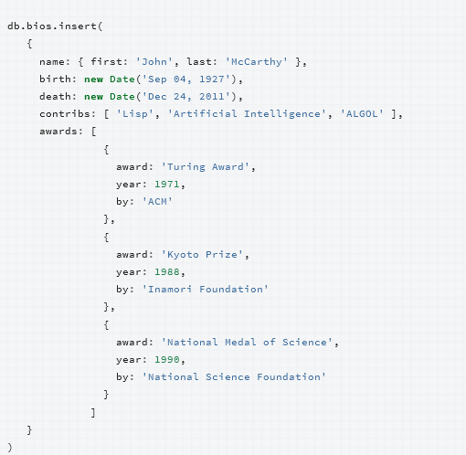

Slide 18
CRUD Operations - Insert
db.source.copyTo(target)
Copies all documents from old collection into new Collection .
If newCollection does not exist, MongoDB creates it.

Slide 19
CRUD Operations
Insert
Find
Update
Delete

Slide 20
CRUD Operations - Find
The find() Method- To display data from MongoDB collection. Displays all the documents in a non structured way.
Syntax
>db.COLLECTION_NAME.find()
The pretty() Method- To display the results in a formatted way, you can use pretty() method.
Syntax
>db. COLLECTION_NAME.find().pretty()

Slide 21
CRUD Operations - Find
db.stud.find()
db.stud.find().pretty()
Select All Documents in a Collection in unstructured form
Select All Documents in a Collection in structured form

Slide 22
CRUD Operations - Find
Specify Equality Condition
use the query document { <field>: <value> }
Examples:
db.stud.find( name: “Jiya" } )
db.stud.find( { _id: 5 } )

Slide 23
CRUD Operations – Find Comparison Operators
Operator | Description
$eq | Matches values that are equal to a specified value.
$gt | Matches values that are greater than a specified value.
$gte | values that are greater than or equal to a specified value.
$lt | Matches values that are less than a specified value.
$lte | Matches values that are less than or equal to a specified value.
$ne | Matches all values that are not equal to a specified value.
$in | Matches any of the values specified in an array.
$nin | Matches none of the values specified in an array.

Slide 24
CRUD Operations – Find Examples with comparison operators
db.stud.find( { rno: { $gt:5} } ) Shows all documents whose rno>5
db.stud.find( { rno: { $gt: 0, $lt: 5} } ) Shows all documents whose rno greater than 0 and less than 5

Slide 25
CRUD Operations – Find Examples to show only particular columns
db.stud.find({name: “Jiya”},{Rno:1}) To show the rollno of student whose name is equal to Jiya (by default _id is also shown)
db.stud.find({name: “jiya”},{_id:0,Rno:1}) show the rollno of student whose name is equal to Jiya (_id is not shown)

Slide 26
CRUD Operations – Find Examples for Sort function
db.stud.find().sort( { Rno: 1 } )
Sort on age field in Ascending order (1)
db.stud.find().sort( { Rno: -1 } )
Sort on age field in Ascending order(-1)

Slide 27
CRUD Operations – Find Examples of Count functions
db.stud.find().count()
Returns no of documents in the collection
db.stud.find({Rno:2}).count()
Returns no of documents in the collection which satisfies the given condition Rno=2

Slide 28
CRUD Operations – Find Examples of limit and skip
db.stud.find().limit(2)
Returns only first 2 documents
db.stud.find().skip(5)
Returns all documents except first 5 documents

Slide 29
CRUD Operations – Find Examples of limit and skip
db.stud.find({ rno: { $gt:5} } ).skip(5)
Returns all documents except first 5 documents whose rno is greater than 5
db.stud.find({ rno: { $gt:5} } ).limit(2)
Returns only first 2 documents whose rno is greater than 5

Slide 30
CRUD Operations – Find Examples
db.stud.findOne() - Find first document only
db.stud.find({“Address.city”: “Pune”})- Finding in Multicolumned attribute
db.stud.find({name: “Riya”,age:20}) Find documents whose name is Riya and Rno is 20

Slide 31
CRUD Operations – Find Examples with in and not in operator
db.stud.find({name:{$in:[“riya”,”jiya”]}}) Find information whose name is riya or jiya
db.stud.find({Rno:{$nin:[20,25]}}) Find information whose rollno is not 20 or 25

Slide 32
CRUD Operations – Find Examples for Distinct clause
db.stud.distinct(“Address”) Find from which different cities students are coming

Slide 33
CRUD Operations – Find Examples similar to like operator
db.stud.find({name:/^n/}) Find students whose name starts with n
db.stud.find({name:/n/}) Find students whose name contains n letter
db.stud.find({name:/n$/}) Find students whose name ends with n

Slide 34
CRUD Operations – Find Examples
db.collection.stats()
db.collection.explain().find()
db.collection.explain().find().help()

Slide 35
CRUD Operations
Insert
Find
Update
Delete

Slide 36
CRUD Operations – Update
Syntax
db.CollectionName.update(
<query/Condition>,
<update with $set or $unset>,
{
upsert: <boolean>,
multi: <boolean>,
}
)

Slide 37
CRUD Operations – Update
upsert
If set to True, creates new document if no matches found.
multi
If set to True, updates multiple documents that matches the query criteria

Slide 38
CRUD Operations – Update Examples
db.stud.update(
{ _id: 100 },
{ age: 25})
Set age = 25 where id is 100
First Whole document is replaced where condition is matched and only one field is remained as age:25
db.stud.update(
{ _id: 100 },
{ $set:{age: 25}})
Set age = 25 where id is 100
db.stud.update(
{ _id: 100 },
{ $unset:{age: 1}})
To remove a age column from single document where id=100
Only the age field of one document is updated where condition is matched

Slide 39
CRUD Operations – Update Examples
db.stud.update(
{ _id: 100 },
{ $set: { “marks.dmsa": 50} })
Set marks for dbms subject as 50 where id = 100 (only one row is updated)
db.stud.update(
{ class: “TE” },
{ $set: { “marks.dmsa": 50} } ,
{ multi: true } )
Set marks for dbms subject as 50 where class is TE (all rows which matches the condition were updated)
db.stud.update(
{ class: “TE” },
{ $set: { “marks.dmsa": 50} } ,
{ upsert: true } )
Set marks for dbms subject as 50 where class is TE (all rows which matches the condition were updated)
If now row found which matches the condition it will insert new row.

Slide 40
CRUD Operations – Update Examples
db.stud.update
({ },{ $inc:{age: 5}})
db.stud.update
({ },{ $set:{cadd: “Pune”}},
{multi:true})
db.stud.update ({ },{ $rename:{“age”: “Age”}},{multi:true})

Slide 41
CRUD Operations
Insert
Find
Update
Delete

Slide 42
CRUD Operations – Remove
Remove All Documents
db.inventory.remove({})
Remove All Documents that Match a Condition
db.inventory.remove ( { type : "food" } )
Remove a Single Document that Matches a Condition
db.inventory.remove ( { type : "food" }, 1 )

Slide 43
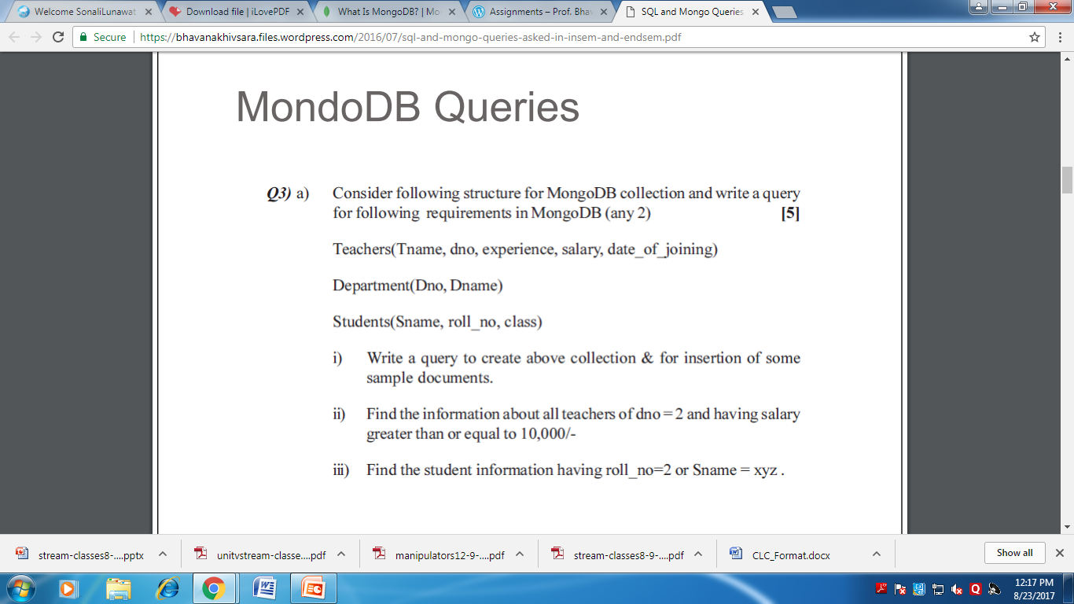

Slide 44
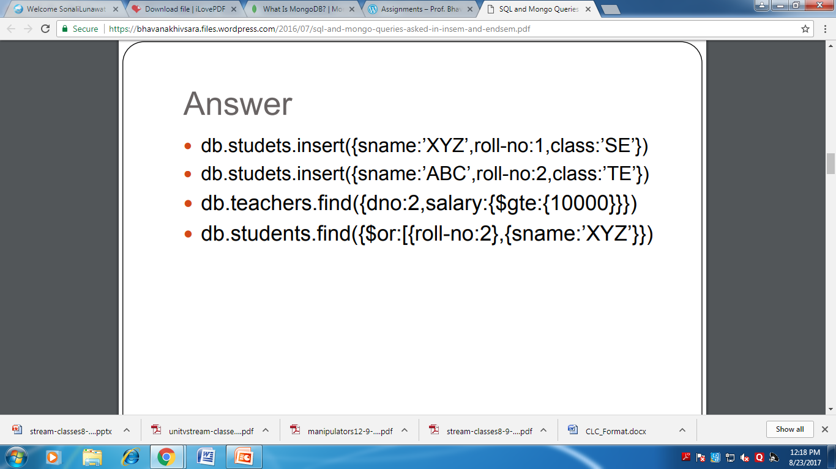

Slide 45
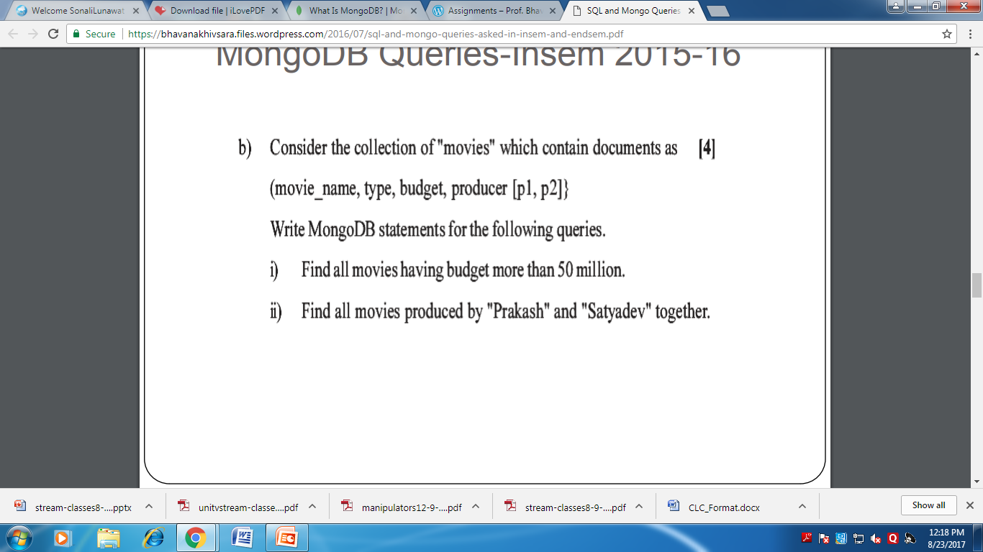

Slide 46
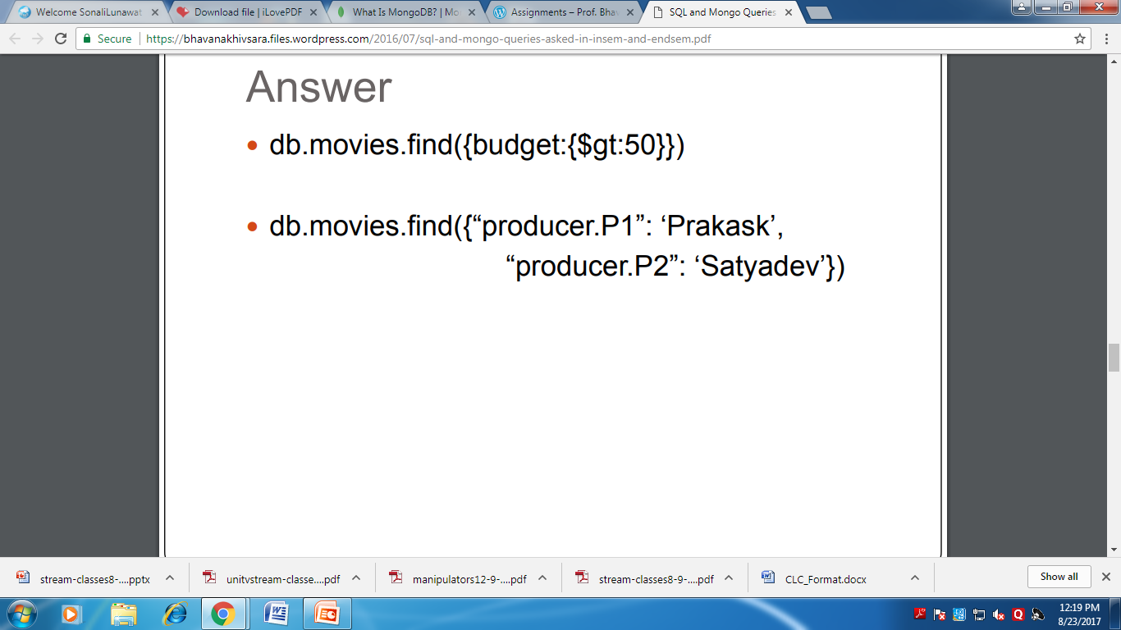

Slide 47
Indexing in Mongodb
Introduction to Indexing A database index is similar to a book’s index. Instead of looking through the whole book, the database takes a shortcut and just looks at an ordered list that points to the content, which allows it to query orders of magnitude faster.
A query that does not use an index is called a table scan (a term inherited from relational databases), which means that the server has to “look through the whole book” to find a query’s results. This process is basically what you’d do if you were looking for infor‐ mation in a book without an index: you start at page 1 and read through the whole thing. In general, you want to avoid making the server do table scans because it is very slow for large collections.

Slide 48
db.emp.ensureIndex({uid:1});
1 : for ascending ordering of index
-1: for Descending ordering of index
Or
db.emp.createIndex({uid:1});
db.emp.dropIndex({uid:1});

Slide 49
for(i=0;i<10000;i++)
{
db.emp.insert({uid:i});
}
If we do find to 7000 elements name then
db.emp.find({uid:7000}).explain();

Slide 50
Types of Indexes
Unique :Unique indexes guarantee that each value will appear at most once in the index
Compound: Combining more than one unique index.
Sparse : the index only references documents with the specified field. These indexes use less space but behave differently in some situations.

Slide 51
Aggregation Aggregations are operations that process data records and return computed results. Unlike queries, aggregation operations in MongoDB use collections of documents as an input and return results in the form of one or more documents. MapReduce is a tool used for aggregating data.
What is an Aggregation Pipeline?
An aggregation pipeline is a series of document transformations which are executed in stages. The original input is a collection whereas the output can be a document, cursor or a collection.

Slide 52
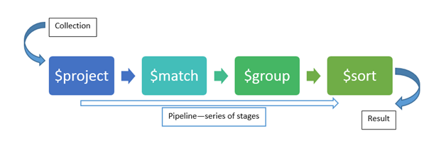
Various stages in pipeline are:
$project – select, reshape data
$match – filter data
$group – aggregate data
$sort – sorts data
$skip – skips data
$limit – limit data
$unwind – normalizes data

Slide 53
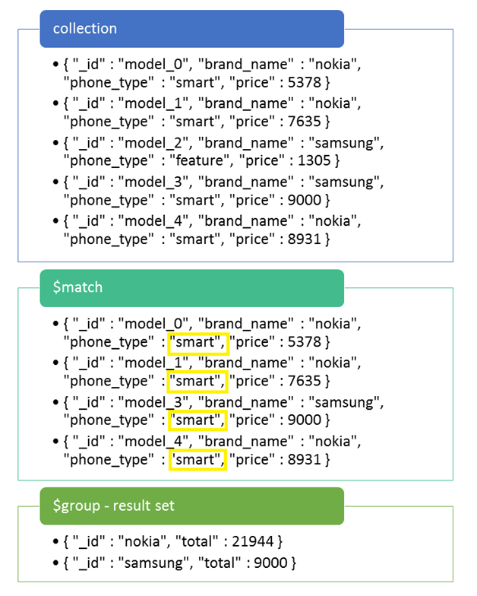

Slide 54
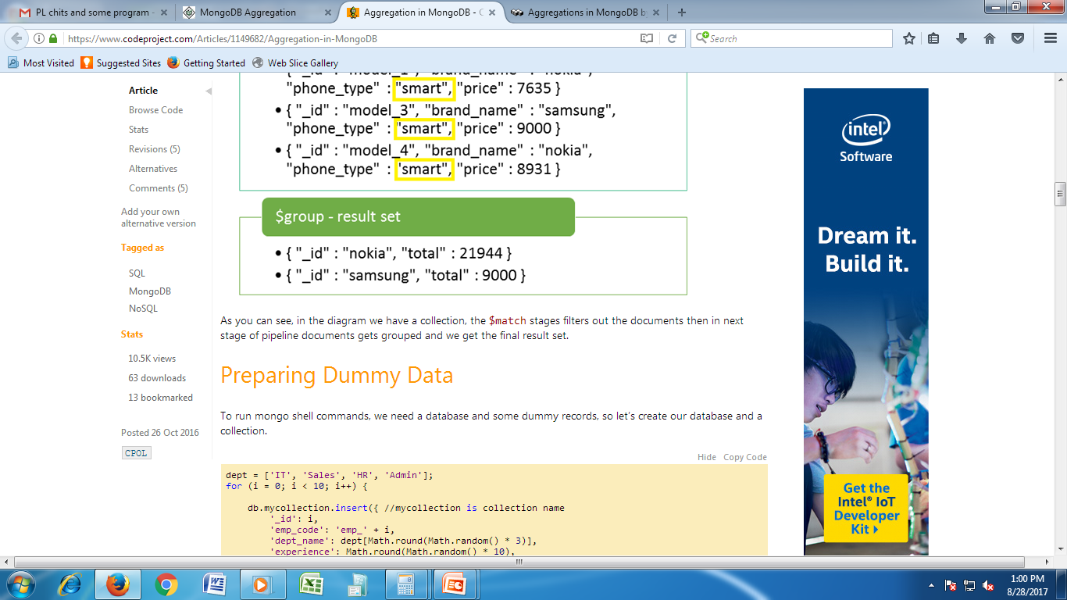
db.mycollection.aggregate([
{$match:{'phone_type':'smart'}}, {$group:{'_id':'$brand_name',total:{$sum:'$price'}}} ])

Slide 55
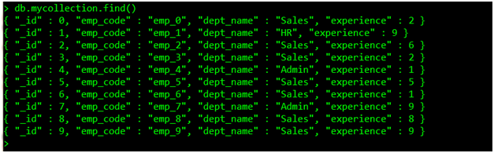

Slide 56

db.mycollection.aggregate
([ { $group:{ _id:'$dept_name', no_of_employees:{$sum:1} } } ])

Slide 57
$sort
db.mycollection.aggregate
([ { $group:{ _id:'$dept_name', no_of_employees:{$sum:1} } },
{ $sort:{ _id:1 } } ])

Slide 58
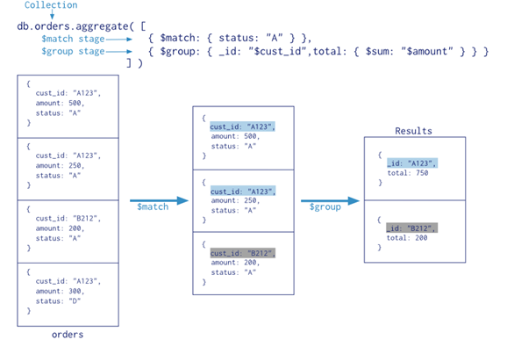

Slide 59
MapReduce
MapReduce is a powerful and flexible tool for aggregating data. It can solve problems which are complex in nature and express using the aggregation framework query language.
It splits up a problem, sends chunks of it to different machines, and lets each machine solve its part of the problem. When all the machines are finished, all the pieces of the solution are merged back into a full solution.

Slide 60
