Slide 1

React

Slide 2
Main sources for this training
Code examples:
https://github.com/bhovhannes/trainings/tree/master/react-intro
Links to other used sources will be provided during the training

Slide 3
0.
What is React?
Meet React

Slide 4
What is React ?
React is a JavaScript library for creating user interfaces, which offers:
Declarative views
Component-based architecture
Server-side rendering
Native rendering on mobile devices (React Native)
Easy integration with your technology stack

Slide 5
Declarative views
React allows you to design simple views for each state of your application.
And when your data changes, React will efficiently update and render your view.
Declarative views makes your code more predictable and easier to debug.

Slide 6
Component-based architecture
React allows you to create encapsulated components that manage their own state and the compose them to make complex UIs.
“Encapsulated” means that everything related to the component is contained inside it. That includes components template, css styles, js code, etc.

Slide 7
Server-side rendering
React components can be rendered server-side to HTML string and then sent back to the browser.
After that, your application will continue just from that point.
That means end-user will not see any loading indicators for loading UI. They will see the UI as soon as HTML loads and UI will become interactive as soon as app loads.

Slide 8
Native rendering on mobile devices
React Native project provides a set of components which can be used to create UIs for mobile devices.
With React Native, you don't build a “mobile web app”, an “HTML5 app”, or a “hybrid app”. You build a real mobile app that's indistinguishable from an app built using Objective-C or Java.
React Native uses the same fundamental UI building blocks as regular iOS and Android apps.
You just put those building blocks together using JavaScript and React.

Slide 9
Easy integration with your technology stack
React does only one thing - rendering.
That makes easy to integrate React with your existing technology stack.
React plays nicely with all other frameworks - Angular, etc.

Slide 10
1.
About React
Some facts

Slide 11


Built by Facebook
React was created in Facebook and then open-sourced.
https://facebook.github.io/react/
Because of its simple API and performance, community quickly adopted React, making it the most popular GitHub project of all times.
Angular stats for comparison (https://github.com/angular/angular)

Slide 12
Battle-tested in production
First React was used in desktop version of Instagram.
After success it has made its way to facebook.com.
Currently React Native powers facebook and instagram mobile apps.
Many other web sites and companies also use React, including AirBnb, BBC, IMDb, etc.
https://github.com/facebook/react/wiki/sites-using-react

Slide 13
2.
JSX
Allows to write HTML directly in JS

Slide 14
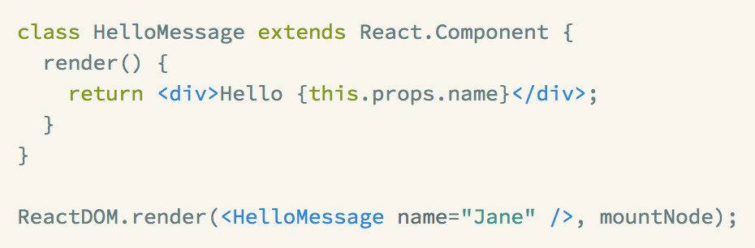
Popularized by React
JSX adds XML syntax to JavaScript.

Slide 15
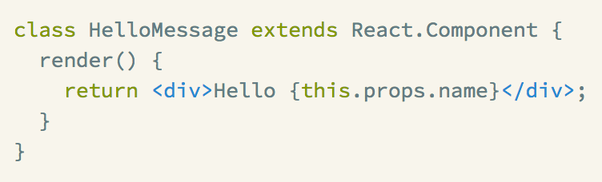
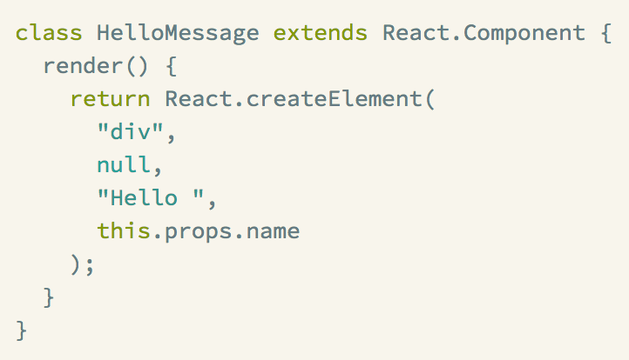
JSX
JSX is optional and not required to use React. It just adds a preprocessor step.

Slide 16
JSX pragma
JSX is a separate standard.
It has its own spec and is not tied to React.
Different implementations provide different JSX pragmas.
JSX pragma

Slide 17
Converting JSX
Both Babel and TypeScript can transpile JSX to JS.
If webpack is used, babel-loader and ts-loader will do the trick.
You may specify JSX pragma using loader options.

Slide 18
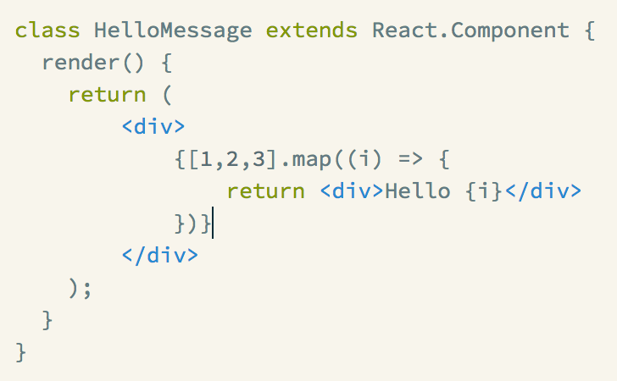
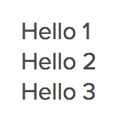
JSX allows you to use JS to write XML
Renders

Slide 19
3.
Virtual DOM
… or why React is fast?

Slide 20
Reasons to have “another” DOM
Real DOM is slow.
Every browser operation with DOM is slow. Because:
1) each DOM node is a heavy data structure holding a lot of attributes (to match spec).
2) altering DOM node may cause browser repaint or even worse - relayout. Both are time consuming operations.

Slide 21
What is virtual DOM?
A virtual DOM tree is a Javascript data structure that describes a DOM tree.
It consists of nested virtual DOM nodes, also known as vnodes.
Technically, altering virtual DOM node is as fast as assigning a new value to variable.
Thus, virtual DOM is very fast.

Slide 22
How virtual DOM works?
Let’s say you want to make some updates to real DOM:
1) setAttribute(“disabled”, “disabled”)
2) … . appendChild(...)
3) removeAttribute(“data-test-id”)
You already have a snapshot of real DOM as a virtual DOM structure.
a) you make all (1-3) changes in virtual DOM data structure
b) after that you diff new virtual DOM with the previous one to get a patch with all changes
c) you apply patch to the real DOM

Slide 23
How virtual DOM works?
So, we have the following cycle:
a) do changes -> b) compute diff -> c) apply patch
(a) is very fast
(b) also is fast because it works on 2 data structures fully in memory without accessing real DOM
(c) is the only point where we touch to real DOM
Summarizing, we did 1 DOM operation instead of 3.
When you frequently change DOM you’ll get a large speed boost.

Slide 24
Who uses Virtual DOM approach ?
React
virtual-dom (https://github.com/Matt-Esch/virtual-dom)
Vue.js (https://vuejs.org)
Mithril.js (https://mithril.js.org/)
and more ...

Slide 25
4.
React components
Building blocks

Slide 26
Components and Props
A component is a building piece in React.
Components let you split the UI into independent, reusable pieces, and think about each piece in isolation.
Conceptually, components are like JavaScript functions.
They accept arbitrary inputs (called "props") and return React elements describing what should appear on the screen.

Slide 27
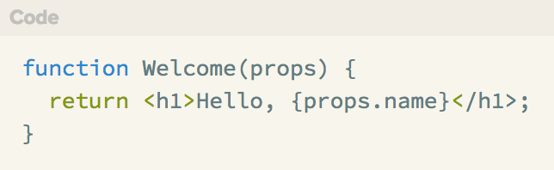
Functional components
This function is a valid React component because it accepts a single "props" object argument with data and returns a React element.
Such components are called "functional" because they are literally JavaScript functions.
All React components must act like pure functions with respect to their props. That is, props are read-only.

Slide 28
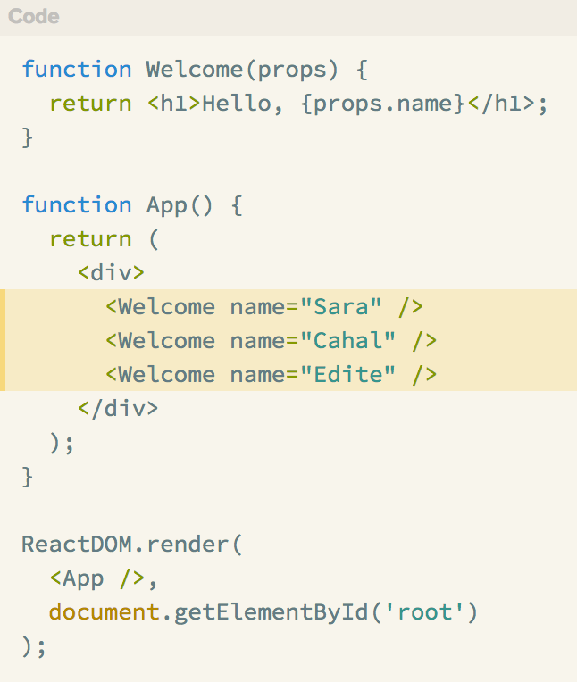
Composing components

Slide 29
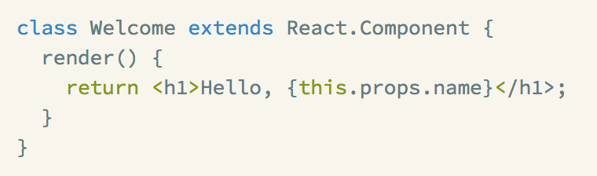
Class components
Components can also be defined as ES6 class.
The component written above, defined as ES6 class.

Slide 30
Class components
Class components allow to:
1) Define internal component state
2) Make use of component lifecycle methods
These 2 things are impossible with functional components.

Slide 31
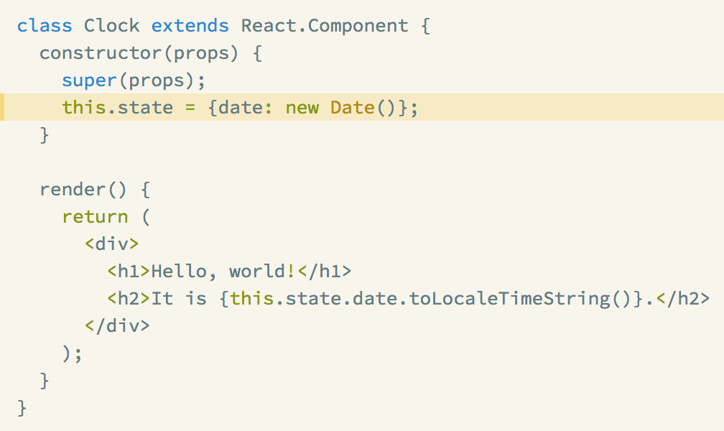
Component state
“State” is a data internal to the given component.
Component may return different output based on its props and state.

Slide 32
Component lifecycle methods
https://facebook.github.io/react/docs/react-component.html#the-component-lifecycle
Let’s say we want to set up a timer whenever our Clock component is rendered to the DOM for the first time ("mounting").
We also want to clear that timer whenever the DOM produced by the Clock is removed ("unmounting").
These special methods on the component class allow to run code when a component mounts and unmounts:
componentDidMount()
componentWillUnmount()

Slide 33
4.
Styling in React
Applying CSS

Slide 34
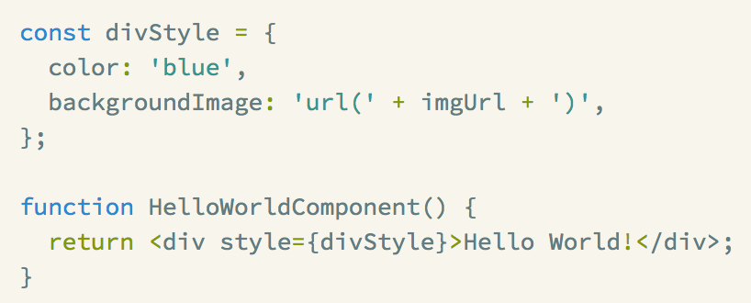
Inline styles out-of-the-box

Slide 35
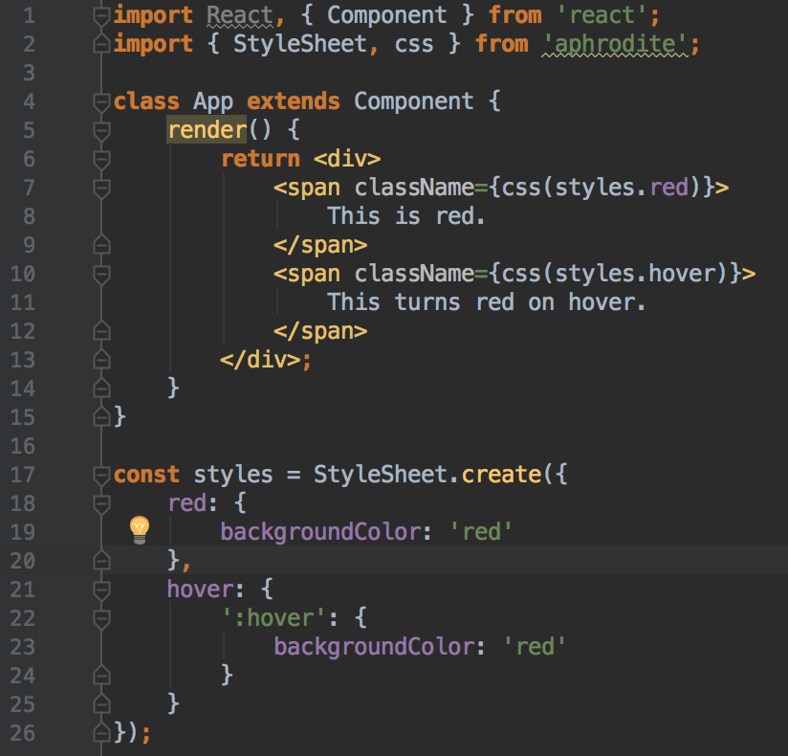
Aphrodite
https://github.com/Khan/aphrodite

Slide 36
Aphrodite
https://github.com/Khan/aphrodite
Aphrodite makes your styles unique so CSS styles of your component just cannot modify look of other components.
It works by applying CSS styles as inline styles.
It also supports server-side rendering.

Slide 37

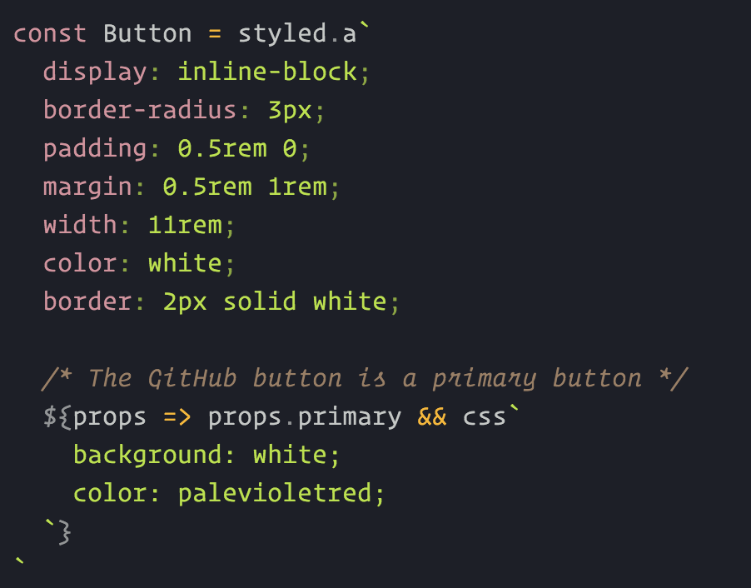
styled-components
https://www.styled-components.com

Slide 38
styled-components
https://www.styled-components.com
styled-components works by generating unique CSS class names and passing them to your component via props.
Uniqueness of class names guarantees that styles do not leak outside of your component thus providing full encapsulation of styles.

Slide 39
5.
What React can’t?
Accompanying libraries

Slide 40
Make network calls
In order to make network calls any library can be chosen.
Popular choices in React community are:
1) Fetch API (https://developer.mozilla.org/en/docs/Web/API/Fetch_API)
with polyfill (https://github.com/github/fetch)
2) Axios (https://github.com/mzabriskie/axios)

Slide 41
Handle data-flow at a large scale
At a large scale, when you have a huge amount of data, actions, and tangled communication between your components, you should pick a data-flow library to keep code easier to follow, more error prone and bug-free.
Popular choices in React community are:
1) Redux (http://redux.js.org)
with redux-thunk/redux-saga and react-redux
2) MobX (https://mobx.js.org)

Slide 42
Routing
Popular choice in React community is:
react-router (https://reacttraining.com/react-router/)
It was source of inspiration for Ember and Angular 2 routers and according to all comments across the web is the best router available.

Slide 43
Drag & drop
Popular choice in React community is:
react-dnd (https://react-dnd.github.io/react-dnd/)
It has excellent designed API with very good level of abstraction.
Even if you don’t need drag&drop reading its docs may change your mind about how api can be organized.

Slide 44
CREDITS
Special thanks to all the people who made and released these awesome resources for free:
Simple line icons by Mirko Monti
E-commerce icons by Virgil Pana
Streamline iconset by Webalys
Presentation template by SlidesCarnival

