Slide 1
Modern C++11/14 Concepts

Slide 2
Topics
Smart Pointers
Move Semantics
Lambda Expressions
Concurrency
Task Based Concurrency

Slide 3
Smart Pointers
Pointers to avoid memory leak by normal pointers
We use a copy of the resource, and to make a change, it is done in the copied version. To change the content of the original resource, smart pointers are used
Implement such as that they will release the memory of unused resources.
Create a class with a pointer, overloaded operators(->, *) and destructors.
The destructor will be automatically called when its object goes out of the scope, and automatically the dynamically allocated memory will be deleted.

Slide 4
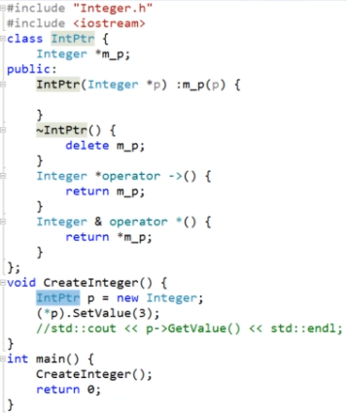
Smart Pointers

Slide 5
Types of Smart Pointer
std::unique_ptr
std::shared_ptr
Std::weak_ptr

Slide 6
std::unique_ptr
This type of object stores only a single object. To assign a different object, current object is deallocated.
A unique pointer is an object that owns another object and manages that other object through a pointer.
The unique pointer has exclusive ownership of the object it points to. This means unique_ptr does not share its pointer with any other unique_ptr. It cannot be copied to another unique_ptr.
Should use unique_ptr for all pointers unless you know you want to share it, in which case you should use shared_ptr . The reason is that unique_ptr has less overhead since it doesn't count references.

Slide 7
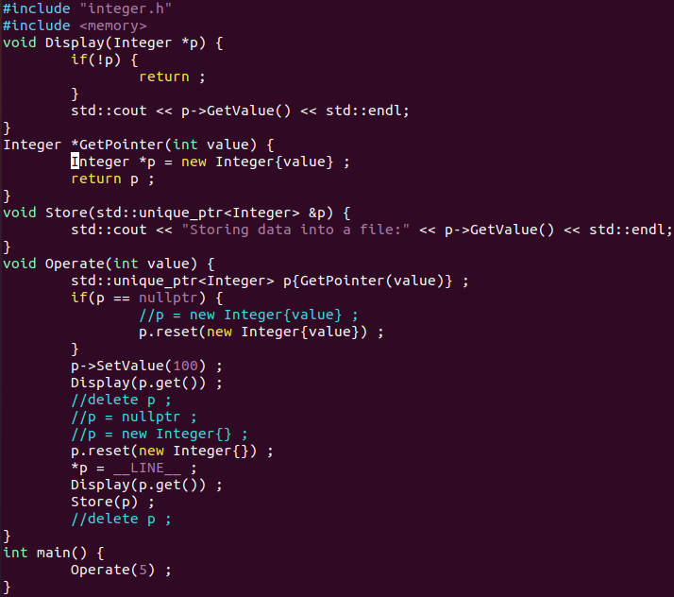

Slide 8
Sharing Pointers- std::shared_ptr
In shared_ptr, more than one object can point to a single pointer at the same instance of time. A reference counter is maintained for denoting the object using the use_count() method.
The shared pointer maintains a reference count which is incremented when another shared pointer points to the same object. So, when the reference count is equal to zero (i.e., no pointer points to this object), the object is destroyed.
A shared_ptr can share ownership of an object while storing a pointer to another object.

Slide 9
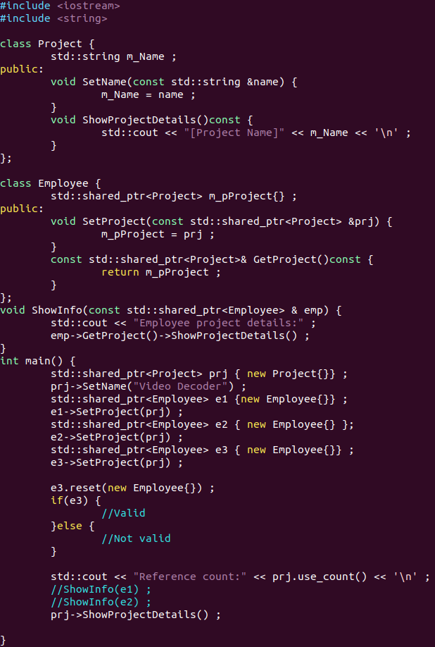
Std::shared_ptr

Slide 10
Std::weak_ptr
Weak_ptr is similar to the shared pointer. The difference is that it does not maintain a reference counter and there is no strong hold of the object on the pointer.
This property may result in a deadlock as different objects will try to hold the pointer.
holds a non-owning ("weak") reference to an object that is managed by std::shared_ptr.

Slide 11
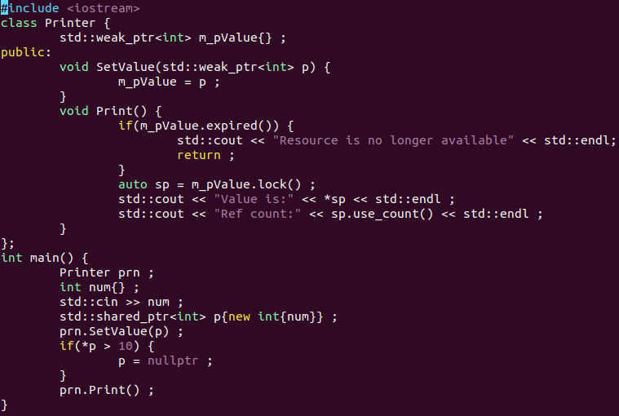

Slide 12
Move Semantics: std::move()
Move constructors typically “steal” the resource of the source (original) object rather than making several copies of them, and leaves the source object in a “valid but unspecified state”.
Std::move()-is a function used to convert an lvalue reference into the rvalue reference. Used to move the resources from a source object i.e. for efficient transfer of resources from one object to another.
Defined in <utility> header
Performance optimisation.
On declaring the new object and assigning it with the r-value, firstly a temporary object is created, and then that temporary object is used to assign the values to the object. Due to this the copy constructor is called several times and increases the overhead and decreases the computational power of the code. To avoid this overhead and make the code more efficient we use move constructors.

Slide 13
Lambda Expressions
A lambda is an unnamed function object capable of capturing variables in scope. It features: a capture list; an optional set of parameters with an optional trailing return type; and a body. Examples of capture lists:
[] - captures nothing.
[=] - capture local objects (local variables, parameters) in scope by value.
[&] - capture local objects (local variables, parameters) in scope by reference.
[this] - capture this by reference.
[a, &b] - capture objects a by value, b by reference.
nt x = 1;
auto getX = [=] { return x; };
getX(); // == 1
auto addX = [=](int y) { return x + y; };
addX(1); // == 2
auto getXRef = [&]() -> int& { return x; };
getXRef(); // int& to `x`

Slide 14
By default, value-captures cannot be modified inside the lambda because the compiler-generated method is marked as const. The mutable keyword allows modifying captured variables. The keyword is placed after the parameter-list (which must be present even if it is empty).
int x = 1;
auto f1 = [&x] { x = 2; }; // OK: x is a reference and modifies the original
auto f2 = [x] { x = 2; }; // ERROR: the lambda can only perform const-operations on the captured value
// vs.
auto f3 = [x]() mutable { x = 2; }; // OK: the lambda can perform any operations on the captured value

Slide 15
Deleted functions
A more elegant, efficient way to provide a deleted implementation of a function. Useful for preventing copies on objects.
class A {
int x;
public:
A(int x) : x{x} {};
A(const A&) = delete;
A& operator=(const A&) = delete;
};
A x {123};
A y = x; // error -- call to deleted copy constructor
y = x; // error -- operator= deleted

Slide 16
Default functions
A more elegant, efficient way to provide a default implementation of a function, such as a constructor.
struct A {
A() = default;
A(int x) : x{x} {}
int x {1};
};
A a; // a.x == 1
A a2 {123}; // a.x == 123
With inheritance:
struct B {
B() : x{1} {}
int x;
};
struct C : B {
// Calls B::B
C() = default;
};

Slide 17
Noexcept specifier
The noexcept specifier specifies whether a function could throw exceptions. It is an improved version of throw().
void func1() noexcept; // does not throw
void func2() noexcept(true); // does not throw
void func3() throw(); // does not throw
void func4() noexcept(false); // may throw
Non-throwing functions are permitted to call potentially-throwing functions. Whenever an exception is thrown and the search for a handler encounters the outermost block of a non-throwing function, the function std::terminate is called.
extern void f(); // potentially-throwing
void g() noexcept {
f(); // valid, even if f throws
throw 42; // valid, effectively a call to std::terminate
}

Slide 18
Standard Template Library(STL)
Std::array
Std::list and std::forward_list
Unordered containers
Std::hash

Slide 19
Concurrancy
Large applications have multiple components which may have run concurrently.
Concurrency can be achieved by creating multiple threads
This allows efficient usage of CPU
C++11 added support for concurrency
Includes utilities for starting and managing threads

Slide 20
Thread Creation- std::thread
The std::thread library provides a standard way to control threads, such as spawning and killing them. In the example below, multiple threads are spawned to do different calculations and then the program waits for all of them to finish.
void foo(bool clause) { /* do something... */ }
std::vector<std::thread> threadsVector;
threadsVector.emplace_back([]() {
// Lambda function that will be invoked
});
threadsVector.emplace_back(foo, true); // thread will run foo(true)for (auto& thread : threadsVector) {
thread.join(); // Wait for threads to finish
}

Slide 21
Thread Synchronization- std::mutex
The mutex class is a synchronization primitive that can be used to protect shared data from being simultaneously accessed by multiple threads.
mutex offers exclusive, non-recursive ownership semantics:
A calling thread owns a mutex from the time that it successfully calls either lock or try_lock until it calls unlock.
When a thread owns a mutex, all other threads will block (for calls to lock) or receive a false return value (for try_lock) if they attempt to claim ownership of the mutex.
A calling thread must not own the mutex prior to calling lock or try_lock.
The behavior of a program is undefined if a mutex is destroyed while still owned by any threads, or a thread terminates while owning a mutex. The mutex class satisfies all requirements of Mutex and StandardLayoutType.
std::mutex is neither copyable nor movable.

Slide 22
Std::lock_guard
The class lock_guard is a mutex wrapper that provides a convenient RAII-style mechanism for owning a mutex for the duration of a scoped block.
When a lock_guard object is created, it attempts to take ownership of the mutex it is given. When control leaves the scope in which the lock_guard object was created, the lock_guard is destructed and the mutex is released.
The lock_guard class is non-copyable.

Slide 23
Task based concurrency: std::async
The function template async runs the function f asynchronously (potentially in a separate thread which might be a part of a thread pool) and returns a std::future that will eventually hold the result of that function call.
1) Behaves as if (2) is called with policy being std::launch::async | std::launch::deferred.
2) Calls a function f with arguments args according to a specific launch policy.

Slide 24
Std::future wait functions
The class template std::future provides a mechanism to access the result of asynchronous operations: An asynchronous operation (created via std::async, std::packaged_task, or std::promise) can provide a std::future object to the creator of that asynchronous operation.

Slide 25
Std::promise
The class template std::promise provides a facility to store a value or an exception
that is later acquired asynchronously via a std::future object created by the std::promise object.
Note that the std::promise object is meant to be used only once.

Slide 26
References:
https://en.cppreference.com/

