Slide 1
HINDUSTANI CLASSICAL MUSIC VISUALISATION USING FEATURE EXTRACTION AND EMOTION RECOGNITION
SEMINAR PRESENTATION
Anusha Bhowmick [RA1811003010572]
CSE-B2

Slide 2
ACKNOWLEDGEMENT
I would like to express my deep gratitude to Asst. Professor Nithya P.S. Ma’am, for her patient guidance, enthusiastic encouragement and useful critiques of this review. I would also like to thank her for her advice and assistance in keeping my progress on schedule.
Finally, I wish to thank my parents for their support and encouragement throughout my study.

Slide 3
ABSTRACT
Traditionally, Hindustani classical ragas have been depicted traditionally in miniature paintings called Ragamalas. In this seminar, I review previous work done on classifying music into emotions and find the methods of classification and representing a Hindustani music clip visually, by using Machine Learning, audio signal processing and visual programming libraries.
Previously, research work has been done to correlate the relationship between raga or Hindustani classical music features with emotions. Many research work has also been done on Western music datasets. Emotion classification can be done as single-labelling or multi-labelling. The models which have been worked with and studied here, are: SVM, KNN, MMG, GMM, ML-KNN, M3L, and Fuzzy K-NN approach. These methods have shown good accuracy, and have been used in music recommendation and tagging systems. Feature extraction for emotion recognition and classification has also been discussed and methods have been stated for their processing. A song or audio file can be represented visually with the help libraries of Processing written in Java.

Slide 4
INTRODUCTION
My literature review focuses on four major themes:
selection of emotion model for emotion classification of a music file;
gathering of musical features like tempo, pitch, intensity, spectral resolution and rhythm from audio files;
generating or training a Machine Learning model that can detect the emotions in any audio file put as input, the features and benefits of this training model;
and using emotion class values as data input into a Processing program.

Slide 5
Paper 1: Analysis of Features for Mood Detection in North Indian Classical Music - A Literature Review, Bhavana Tiple* 1 , Prof. Achamma Thomas 2 Research Scholar, G.H.Raisoni College of Engineering,Nagpur, CSE Department Head CSE, G.H.Raisoni College of Engineering, Published in: International Journal of Research in computer and communication Technology , Vol 6, Issue- 6, June- 2017
Bhavana Tiple[1] analyses the features that are required for mood/emotion detection in North Indian Classical music.
She maps music features to mood and gives a table correlating shruti, rasa and musical features. The paper uses Thayer’s 2-D valence-Arousal emotional model as the basis for deciding the emotion classes to categorize into.
The different features of raga that contribute to its mood are: Sur (Tonality), Taal (Rhythm) and Laya (Tempo). Thus the low level features of musical signal and with high level emotional labels i.e. Rasa, along with Pakad and Chalan, the pitch quality, tonality, intensity, rhythm, timbre, lyrics, and musical environment are some other key parameters that can affect the mood of the listener.
Since detection of mood from Hindustani classical music based on the above mentioned factors has very less work done on it, so Tiple[1] used analysis done on western music features. Various emotional models like Thayer’s Model, Russell’s Circumplex Model and Raga - Nava Rasa theory were analysed to discover the relationship between Indian Classical Music features and Mood.
Notes:
This is itself a detailed literature review, but it gave me the direction to start off with my implementation. She analyses previous work done on emotion recognition and applies classical music knowledge to conclude the relationship between musical features and raga emotions. She concludes that: Thayer’s valence-arousal emotional model, Tonality, Ryhthm, Tempo…also identifies low-level features that can be used to identify a raga wrt emotions.

Slide 6
PROS & CONS
Pros:
The paper gives a direction on how to approach emotion recognition for Hindustani classical music
Paper gives an overview on the characteristics of Hindustani classical music necessary for detailed emotion recognition using Machine Learning
Is an overall study/literature review on the entire emotion recognition in Hindustani classical music, derived from other papers
Cons:
Does not go into detail on the methodologies
Is not a focussed literature

Slide 7
Paper 2: Marius Kaminskas, Francesco Ricci, Contextual music information retrieval and recommendation: State of the art and challenges, Computer science review6, 2012, 89 -11. Published in: Computer Science Review, 7 April 2012
Emotional models for music cognition are discussed. Emotional models are divide into two categories: two groups of models: category-based models, and dimensional models.
A number of emotion adjectives, were organised into 9 clusters and the Geneva Emotional Music Scale (GEMS) model was formed. The emotions representing the clusters are: wonder, transcendence, tenderness, nostalgia, peacefulness, power, joyful activation, tension, and sadness.
Dimensional models represent emotional states using independent dimensions, i.e. activeness and positiveness of emotion. The first dimension represents the Activation level, which contains values between quiet and energetic; and the second dimension represents the Valence level, which contains values between negative and positive.
The most famous 2-D emotion models are: Russell’s Circumplex model, Thayer’s model, and Tellegen–Watson–Clark (TWC) model. Russell designed a model where emotions are placed in a circle on a 2-D space where the dimensions are called Arousal and Pleasure.
2D models reduce complex human emotions into two dimensions. Thus, there is information loss. Category-based models are suitable for applications that require tagging and dimensional models are better for the visualization of emotions, in applications that use visual navigation and content discovery systems.
The main classification approaches found in the literature include Support Vector Machines (SVM) (accuracy of 50% for 6 emotion clusters), k-Nearest Neighbors (kNN), Mixed Media Graph (MMG)(accuracy of 50%), and Gaussian Mixture Models (GMM).
Notes:
In this paper, I primarily focused on the emotional models section. It was discussed that 2 types of models:

Slide 8
PROS & CONS
Pros:
The paper explains in depth about the various emotional models
Forms the basis for choosing the emotion model to work with
Paper also describes in depth about Music Information Retrieval
Evaluates and compares different models
Cons:
Long, and in-depth read

Slide 9
Paper 3: Hiba Ahsan, Vijay Kumar and C.V. Jawahar, “Multi- Label Annotation of Music” Published in: IEEE 2015
In [3], Ahsan, Kumar, Jawahar et al extract standard Mel-frequency Cepstral Coefficients (MFCC) features in MIRToolbox and work on an Indian classical dataset. They extracted two kinds of features- rhythmic and timbre.
In this paper music annotation is modelled as a multi-label classification problem. Multiple tags are assigned to a music piece. They evaluate the following ML models for emotion tagging: Support Vector Machine (SVM), K-Nearest Neighbour (KNN), Multi-Label KNN (ML-KNN) and Max-Margin Multi-Label Classification (M3L). SVM and KNN are adapted for multi-label classification using one-vs-rest strategy while ML-KNN and M3L are the direct formulations of multi-label classification.
For the emotion classification model, they compared both Multi-single label classification in KNN and SVM, and Multiple label classification (ML-KNN and M3L classification).
They thus suggest that all the four algorithms have similar performance and can be used for multi-label annotation of music.
Notes:
ACCURACY???

Slide 10
PROS & CONS
Pros:
Paper explains in detail on features extracted
Shows satisfactory results on all 4 ML models
Applies feature augmentation for improvement of performance
Cons:
Applies to mostly instrumentals
Intended for multi-label annotation

Slide 11
Paper 4: D. Liu, L. Lu and H-J. Zang, “Automatic Mood Detection from Acoustic Music Data” Published in: ISMIR 2003
In [4], they present a mood recognition system. They worked on a particular piece of Western classical music.
For timbre: the timbre of sound is determined primarily by the spectral information in different sub-bands.
For intensity: Intensity is approximated by the signal’s root mean-square (RMS) level in decibels. Intensity in music of Contentment and Depression is usually little, but that of Exuberance and Anxious is usually big.
For rhythm: Three aspects of rhythm are closely related with people’s mood response: strength, regularity and tempo. In the Exuberance cluster, the rhythm is usually strong, steady and the tempo is fast; while in Depression, music is usually slow and with no distinct rhythm pattern.
Mode forms an important feature in ragas, which are given by major keys and minor keys. Major keys are consistently associated with positive emotions, whereas minor ones are associated with negative emotions. However, mode is very difficult to obtain from acoustic data.
Gaussian Mixture Model (GMM) is utilized to model each feature set. For a given music clip X, it is firstly classified into Group 1 (Contentment and Depression) or Group 2 (Exuberance and Anxious) based on its intensity information; and then classification is performed in each group based on timbre and rhythm features.

Slide 12
PROS & CONS
Pros:
Present their own mood detection algorithm
Methodology can be utilised in cases to improve accuracy
By introducing two GMM models, divides emotion classification and improves accuracy
Cons
Requires two models to be created
Methodology may not be accurate for all emotion recognition systems, depending on the problem and dataset
Notes:
ACCURACY???

Slide 13
Paper 5: Byeong-jun Han, Seungmin Rho Roger,B Dannenberg, Eenjun Hwang, 2009. SMERS: Music Emotion Recognition Using Support Vector Regression Published in: ISMIR 2009
In [5], Byeong-jun Han, Rho, Hwang et al, extract the following features:
Scale: Scale is an overall rule of tonic formation of music. In their study, they defined scale as a set of key, mode, and tonality.
Rhythm: Rhythm, which is composed of rhythmic features such as tempo and beat.Beat is a fundamental rhythmic element of music. Tempo is usually defined as the beats per a minute (BPM) which is used to represent the global rhythmic feature of music.
Harmonics: Harmonics can be observed in musical tones.
The authors use SVR, SVM and GMM. The result of SVR in the Cartesian coordinate system 91.52%. Using a polar coordinate system, the accuracy was increased to 94.55% and 92.73% using GMM.

Slide 14
PROS & CONS
Pros:
Evaluates in detail the results of the model
Gives good results
Demonstrates good methodology and in depth
Cons:
Evaluated on Western music dataset

Slide 15
Paper 6: Yi-Hsuan Yang, Chia-Chu Liu, and Homer H. Chen, “Music Emotion Classification: A Fuzzy Approach” Published in: ACM, 2006.
In [6], a Fuzzy approach is used. The proposed system can be divided into two parts: model generator (MG) and emotion classifier (EC). The MG generates a model according to the features of the training samples, while the EC applies the resulting model to classify the input samples.
Compared to traditional classifiers which can only assign one class to the input sample, fuzzy classifiers assign a “fuzzy vector” that indicates the relative strength of each class. The ambiguity that fuzzy vectors carry is very important since the music emotion is intrinsically subjective. The following two fuzzy classifiers were adopted in this paper:
Fuzzy k-NN classifier (FKNN): Fuzzy k-NN classifier, a combination of fuzzy logic and k-NN classifier, is designed to solve the above problem. It contains two steps: fuzzy labelling that computes the fuzzy vectors of the training samples (done in MG), and fuzzy classification that computes the fuzzy vectors of the input samples (done in EC).
Fuzzy Nearest-Mean classifier (FNM): For the fuzzy Nearest-Mean classifier, we need to calculate the mean of each feature of the classes in MG.
FNM performs better than FKNN (78.33% vs. 70.88%).

Slide 16
PROS & CONS
Pros:
Most apt approach for emotion recognition as emotions in a song vary from person to person and can be different for different segments of a music clip
Methodology explained in detail
Cons:
Focuses on the Fuzzy approach model
Less detailed on feature extraction

Slide 17
Paper 7: An Introduction to Processing and Music Visualization, Christopher Pramerdorfer∗ Vienna University of Technology
In [7], the author gives an introduction to what Processing is. Processing is a programming language and environment based on the Java programming language that processes information in a visual way. Data visualisation is used for information interpretation.
Processing was created to make it easier to develop visually oriented applications with emphasis on animation and provide users with instant feedback through interaction. Interactivity is done through event functions.
Programs written with Processing are called sketches. The setup method is called once when the program starts, and is executed only once.
The draw method, is called by default at a rate of 60 times per second which provides interactivity.
Thus processing can be used to visually represent the extracted musical features and emotions detected using the various functionalities provided in it.

Slide 18
PROS & CONS
Pros:
Easy read, easy to get an overview of the topic
Cons:
Does not talk about a specific methodology in depth

Slide 19
IMPLEMENTATION

Slide 20
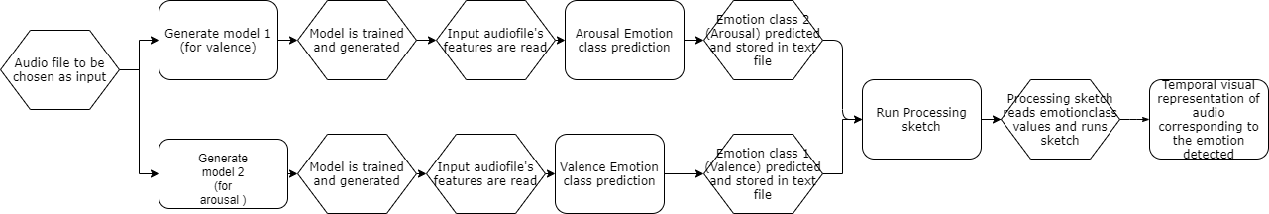
DIAGRAM: Implementation flowchart
Fig. Flowchart of implementation approach

Slide 21
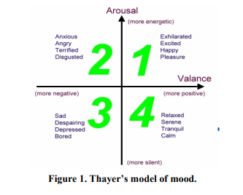
DIAGRAM: Thayer’s emotion model
V A
1 1
V A
2 1
V A
2 2
V A
1 2
Fig. Thayer’s 2D emotional model

Slide 22
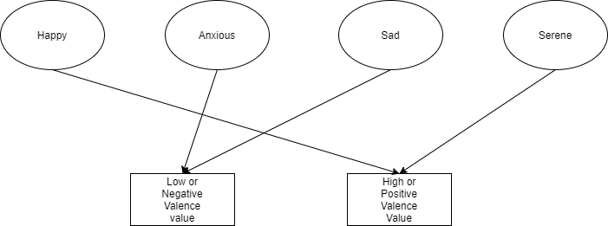
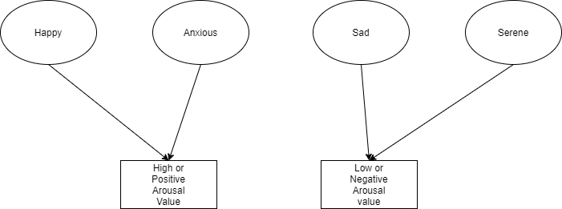
DIAGRAM: Emotion Classes
Fig. Classification of four emotion classes into Positive and Negative Valence classes
Fig. Classification of four emotion classes into Positive and Negative Arousal classes

Slide 23
TO IMPROVE ACCURACY
Added more audio clips in dataset
Removed redundant musical features as variables or parameters from the dataset
Divided one ML model into two, for better and easier classification
For this, identified musical features corresponding to Valence emotions and Arousal emotions. i.e, for classifying into High Valence or Low valence, I took attacktime, zerocross, rolloff, brightness, centroid, roughness, regularity, and pitch as parameters, & for classifying into High Arousal or Low Arousal, took RMS, low-energy and tempo as parameters
Changed hyper-parameters for each model to get best accuracy

Slide 24
TABLE: ACCURACIES OF ML MODELS IMPLEMENTED AND THEIR BEST HYPER-PARAMETERS
Model/Algorithm | Best Accuracy in Python | Best Accuracy in Matlab | Best Hyper-parameters
KNN | 67.53% | 53% | 'algorithm': 'auto', 'leaf_size': 6, 'metric': 'minkowski', 'n_jobs': -1, 'n_neighbors': 8, 'weights': 'distance'
Decision Tree | 67.53% | - | max_features': 'auto', 'min_samples_leaf': 1, 'min_samples_split': 5, 'random_state': 123
SVM | 49.35% | 37.641% | 'C': [6,7,8,9,10,11,12], 'kernel': ['linear','rbf']
Fuzzy-KNN | - | 57%
Random Forest | 79.22% : model1 67.53% : model2 | - | 'criterion': 'gini', 'min_samples_leaf': 1, 'min_samples_split': 10, 'n_estimators': 35, 'n_jobs': -1, 'random_state': 123 (for model1) 'criterion': 'entropy‘ (for model2)

Slide 25
DEMO

Slide 26
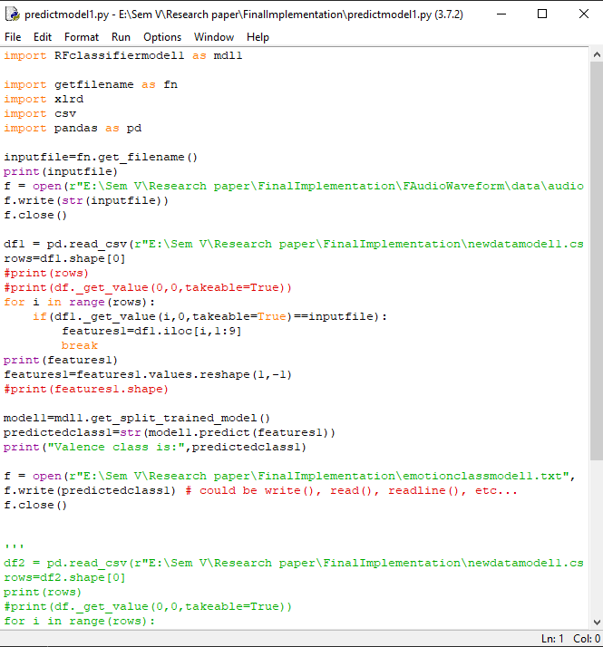
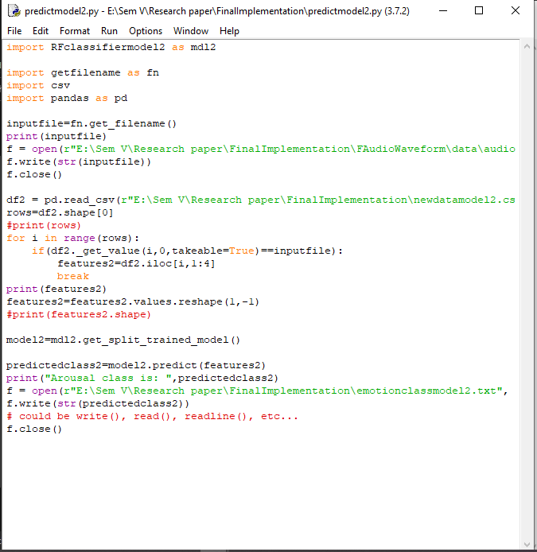
CODE SCREENSHOT: model generation and class prediction

Slide 27
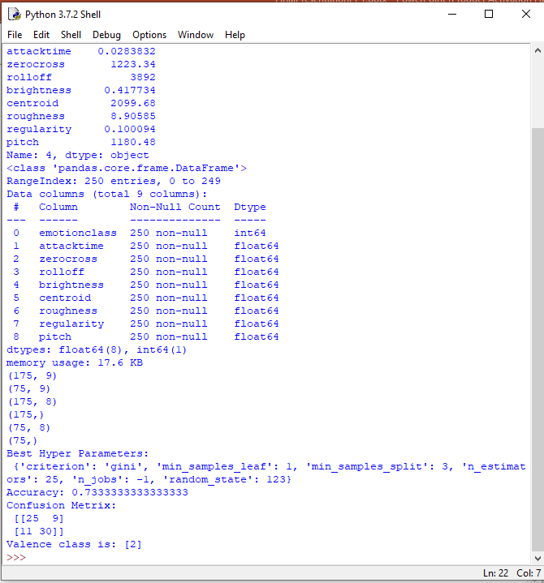
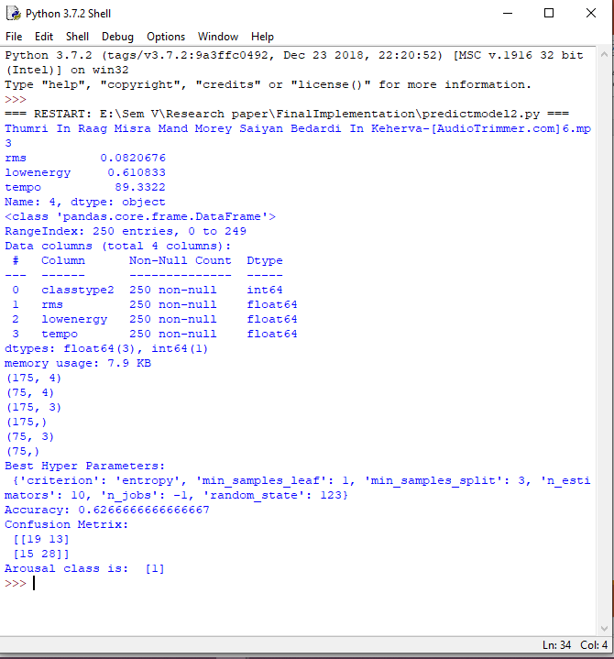
OUTPUT: Random Forest Classifier model generation and class prediction
Model 1 Output
Model 2 Output

Slide 28
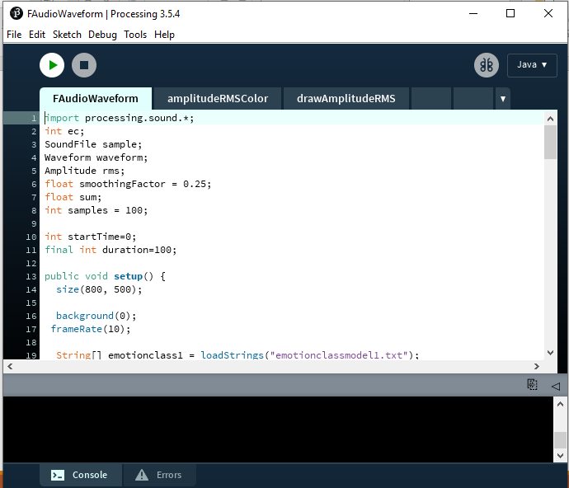
CODE SCREENSHOT: Processing sketch
Fig. Screenshot of code for processing sketch

Slide 29
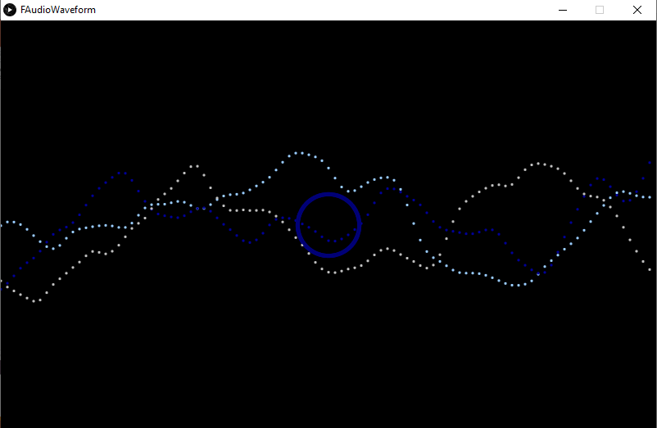
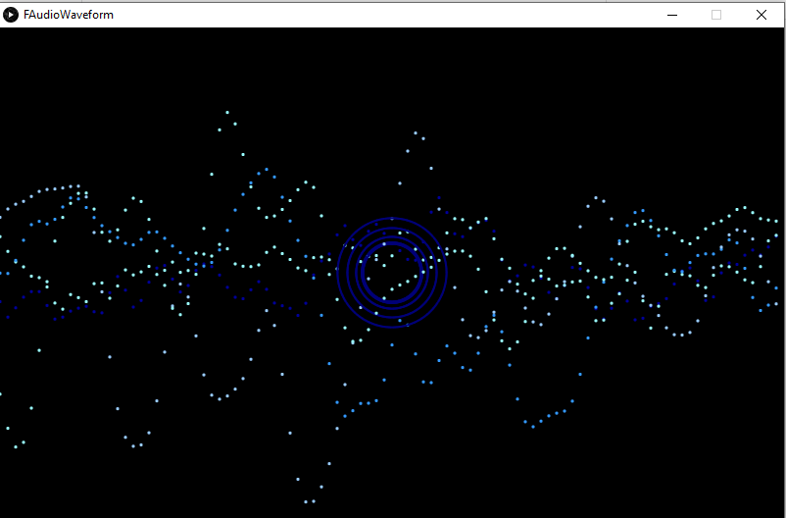
OUTPUT: Audio waveform visualization
Figs. Audio waveform visualization output in Processing for emotion class 3 (Sad, bored, depressed)

Slide 30
INFERENCES
For classifying a Hindustani classical music audio clip into an emotion, it needs to be classified into an emotion group. A particular emotion cannot be pinpointed for a particular audio clip since human emotions that can be linked to music vary from person to person.
Out of two major emotion models which consist of emotion classes, Thayer’s emotion model seems best to use as it involves classifying into class groups which constitute a group or cluster of emotions instead of one particular specific emotion.
For musical features, rhythm, pitch, tone and timbre are the primary features chosen. These are the features which can uniquely identify and differentiate among the audio clips.
To be specific, attacktime, zerocross, rolloff, brightness or intensity, centroid, roughness, regularity, pitch, RMS energy, tempo, mode are the features which can be worked upon. These features, depending on how they are extracted, are processed for ease in associating it with a particular audio clip and for the purpose of classification by an ML model.
There are many applications of emotion classification of music: Music recommendation systems, label tagging, music players, etc. For all these, music information retrieval forms the basis.
Various Machine Learning algorithms have been used for multi-label classification: SVM, KNN, MMG, GMM, ML-KNN, M3L

Slide 31
INFERENCES CONTINUED…
Some models have shown a low accuracy due the subjectivity of emotions in music when it comes to classifying into a particular emotion class. However, most other models have shown better accuracy with better model formations and multi label tagging or classification.
Accuracy for emotion classification can be improved by choosing better datasets, cleaner audio clips (which have been properly processed) to exclude noise as much as possible, to extract musical features as efficiently and cleanly as possible.
Also, the varying of emotions in a music clip has to be taken care of. Thus, using long music clips should be avoided and should be segmented into short overlapping clips for better classification and results.
The fuzzy approach classifies into multiple emotion classes along with the percentage of its belonging to that class. Fuzzy approach seems most justified as an approach or methodology, as a particular music clip may inspire multiple emotions in varying degrees. Thus, it is closest to human classification of a music piece into emotions.
For the visual representation of a music clip and the emotions it inspires, Processing in Java can be used as it has ample libraries and functionalities to represent sound and audio, visually in real time, using the desired visual parameters.

Slide 32
CONCLUSION
Thus, from the literature review, we conclude that there has been ample work done on emotion classification of music. However more future research work needs to be done in the same field on Hindustani classical music especially, as it is difficult to implement the same on Hindustani Classical than on Western and general music. Furthermore, music has been represented visually so far in many commercial music player systems and recommendation systems, but those do not account for representing the emotion which the music belongs to or evokes. Thus, further research work needs to be done to accurately classify and represent emotions in Hindustani Classical music visually.

Slide 33
REFERENCES
[1] Analysis of Features for Mood Detection in North Indian Classical Music - A Literature Review, Bhavana Tiple* 1 , Prof. Achamma Thomas 2 Research Scholar, G.H.Raisoni College of Engineering,Nagpur, CSE Department Head CSE, G.H.Raisoni College of Engineering,
[2] Marius Kaminskas, Francesco Ricci, Contextual music information retrieval and recommendation: State of the art and challenges, Computer science review6, 2012, 89 -11.
[3] Hiba Ahsan, Vijay Kumar and C.V. Jawahar, “Multi- Label Annotation of Music”, IEEE 2015
[4] D. Liu, L. Lu and H-J. Zang, “Automatic Mood Detection from Acoustic Music Data” ISMIR 2003
[5] Byeong-jun Han, Seungmin Rho Roger,B Dannenberg, Eenjun Hwang, 2009. SMERS: Music Emotion Recognition Using Support Vector Regression, (ISMIR 2009), 651-656
[6] Yi-Hsuan Yang, Chia-Chu Liu, and Homer H. Chen, “Music Emotion Classification: A Fuzzy Approach”, ACM, 2006.
[7] An Introduction to Processing and Music Visualization Christopher Pramerdorfer∗ Vienna University of Technology

Slide 34
THANK YOU

