Slide 1
Next hike project 1
Data wrangling
Data acquisition

Slide 2
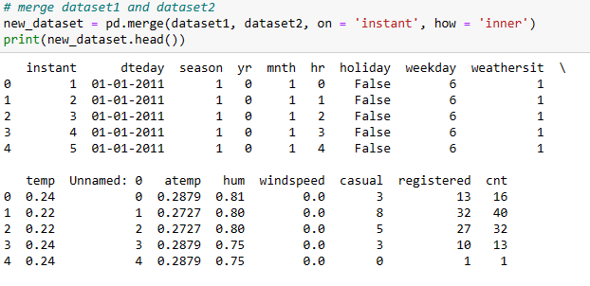
Merge two data set

Slide 3

After merge two dataset show new value

Slide 4
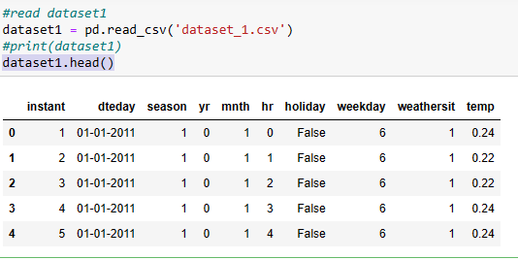
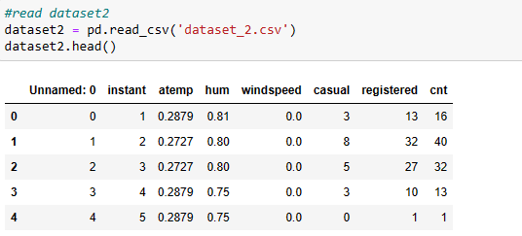
Load two data set

Slide 5
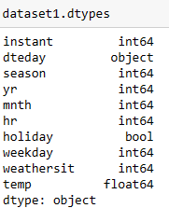
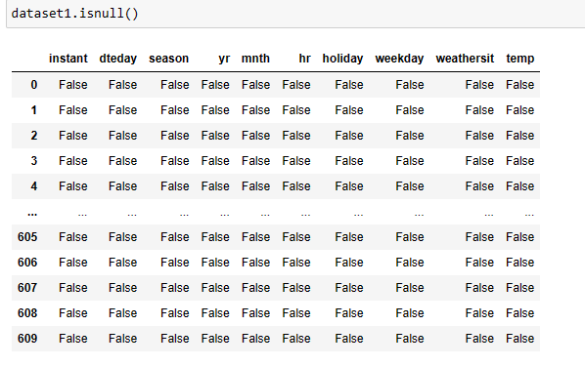
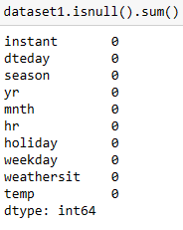
Locate Datatype and null value

Slide 6
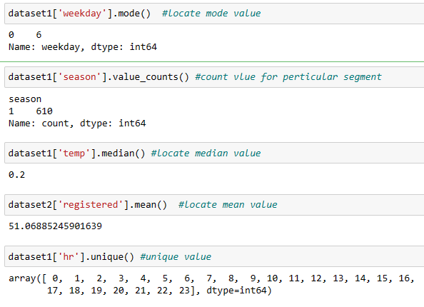
Locate mean, median, value count and unique value

Slide 7
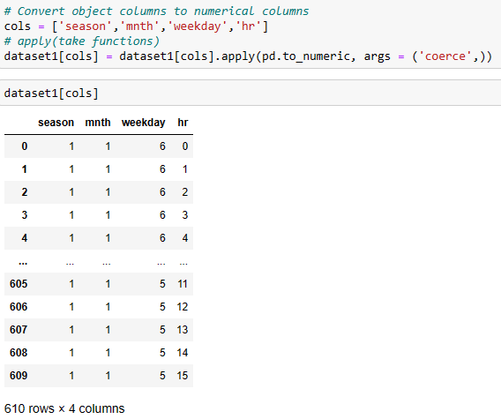

Showing only numeric value and convert object to float

Slide 8
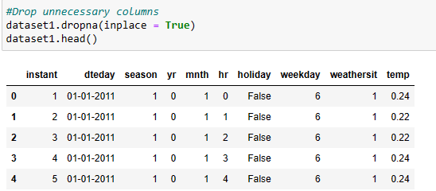
Drop unnecessary columns in Dataset

Slide 9
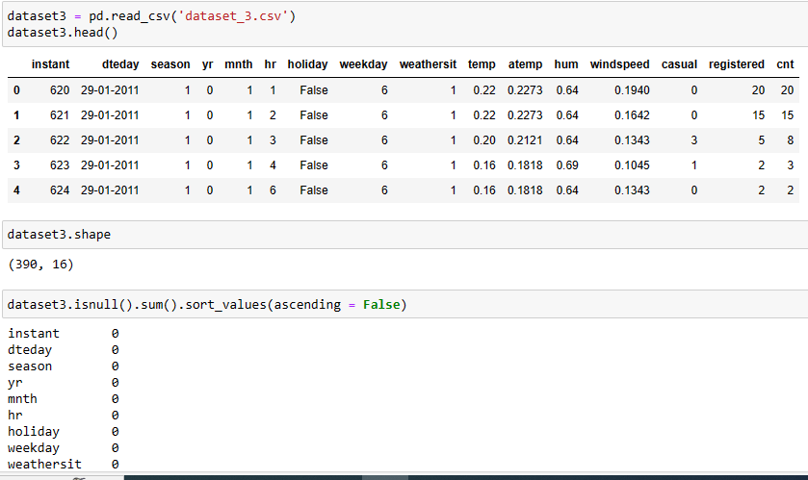
Read dataset 3, shape and sort the value

Slide 10

Check duplicate Value

Slide 11
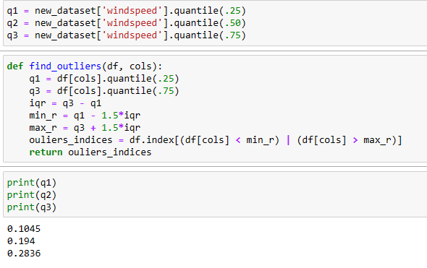
Find outliers

Slide 12
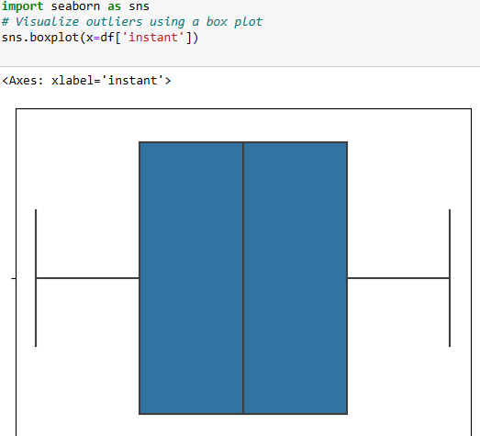
Visualization outlier using boxplot

Slide 13
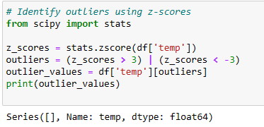
Identify outliers using z-scores

