Slide 1




Criterion for Anderson Localization in active random media
Ben Payne
Comprehensive exam
2010
Notes:
Desired time = 50 minutes (50 slides)
NSF and MST logos are from
SVN\research\oned\presentation_April08_TE_poster\pictures
Teragrid logo:
http://www.mcs.anl.gov/uploads/cels/images/news/2009/tglogo.png
SVN\research\quasi1d\presentations_09

Slide 2
Outline
Motivation: no criterion currently for Anderson Localization – diffusion transition in active media
history, existing criteria for passive media
1D numerical model
T/E, improvements
Quasi-1D waveguide numerical model
Regimes plot
Plan for future work

Slide 3
Motivation, problem statement
Existing criteria for transition between diffusion and Anderson Localization apply to passive random media
The goal of my work will be to characterize the transition in active media.
The method will be numerical modeling, using mathematical techniques not previously applied.

Slide 4
History
1958: Anderson writes “Absence of Diffusion in Certain Random Lattices”
  Applied to electronic mesoscopic transport
  Developed the tight-binding Hamiltonian to describe transport in random media
Notes:
Describe the phenomena here. An explicit example of the transition would be good.

Slide 5

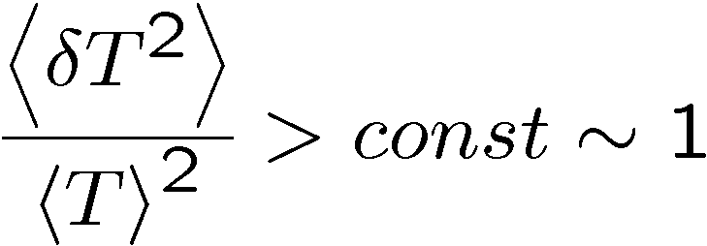
Available criteria
Existing criteria for localization
  Ioffe-Regal [1960]
    not easy to generalize
  Thouless [1977]
    average width of mode < mode spacing
      mode width decreases with gain
  Transmission fluctuations [Genack, 2000]
      Fluctuations increase with gain
Thouless and transmission fluctuations not developed with gain in mind.
Add gain needs to be theoretically derived (re-evaluate for active system)
No existing models address divergence due to gain
No obvious corrections to passive criteria
Possible solution: a ratio of two divergent parameters, T/E
Notes:
Source: SVN\research\oned\presentation_Oct08_FiOS
Ioffe-Regal: wavenumber times transport mean free path is roughly one is the transition
not easy to generalize since there’s no explicit gain dependent factor
Thouless and Transmission fluctuations do not have gain dependent factors. They apply more to absorption and passive systems
In passive systems, such as electronic systems, phenomenon of localization was predicted by P.W. Anderson in 1958. For such systems Thouless and Ioffe-Regel localization criteria were developed. Light localization in random medium with gain is of interest in studies of random lasers [1]. However, the above criteria cannot be directly extended to include gain because of a possibility of divergence of relevant transport coefficients due to lasing in some (maybe rare) realizations of the statistical ensemble. It can be shown that a ratio between transmission coefficient (T) and energy stored in system (Ξ) should remain finite under these conditions. We investigate the possibility of using the ratio T/Ξ as a criterion for localization of light in random media with gain.
Goal:find criteria for localization in random media with gain
Began by studying diffusive (slab) systems with gain
Summary from AY notes from this summer:
(i) T and E diverge near lasing threshold, whereas their ratio remains finite
(ii) T/E is expected to be a smooth function of frequency
The diffusion equation can not describe localized system
[need to account for interference]
What can we say about T/E in the localization regime?
Ioffe & Regal, Prog. Semiconductors 4, 237(1960)
Thouless, Phys. Rev.Lett. 39, 1167(1977)
Statistical signatures of photon localization
A. A. CHABANOV, M. STOYTCHEV, A. Z. GENACK
Nature 404, 850-853 (20 April 2000)

Slide 6
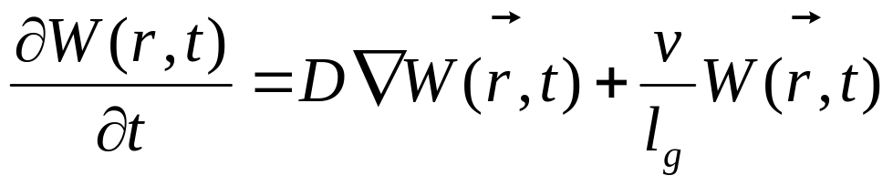
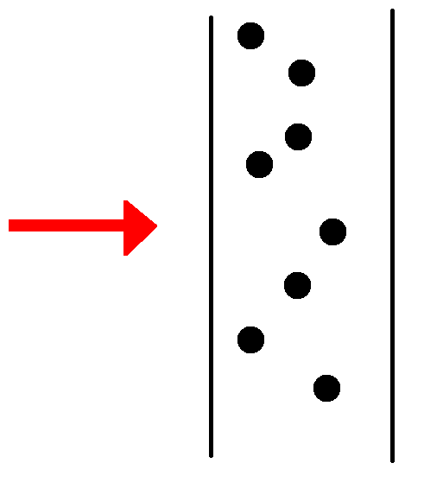
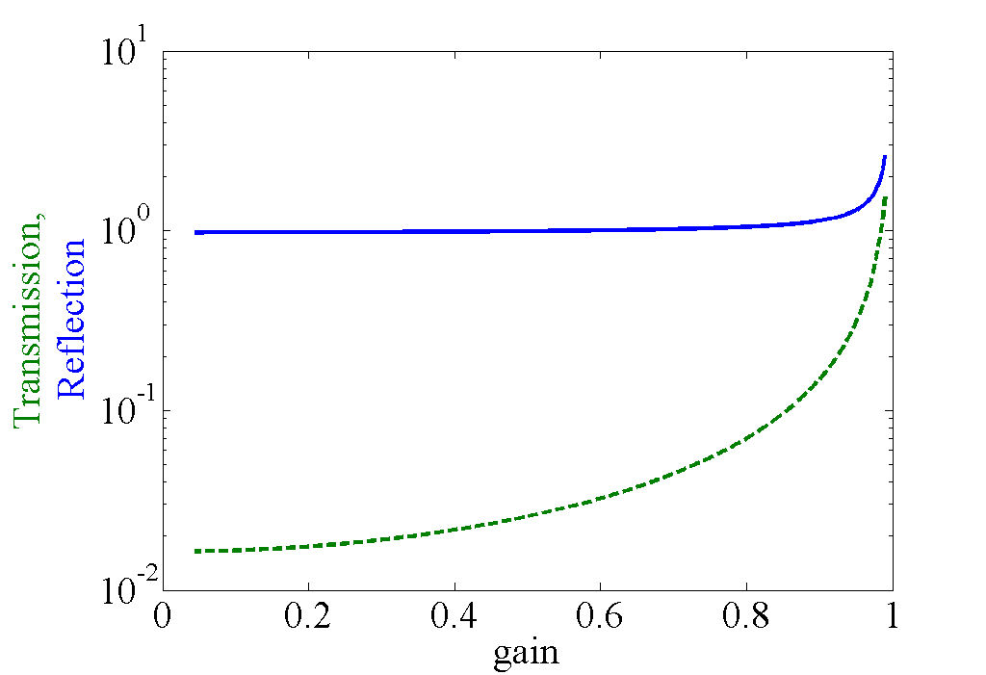
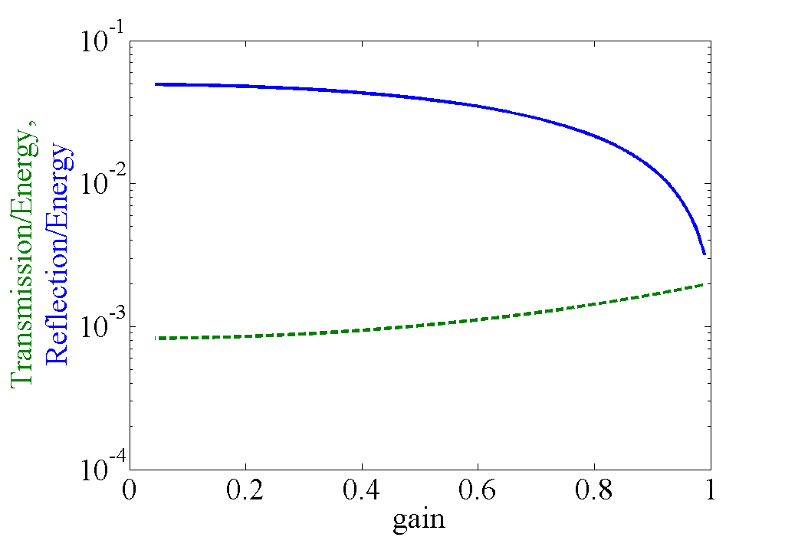

Analytical Diffusion slab
Diffusion slab model:
T/E converges for
No localization since no phase
Q: How does T, E behave with light waves?
A: Need wave description → Maxwell Equations
Simplest where we know localization exists
Notes:
Source: SVN\research\oned\presentation_Oct08_FiOS
Note: a diffusive model can not actually include wave-effect lasing
This model breaks if lasing threshold is reached since(?)
Next: try the simplest model that has localization present, 1D

Slide 7
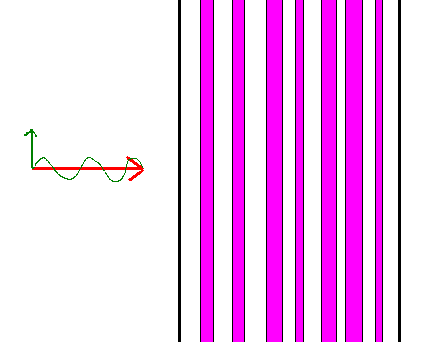
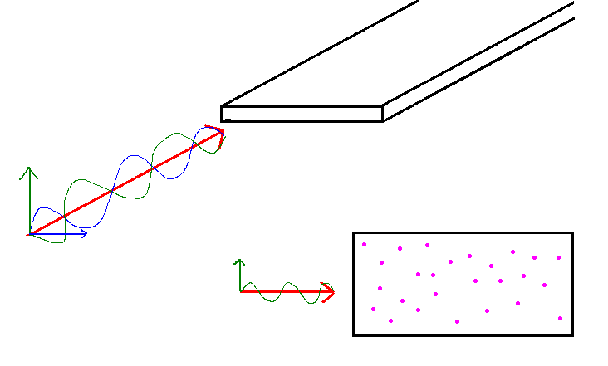
Numerical models used
Model propagation of light through a metallic waveguide
Mathematically, use transfer matrices and Maxwell's equations
L
W
L
1D: stack of glass plates quasi-1D: plane w/ boundaries
Notes:
These pictures are from Ben's /research/what I do/pictures

Slide 8
Why 1-D random media?
Simplest model that exhibts localization behavior
Computationally simpler
  -one computer, running on the order of hours to generate quantitatively analyzable statistical data
Lacks diffusion
Physically realistic despite simplicity
Is the first step towards quasi 1-D
Notes:
Source: SVN\research\oned\presentation_Nov07_Northwestern
The lack of diffusion has been tested in higher dimensions and has no significant impact
Physical: see Genack, fiber model

Slide 9
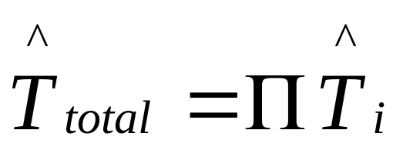
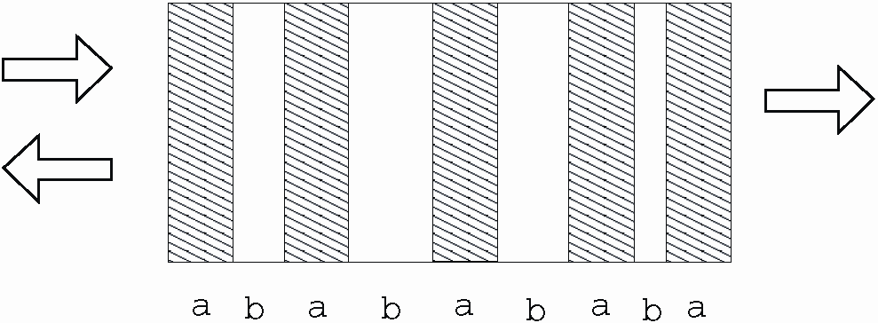
Computational Setup Maxwell Equations 1D model
Alternating Layers of dielectric with varying width
Transfer matrix method implemented in Fortran
Computed:
  Energy in each slab as a function of position
  Transmission, Reflection
  Electric field as a function of position
Systems with 1000 slab pairs (to be in the localization regime)
Parameters:
  number of pairs
  Number of realizations
  refractive index
  Incident wave frequencies
  absorption/gain
Notes:
Source: SVN\research\oned\presentation_Nov07_Northwestern
What; How; Why

Slide 10
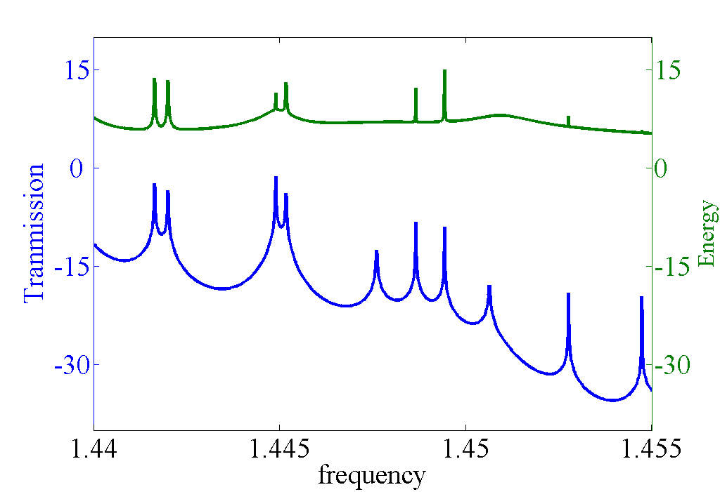
Results of 1-D Fortran simulation
Varied incident frequency for one realization
  a<<ζ<<L (localization range)
  ls << ζ
The energy and transmission of the light was found in many samples
Why is the ratio not smooth?
Notes:
Source: SVN\research\oned\presentation_Nov07_Northwestern
The range of viable frequencies were scanned.
The range was determined by localization constraints
Point out areas where ratio is smooth for T,E peak [expected behavior]

Slide 11
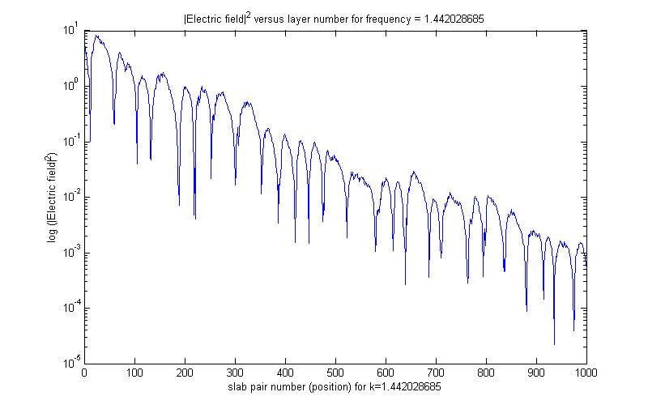
Expected result: Electric field in the sample decays exponentially
For a frequency where there are no peaks in transmission, transmission exponentially decays (evanescent wave)
Notes:
Source: SVN\research\oned\presentation_Nov07_Northwestern

Slide 12
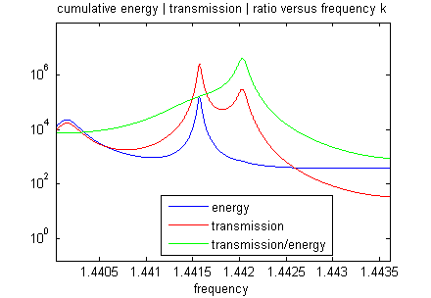
Anomalies encountered in
Fortran 1-D simulation
Regions of interest: two adjacent peaks in transmission, with only one peak in energy.
(I initially called this a “Left-Right” peak.)
  Why is there more activity in transmission than energy?
  Why did the peaks occur in a Left-Right or Right-Left order?
  Was the spacing between peaks constant?
Notes:
Source: SVN\research\oned\presentation_Nov07_Northwestern

Slide 13
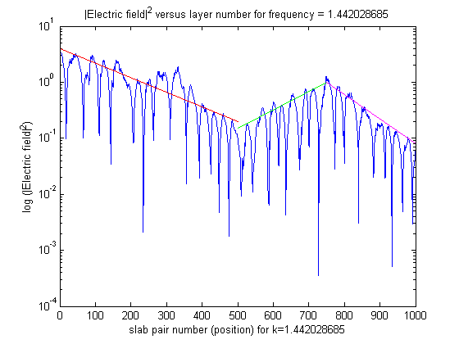
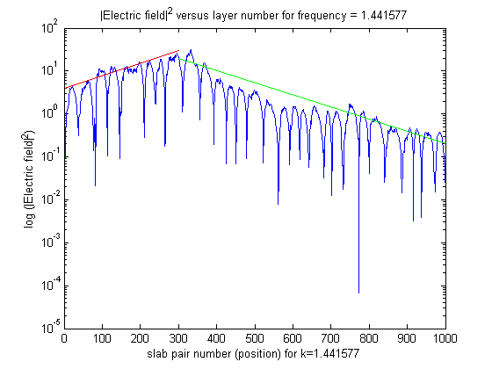
Electric field in the sample
For a “Left-right” peak pair where transmission doesn't match energy
For a “Left-right” peak pair where transmission matches energy
Notes:
Source: SVN\research\oned\presentation_Nov07_Northwestern

Slide 14
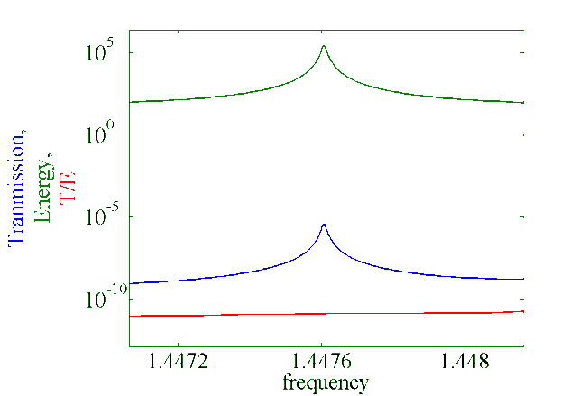
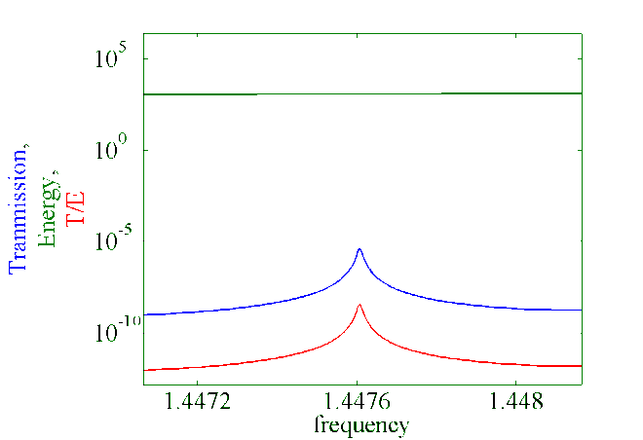
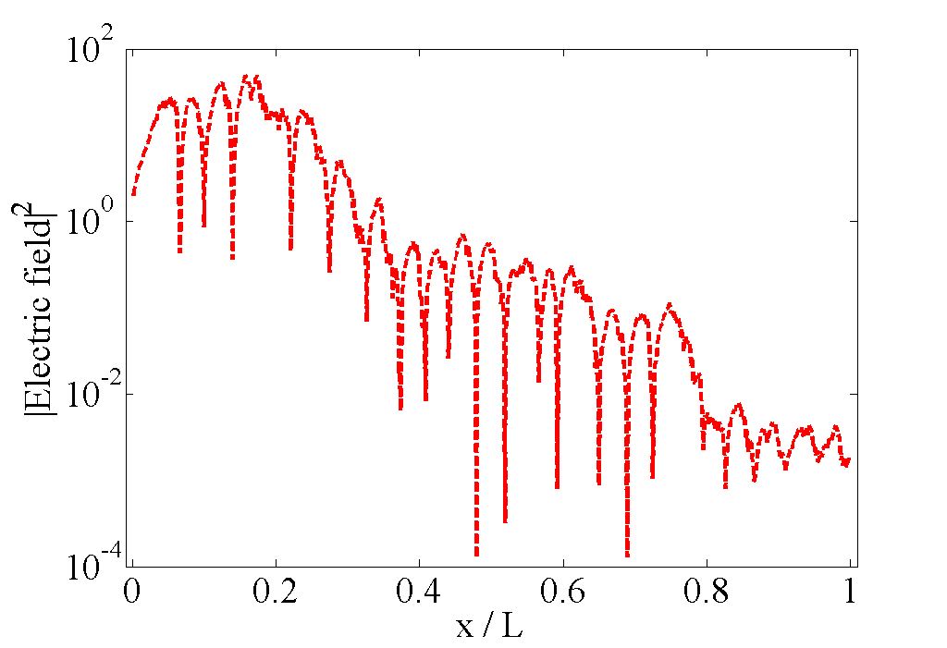
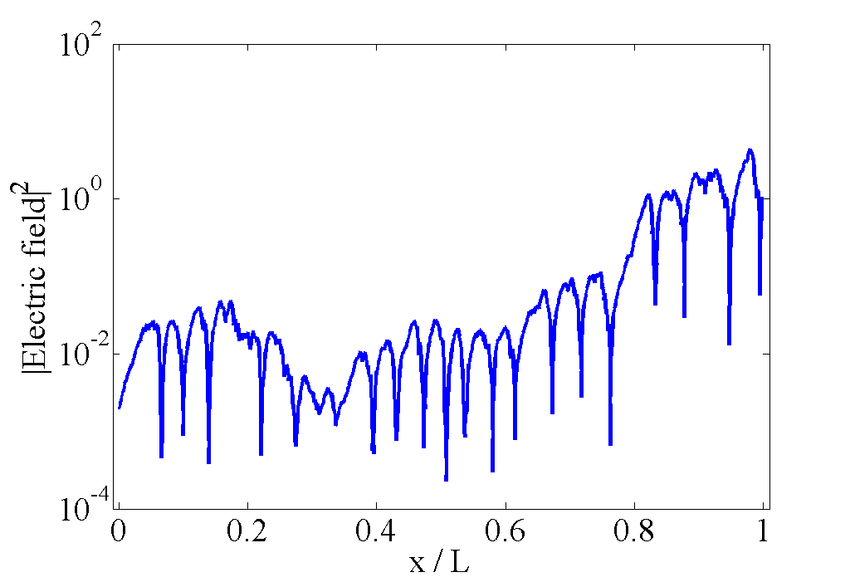
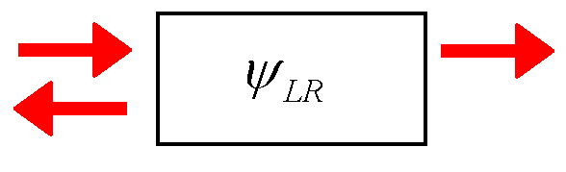
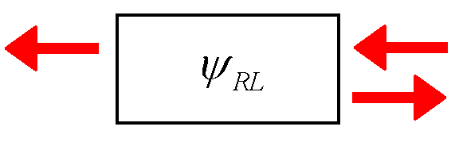
Analysis of results, passive
T/E not smooth
Ratio smooth implies center of localization in first half
No spike in energy implies localization in second half
Resonant tunneling evident
Verified with analytical models
How is T/E affected by gain?
Notes:
Source: SVN\research\oned\presentation_Oct08_FiOS
Small change in boundry conditions: flipping the sample orientation, aka flipping beam orientation
We find that when a center of localization is in the first half of a sample a larger amount of energy builds up, compared to the case when the center
of localization appears in the second half of a sample. In fact, both cases can refer to the same sample being illuminated from left or from right (Ψ1 and Ψ2 respectively), c.f. Fig. 1a,b. We note that these two drastically different profiles appear due to the openness of the system at the boundaries and can be used as two linearly independent solutions of Maxwell equations.

Slide 15
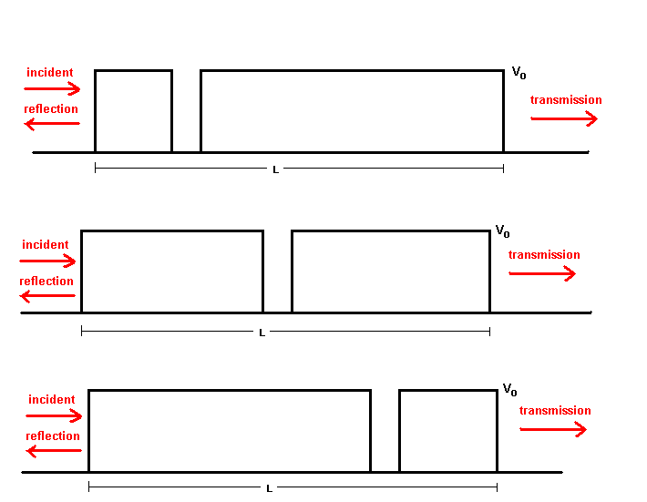
Where else have we seen those waveforms?
Double barrier potential wells from quantum mechanics
The single well location can either be on the left, in the center, or on the right.
Although familiar from quantum mechanics, it’s actually just the result of the Schrodinger Equ, which describes waves.
Notes:
Source: SVN\research\oned\presentation_Nov07_Northwestern

Slide 16
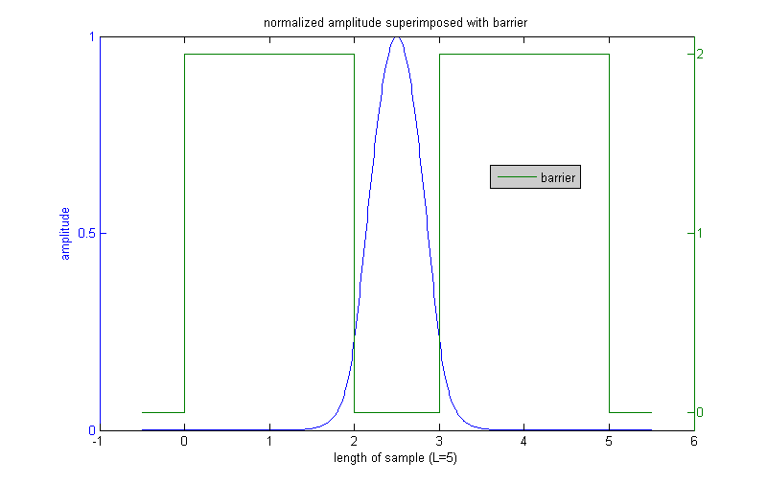
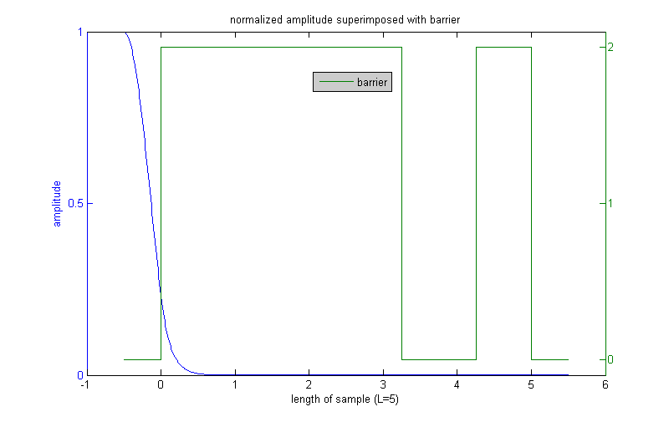
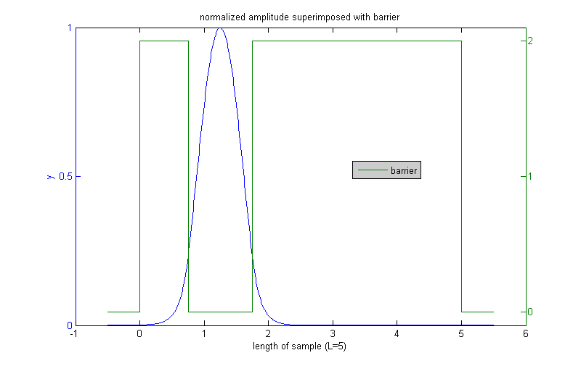
Analytical model of double barrier
With a well at ¼ L, ½ L, and ¾ L we see the expected result: a wave in the well.
Notes:
Source: SVN\research\oned\presentation_Nov07_Northwestern

Slide 17
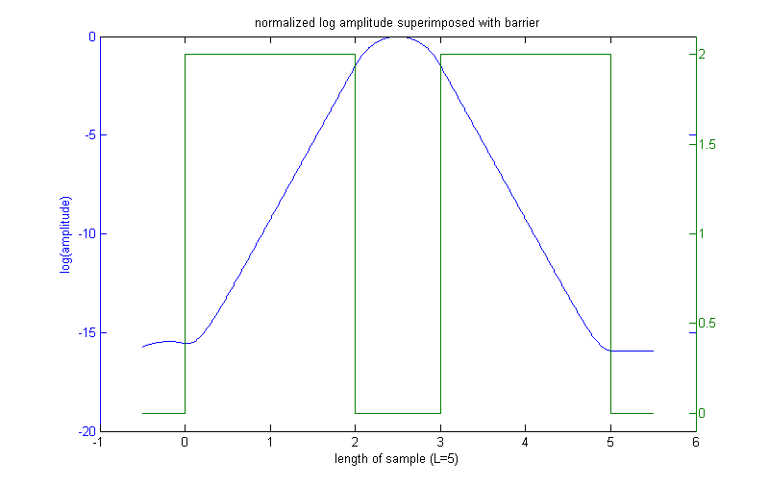
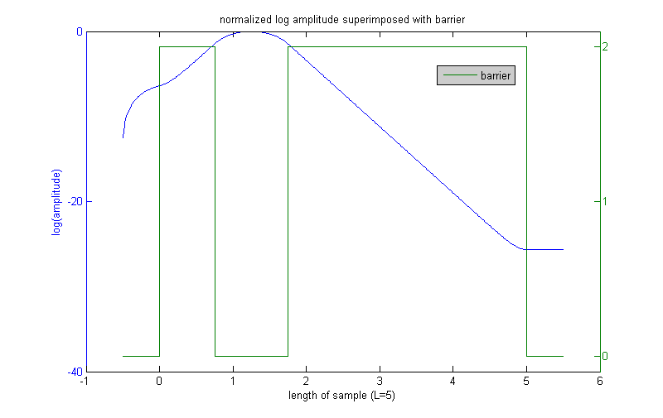
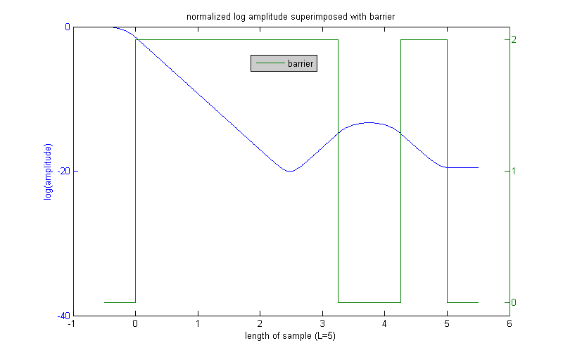
Same plots for double barrier, but on a log y scale
Now wee see similar behavior to the electric field from the random slabs of dielectric
Notes:
Source: SVN\research\oned\presentation_Nov07_Northwestern

Slide 18
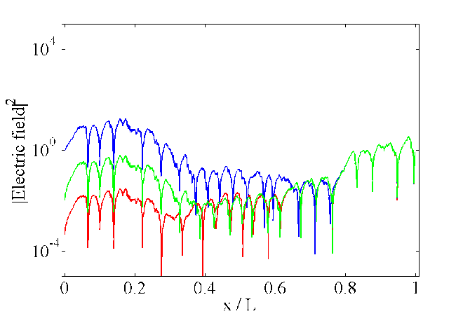
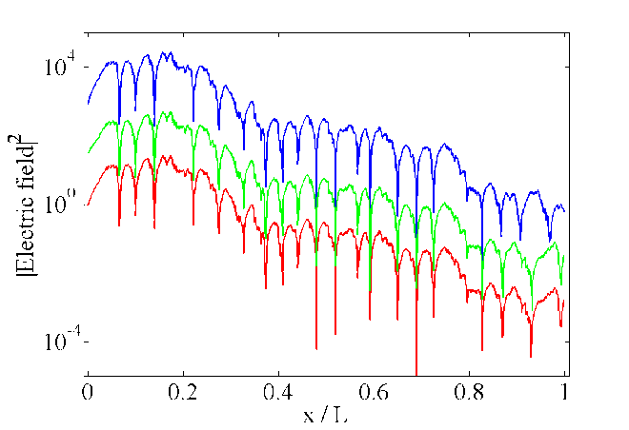

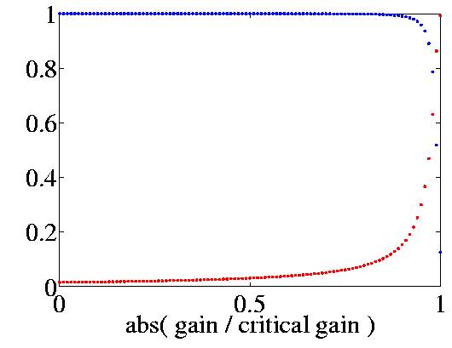
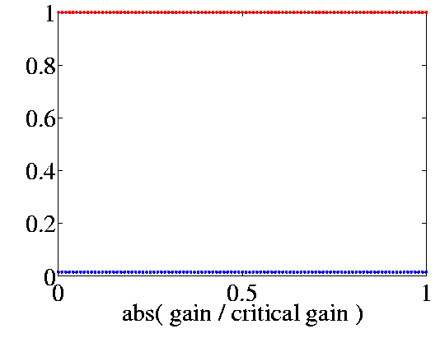
Results with gain: alpha, beta
Change of waveform when gain is added
Closed system, two solutions
Incident light on left and right sides (aka flipping the sample)
  At resonant frequencies,
Introduce two parameters, α and β, associated with the two incident directions, for passive system
Orthogonality verified
completeness Wronskian
Notes:
Source: SVN\research\oned\presentation_Oct08_FiOS
Accuracy of alpha, beta is dependent on how localized the system is (far from diffusion is better).
Sebbah’s paper: same state until lasing threshold
When we begin with the system in Fig. 1b and add gain, we observe that electric field distribution (and thus Ξ) is changed, c.f. Fig. 1c. This is in contrast to the previous work [2] which concluded that in localized regime a random lasing state strongly resembles the state of the corresponding passive system. We attribute the contradiction to the difference in exciting random medium. Unlike local excitation in [2], we consider the transmission setup commonly used in an experiment. The change of electric field distribution with gain can be described (in localized regime) in basis of functions Ψ1 and Ψ2. Fig. 1d shows that the contribution of Ψ2 diminishes close to the critical gain and one recovers the profile Ψ1, as expected based on local excitation.

Slide 19
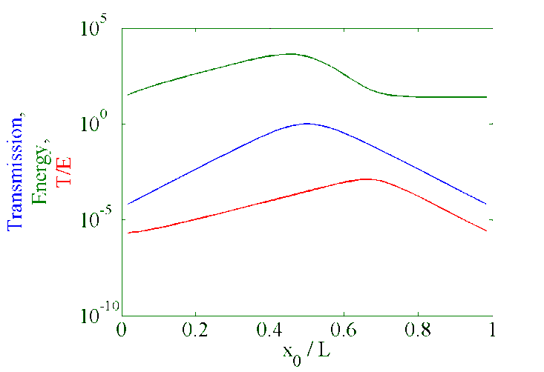
Re-evaluate T/E at critical gain
T/E smooth at critical gain (non-divergent)
Not constant
  Due to variation of center of localization
Passive (no gain)
Notes:
Source: SVN\research\oned\presentation_Oct08_FiOS

Slide 20
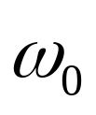


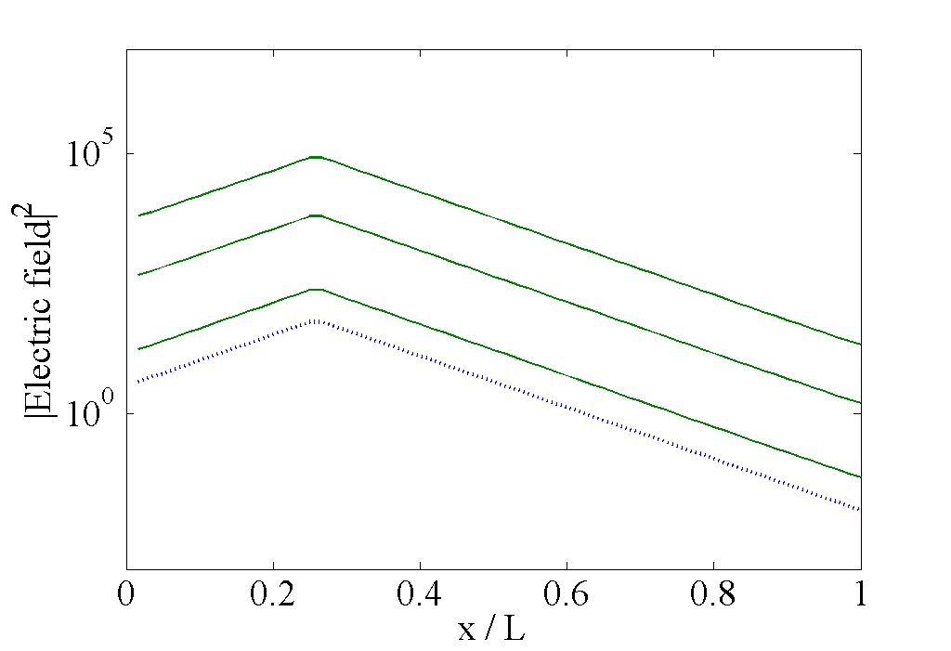
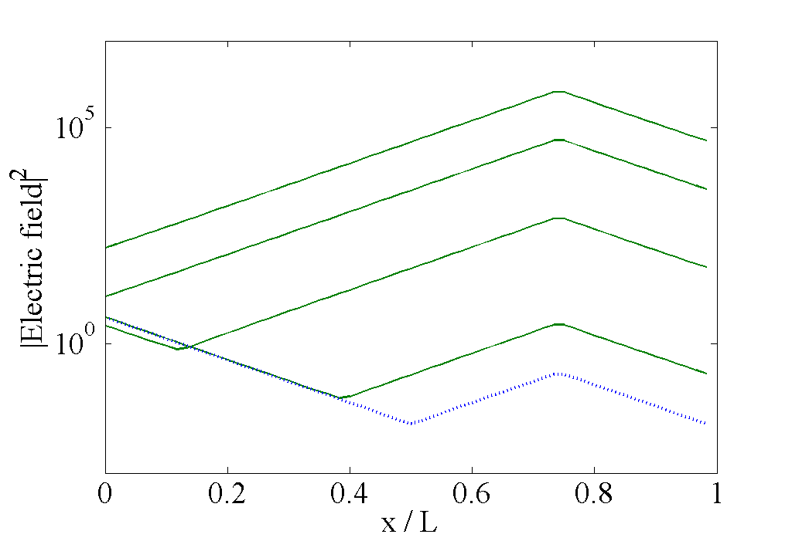
Conclusion: T/E fluctuates
T/E not divergent,
as predicted by diffusion model
Instead of or we looked at T/E at
understand 1D
α→ 1, β→ 0 at critical gain
Notes:
Source: SVN\research\oned\presentation_Oct08_FiOS
From the above analysis we find that T/Ξ (i) fluctuates strongly from sample to sample even in passive system; (ii) shows gain dependence which reflects factors other then localization properties of the system. We conclude that although T/Ξ parameter does not diverge when the threshold for random lasing is approached, it may not be an unambiguous criterion of localization in random medium with gain.
1] H. Cao, J. Phys. A: Math. Gen.. 38, 10497 (2005)
2] C. Vanneste, P. Sebbah, Phys. Rev. Lett. 87, 183903 (2001)

Slide 21
Conclusion: T/E not ideal criterion
T/E fluctuates
T/E changes when waveform changes as a function of gain
T/E is not constant at critical gain
T/E depends on center of localization
Change in T/E signifies a change in waveform as function of gain
Higher dimensions:
  Orientation specific: waveform changes
  Two solutions for slab and quasi-1D geometries
  Improvement: (T’/E’)E
Notes:
Source: SVN\research\oned\presentation_Oct08_FiOS
Mention that negative gain doesn’t apply since it doesn’t predict change in waveform?

Slide 22
Quasi-1D motivation
Q1D is usually described only in terms of open waveguide channels, whereas the evanescent (closed) ones are neglected
Real systems contain an infinite number of closed channels.
It was suggested their effect on the light propagation is can be essential (e.g. when new channels open)
It is important assess the effect of closed channels on statistical properties of transmission (may be crucial in random media with gain)
We show the effect of closed channels is quantitative and not qualitative
We demonstrate how to properly account for the closed channels
Notes:
Source: SVN\research\quasi1d\presentation_Nov07_Yale

Slide 23
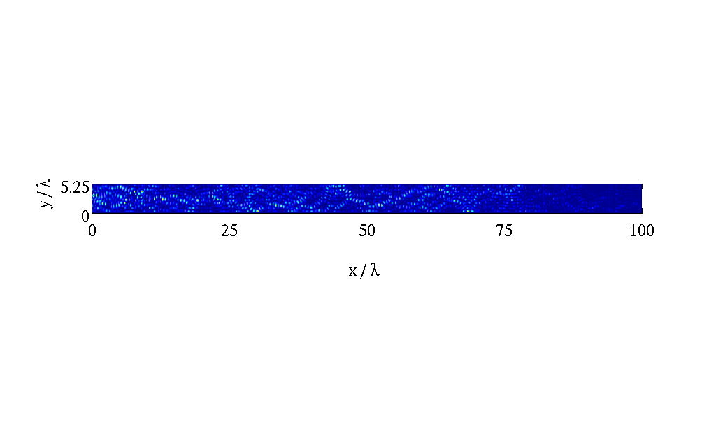
Increase complexity: quasi1D
[progressing towards the goal of 3D]
Point scatterers instead of layers of dielectric
Still able to observe Electric field inside
Scatterers can be passive or active
Results in more calculations, longer to compute

Slide 24
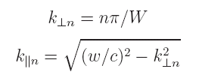
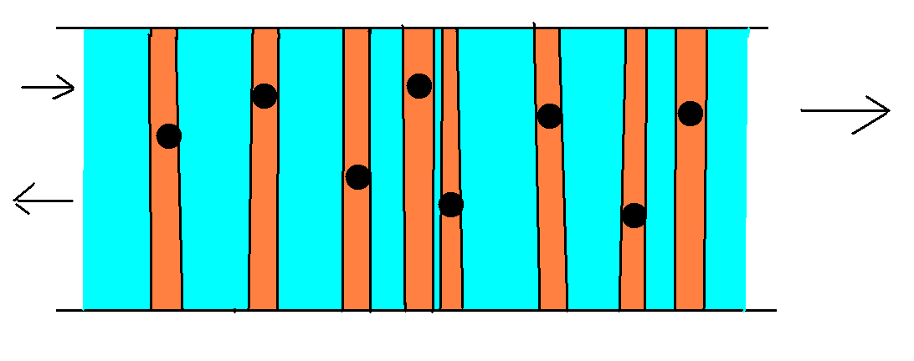

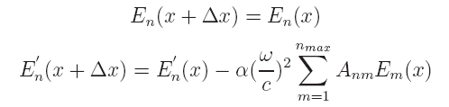
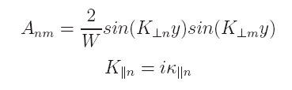
Numerical simulation overview
Quantization of transverse momentum allows for the simplification of this two-dimensional system to a one-dimensional system referred to as quasi-1D
Models an arbitrary number of randomly placed point scatterers in a quasi-1D optical waveguide
The electric field is described throughout the system for both the free space (blue) and scattering events (orange)
Notes:
Source: SVN\research\quasi1d\presentation_Nov07_Yale

Slide 25
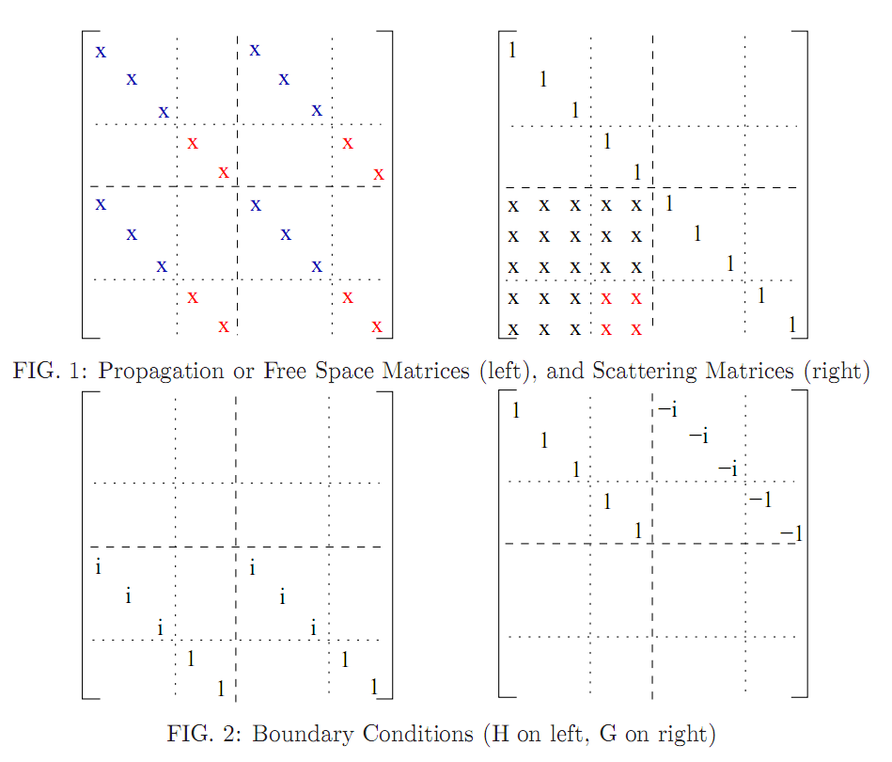
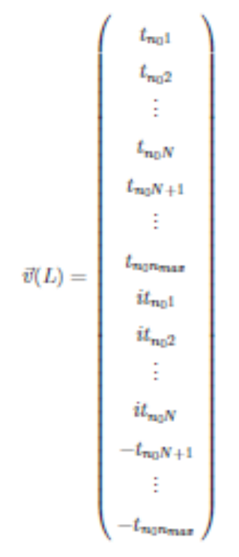
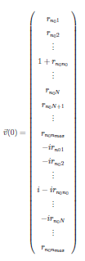
Self embedding algorithm
  A set of transfer matrices (Free Space and Scattering) propagates the electric field for the whole system
  These matrices are used to calculate the transmission and reflectance coefficients matrices
To control numerical error we implemented self-embedding procedure:
  (A*B*A*B*A*B)SE(A*B*A*B*A*B)SE(…
Notes:
Source: SVN\research\quasi1d\presentation_Nov07_Yale
Note: this slide is crap: colors are incorrect, no information is imparted to the viewer.

Slide 26
Effect of evanescent modes

Slide 27
Regime plot

Slide 28
Field distribution in media, optimization of transmission

