Slide 1




Criterion for Anderson Localization in active random media
Ben Payne
Comprehensive exam
2010
Notes:
Desired time = 50 minutes (50 slides)
NSF and MST logos are from
SVN\research\oned\presentation_April08_TE_poster\pictures
Teragrid logo:
http://www.mcs.anl.gov/uploads/cels/images/news/2009/tglogo.png
SVN\research\quasi1d\presentations_09

Slide 2
Outline
transport of light in random media at mesoscopic scale
no criterion currently for diffusion-Anderson Localization transition in non-conservative systems
existing criteria for passive media
Proposed criterion: T/E
1D numerical model
Quasi-1D waveguide numerical model
Two parameter space, transport regimes

Slide 3
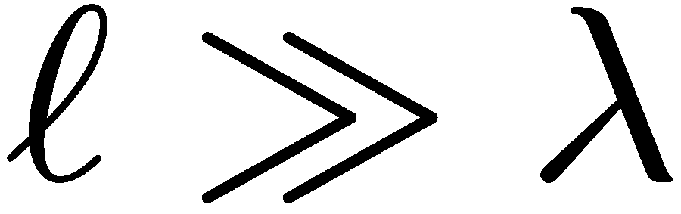
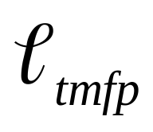
Definition of Mesoscopic length scale
Wavelength λ
Energy ε
Scattering length
Transport mean free path
Length scales:
λ_{F} Fermi wavelength – only electrons close to Fermi level are mobile
l Scattering length – distance between successive scatterings
L System length
L_{φ} Phase relaxation length (inelastic collisions)
l << L << L_{φ}

Slide 4
System and its parameters
L
λ
l
Waveguide
(quasi-1D)
W
λ
l
Slab
(3D)
λ – wavelength
L – thickness of
random medium
l – scattering length / mean free path
W – width of waveguide;
it determines the number of modes, N

Slide 5
What is Anderson localization?
λ
Quasi-1D
waveguide
Long (with many scatterings) paths lead to loops
Loops increase the return probability, thus, confinement
1958: Anderson “Absence of Diffusion in Certain Random Lattices”
  Applied to electronic mesoscopic transport

Slide 6
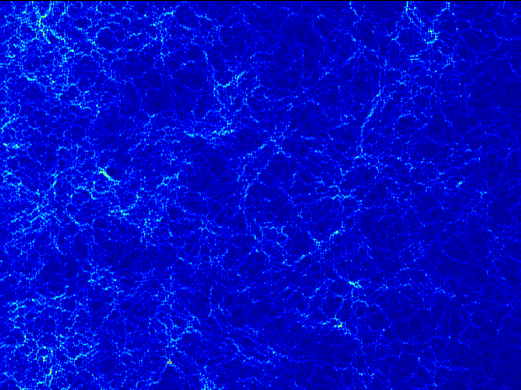
Notes:
What does the wave interference actually look like? How important is it?
4890 scatterers, L=100, W=100, alpha=4

Slide 7
Overview of passive criteria
Existing criteria for transition between diffusion and Anderson Localization apply to passive random media
The goal of my work will be to characterize the transition in active media.
The method will be numerical modeling, using mathematical techniques not previously applied.
Notes:
Now that the audience has a sufficient background, what is the plan?

Slide 8

Existing criteria for Anderson localization-diffusion transition
Ioffe-Regal [1960]
  not easy to generalize (3D only)
Correlation functions
Inverse participation ratio
g>1, g<1, T=g
Transmission fluctuations [Genack, 2000]
  Fluctuations increase with gain
Self-consistent D(z)
Notes:
Source: SVN\research\oned\presentation_Oct08_FiOS
Ioffe-Regal: wavenumber times transport mean free path is roughly one is the transition
not easy to generalize since there’s no explicit gain dependent factor
Thouless and Transmission fluctuations do not have gain dependent factors. They apply more to absorption and passive systems
In passive systems, such as electronic systems, phenomenon of localization was predicted by P.W. Anderson in 1958. For such systems Thouless and Ioffe-Regel localization criteria were developed. Light localization in random medium with gain is of interest in studies of random lasers [1]. However, the above criteria cannot be directly extended to include gain because of a possibility of divergence of relevant transport coefficients due to lasing in some (maybe rare) realizations of the statistical ensemble. It can be shown that a ratio between transmission coefficient (T) and energy stored in system (Ξ) should remain finite under these conditions. We investigate the possibility of using the ratio T/Ξ as a criterion for localization of light in random media with gain.
Goal:find criteria for localization in random media with gain
Began by studying diffusive (slab) systems with gain
Summary from AY notes from this summer:
(i) T and E diverge near lasing threshold, whereas their ratio remains finite
(ii) T/E is expected to be a smooth function of frequency
The diffusion equation can not describe localized system
[need to account for interference]
What can we say about T/E in the localization regime?
Ioffe & Regal, Prog. Semiconductors 4, 237(1960)
Thouless, Phys. Rev.Lett. 39, 1167(1977)
Statistical signatures of photon localization
A. A. CHABANOV, M. STOYTCHEV, A. Z. GENACK
Nature 404, 850-853 (20 April 2000)

Slide 9
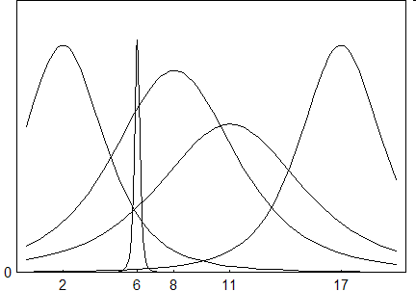
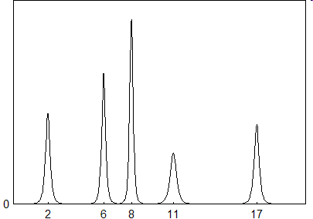
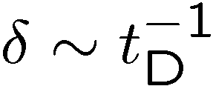

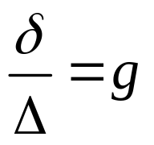
Thouless criterion
Diffuse regime:
Localized regime:
The spectrum is continuous
Spectrum consists of
individual modes
Thouless, Phys. Rev. Lett. 39, 1167(1977)
Notes:
In passive media, narrowing signifies AL. However, a diffusive passive system also exhibits narrowing as gain is added

Slide 10
Application of passive criteria in active media
No existing models address divergence due to gain
No obvious corrections to existing passive criteria
Add gain needs to be theoretically derived (re-evaluate for active system)
transmission fluctuations not developed with gain in mind.
Possible solution:
a ratio of two divergent parameters, T/E

Slide 11
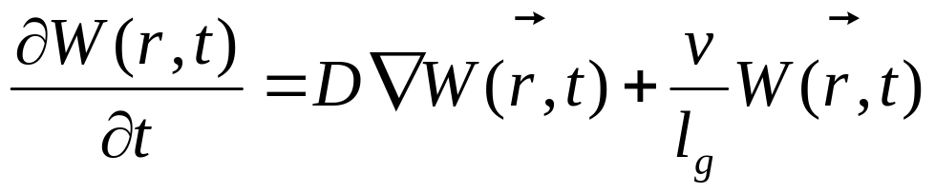
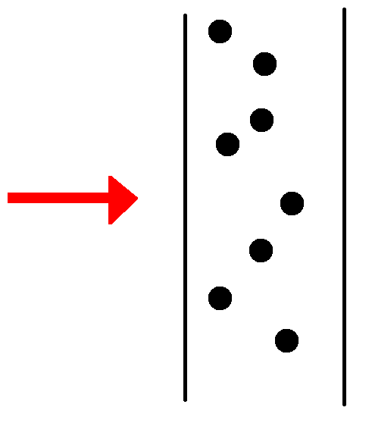
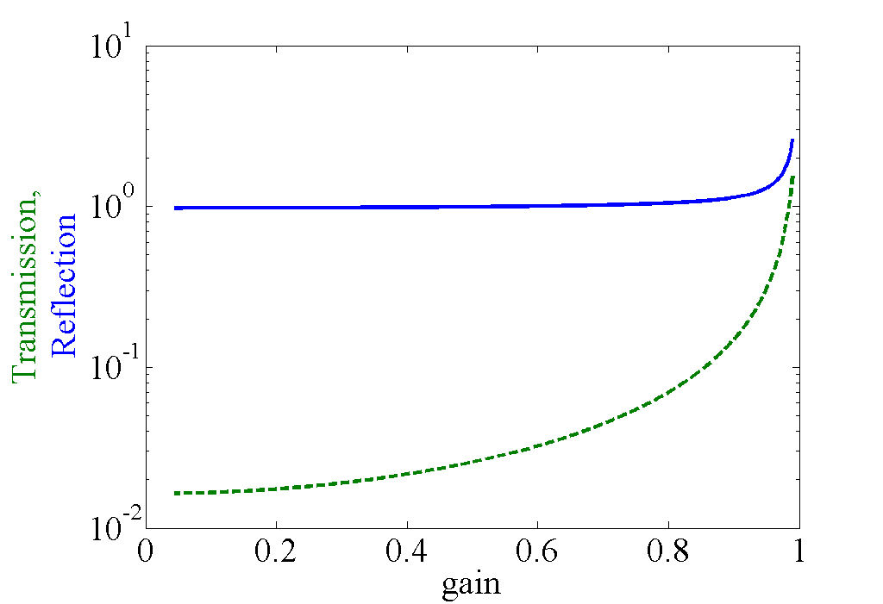
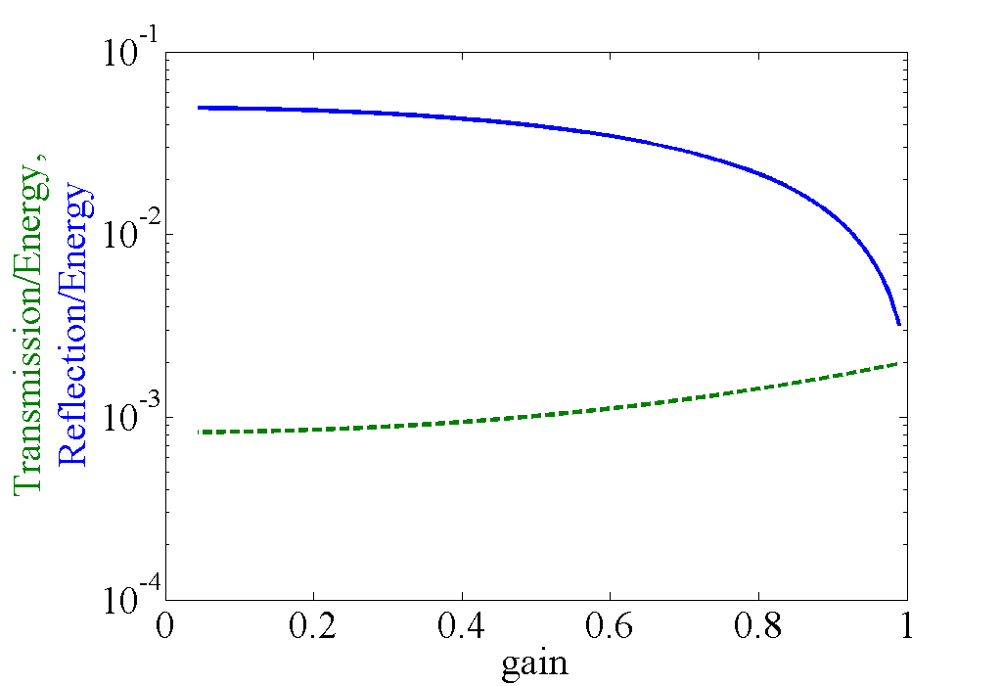

Analytical Diffusion slab
Diffusion slab model:
T/E converges for and is related to D(z)
No localization since no phase
Alternative derivation: Energy conservation
Q: How does T, E behave with light waves?
A: Need wave description → Maxwell Equations
Notes:
Source: SVN\research\oned\presentation_Oct08_FiOS
Note: a diffusive model can not actually include wave-effect lasing
This model breaks if lasing threshold is reached since(?)
Next: try the simplest model that has localization present, 1D

Slide 12
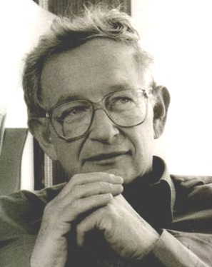
Why numerical simulations?
"Localization [..], very few believed it at the time, and even fewer saw its importance, among those who failed to fully understand it at first was certainly its author. It has yet to receive adequate mathematical treatment, and one has to resort to the indignity of numerical simulations to settle even the simplest questions about it."
P.W. Anderson, Nobel Lecture, 1977

Slide 13
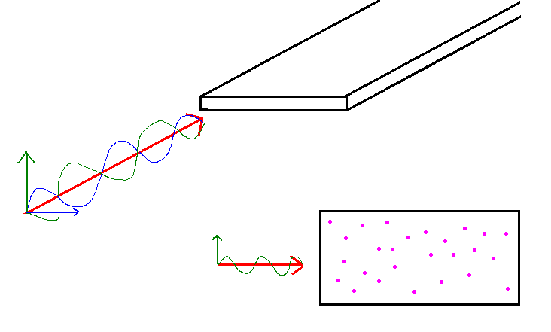
Numerical models used
L
W
1D: stack of glass plates quasi-1D: plane w/ boundaries
Notes:
These pictures are from Ben's /research/what I do/pictures

Slide 14
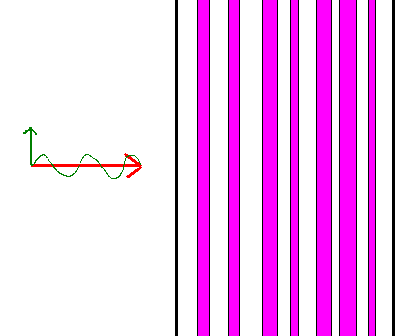
Why 1-D random media?
Simplest model that exhibits localization behavior and no diffusion
Computationally simpler
  one computer, running on the order of hours to generate quantitatively analyzable statistical data
Physically realistic despite simplicity
L
Notes:
Source: SVN\research\oned\presentation_Nov07_Northwestern
The lack of diffusion has been tested in higher dimensions and has no significant impact
Physical: see Genack, fiber model

Slide 15
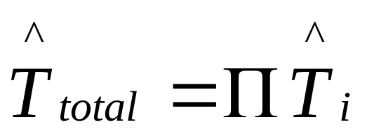
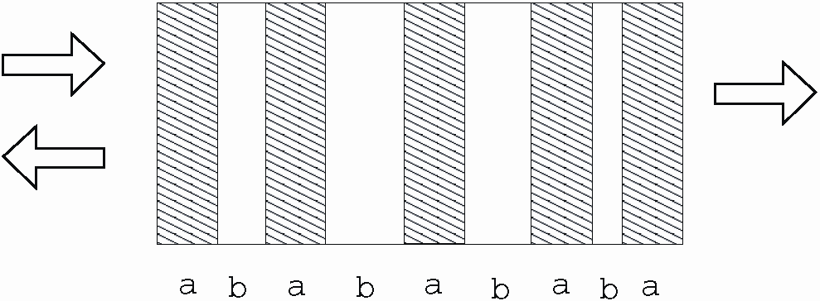
Computational Setup Maxwell Equations 1D model
Alternating Layers of dielectric with varying width
Transfer matrix method implemented in Fortran
Computed:
  Energy in each slab as a function of position
  Transmission, Reflection
  Electric field as a function of position
Systems with 1000 slab pairs
(to be in the localization regime)
No diffusion
Parameters:
  number of pairs (L)
  number of realizations
  refractive index
  Incident wave frequencies
  absorption/gain
Notes:
Source: SVN\research\oned\presentation_Nov07_Northwestern
What; How; Why

Slide 16
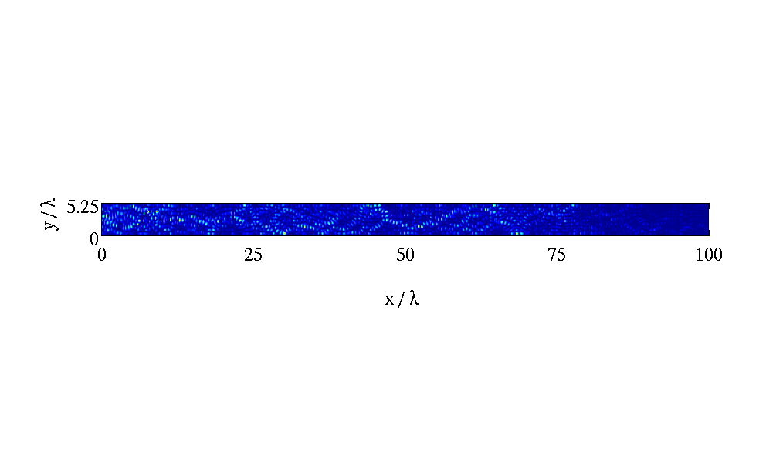
Quasi-1D metallic waveguide
Scattering potentials instead of layers of dielectric
able to observe Electric field inside
Scatterers can be passive or active
Model propagation of light through a metallic waveguide
use transfer matrices and Maxwell's equations

Slide 17
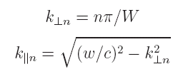
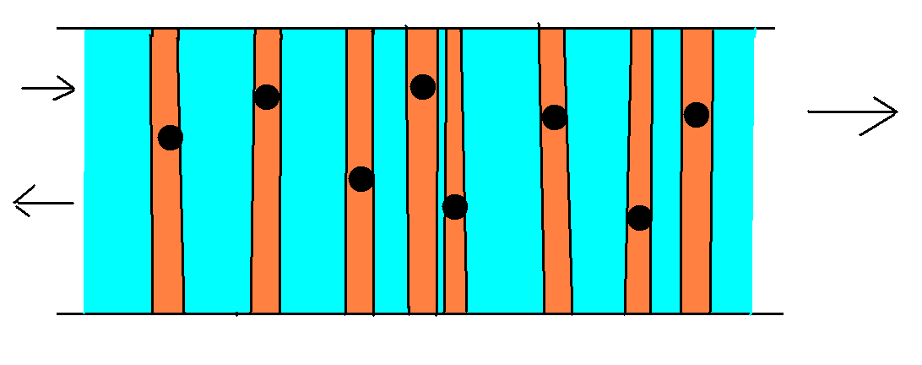

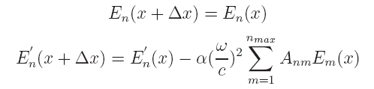
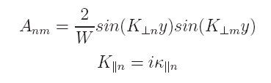
Numerical simulation overview
Quantization of transverse momentum allows for the simplification of this two-dimensional system to a one-dimensional system referred to as quasi-1D
Models an arbitrary number of randomly placed point scatterers in a quasi-1D optical waveguide
The electric field is described throughout the system for both the free space (blue) and scattering events (orange)
Renormalization: self-embedding technique
Yamilov, Phys. Rev. B 59, 11339 (1999)
Notes:
Source: SVN\research\quasi1d\presentation_Nov07_Yale
Self-embed citation key: 1999_Yamilov_selfembed

Slide 18
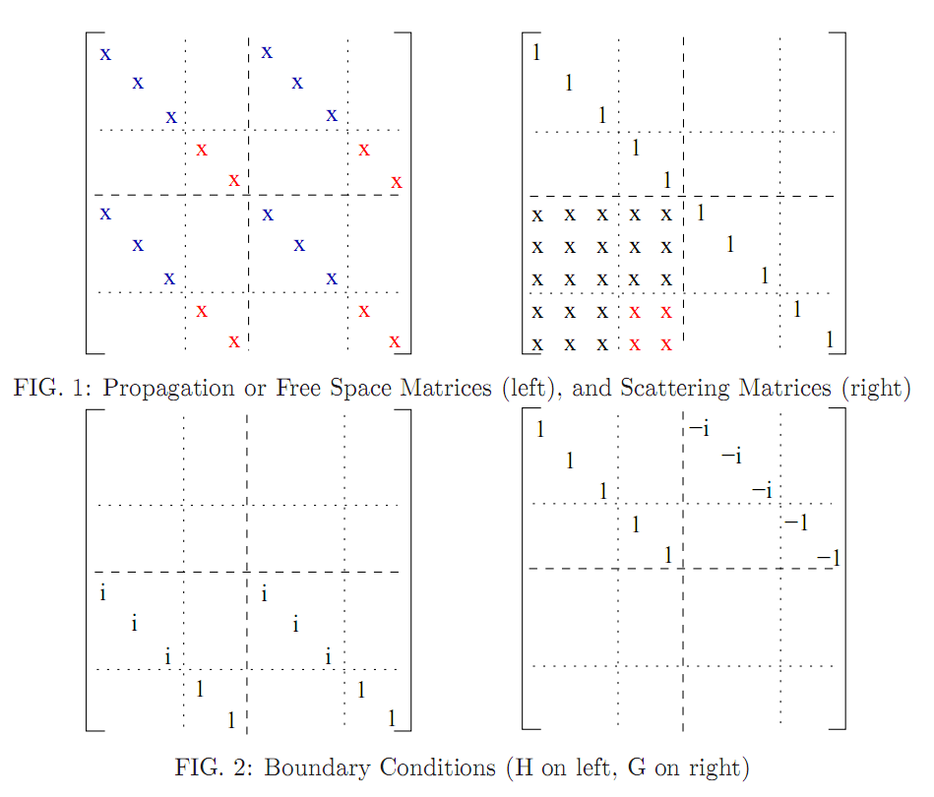
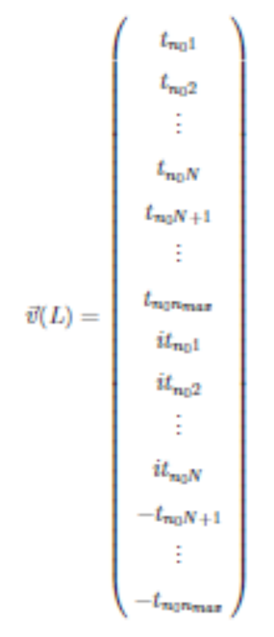
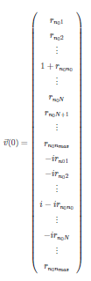
Self embedding algorithm
  A set of transfer matrices (Free Space and Scattering) propagates the electric field for the whole system
  These matrices are used to calculate the transmission and reflectance coefficients matrices
To control numerical error we implemented self-embedding procedure:
(A*B*A*B*A*B)SE(A*B*A*B*A*B)SE(…
Notes:
Source: SVN\research\quasi1d\presentation_Nov07_Yale
Note: this slide is crap: colors are incorrect, no information is imparted to the viewer.

Slide 19
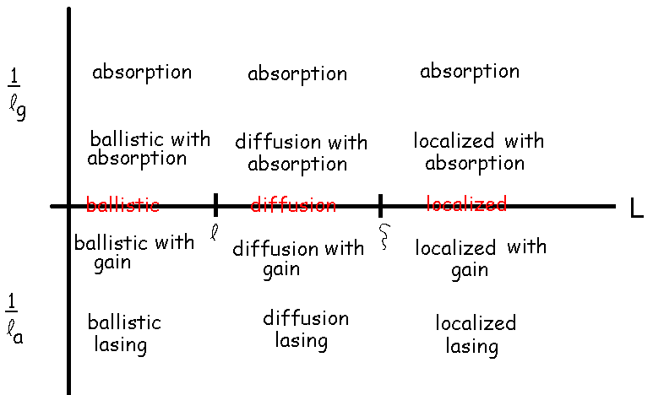
Expected transport behavior regimes
only for quasi-1D waveguides with random media
Notes:
At a minimum, the following regimes are expected. How to draw distinctions between regimes?

Slide 20
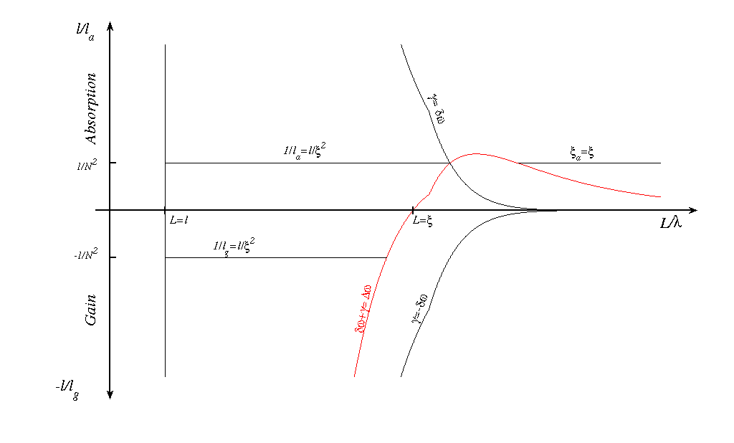
Boundaries
Characteristic lengths
Mode widths (modified Thouless criterion)
Notes:
Two types:
- permutations of characteristic lengths
- Modified Thouless/DOS widths

Slide 21
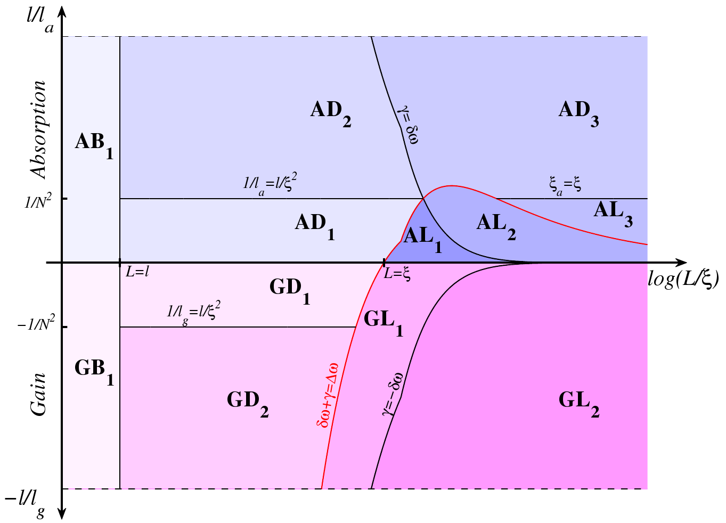
AL-diffusion transitions in
non-conservative random media
L
Gain/Absorption + Ballistic/Diffiusion/Localization

Slide 22
Recap
A criterion for the AL-diffusion transition in active random media is sought
Current passive criteria are not applicable
Numerical models have been developed for 1D and quasi-1D wave transport
A two parameter plot outlines various transport behavior and the boundaries

Slide 25
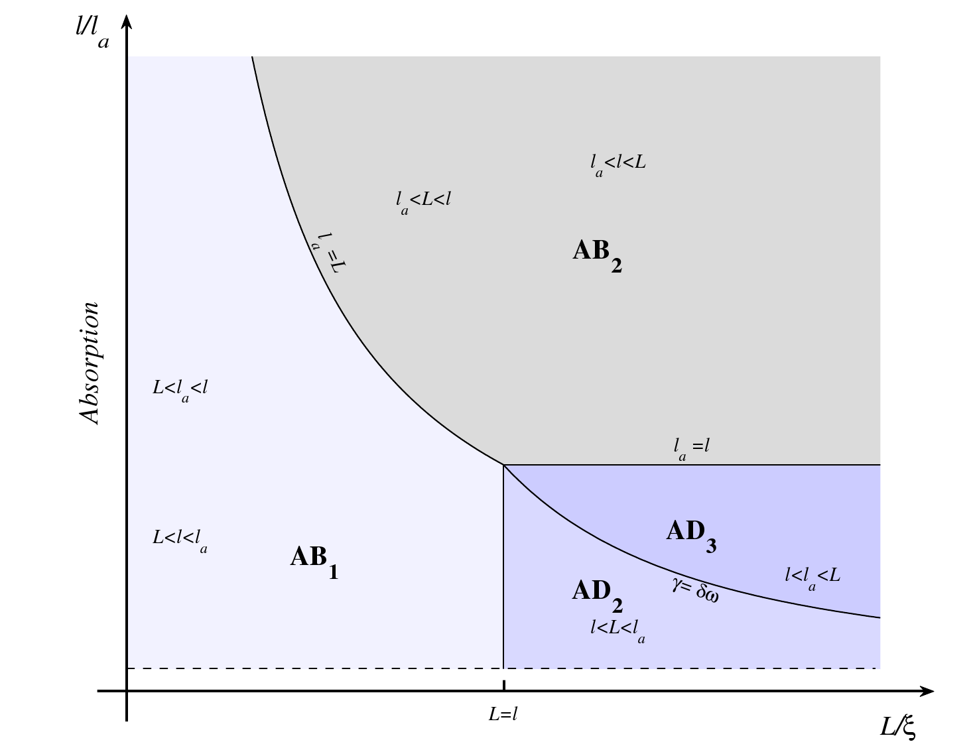

Slide 26
