Slide 1

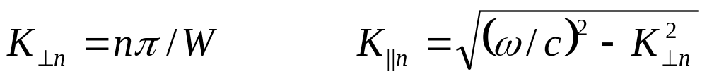
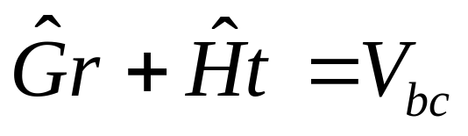
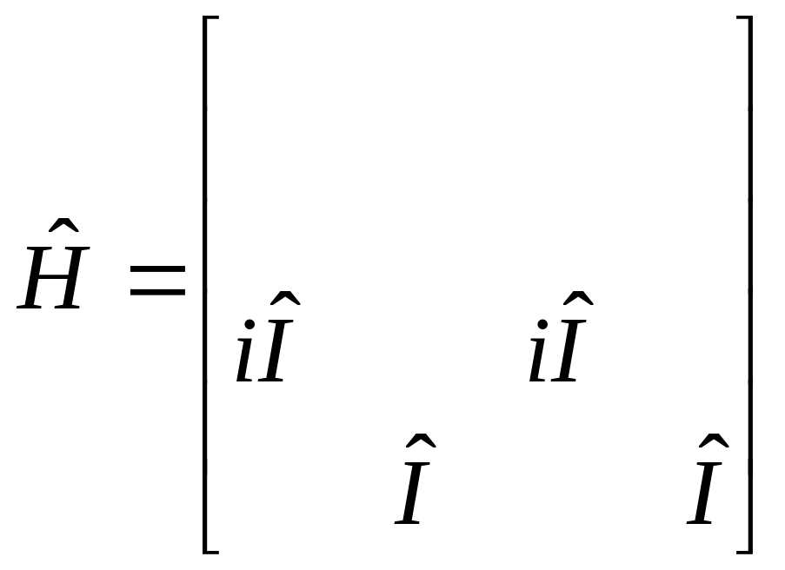
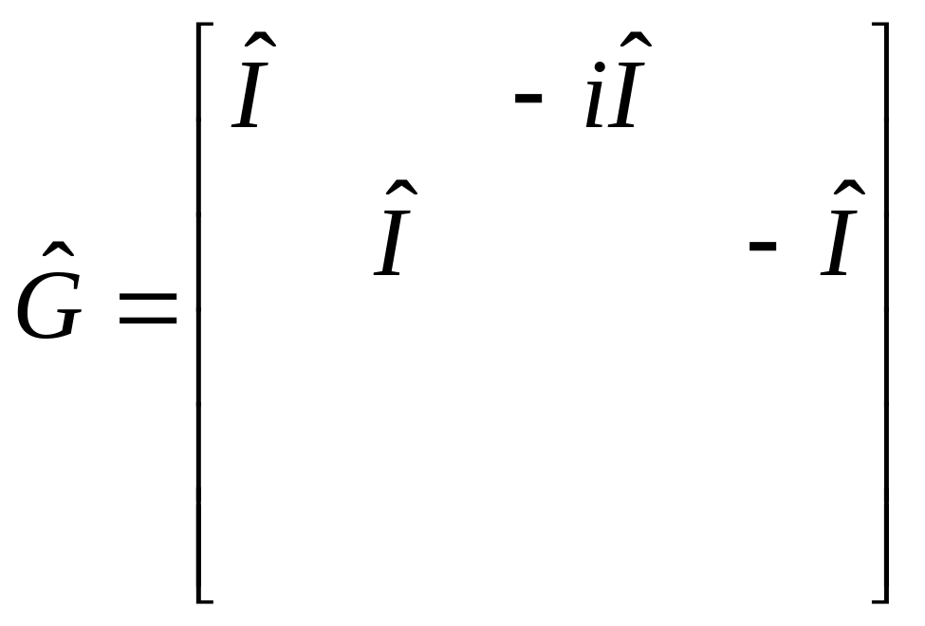
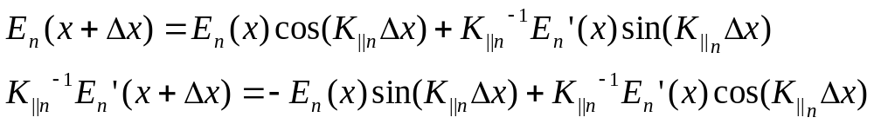
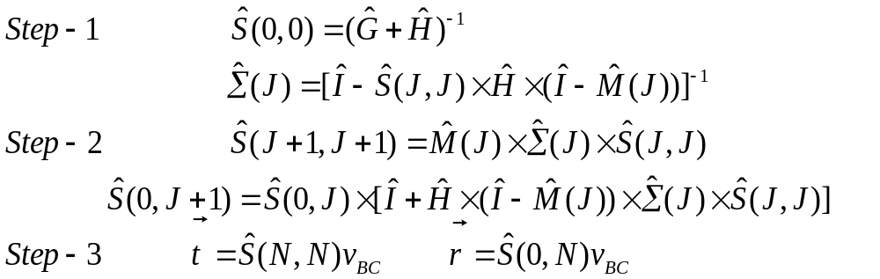
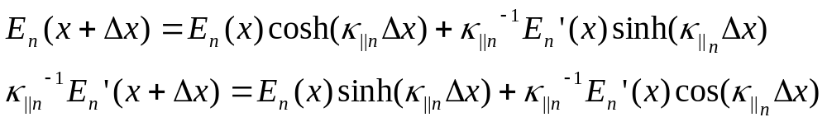
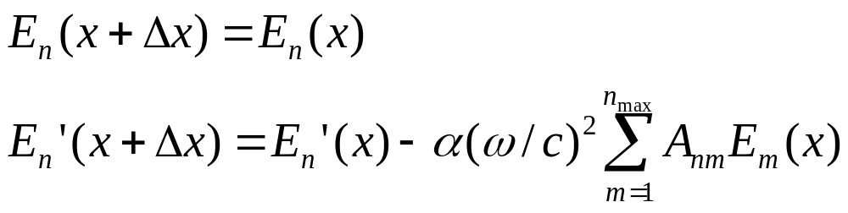
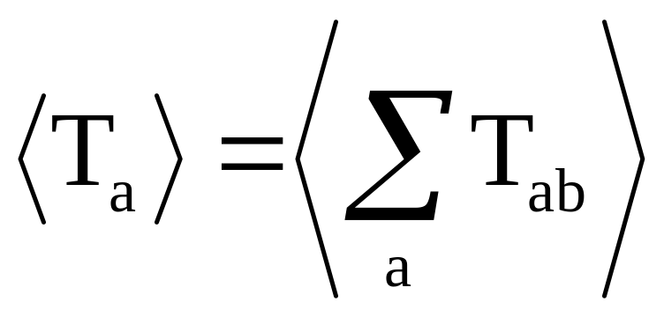
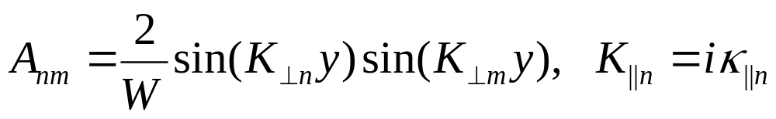
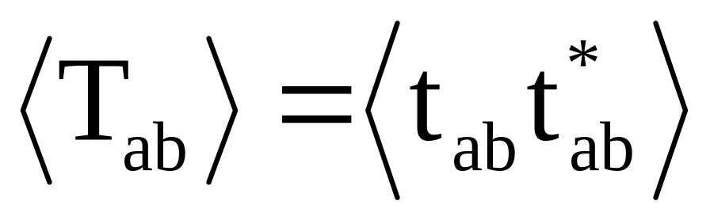
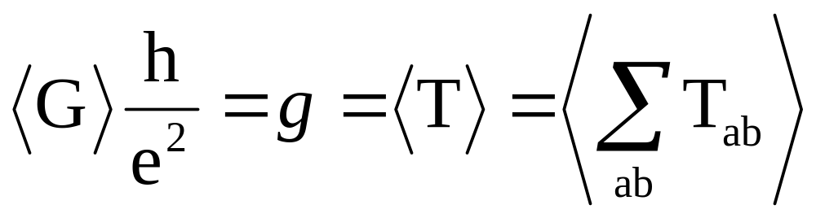
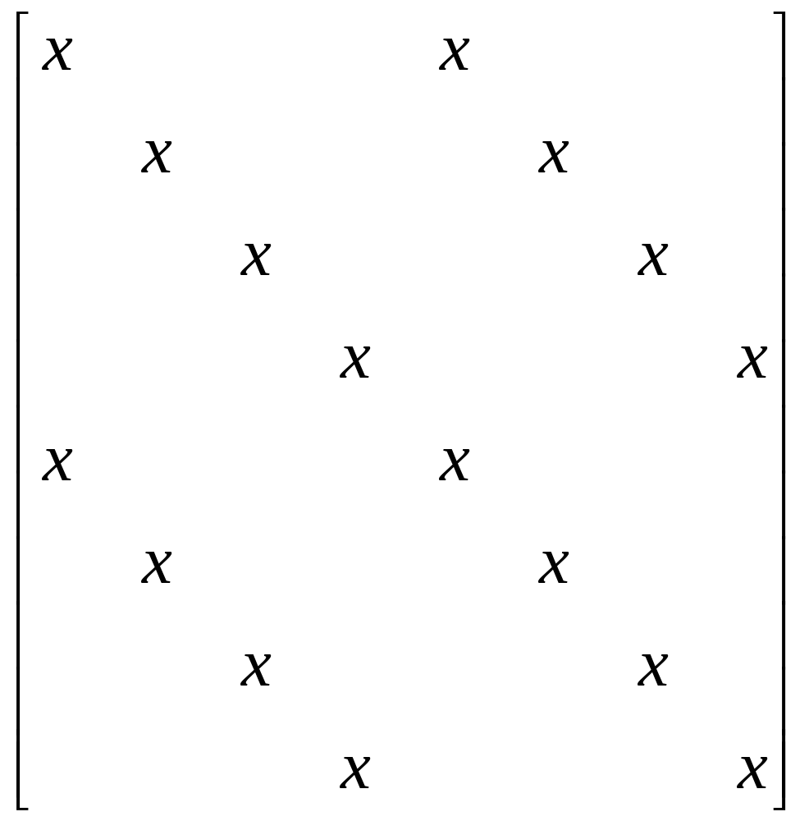
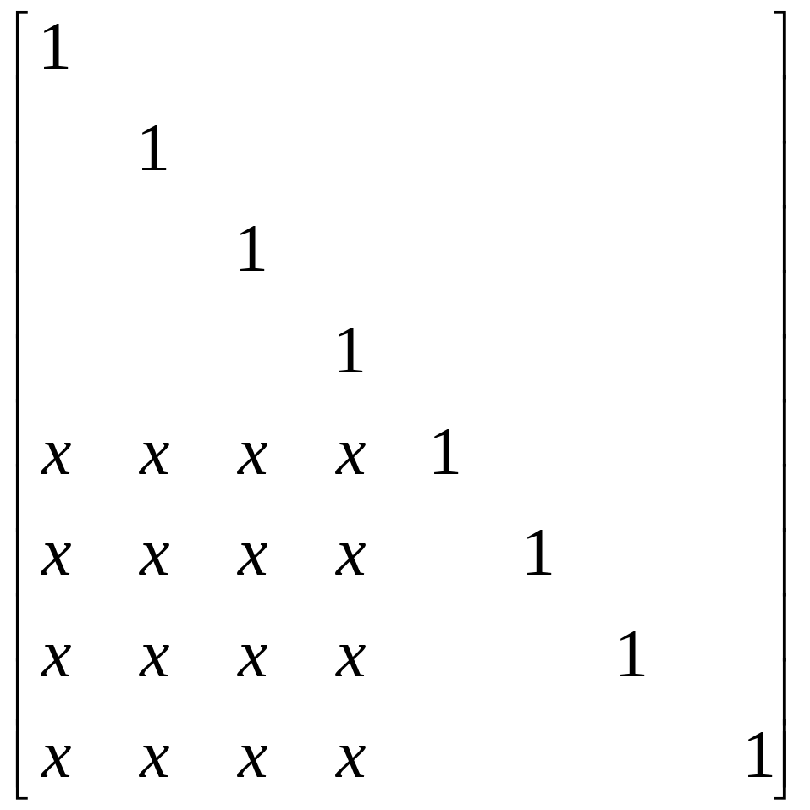
Numerical Simulation of Wave Propagation
through Quasi-1D Random Scattering Medium
Jeffrey Jau and Alexey Yamilov
Department of Physics, University of Missouri Rolla
Abstract
Transfer-Matrix Formalism
Self-Embedding Ansatz
Mesoscopic metal wire and disordered optical waveguide are two examples of quasi-1D random scattering media. The goal of this project is to develop a flexible numerical code for examining wave transport through the random media. Evolution of electric field from the beginning to the end of the system is described with a set of transfer matrices in terms of open and closed channels of the waveguide. To achieve numerical stability we also implement self-embedding procedure. The simulation will run under various regimes of wave transport: from diffusion to Anderson localization. Consistent account of closed channels in our approach will allow to determine the importance of evanescent fields on the statistics of mesoscopic transport.
Channels: The goal of this project is to simulate numerically the propagation of the incident wave as it is being scattered by the randomly positioned scatters. The simulation will keep track of and ensure continuity of the electric field and its first derivative after every disturbance the wave experiences. To find the electric field at and after each scatter, the value of the electric field and its first derivative at previous point was needed. Waveguide geometry leads to discretization of transverse momentum
Due to the numerical instability which arises in the presence of closed channels, computation of simple product of individual matrices is not sufficient. The self-embedding method is introduced to correct any computation error within the simulation. This method consistently corrects any deviation due to rounding on every step of the calculation and insures the accuracy of the final result.
Boundary conditions are written in matrix form:
where W is width of the system, n = 1, 2, …, n_{max.} The total number of channels (n_{max}) is determined based on the desired accuracy of the simulation. From the above equations, we can conclude which channels are open (where the electric fields propagate through space), and which channels are closed (where the electric fields exponentially decay through space – evanescent waves). If K_{||n} is real, the channel is open; if K_{||n} is imaginary, the channel is closed.
Studied System
Construction of propagation matrices:
Free Space Open Channels:
Free Space Closed Channels:
Scatters:
where , and α defines scattering
strength of the scatters.
Thus wave propagation can be described by 2n_{max}X2n_{max} matrices of two types:
Transmission and reflection vectors are related to S matrix that is determined via self-embedding:
We consider wave propagation in two-dimensional disordered waveguide. Quantization of transverse momentum makes system quasi-1D. Transition from diffusive transport to Anderson localization can be achieved by varying system parameters.
Algorithm and Implementation
One can directly compute transmission coefficients:
Parameter definition
Generate random medium
Angular transmission
Total transmission
Generate Matrices
Set frequency
Statistics accumulation
Propagation (Free Space) Matrices
Scattering Matrices
Dimensionless conductance
Self-embedding
Calculate t_{ab} and r_{ab} coefficients
Motivation
In the above formalism only open channels are usually considered. With advances in near-field optical spectroscopy, statistics of evanescent field came into focus. We devise an efficient numerical method that accounts for presence of closed channels that describe evanescent field.
This algorithm permits straightforward generalization to 3D waveguides where one can consider polarization related effects, such as long-range mesoscopic correlations of fields with different polarization.
Code testing
Verify stability of algorithm: energy conservation should be satisfied.
Determine the range of physical parameters.
Accumulate large ensemble of transmission and reflection coefficients and plot the distributions of various transport coefficients. Compare to known results in limiting situations.
where x’s denote non-zero terms, that are not necessarily the same. Matrices are separated into four n_{max}Xn_{max} quadrants each containing information from open and closed channels.

