Slide 1
Localization criteria
18 October 2008
Yale University
Notes:
Conventions:
Font = Times new roman
Titles =40 pt
Text = 20 pt
Leave a boarder around each slide

Slide 2
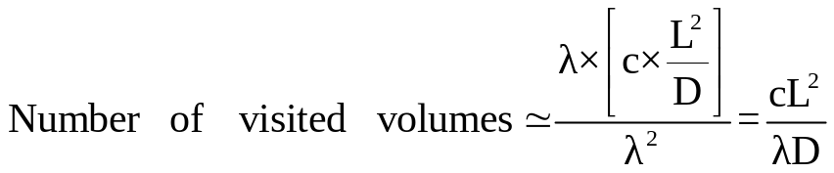
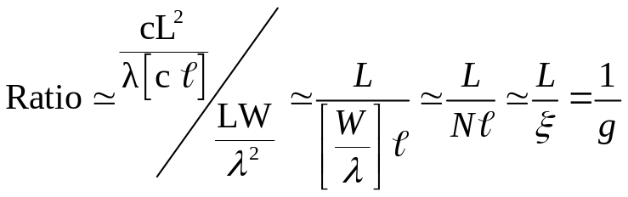
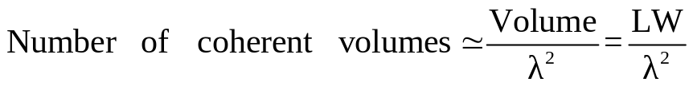

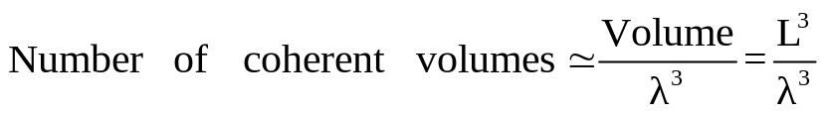
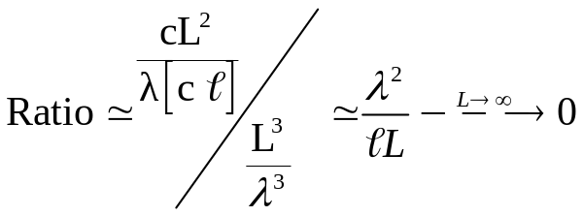
Ioffe-Regel Criterion
Waveguide
(quasi-1D)
Probability of loops approaches 1
when ξ~L or g~1
Slab
(3D)
Diffusive system remains
diffusive
To destroy random-walk
propagation, very strong
scattering is needed
Ioffe-Regel Criterion: k l ~ 1
Ioffe & Regel, Prog. Semicond. 4, 237(1960)

Slide 3
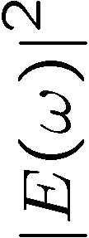
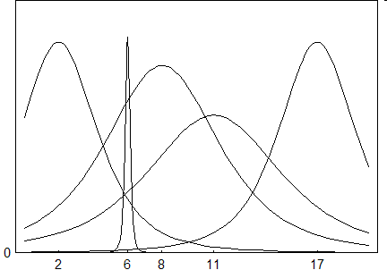
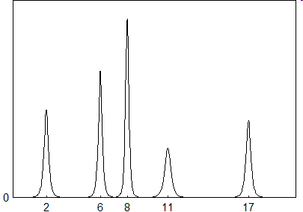
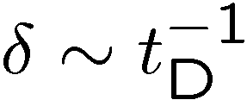

Thouless Criterion
Diffuse regime:
Localized regime:
The spectrum is continuous
There are many modes
Thouless, Phys. Rev.Lett. 39, 1167(1977)

Slide 4

Experimental manifestation of localization
Diffuse regime
Localized regime
Exponential decrease of the average transmission as a function of L
An increase of fluctuations in transmission
Non-exponential time decay of transmission
Chabanov … Genack, Nature 404, 850 (2000)
Aegerter … Maret, J. Opt. Soc. Am. A 24, A25 (2007)

Slide 5
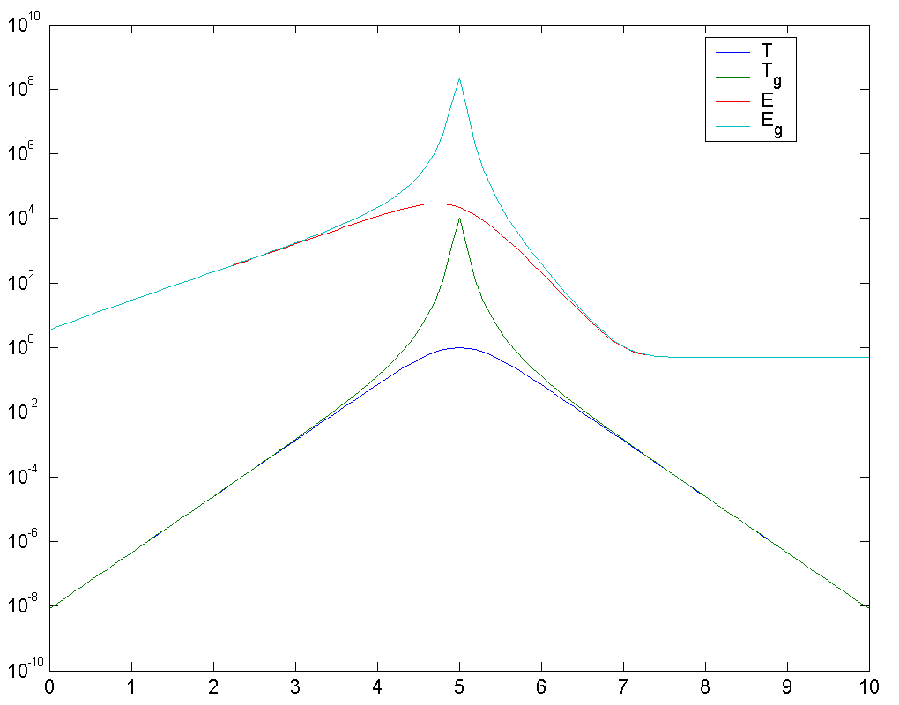
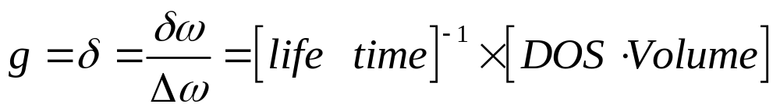
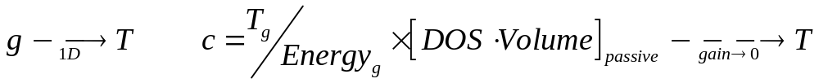
Localization in random medium with gain
Criterion should not be divergent
Criterion should agree with known criteria when gain vanishes
We can look at the average value or the fluctuation of c
Notes:
The list is by no means exhaustive. S. John’s prediction of localization in periodic photonic crystals is not shown.

Slide 7

Effect of closed channels on statistics of mesoscopic transport in Quasi 1D random medium
Tom Mahler, Ben Payne, Alexey Yamilov
18 October 2008
Yale University
Notes:
Conventions:
Font = Times new roman
Titles =40 pt
Text = 20 pt
Leave a boarder around each slide

Slide 8
Motivation
Q1D is usually described only in terms of open waveguide channels, whereas the evanescent (closed) ones are neglected
Real systems contain an infinite number of closed channels.
It was suggested their effect on the light propagation is can be essential (e.g. when new channels open)
It is important assess the effect of closed channels on statistical properties of transmission (may be crucial in random media with gain)
We show the effect of closed channels is quantitative and not qualitative
We demonstrate how to properly account for the closed channels

Slide 9
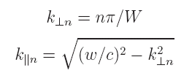
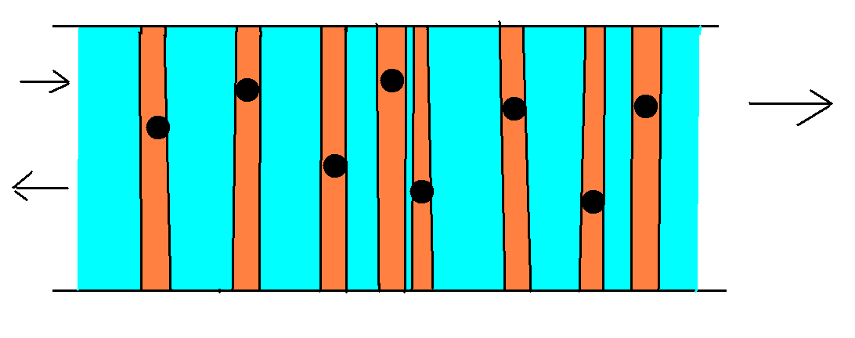

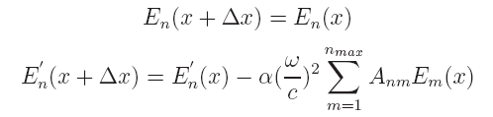
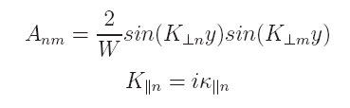
Numerical simulation overview
Quantization of transverse momentum allows for the simplification of this two-dimensional system to a one-dimensional system referred to as quasi-1D
Models an arbitrary number of randomly placed point scatterers in a quasi-1D optical waveguide
The electric field is described throughout the system for both the free space (blue) and scattering events (orange)

Slide 10
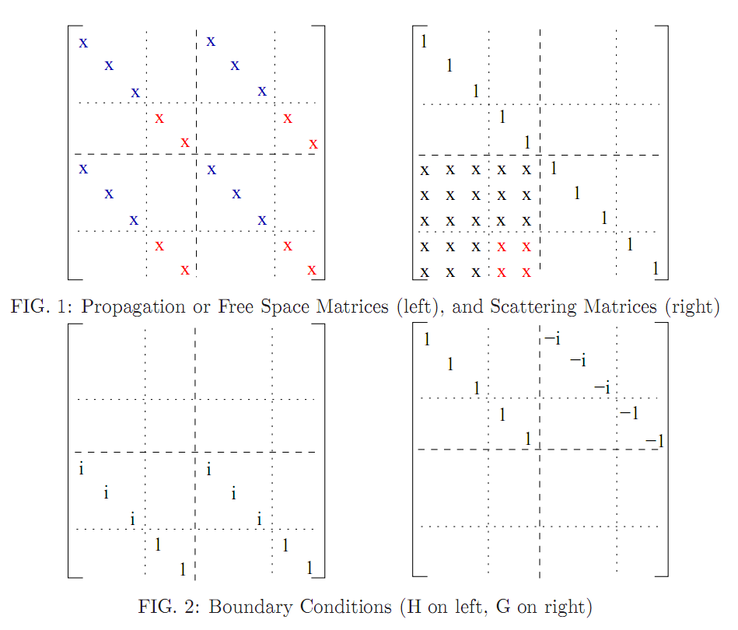
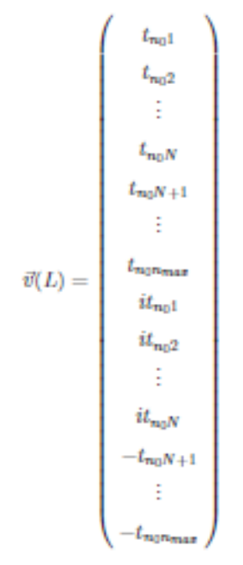
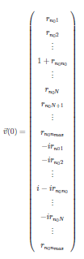
Self embedding algorithm
  A set of transfer matrices (Free Space and Scattering) propagates the electric field for the whole system
  These matrices are used to calculate the transmission and reflectance coefficients matrices
To control numerical error we implemented self-embedding procedure:
  (A*B*A*B*A*B)SE(A*B*A*B*A*B)SE(…

Slide 11


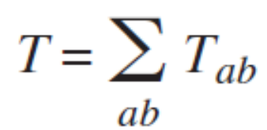
Input/output parameters
Input:
Number of open, closed channels
System length
Transport mean free path (via scatterer density and strength)
Incident wavelength
Number of realizations
Direct output:
Reflection matrix
Transmission matrix
After post-processing:
Angular transmission coefficient
Transmission coefficient
Conductance

Slide 12
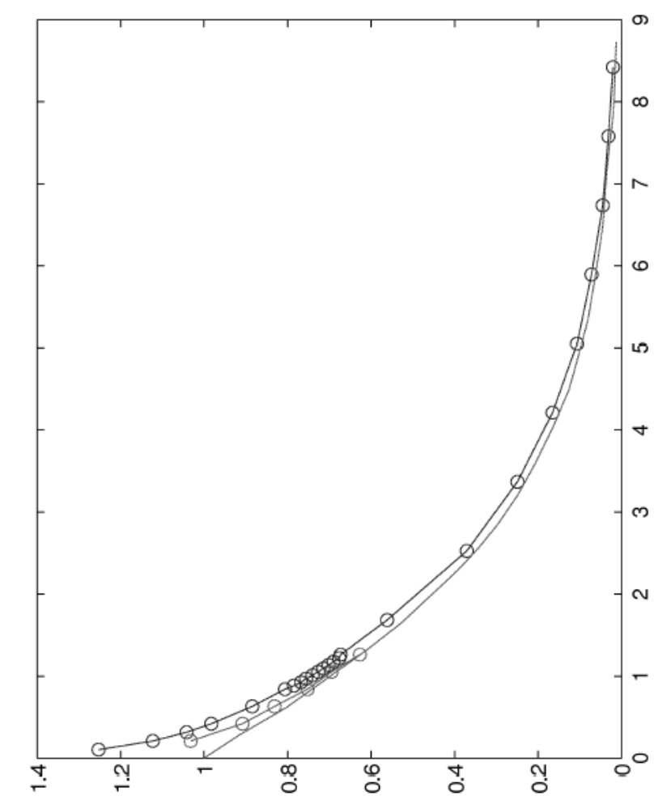
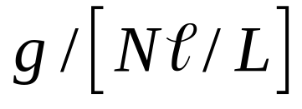

Average conductance vs size
Diffusion
Localization

Slide 13
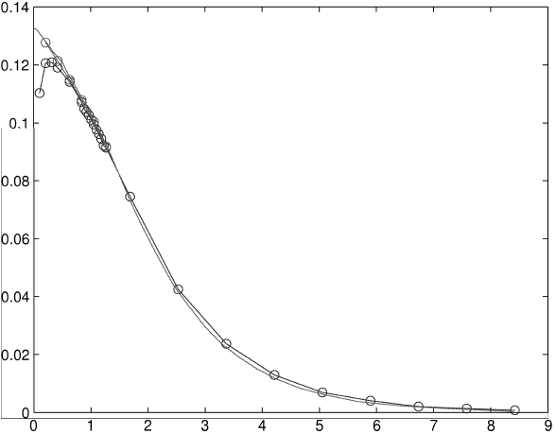

Variance of conductance vs size
Diffusion
Localization

Slide 14
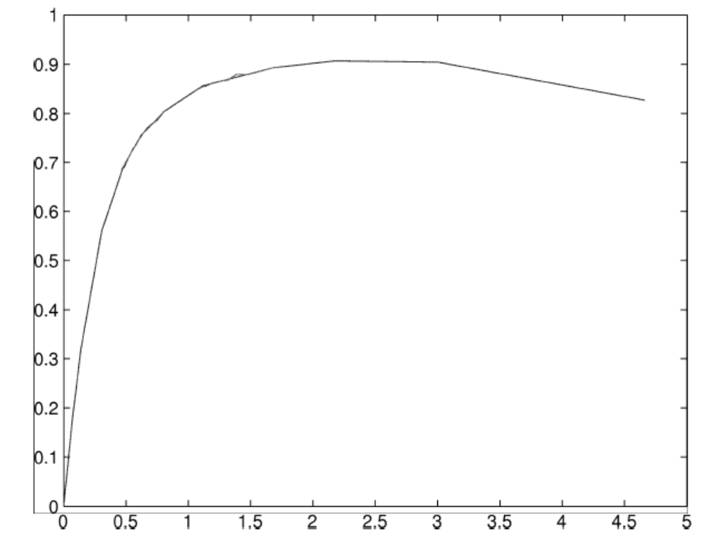
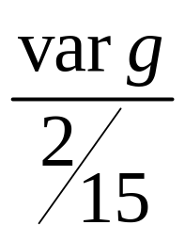

Effect of closed channels
Diffusion
Localization

Slide 15
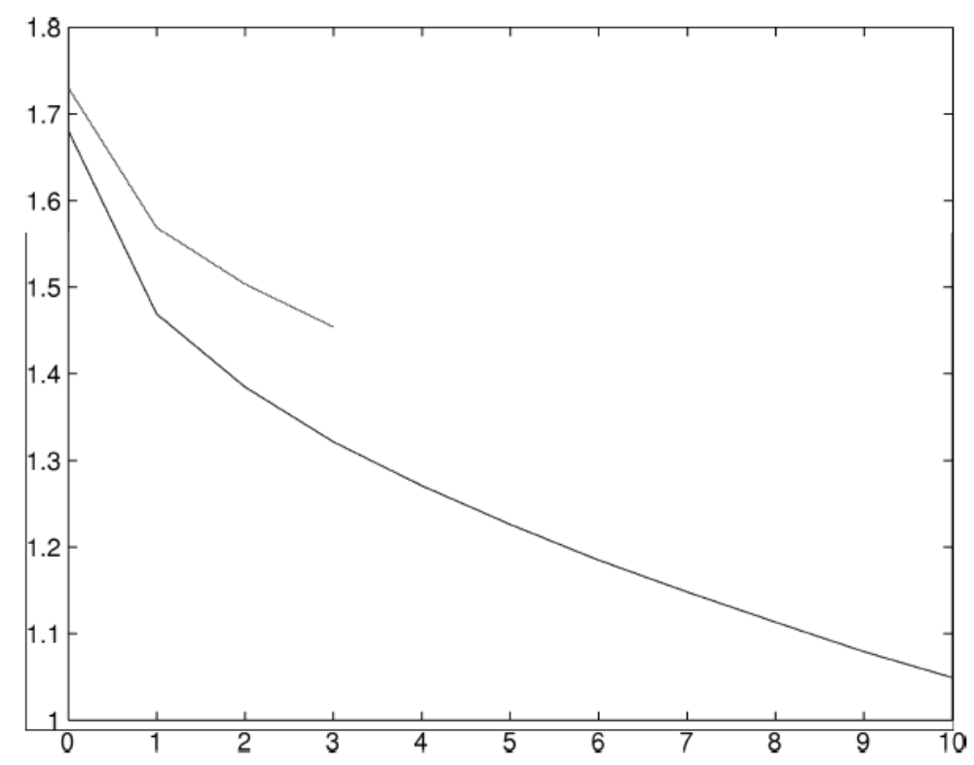
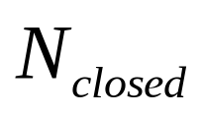
Average conductance vs size
Diffusion
Localization

Slide 16
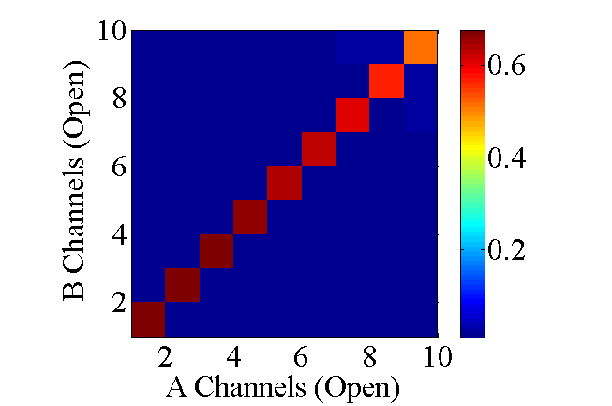
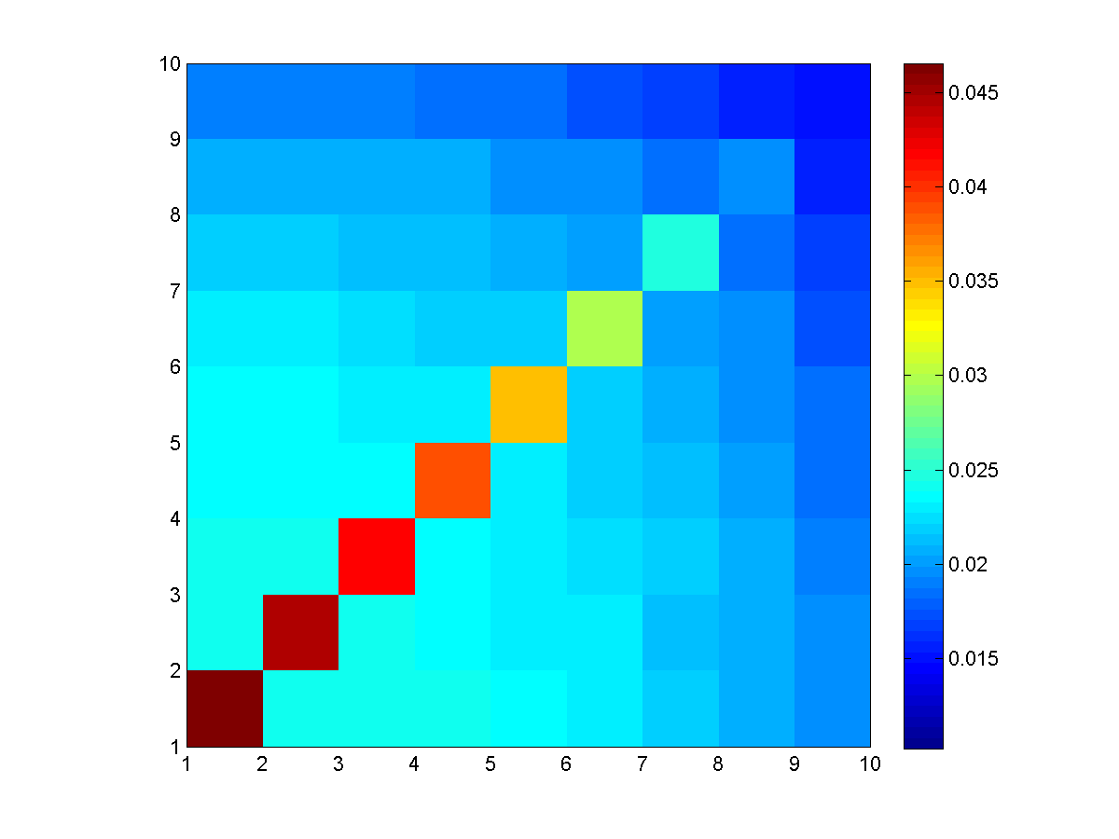
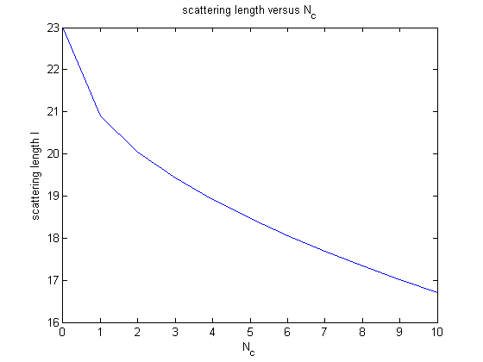
Scattering Length
The matrix shows the average scattering of the open channels into each other
Weak scattering left
Strong scattering right
The scattering lengths of each open channel are calculated and average for systems containing different numbers of closed channels

Slide 17
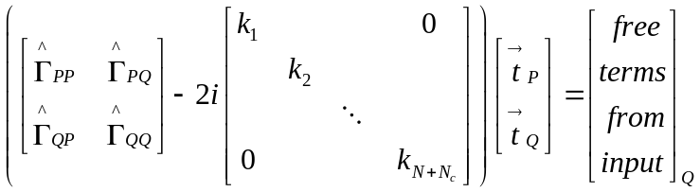
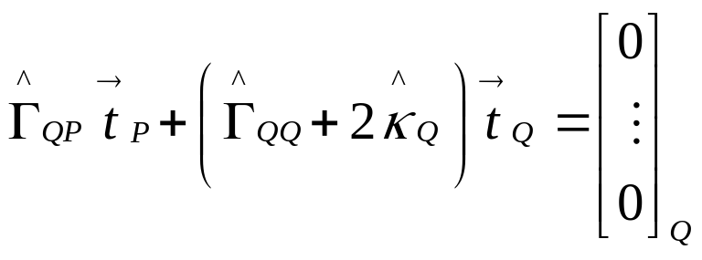
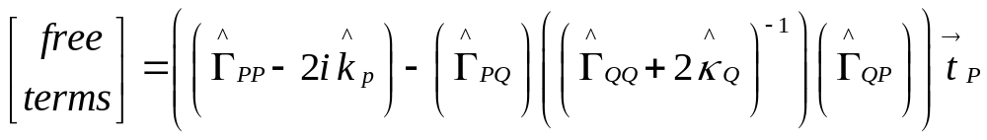
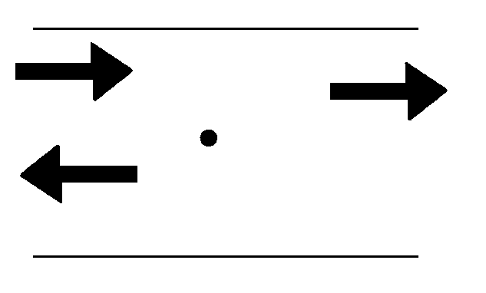
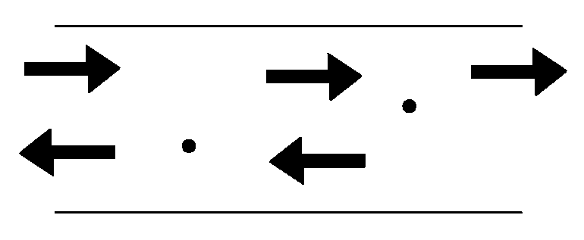
Analytical single/double scatterer
Based on calculations from Bagwell, Mello & Kumar

Slide 18
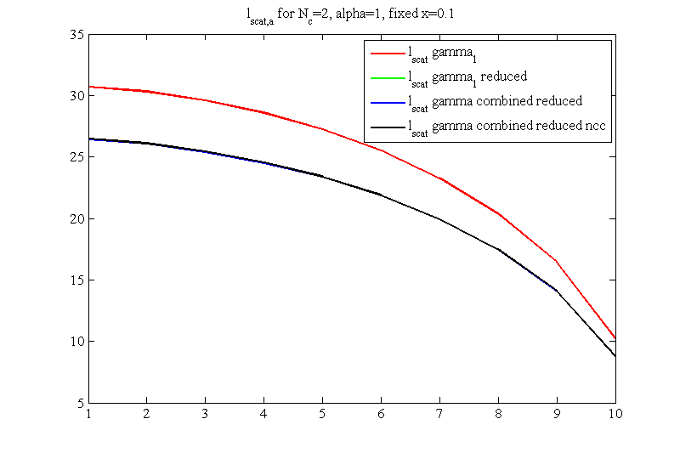
Closed Channel Folding
Notes:
Picture is from
P:\quasi1D analytical models\comparison with numerical sim\

Slide 19
Conclusions
Including closed channels is statistically equivalent to increasing system size
Transport mean free path can be renormalized to account for presence of closed channels
Transport mean free path decreases with increasing number of closed channels
Eliminating (by renormalization) MFP leads to significant increase of numerical accuracy and efficiency

Slide 21
Relation between channel and spatial mesoscopic correlations in volume-disordered waveguides
Alexey Yamilov
18 October 2008
Yale University
Yamilov, Phys. Rev. B 78, 045104 (2008)
Notes:
Conventions:
Font = Times new roman
Titles =40 pt
Text = 20 pt
Leave a boarder around each slide

Slide 22
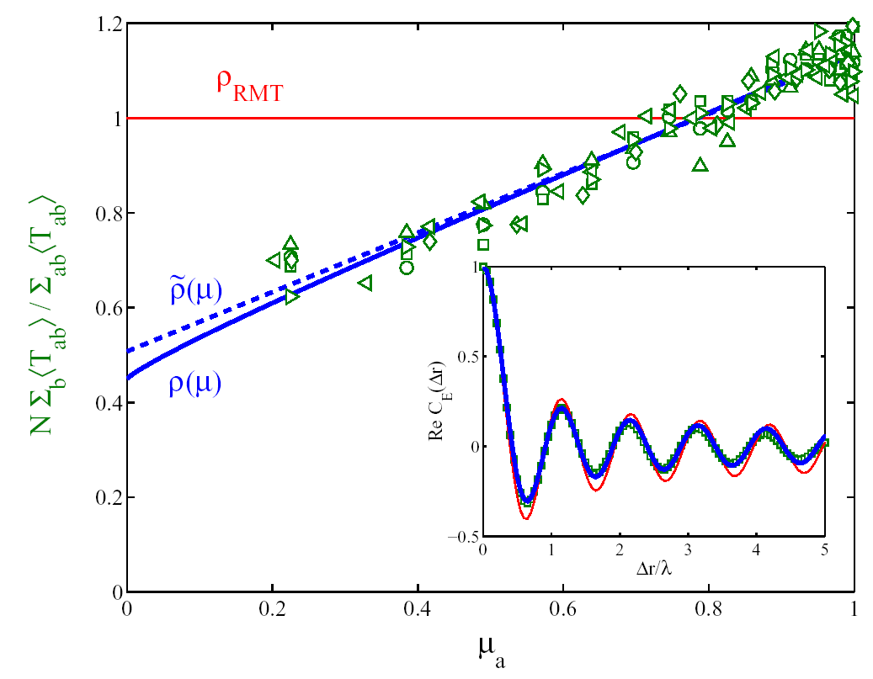
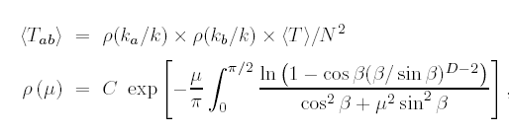

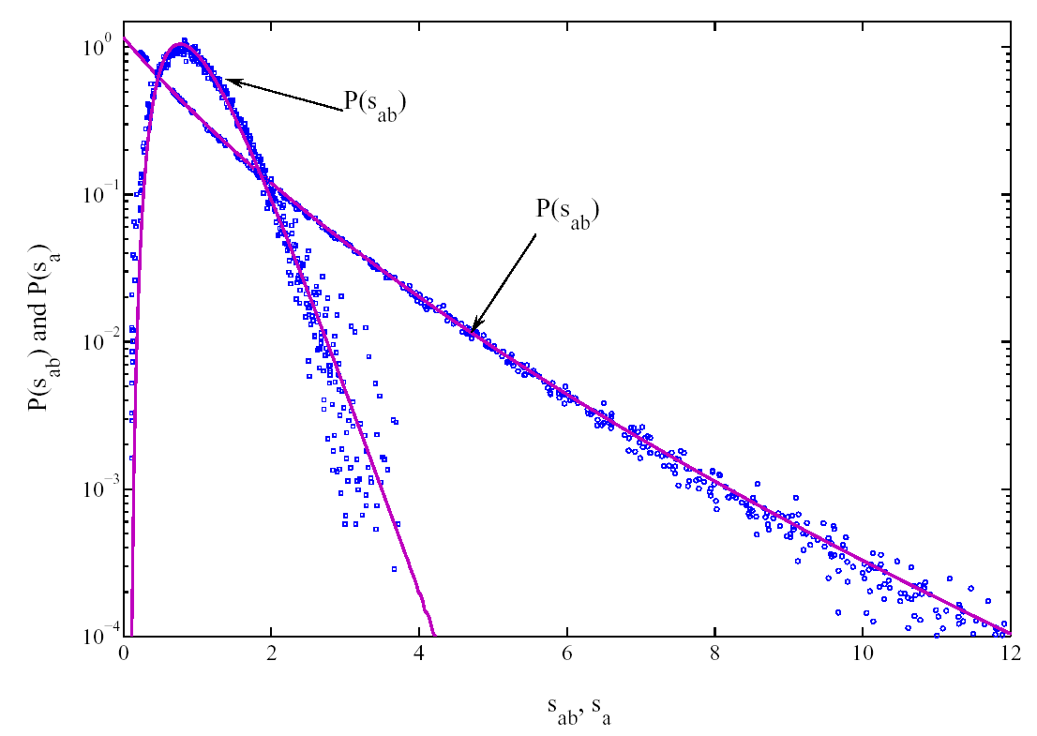

On validity of equivalent channel approximation
Strong angular anisotropy describes by Chandrasekhar function without adjustable parameters
Surface
escape function makes channels
not equivalent
k_{||a}
When comparing experiments with DMPK,
it has been customary to associate
with from DMPK
Yes
Are statistically equivalent?

Slide 23
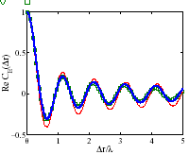
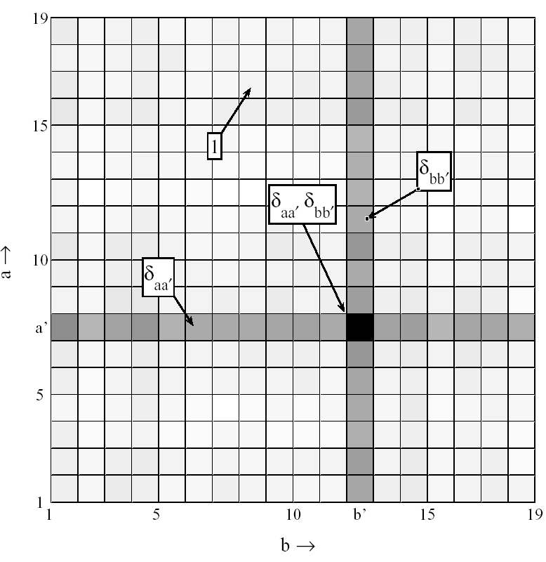
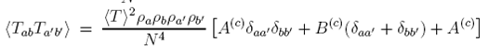
Correlations reconciled
Multiplication by is sufficient to recover proper channel-channel field and intensity correla-tions:
Correlations depend on the dimen-sionality of waveguide (through ρ_{a})
Spatial correlations follow from the channel ones

Slide 24
Correlations reconciled
Multiplication by is sufficient to recover proper channel-channel field and intensity correla-tions:
Correlations depend on the dimen-sionality of waveguide (through ρ_{a})
Spatial correlations follow from the channel ones

Slide 26
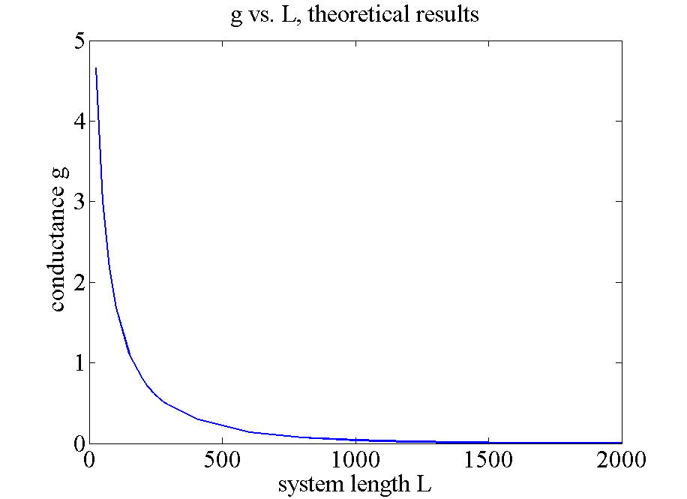
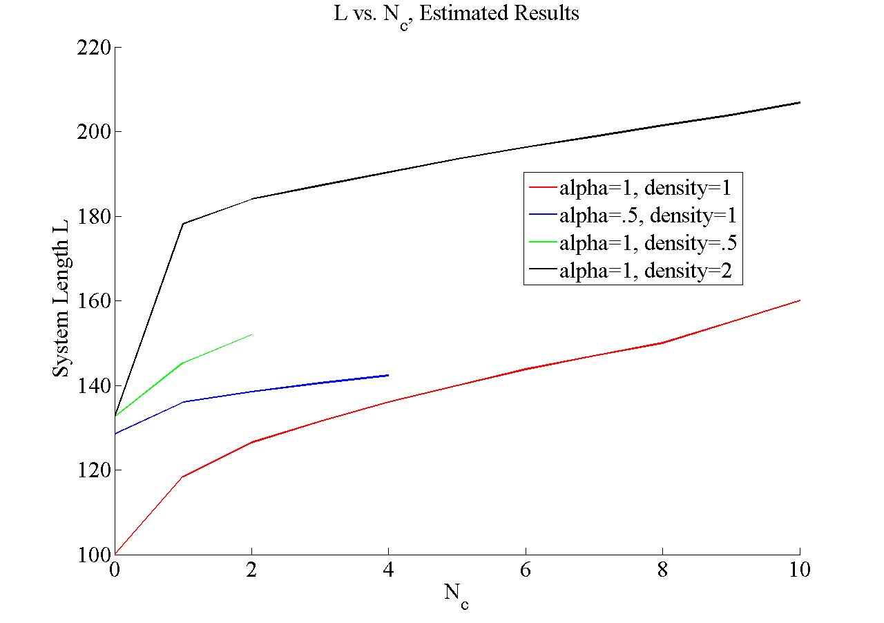
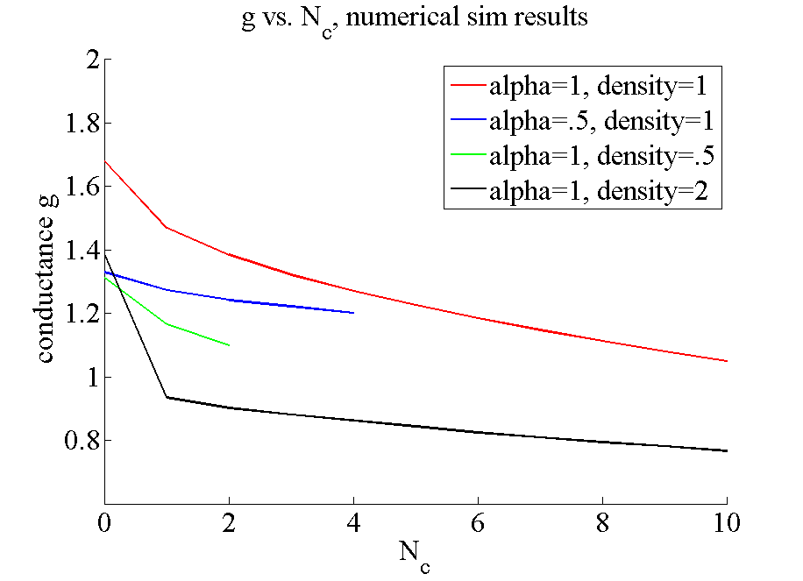
conductivity
How to get conductivity:
  Numerical sim: Using the transmission matrix
  Analytical: no conductivity
Numerical sim results
Theoretical results
Increasing number of closed channels correlates to longer system length

