Slide 1

Research opportunity: diffusive waveguides
Ben Payne
ben.is.located@gmail.com
Dr Yamilov
yamilov@mst.edu

Slide 2
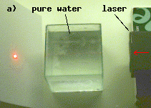
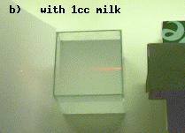
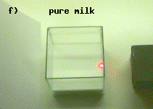
What is diffusion?
Wavelength λ Mean free paths l Localization length ξ
Waveguide
(quasi-1D)
Size L of the medium
Ballistic propagation
(no scattering)
Single scattering
Multiple scattering
(diffusion)
Strong (Anderson)
localization
http://omlc.ogi.edu/

Slide 3
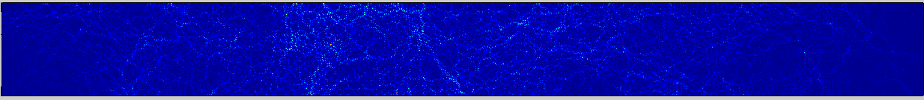
What we do
Waveguides are used to study light transmission and propagation
Maxwell's equations describe process
We can observe the electric field inside

Slide 4
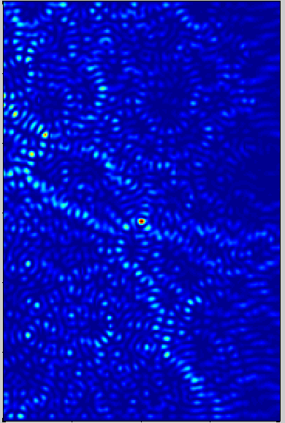
What we want to do
By varying input beam, the light can be “focused” to a single point
The desired focus location is located inside the medium

Slide 5
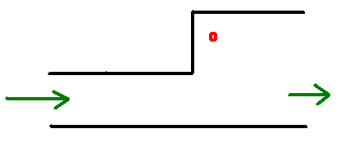
What we want to do
The desired focus location can be out of line of sight (“around the corner”)
Programing
$ available: scholarship, pay
Questions?

