Slide 1
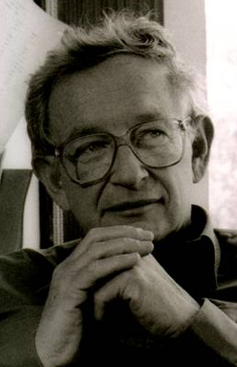


1D and quasi-1D waveguide model development and results
Dr. Yamilov’s
Random Active Scatterer Emission Research (R.A.S.E.R.) Group
very few believed [localization] at the time, and even fewer saw its importance, among those who failed to fully understand it at first was certainly its author. It has yet to receive adequate mathematical treatment, and
one has to resort to the indignity of numerical simulations to settle even the simplest questions about it."
P.W. Anderson, Nobel Lecture, 1977
Notes:
First presented to Dr Yamilov and Sumudu @ MST, 20090915
http://www.andersonlocalization.com/historyal50.php

Slide 2
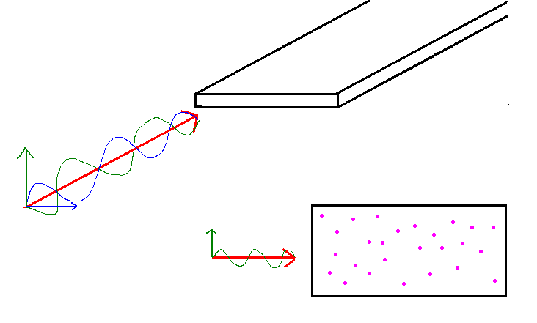
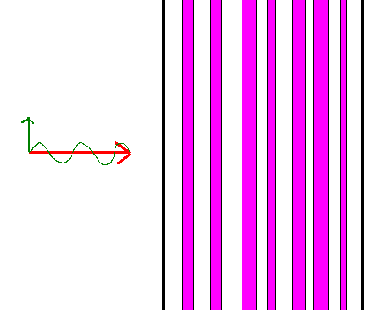
What is this talk going to cover?
Motivation: characterization of light propagation in waveguides with randomly placed scatterers
  when is Anderson Localization occurring?
what is physically going on in the waveguide?
  What is 1D, quasi-1D?

Slide 3
What is being described?
Model propagation of light through a metallic waveguide
Mathematically, use transfer matrices and Maxwell's equations
L
W
L
1D: stack of glass plates quasi-1D: plane w/ boundaries
Notes:
These pictures are from Ben's /research/what I do/pictures

Slide 4
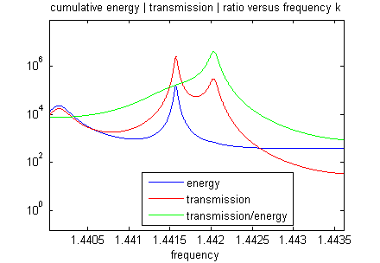
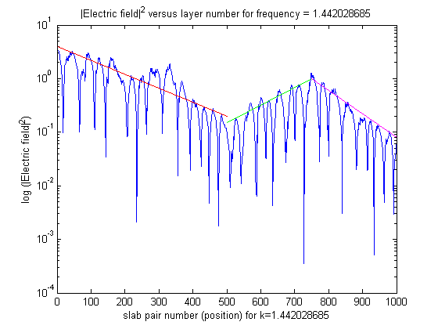
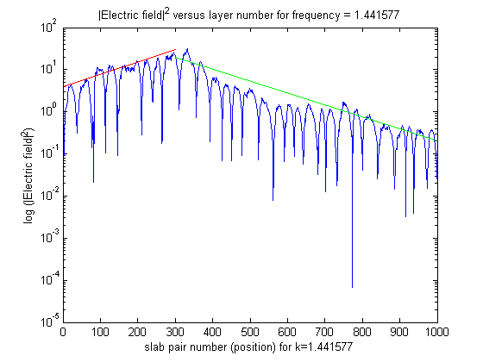
What is the simplest model? 1D
Alternating layers of dielectric material
shine light, measure responses
  (T, R, interior field)
Results:

Slide 5
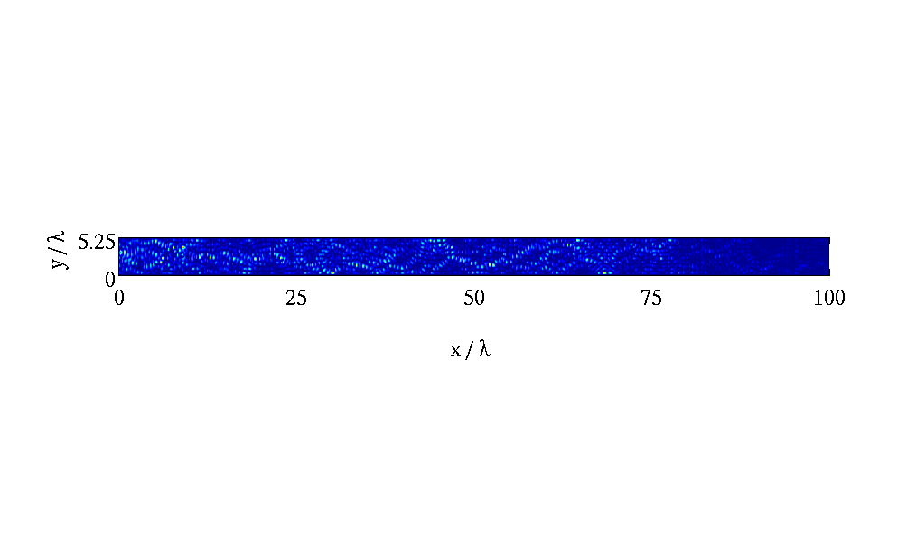
Increase complexity: quasi1D
[progressing towards the goal of 3D]
Point scatterers instead of layers of dielectric
Still able to observe Electric field inside
Scatterers can be passive or active
Results in more calculations, longer to compute

Slide 6
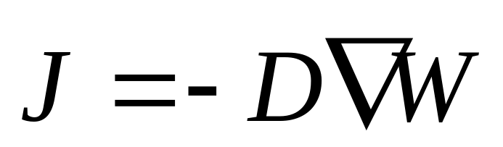
Why diffusive waveguides?
Collaboration on diffusion with Skipetrov
Resulting in interesting insights
  Plane wave versus unit flux
  Effects of boundary conditions
Notes:
Need more content

Slide 7
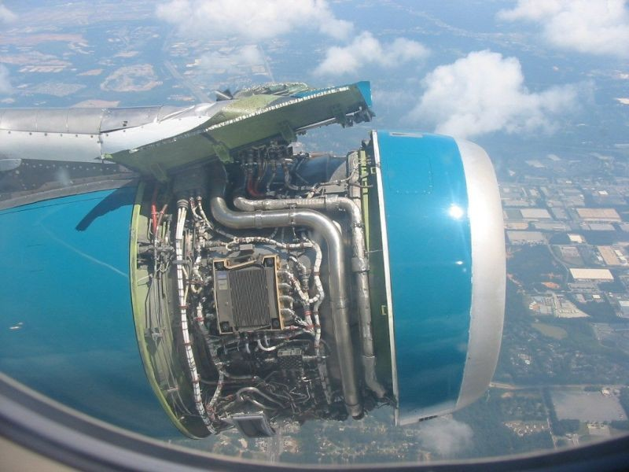
Notes:
If you didn’t understand the prior material in this talk, this is a great analogy for what we can do using the numerical models: in-flight analysis of the operation

Slide 8
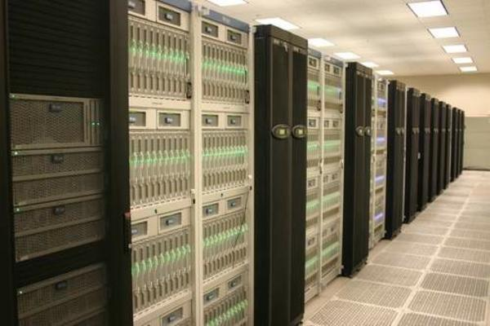
Tools we use
Fortran 90
MPIF90
Matlab
Mathematica
SVN
OS: Ubuntu,
Windows XP
WinSCP/Putty
MST NIC
TeraGrid: Ranger
Google Groups
Notes:
The purpose of this slide is to introduce some jargon related to how we get our work done
http://www.top500.org/files/imagecache/gallery/files/systems/tacc.jpg

Slide 9
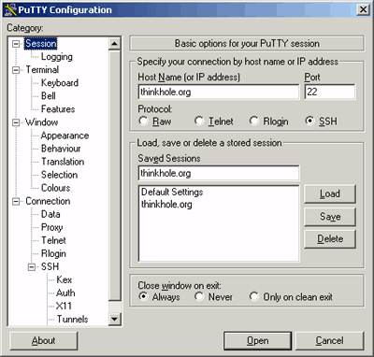
How to get started?
Windows: need local administrator rights
Install Matlab, Mathematica (IT Helpdesk)
Add account to SVN server (Dr Yamilov)
Install gfortran, Tortoise/kdesvn, WinSCP, Putty
Add email to google groups list

Slide 10
New member tips
9am Tuesday group meeting
Before analyzing large data sets, test a small sample
Mathematica on Linux: numlock OFF
Dr Yamilov = room 117, Ben = room 220
Computers available in SPS, 211, CLC

Slide 11
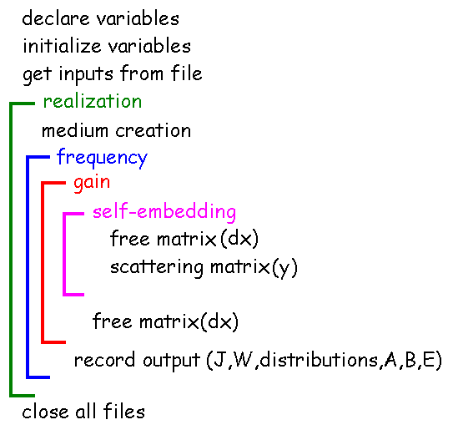
Quasi-1D Code overview

Slide 12
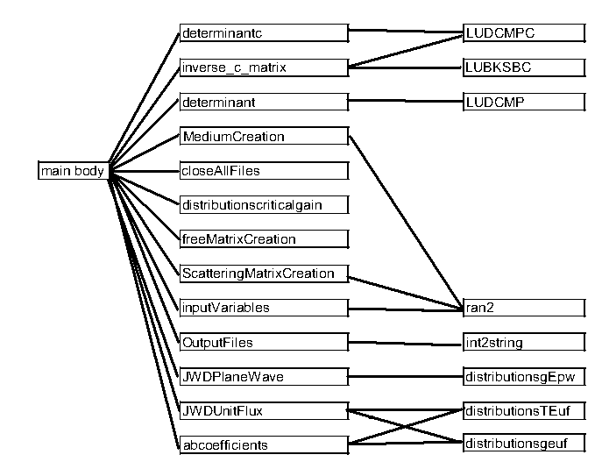
dependencies

