Slide 1
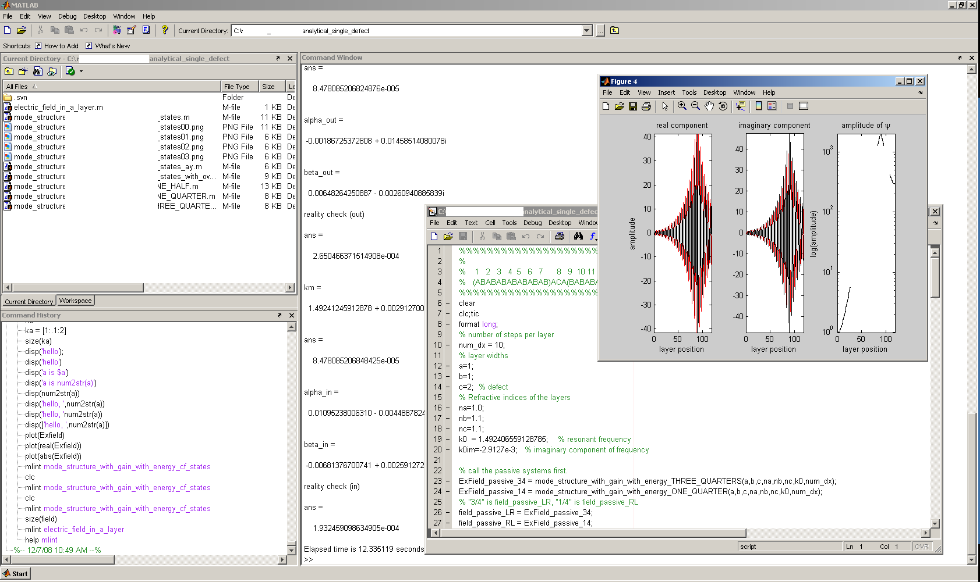
Matlab tutorial
See also
http://131.151.77.11/mediawiki/index.php/Matlab_tips
Free alternative: octave
http://homepages.nyu.edu/~kpl2/dsts6/octaveTutorial.html

Slide 2
What is going to be covered?
Why use matlab
  Linear algebra (vectors and matrices)
  Publication-quality plots
  Cross-platform support (Windows, Linux)
Scalars, vectors, matrices
Plotting
File Input Output
Tips and tricks

Slide 3
I'll take “scalars and vectors” for $400
Scalars:
  4+5=9
  a+b=c
Vectors:
  [x y z]; [x; y; z];
  A = [x y z]; B = [p m n]; A+B
  g*A, A.^2
  sum(A)
    Sum, sort, max, min,size
Notes:
Scalars are treated as one would expect
Symbolic math is not part of matlab's basic features, so “a+b=c” is not a valid statement unless a,b are defined
To suppress output, include a “;”
Vectors: column versus row
Assigning vectors to variables
Vector addition, scalar multiplication
Sum, sort, max, min act as expected

Slide 4
Matrices are not scary
Until you take linear algebra, think of matrices as a box of number with very specific rules
A=[4 5; 2 1]; B=[3 1; 4 1];
A(1,2) = element in row 1, column 2
A*B versus A.*B

Slide 5
Visualization: plot, plot3, surf, pcolor
x=[1:.1:10];
y=sin(2*x);
plot(x,y)
graf3d
hndlgraf

Slide 6
For i=1, print loop, end
% single instance:
disp('hello')
% looped:
for i=1:5
disp('hello')
end

Slide 7
FileIO
raw_data = load('input_file.dat')
size(raw_data)
whos
save
Homework 1: plot E(z,y)
Homework 2: plot abs(E(z,y))^2

Slide 8
Tips and tricks
No declaration or type necessary, but zeroing is good
  A = zeros(3,4); B = eye(4)
To get help for a command,
  Help command
MatLAb is case sensitive
Script and function files end in *.m
File names should not conflict with existing functions
  plot.m

