Slide 1



Affect of closed channels on conductivity
Ben Payne
Alexey Yamilov
Mesoscopic Optics Group
Schearer prize 20091203
Notes:
12 minutes for presentation, 3 minutes for questions
Committee members will ask questions. Tip: plant “unanswered questions” in presentation so that I know what they’ll ask.
Group name suggestion from Dr Silvius:
CMOS: computational Meso. Opt. Squad
AMOK: Advanced Mesoscopic Optics Klan
MOB: Mesoscopic Optics Bureau
SMOG: Superior Mesoscopic Optics Gang
MODE: Mesoscopic Optics
MOAN
MOJO:
MORT: meso. Opt research team
DEMO
SUMO
TOM
TUMOR: team of ultimate meso opt researchers
Note: based on the presentation
/research/quasi1d/quasi1d_paper_FiOS/20091012_FiOS_presentation.ppt
given at Frontiers in Optics, Oct 2009
Schearer prize supporting material is at
131.151.79.133:/media/primary/stuff/mst/schearer_prize

Slide 2
Outline
Transport in metallic waveguides
Inclusion of closed channels affect on mesoscopic transport (gain)
Numerical model of quasi-1D waveguide
Results
  no closed channels
  with closed channels
  affect on distribution of conductance g
How this is done analytically: “folding” transfer matrices
from N_{open} + N_{closed} to N_{open}
Summary
Notes:
Need to verbally say that our ultimate goal is to explore effects of gain. [We are not interested in closed channels as an isolated topic.] To do this, we’ll investigate the statistics of transport, specifically g because of single parameter scaling
Structure:
Title
Outline
Motivation
-cite Bagwell
-cite Mello
-bragging: electric field
-[Markos has electric field in his review article]
Model
-transfer matrices for scattering potential, in this case delta function scatterers
-extend numerical accuracy using self-embedding
Results: Nc: <g> versus var(g) [matches Mirlin]
1) N_c = 0: works in transition regime
2) N_c > 0
Results: shape of distribution of g
How (math)
-folding matrices captures interaction
Summary/Recap

Slide 3
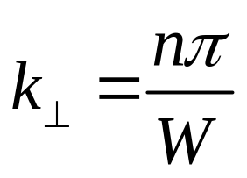
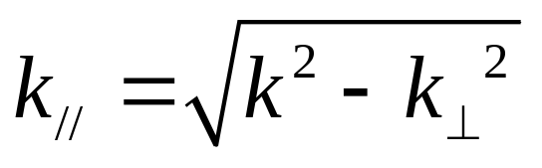
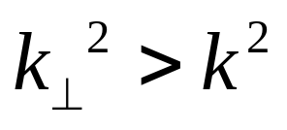
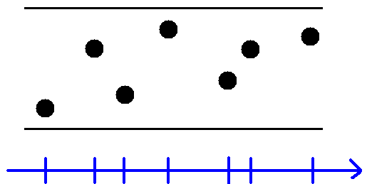
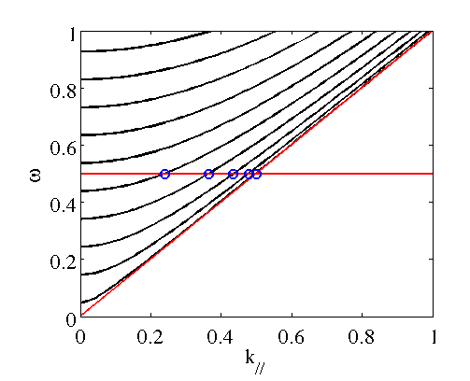
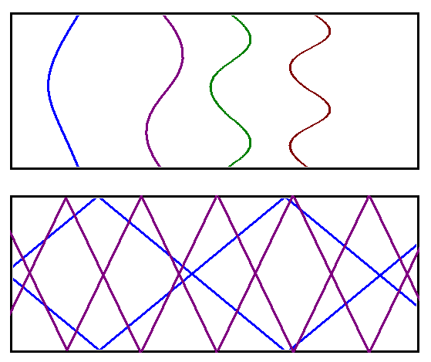
channels = modes = sub-bands
Quasi-1D is useful because transfer matrices describe transport
→ evanescent (“closed”) channels
Notes:
Quasi1D geometry is useful because the quantization of modes means transport can be described by transfer matrices. The quantized field is given by vectors, and propagation is done using matrix operations.
Transfer matrices usually include open channels since “closed channels” are non-propagating modes. However, the phrase “closed channels” only applies to empty waveguides. [Scatterers act as “islands” for transport, as shown by Bagwell.]
→ Praise the success of old methods

Slide 4
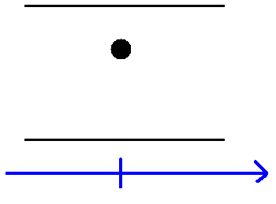
Theoretical assumptions, predictions
Dorokhov, Mello, Pereyra, Kumar assumption: closed channels do not propagate
Mirlin prediction (for N_{c} =0)
<g> vs var(g)
Bagwell studied single scatterer
And these predictions match experiment, which validates assumptions
  l_{tmfp} is a fitting parameter
Mello, Pereyra, Kumar, Ann. of Phys 181 (1988)
Dorokhov, Pisma Zh Eksp Teor Fiz, 36, (1982)
A. Mirlin, Phys. Reports. 326, 259-383 (2000)
P. Bagwell, Phys. Rev B 41, 10354 (1990)
Notes:
Motivation:
-provide relevance
-provide an education background for the audience
-raise the question (which will be answered)
DMPK and Mirlin have general theories, which apply to open channels. Bagwell and Heinrich offer adjustments for accounting for evancescent modes.
Bagwell's paper is for a single scatterer. Thus, the results only apply to scattering length (not transport mean free path, which is a multiple scatterer phenomenon).
Conclusion: a single scatterer can be folded. Closed channels have an effect on scattering length
keywords: theoretical, single scatterer, delta function, point scatterers, transfer matrices, electronic sytems, attractive and repulsive scatterers
Heinrich: Anderson model, closed channels have an effect on scattering length
Mello (2007) also studied single scatterer. Mention Bagwell because he was first.
Presentation tip: spell out abbreviations on the slide, then one can verbally say “DMPK” without confusion for the audience

Slide 5
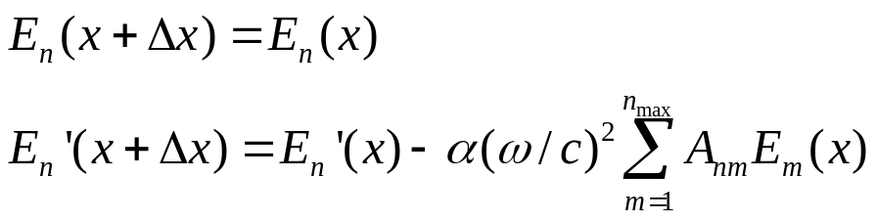
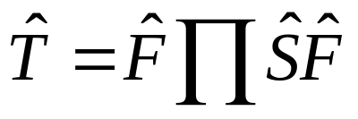
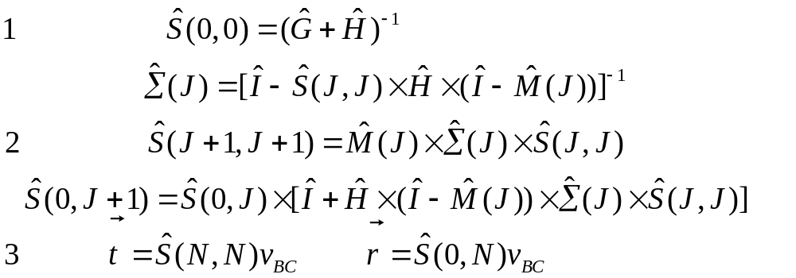
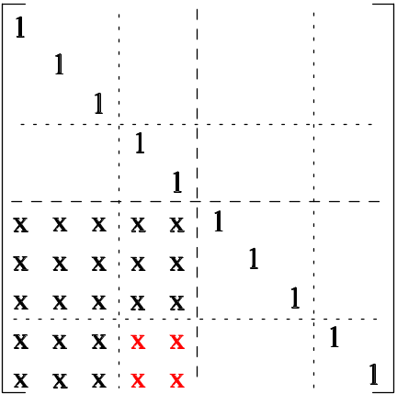
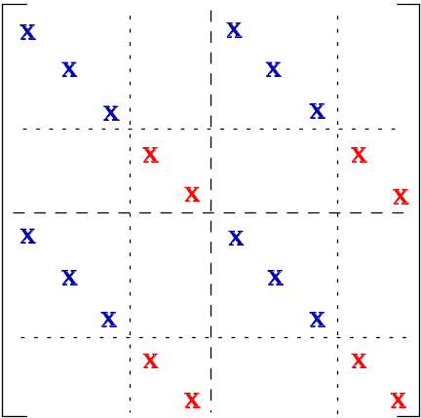
Numerical model overview
Quasi1D planar metallic waveguide
randomly placed scattering potentials
Maxwell's equations
Finite number of open and closed channels
Numerical accuracy extended
by self-embedding
Deych, Yamilov, Lisyansky, Phys Rev B 17 (1999)
Bellman, Wing, Intro Invariant Embedding, Wiley (1976)
Notes:
If asked why self-embedding (instead of Gram-Schmidt orthogonalization, as in 2009 Sheikhan paper), GS orthog only retains a single Lyponov exponents, whereas self-embedding keeps all the eigen values.
The idea of “delta function scatterers” is only valid for an infinite number of closed channels. Since we have a finite number of channels, the correct phrase is “scattering potential”
TM polarization renders the Maxwell equ equivalent to Schrodinger equ.
Source of equations: quasi1d overview poster

Slide 6

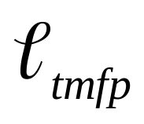
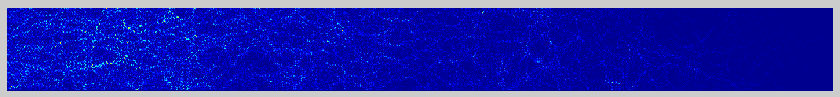
Numerical model capabilities
can find Electric field
variable frequency (CW or FT to get time response)
active or passive media
L up to 1000, 50 open channels → 100x100 matrices
10⁷ realizations → good ensemble averaging
Can vary L to be less than to greater than
→ ballistic, diffusive, localized regimes
Notes:
L < tmfp ➔ ballistic
Tmfp < L < N tmfp ➔ diffusive
L > N tmfp ➔ localized

Slide 7
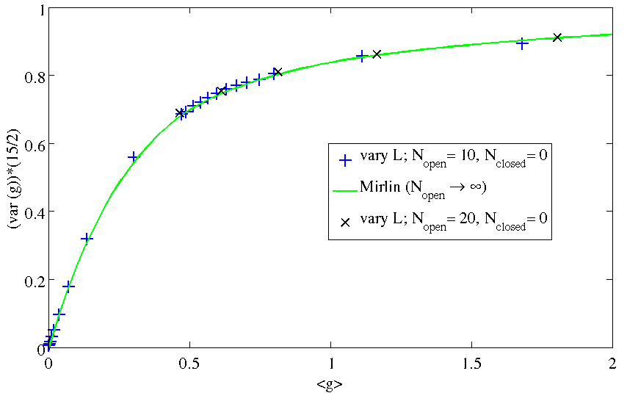
Agreement of numerical model and theory
With no fitting parameter, we have
no closed channels: good match of numerical results and theory
range captures diffusion-localization transition
We expect agreement due to single parameter scaling:
N_{open} and
on same curve
A. Mirlin, Phys. Reports. 326, 259-383 (2000)
Notes:
Mirlin's g match
what are the error bars for this plot?
To determine if there is error, one can first plot statistics based on the first half of the ensemble, then compare that to results of the second half of the ensemble. The difference between these two ensembles is roughly the error
Mathematically, the precision is 1/sqrt{n_rlz}

Slide 8
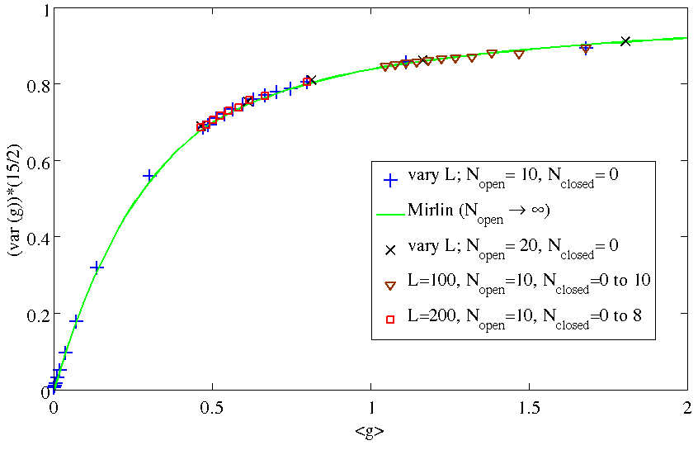
Effect of closed channels
With no fitting parameter, we have
addition of closed channels: ratio of var(g) vs g maintained
→ single parameter scaling
more closed channels decreases the ratio
Notes:
Distributions
what are the error bars for this plot?

Slide 9
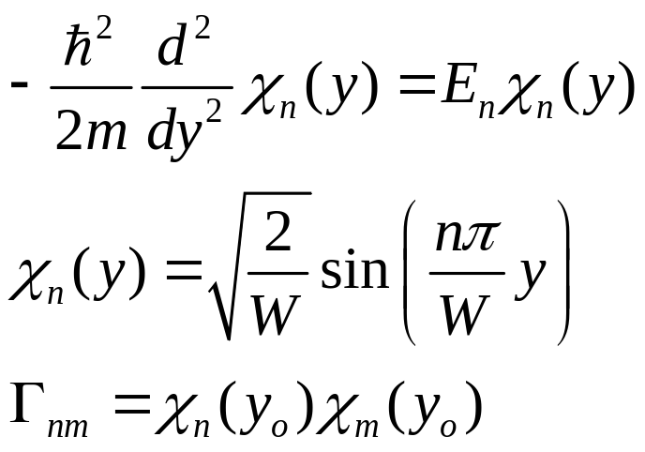
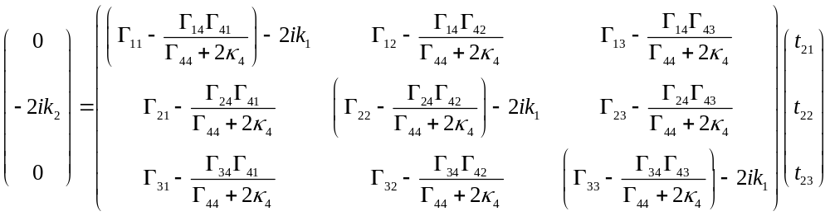
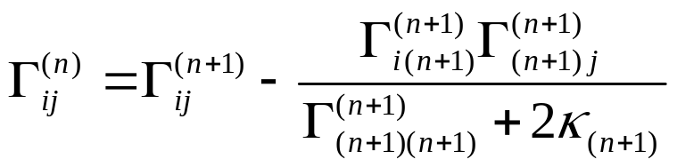
Analytical explanation for single scatter
“Folding” transfer matrices to include closed channels [Bagwell, 1990], reduce to just open channels
Fold adjacent matrices to capture interaction
P. Bagwell, Phys. Rev B 41, 10354 (1990)
Frouofe-Perez, Yepez, Mello, Saenz, Phys. Rev. E 75, 031113 (2007)
Notes:
partially solve the set of equations using boundary conditions that closed channels do not couple to input or output
Source of equations:
“quasi-1d_progress_report.pdf” Appendix A

Slide 10
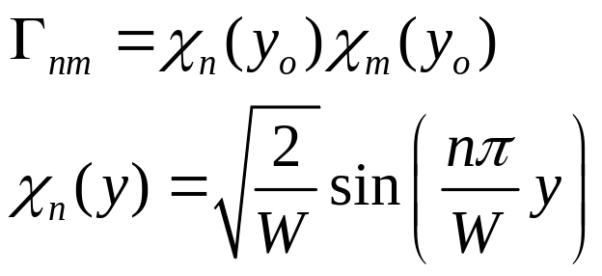
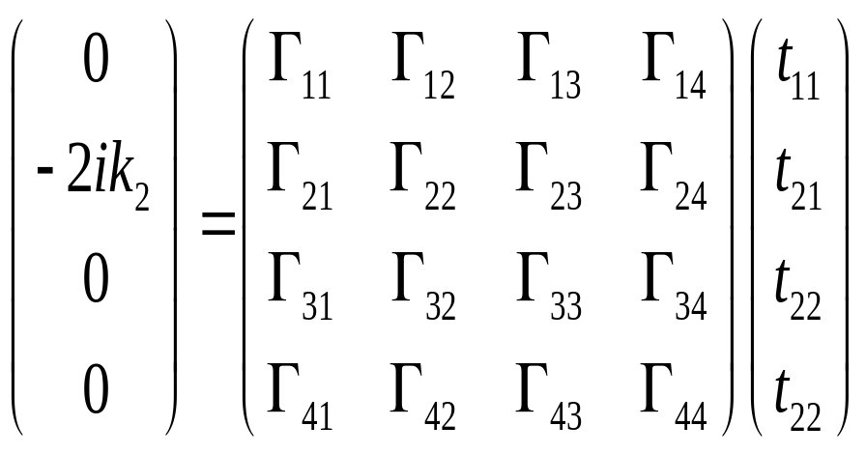
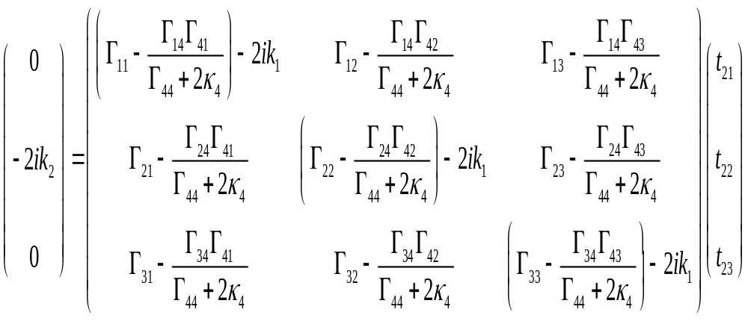
Analytical explanation for single scatter
“Folding” transfer matrices to include closed channels [Bagwell, 1990], reduce to just open channels
Fold adjacent matrices to capture interaction
P. Bagwell, Phys. Rev B 41, 10354 (1990)
Frouofe-Perez, Yepez, Mello, Saenz, Phys. Rev. E 75, 031113 (2007)
Notes:
partially solve the set of equations using boundary conditions that closed channels do not couple to input or output
Source of equations:
“quasi-1d_progress_report.pdf” Appendix A

Slide 11
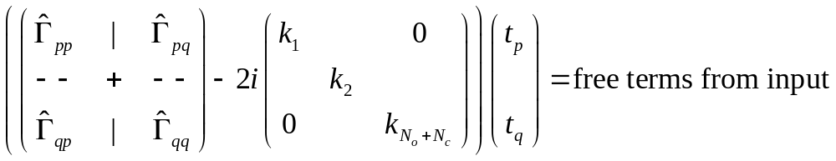
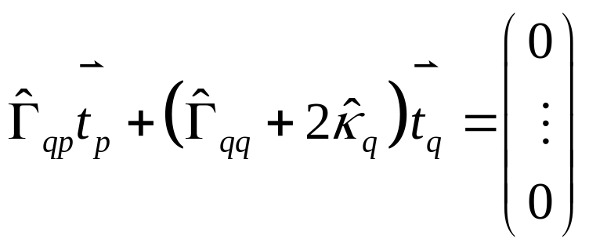
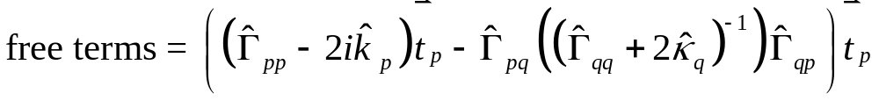
Equation sheet for single scatterer folding
Mello has same result for single scatterer
Frouofe-Perez, Yepez, Mello, Saenz, Phys. Rev. E 75, 031113 (2007)

Slide 12
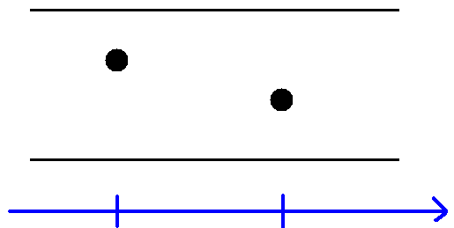
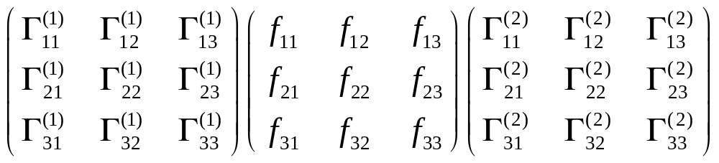
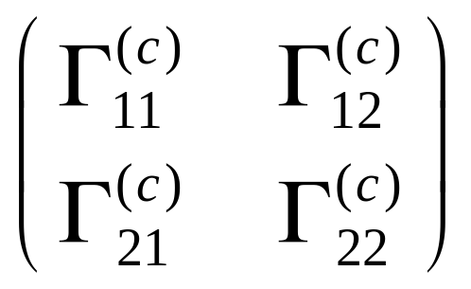
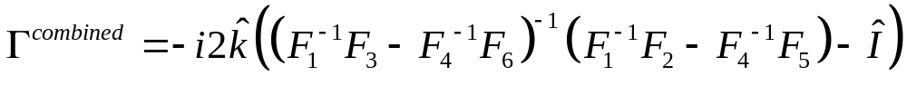
Folding closed channels, two scatterers
x=0 x=a
Notes:
Source of equations:
“quasi-1d_progress_report.pdf” Appendix B
In comparison to Mello, PRE 75 031113, Equation B8, for a single scatterer
Heinrichs

Slide 13
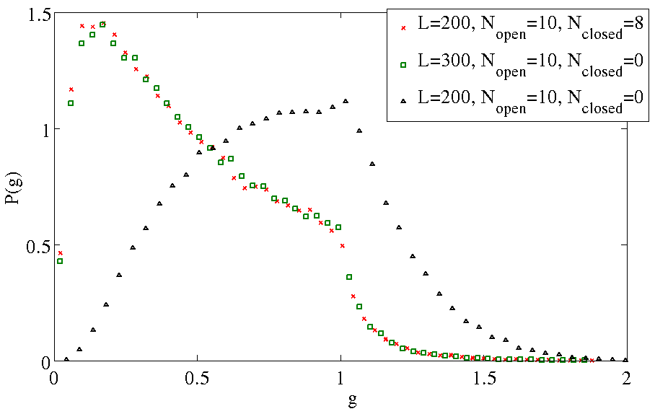
Effect of closed channels on dist(g)
not only does var(g) vs g maintain same curve,
the entire distribution has the same shape!
including closed channels = longer system, aka shorter

Slide 14
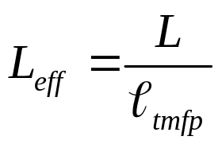
Recap
There is a consequence of including closed channels, but the effect is the same as a shorter transport mean free path
Need a minimum of two scatterers to capture interaction (or density) information when folding transfer matrices
Mello concluded that inclusion of closed channels would make the microscopic derivation of DMPK prohibitively difficult
var(g) vs g is maintained even though P(g) changes
Single parameter scaling works even with evanescent modes
Notes:
The conclusions we would like to emphasize are
-there is a consequence of including closed channels
-the result is an effectively shorter transport mean free path
-we have quantized the effect of closed channels on tmfp for quasi1D point scatterers
-quantitatively demonstrated that the distribution does not change
Reminders for Ben:
-do not directly criticize work of others. Just mention them

Slide 15
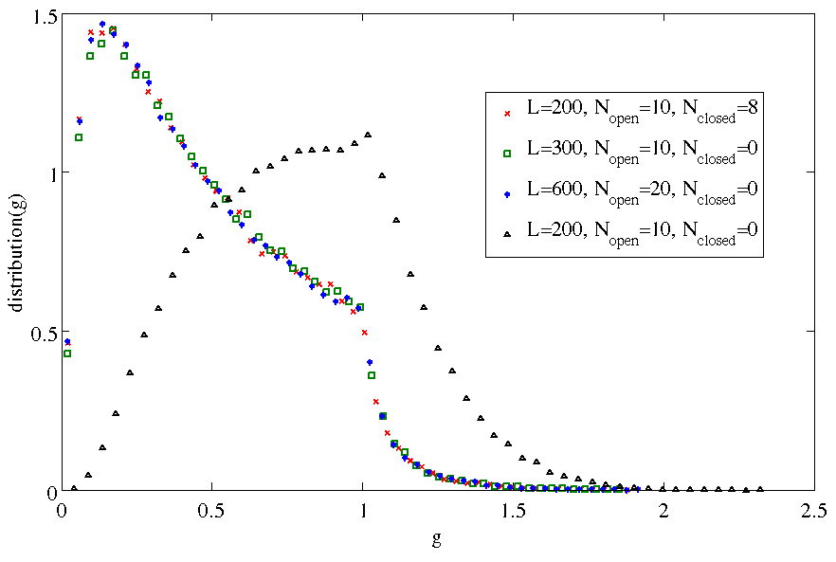
Effect of closed channels on dist(g)
not only does var(g) vs g maintain same curve, the entire distribution has the same shape
including closed channels = longer system, aka shorter tmfp
Notes:
HIDDEN SLIDE
[only show if someone asks about limited waveguide sizes]
what are the error bars for this plot?

