Slide 1
Transport of Light with Wave Interference
Ben Payne
Advisor: Dr Alexey Yamilov
Department of Physics
Missouri University of Science and Technology
Board of Curators

Slide 2
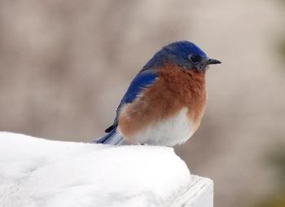
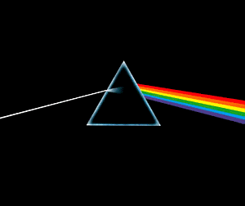
Light as particles
Light passes through crystals of snow, salt
When crystal is powderized light reflects and substance appears white
Multiple scattering causes speckle
→How do we explain different colors?
Notes:
Do demo here: light scattering through tape

Slide 3
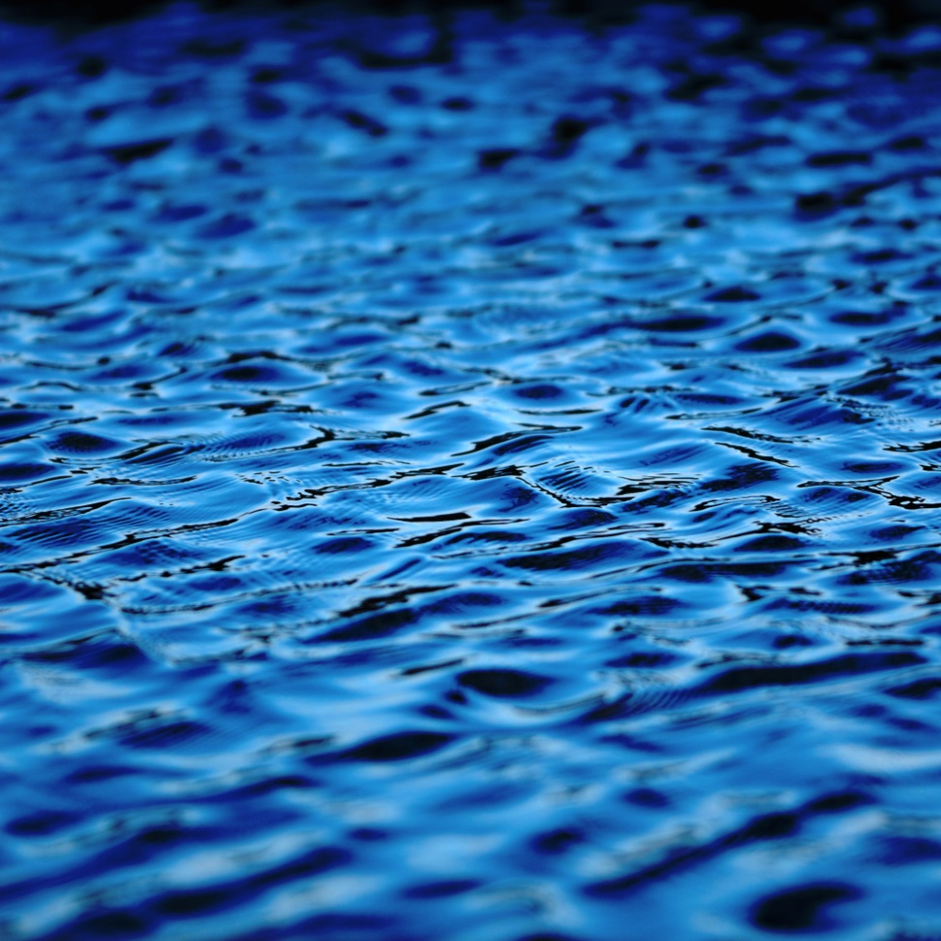

Light as waves: new behavior
Particle description of light is an approximation
Light is actually waves
Approximation made because waves are complex
Anderson Nobel 1977
→ Computationally more complicated for realistic models
Notes:
Demo of scattering laser through scotch tape here

Slide 4
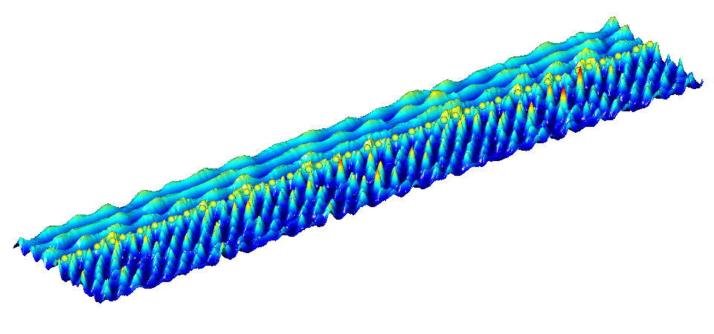
Control in random systems
Scatterers at glass/air interface
Normal incident wave

Slide 5
Focusing waves
By controlling the input of many waves, we can focus the beam

Slide 6
Moving the focus
The location of the focus can be changed by controlling the input waves

Slide 7
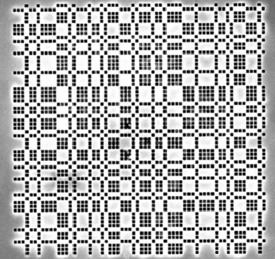
Designed disorder
In addition to manipulation of random media, we can design systems with a mix of periodic and random
Scanning electron microscope
view of experimental
aperiodic design

Slide 8
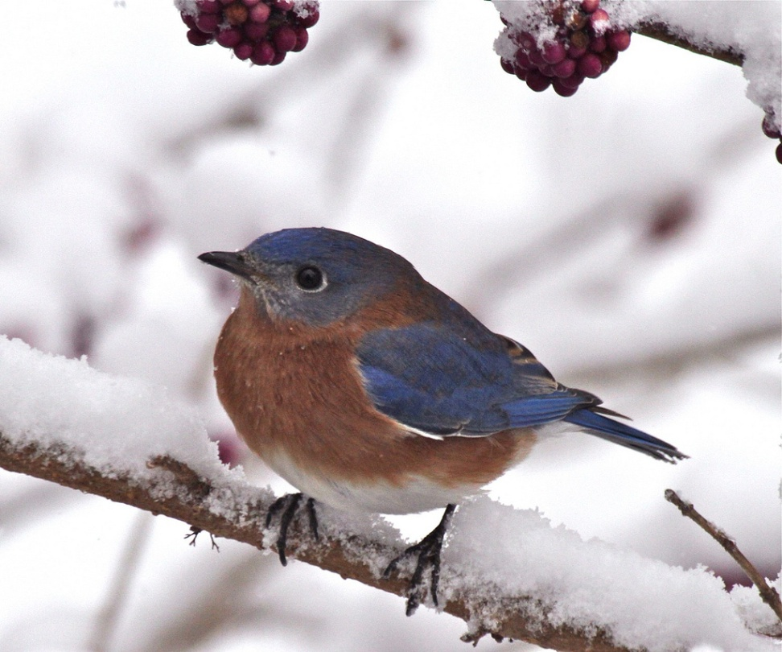
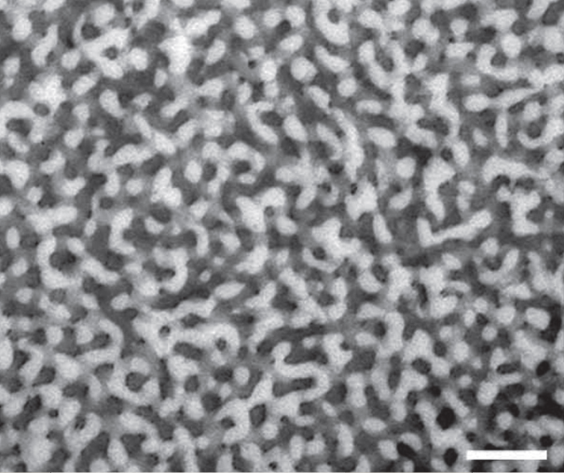
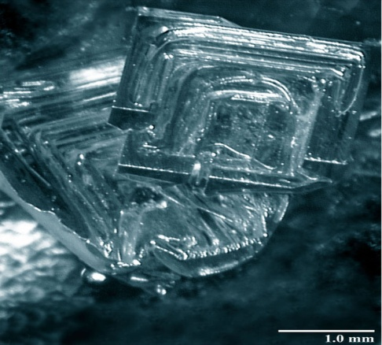
Flying nanotechnology
Nature already uses
nanotechnology
Notes:
Snow SEM from
http://emu.arsusda.gov/snowsite/
depth hoar crystal using light
Eastern blue bird and SEM of feather from
http://www.eng.yale.edu/caolab/
E. R. Dufresne, H. Noh, V. Saranathan, S. G. J. Mochrie, H. Cao, and R. O. Prum, "Self-assembly of amorphous biophotonic nanostructures by phase separation," Soft Matter, 5, 1792, Mar. 2009.

Slide 9
Teaching
Nanotechnology
Distance education

Slide 10
Acknowledgements
Funding
NSF
Teragrid
Graduate Students:
Sumudu
Ben
Undergraduates
Jeff
Mark
Tom
Laura
Winston

