Slide 1
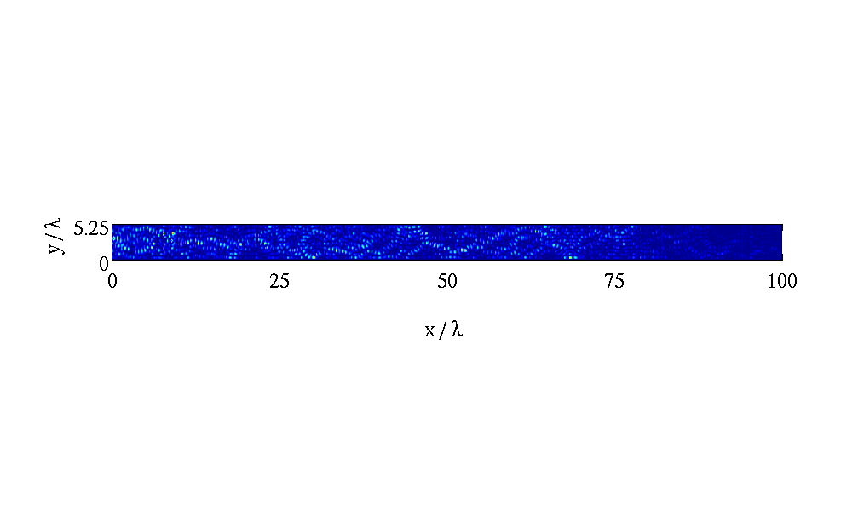
Ben's status report
20090820

Slide 2
Why Numerical modeling?
continuum: Theoretical, Numerical, Experimental
Computational combines modeling of theory, ability to do 1E7 configurations, while remaining mostly generalized
Also do derivations, will be collaborating with experimentalists

Slide 3
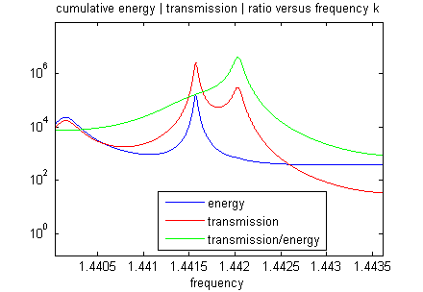
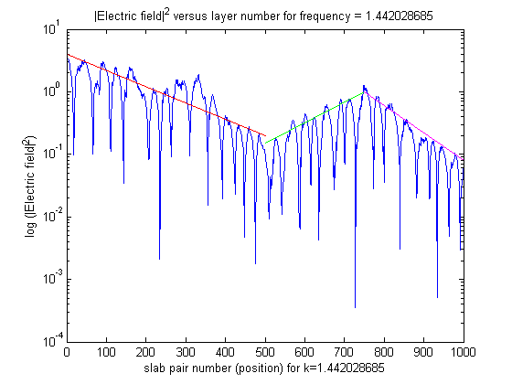
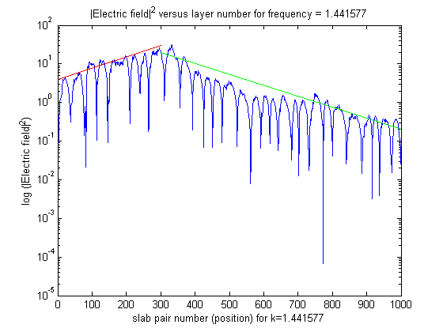
Is T/E a good criterion? Tested in 1D
Based on prior work by Dr Yamilov in diffusive regime
RESULT: field inside media → E is not symmetric

Slide 4
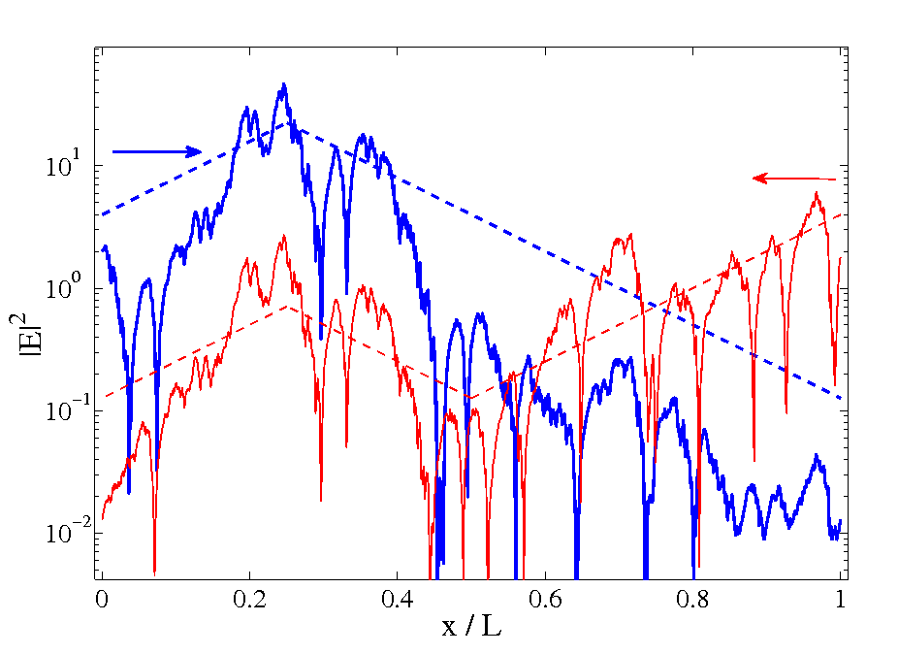
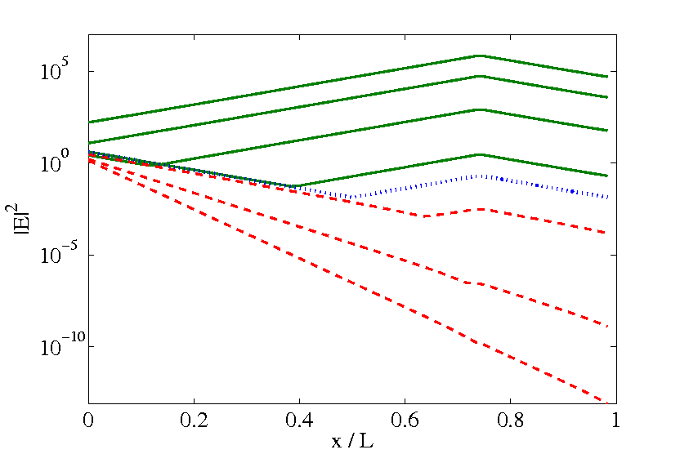
1D Anderson Localization
Criterion for active media: T/E
  still not good
Revised criterion:g'= (T'/E')E
Note: time to do all of this: Summer 2007-Summer 2008, visited NW Uni, Yale, conference in Rochester, 1 article

Slide 5
AL in Quasi-1D
Rectangular waveguide, metallic boundaries
→ can record T,E,vary channels, including closed
Effect of closed channels on conductivity: lengthen
“Folding” closed channels
Variable frequency, active media
  Developed regime plot, delineated by characteristic lengths
  Interested in AL with gain transition criterion
Note: time line = summer 08 – summer 09

Slide 6
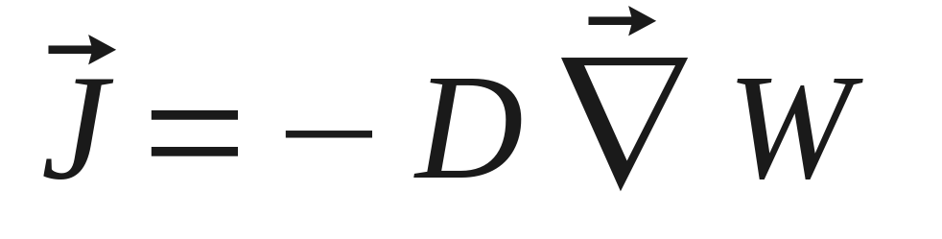
The latest effort: SC, Diffusion
Collaboration on diffusion with Skipetrov
Notes:
Need more content

Slide 7
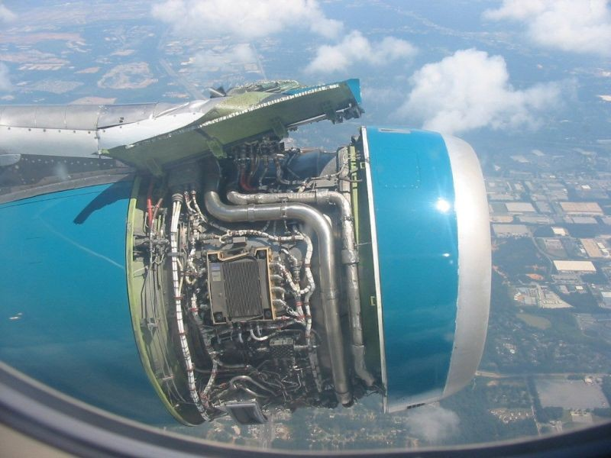
Notes:
This is a great analogy for what we can do using the numerical model:
In-flight analysis of the operation

Slide 8
Tools we use
Fortran 90
MPIF90
Matlab
Mathematica
SVN
OS: Ubuntu, Windows XP
WinSCP/Putty
NIC
TeraGrid
Google Groups

Slide 9
New member tasks
Windows: need local administrator rights
Install Matlab, Mathematica (IT Helpdesk)
Add NIC user account (IT Helpdesk)
Add account to SVN server (Dr Yamilov)
Install gfortran, Tortoise/kdesvn, WinSCP, Putty
Add email to google groups list

Slide 10
New member tips
9am Monday group meeting
Maximum 8 CPUs on the Physics NIC queue
On NIC, test a small sample before large n_rlz
Mathematica on Linux: numlock OFF
Dr Yamilov filters IT questions

