Slide 1

[1]
Petabyte-scale distributed data processing
Brook Queree 48423384

Slide 2
Introduction
Initally inspired by the Google Research MapReduce paper released in 2004 [2]

Slide 3
Major Components
Resource Component (YARN – Yet Another Resource Negotiator)
Responsible for resource management within the cluster. Allows for resource allocation according to CPU and Memory constraints of the nodes.
Data Component (HDFS – Hadoop Distributed File System)
Responsible for distributing data across the cluster. Allows for data partitioning across the cluster as well as replication of partitions between nodes for resiliency.
MapReduce Component (MapReduce)
Responsible for receiving, coordinating and processing MapReduce jobs and queries.

Slide 4
ASRs
Resource Component
Performance: Work must be allocated effectively across the cluster to ensure resources are used optimally.
Data Component
Availability: The data must remain available even during hardware failure events.
Scalability: The data storage must scale reliably into the terabyte and petabyte range.
Portability: The data component must be compatible with a wide array of hardware arrangements [3]
MapReduce Component
Scalability: The MapReduce compute must scale horizontally across potentially thousands of nodes.

Slide 5
Master-Slave Design
All three major components (resource, data, and MapReduce) have a similar scaling philosophy
All follow a master-slave architecture
The master component is deployed on one node in the cluster (additional master instances optional in case of failover)
All deploy homogenous slave components across all nodes in the cluster
The master components poll and direct the slave components to manage resource usage and scheduling
The slave components a responsible for a horizontal segment of the clusters work

Slide 6
TODO: Context

Slide 7
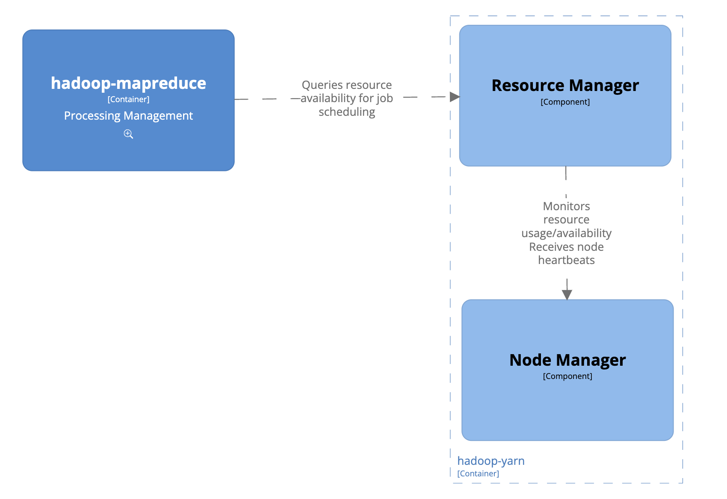
YARN (Resource Component)
[4]

Slide 8
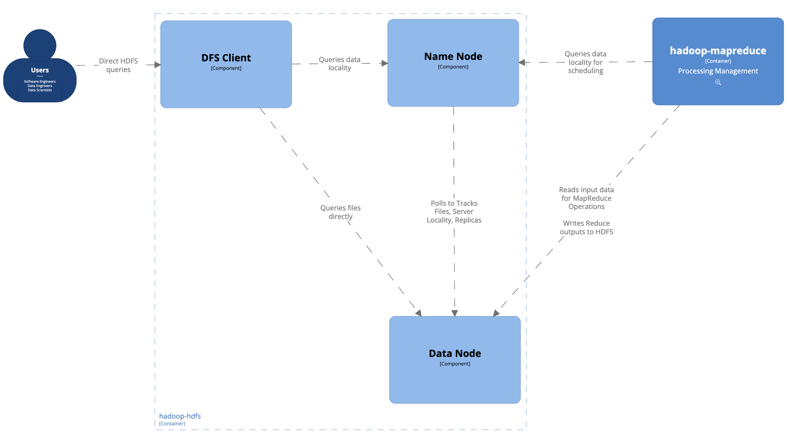
HDFS (Data Component)

Slide 9
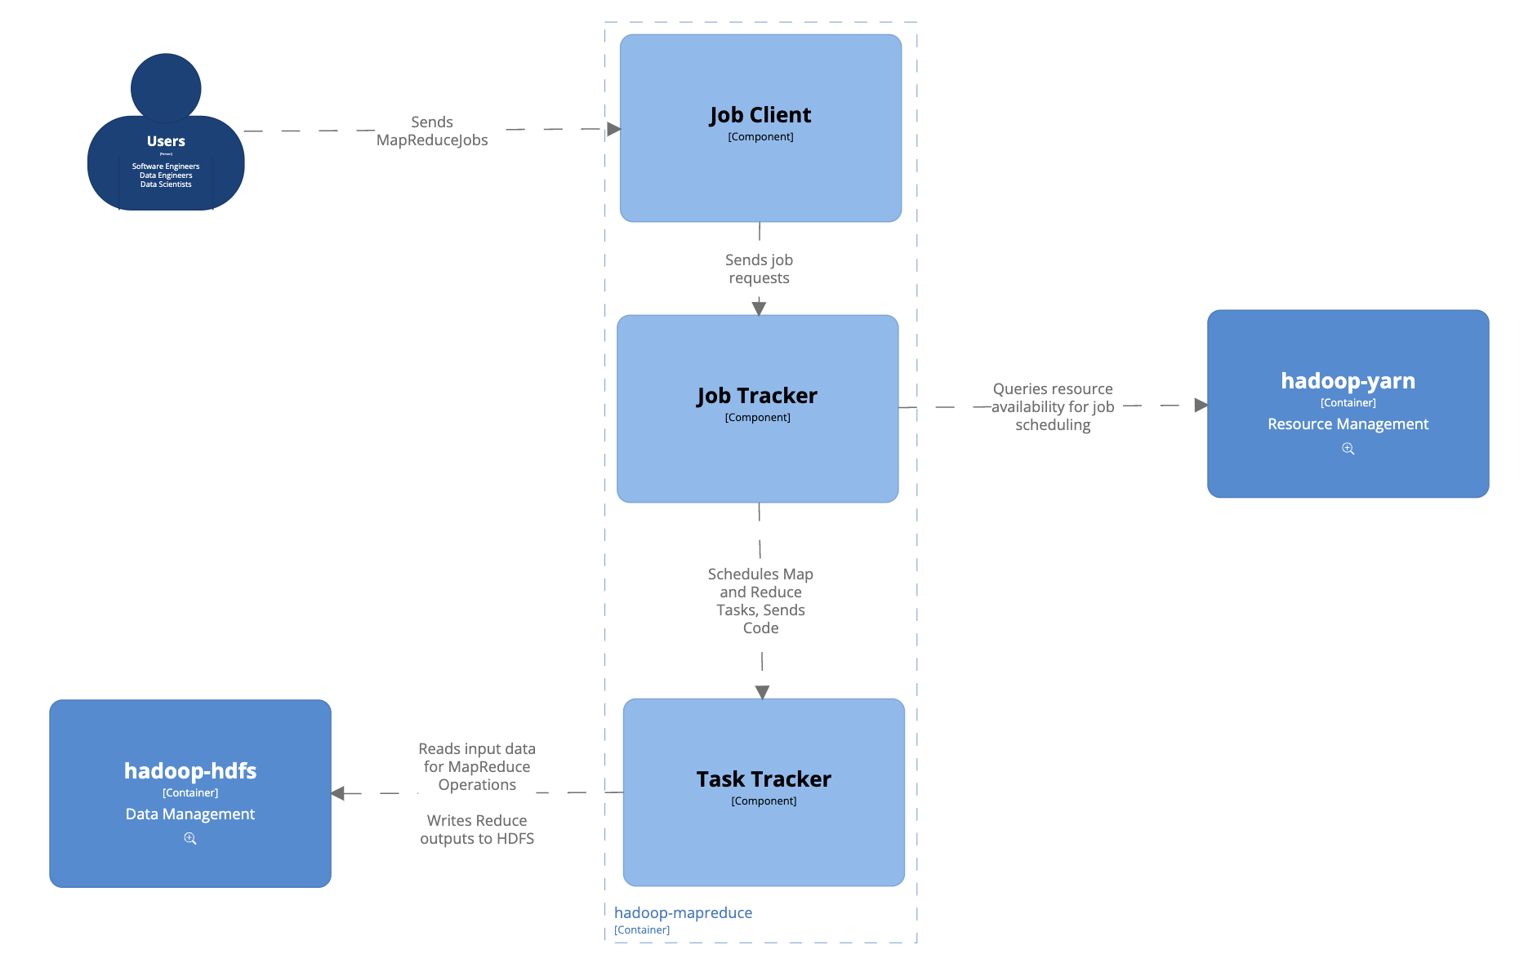
MapReduce Component
Job: Complete MapReduce job
Task: Map or Reduce task to be executed on a single node

Slide 10
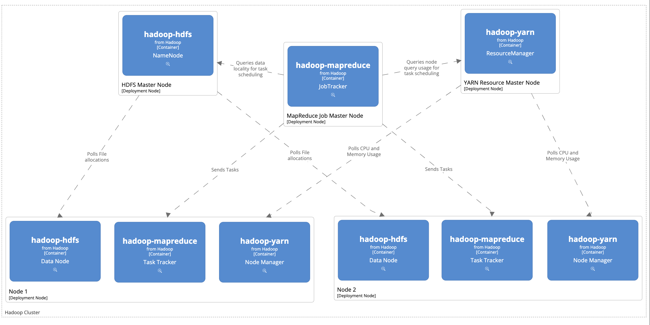
Deployment: Hadoop Cluster

Slide 11
Committees & Contacts
Business, Economics and Law (BEL) - capbel@uq.edu.au
Engineering, Architecture and Information Technology (EAIT), Australian Institute for Bioengineering and Nanotechnology and Sustainable Minerals Institute - capeait@uq.edu.au
Health and Behavioural Sciences (HABS) – caphabs@uq.edu.au
Humanities and Social Sciences (HASS), Institute for Teaching and Learning Innovation, Aboriginal and Torres Strait Islander Studies Unit - caphass@uq.edu.au
MEDICINE, Institute for Molecular Bioscience, Queensland Brain Institute - capmed@uq.edu.au
SCIENCE, Centre for Advanced Imaging, Queensland Agriculture and Food Innovation, Global Change Institute, Centre for Microscopy & Microanalysis, Terrestrial Ecosystem Research Network, Australian Equine Genetics Research Centre - capscience@uq.edu.au
Central: cap@uq.edu.au

Slide 12
Committees & Contacts
Business, Economics and Law (BEL) - capbel@uq.edu.au
Engineering, Architecture and Information Technology (EAIT), Australian Institute for Bioengineering and Nanotechnology and Sustainable Minerals Institute - capeait@uq.edu.au
Health and Behavioural Sciences (HABS) – caphabs@uq.edu.au
Humanities and Social Sciences (HASS), Institute for Teaching and Learning Innovation, Aboriginal and Torres Strait Islander Studies Unit - caphass@uq.edu.au
MEDICINE, Institute for Molecular Bioscience, Queensland Brain Institute - capmed@uq.edu.au
SCIENCE, Centre for Advanced Imaging, Queensland Agriculture and Food Innovation, Global Change Institute, Centre for Microscopy & Microanalysis, Terrestrial Ecosystem Research Network, Australian Equine Genetics Research Centre - capscience@uq.edu.au
Central: cap@uq.edu.au

Slide 13
References
[1] Apache Software Foundation, “File:Hadoop logo new.svg,” Wikimedia Commons, https://commons.wikimedia.org/wiki/File:Hadoop_logo_new.svg
[2] J. Dean and S. Ghemawat, “MapReduce: Simplified Data Processing on Large Clusters,” 2004. https://static.googleusercontent.com/media/research.google.com/en//archive/mapreduce-osdi04.pdf
[3] M. R. Ghazi and D. Gangodkar, “Hadoop, MapReduce and HDFS: A Developers Perspective,” Procedia Computer Science, vol. 48, pp. 45–50, 2015, doi: https://doi.org/10.1016/j.procs.2015.04.108.
[4] Apache Software Foundation. (n.d.-a). Apache Hadoop Yarn. Apache Hadoop 3.3.6 – Apache Hadoop YARN. https://hadoop.apache.org/docs/stable/hadoop-yarn/hadoop-yarn-site/YARN.html
https://hadoop.apache.org/docs/r1.2.1/mapred_tutorial.html
https://hadoop.apache.org/docs/r2.8.0/hadoop-mapreduce-client/hadoop-mapreduce-client-core/MapReduceTutorial.html
https://community.cloudera.com/t5/Community-Articles/Understanding-basics-of-HDFS-and-YARN/ta-p/248860
https://hadoop.apache.org/docs/stable/hadoop-yarn/hadoop-yarn-site/YARN.html
https://hadoop.apache.org/docs/r1.2.1/hdfs_design.html

