Slide 1

[1]
Petabyte-scale distributed data processing
Brook Queree 48423384

Slide 2
Introduction
Goal: To allow efficient storage and processing of large data stores ranging into the Petabyte-scale
Initially inspired by the Google Research MapReduce paper released in 2004 [2]
Core concepts [3]:
MAP:
Perform data selection, filtering and sorting/shuffling
This step produces the data to be processed by the REDUCE step, allocated appropriately to the distributed worker nodes
REDUCE:
Perform aggregates, calculations and summaries across the data
Writes the processing result to the permanent distributed data store.
This MapReduce framework allows for efficient horizontal partitioning of both compute and data

Slide 3
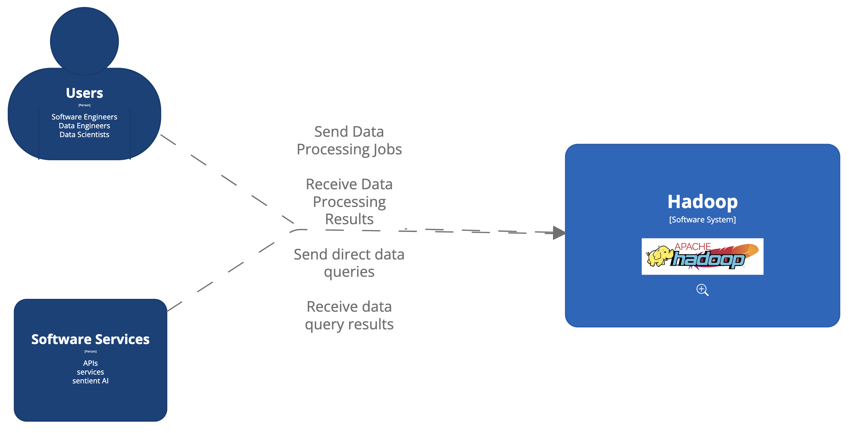
Context

Slide 4
Major Containers
Resource Container (YARN – Yet Another Resource Negotiator)
Responsible for resource management within the cluster. Allows for resource allocation according to CPU and Memory constraints of the nodes. This was introduced in Hadoop 2.0 to decouple resource management from the MapReduce container.
Data Container (HDFS – Hadoop Distributed File System)
Responsible for distributing data across the cluster. Allows for data partitioning across the cluster as well as replication of partitions between nodes for resiliency.
MapReduce Container (MapReduce)
Responsible for receiving, coordinating and processing MapReduce jobs and queries.

Slide 5
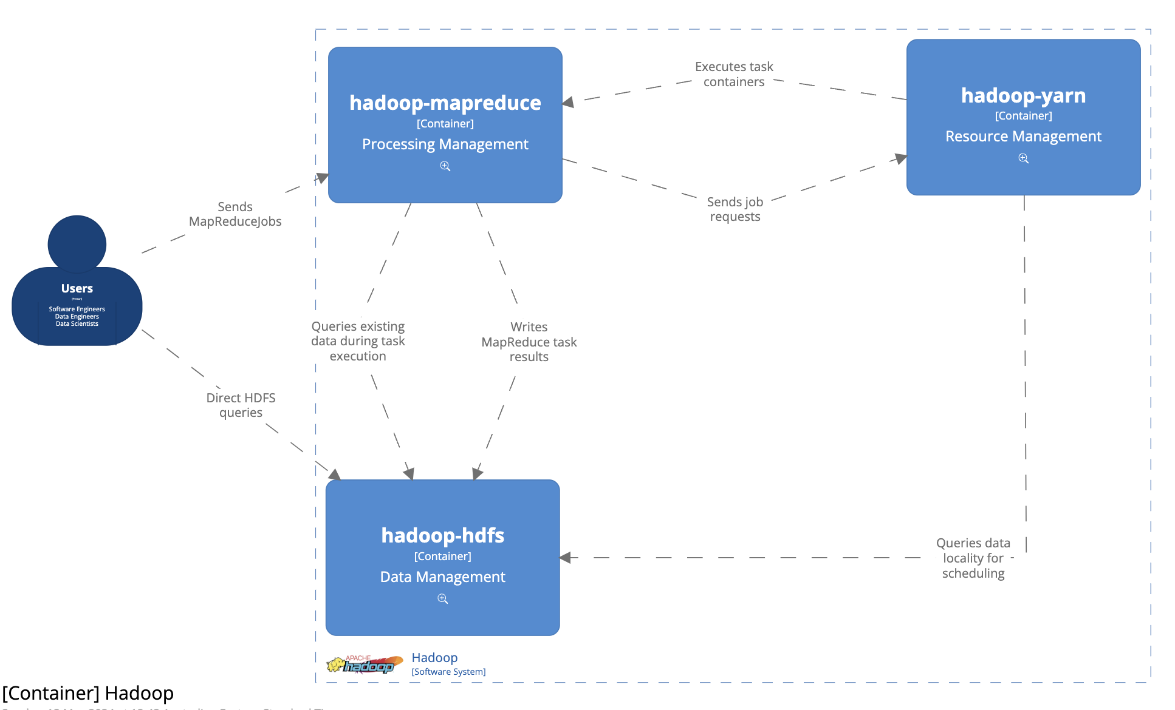
Major Containers

Slide 6
ASRs
Resource Container (YARN)
Efficiency: Work must be spread out across the cluster to ensure resources are used optimally.
Performance: Work must be allocated effectively across the cluster to allow for performant horizontal scaling and reduce bottlenecks.
Data Container (HDFS)
Availability: The data must remain available even during hardware failure events.
Scalability: The data storage must scale reliably into the terabyte and petabyte range.
Portability: The data component must be compatible with a wide variety of hardware arrangements [4]
MapReduce Container
Scalability: The MapReduce compute must scale horizontally across potentially thousands of nodes.

Slide 7
Master-Slave Design
All three major containers (YARN, HDFS, and MapReduce) have a similar scaling philosophy
All follow a master-slave architecture
The master component is deployed on one node in the cluster (additional master instances optional in case of failure)
All deploy homogenous slave components across all nodes in the cluster
The master components poll and direct the slave components to manage resource usage and scheduling
The slave components a responsible for a horizontal segment of the clusters work (both data storage and compute processing)

Slide 8
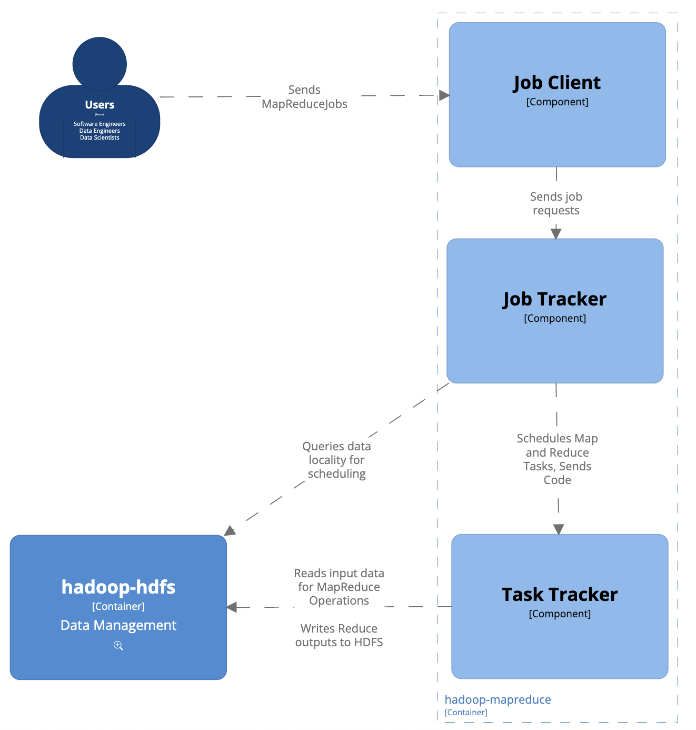
MapReduce Components 1.0
Job: Complete MapReduce piece of work
Task: Map or Reduce task to be executed on a single node

Slide 9
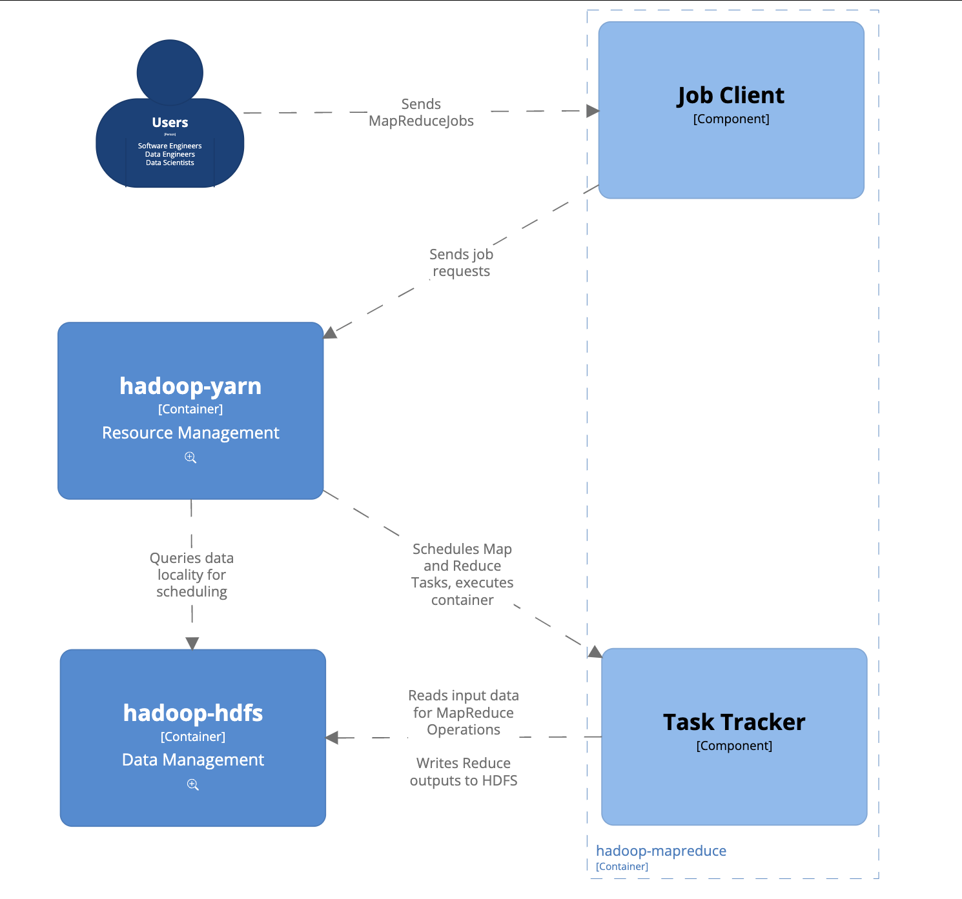
MapReduce Components 2.0
[5][6]

Slide 10
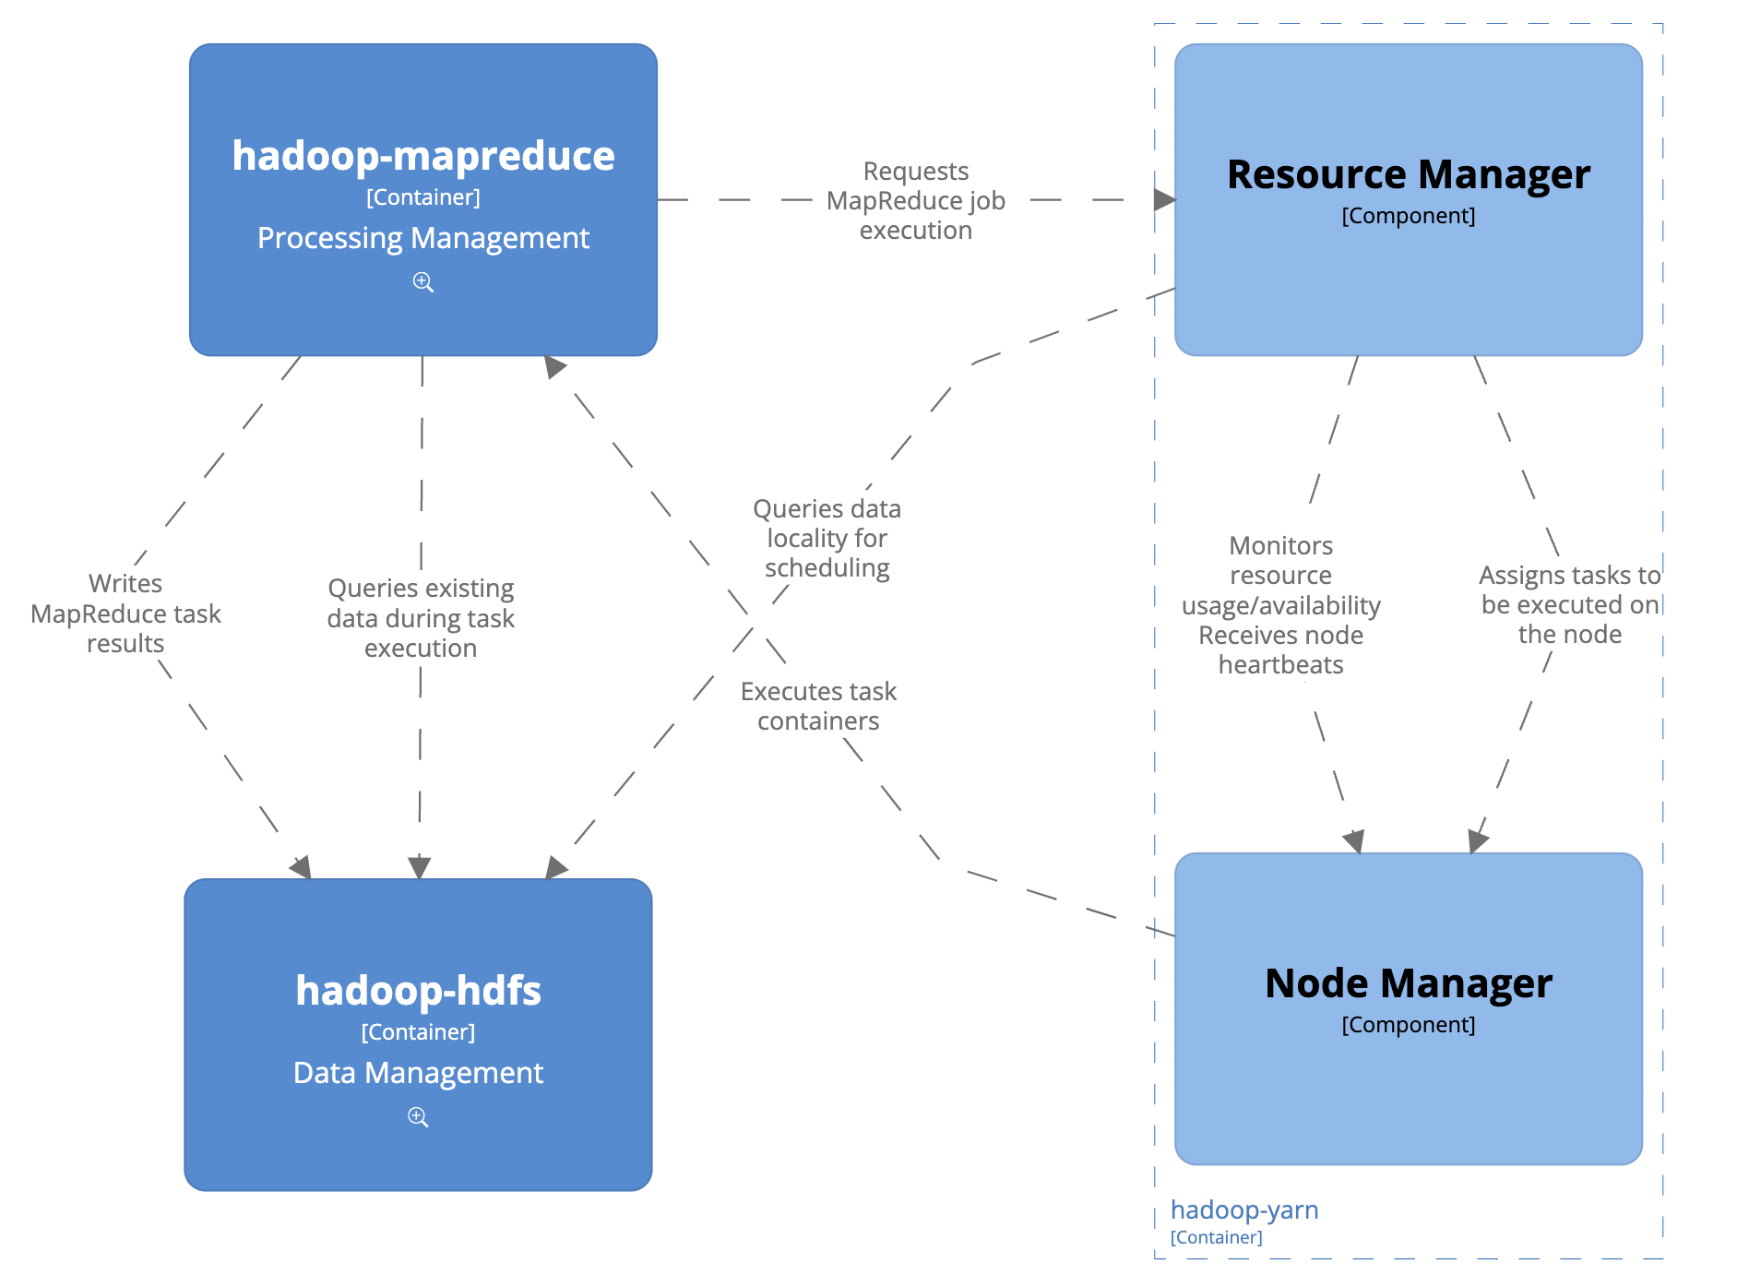
YARN (Resource) Components
[4]

Slide 11
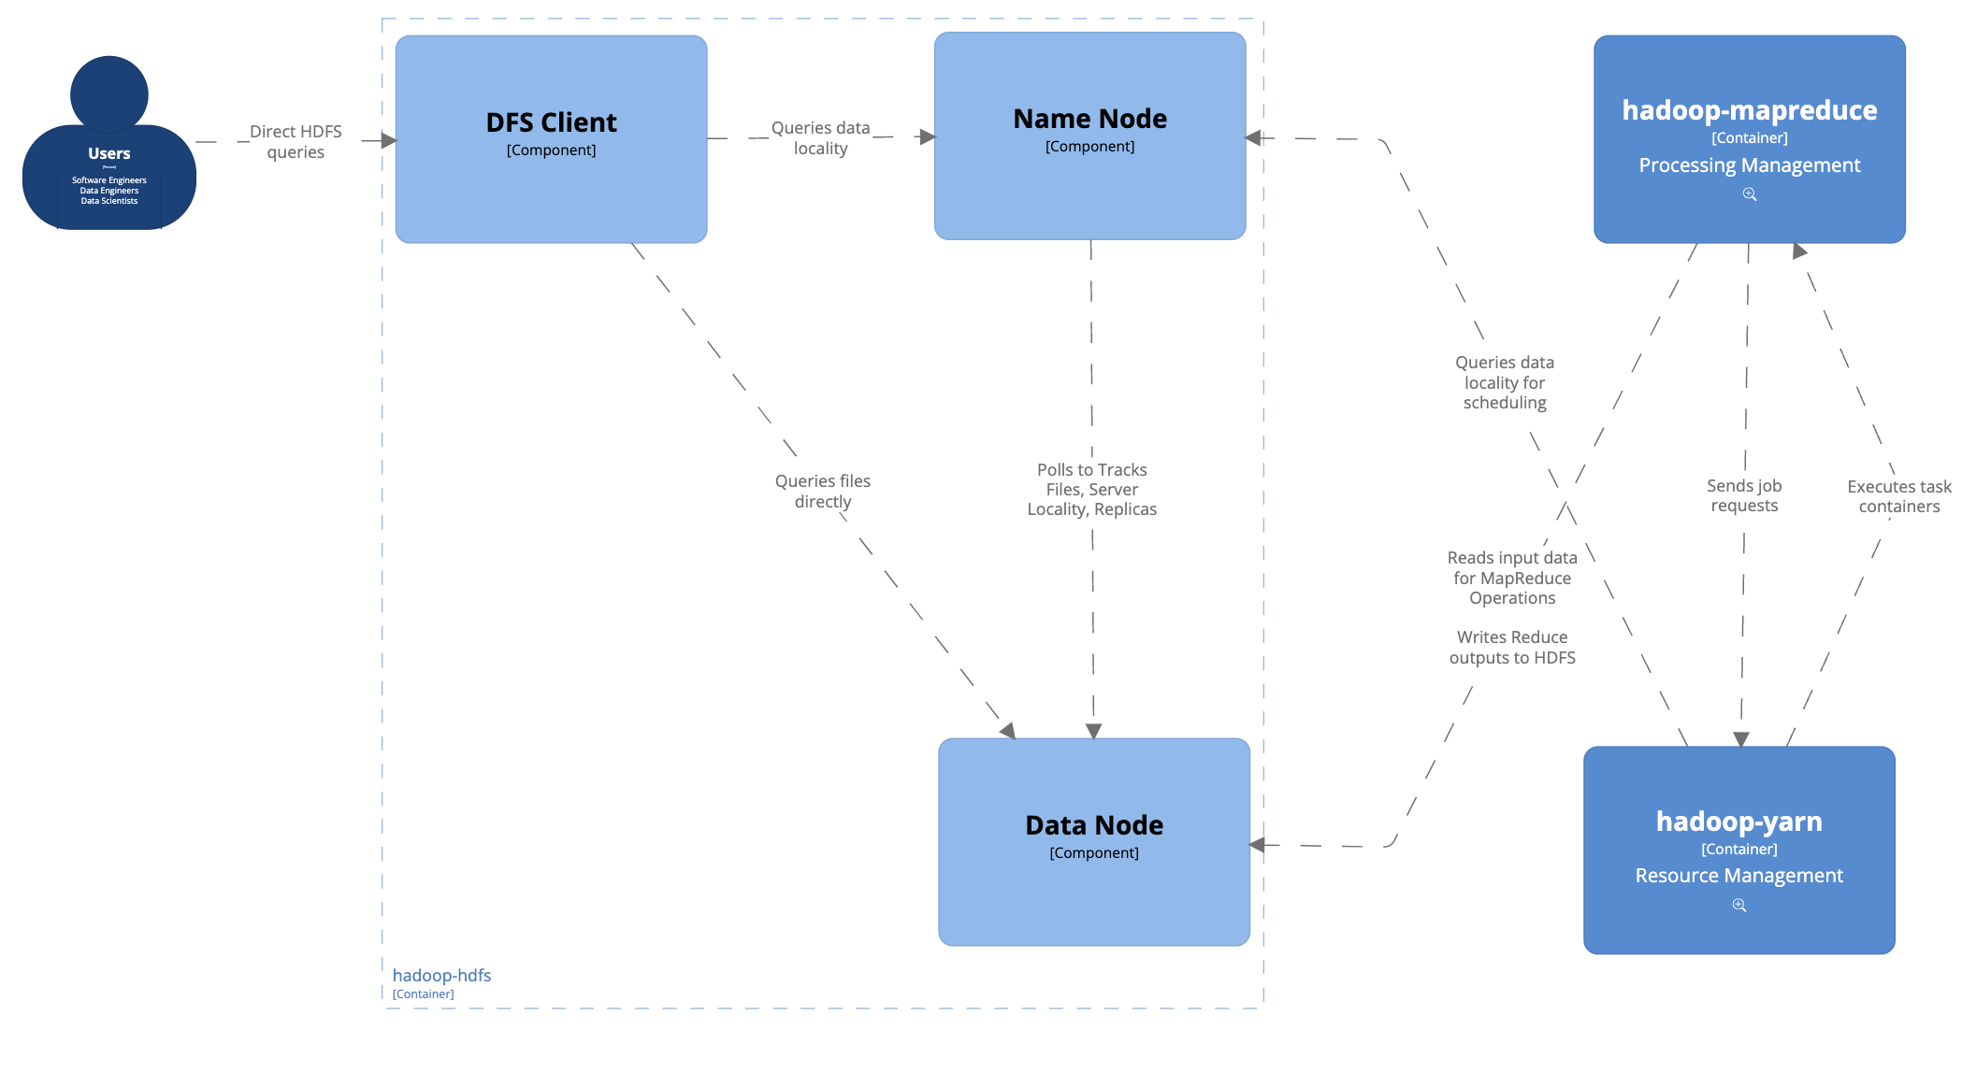
HDFS (Data) Components

Slide 12
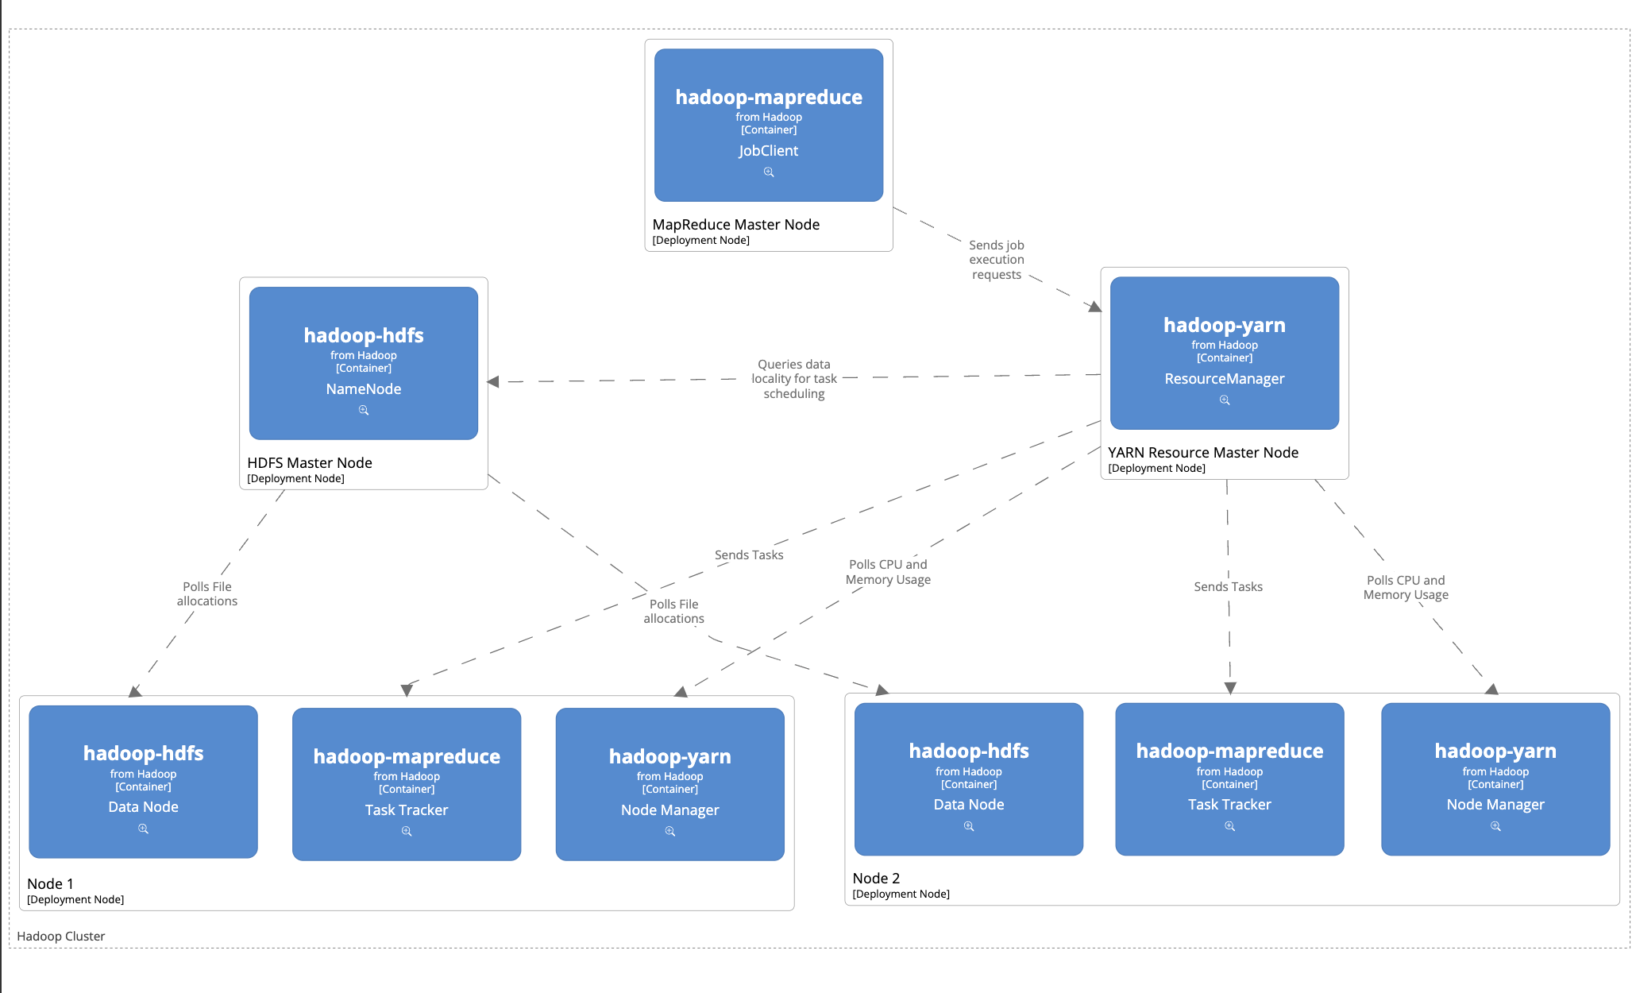
Deployment: Hadoop Cluster

Slide 13
Critique
Pros:
As an open source framework, Hadoop allows organisations of any size free access to large scale distributed data processing
The HDFS system allows for both data redundancy and large scale concurrency across the cluster.
YARN effectively decouples resource management and scheduling from the MapReduce logic
Cons:
Hadoop requires high technical proficiency to setup, maintain, and write MapReduce jobs
Java-first development means there is little native support for non-java-runtime access methods.
Lack of out-of-the-box support for SQL and popular data query methodologies means you need a large number of extensions and additional libraries for common use cases
The Hadoop MapReduce operations primarily operate on data directly from disk. This has allowed newer frameworks such as Apache Spark to leapfrog Hadoop’s performance, leading to a migration away from direct Hadoop MapReduce usage.

Slide 14
References
[1] Apache Software Foundation, “File:Hadoop logo new.svg,” Wikimedia Commons, https://commons.wikimedia.org/wiki/File:Hadoop_logo_new.svg
[2] J. Dean and S. Ghemawat, “MapReduce: Simplified Data Processing on Large Clusters,” 2004. https://static.googleusercontent.com/media/research.google.com/en//archive/mapreduce-osdi04.pdf
[3] Apache Software Foundation, MapReduce Tutorial, https://hadoop.apache.org/docs/r1.2.1/mapred_tutorial.html
[4] Apache Software Foundation, “HDFS architecture guide,” Hadoop, https://hadoop.apache.org/docs/r1.2.1/hdfs_design.html (accessed May 11, 2024).
[5] Apache Software Foundation, “Apache Hadoop Yarn,” Apache Hadoop 3.3.6 – Apache Hadoop YARN, https://hadoop.apache.org/docs/stable/hadoop-yarn/hadoop-yarn-site/YARN.html
[6] K. Gautam, “Understanding basics of HDFS and Yarn,” Understanding basics of HDFS and YARN - Cloudera Community - 248860, https://community.cloudera.com/t5/Community-Articles/Understanding-basics-of-HDFS-and-YARN/ta-p/248860

