Slide 1







ANALYSIS
DATA
Banglore

Slide 2

Project Team
Saurav Kumar
Vishwanath J
Brajesh V Kulkarni
Bhrat Sharma

Slide 3
Tools Used
Selenium for web scrapping
Python,pandas for Data cleaning
Excel for analysis and visualisation

Slide 4
OBJECTIVE
To analyse the swiggy(banglore) data and create useful insights from
It which will help management to make decisions

Slide 5
Top 5 places where most number of orders were placed
Kormangala was the place where most number of orders were placed

Slide 6
Location with maximum number of restraunt where delivery review number > 1000

Slide 7
Location with the maximum number of less rated restraunt

Slide 8
Most Popular Cuisines

Slide 9
Average rating of most popular Cuisines

Slide 10
Average price for most popular Cuisines

Slide 11
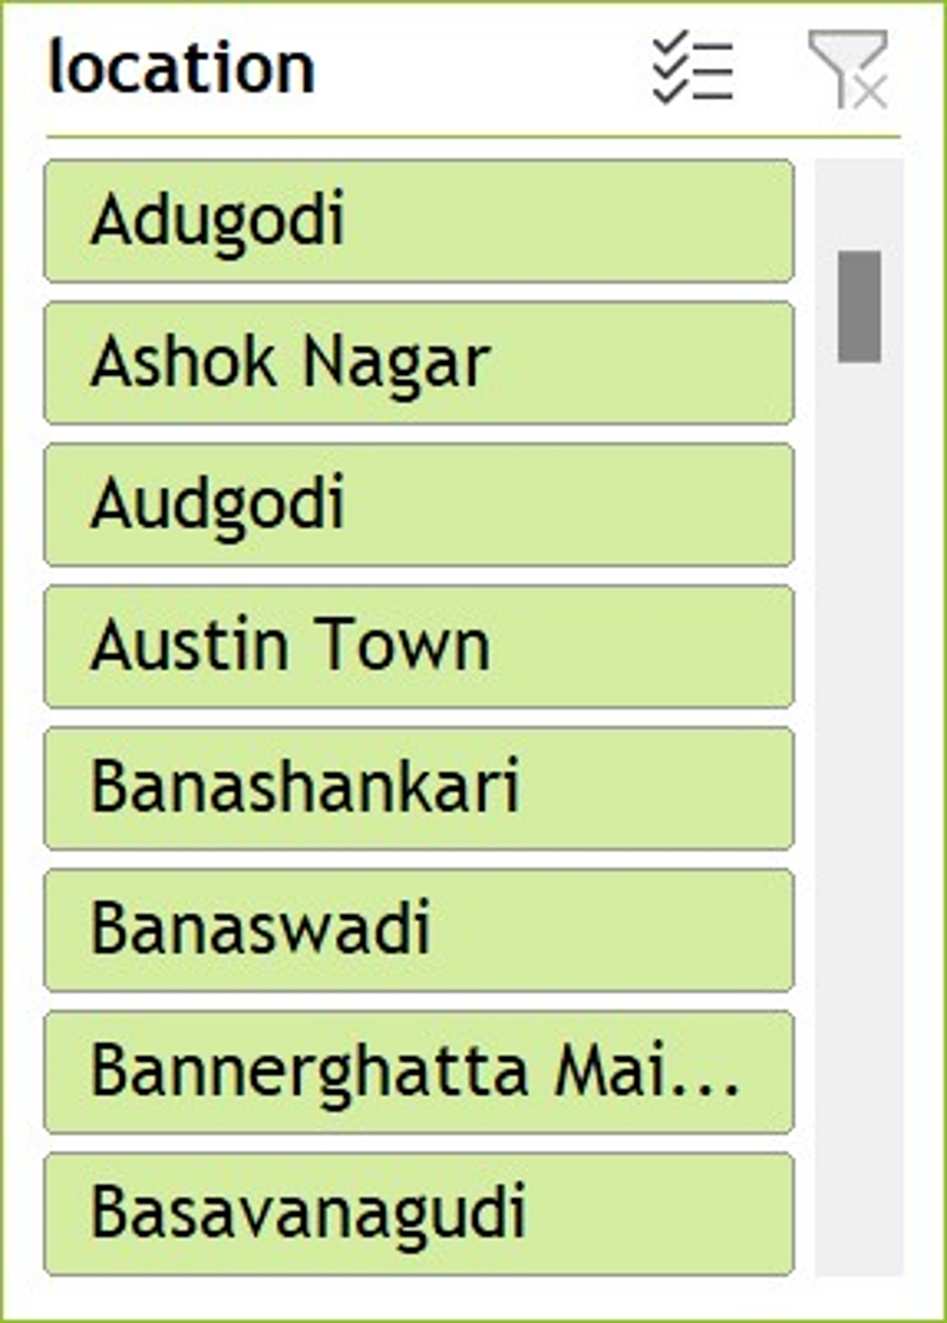
SWIGGY ANALYSIS DASHBOARD

Slide 12
Useful insights based on our analysis
Kormanglam is the best location to open a restraunt
Because of less rating of Indian cusine it shows that public is not satisfied with Indian food in kormanglam banglore
Also Indian cuisine is one of the most popular dish in kormanglam banglore
Average price of Indian dish in kormanglam is 170
Based on that we can conclude that we should open a restraint in kormanglam , have Indian dish in the menu and price of that dish should be less than 170

Slide 13
THANK YOU

