Slide 1
CSE 502 : fLASH
By : Team 31
Team Members :
Anant Srivastava
Bharat Singh
Vidyaabharathi Vasudevan
Wenbo Tian

Slide 2
Introduction
Flash is an new programming language which aims at fast execution of complex tasks.
It inherits from the following languages:- C, C++, Java and Fortran and Pascal.
Pascal and C are the main source of Inspiration; as the pioneers of structured programming, helped teaching students.
Additionally, it contains some interesting new features for common programming challenges, which are a result of both expected and unexpected behaviors.
Build in Arch-Linux and Windows.
Tools:
Flex ( 2.6.0 )-> Scanner / Lexer
Bison( 3.0.4 ) -> Parser.
Java -> Runtime

Slide 3
Compiling and Running Flash programs
Program.fl
Program.fl.cls
Final Output
fLASH program
fLASH Machine Code
$flash.exe Program.fl
java –cp Program.fl.cls
Bison $bison –dv flash.y
Flex $flex flash.lex

Slide 4
Setting Up fLASH
Directory /CompilerRuntime –
Make Compiler --
cd Compiler – “$make all” or double click “makeCompiler.bat” .
Make Runtime –
cd Runtime – “$javac *.java -d ../bin” or double click “makeRuntime.bat” “having done this the compiler and runtime are build.”
Run fLASH –
To execute a fLASH program do the following. 1. “$cd FlashCode”, “$../Compiler/flash filename.fl” “-- file is compiled” 2. “ $java -classpath bin FlashExecutor program.fl.cls” “-- file is executed”
Or just double click “runFlash.bat” and follow instructions.

Slide 5
HelloWorld in Flash
let string s1; in s1 := "Hello World"; write @s1; end | 0: def s1%str 1: data 0 2: ld_str "Hello World" 3: store s1 4: ld_var s1 5: out_str 2 6: halt 0

Slide 6
Some Syntax
Function | Keyword
integer, Boolean, String | Integer, Boolean, String
let<declaration><functions> in<commands> end | Program Structure
if <exp> then <commands> fi | If syntax
If <exp> then <commands> else <commands> fi | If else syntax
while <exp> do <commands> end | while
fun <identifier>(<form_parameters>) <declaration><commands> end fun | Functions
call <identifier>(<actual_parameters>) | Function call
operators | Meaning
‘<’, ‘=’, ‘<=’, “>”, ‘>=’ | less then, equals, less then equals, greater then ,greater then equals
‘+’ , ‘-’, ‘*’, ‘/’ | Left associative
‘^’, ‘|’ , ‘&’ | Pow, or, and right associative
‘;’ | End declaration and end commands
‘ , ’ | Separation of multiple similar declarations
‘:=’ | Assignment operator

Slide 7
The Flash type system
Flash supports three types:
integers – for signed integer types
boolean – for Boolean types
string – for character array.
stack – for a stack implementation.
Intermediate Code | Output
ld_int 5 store t ld_var t out_int 0 | 5
ld_bol true store t ld_var t out_bol 1 | true
ld_str “Hello” out_str 2 | Hello
ld_int 5 ld_var n addstk st | 5

Slide 8
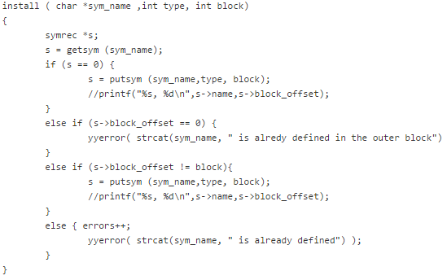
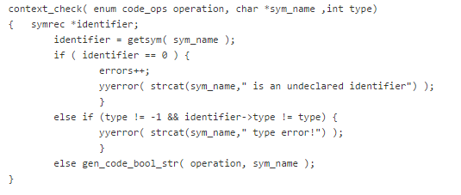
Compiler
Made using Flex and bison. (“bottom up parser”)
Supports Strong type checking. install – refers to symbol table. context check – type checking. Maintains block structure : block_offset Maintains fun structure : fun_offset Maintains argument and formal parameter check : arg_offset
Handles compile time errors
yyerror(char *s), yylineno(track parser line no.)

Slide 9
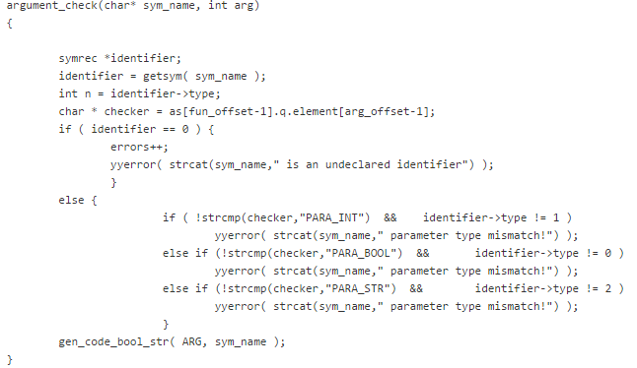
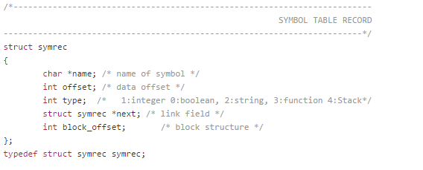
Compiler
Maintains Symbol Table
saves data for identifiers including type and block they are in.
Maintains Function Activation Record
Saves the function name level offset, number of calling arguments and a queue for checking parameter calls types establishing a synergy with calling functions thus saving runtime lots of book keeping.
“Makes the language robust and reliable.”

Slide 10
Runtime
The runtime has the following data structures to handle the execution:
Instruction pointer (ip)
Line number of the current instruction being executed.
Execution Stack
Contains operands on which the operator is applied and the result is pushed.
Call Stack
When a function is called current state of the environment is save on this stack with the return ip after the function completes execution.
Function class
For each function a function class is created which contains the parameters required by the function and the line number to the start of the function.

Slide 11
Recursion Handling
For each recursive call the Environment table which is a HashMap is pushed to a Call Stack and when the function end the store environment table is restored which the updated return value.
case CALL:
callStack.push(varList.clone());
callStack.push(ip);
case POP:
ip = (Integer) callStack.pop();
varList = (HashMap<String, Object>) callStack.pop();
Calling a Function
Returning from Function

Slide 12
Special Features
When a function is called The Environment table contains all the global variables too.
The global variables can be used as temporary variables inside a function.
The changes are roll-backed when control move out of the function.
Only the return value reflects in the Environment Table.

Slide 13
Constraints
Flash does not support more than 1,000 functions in a single file.
Machine code must not be more than 10,000 lines.

Slide 14
Arithmetic Operations:
Operation | Intermediate Code | Output
ADDITION t := 5 + 10; write t; | ld_int 5 ld_int 10 add store t ld_var t out_int 0 | 15
MULTIPLICATION t := 5 * 10; write t; | ld_int 5 ld_int 10 mult store t ld_var t out_int 0 | 50
SUBTRACTION t := 15 - 10; write t; | ld_int 15 ld_int 10 sub store t ld_var t out_int 0 | 5
DIVISION t := 50 / 10; write t; | ld_int 50 ld_int 10 divide store t ld_var t out_int 0 | 5

Slide 15
Operators
Operator | Intermediate Code | Output
= | ld_int 50 ld_int 10 eq store t ld_var t out_bol 1 | false
> | ld_int 50 ld_int 10 gt store t ld_var t out_bol 1 | true
< | ld_int 50 ld_int 10 lt store t ld_var t out_bol 1 | false
<= | ld_int 50 ld_int 10 lteq store t ld_var t out_bol 1 | false

Slide 16
The if-else statement
Flash supports if and else statements. If and else statements can also be nested. The below example demonstrates this:
let integer i; in read i; if (i < 10) then i := i + 100; else i := i - 10; fi; write i; end | 0: def i%0 1: data 0 2: in_int i 3: ld_var i 4: ld_int 10 5: lt 0 6: jmp_false 12 7: ld_var i 8: ld_int 100 9: add 0 10: store i 11: goto 16 12: ld_var i 13: ld_int 10 14: sub 0 15: store i 16: ld_var i 17: out_int 1 18: halt 0

Slide 17
Functions:
Flash supports functions. The following code demonstrates an example.
Code | Output
let integer n, x; string s1; fun inc(integer a;) return a+1; end_fun in read n; x := inc(n); write x; End | Input: 4 Output: 5

Slide 18
Stack
Flash supports the stack Data structure. It includes the push and pop functionality.
Code | Intermediate
let integer n, i; stack st; in read n; st.onto<n>; read n; st.onto<n>; read n; st.onto<n>; i := st.outfrom; write i; i := st.outfrom; write i; i := st.outfrom; write i; end | 0: def n%0 1: def i%0 2: def st%stk 3: data 2 4: in_int n 5: ld_var n 6: addstk st 7: in_int n 8: ld_var n 9: addstk st 10: in_int n 11: ld_var n 12: addstk st 13: remstk st 14: store i 15: ld_var i 16: out_int 1 17: remstk st 18: store i 19: ld_var i 20: out_int 1 21: remstk st 22: store i 23: ld_var i 24: out_int 1 25: halt 0

Slide 19
Fibonacci:
Flash has the ability to compute the Fibonacci of a number given.
let integer n, x, y, z, u; fun fib(integer a;) if a = 1 | a = 2 then return a - 1; else skip; fi; z := a - 1; u := a - 2; x := call fib(z); y := call fib(u); return x+y; end_fun in read n; x := call fib(n); write x; end | Example: Input: 11 Output: 55

Slide 20
Conclusion
Our language is an incremental block structured language.
Once a block is created, it is never destroyed. It is kept in the records and its freed once the program execution ends.
Same applies to procedures.
When a procedure is created it gets activated and it can be called from any block proceeding the procedure block.

Slide 21
Thank You

