Slide 1
eLearning Portal
made easy :)
redefining the way you learn!
Bharat Gupta-IIT2014156
Anujraaj Goel-IIM2014002
Parshant Singh-IIT2014157
Likhama Ram-IIT2014163

Slide 2
Features
1)Login/Sign in by teacher/Student.
2)Teacher can choose a subject of his own choice.
3)Teacher can add/modify questions for the quiz.
4)Student can select from a variety of subjects and give the quiz.
5)Detailed mark sheet of the student showing history of his results and pie charts.
6)Solutions to wrong answers also given.

Slide 3
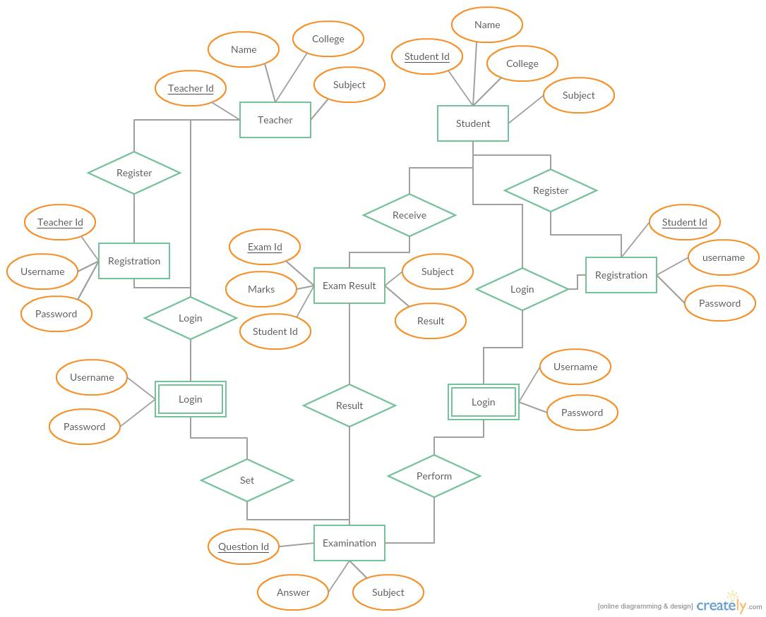
E-R Diagram

Slide 4
Languages Used
1)HTML/CSS for front end.
2)Javascript for animations and effects.
3)Python for server side scripting.
4)Sql for storing data .

Slide 5
Normalisation
First Normal Form
Second Normal Form
Third Normal Form

Slide 6
In our database, those tables which have an entity identifier (primary key) is in 1st normal form. Eg:
StudentId Name college
TeacherId Name Subject college
Student table
Teacher table

Slide 7
Initially we had student table shown below .
In this table we had partially dependent non prime attributes
studentId -> name , college ; Username -> password .
Thus we decomposed student table into student and studentRegister to get 2nd normalize form.
Student table
Candidate keys = (studentId , username)
Prime attributes = studentId, username
Non prime attributes = name , college , password
Functional dependencies =
(studentId , username ) -> name, college, password
studentId -> name , college
Username -> password
studentId Name College Username password

Slide 8
In our database, consider tables student and studentRegister. If they are a same entity , then we will have two primary keys in a table- studentId ,username. So we make another table studentRegister with studentId as foreignkey and username as the primary key.
Candidate keys = studentId
Prime attributes=studentId
Non prime attributes = name , college
Functional dependencies =
studentId -> name,college
studentId Username password
studentId Name College
StudentRegister table
Candidate keys = (studentId ,username)
Prime attribute = studentId , username
Non prime attributes = password
Functional dependencies =
(studentId , username ) -> password
Student table

Slide 9
Similarly , we have teacher and teacherRegister tables
teacherId username password
teacherId Name subject College
TeacherRegister table
Teacher table

Slide 10
In our database, initially we had studentanswer as given below.
As we see two non prime attributes (correctanswer -> points) are fully dependent , thus the studentanswer is not in 3rd normalized
form.
studentAnswer
studentId questionId answer correctAnswer points
Candidate keys = (studentId, questionId)
Prime Attributes = studentId, questionId
Non prime attributes = Answer , correctAnswer, points
Functional dependencies :
(studentId , questionId) -> Answer , correctanswer , points
correctAnswer -> points

Slide 11
After 3rd normalization, we get studentanswer as given below.
And correctanswer attribute is added to the questionBank table.
studentAnswer
studentId questionId answer points
Candidate keys = (studentId, questionId)
Prime Attributes = studentId, questionId
Non prime attributes = answer , points
Functional dependencies :
(studentId , questionId) -> answer , points

Slide 12
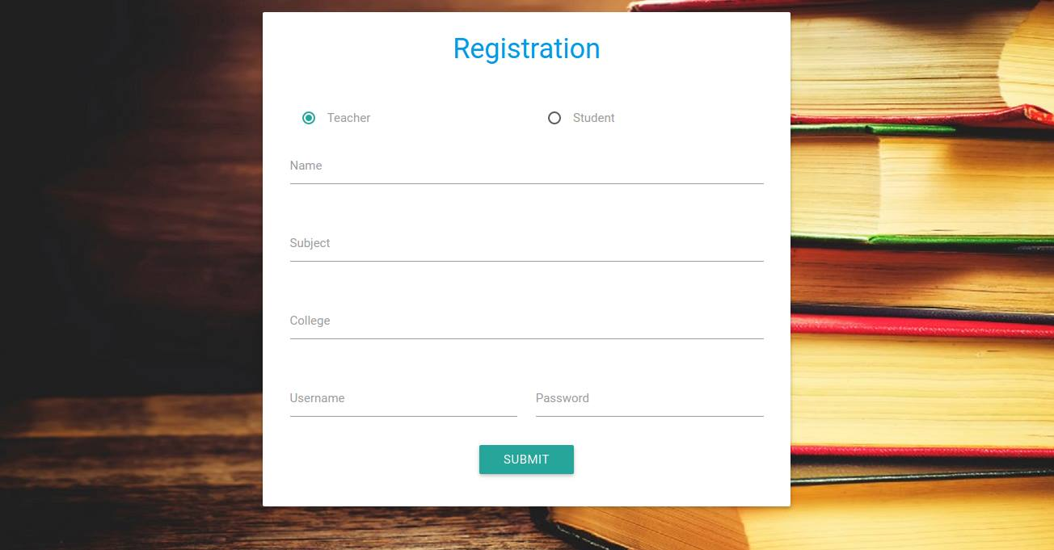

Slide 13


Slide 14
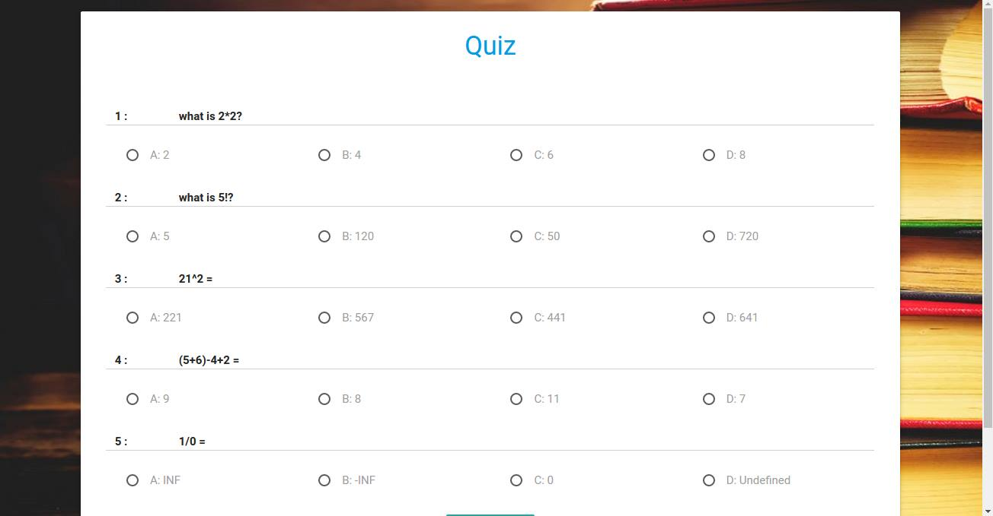

Slide 15
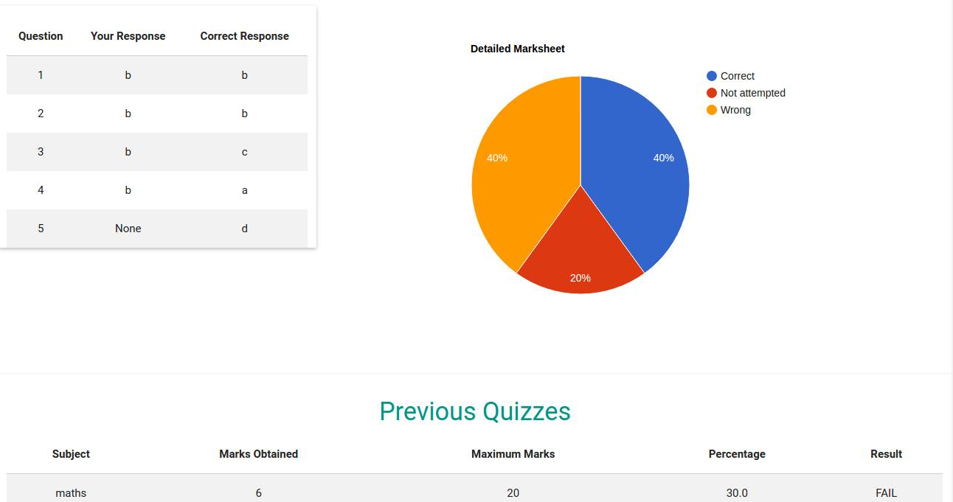

Slide 17
END

